Slide 1

Library Class & Library Instance
Insyde Software March 2021

Slide 2
Copyright 2021 Insyde Software Corp., All Rights Reserved.
No part of this publication may be reproduced, transmitted, transcribed, stored in a retrieval system, or translated into any language or computer language, in any form, or by any means, electronic, mechanical, magnetic, optical, chemical, manual or otherwise, without the prior written permission of Insyde Software Corp.
Disclaimer
Insyde Software Corp. (“Insyde”), provides this document and the programs "as is" without warranty of any kind, either expressed or implied, including, but not limited to, the implied warranties of merchantability or fitness for a particular purpose.
This document may contain technical inaccuracies or typographical errors. Changes are periodically made to the information herein; these changes will be incorporated in future revisions of this document. Insyde is under no obligation to notify any person of the changes. Some code names featured in this document are used to identify products that are in development and not yet publicly announced for release. Insyde is not obligated for its accuracy or completeness.
This document may contain third party’s information, features, schedules, code names, and product names, which are based on Insyde’s interpretation available as of the creation of this document and may be changed from time to time. Neither Insyde nor the third party is obligated to notify such change. If you are interested in third party’s information, you may contact the local third party sales office or the local distributor to obtain the latest specifications. All the intellectual property right of any third party information remains to its owner or steward.

Slide 3
Agenda
Goals & Target Audience
Overview
How to Add Library Class API
How to Implement New Library Instance
How to Use Library
How to Change Library Class/Instance Mapping
Others
Internal Use

Slide 4
Goal & Target Audience

Slide 5
Goal & Target Audience
Target Audience:
BIOS developers who use InsydeH2O 5.x (EDK II) to create their firmware products.
Goals:
Understand the concept of EDK II Library Class & Instance.
Know how to create Library Class API.
Know how to implement new Library Instance.
Know how to change the Library Class/Instance mapping.
Requirements:
InsydeH2O 5.x source code

Slide 6
Overview

Slide 7
Overview EDK2 Library Classes/Library Instances
Library Classes/Library Instances
Different implementations for the same functionality
Library Classes
Standard interfaces for common support routines
Usually represented in the form of .h files under “Include/Library” folder of a package
Library Classes are phase independent
Library Instances
Implementations of Library Classes
Library modules in “Library” folder of a package
A library class can be implemented by several library instances
Library Instance is selected by platform build and a module only defines the Library Class it requires

Slide 8
Overview Library Classes/Library Instances Parsing Precedence
<LibraryClasses> option specified in INF statement of [Components] section in .dsc file
[Components]
…
MdeModulePkg/Universal/Console/TerminalDxe/TerminalDxe.inf {
<LibraryClasses>
PcdLib|MdePkg/Library/DxePcdLib/DxePcdLib.inf
}
…

Slide 9
Overview Library Classes/Library Instances Parsing Precedence
<LibraryClasses> option specified in INF statement of [Components] section in .dsc file
[LibraryClasses.$(ARCH).$(MODULE_TYPE), LibraryClasses.$(ARCH).$(MODULE_TYPE)]
[LibraryClasses.IA32.PEIM, LibraryClasses.X64.PEIM]
…
PeiServicesTablePointerLib|MdePkg/Library/PeiServicesTablePointerLibIdt/
PeiServicesTablePointerLibIdt.inf
…

Slide 10
Overview Library Classes/Library Instances Parsing Precedence
<LibraryClasses> option specified in INF statement of [Components] section in .dsc file
[LibraryClasses.$(ARCH).$(MODULE_TYPE), LibraryClasses.$(ARCH).$(MODULE_TYPE)]
[LibraryClasses.$(ARCH).$(MODULE_TYPE)]
[LibraryClasses.X64.UEFI_DRIVER]
…
PcdLib|MdePkg/Library/BasePcdLibNull/BasePcdLibNull.inf
…

Slide 11
Overview Library Classes/Library Instances Parsing Precedence
<LibraryClasses> option specified in INF statement of [Components] section in .dsc file
[LibraryClasses.$(ARCH).$(MODULE_TYPE), LibraryClasses.$(ARCH).$(MODULE_TYPE)]
[LibraryClasses.$(ARCH).$(MODULE_TYPE)]
[LibraryClasses.common.$(MODULE_TYPE)]
[LibraryClasses.common.UEFI_DRIVER]
…
PcdLib|MdePkg/Library/BasePcdLibNull/BasePcdLibNull.inf
…

Slide 12
Overview Library Classes/Library Instances Parsing Precedence
<LibraryClasses> option specified in INF statement of [Components] section in .dsc file
[LibraryClasses.$(ARCH).$(MODULE_TYPE), LibraryClasses.$(ARCH).$(MODULE_TYPE)]
[LibraryClasses.$(ARCH).$(MODULE_TYPE)]
[LibraryClasses.common.$(MODULE_TYPE)]
[LibraryClasses.$(ARCH)]
[LibraryClasses.X64]
…
PcdLib|MdePkg/Library/BasePcdLibNull/BasePcdLibNull.inf
…

Slide 13
Overview Library Classes/Library Instances Parsing Precedence
<LibraryClasses> option specified in INF statement of [Components] section in .dsc file
[LibraryClasses.$(ARCH).$(MODULE_TYPE), LibraryClasses.$(ARCH).$(MODULE_TYPE)]
[LibraryClasses.$(ARCH).$(MODULE_TYPE)]
[LibraryClasses.common.$(MODULE_TYPE)]
[LibraryClasses.$(ARCH)]
[LibaryClasses.common] or [LibraryClasses]
[LibraryClasses]
…
PcdLib|MdePkg/Library/BasePcdLibNull/BasePcdLibNull.inf
…

Slide 14
How to Add Library Class API

Slide 15
How to Add Library Class API
Format for the entries in this section is two fields, with a pipe “|” character as the field separator, as shown below.
LibraryClassName | Relative/path/and/header_filename.h
[LibraryClasses]
## Library class name is same to library header file name
OneClassLib|Include/Library/OneClassLib.h
[LibraryClasses]
PrintLib|Include/Library/PrintLib.h

Slide 16
How to Add Library Class API
SamplePkg/SamplePkg.dec
[LibraryClasses]
ExampleLib|Include/Library/SampleLib.h
SamplePkg/Include/Library/SampleLib.h
API Declaration
VOID *
EFIAPI
SampleFunc1 (
IN UINTN Parameter1,
IN OUT UINTN Parameter2
);

Slide 17
How to Implement New Library Instance

Slide 18
How to Implement New Library Instance
[Defines]
INF_VERSION = 0x00010005
BASE_NAME = PeiServicesTablePointerLib
FILE_GUID = XXXXXXXX-XXXX-XXXX-XXXX-XXXXXXXXXXXX
MODULE_TYPE = PEIM
VERSION_STRING = 1.0
LIBRARY_CLASS = PeiServicesTablePointerLib|PEIM PEI_CORE SEC
CONSTRUCTOR = PeiServicesTablePointerLibConstructor
DESTRUCTOR = PeiServicesTablePointerLibDestructor

Slide 19
How to Implement New Library Instance
SamplePkg/Library/BaseExampleLibNull/
BaseExampleLibNull.inf
[Defines]
INF_VERSION = 0x00010005
BASE_NAME = BaseExampleLibNull
FILE_GUID = 85A473BB-3729-4ba0-848B-A762F404EE78
MODULE_TYPE = BASE
VERSION_STRING = 1.0
LIBRARY_CLASS = ExampleLib
[Sources]
BaseExampleLibNull.c
[Packages]
MdePkg/MdePkg.dec
SamplePkg/SamplePkg.dec

Slide 20
How to Implement New Library Instance
SamplePkg/Library/BaseExampleLibNull/
BaseExampleLibNull.c
#include <Library/SampleLib.h>
VOID *
EFIAPI
SampleFunc1 (
IN UINTN Parameter1,
IN OUT UINTN Parameter2
) {
return EFI_UNSUPPORTED;
}

Slide 21
How to Implement New Library Instance
SamplePkg/Library/PeiExampleLib/PeiExampleLib.inf
[Defines]
INF_VERSION = 0x00010005
BASE_NAME = PeiExampleLib
FILE_GUID = 3D683F65-7D65-476b-AAA2-D1BAD69AFC08
MODULE_TYPE = PEIM
VERSION_STRING = 1.0
LIBRARY_CLASS = ExampleLib|PEIM PEI_CORE SEC
[Sources]
PeiExampleLib.c
[Packages]
MdePkg/MdePkg.dec
SamplePkg/SamplePkg.dec

Slide 22
How to Implement New Library Instance
SamplePkg/Library/PeiExampleLib/PeiExampleLib.c
#include <Library/SampleLib.h>
VOID *
EFIAPI
SampleFunc1 (
IN UINTN Parameter1,
IN OUT UINTN Parameter2
) {
…
Status = PeiServicesLocatePpi (
&gEfiInterfacePpiGuid,
0,
NULL,
(VOID **)&InterfacePpi);
ASSERT_EFI_ERROR (Status);
…
}

Slide 23
How to Implement New Library Instance
AnotherSamplePkg/Library/DxeExampleLib/
DxeExampleLib.inf
[Defines]
INF_VERSION = 0x00010005
BASE_NAME = DxeExampleLib
FILE_GUID = 6DF40EE4-82D6-4a92-A3D9-5A75EA38D00B
MODULE_TYPE = DXE_DRIVER
VERSION_STRING = 1.0
LIBRARY_CLASS = ExampleLib| DXE_CORE DXE_DRIVER DXE_RUNTIME_DRIVER DXE_SAL_DRIVER DXE_SMM_DRIVER SMM_CORE UEFI_APPLICATION UEFI_DRIVER
[Sources]
DxeExampleLib.c
[Packages]
MdePkg/MdePkg.dec
SamplePkg/SamplePkg.dec

Slide 24
How to Implement New Library Instance
AnotherSamplePkg/Library/DxeExampleLib/
DxeExampleLib.inf
#include <Library/SampleLib.h>
VOID *
EFIAPI
SampleFunc1 (
IN UINTN Parameter1,
IN OUT UINTN Parameter2
) {
…
Status = gBS->LocateProtocol (
&gEfiInterfaceProtocolGuid,
NULL,
(VOID **) &InterfaceProtocol);
ASSERT_EFI_ERROR (Status);
…
}

Slide 25
How to Use Library

Slide 26
How to Use Library
SamplePkg/TestModulePei/TestModulePei.inf
[Sources]
TestModulePei.c
[Packages]
MdePkg/MdePkg.dec
SamplePkg/SamplePkg.dec
[LibraryClasses]
ExampleLib
PeimEntryPoint
SamplePkg/TestModulePei/TestModulePei.c
#include <Library/PeimEntryPoint.h>
#include <Library/SampleLib.h>
…
SampleFunc1 (Parameter1, Parameter2);

Slide 27
How to Use Library
SamplePkg/TestModuleDxe/TestModuleDxe.inf
[Sources]
TestModuleDxe.c
[Packages]
MdePkg/MdePkg.dec
SamplePkg/SamplePkg.dec
[LibraryClasses]
ExampleLib
UefiDriverEntryPoint
SamplePkg/TestModuleDxe/TestModuleDxe.c
#include <Library/UefiDriverEntryPoint.h>
#include <Library/SampleLib.h>
…
SampleFunc1 (Parameter1, Parameter2);

Slide 28
How to Change Library Class/Instance Mapping

Slide 29
How to Change Library Class/Instance Mapping
$(PROJECT_PKG)/Project.dsc
[LibraryClasses]
ExampleLib|SamplePkg/Library/BaseExampleLibNull/BaseExampleLibNull.inf
[LibraryClasses.common.PEIM]
ExampleLib|SamplePkg/Library/PeiExampleLib/PeiExampleLib.inf
[LibraryClasses.common.DXE_DRIVER]
ExampleLib|AnotherSamplePkg/Library/DxeExampleLib/DxeExampleLib.inf

Slide 30
Others

Slide 31
Others Constructor & Destructor
[Defines]
INF_VERSION = 0x00010005
BASE_NAME = PeiServicesTablePointerLib
FILE_GUID = XXXXXXXX-XXXX-XXXX-XXXX-XXXXXXXXXXXX
MODULE_TYPE = PEIM
VERSION_STRING = 1.0
LIBRARY_CLASS = PeiServicesTablePointerLib|PEIM PEI_CORE SEC
CONSTRUCTOR = PeiServicesTablePointerLibConstructor
DESTRUCTOR = PeiServicesTablePointerLibDestructor

Slide 32
Others UEFI Image Execution
EntryPoint.c
Dxe Driver/Pei Module/Application
_ModuleEntryPoint()
ModuleInit()
ProcessLibraryConstructorList()
ProcessModuleEntryPointList()
ProcessLibraryDestructorList()
AutoGen.c
ProcessLibraryConstructorList()
Lib1
Lib2
Lib3
Lib1Constructor()
Lib2Constructor()
Lib3Constructor()
ProcessModuleEntryPointList()
Lib1Destructor()
Lib2Destructor()
Lib3Destructor()
ProcessLibraryDestructorList()

Slide 33
Others Dependency Expression – Library Instance Dependency
Library Instance might have dependency rule defined by the [Depex] section in the INF file
The dependency rule of the Library Instance will be added to the driver dependency if it is linked by the driver

Slide 34
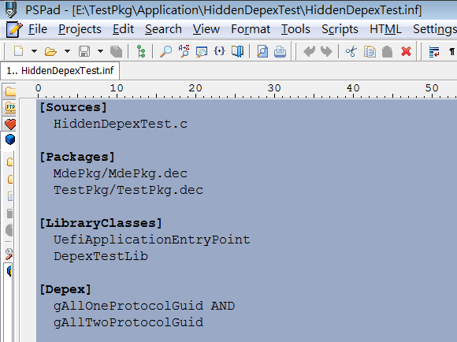
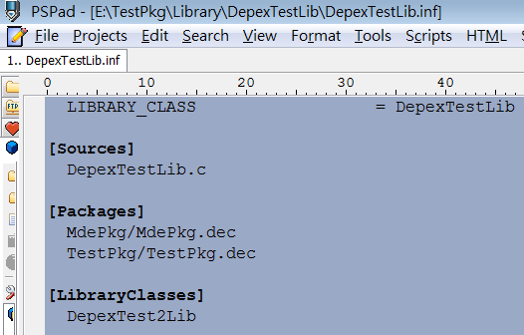
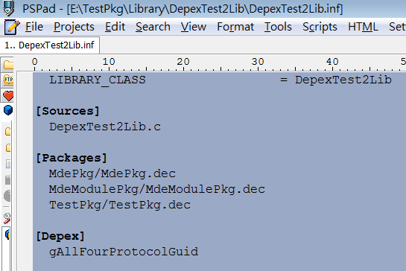
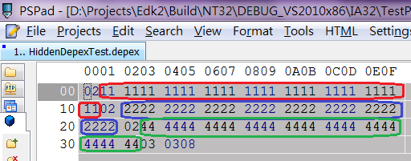
Others Dependency Expression – Library Instance Dependency
HiddenDepexTest.inf
DepexTestLib.inf
DepexTest2Lib.inf
Dependency output
34

Slide 35
Others Dependency Expression – Library Instance Dependency
MdePkg/Library/DxeSmbusLib/DxeSmbusLib.inf
[Depex.common.DXE_DRIVER, Depex.common.DXE_RUNTIME_DRIVER, Depex.common.DXE_SAL_DRIVER, Depex.common.DXE_SMM_DRIVER]
gEfiSmbusHcProtocolGuid

Slide 36
Thanks!

