Slide 1

Introduce UBA
Insyde Software July 2022

Slide 2
Copyright 2022 Insyde Software Corp., All Rights Reserved.
No part of this publication may be reproduced, transmitted, transcribed, stored in a retrieval system, or translated into any language or computer language, in any form, or by any means, electronic, mechanical, magnetic, optical, chemical, manual or otherwise, without the prior written permission of Insyde Software Corp.
Disclaimer
Insyde Software Corp. (“Insyde”), provides this document and the programs "as is" without warranty of any kind, either expressed or implied, including, but not limited to, the implied warranties of merchantability or fitness for a particular purpose.
This document may contain technical inaccuracies or typographical errors. Changes are periodically made to the information herein; these changes will be incorporated in future revisions of this document. Insyde is under no obligation to notify any person of the changes. Some code names featured in this document are used to identify products that are in development and not yet publicly announced for release. Insyde is not obligated for its accuracy or completeness.
This document may contain third party’s information, features, schedules, code names, and product names, which are based on Insyde’s interpretation available as of the creation of this document and may be changed from time to time. Neither Insyde nor the third party is obligated to notify such change. If you are interested in third party’s information, you may contact the local third party sales office or the local distributor to obtain the latest specifications. All the intellectual property right of any third party information remains to its owner or steward.

Slide 3
Agenda
What is UBA ?
What kind of UBA Configuration are provided by Insyde?
Introduce UBA Configuration
Flow Diagram
Details information for every driver in “ChipsetPkg/Uba”
Internal Use

Slide 4
What is UBA ?

Slide 5
What is UBA ?
The Unified Board Abstraction (UBA) contains the common support for Unified Board Interface that can be shared by multiple boards.
UBA is a database, that contains specific configurations for different boards in the same BIOS.
Easy porting for customer.

Slide 6
What is UBA ?
Below configurations can be covered by UBA
GPIO, Clockgen, Softstrap initialization.
USB Over Current and port length settings.
OEM Table ID, SSID/SVID programming.
SMBIOS platform related Type.
IIO/PCH Silicon policies settings, KtiEparamUpdate.
Etc….

Slide 7
What kind of UBA Configuration are provided by Insyde?

Slide 8
What kind of UBA Configuration are provided by Insyde?
The following chart lists which UBA databases in the Insyde codebase are currently in use or not in use.
Name of UBA Database | Is using in Insyde codebase | Driver/Library
UbaAcpiUpdate | Y | AcpiPlatformTableLib
UbaBoardSioInfo | N | N/A
UbaClkGenUpdate | N | N/A
UbaClocksConfig | Y | ChipsetSvcPei
UbaFpkConfig | N | N/A
UbaGpioInit | Y | ProgramGPIOPei
UbaGpioPlatformConfig | Y | ChipsetSvcPei PeiMemoryPolicyUpdateLib RasInit
UbaGpioUpdate | N | N/A
UbaHsioPtssTableConfig | N | N/A
UbaIioConfig | Y | PeiIioSiPolicyUpdateLib
UbaIioPortBifurcationInit | Y | PeiIioSiPolicyUpdateLib
UbaMpTableUpdate | N | N/A
UbaOpromUpdate | Y | PciPlatform
UbaPcdUpdate | Y | UpdatePcdPei
Name of UBA Database | Is using in Insyde codebase | Driver/Library
UbaPchEarlyUpdate | Y | ChipsetSvcPei
UbaPcieBifurcationUpdateLib | Y | PeiPolicyUpdateLib
UbaPirqUpdate | N | N/A
UbaSetupUpdate | N | N/A
UbaSlotUpdate | N | N/A
UbaSmbiosUpdate | Y | PlatformBdsLib
UbaSoftStrapUpdate | N | N/A
UbaSsidSvidUpdate | N | N/A
UbaSystemBoardInfo | N | N/A
UbaSystemConfigUpdate | N | N/A
UbaUsbOcUpdate | Y | PeiPolicyUpdateLib
Notes:
LibraryFile: Intel/EagleStream/ServerPlatformPkg/Include/Library/Ubaxxx*.h
Include : Intel\EagleStream\ServerPlatformPkg\Include\Library\UbaPlatLib.h
Project.dsc

Slide 9
Introduce UBA Configuration

Slide 10
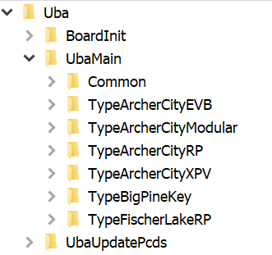
UBA Configuration
In Insyde codebase, we can find UBA Configuration in Board/Intel/EagleStreamMultiBoardPkgUba/UbaMain/TypeXXXXX/….(Take Eagle Stream platform for example).
In UbaMain folder, provide many different type of CRB, user can customize own setting(ex: GPIO, IIO/PCH Silicon policies settings...) for their HW designed.

Slide 11
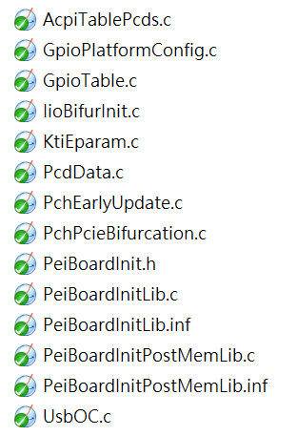
UBA Configuration (PEI)
Take “TypeArcherCityRP/Pei” for example. In this folder, Insyde provide “GpioTable, IioBifurInit, KtiEparam, PcdData, PchEarlyUpdate, PchPcieBifurcation, SlotTable, UsbOC” settings, that can be customized.
After customized, “PeiBoardInitLib” will install those settings.

Slide 12
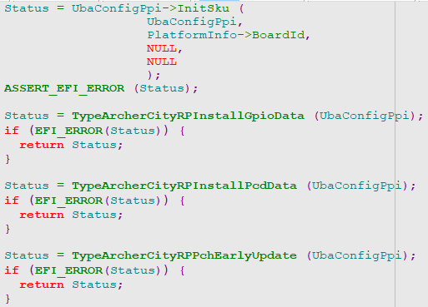
UBA Configuration (PEI)
PeiBoardInitLib.c
”UbaConfigPpi→InitSku” create, initialize UBA node and ”TypeArcherCityRPInstallXXXXData” will install ”GPIO, PCD...” data to the UBA node, that is a database for ArcherCityRP.

Slide 13
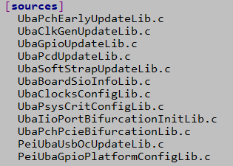
UBA Configuration (PEI)
PeiUbaPlatLib
This library will get configurations from UBA node and initialize platform.
EX: Intel\EagleStream\ServerPlatformPkg\Platform\Pei\PlatformInit\PlatformInit.c →PlatformInitEntryPoint() →PeiPolicyInit() →UpdatePeiPchPolicy() →UpdatePcieRpConfig() →PlatformGetPchPcieBifurcationConfig()

Slide 14
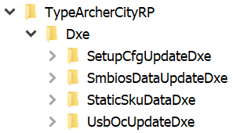
UBA Configuration (DXE)
Take “TypeArcherCityRP\Dxe” for example. After installing UbaCfgDbProtocol, Re-creating UBA DB from Hob, and loading BoardInitDxe driver, that install ”PlatformTypeXX” protocol.
“TypeArcherCityRP\Dxe” Dxe driver will depend on specific protocol which is installed by BoardInitDxe driver to loading.

Slide 15
Flow Diagram

Slide 16
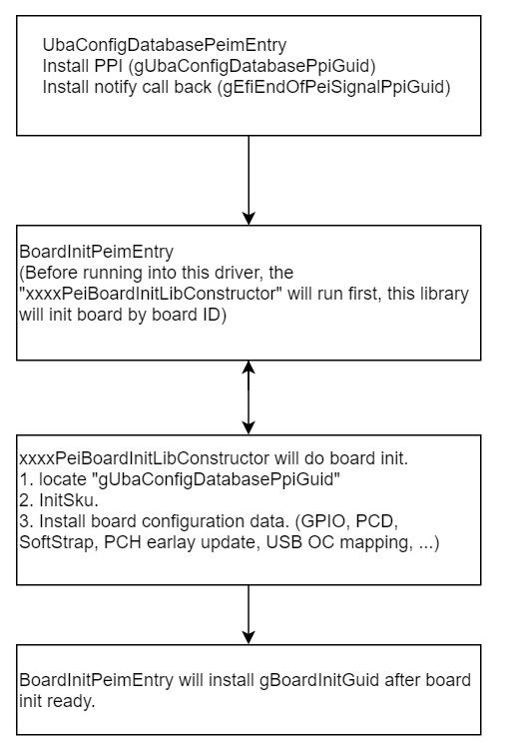
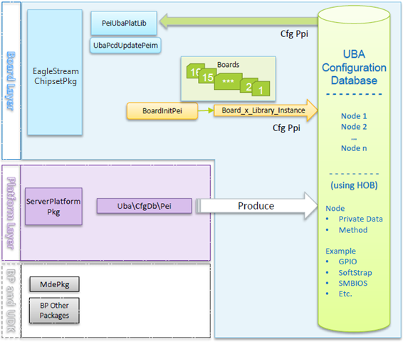
Flow Diagram
PEI

Slide 17


UBA driver (PEI)
Board \Intel → EagleStreamMultiBoardPkg → Uba→BoardInit→Pei
After installing board specific configuration data, this driver will install gBoardInitGuid Ppi.
Intel→EagleStream→ServerPlatformPkg→Uba→CfgDb→Pei
Installing gUbaConfigDatabasePpiGuid for initialization board confguration data.
Installing notify function, this call back function build data hob, it will pass to DXE driver.

Slide 18
UBA driver (PEI) - 2
Board → Intel → EagleStreamMultiBoardPkg → →Uba → UbaMain->TypeXXXX
In PEI phase, most of the code are NULL library type. These library will initialize specific board with “CONFTRUCTOR” before loading “BoardInitPei”

Slide 19
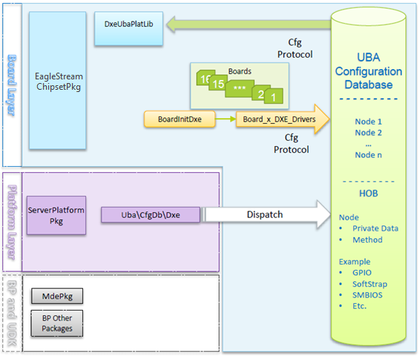
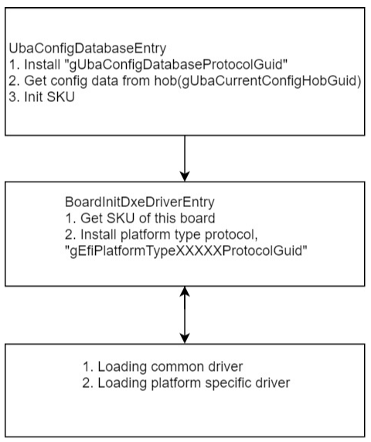
Flow Diagram
DXE

Slide 20
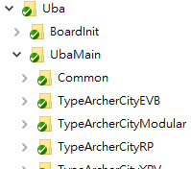
UBA driver (DXE)
Board \ Intel \ EagleStreamMultiBoardPkg \ Uba \ BoardInit \ Dxe
This driver will get SKU and install gEfiPlatformTypeXXXXXProtocolGuid
Intel \ EagleStream \ ServerPlatformPkg \ Uba \ CfgDb \Dxe
Installing gUbaConfigDatabase…..Guid and initialize board according the hob data.
Board \ Intel \ EagleStreamMultiBoardPkg \ Uba \ UbaMain \ TypeXXXX \ Dxe \ ….
Loading platform specific driver

Slide 21
Detail information for every driver (related UBA)

Slide 22
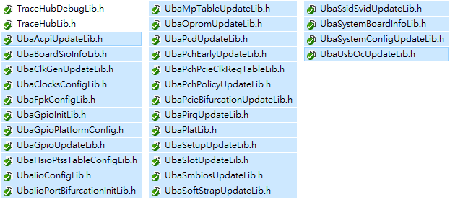
UBA Library for Initializing Platform Config (DXE/PEI)
In Intel/EagleStream/ServerPlatformPkg/Include/Library we can find many header files for UBA setting.
These library will get specific config data from UBA.

Slide 23
Thanks!

