Slide 1

H2ODDT Diagnostic & Debugging Tool
Employee Name Insyde Software
March, 2021

Slide 2
Agenda
Goals & Target Audience
Insyde H2ODDT™ Overview
Goal of H2ODDT™
Build H2ODDT™
Major Features Introduction
Trouble Shooting

Slide 3
Goals & Target Audience

Slide 4
Goals & Target Audience
Target Audience:
BIOS developers who will use Insyde H2ODDT to debug
Goals:
Be familiar with Insyde H2ODDT’s basic functions & interfaces.
Understand how to generate a BIOS binary with Insyde H2ODDT enabled.
Build up the ability to use Insyde H2ODDT to debug.
Requirements:
InsydeH2O 5.4 source code
Insyde H2ODDT
Target board for debug

Slide 5
Insyde H2ODDT™ Overview

Slide 6
Insyde H2ODDT™ Overview
ICE like feature support
Connection type flexibility of USB3.0./ com
Able to view and trace in C source code and Assembly code concurrently.
Customized project profile settings
Individual windows can be easily invoked to access I/O registers, PCI register space, read/write Memory region, show CPU registers, manipulate HW/SW breakpoints, dump POST Code, etc.

Slide 7
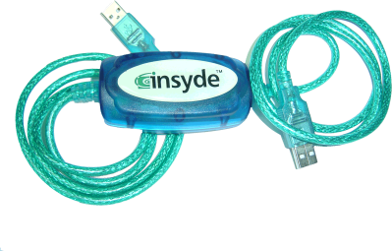

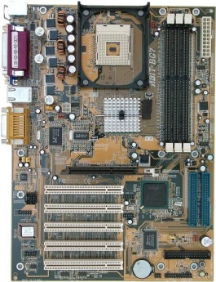
Hardware Requirements
H2ODDT™ cable
Target board (USB3.0 with debug capability)
Host machine (Notebook or desktop with USB3.0)

Slide 8
Hardware Requirements
USB Port Support Matrix
 | Host | Target | Supported?
Build in USB 3.0 BIOS | 2.0 | 2.0 | NO
 | 3.0 | 2.0 | NO
 | 2.0 | 3.0 | NO
 | 3.0 | 3.0 | YES

Slide 9
Software Requirements
H2ODDT™ Application
H2ODDT™ USB cable drivers
Source codes of InsydeH2O™

Slide 10
H2ODDT™ PEIMs
InsydeModulePkg/Package.dsc
!if gInsydeTokenSpaceGuid.PcdInsydeDebugger
InsydeModulePkg/H2ODebug/$(H2O_DDT_DEBUG_IO)DebugIoPei/ $(H2O_DDT_DEBUG_IO)DebugIoPei.inf
InsydeModulePkg/H2ODebug/DebugEnginePei/DebugEnginePei.inf
…
!endif
InsydeModulePkg/Package.fdf
!if gInsydeTokenSpaceGuid.PcdInsydeDebugger
INF APRIORI=0xC000 InsydeModulePkg/H2ODebug/$(H2O_DDT_DEBUG_IO)DebugIoPei/ $(H2O_DDT_DEBUG_IO)DebugIoPei.inf
INF APRIORI=0xC000 InsydeModulePkg/H2ODebug/DebugEnginePei/DebugEnginePei.inf
…
!endif

Slide 11
H2ODDT™ Drivers
InsydeModulePkg/Package.dsc
!if gInsydeTokenSpaceGuid.PcdInsydeDebugger
InsydeModulePkg/H2ODebug/$(H2O_DDT_DEBUG_IO)DebugIoDxe/ $(H2O_DDT_DEBUG_IO)DebugIoDxe.inf
InsydeModulePkg/H2ODebug/DebugEngineDxe/DebugEngineDxe.inf
…
!endif
InsydeModulePkg/Package.fdf
!if gInsydeTokenSpaceGuid.PcdInsydeDebugger
INF APRIORI=0xC000 InsydeModulePkg/H2ODebug/$(H2O_DDT_DEBUG_IO)DebugIoDxe/ $(H2O_DDT_DEBUG_IO)DebugIoDxe.inf
INF APRIORI=0xC000 InsydeModulePkg/H2ODebug/DebugEngineDxe/DebugEngineDxe.inf
…
!endif

Slide 12
Goal of H2ODDT ™

Slide 13
Goal of H2ODDT ™
CSM Driver
PEI Core
PCI Driver
PlatformStage1
PEIM
Bus Driver
Debug all UEFI phases
Pre Verifier
SMM Driver
Pre Verifier
OS-Absent
App
OS-Absent
App
Previously
Exposed
Tiano APIs
Now limited
CPU
Init
Previously
Exposed
Tiano APIs
Now limited
CPU
Init
Device, Bus, or Service Driver
Device, Bus, or Service Driver
Transient OS
Environment
Chipset
Init
Transient OS
Environment
Chipset
Init
Verify
Verify
Board
Init
Board
Init
Transient OS
Boot Loader
Transient OS
Boot Loader
ICHx Driver
OS-Present
App
OS-Present
App
DXE Dispatcher
DXE Dispatcher
DXE Dispatcher
DXE Dispatcher
MCH Driver
Final OS
Environment
Final OS
Boot Loader
Final OS
Environment
Boot Service
Runtime Service
Final OS
Boot Loader
Boot Service
Runtime Service
?
?
Pre EFI Initialization Environment
(PEI)
Security
(SEC)
Pre EFI Initialization Environment
(PEI)
Security
(SEC)
Driver Execution Environment
(DXE)
Driver Execution Environment
(DXE)
Boot Device Selection
(BDS)
Boot Device Selection
(BDS)
Transient System Load
(TSL)
Transient System Load
(TSL)
Run Time
(RT))
Run Time
(RT))
After Life (AL)
After Life (AL)
Power on → […..Platform initialization…..] → [….OS boot….] → Shutdown
Power on → […..Platform initialization…..] → [….OS boot….] → Shutdown

Slide 14
Build H2ODDT™

Slide 15
Build H2ODDT™
Step 1: Install H2ODDT Cable driver
Check Device Manager – it should be “isusb.sys”
Step 2: Compiler your source code
Turn on switch in Project.env
INSYDE_DEBUGGER = YES
It will sync the PCD in $(PROJECT_PKG)/Project.dsc
gInsydeTokenSpaceGuid.PcdH2ODdtSupported|$(INSYDE_DEBUGGER)
Change the debug IO interface in Project.env if needed
EDK_GLOBAL H2O_DDT_DEBUG_IO = Xhc
Com/Xhc
clean build – “nmake clean”
New build – “nmake uefi64ddt”

Slide 16
Build H2ODDT™
Step 3: Power On the target
You should see 0xD0/0x0D on port 80
Step 4: Plug-in H2ODDT Cable
If the debug port is correctly selected, you will see 0xD1
Step 5: Connect the H2ODDT cable to host
Then run H2ODDT application

Slide 17
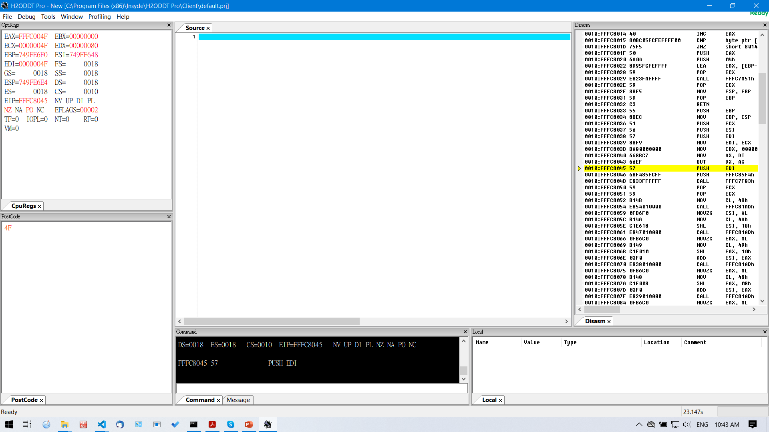
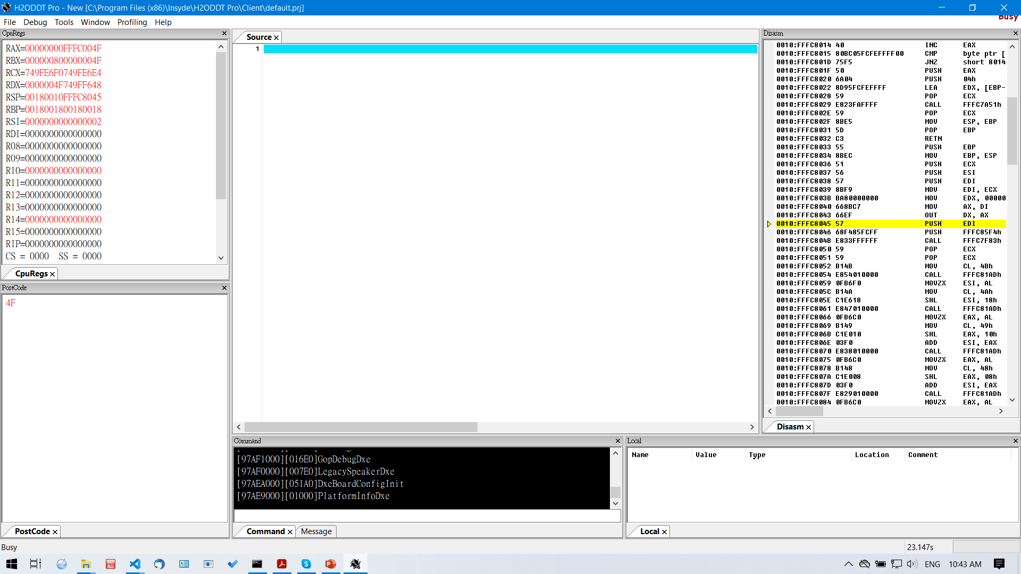
Build H2ODDT™
Ready vs. Busy
Ready
Busy

Slide 18
Major Features Introduction

Slide 19
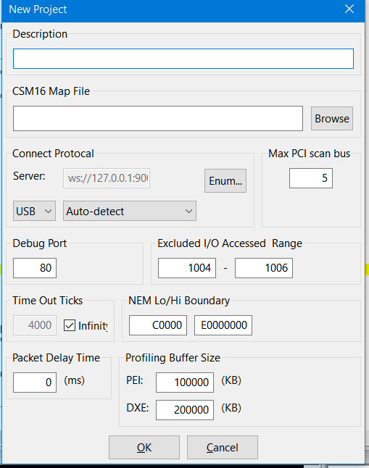
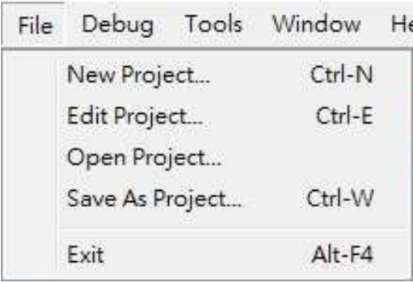
File Menu – Project Maintenance
*.prj
USB

Slide 20
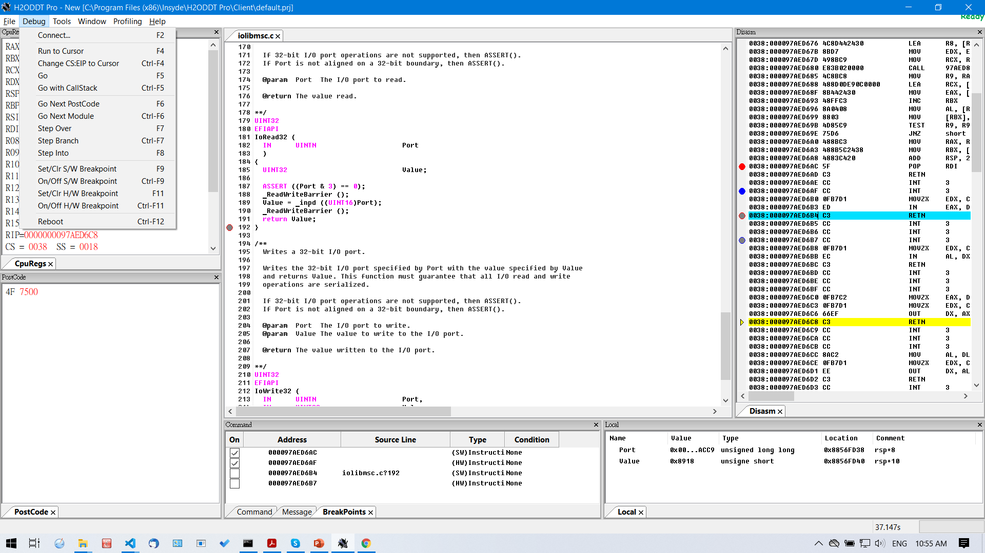
Debug Menu – Trace the Execution Flow

Slide 21
Debug Menu – Trace the Execution Flow

Slide 22
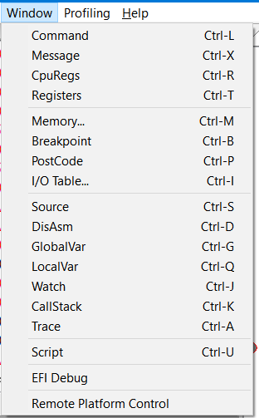
Window Menu – Monitor the Changes during Debugging
Individual windows can be easily invoked to access I/O registers, PCI register space, read/write Memory region, show CPU registers, manipulate HW/SW breakpoints, dump POST Code, etc.

Slide 23
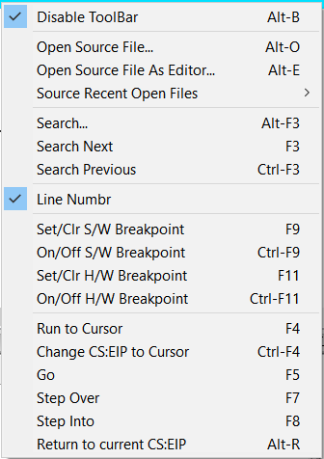
Source Code Window

Slide 24
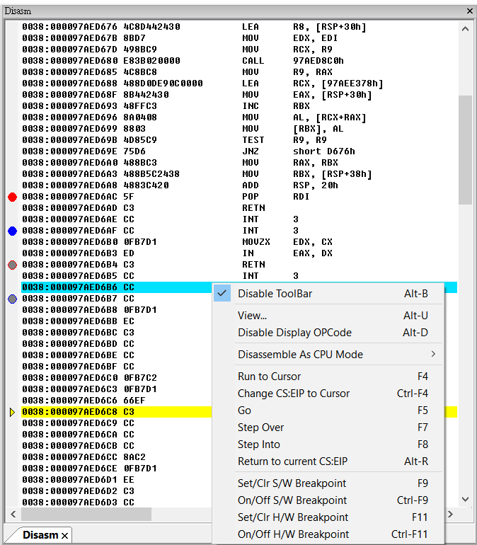
DisAsm Window

Slide 25
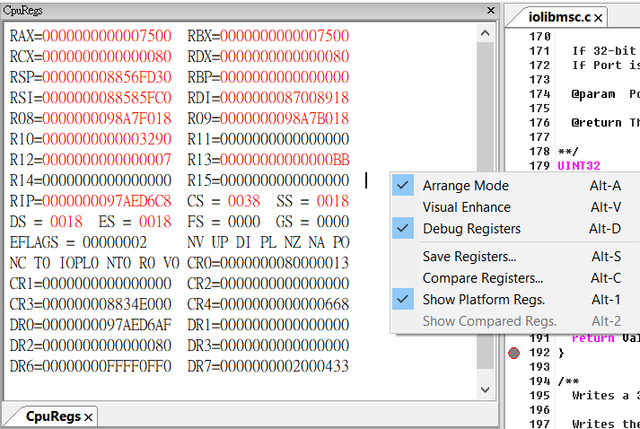
CPU Registers Window

Slide 26
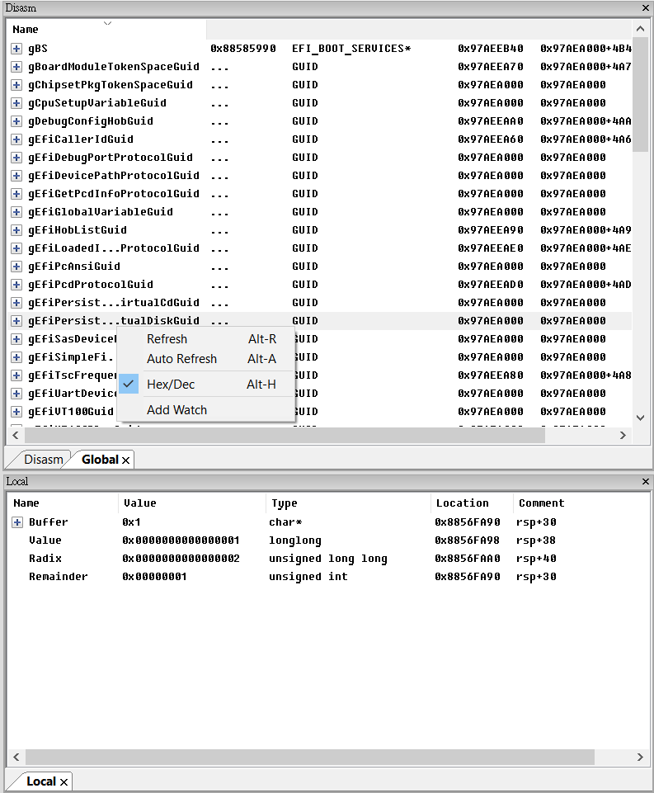
Variable Windows – LocalVar, GlobalVar & Watch Window

Slide 27
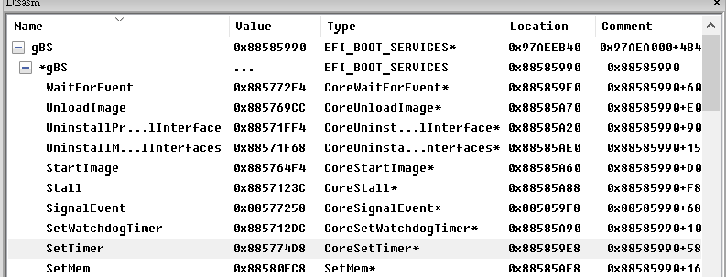
Variable Windows – LocalVar, GlobalVar & Watch Window
The Watch window supports drag and drop
You can drag a variable from LocalVar, GlobalVar or Source window and drop it in the Watch window.

Slide 28
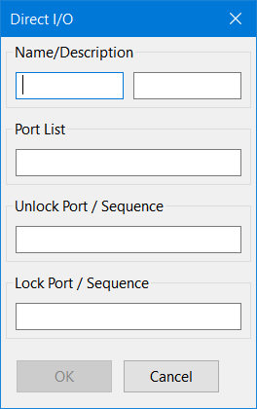
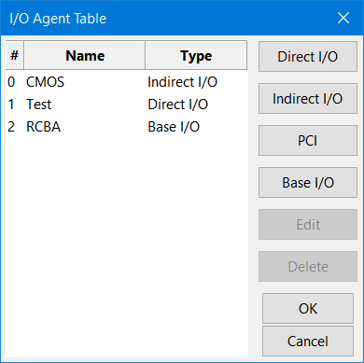
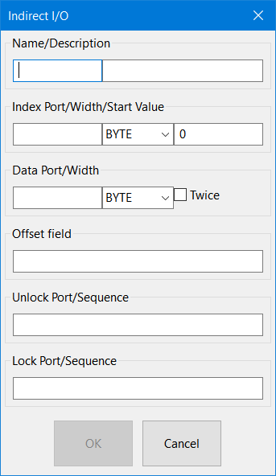
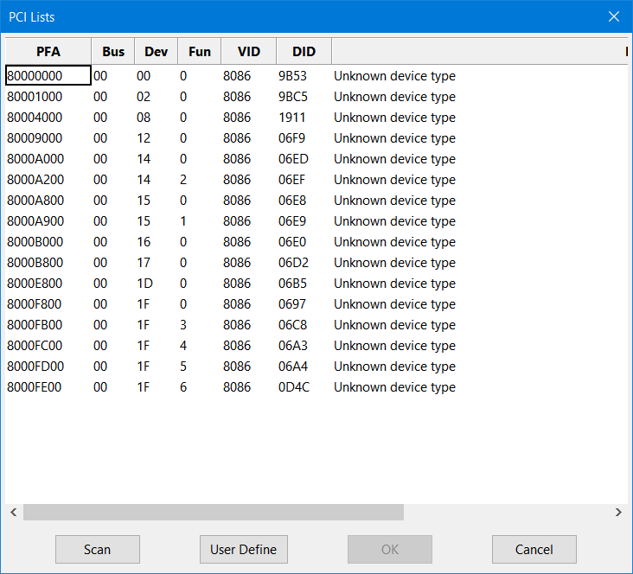
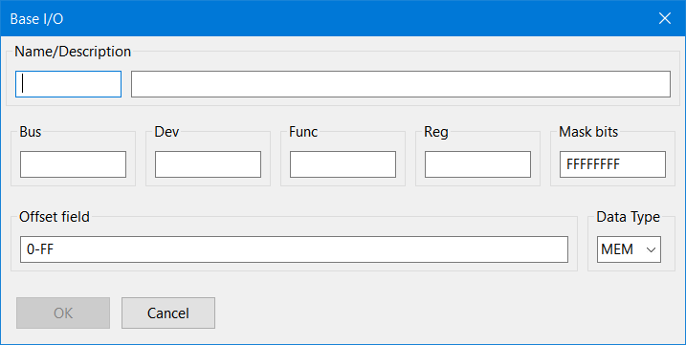
I/O Table Agent Window

Slide 29
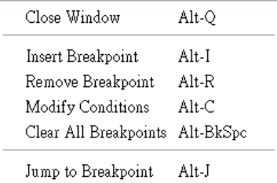
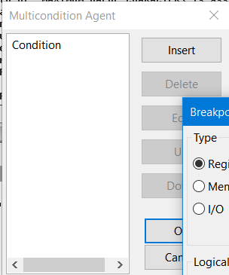
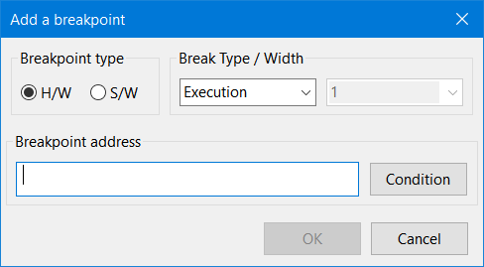

Breakpoint Window
Tip:
Press Space bar to pause BIOS running

Slide 30
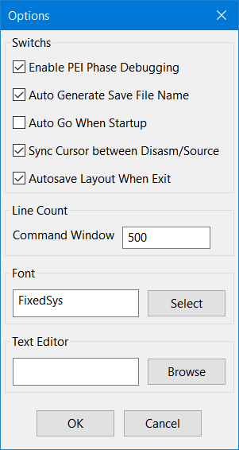
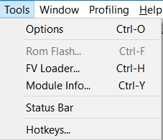
Tool Menu – Misc. Functions

Slide 31
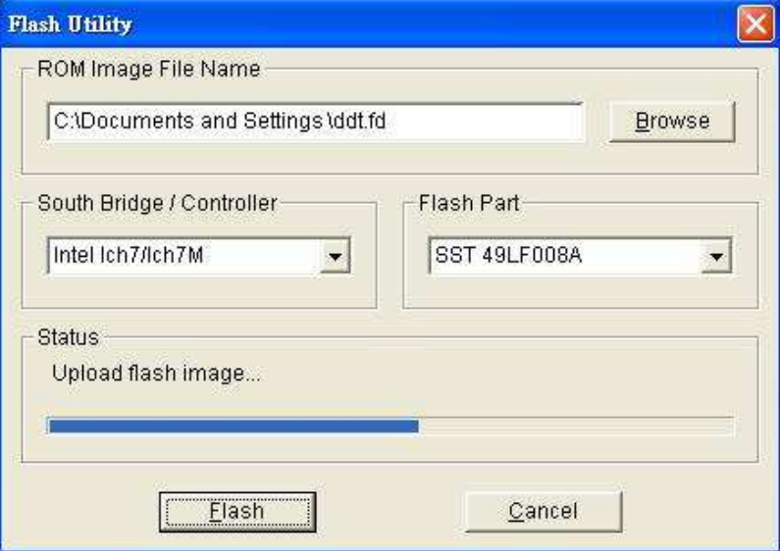
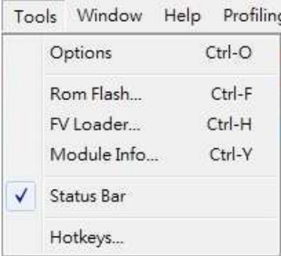
Tool Menu – Misc. Functions

Slide 32
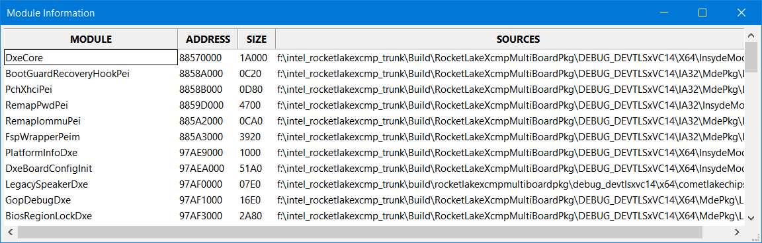
Tool Menu – Misc. Functions

Slide 33
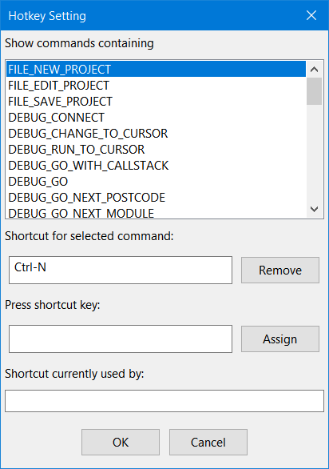
Tool Menu – Misc. Functions

Slide 34
Troubleshooting

Slide 35
POST Code of DDT Debug Engine
D0: Waiting for USB debug cable insert
D1: Ready for connect. This is the signal to indicate that everything ready.
D2: USB 2.0 (EHCI controller) not found.
D3: Low speed device in USB port 0
D4 – D8: USB debug cable initialization error(May indicate the debug cable’s firmware crashed)

Slide 36
Local variable is not traceable
Solution: Turn off compiler optimization
Locally
In [BuildOptions] section of .inf file
Adds "*_*_*_CC_FLAGS = /Od“
In [Component] section of Project.dsc file
Use <BuildOptions> to add "*_*_*_CC_FLAGS = /Od“
Ex:
MdeModulePkg/Core/Pei/PeiMain.inf {
<BuildOptions>
*_*_*_CC_FLAGS = /Od
}

Slide 37
Thanks!
For more information, contact:
employee@insyde.com

