Slide 1
Food Image Classifier and Food Nutrition Analyzer
Hanwei Peng (hp2166)
Zijing Sun (zs2198)

Slide 2
Approach
Solution Diagram
Implementation details
Summary
Motivation
Background work
Technical challenges
Demo

Slide 3
Summary
Our goal is to train a food image classifier and implement a food nutrition analyzer.
Train food image classifier: Food-101 dataset, InceptionV3, ResNet50
Implement food nutrition analyzer: Open Food Facts dataset
The customer needs to upload the photo of food and our system will recognize what the food is and give the user the analysis of its nutrition details, including Energy, Vitamins, Minerals and its Score.

Slide 4
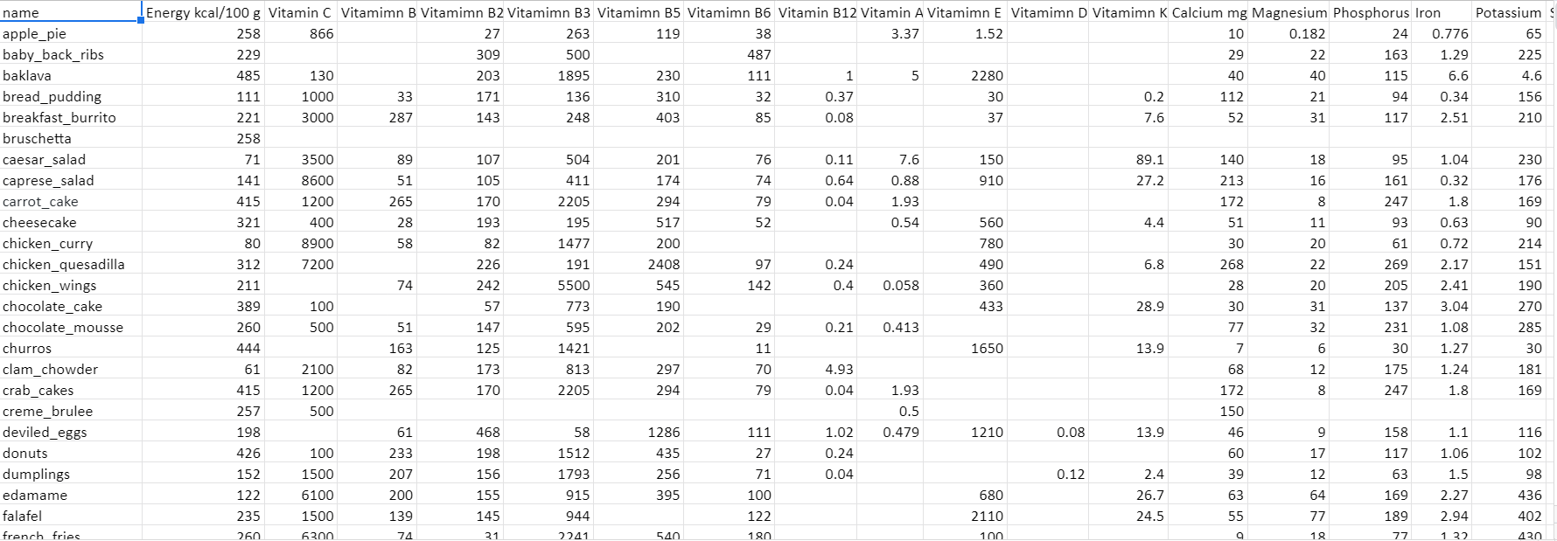

Slide 5
Problem Motivation
Image recognition has already been a mature technique
How can we implement such technique into practice
Many Nutrition website
The demand for food nutrition analyzers is increasing

Slide 6
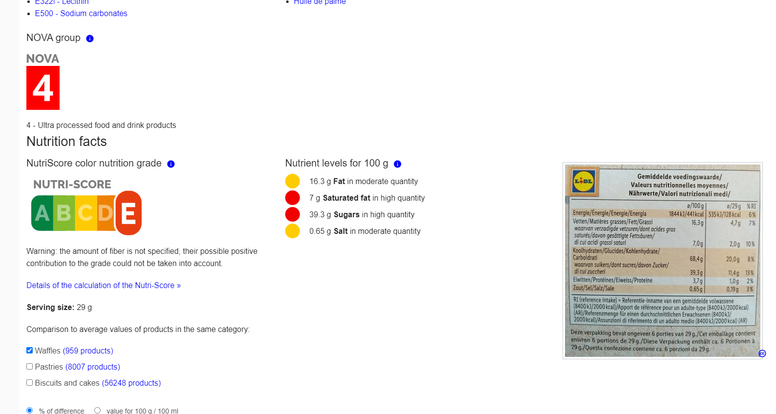
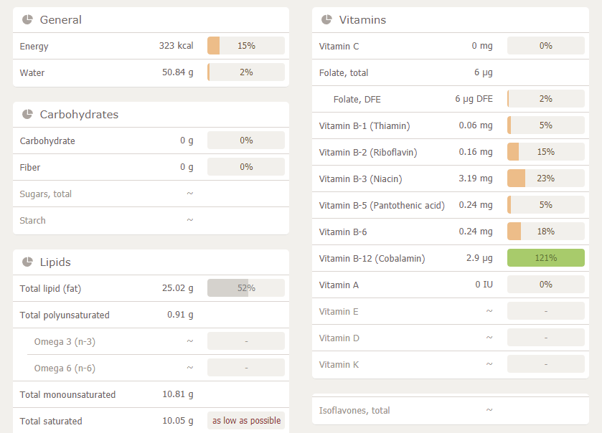
Background work
Open Food Facts
happyforks

Slide 7
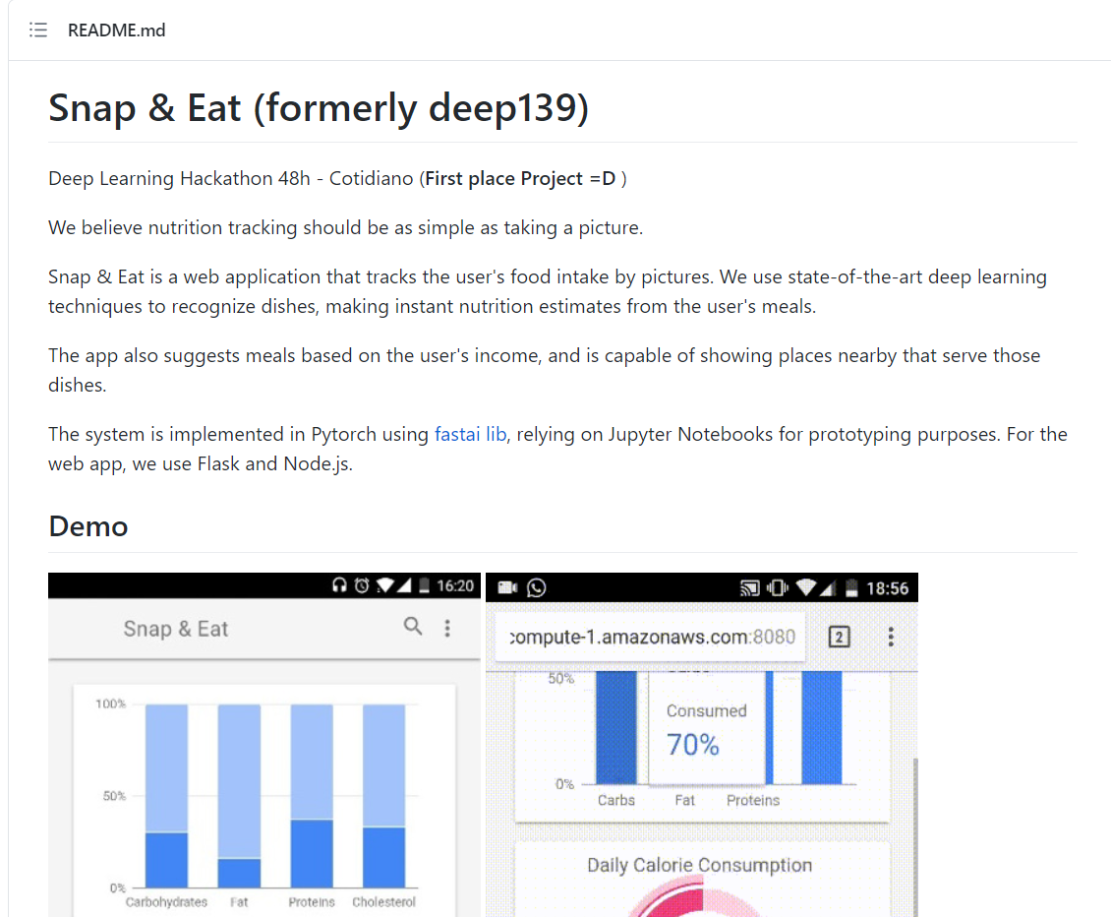
Background work
github repo Snap & Eat

Slide 8
Technical challenges
Large Input Dataset → Long Training Time
Colab Pro GPU limitation
Low accuracy

Slide 9
Approach
Long Training Time
decrease food class (101 60）(101000 60000)
decrease test and train image size (origin 299x299 )
Colab Pro GPU limitation
change platform (Colab Pro GCP)

Slide 10
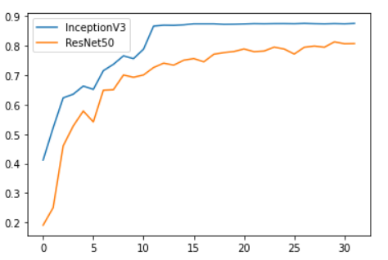
Approach
Low accuracy
change model (ResNet 0.8135 InceptionV3 0.8719 )
adjust hyperparameter

Slide 11
Solution Diagram
Collecte Data
Tensorflow Food101
Open Food Facts
HappyForks.com
Train Model
InceptionNet-V3
ResNet50
1
2
3
4
5
Manage Input
Decrease Class
Decrease Input size
Upgrade GPU and RAM
Eval Model
Retain
Analyze Nutrition

Slide 12
Implementation Details
Dataset: Tensorflow Food101, Open Food Facts, HappyForks.com
FrameWork: Pytorch 1.8.1, Scipy 1.1.0, Keras 2.4.3, TensorFlow 2.4
Model: ResNet50, InceptionNet-V3
Software: Colab Pro (RAM 25BG, GPU V100)， GCP (RAM 26BG, GPU V100)

Slide 13
Demo

Slide 14
Conclusion
Choosing of model and adjusting hyperparameter are both important.
It’s hard to define a kind of food.

Slide 15
Github Link
https://github.com/hanweii/CSCI3303FinalProject

Slide 16
Reference
https://happyforks.com/
https://world.openfoodfacts.org/
https://github.com/gabrielilharco/snap-n-eat
https://github.com/stratospark/food-101-keras

