Slide 1
STEMotion Export Spike
Ohm Law Export Spike
A minimal self-contained STEMotion widget used to validate screenshot and PPTX export.
Topic
Ohm Law
Quality Score
91 (excellent)

Slide 2
Learning Objectives
- Explain the relationship between voltage, resistance, and current.
- Use I = U / R to predict current when voltage or resistance changes.
- Identify voltage and resistance as controllable variables.
These objectives are sourced from the test artifact blueprint fixture.

Slide 3
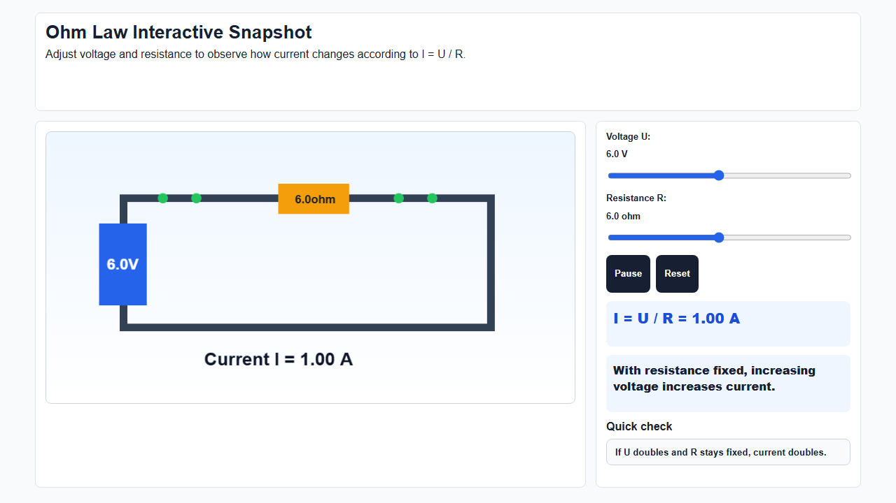
Artifact Snapshot

Slide 4
Expected Insight / Core Variables
Current increases as voltage increases and decreases as resistance increases, following I = U / R.
Symbol | Variable | Role | Unit
U | Voltage | independent | V
R | Resistance | independent | ohm
I | Current | dependent | A

Slide 5
Quality Report
Final score: 91 / 100
Level: excellent
Strengths
Suggestions
- The widget keeps voltage, resistance, and current visible together.
- The formula and observation panel reinforce the expected insight.
- Stable data-role targets support teacher actions.
- Add a second scenario comparing two resistors side by side.
- Include a short reflection prompt after the quiz.

Slide 6
Interactive Demo
Use the deck for explanation, then open the companion HTML file for the real interaction.
Companion file
interactive-demo.html
If the local hyperlink is blocked, open this HTML file manually from the same folder.
Open Interactive Experiment
Compatibility with PowerPoint, WPS, and Keynote must be checked manually.

