Slide 1
CurveLab
A launch-design workspace for Meteora DBC
Crypto World’s Fair · Meteora DBC track
Notes:
Working local MVP. Public release materials prepared for the Meteora DBC track. Source: CurveLab implementation and locally verified SDK results, 7 October 2026. Official SDK: https://github.com/MeteoraAg/dynamic-bonding-curve-sdk

Slide 2
The launch configuration problem
A curve sets the terms of early participation
Launchpad builders must understand how liquidity distribution changes price movement and graduation capital requirements.
CurveLab makes these choices observable before a builder signs a launch transaction.
CurveLab / 2
Notes:
Source: CurveLab implementation and locally verified SDK results, 7 October 2026. Official SDK: https://github.com/MeteoraAg/dynamic-bonding-curve-sdk

Slide 3
Graduation reserves depend on the curve
Same supply and market-cap targets; different liquidity weights
1B TOKEN
30 → 300 SOL market cap
1% fixed DBC fee
SOL quote reserves
Calculated by the official SDK
Balanced = equal weights · Patient = more early liquidity · Momentum = more late liquidity
CurveLab / 3
Notes:
Source: CurveLab implementation and locally verified SDK results, 7 October 2026. Official SDK: https://github.com/MeteoraAg/dynamic-bonding-curve-sdk Inputs: 1B token supply, initial market cap 30 SOL, graduation market cap 300 SOL, fixed fee 1%, 1% leftover parameter. Quote reserves are SDK-computed, not USD values or committed funding.

Slide 4
Identical trades expose different outcomes
Buy 1 SOL → Buy 2 SOL → Sell 1M TOKEN → Buy 5 SOL
Balanced
Patient launch
Momentum
212.1M
236.6M
161.0M
TOKEN held
TOKEN held
TOKEN held
11.05% graduation progress
15.30% graduation progress
8.22% graduation progress
Official SDK swap quotes · reproducible JSON exports · simulation only
CurveLab / 4
Notes:
Source: CurveLab implementation and locally verified SDK results, 7 October 2026. Official SDK: https://github.com/MeteoraAg/dynamic-bonding-curve-sdk Scenario: buy 1 SOL, buy 2 SOL, sell 1,000,000 TOKEN, buy 5 SOL. Single simulated trader, fixed fees, no external trading, MEV or network fees.

Slide 5
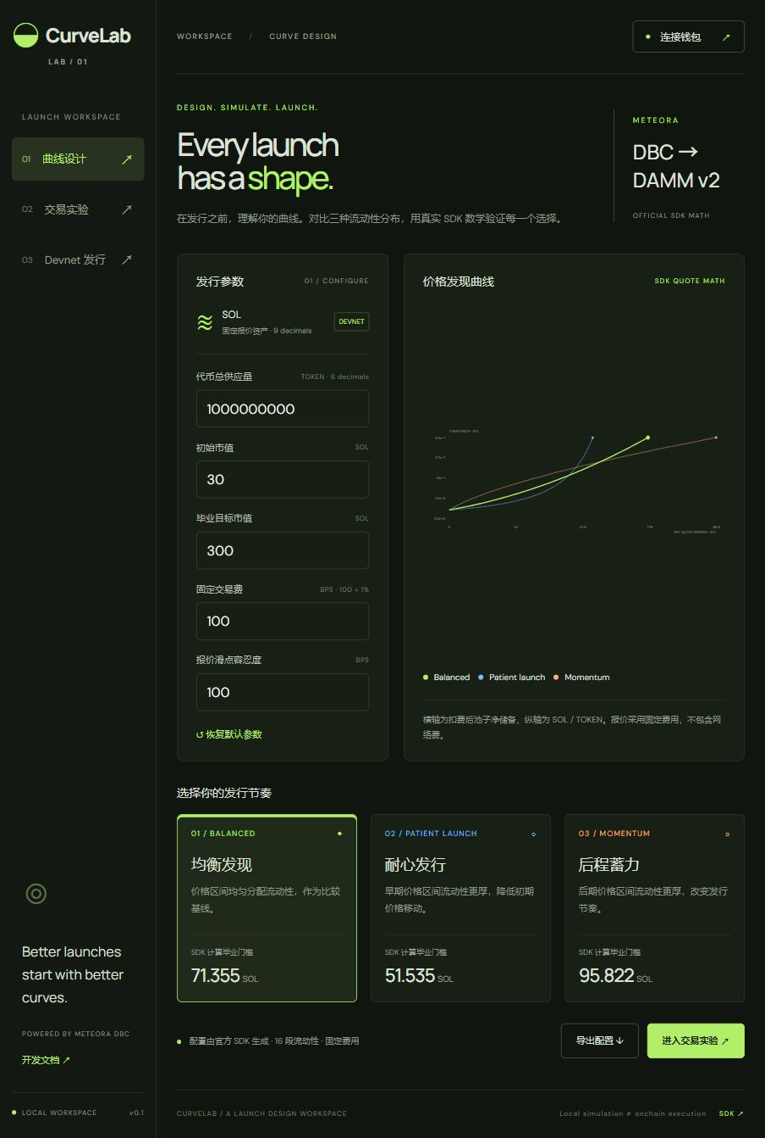
The working design workspace
Adjust launch parameters
Compare three SDK configurations
Inspect the price-discovery curves
Export parameters and experiment results
React frontend + local Node API
CurveLab / 5
Notes:
Source: CurveLab implementation and locally verified SDK results, 7 October 2026. Official SDK: https://github.com/MeteoraAg/dynamic-bonding-curve-sdk Screenshot of the actual local CurveLab interface.

Slide 6
Meteora integration and current validation
Official DBC SDK
buildCurveWithLiquidityWeights → quote and scenario math → configuration and pool-creation transaction
Devnet launch flow
Phantom signature, preflight, confirmation and pool lookup are implemented. Configurations target DAMM v2; migration uses the official manual migrator.
CurveLab / 6
Notes:
Source: CurveLab implementation and locally verified SDK results, 7 October 2026. Official SDK: https://github.com/MeteoraAg/dynamic-bonding-curve-sdk Confirmed: six engine tests, five HTTP API checks, TypeScript and Vite build, browser scenario, Devnet RPC, SDK two-instruction creation transaction. Not confirmed: onchain creation, real swaps, DAMM v2 migration. Faucet error prevented funded smoke testing.

Slide 7
Release status and next milestones
Verified local MVP
SDK curve generation and simulations work. Tests, build and browser checks pass.
Chain validation remains pending
A Devnet faucet error blocked funded pool creation. No confirmed launch or DAMM migration is claimed. Upstream dependency findings remain documented.
Next: funded Devnet lifecycle → launchpad-builder feedback → broader configurations
CurveLab / 7
Notes:
Source: CurveLab implementation and locally verified SDK results, 7 October 2026. Official SDK: https://github.com/MeteoraAg/dynamic-bonding-curve-sdk Dependency audit records 13 upstream findings: 6 high, 7 moderate. No mainnet deployment or traction claimed. Future model is a hypothesis.

