Slide 1
How volcanoes form
Magma rises where tectonic plates pull apart
or where one plate dives under another

Slide 2
Famous eruptions
Vesuvius buried Pompeii in 79 AD
Krakatoa in 1883 was heard 4,800 km away

Slide 3
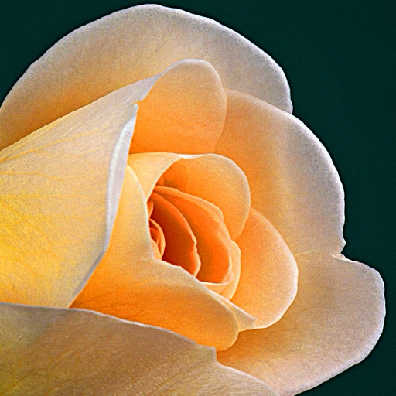

Slide 4
Our model volcano
Baking soda, vinegar and red food colouring
in a cone of modelling clay

