Slide 1

Emse 6992 Final Project
Google Play Store Apps EDA
Xiao Han

Slide 2
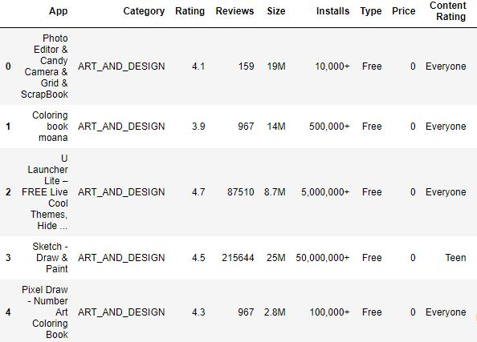
Data Pre-Processing
Remove + in Installs
Change all Size to MB
Remove MB in Size
Drop nan

Slide 3

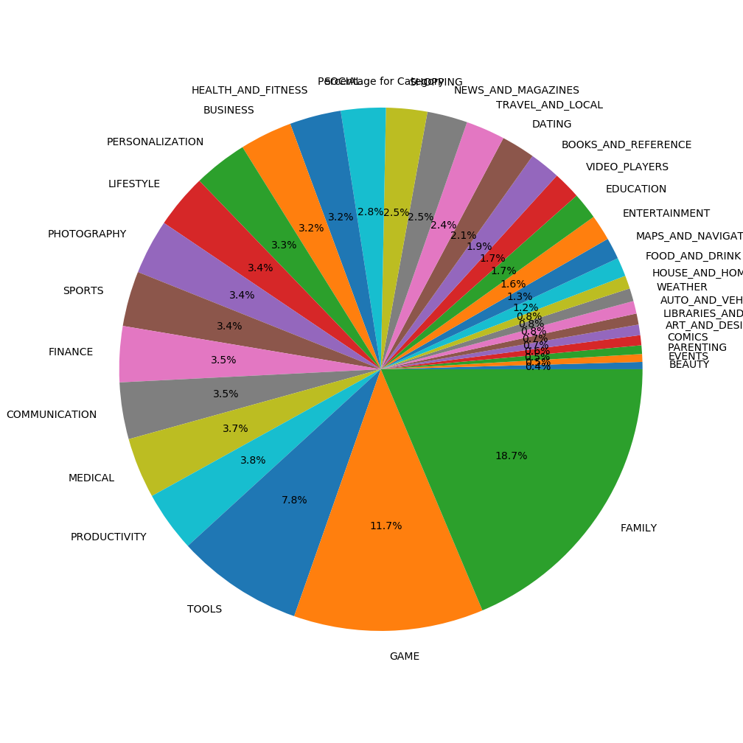
Android Market Breakdown

Slide 4
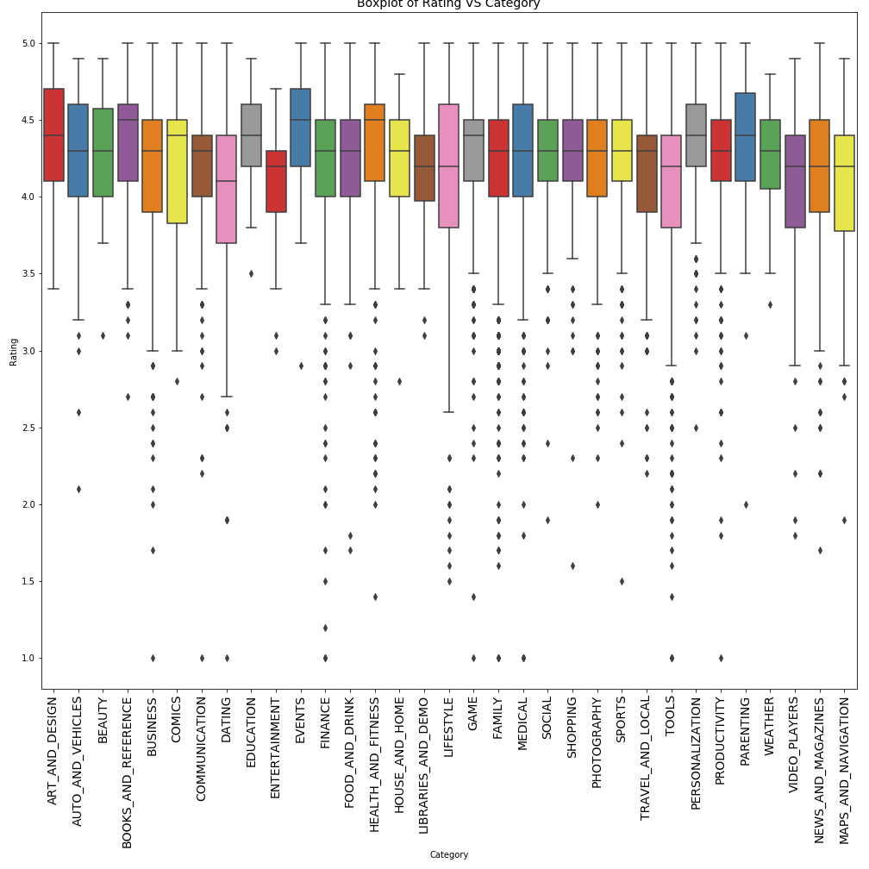
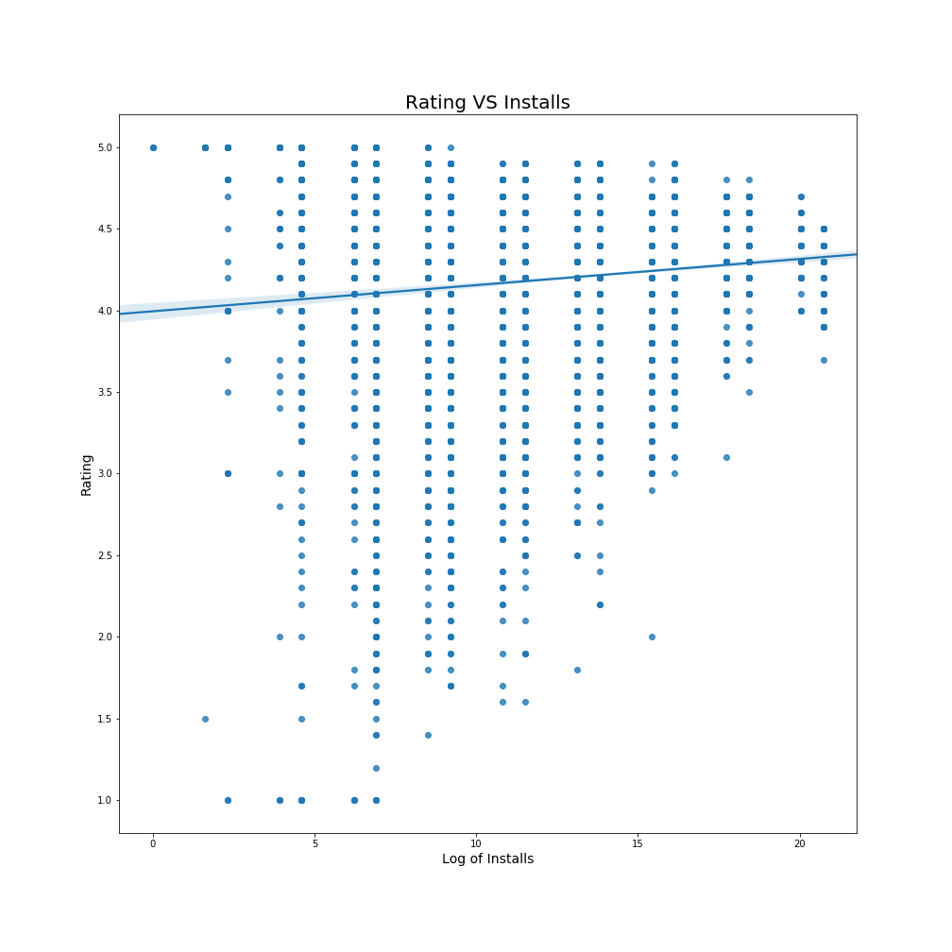
Rating & Installs

Slide 5
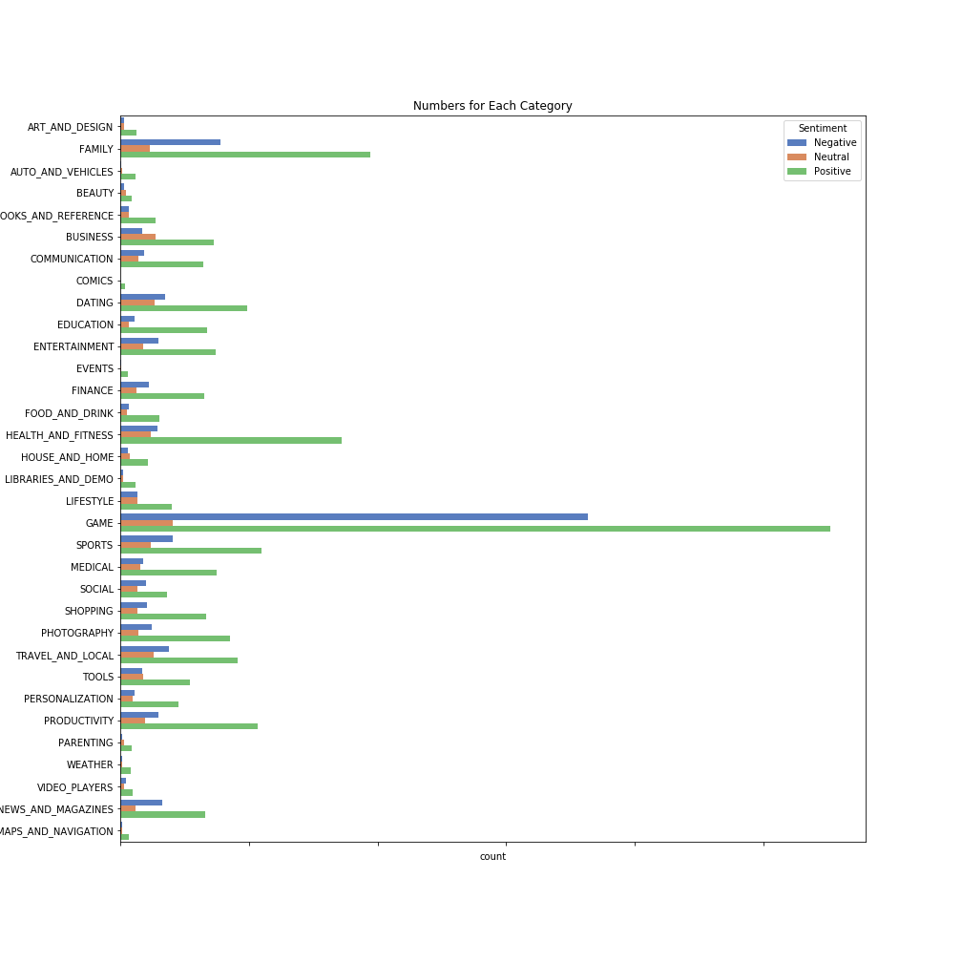
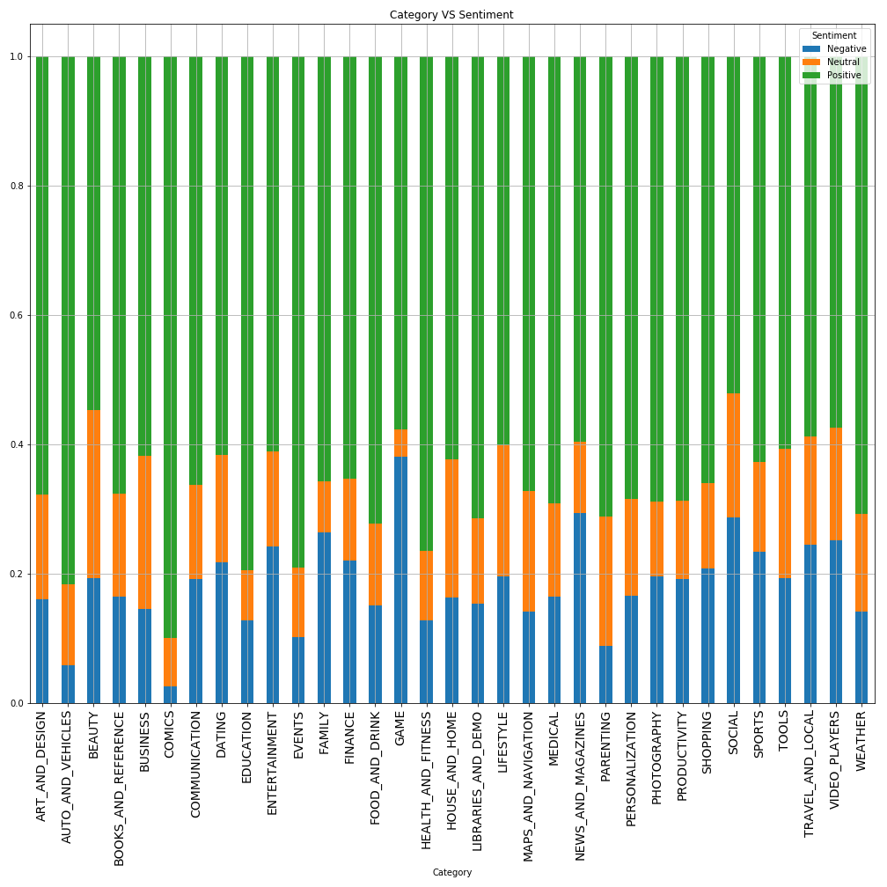
Reviews for Category

Slide 6
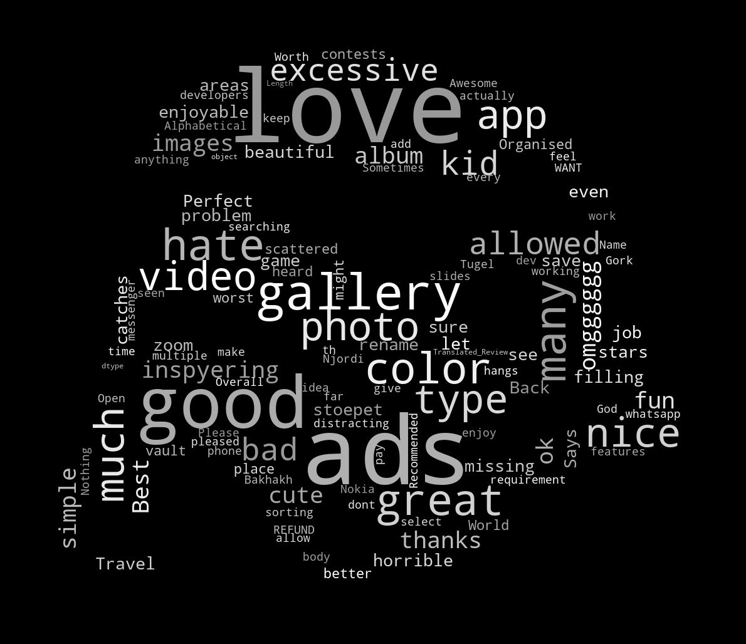

Better Way to Show the Result

