Slide 1

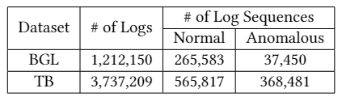
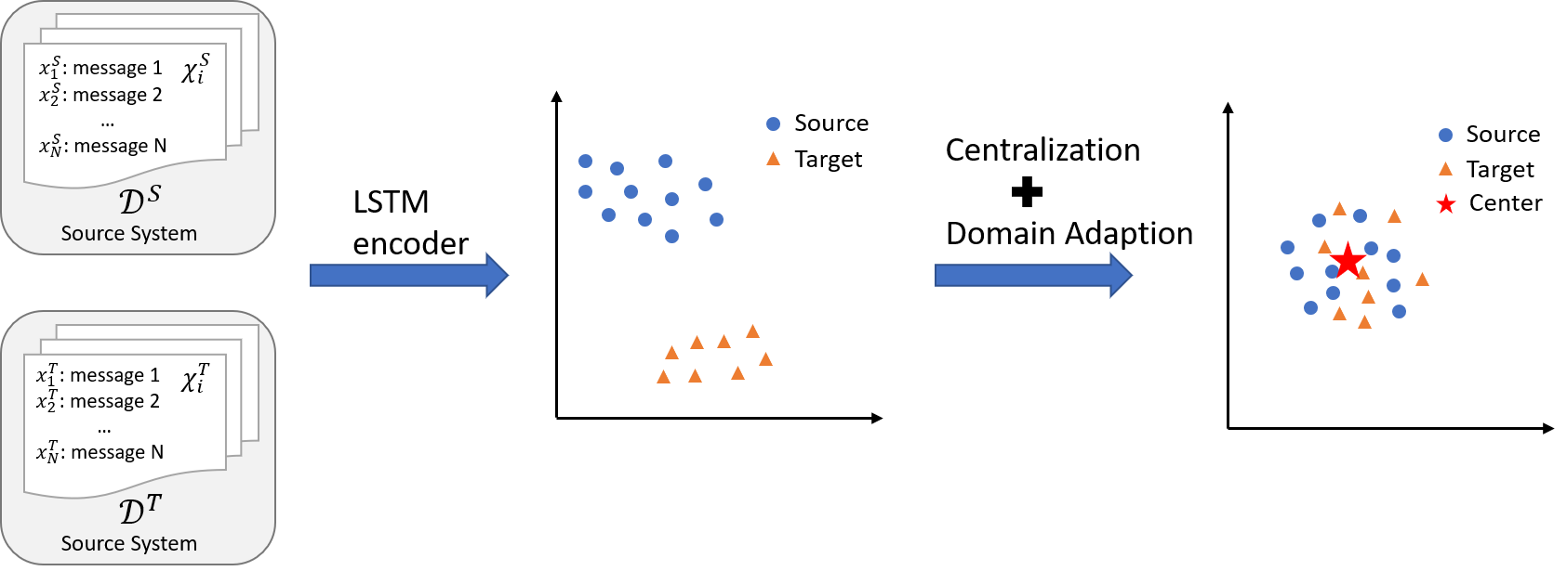
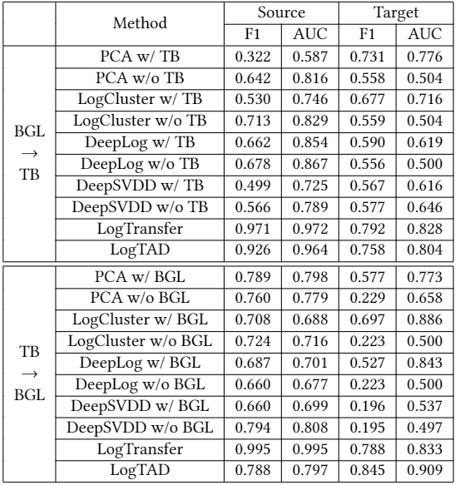
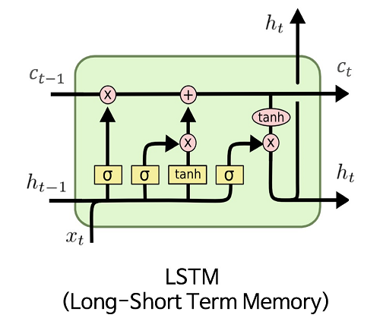
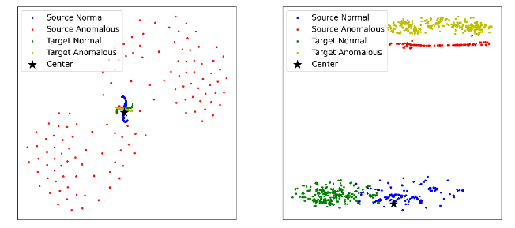
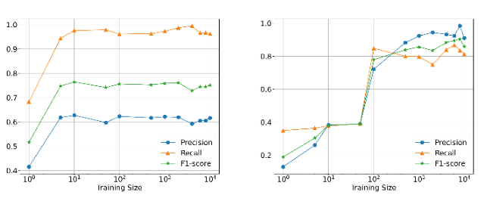
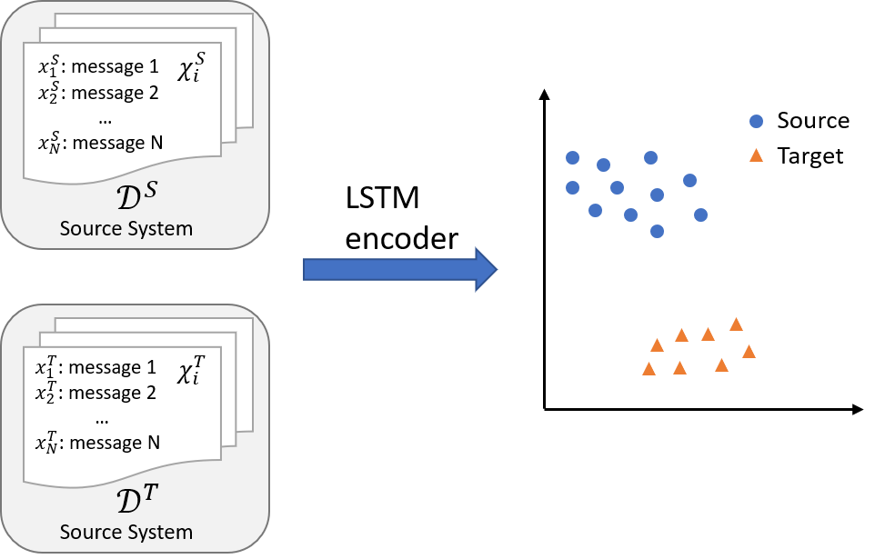
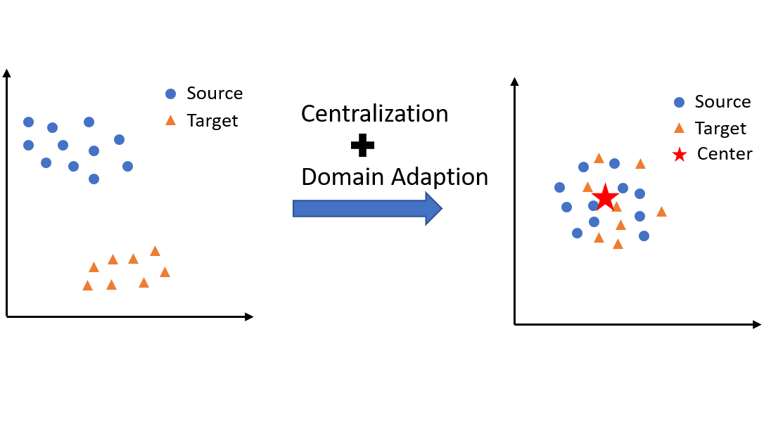
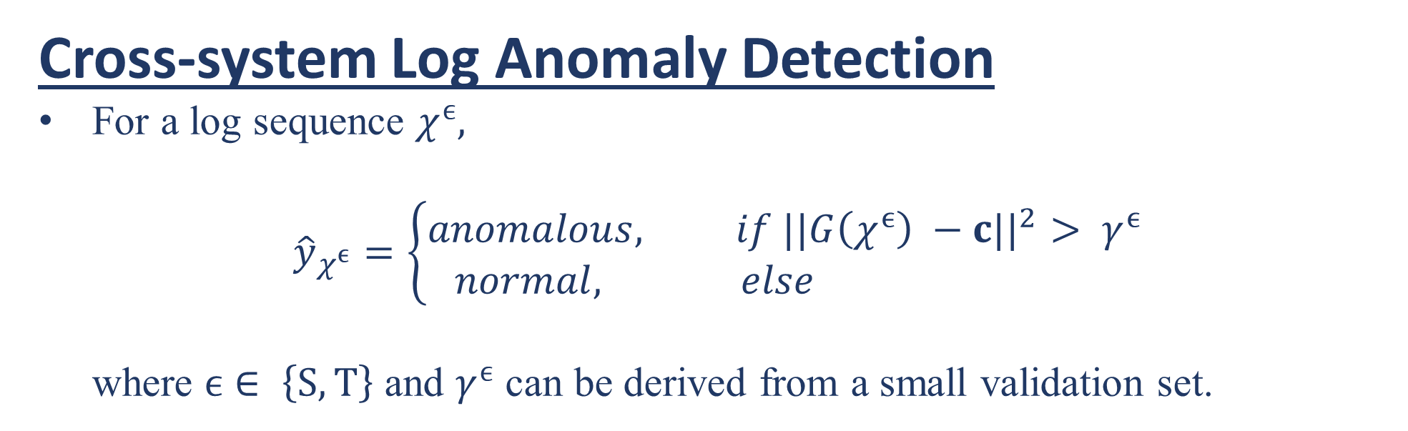

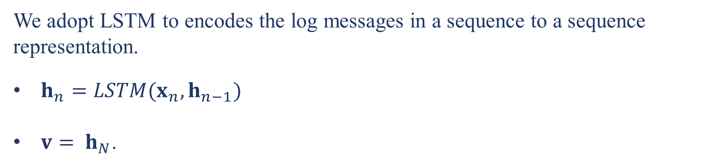
Unsupervised Cross-system Log Anomaly Detection via Domain Adaptation
Xiao Han and Shuhan Yuan
Utah State University
INTRODUCTION
Cross-system Log Anomaly Detection
For a log sequence $χ^{ϵ},$
$${\hat{y}}_{χ^{ϵ}}=\left\{\begin{aligned}anomalous, if ||G\left(χ^{ϵ}\right) −c{||}^{2}> γ^{ϵ} \\ normal, else \end{aligned}\right.$$
where $ϵ$ $∈ \left\{S, T\right\}$ and $γ^{ϵ}$ can be derived from a small validation set.
Currently, many unsupervised log anomaly detection approaches are developed to address the challenge of limited anomalous samples. However, collecting enough data to train an unsupervised model is not practical when the system is newly deployed online.
Challenges: (1) Data Imbalance: Few anomalous samples especially for novel deployed online systems; (2) Cold-start Problem: Limited normal samples available from newly deployed systems.
Goals: Identifying anomalies in newly deployed systems with limited normal samples.
The basic idea is to adopt log sequence centralization with system-agnostic representation via domain adversarial training to map sequences from both systems to the same center.
EXPERIMENTS
Experimental Settings:
Table 1: Statistics of the Datasets
Experimental Results:
LogTAD
Table 2: Anomaly Detection on Source and Target Systems
Framework Overview
LogTAD vs. Unsupervised Anomaly Detection Approaches:
PCA
LogCluster
DeepLog
DeepSVDD
LogTAD vs. Supervised Anomaly Detection Approach
LogTransfer
Log Sequence Representation
We adopt LSTM to encodes the log messages in a sequence to a sequence representation.
$h_{n}=LSTM(x_{n}, h_{n−1})$
$v= h_{N}$.
Log Sequence Visualization
Log Sequence Centralization
Inspired by the DeepSVDD that the normal log sequences should be in a hypersphere and close to the center in the embedding space,
$c=Mean(v_{i}^{ϵ})$, where $ϵ$ $∈ \left\{S, T\right\}$.
To make the representation of normal log sequences close to the center $c$, we develop the following objective function,
$ℒ_{en}= \sum_{ϵ ∈ \left\{S, T\right\}}{\sum_{i=1}^{M_{ϵ}}{||{ v}_{i}^{ϵ} −c {||}^{2}}}$,
where $M_{ϵ}$ is the number of samples from the specific domain.
With the adversarial training objective function,
$ℒ_{adv}= \min_{G}{\max_{D}{(𝔼_{χ^{s}\sim P_{source}}\left[\log{D(G(χ^{s}))}\right]+𝔼_{χ^{T}\sim P_{target}}\left[\log{(1−D(G(χ^{T}))}\right])}}$,
our goal is to mix the distributions of source and target log sequences.
Final objective function for LogTAD,
$ℒ= ℒ_{en}+ {λℒ}_{adv}$.
(a) Without domain adaptation (b) With domain adaptation
LogTAD performance with different training sizes from the target system
System-agnostic Representation via Domain Adversarial Training
Although we adopt one shared LSTM model to map log sequences into a hypersphere, the representations of log sequences from different systems can be still located in different regions.
Hence, we propose an adversarial training method for cross-system data mapping.
In specific, we formulate the adversarial training with a discriminator 𝐷 and a shared LSTM as a generator 𝐺.
(a) BGL Thunderbird (b) Thunderbird BGL
REFERENCE
[1] Rui Chen, Shenglin Zhang, Dongwen Li, Yuzhe Zhang, Fangrui Guo, WeibinMeng, Dan Pei, Yuzhi Zhang, Xu Chen, and Yuqing Liu. 2020. LogTransfer: Cross-System Log Anomaly Detection for Software Systems with Transfer Learning.In2020 IEEE 31st International Symposium on Software Reliability Engineering(ISSRE).
[2] Min Du, Feifei Li, Guineng Zheng, and Vivek Srikumar. 2017. Deeplog: Anomalydetection and diagnosis from system logs through deep learning. InProceedingsof the 2017 ACM SIGSAC Conference on Computer and Communications Security.
ACKNOWLEDGEMENT
This work is supported in part by US National Science Foundation (2103829)
Email: {xiao.han, shuhan.yuan}@usu.edu
CIKM ’21, November 1–5, 2021, Virtual Event, QLD, Australia

