Slide 1
InterpretableSAD: Interpretable Anomaly Detection in Sequential Log Data
Xiao Han¹, He Cheng¹, Depeng Xu², and Shuhan Yuan¹
¹Utah State University
²University of Arkansas

Slide 2
Outline
Background
Anomaly Detection
System Logs
Challenges
Preliminary
Problem Statement
Method
Experiment
Conclusion

Slide 3
What is Anomaly Detection
Anomaly detection in sequential data aims to identify sequences that deviate from the expected behavior or patterns.
Anomaly detection receives much attention due to its broad application.
E.g., fraud, intrusion, medical, social network, etc.
Log anomaly detection uses system logs to detect anomalous events or patterns in computer systems.

Slide 4
What are System Logs
Logkey Template:
k1,dc2c74b7,PacketResponder <*> for block <*> terminating
k2,5d5de21c,BLOCK* NameSystem.addStoredBlock: blockMap updated: <*> is added to <*> size <*>
1 081109 203615 148 INFO dfs.DataNode$PacketResponder: PacketResponder 1 for block blk_38865049064139660 terminating
2 081109 203807 222 INFO dfs.DataNode$PacketResponder: PacketResponder 0 for block blk_-6952295868487656571 terminating
3 081109 204005 35 INFO dfs.FSNamesystem: BLOCK* NameSystem.addStoredBlock: blockMap updated: 10.251.73.220:50010 is added to blk_7128370237687728475 size 67108864
4 081109 204015 308 INFO dfs.DataNode$PacketResponder: PacketResponder 2 for block blk_8229193803249955061 terminating
5 081109 204106 329 INFO dfs.DataNode$PacketResponder: PacketResponder 2 for block blk_-6670958622368987959 terminating
6 081109 204132 26 INFO dfs.FSNamesystem: BLOCK* NameSystem.addStoredBlock: blockMap updated: 10.251.43.115:50010 is added to blk_3050920587428079149 size 67108864
7 081109 204324 34 INFO dfs.FSNamesystem: BLOCK* NameSystem.addStoredBlock: blockMap updated: 10.251.203.80:50010 is added to blk_7888946331804732825 size 67108864
8 081109 204453 34 INFO dfs.FSNamesystem: BLOCK* NameSystem.addStoredBlock: blockMap updated: 10.250.11.85:50010 is added to blk_2377150260128098806 size 67108864
1,s1
2,s1
3,s2
4,s1
5,s1
6,s2
7,s2
8,s2
New log: dfs.DataNode$PacketResponder: PacketResponder 1 for block blk_38865049064139660 terminating
New log: dfs.DataNode$PacketResponder: PacketResponder 0 for block blk_-6952295868487656571 terminating
New log:
INFO dfs.FSNamesystem: BLOCK* NameSystem.addStoredBlock: blockMap updated: 10.251.73.220:50010 is added to blk_7128370237687728475 size 67108864
Logkey template
Logkey template
Logkey template
s1,dfs.DataNode$PacketResponder: PacketResponder 1 for block blk_38865049064139660 terminating
s1, PacketResponder <*> for block <*> terminating
Raw Data
Log Parsing

Slide 5
Challenges
Scarcity of anomalous samples
Negative sampling algorithm
Lack of anomalous event interpretability
Integrated Gradients (IG)
No common IG baseline for log data
IG baseline generation algorithm

Slide 6
Outline
Background
Preliminary
Anomaly Detection in Sequential Log Data
Data Augmentation
Interpretable Machine Learning
Problem Statement
Method
Experiment
Conclusion

Slide 7
Anomaly Detection in Sequential Log Data
Traditional supervised learning -> Require an enormous number of labeled data
Logistic regression, decision tree, and SVM
Traditional unsupervised learning -> Hard to capture the order information of sequence data
PCA, Isolation forest, and OC-SVM
Deep learning -> No detailed information on the sub-sequence level
DeepLog and LogAnomaly

Slide 8
Data Augmentation
Data augmentation technique is to tackle the scarcity of labeled data issue by artificially expanding the labeled dataset.
Extensively used in image classification and natural language processing.
Rotation and flip for image data, synonym replacement for text data
Negative sampling is a special data augmentation technique.

Slide 9
Interpretable Machine Learning
Interpretable machine learning aims at providing a human understandable explanation about the decisions.
The interpretable anomaly detection models are very limited.
The attention mechanism provides an attention score that is more about the correlation among events instead of the correlation between events and the label.

Slide 10
Outline
Background
Preliminary
Problem Statement
Method
Experiment
Conclusion

Slide 11
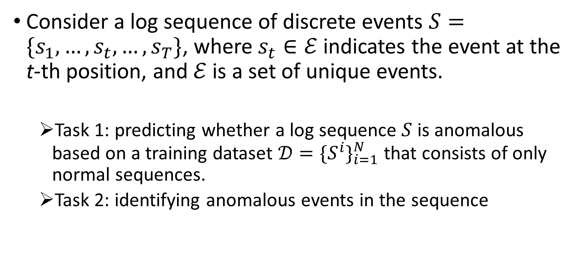
Problem Statement
Consider a log sequence of discrete events $S=\{s_{1},…,s_{t},…,s_{T}\}$, where $s_{t}∈ℰ$ indicates the event at the t-th position, and $ℰ$ is a set of unique events.
Task 1: predicting whether a log sequence $S$ is anomalous based on a training dataset $𝒟={\{S^{i}\}}_{i=1}^{N}$ that consists of only normal sequences.
Task 2: identifying anomalous events in the sequence

Slide 12
Outline
Background
Preliminary
Problem Statement
Method
Data Augmentation via Negative Sampling
Anomaly Detection at a Sequence Level
Anomalous Event Detection via Integrated Gradients
Experiment
Conclusion

Slide 13
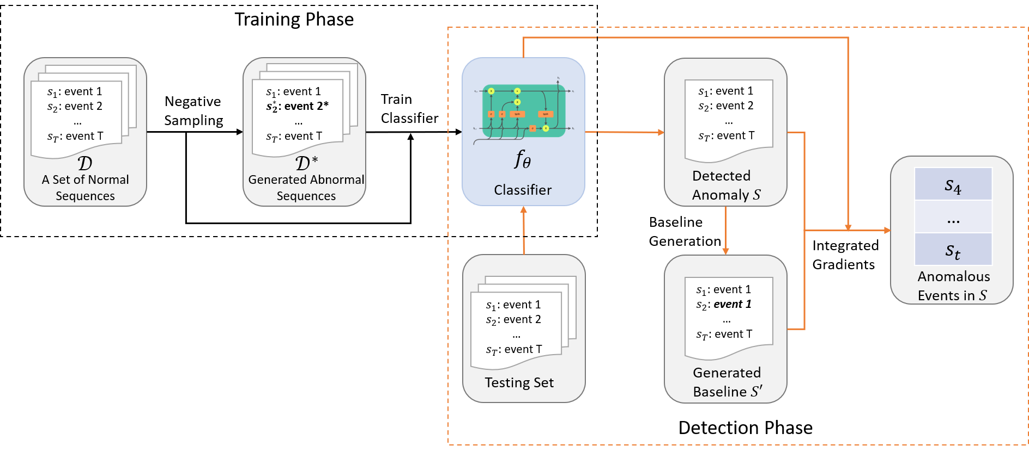
Framework of InterpretableSAD

Slide 14
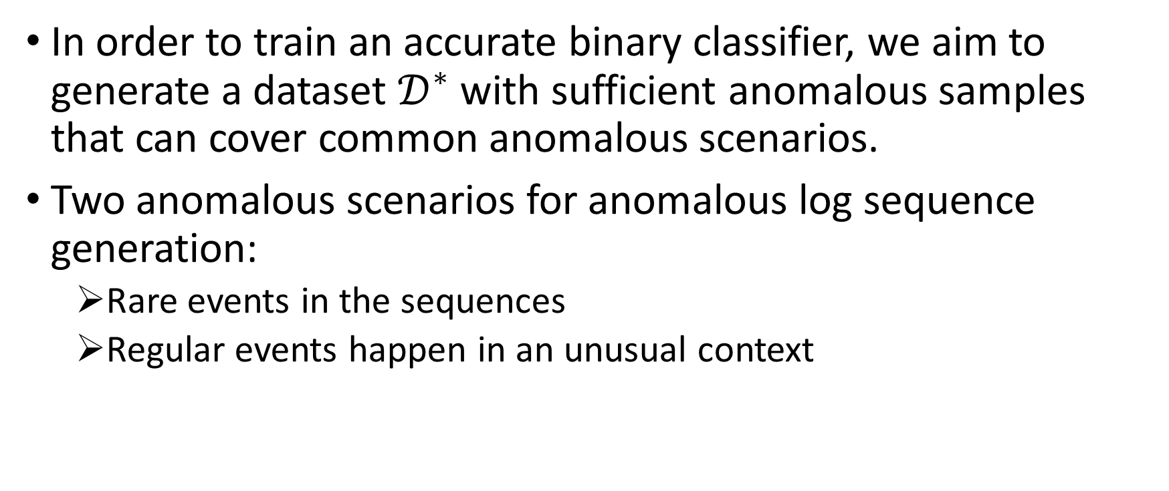
Data Augmentation via Negative Sampling
In order to train an accurate binary classifier, we aim to generate a dataset $𝒟^{∗}$ with sufficient anomalous samples that can cover common anomalous scenarios.
Two anomalous scenarios for anomalous log sequence generation:
Rare events in the sequences
Regular events happen in an unusual context

Slide 15
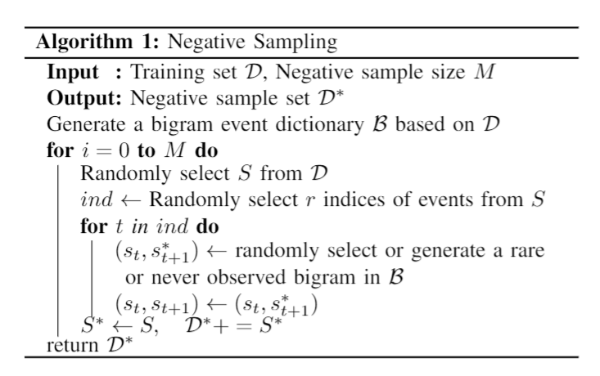
Data Augmentation via Negative Sampling Cont.

Slide 16
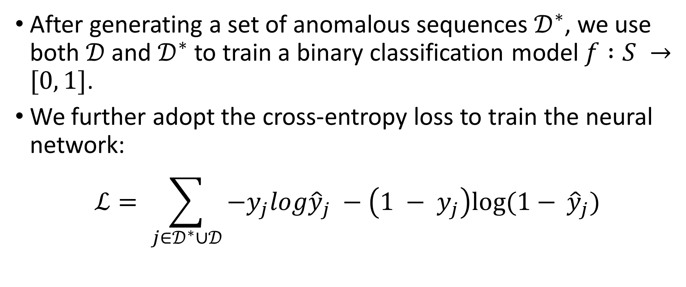
Anomaly Detection at a Sequence Level
After generating a set of anomalous sequences $𝒟^{∗}$, we use both $𝒟$ and $𝒟^{∗}$ to train a binary classification model $f :S →[0, 1]$.
We further adopt the cross-entropy loss to train the neural network:
$$ℒ= \sum_{j∈𝒟^{∗}∪𝒟}{−y_{j}log{\hat{y}}_{j} −\left(1 − y_{j}\right)log⁡(1− }{\hat{y}}_{j})$$

Slide 17
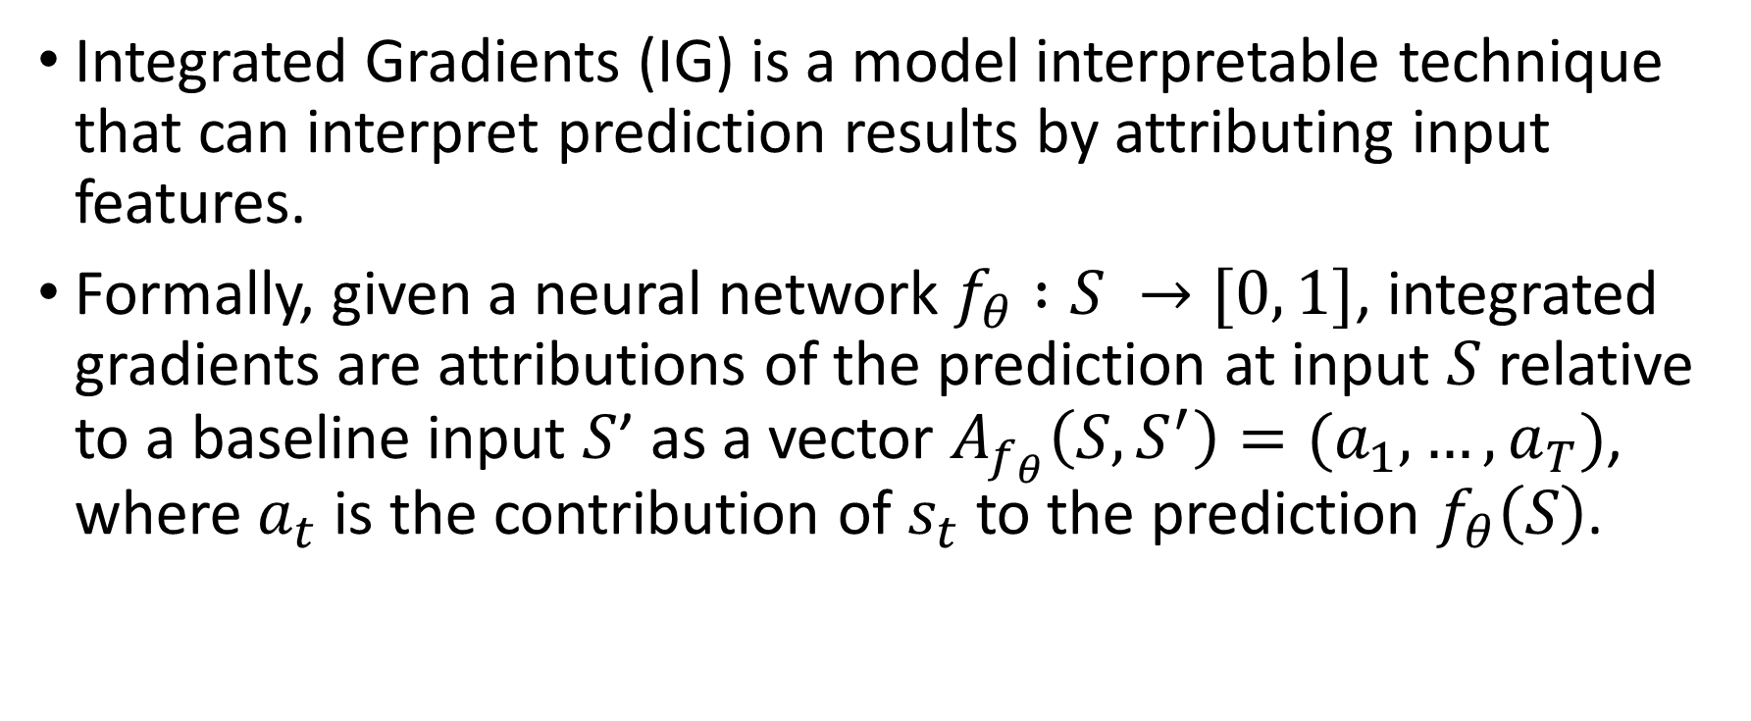
Anomalous Event Detection via Integrated Gradients
Integrated Gradients (IG) is a model interpretable technique that can interpret prediction results by attributing input features.
Formally, given a neural network $f_{θ} :S →[0, 1]$, integrated gradients are attributions of the prediction at input $S$ relative to a baseline input $S$’ as a vector $A_{f_{θ}}\left(S, S^{′}\right)=(a_{1},…,a_{T})$, where $a_{t}$ is the contribution of $s_{t}$ to the prediction $f_{θ}\left(S\right)$.

Slide 18
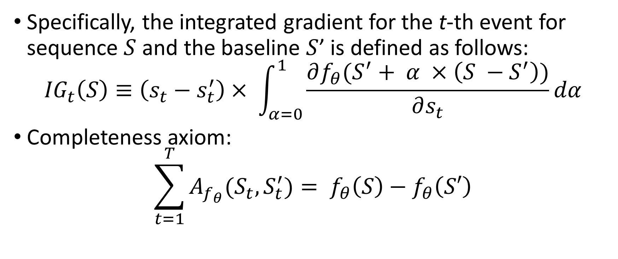
Anomalous Event Detection via Integrated Gradients Cont.
Specifically, the integrated gradient for the t-th event for sequence $S$ and the baseline $S$’ is defined as follows:
$${IG}_{t}\left(S\right)≡\left(s_{t}−s_{t}^{′}\right)× \int_{α=0}^{1}{\frac{∂f_{θ}(S^{′}+ α ×\left(S −S^{′}\right))}{∂s_{t}}dα}$$
Completeness axiom:
$$\sum_{t=1}^{T}{A_{f_{θ}}(S_{t},S_{t}^{′})}= f_{θ}\left(S\right)−f_{θ}\left(S′\right)$$

Slide 19
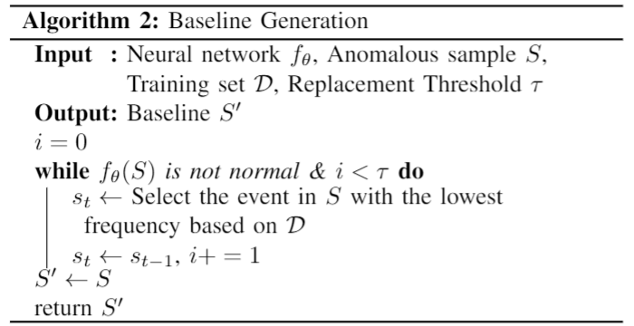
IG Baseline Generation

Slide 20
Outline
Background
Preliminary
Problem Statement
Method
Experiment
Datasets
Baselines
Experimental Results
Conclusion

Slide 21
Datasets
Log parser – Drain; Window size – 100; Step size – 20.
Training dataset consists of 100,000 normal log sequences and 2,000,000 generated anomalous sequences for each log dataset .
TABLE I: Statistics of Test Datasets
Dataset | # of Unique Log Keys | # of Log Sequences |  | # of Log Keys in Anomalous Sequences
 |  | Normal | Anomalous | Normal | Anomalous
HDFS | 48 (19) | 458,223 | 16,838 | N/A | N/A
BGL | 396 (318) | 19,430 | 4,190 | 326,491 | 7,139
Thunderbird | 806 (774) | 22,538 | 76,189 | 6,866,417 | 479,883

Slide 22
Baselines for Anomalous Log Sequence Detection
Traditional machine learning models:
Principal Component Analysis (PCA)
One-Class SVM (OCSVM)
Isolation Forest (iForest)
LogCluster
Deep learning models:
DeepLog
LogAnomaly

Slide 23
Baselines for Anomalous Event Detection
Anchors
Low-Freq
Integrated Gradients without our IG baseline generation

Slide 24
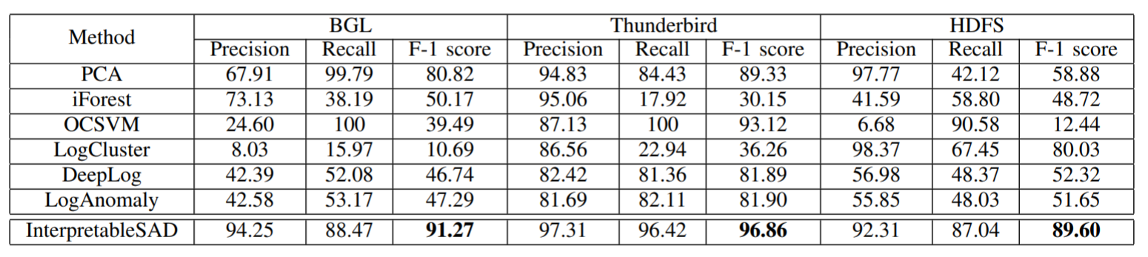
Results on Anomalous Log Sequence Detection

Slide 25
Results on Anomalous Log Sequence Detection

Slide 26
Results on Anomalous Log Sequence Detection

Slide 27
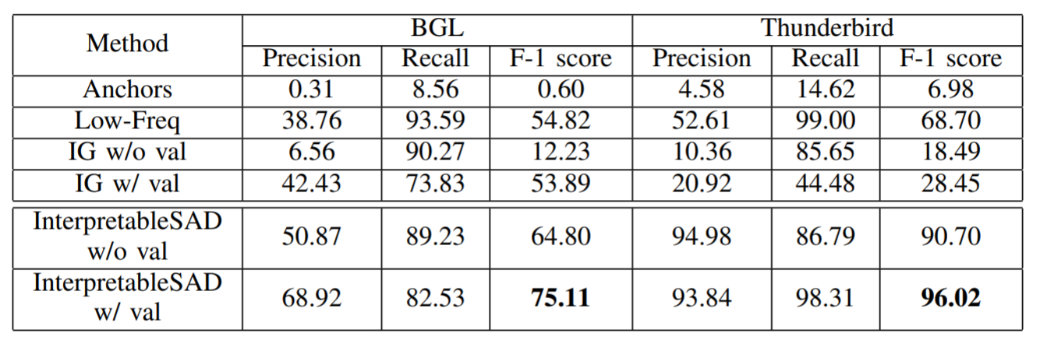
Results on Anomalous Event Detection
We consider two scenarios, with or without a validation set consisting of 10% anomalous sequences in the testing datasets to tune a detection threshold for anomalous event detection.

Slide 28
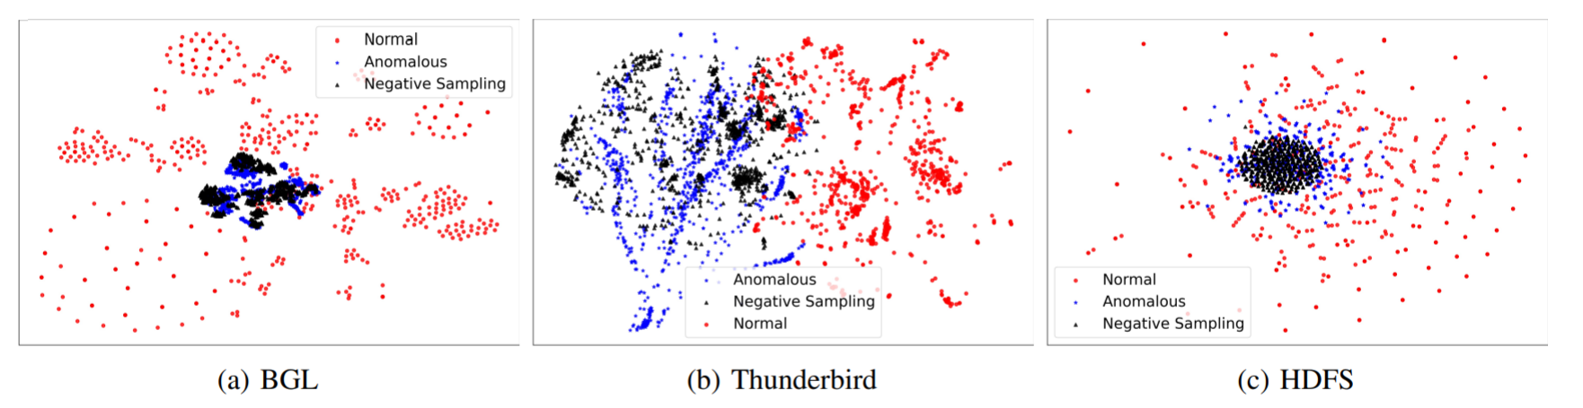
Visualization of the normal, anomalous, and generated anomalous sequences

Slide 29
Outline
Background
Preliminary
Problem Statement
Method
Experiment
Conclusion

Slide 30
Conclusion
Leverage the data augmentation strategy to generate anomalous samples by proposing a novel negative sampling algorithm.
Apply an interpretable machine learning technique, Integrated Gradients (IG), to detect the potential anomalous events.
Propose a novel feature attribution baseline generation algorithm.
Experimental results on three log datasets show that our model can achieve state-of-the-art performance on the anomalous sequence and event detection.

Slide 31
Thank You for Your Attention!
This work was supported in part by NSF 1502273 and 2103829.

