Slide 1

InterpretableSAD: Interpretable Anomaly Detection in Sequential Log Data
Xiao Han¹, He Cheng¹, Depeng Xu², and Shuhan Yuan¹
¹Utah State University
²University of Arkansas

Slide 2
Outline
Background
Anomaly Detection
System Logs
Challenges
Preliminary
Method：InterpretableSAD
Experiments
Conclusion

Slide 3



What is Anomaly Detection
Anomaly detection in sequential data aims to identify sequences that deviate from the expected behavior or patterns.
Anomaly detection receives much attention due to its broad applications.
Log anomaly detection uses system logs to detect anomalous events or patterns in computer systems.
Credit Card Fraud Cyber Intrusions Medical Diagnostics
Images from: https://traderdefenseadvisory.com/financial-protection/credit-card-fraud/
https://www.vodigynetworks.com/how-intrusion-prevention-systems-sniff-out-sneaky-cyber-attacks/
https://www.trademed.com/news/294779083/AI-Paving-the-Way-for-New-Generation-of-Medical-Diagnostic-Devices.html

Slide 4
Log Preprocessing
Logs are generated by logging statements (print, logging.info)
A log message (log entry) records timestamp, PID, level, and content
Logs are unstructured data
Logevent Template:
event1,dc2c74b7,PacketResponder <*> for block <*> terminating
event2,5d5de21c,BLOCK* NameSystem.addStoredBlock: blockMap updated: <*> is added to <*> size <*>
1 081109 203615 148 INFO dfs.DataNode$PacketResponder: PacketResponder 1 for block blk_38865049064139660 terminating
2 081109 203807 222 INFO dfs.DataNode$PacketResponder: PacketResponder 0 for block blk_-6952295868487656571 terminating
3 081109 204005 35 INFO dfs.FSNamesystem: BLOCK* NameSystem.addStoredBlock: blockMap updated: 10.251.73.220:50010 is added to blk_7128370237687728475 size 67108864
4 081109 204015 308 INFO dfs.DataNode$PacketResponder: PacketResponder 2 for block blk_8229193803249955061 terminating
5 081109 204106 329 INFO dfs.DataNode$PacketResponder: PacketResponder 2 for block blk_-6670958622368987959 terminating
6 081109 204132 26 INFO dfs.FSNamesystem: BLOCK* NameSystem.addStoredBlock: blockMap updated: 10.251.43.115:50010 is added to blk_3050920587428079149 size 67108864
7 081109 204324 34 INFO dfs.FSNamesystem: BLOCK* NameSystem.addStoredBlock: blockMap updated: 10.251.203.80:50010 is added to blk_7888946331804732825 size 67108864
8 081109 204453 34 INFO dfs.FSNamesystem: BLOCK* NameSystem.addStoredBlock: blockMap updated: 10.250.11.85:50010 is added to blk_2377150260128098806 size 67108864
1,event1
2,event1
3,event2
4,event1
5,event1
6,event2
7,event2
8,event2
New log: dfs.DataNode$PacketResponder: PacketResponder 1 for block blk_38865049064139660 terminating
New log: dfs.DataNode$PacketResponder: PacketResponder 0 for block blk_-6952295868487656571 terminating
New log:
INFO dfs.FSNamesystem: BLOCK* NameSystem.addStoredBlock: blockMap updated: 10.251.73.220:50010 is added to blk_7128370237687728475 size 67108864
Logevent template
Logevent template
Logevent template
evnnt1,dfs.DataNode$PacketResponder: PacketResponder 1 for block blk_38865049064139660 terminating
event1, PacketResponder <*> for block <*> terminating
Raw Data
Log Parsing

Slide 5
Goals
To detect anomalous sequences as well as anomalous events in the sequences (interpretability).
To train a binary classifier for the sequence-level log anomaly detection, we propose a novel negative sampling strategy to generate potential anomalous samples.
To achieve anomalous event detection, we novelty apply a model interpretation approach, Integrated Gradients (IG).
As IG relies on an appropriate baseline input for feature attributions, we further propose a novel baseline generation algorithm for log anomaly detection.

Slide 6
Outline
Background
Preliminary
Anomaly Detection in Sequential Log Data
Data Augmentation
Interpretable Machine Learning
Method：InterpretableSAD
Experiments
Conclusion

Slide 7
Anomaly Detection in Sequential Log Data
Traditional supervised learning -> Require an enormous number of labeled data
Logistic regression, decision tree, and SVM
Traditional unsupervised learning -> Hard to capture the order information of sequence data
PCA, Isolation forest, and OC-SVM
Deep learning -> No detailed information on the sub-sequence level
DeepLog and LogAnomaly

Slide 8
Data Augmentation
Data augmentation technique is to tackle the scarcity of labeled data issue by artificially expanding the labeled dataset.
Extensively used in image classification and natural language processing.
Rotation and flip for image data, synonym replacement for text data
Negative sampling is a special data augmentation technique.

Slide 9
Interpretable Machine Learning
Interpretable machine learning aims at providing a human understandable explanation about the decisions.
The interpretable anomaly detection models are very limited.
The attention mechanism provides an attention score that is more about the correlation among events instead of the correlation between events and the label.

Slide 10
Outline
Background
Preliminary
Method：InterpretableSAD
Data Augmentation via Negative Sampling
Anomaly Detection at a Sequence Level
Anomalous Event Detection via Integrated Gradients
Experiments
Conclusion

Slide 11
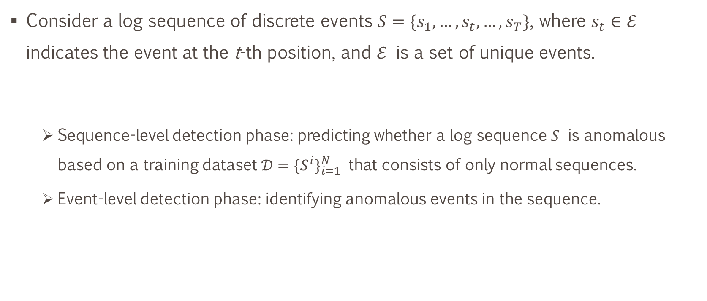
Problem Statement
Consider a log sequence of discrete events $S=\{s_{1},…,s_{t},…,s_{T}\}$, where $s_{t}∈ℰ$ indicates the event at the t-th position, and $ℰ$ is a set of unique events.
Sequence-level detection phase: predicting whether a log sequence $S$ is anomalous based on a training dataset $𝒟={\{S^{i}\}}_{i=1}^{N}$ that consists of only normal sequences.
Event-level detection phase: identifying anomalous events in the sequence.

Slide 12
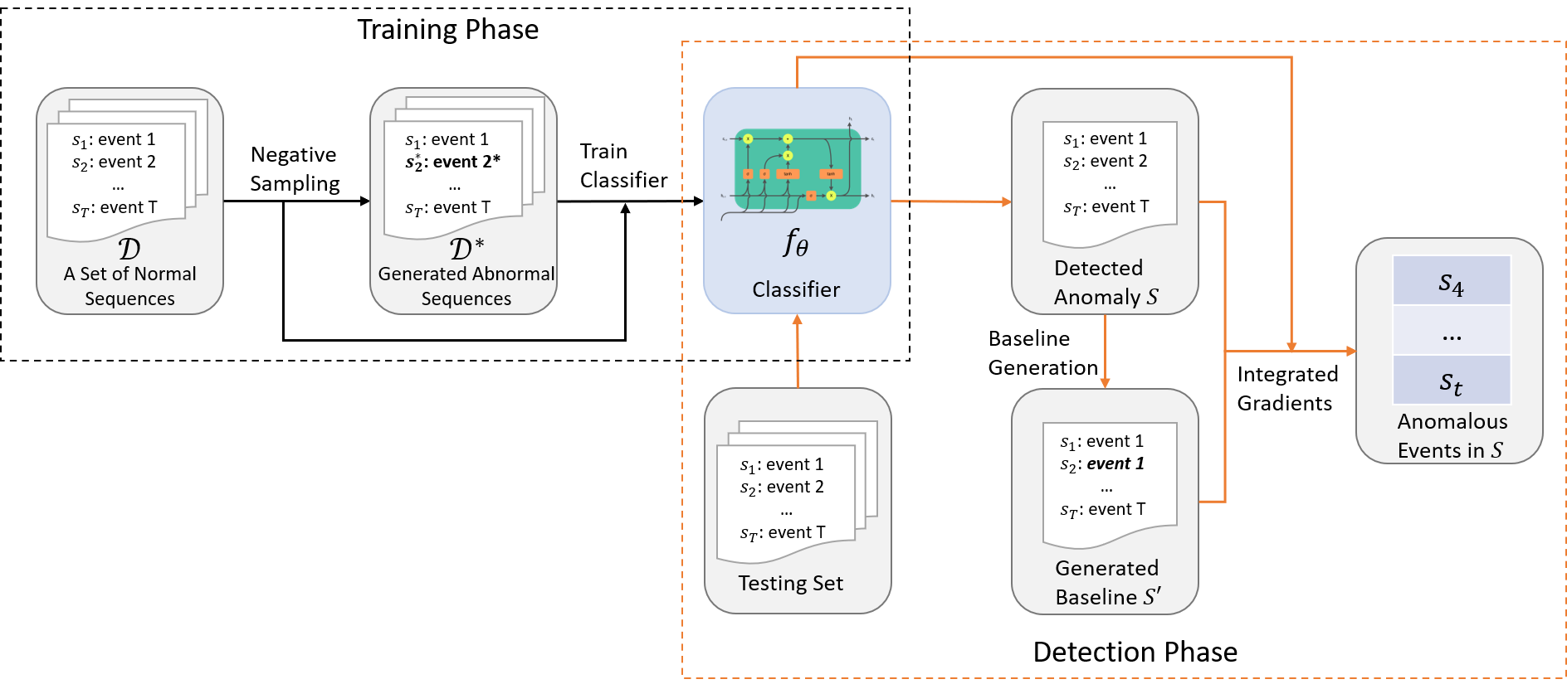
Framework of InterpretableSAD

Slide 13

Training Phase – Negative Sampling
In order to train an accurate binary classifier, we aim to generate a dataset $𝒟^{∗}$ with sufficient anomalous samples that can cover common anomalous scenarios.

Slide 14
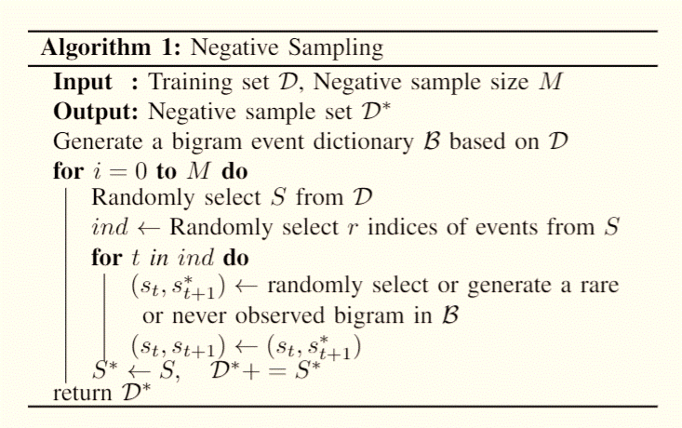
Training Phase – Negative Sampling Cont.
Two anomalous scenarios for anomalous log sequence generation:
1. Anomalous events in the sequences
2. Regular events happen in an unusual context

Slide 15
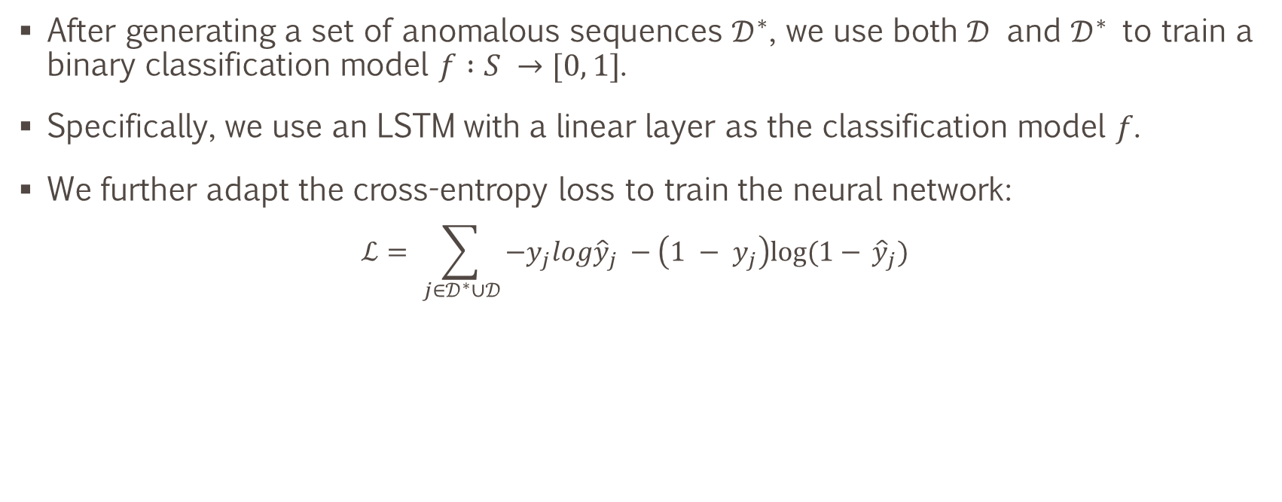
Detection Phase – Anomaly Detection on a Sequence Level
After generating a set of anomalous sequences $𝒟^{∗}$, we use both $𝒟$ and $𝒟^{∗}$ to train a binary classification model $f :S →[0, 1]$.
Specifically, we use an LSTM with a linear layer as the classification model $f$.
We further adapt the cross-entropy loss to train the neural network:
$$ℒ= \sum_{j∈𝒟^{∗}∪𝒟}{−y_{j}log{\hat{y}}_{j} −\left(1 − y_{j}\right)log⁡(1− }{\hat{y}}_{j})$$

Slide 16
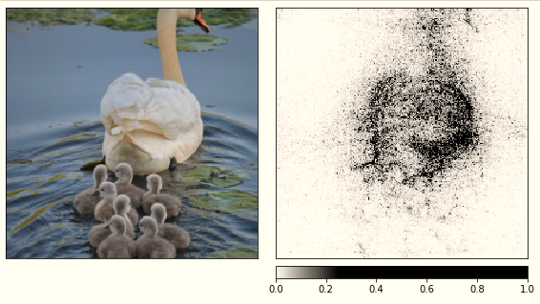
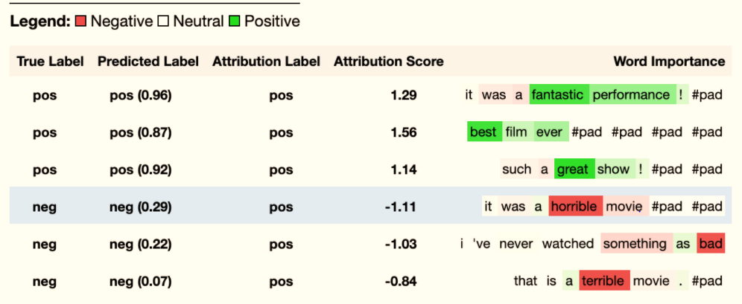
Detection Phase – Anomalous Event Detection
Integrated Gradients (IG) is a model interpretable technique that can interpret prediction results by attributing input features.
For example,
Image Classification
Sentiment Analysis
Images from: https://captum.ai/tutorials/

Slide 17
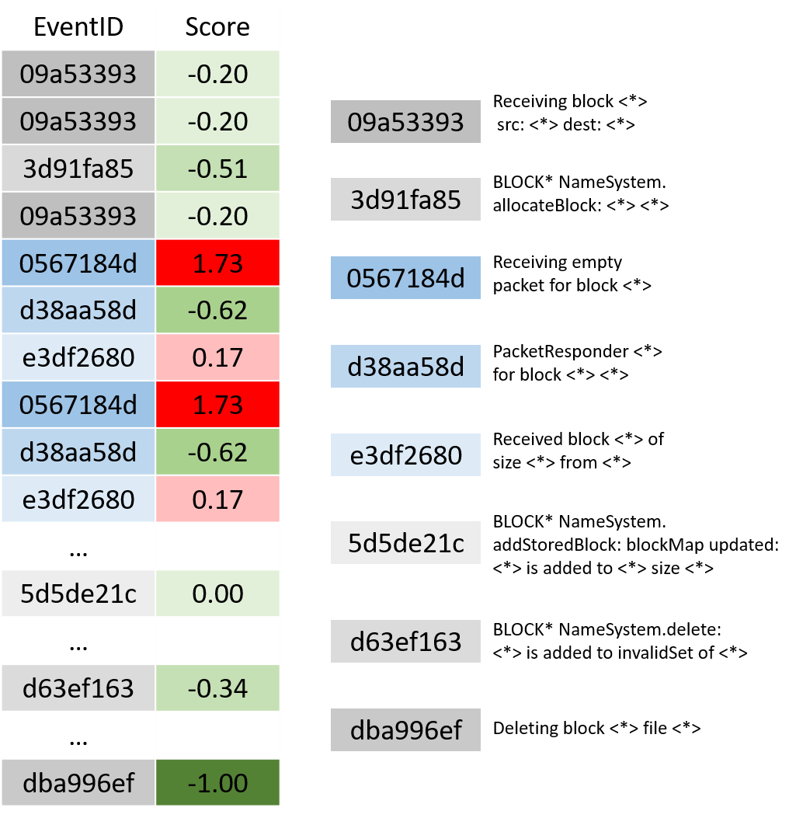
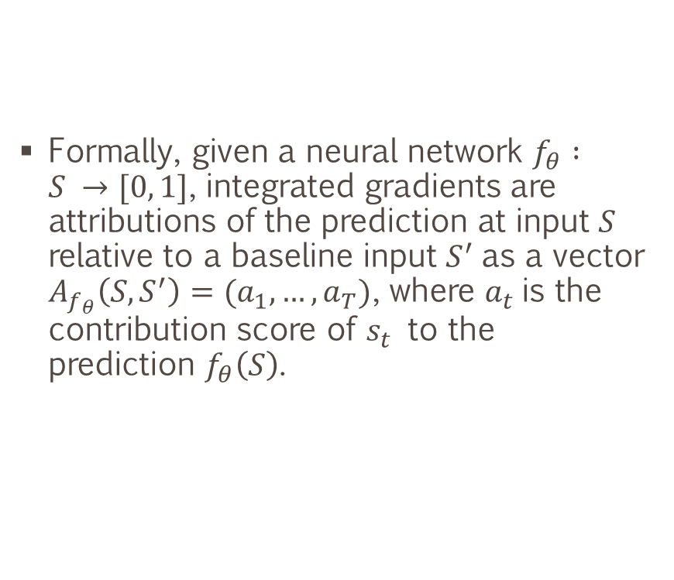
Detection Phase – Anomalous Event Detection Cont.
Formally, given a neural network $f_{θ} :S →[0, 1]$, integrated gradients are attributions of the prediction at input $S$ relative to a baseline input $S^{′}$as a vector $A_{f_{θ}}\left(S, S^{′}\right)=(a_{1},…,a_{T})$, where $a_{t}$is the contribution score of $s_{t}$ to the prediction $f_{θ}\left(S\right)$.

Slide 18
Detection Phase – Baseline Generation
Finding a reasonable baseline is an essential step for applying the IG method.
For the image classification models, the black image is widely used as a baseline, while the zero-embedding matrix is a common baseline for the text classification task.
Therefore, we propose to generate a unique baseline for each sequence.

Slide 19
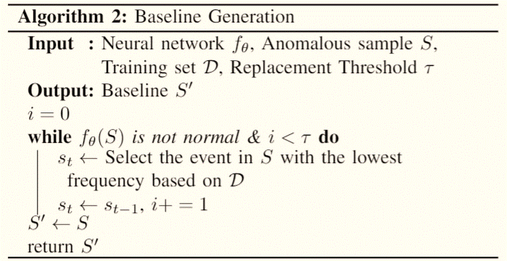
Detection Phase – Baseline Generation Cont.
Sort the events based on their frequencies in the training set
Replace the lowest frequent event with its preceding event
Check whether the sequence is normal

Slide 20
Outline
Background
Preliminary
Method：InterpretableSAD
Experiments
Datasets
Baselines
Experimental Results
Conclusion

Slide 21
Datasets
Log parser – Drain; Window size – 100
Training dataset consists of 100,000 normal log sequences and 2,000,000 generated anomalous sequences for each log dataset.
Dataset | # of Unique Log Keys | # of Log Sequences |  | # of Log Keys in Anomalous Sequences
 |  | Normal | Anomalous | Normal | Anomalous
HDFS | 48 (19) | 458,223 | 16,838 | N/A | N/A
BGL | 396 (318) | 19,430 | 4,190 | 326,491 | 7,139
Thunderbird | 806 (774) | 22,538 | 76,189 | 6,866,417 | 479,883
TABLE I: Statistics of Test Datasets

Slide 22
Baselines for Anomalous Log Sequence Detection
Traditional machine learning models:
Principal Component Analysis (PCA)
One-Class SVM (OCSVM)
Isolation Forest (iForest)
LogCluster
Deep learning models:
DeepLog
LogAnomaly

Slide 23
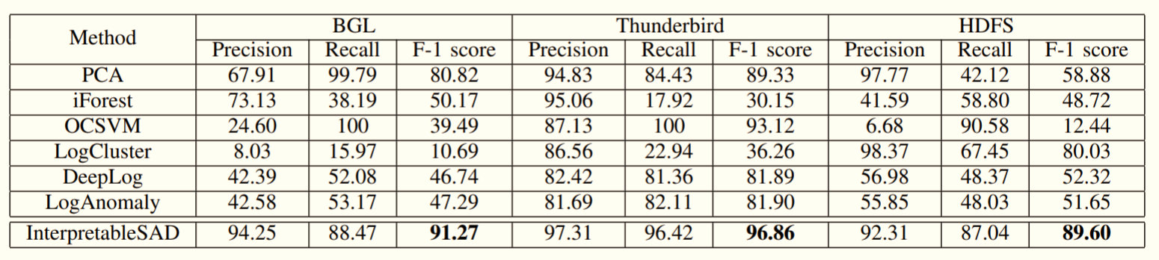
Results on Anomalous Log Sequence Detection

Slide 24
Results on Anomalous Log Sequence Detection

Slide 25
Results on Anomalous Log Sequence Detection

Slide 26
Baselines for Anomalous Event Detection
Anchors – A model-agnostic method that explains the behavior of complex models
Low-Freq – Labeling low frequency events as anomalous
Integrated Gradients without our IG baseline generation

Slide 27
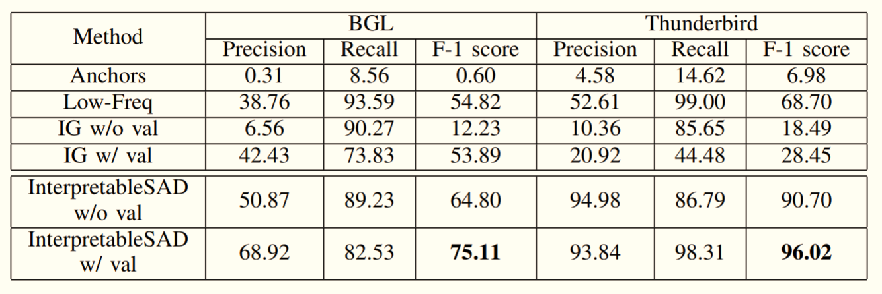
Results on Anomalous Event Detection
We consider two scenarios, with or without a validation set consisting of 10% anomalous sequences in the testing datasets to tune a detection threshold for anomalous event detection.

Slide 28
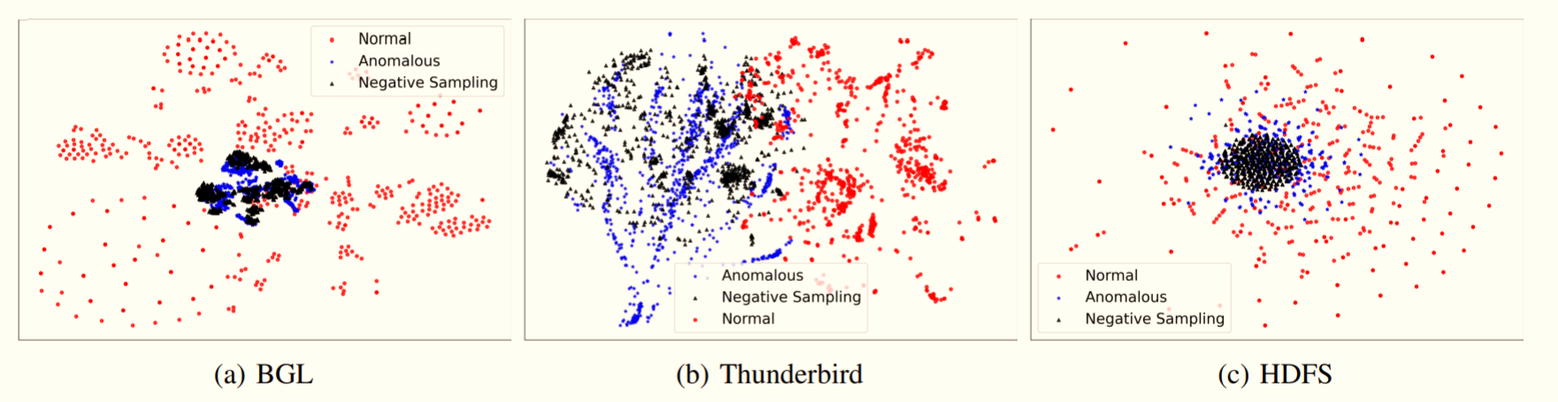
Visualization of the Normal, Anomalous, and Generated Anomalous Sequences
We randomly select 1,000 sequences of normal, anomalous, and generated samples, separately.

Slide 29
Outline
Background
Preliminary
Method：InterpretableSAD
Experiment
Conclusion

Slide 30
Conclusion
Propose a novel framework to detect anomalous sequences as well as anomalous events in the sequences.
Propose a novel negative sampling algorithm that can accurately generate anomalous samples.
Apply an interpretable machine learning technique, Integrated Gradients (IG), to detect potential anomalous events.
Experimental results on three log datasets show that our model can achieve state-of-the-art performance on the anomalous sequence and event detection.

Slide 31
Thank You For Your Attention!
This work was supported in part by NSF 1502273 and 2103829.

