Slide 1
Docker Introduction
Yanan Wang
Notes:
Good afternoon, everyone. Today I want to introduce some basic usages about docker.

Slide 3

What is Docker
The Docker Platform is a set of integrated technologies and solutions for building, sharing and running container-based applications, from the developer’s desktop to the cloud.
In a word, Docker can package code and dependencies into containers and can run on any machine.
Just like virtual machine.
Notes:
To start with, I want to explain what is docker. According to the official website, ……….

Slide 4
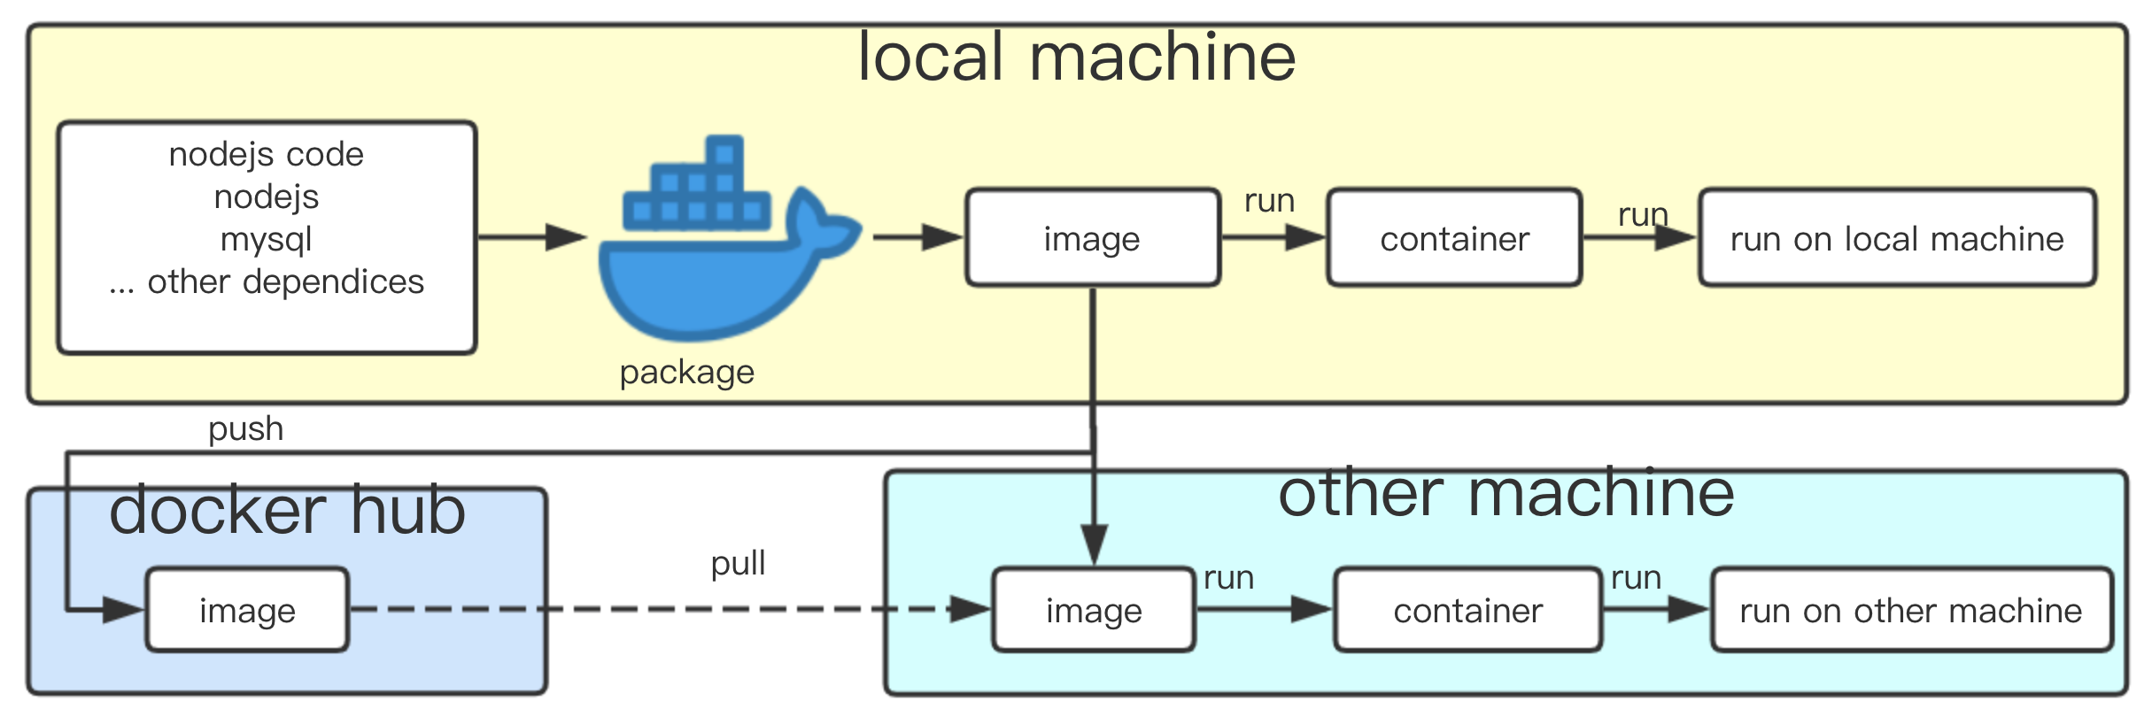
What is Docker
Notes:
This is a shematic diagram according to my understanding. We package our code and dependices into a image, and then we can transfer this image to other machine or docker hub, it also can run in local machine. Use image, we can simply use command to run the project.

Slide 5
Why Docker
Compared with virtual machine:
Fast start.
Less resource usage.
Small file size.
Notes:
So why many people choose to use docker rather than virtual machine? Since docker only runs the container instead of the operating system, it starts fast, use less resource and has small size.

Slide 6
Download
Official website : https://www.docker.com
Mac or Windows: Download in official website.
Linux: https://docs.docker.com/install/linux/docker-ce/ubuntu/
Notes:
We can download docker from the url.

Slide 7
Process
Get image
Run image
Run container
Export
Basic Command
Notes:
These are the general processes of using docker. At first, we need get a image, and then according this image we can create a container. This container can stop, restart and delete. It also can export to other machine.

Slide 8
Basic Command
List all images : docker image ls
List all containers : docker container ls –all (or docker ps -a)
Kill container : docker kill [containerId] (or docker stop [containnerId])
Delete container : docker rm [containerId]
Delete image : docker image rm [imageId]
Notes:
These are some basic docker command. Brackets are variables, and I use green to mark it. You can list, stop or delete image and container by them.

Slide 9
Get image
Project
Create Dockerfile, .dockerignore file
Container
docker commit [containerId] [image_new_name]
docker build –t [dockerdemo] .
cd [ProjectFolder]
http://10.10.2.100/Yanan/docker-example
http://10.10.2.100/Yanan/docker-example
Docker Hub
docker image pull username/repository:tag'
Notes:
We can get image by three methods: from project, container and docker hub. I will show the project method.

Slide 10
Run image
CMD
-p: port
-v: file mount
-e: environment
-network: network
docker-compose
docker-compose up
docker container run -p 81:5678 -it [dockerdemo]
ports: port
volumes: file mount
environment: environment
network: set network
You can add ‘/bin/bash’ to the container shell after the command
cd [ProjectFolder]
add docker-compose.yml file
Notes:
We can run docker image by command or docker-compose file. I’d like to use docker-compose file because I can write some parameters in advance.

Slide 11
Run container
Start
Entering the container
docker start [containerId]
docker exec -it [containerId] /bin/bash
Notes:
This is some command about container. We can restart and enter it by the command.

Slide 12
Export
Docker Hub
Compressed file
docker login
docker save -o tarname.tar imageName
Transfer files to other machines
docker load < tarname.tar
Docker image tag [imageName] [username]/[repositoryName]:[tag] .
docker image build -t [username]/[repositoryName]:[tag] .
docker image push [username]/[repository]:[tag]
Notes:
We can export the image by docker hub or compressed file. I will show the compressed file methods.

Slide 13
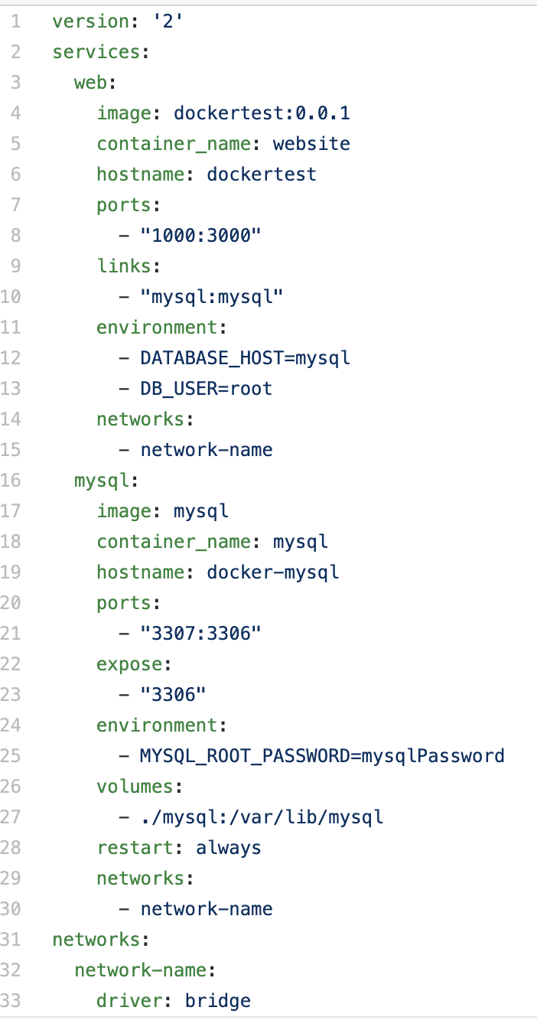
Docker-compose.yml
Notes:
This is a docker compose file example. You can set some parameters like this. It has two containers: web and mysql.The web container use dockertest image and named website, use local machine port 1000 connect to container port 3000. And it need link with mysql. The enviroment parament is DATABASE_HOST and DB_USER. Because it need to connect with mysql, so web and mysql should in save network.

