Slide 1
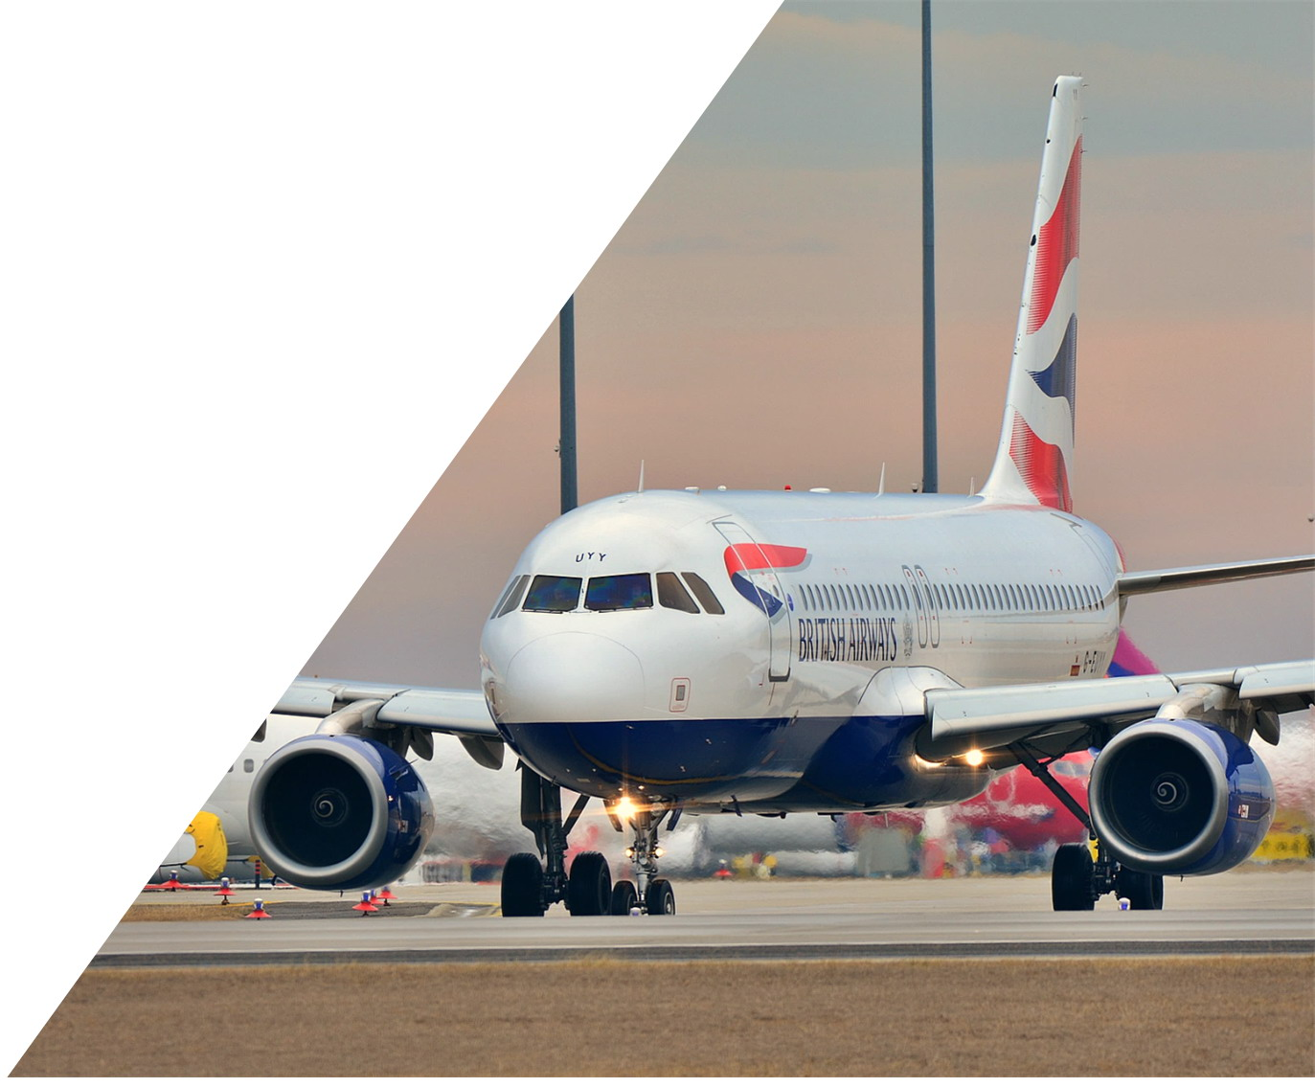
2020
Digital Transformation Analysis Report
Delta Air Lines
Presented by Hanxin Fan & ABC
11/18/2020

Slide 2
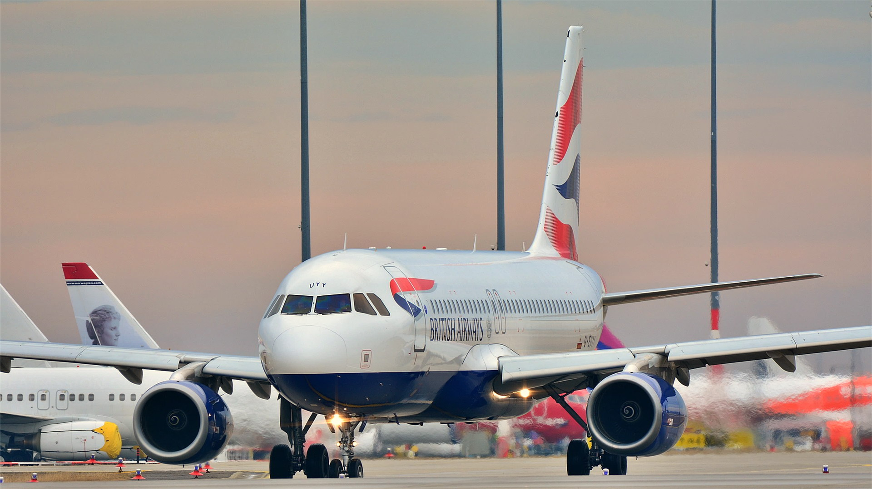
CONTEXTS
1
2
3
4
Problem &
Opportunity
Goals
Objectives
Success Criteria

Slide 3
1
Problem & Opportunity

Slide 4
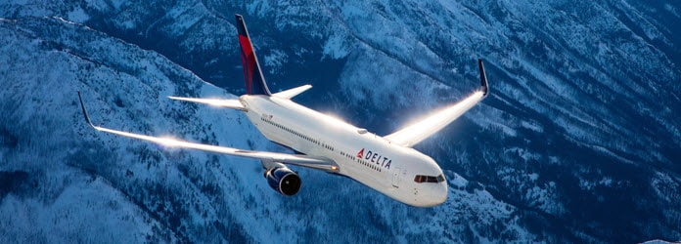
Problem & Opportunity
HISTORY
Delta Air Lines founded in 1928 as Delta Air Service. It merged with Northwest Airlines in 2008 to form Delta Air Lines. Delta is the second-largest airline in the United States, headquartered in Atlanta, with nearly 700 aircraft and more than 75,000 employees worldwide.
Today, Delta serves more than 13,000 passengers per day and operates delta hubs at many airports around the world.

Slide 5
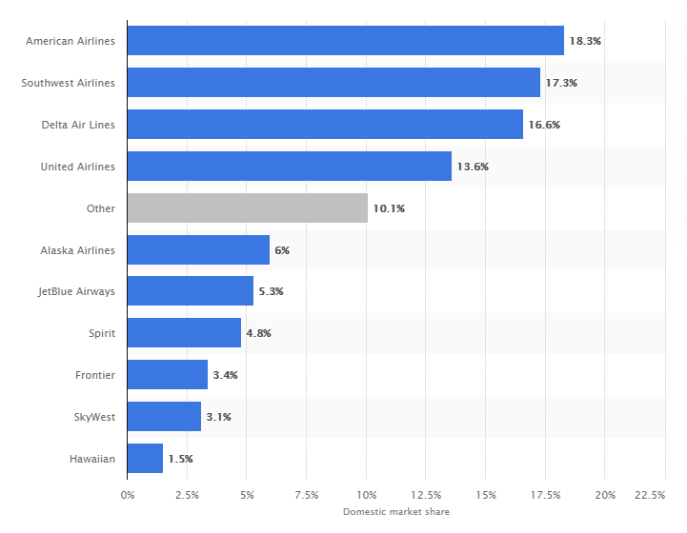
Problem & Opportunity
Domestic market share of leading U.S. airlines in 2020
Market Structure
As a result of mergers and acquisitions among large airlines, the market concentration is increasingly high, and CR4(Delta, UA, AA, and SA) in the U.S. has exceeded 65%. Delta has a very large oligopoly advantage. Large companies continue to grow, small companies cannot survive, and eventually a small number of enterprises to form the situation of fierce competition.
Threats to the Delta Air Lines
Airlines often pay more attention to direct operational challenges, but they cannot fully differentiate their products and services to meet the specific needs of diverse customers. In oligopolistic markets, focusing on direct operational challenges is not a good strategy. This strategy will simply not be sustainable if the threat of alternative travel continues to rise, or if competitors start to offer truly differentiated, attractive, and targeted service-based products.

Slide 6
Problem & Opportunity
Diversification
If competitors start to offer truly differentiated, attractive, and targeted service-based products, direct operational challenges won’t win more customers for Delta.
Threats
1
2
3
Substitution
As travelers gain a better experience through other transportation, their expectations of what airlines can offer and how they can deliver will grow higher. Failure to meet those expectations will cause airlines to lose potential customers and make them more willing to use other transportation.
Customer Experience
Airlines have seen customer satisfaction decline despite their efforts to improve the customer experience over the years. In fact, the airline industry consistently scores the lowest in customer satisfaction surveys in the United States.

Slide 7
2
Goals

Slide 8
Goals
01
02
03
Reduce the Costs
Increase Revenue
Improve the Loyalty Rate & Customer Satisfaction
Almost all of the innovations in business models, from the low-cost operations of the U.S. airlines to the marketing revolution of the European airlines, are based on digitization. Digitization will help Delta Air Lines create real value in three ways. First, digitization can help Delta reduce their fixed and variable costs; secondly, digitization could help Delta increase revenue. Thirdly, digitization can improve the overall customer experience and customer satisfaction.

Slide 9
Goals
1
Reduce the Costs
Predictive Maintenance
Cross-Industry Marketing
Mobile Terminal Solution
From an operational point of view, better data applications enable airlines to have more accurate forecasts for maintenance, replacement of parts, and so on. Therefore, engineers can anticipate and take early action, including when flight lights appear, and which parts need to be replaced.
From a cost management perspective, in terms of passenger processes, work should be done around getting through the mismatched nodes between these processes. For example, when a company launches a new product, the development, sales, and operation processes are relatively close to each other. Digitization can completely break through all the barriers between those processes and form the concept of integrated delivery.
Delta is outfitting most of its employees with phablets that make data about airline operations and passenger portraits available to front-line personnel on a digital platform. This allows them to feedback to each other as quickly as possible.

Slide 10
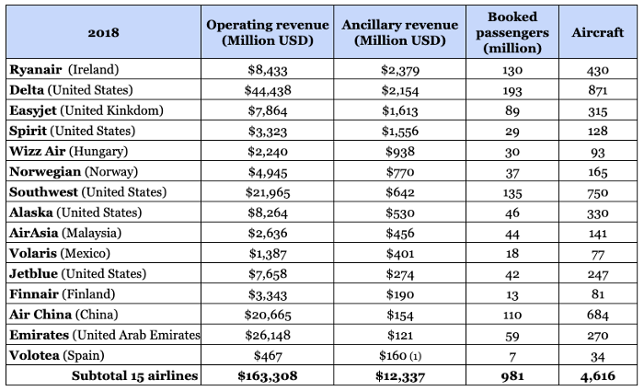
Goals
2
Increase Revenue
2018 Airline Ancillary Revenue Calculation
Optimize Flight Utilization
Ancillary Revenue
As Delta go digital, it gains more customer insights and grow revenue. Moreover, digitization can further optimize the revenue management of high-utilization flights.
From the statistical data, there is a gap of 2 to 4 times between the income of companies with good ancillary revenue and those with average ancillary revenue. Digitization will help Delta increase ancillary revenue across the board.

Slide 11

Goals
3
Improves the Loyalty Rate & Customer Satisfaction
When it comes to solving customer experience problems digitally, there's a keyword called the whole journey concept. This is very important for airlines, but most airlines rarely take a whole journey perspective. There are a lot of touchpoints in a traveler's journey from exploring the future, to searching for flights, to departure, to airport, to plane, to the end of the journey. Delta should start from this aspect, improve customer experience and customer satisfaction to expand its competitive advantage.
Customers
Go to Airport
Before Departure
During the Flight
Transfer
Landing
Leaving Airport

Slide 12
3
Objectives

Slide 13
Objectives
Onboarding and Employee Training to Improve Standardized Management
Predictive Maintenance
Use Some Effective Statistical tools to Track Customer Groups
Optimize Flight Utilization
Increase the Comfort of the Seat
Cross-Industry Marketing

Slide 14
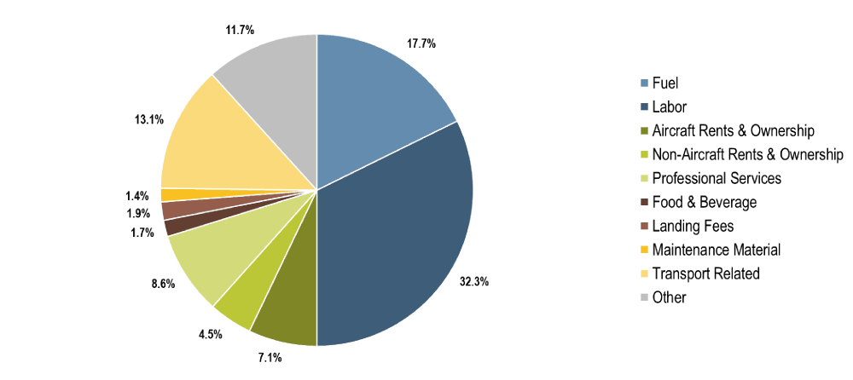
Objectives
Predictive Maintenance
Faced with the changes in customer demand, the first thing airlines need to do is to reduce their costs. This will ensure that the ticket price can remain stable while developing new products. Predictive maintenance can significantly reduce the cost of maintenance, which accounts for 13 percent of all aircraft operating costs.
Airline has accumulated a lot of data over the years, but it has not been organically linked to form a model to connect all the nodes. From pilot reports to maintenance logs to Aircraft Communications Addressing and Reporting Systems (ACARS) is often distributed over networks in isolation. Now a new idea is to string all the data together and capture the model through algorithm-based analysis and machine learning. Although there is a lot of work to be done, digitization can enhance aircraft availability, reduce turnaround time, reduce maintenance delays and save operating costs.
Not only will predictive maintenance significantly reduce maintenance costs, but it will also help Delta operate more efficiently. With the predictive maintenance system, managers can decide whether to wait for the aircraft to be serviced or to use a standby aircraft. This will help reduce flight delays and improve the customer experience.

Slide 15





Objectives
Optimize Flight Utilization
Moving flexible passengers with lower returns between flights can unlock new revenue opportunities …
... and digitization can help identify appropriate opportunities while optimizing costs
Identify opportunity flights
Identify voluntary customers and solutions
Customer Decision
8am Flight Fully Booked
12pm Flight
Has some Seats Left
Passengers who have been booked temporarily
Passengers willing to adjust
analyzes the number of passengers currently on board to estimate the cost of relocating passengers and determine how many seats will eventually be released
the system will use the user's historical flight data to determine which customers are more likely to be adjusted. Once the customers have been identified, the system can contact customers automatically by text or email and offer incentives such as upgrades and coupons to get them to accept adjustments.
The customer can choose to rebook or choose a new trip, and the reward will be given to the customer electronically.
suddenly decide to take this Flight, and they are willing to pay the high full price
had already booked discounted tickets long ago

Slide 16

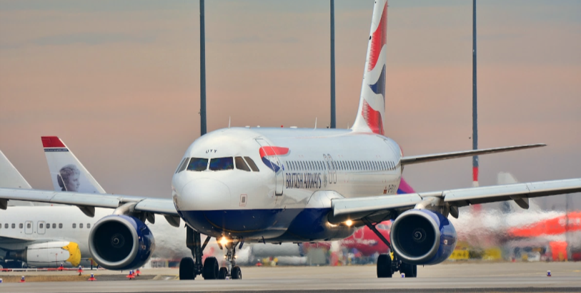
Objectives
Cross-Industry Marketing
With the rise of the Internet, service providers have found a whole new way of communicating with their customers. They can communicate directly with customers through the intermediate links. As customers gain more control through digital devices, their behavior is changing as never before. Today's travelers have more options than ever before on their entire journey, as customers have direct access to many professional service providers via their smartphone.
The big data of Delta is not limited to the simple use of promotion, customer maintenance, and product notification. Instead, it aims to achieve the accuracy, personalization, and relevance of corresponding advertising products through the analysis of a large amount of behavioral data on the Internet, and it improves customer experience. Through the mining of customer demand, Delta can deliver the products of cooperative service providers to target customers more precisely and receive commissions.

Slide 17
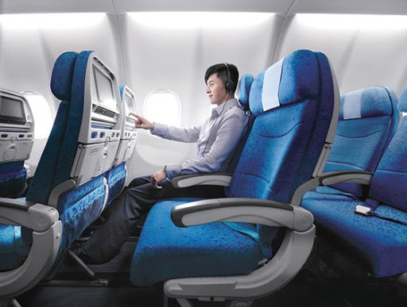
Objectives
Increase the Comfort of the Seat
More and more large airlines are increasingly aware of the significance of comfort in fascinating and keeping customers. People have different understandings of comfort in daily life. There are many disputes about the exact definition and understanding of its components and their relationship with discomfort. Fundamentally speaking, comfort refers to meeting people's needs. It is the ideal result or best state in a given environment. Everyone has different needs, and their comfort experience is subjective, influenced by internal or personal factors, and external stimulation. For example, the concept of carbon is separated from different activity areas like entertainment, leisure, and work areas to meet specific needs based on different activity areas. Meanwhile, nerve sensors and fiber optic blankets are used to weigh the mental state of passengers during the whole flight. Improving cabin service for every single passenger’s blanket will show different colors based on the individual’s degree of relaxation to make a suitable response (cabin design, interior, etc.) By improving the comfort of airplane seats, Delta can better improve customer experience and customer loyalty.

Slide 18
Objectives
Use some Effective Statistical Tools to Track Customer Groups
Benchmarking
Analysis of variance (ANOVA) test
Cluster Analysis
Benchmarketing is a standardized approach to fair competition to make your data and results meaningful in context. It involves considering external factors so that you can adjust the research parameters and get a more accurate understanding of what is going on right now. Benchmarking techniques use weighting to adjust for variables that have an impact on seasonal changes and ticket sales.
Like the T-test, ANOVA (analysis of variance) is a way of testing the differences between groups to see if they’re statistically significant. However, ANOVA allows you to compare three or more groups rather than just two such as men and female’s income level, family education background, working condition, and so on.
Cluster analysis is a method of processing data sets by identifying the degree of correlation between individual data points. Under cluster analysis, you can determine whether there are defined groups (clusters) in a certain data pool, or whether the data is evenly distributed.
The new analytics provide delta with a new way to analyze unstructured data, and we will see more analytics applications in the aviation industry in the coming days.

Slide 19
Objectives
Onboarding and Employee Training to Improve Standardized Management
Nowadays, the awareness of airline business management is weak. The relevant persons in charge of airlines have insufficient understanding of the importance of corporate management.
The majority of pilots training who use aviation simulators are a detailed, piece of equipment built to look and feel as much like the real thing as possible. Virtual reality is beginning to offer an alternative to physical flight simulators. A French technology company called Go Touch VR is developing virtual flight simulators that use sensors on the fingertips to give trainees the feeling of touching the controls on the instrument panel.
Pilots must complete several hours of training and evaluation each year to obtain a permit. Flight attendants must also update their training every year. In most cases, this means that pilots will go to a training center for courses, while flight attendants must return to the academy for a one or two-day refresher course. Keeping track of renewal requirements and remaining employees when it is time for training is also significant. In this way, this continuous and regular training of airline employees, can not only increase Delta's passenger flow and attendance but also bring greater profits to Delta's future development.
Flight Training- Without the Simulators
Renewal Training
Customer experience is one of the most important factors in all industries, but on airplanes — where customers are seated together for hours on end, sometimes in stressful situations — customer experience is paramount. And when situations are handled badly, footage of incidents often go viral. Training is a good way to ensure those incidents don’t happen.
Training remote workers is a new problem in many industries, but not for business. It has employed remote mobile hydraulics for nearly a century, and it took decades to figure out how to deal with sudden changes or new regulations. Training and communication with these workers during training are necessary. Interestingly, according to a conversation I had with a senior airline pilot, airlines used to use a three-ring binder filled with memos to meet this challenge. Workers had to initial each page to prove they had read the information. That was in the 1980s. In the 90s, email took over. Now Delta
use apps and internal social networks to communicate vital information to remote employees.
Customer Experience
Airlines and the Remote Workforce
Spotting Crime
a new online plan was announced by Delta Airlines in February 2020. The company said that the new plan "targets those roles in airlines that are most likely to take place in illegal activities" and will help employees understand smugglers' routes, methods, and how to report and respond to illegal activities.

Slide 20
4
Success Criteria

Slide 21
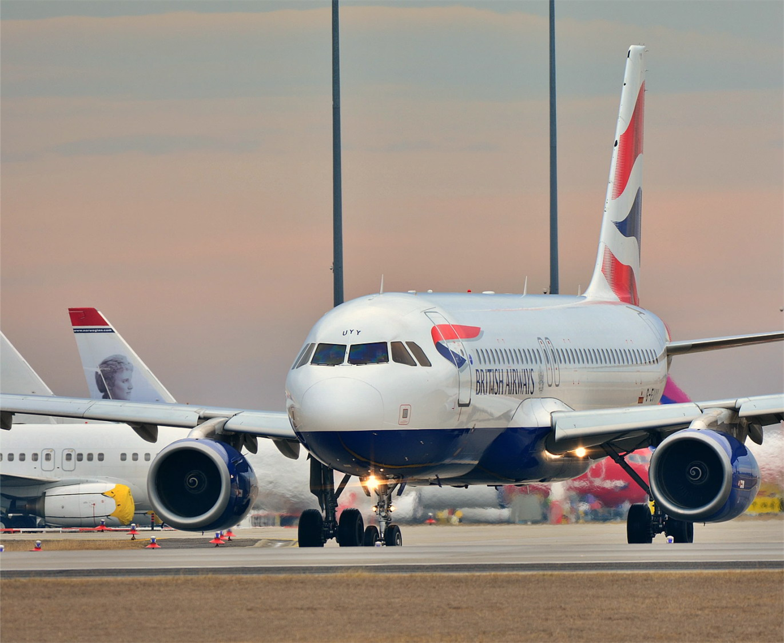
Success Criteria
Financial Competitiveness
01
Operating profit, net profit, operating margin, net profit margin, and total revenue are commonly used indicators to reflect a company's financial competitiveness. Passenger revenue of main routes is the performance of financial competitiveness of airlines, and it is an important indicator to reflect whether airlines are in an advantageous position in competition. Delta's profits should improve through a range of digital applications and those improvements should ultimately increase Delta's financial competitiveness. By examining the rankings of Delta's financial competitiveness, it could show whether the digital revolution at Delta has been successful.
Operational Competitiveness
02
Occupation Rate of Flight Guest Seats is an important indicator to reflect the capacity utilization rate of an airline company. If this index is high, it means that the airline company has fully explored its operation ability, indicating its strong competitiveness in the market. Through cross-industry marketing and optimizing flight utilization will ultimately affect Delta's operational competitiveness. By examining the rankings of Delta's operational competitiveness, it could show whether the digital revolution at Delta has been successful.

Slide 22
Assumptions, Risks and Obstacles
01
System Security Risk
Risks
02
Information Security Risk
Airlines use digital transformation to seek new development, but they are also introducing many security risks brought by digital. The digital transformation of airlines requires a lot of Information Technology construction. In addition to the necessary infrastructure and application systems, airlines are facing a lot of risks in terms of IT-related security. It is a worrying challenge for airline management to manage these risks.
03
Economic Property Security Risk

Slide 23
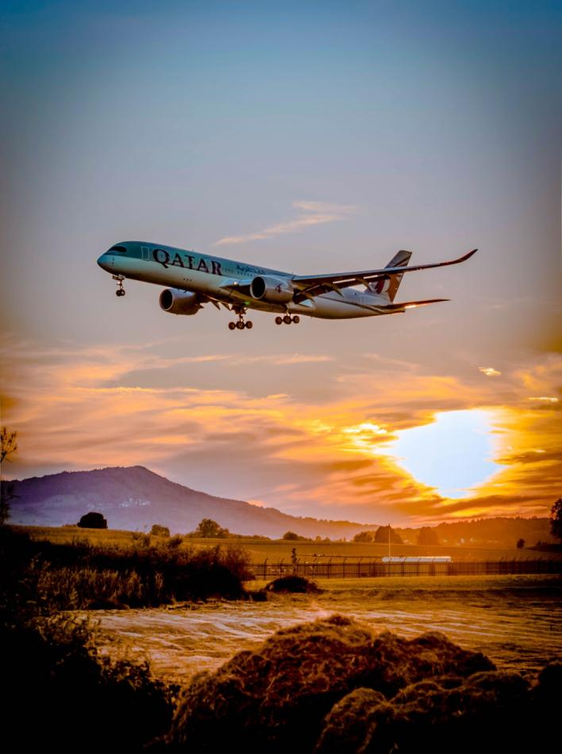
System Security Risk
01
With the continuous progress of the digital transformation of airlines, the paperless strategy has been gradually implemented, and airline operations are increasingly dependent on IT systems. No matter network, server, or application system failure will cause the corresponding airline business to stop, thus bringing huge losses.
Information Security Risk
02
In the process of digital transformation of airlines, a large number of information systems will be built quickly due to the need to give priority to meet the needs of business transformation. Due to the lack of unified security architecture design and security standard management, there are many information security vulnerabilities. In terms of information security, IT departments of airlines generally lack their professionals but need the support of professional suppliers, including the support of protection systems and professional technical personnel.
03
Economic Property Security Risk
During the COVID-19 Pandemic, global aviation companies like Delta have regarded supply chain management as the second biggest threat to the aviation industry in 2019 and beyond. The recorded delivery of new aircraft will make the supply chain extremely busy in the next 8-10 years. To meet demand, the entire supply chain must improve investment to make sure timely delivery while maintaining high quality and controlling costs. Of course, everything is like a coin that has two sides, appropriate investment in Delta Airline’s stocks and sells it a timely can also bring significant benefits to the entire company.

Slide 24
Conclusion
With the covid-19 outbreak, airlines around the world are starting to re-examine the support of informatization for their business. The digital transformation of aviation enterprises is of great significance in terms of commercial emergency response. On the other hand, covid-19 is also accelerating the process of digital transformation of aviation enterprises. When the hard times are over, the airline industry's recovery will accelerate, and its practitioners will be hoping for a recovery. After the outbreak subsides, the airline industry will face a relatively big rebound. In the face of such a trend, passenger flow will rise again.
Airlines can make intelligent adjustments from flight recovery, crew scheduling, and network optimization through digital solutions, and establish relatively reasonable resource allocation, to ensure the highest efficiency and cost optimization of aviation operation. At the same time, based on the analysis and prediction of market demand, airlines need digital tools to judge the future market and optimize the transport capacity structure to achieve revenue protection. The impact of covid-19 has completely broken the existing global economic pattern, changing the supply structure and cost structure. Therefore, the digital transformation of airlines is no longer an option, the emergence of digital airlines is also an inevitable result.

Slide 25
Reference
Becker, G., Bouwer, J., John, D., & Toutaoui, J. (2020, November 05). Walk before you fly--capturing the digital opportunity in airlines. Retrieved November 18, 2020, from https://www.mckinsey.com/industries/travel-logistics-and-transport-infrastructure/our-insights/walk-before-you-fly-capturing-the-digital-opportunity-in-airlines
Bouwer, J., Esque, A., & Riedel, R. (2020, November 05). Leading from the front line: How airlines can boost ancillary revenues. Retrieved November 18, 2020, from https://www.mckinsey.com/industries/travel-logistics-and-transport-infrastructure/our-insights/leading-from-the-front-line-how-airlines-can-boost-ancillary-revenues
Chang, Y.-H., & Yeh, C.H. (2002). A survey analysis of service quality for domestic airlines. European Journal of Operational Research doi: 10.1016/S0377-2217(01)00148-5
Chreene, L. (2020, September). An Onboarding Makeover to Match a Hiring Boom: A rapid increase in district managers at Securitas necessitated a program revamp, which is showing early promise. TD Magazine, 74(9), 21+. https://link.gale.com/apps/doc/A635546264/PROF?u=ulv_gvrl&sid=PROF&xid=3cd180b9
Delta Air Lines. (2020, November 15). Retrieved November 18, 2020, from https://en.wikipedia.org/wiki/Delta_Air_Lines
Hannigan, T., Hamilton, R., & Mudambi, R. (2015, March). (PDF) Competition and competitiveness in the US airline industry. Retrieved November 18, 2020, from https://www.researchgate.net/publication/276927107_Competition_and_competitiveness_in_the_US_airline_industry
Low, T. (2020, August 07). COVID-19: Strategizing airport operations for the new norm: ACI World Blog. Retrieved November 18, 2020, from https://blog.aci.aero/covid-19-strategizing-airport-operations-for-the-new-norm/
Mazareanu, E. (2020, October 19). U.S. airline industry market share 2019. Retrieved November 18, 2020, from https://www.statista.com/statistics/250577/domestic-market-share-of-leading-us-airlines/
Murphy, R. (2019, September 06). The Cybersecurity Risks Within the Aviation Industry. Retrieved November 18, 2020, from https://www.blackstratus.com/risks-of-cybersecurity-within-aviation/
Myers, J. H. and G. M. Mullet (2003). Managerial Applications of Multivariate Analysis in Marketing, American Marketing Association, Chicago.
Safaei, N. (n.d.). Fleet Utilization Optimization - Aircraft IT. Retrieved November 18, 2020, from https://www.aircraftit.com/articles/fleet-utilization-optimization/
Torres, C. (2018, June 17). Digitalization of Predictive Maintenance. Retrieved November 18, 2020, from https://power-mi.com/content/digitalization-predictive-maintenance
Vink, P.,& Hallbeck, S. (2012). Editorial: Comfort and discomfort studies demonstrate the need for a new model. Applied Ergonomics, 43, 271- 276. doi: 10. 1016/j. apergo.2011.06.001
Wright, G., Robinson, D., & Commentator, E. (2016, December 01). Digital Marketing in the Airline industry. Retrieved November 18, 2020, from https://www.smartinsights.com/b2b-digital-marketing/b2b-strategy/digital-marketing-in-the-airline-industry/

Slide 26
Thanks

