Slide 1

Climate Enthusiasts

Slide 2
Introduction: Overall objectives
Climate change is a critical issue facing our planet, and understanding climate data is essential for monitoring and analyzing its impact. In this project, we explore a Flask web application that connects to a PostgreSQL database containing climate data. The application provides interactive visualizations to help us gain insights into temperature, CO2 emissions, humidity, and sea level rise.

Slide 3
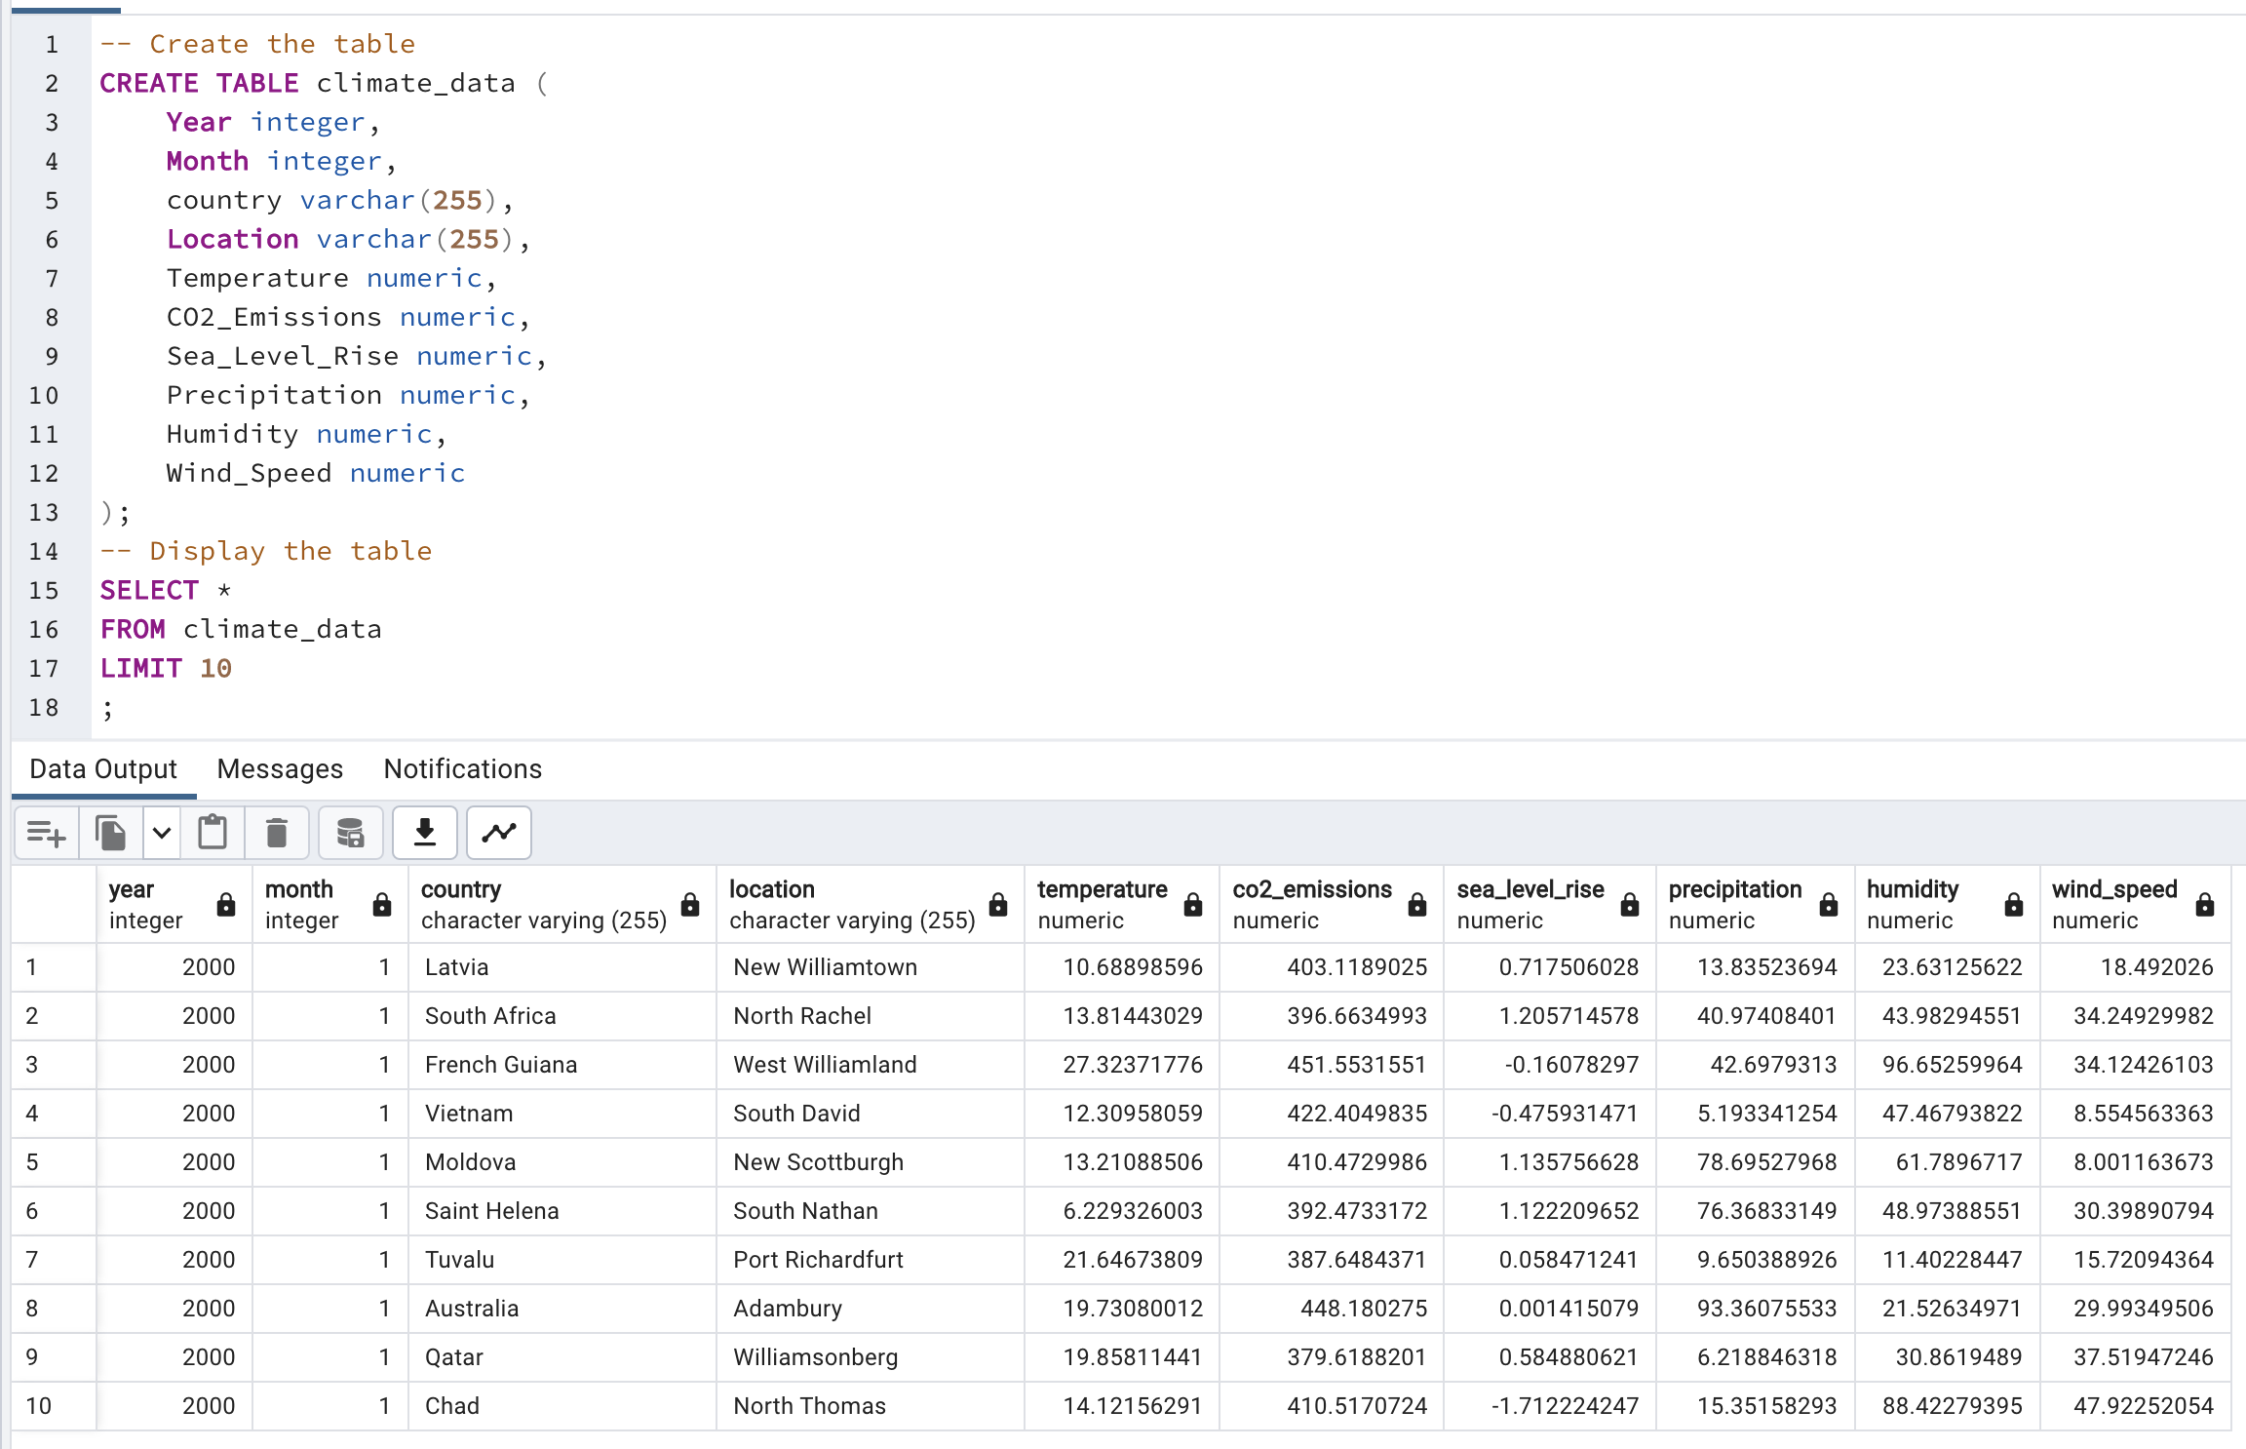
Data sources and Database: Source: https://www.kaggle.com/datasets/goyaladi/climate-insights-dataset

Slide 4
Flask Routes / API Endpoints
The application provides the following routes to retrieve and visualize climate data. The data is grouped by country:
/: Displays the climate data home page.
/temp: Returns the average temperature data. The data is sorted in descending order of temperature and limited to the top 10 entries.
/co2: Returns the average CO2 emissions data. The data is sorted in descending order of CO2 emissions and limited to the top 10 entries.
/humidity: Returns the average humidity data. The data is sorted in descending order of humidity and limited to the top 10 entries.
/sealevel: Returns the average sea level rise data. The data is sorted in descending order of sea level rise and limited to the top 10 entries.
/temperatures: Returns the average temperature data for specific countries ('Finland', 'France', 'Germany', 'Iceland', 'Norway', 'Poland', 'Russia', 'United Kingdom') over the years.
/racebarco: Returns the average CO2 emissions data for each year and country.
/pltmapco: Returns the average CO2 emissions data for each country.

Slide 5
Temperature Analysis
CO2 Emissions Analysis
Image and conclusion
Image and conclusion

Slide 6
Humidity Analysis
Sea Level Rise Analysis
Image and conclusion
Image and conclusion

Slide 7
Front-end: HTML, CSS and JS
show a screenshot of the dashboard and you can add some code to show the external JS package you used

Slide 8
Conclusion
The Flask web application and its visualizations provide valuable insights into climate data. By analyzing temperature, CO2 emissions, humidity, and sea level rise, we can understand the trends and patterns associated with climate change. These visualizations can support decision-making processes, raise awareness, and contribute to ongoing efforts to mitigate and adapt to climate change.

Slide 9
Challenges & Next Steps

Slide 10
Q&A
THANK YOU FOR YOUR ATTENTION!
Q&A
Q&A

