Slide 1
Final Project: Mechanisms of Action (MoA) Prediction
MIE1628

Slide 2
About The Project
Kaggle Project
Methods can be compared to expert solutions
Scientists seek to identify a protein target associated with a disease and develop a molecule that can modulate that protein target
Gene expressions and Cell viability is used to determine MoA of a drug

Slide 3
First Impressions
Cp-Type | Cp-Dose | Cp-Time | Rest of Data
Trt_cp | D1 | 24 | Gene Data
Ctl_vehicle | D2 | 48 | Cell Data
 |  | 72

Slide 4
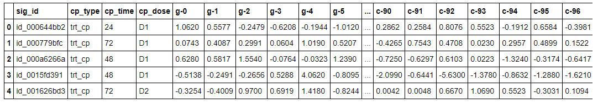
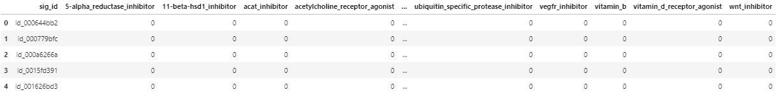
Tabular Visualization
Memory size for 1 sample: Sparse format: 12*3+4 bytes = 40b
Dense format: 8*206 = 1648b
Memory size for all samples - (mem_per_vector * 23000):
Sparse format: 40*23000 = 920000 = 0.92mb
Dense format: 1648*23000 = 37904000 = 37.9mb

Slide 5
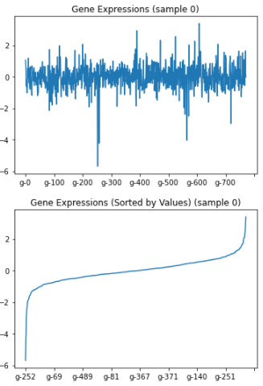
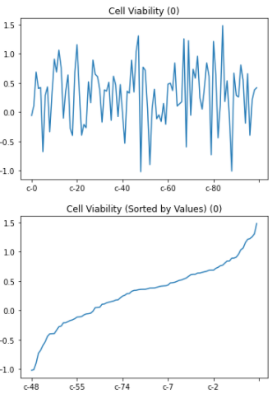
Gene and Cell Visualization (1st id)

Slide 6
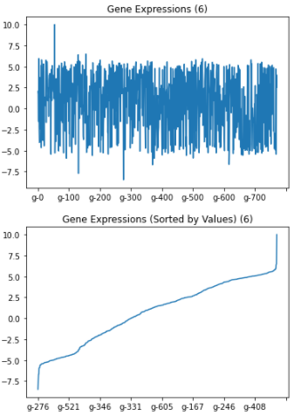
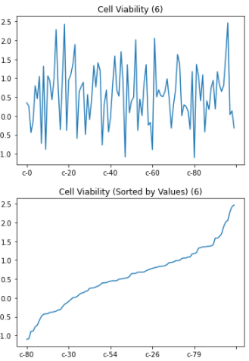
Gene and Cell Visualization(6th id)

Slide 7
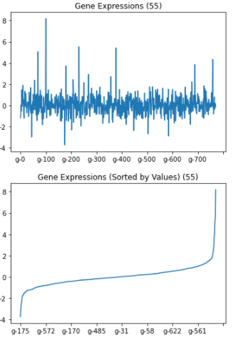
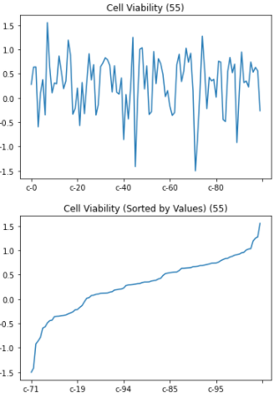
Gene and Cell Visualization (55th id)

Slide 8
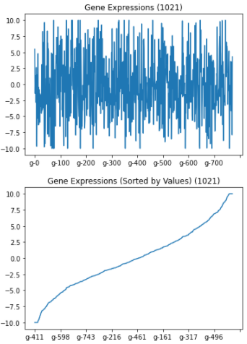
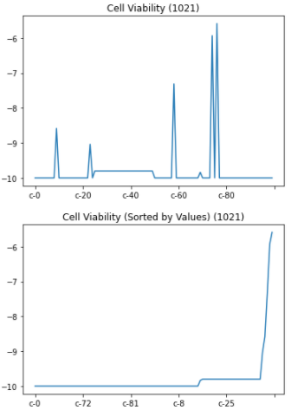
Gene and Cell Visualization (1021th id)

Slide 9
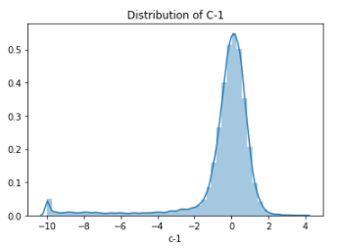
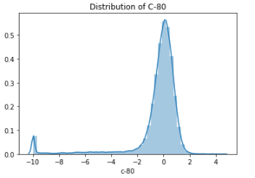
Distribution of Feature C-1 and C-80

Slide 10
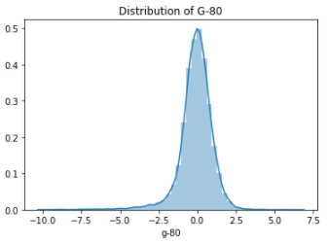
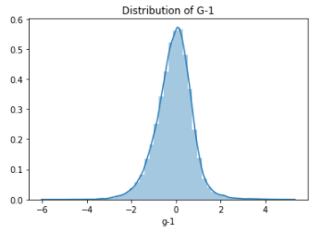
Distribution of Feature G-1 and G-80

Slide 11
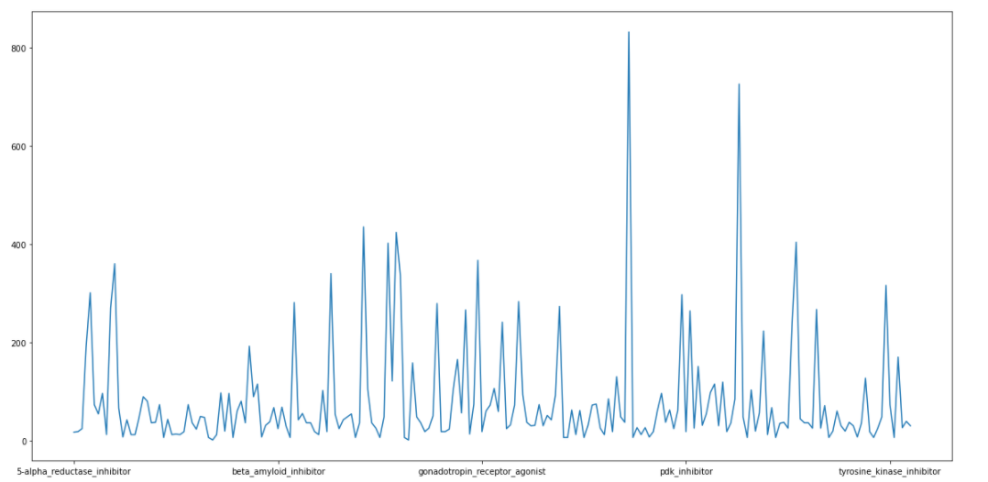
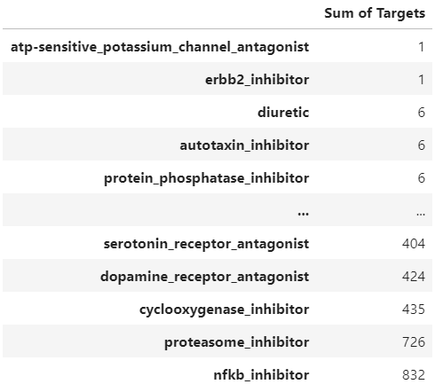
Sum of Targets

Slide 12
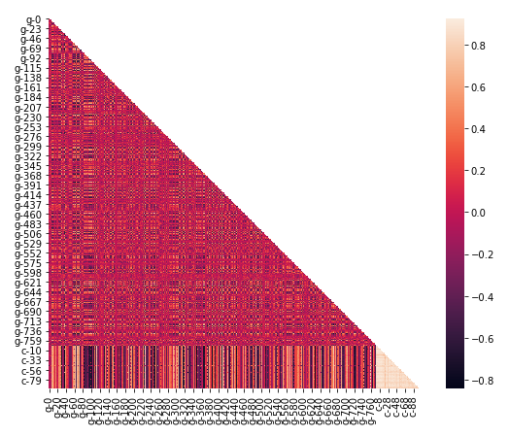
Feature Selection - Correlation Matrix

Slide 13
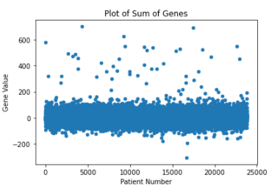
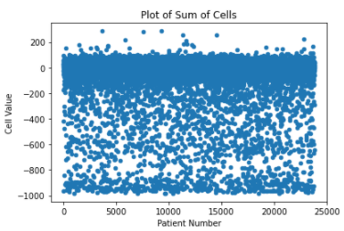
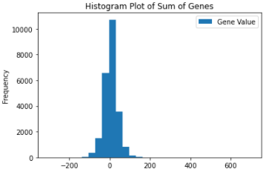
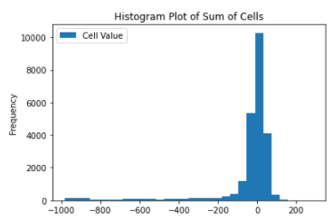
Engineered Features(Sum):

Slide 14
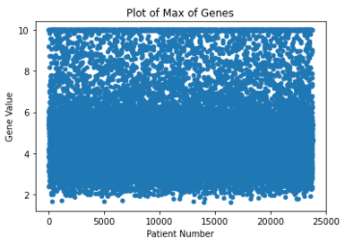
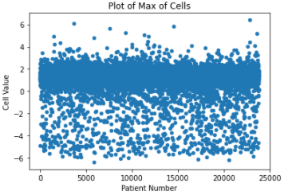
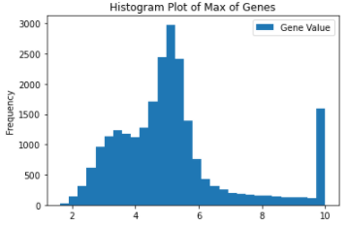
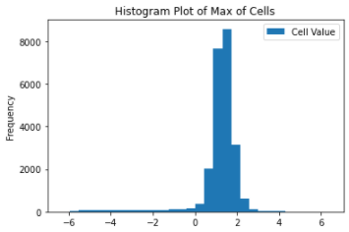
Engineered Features(Max):

Slide 15
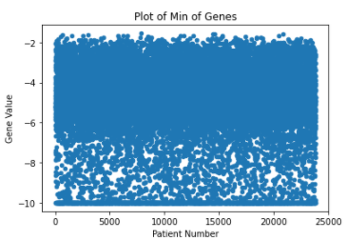
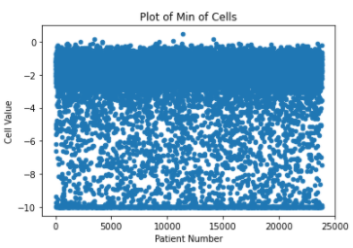
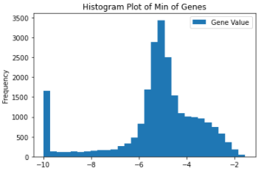
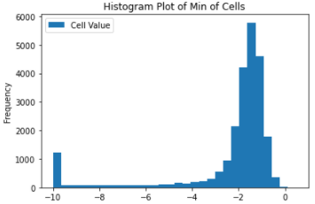
Engineered Features(Min):

Slide 16

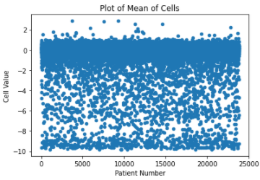
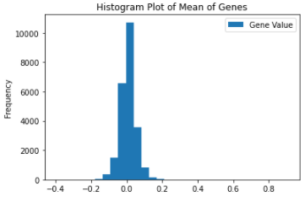
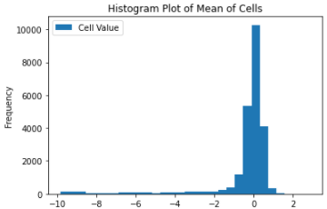
Engineered Features(Mean):

Slide 17
Takeaways
CP Type with clt_Vechicle has no activations (control group)
Correlated features
Multi Label Classification Problem (Binary Relevance Approach)
Cell viability data distribution shows some bumps

Slide 18
Adopted Techniques
The adopted engineered, feature selection techniques
Features Engineered - Max, Min, Mean of gene expressions and cell viability
Feature importance/selection - Correlation, Random Forest
Dimensionality Reduction - PCA (100)
Processing: StandardScaler, One-Hot, Label Encoder
Handle Imbalance - Up/Downsampling + Stratified K-Fold CV

Slide 19
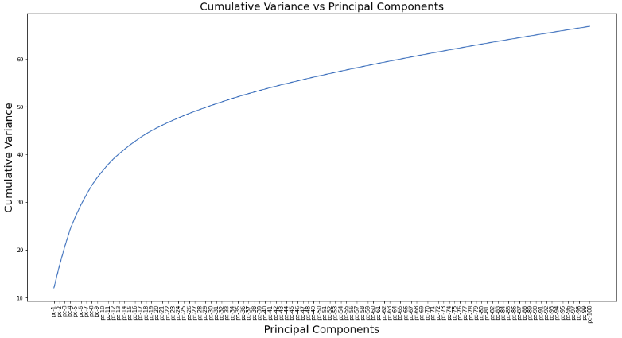
PCA Analysis
Top 100 Principal Components
~ 65% Explained Variance

Slide 20
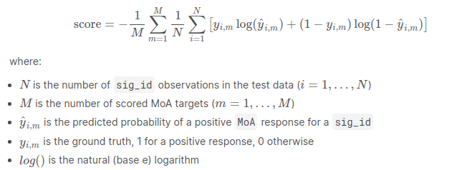
Evaluation Metric
score = Average BCE loss per label per sample
Lower score => Better Model

Slide 21
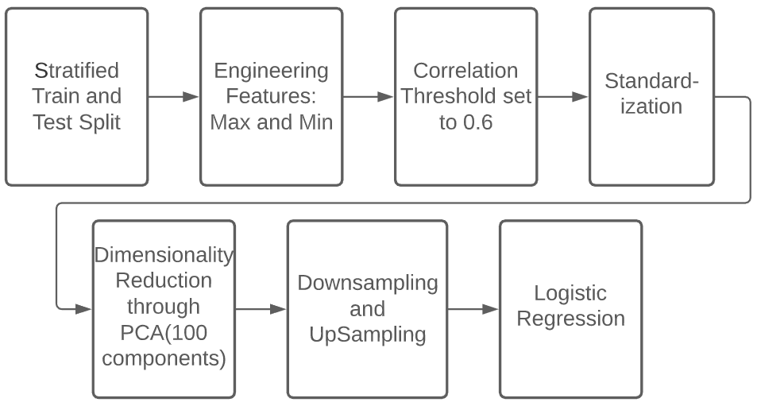
First Model Approach - Logistic Regression

Slide 22
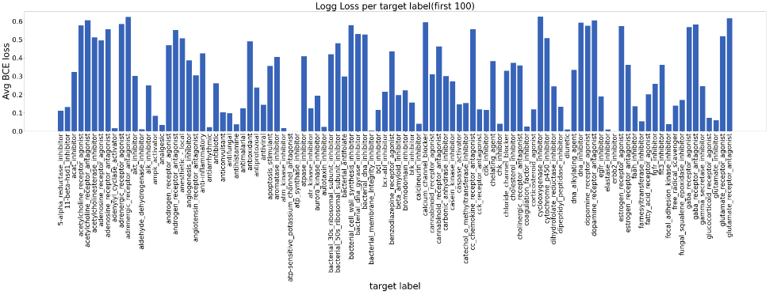
First Model Approach - Logistic Regression

Slide 23
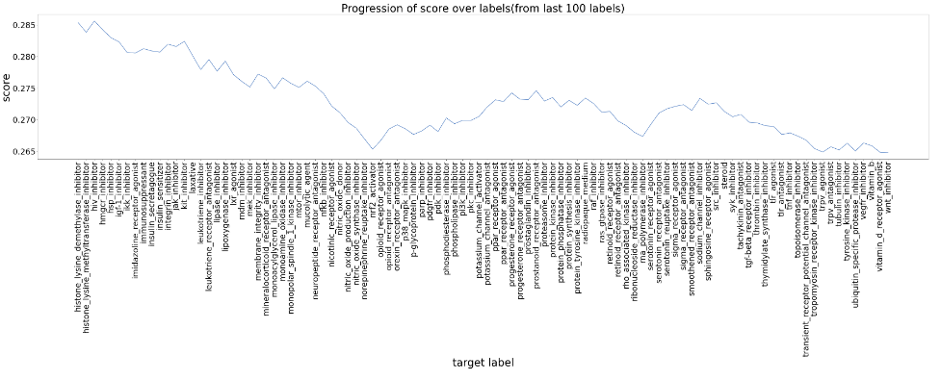
First Model Approach - Logistic Regression
Score: 0.265

Slide 24
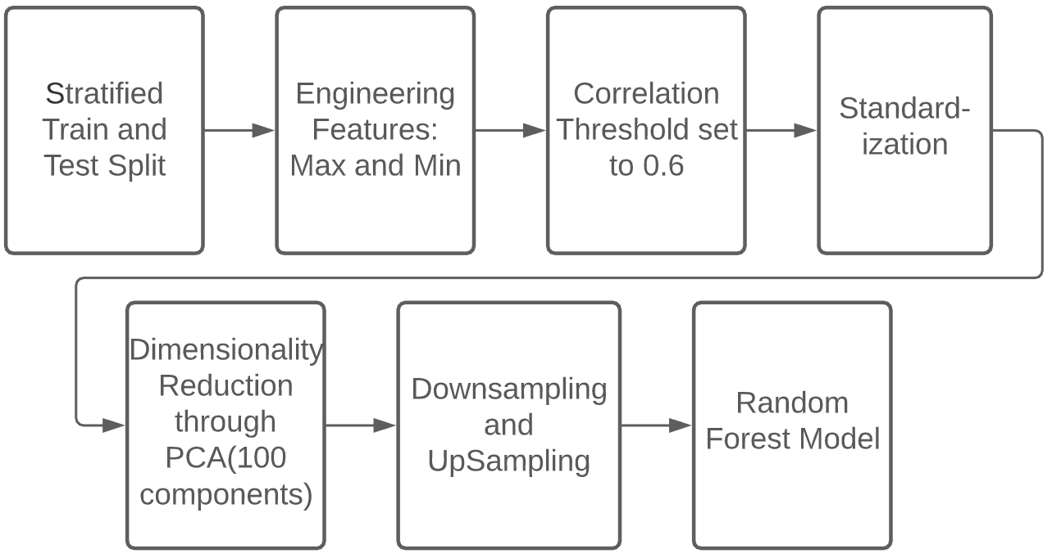
Second Model Approach - Random Forest

Slide 25
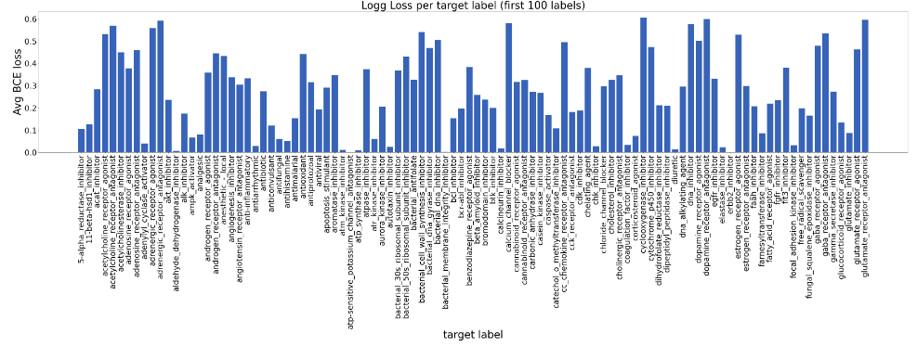
Second Model Approach - Random Forest

Slide 26
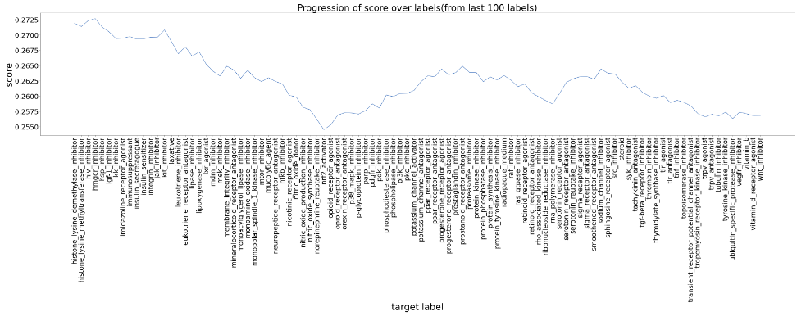
Second Model Approach - Random Forest
Score: 0.256

Slide 27
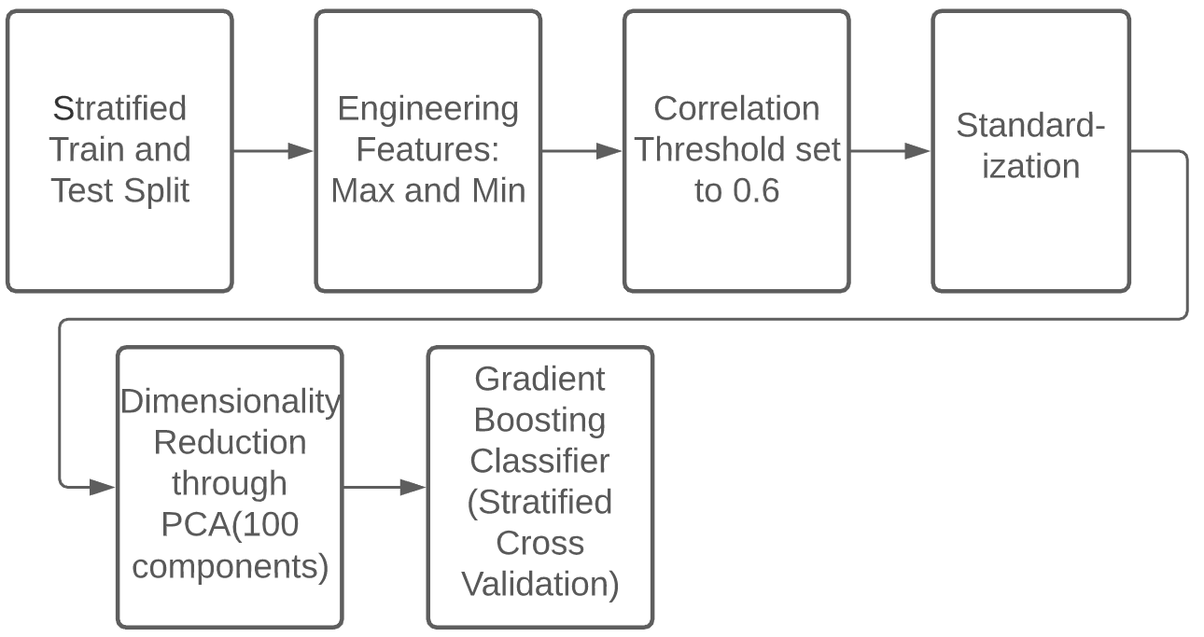
Third Model Approach - Gradient Boosted Trees

Slide 28
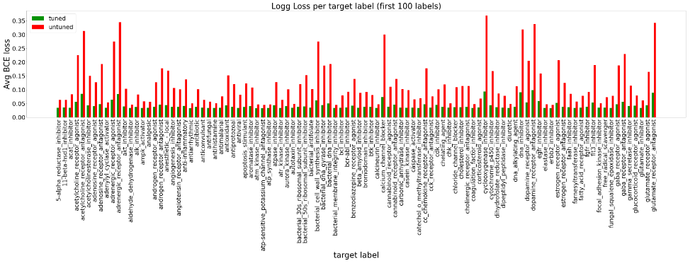
Third Model Approach Results - GBT Model

Slide 29
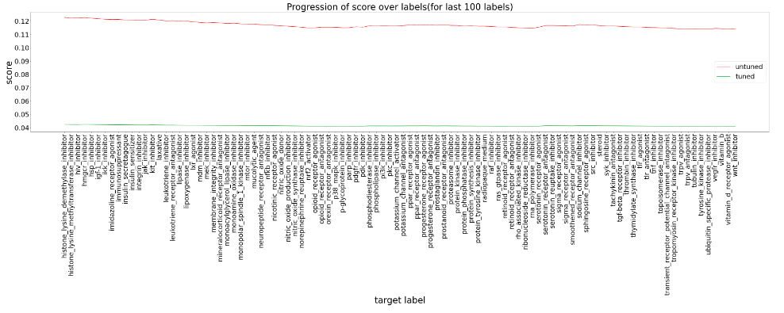
Third Model Approach Results - GBT Model

Slide 30
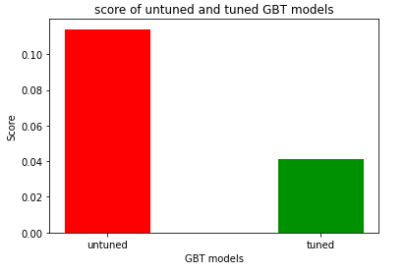
Third Model Approach Results - GBT Model
Untuned Model score for the test set: 0.11
Tuned Model score for the test set: 0.04

Slide 31
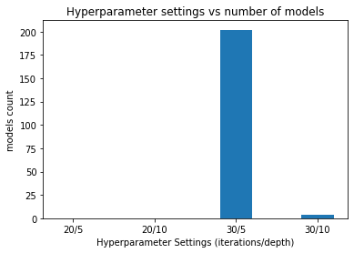
Third Model Approach Results - GBT Model
Default GBT model hyper parameters:
Max iterations = 20
Max depth = 5
Best hyper-parameters after Grid Search
Max iterations = 30,
Max Depth = 5
Max iterations = 30,
Max Depth = 10

Slide 32
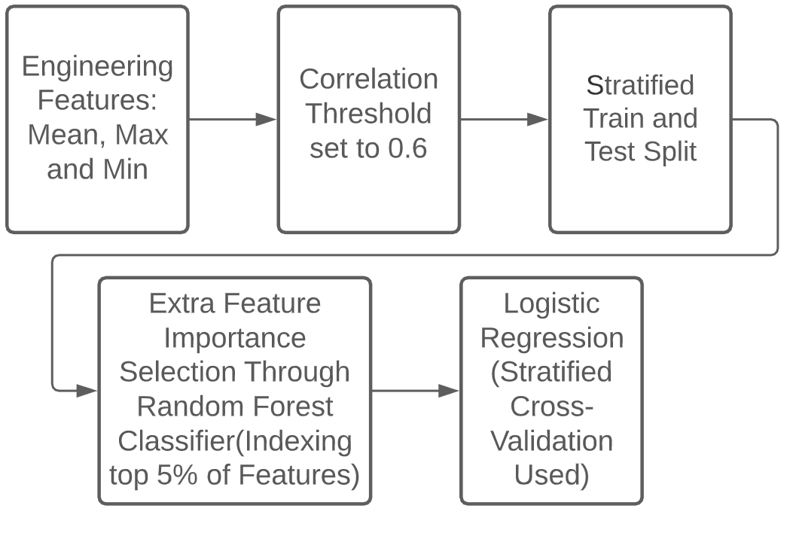
The Challenger Model: Random forest + Logistic Regression

Slide 33
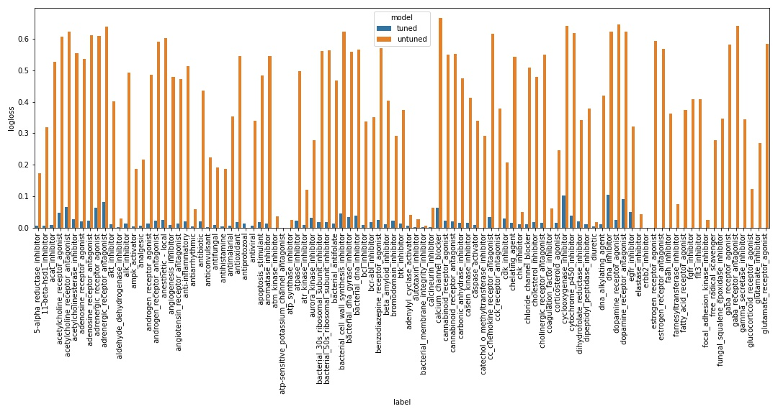
The challenger model: Log-loss

Slide 34
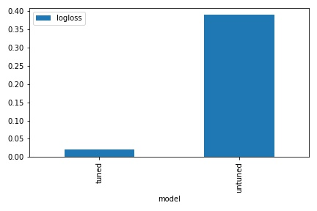
The challenger model: Log-loss

Slide 35
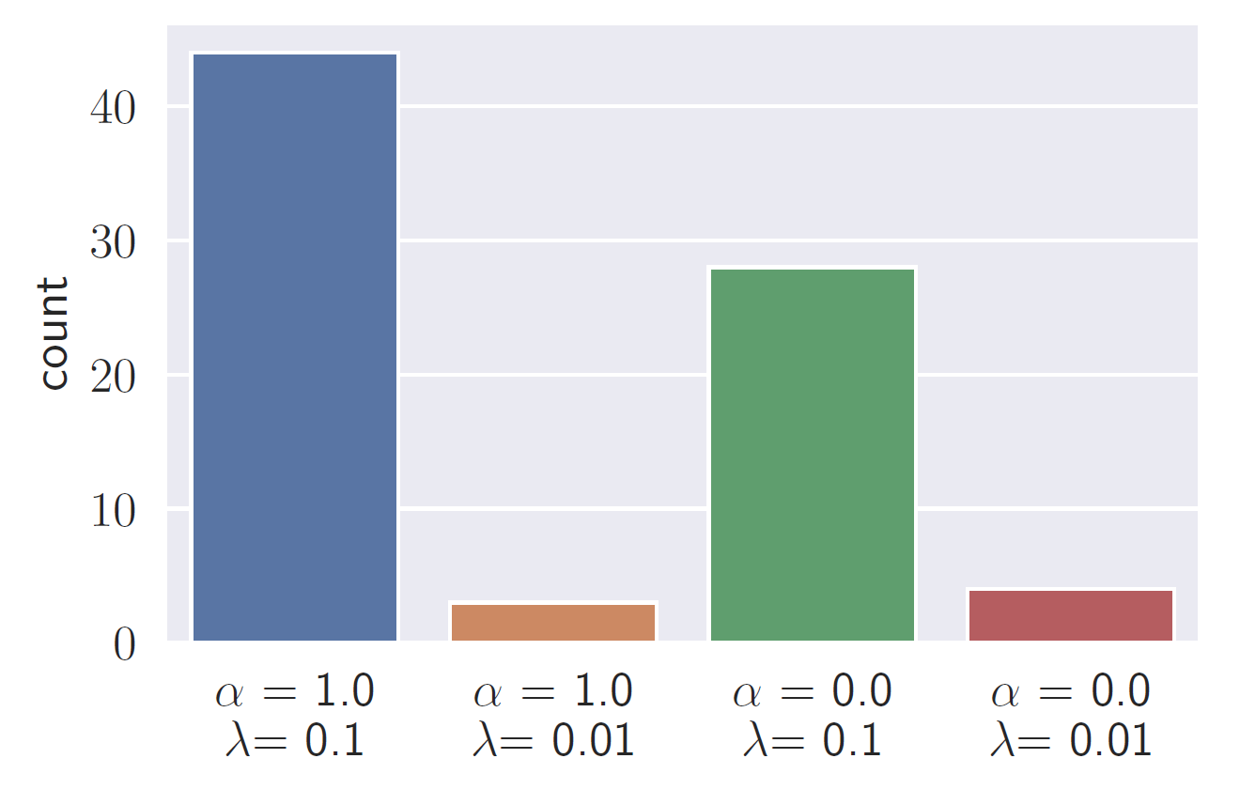
The challenger model: Best parameters
Untuned logistics regression parameters:
α = 0 (ridge regression model)
λ = 0 (no regularization)
Best parameters according to the parameter tuning:
α = 1.0, λ = 0.1
α = 0.0, λ = 0.1

Slide 36
Conclusion
An overview of the techniques:
Min, max, mean
Feature importance selection: Correlations and random forest
PCA
Processing: StandardScaler, One-Hot; and Label Encoder
Class imbalance: Up/Downsampling; and Stratified K-Fold CV
Models:
Logistics regression
Random Forest
Gradient Boosting
Random forest (for feature selection) + logistics regression
Main takeaways:
Hyperparameter tuning is an important step
Simpler model does not mean inaccuracy

