Slide 1
Univariate Exploration
In this section, investigate distributions of individual variables. Such as User_type, member_gender,duration_sec, starting station and time of the trips.

Slide 2
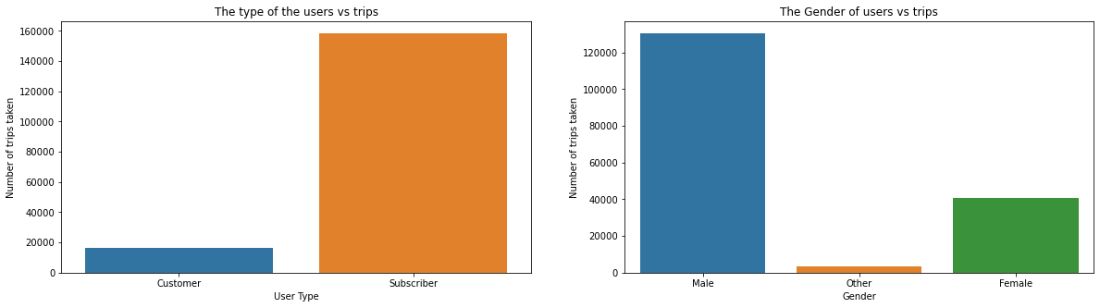
user_type & member_gender
we can see clearly the difference between groups of subscribers and customer, in addition to the high volume of male customers.

Slide 3
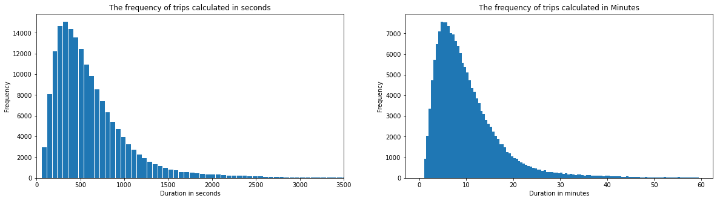
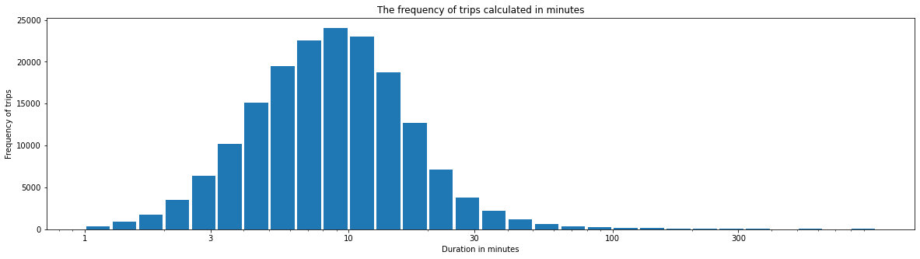
Duration in seconds, minutes
The above histograms show that data are skewed to the right, the majority of the trips fall within 3 to 10 minutes, however it's not very clear, let's do some log transformation for better analysis

Slide 4
Duration in minutes (Transformed)
This histogram is more clear and it confirms that most trips are more than 3 and less than 30 minutes

Slide 5
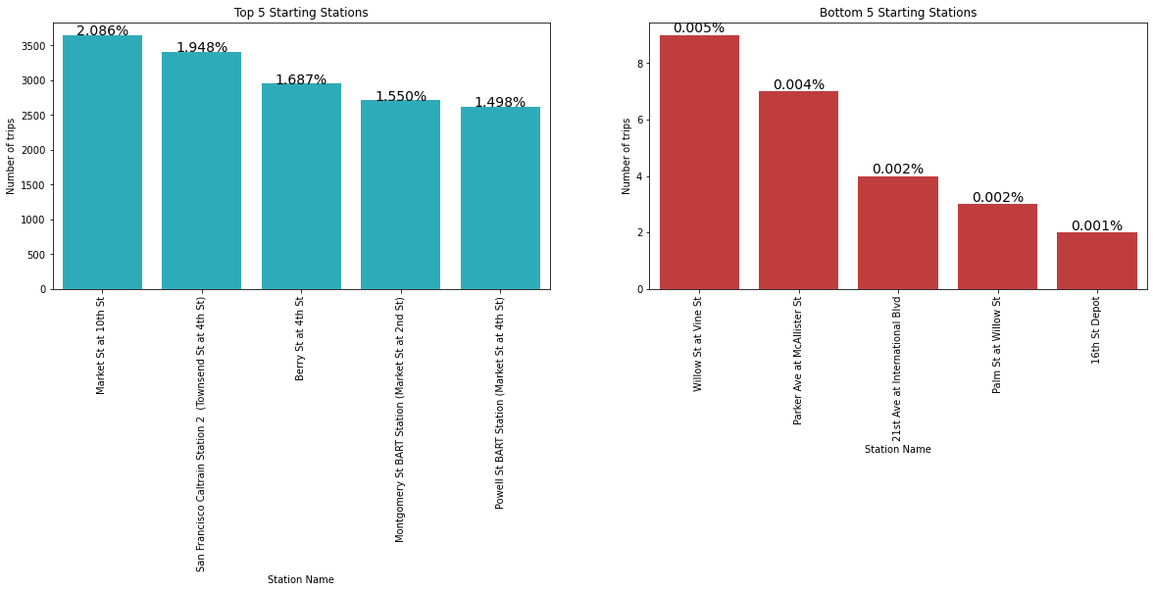
Top and Bottom staring stations
The charts shows that there is a different of number of trips according to the starting stations as shown above.

Slide 6
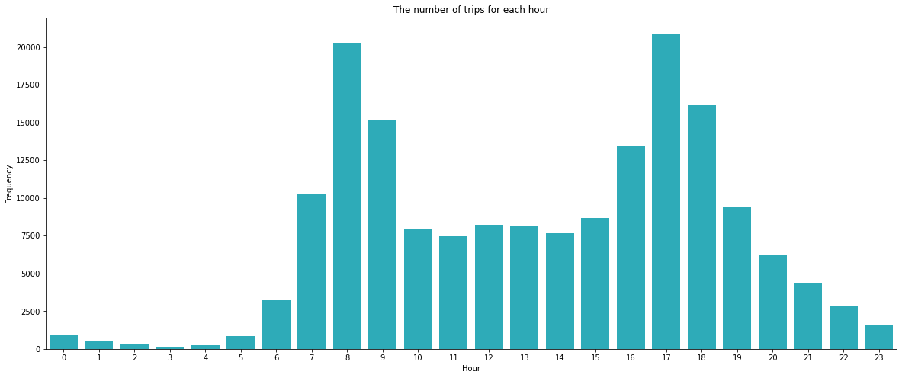
Trips according to hours
The bar plot shows there is relation between the time and the trips frequency, 8am and 5pm are the most frequent.

Slide 7
Discuss the distribution(s) of your variable(s) of interest.
Were there any unusual points? Did you need to perform any transformations?
from the above visualizations we can summarize that the start hour of the trip impact the frequent of the trips, as well the popularity of some stations than other. the trip duration was recorded in seconds therefore we had to transform it to more human understandable way by using minutes and transformation.
Of the features you investigated, were there any unusual distributions?
Did you perform any operations on the data to tidy, adjust, or change the form of the data?
If so, why did you do this?
We have created the Age variable so we can understand how the age influence customers to use our service and will help use later on our multivariate exploration.

Slide 8
Bivariate Exploration
In this section, we will explore variables (Hours, Day of week)and their impact on the other variables such as duration on the trips.

Slide 9
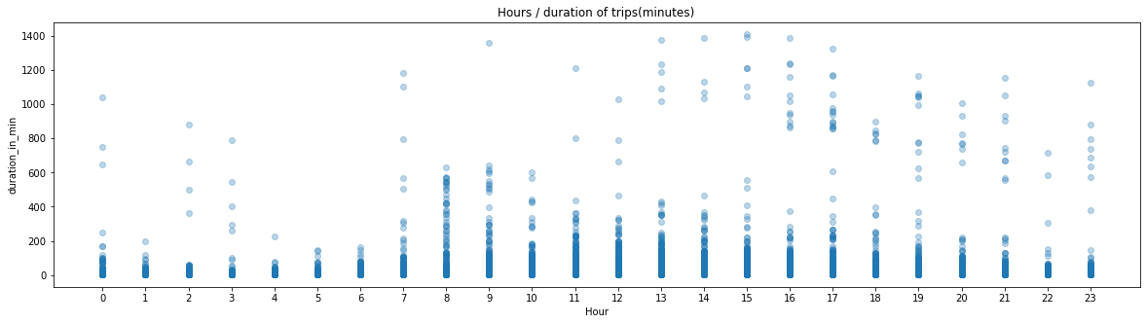
Hours and duration in minutes
The plot explains the variabilities of the trip duration at every hour, if we take a closer look at 8 and 9 AM we can tell they have the least variability even with high number of trips, however 16 and 17 hours have high variabilities.

Slide 10
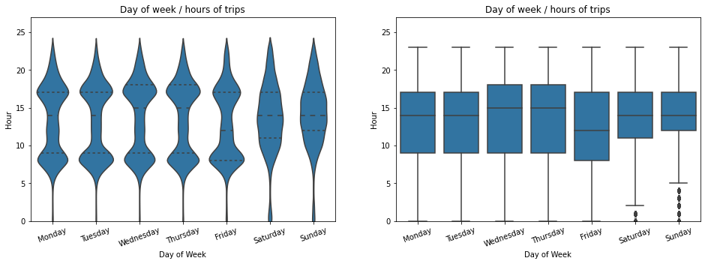
Day Of The Week / Trip time
Another intresting finding here, if we look at saturday and sunday we will notice the most frequent hours to go for bike trips are increasing after 10 in the morning reaching the peak around noon and start decreasing around 16, the other weekdays show high use of bikes early moring and another high use around 14.

Slide 11
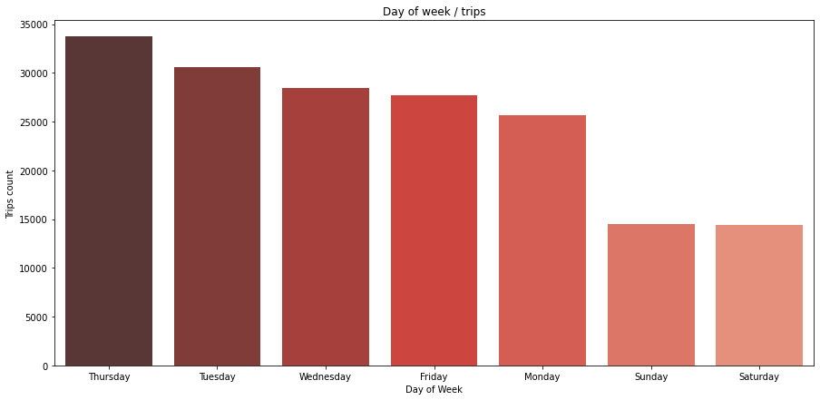
Trips as per day of the week
Showes that how weekday affect the numbers of the trips, weekend has the lowest number of trips in the week

Slide 12
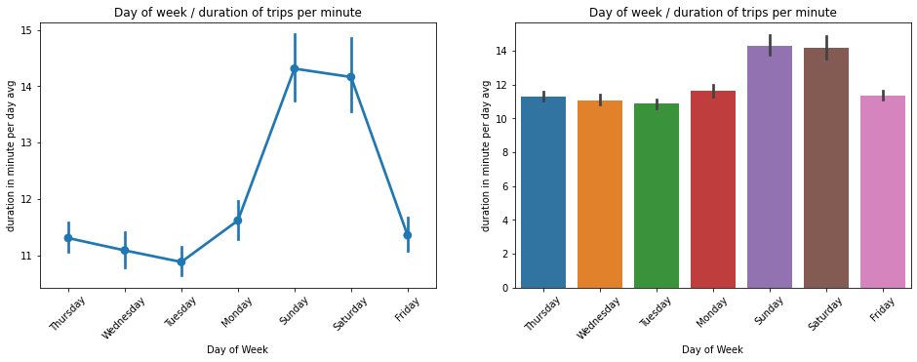
Duration of the trips per day
Despite of the previous findings, we here notice that weekend are more likely to have longer trips than weekdays.

Slide 13
Talk about some of the relationships you observed in this part of the investigation.
How did the feature(s) of interest vary with other features in the dataset?
We concentrated on this section on finding the relation between weekdays, hours and the frequency of the trips and the duration, we could find a strong relation between weekdays and the numbers of the trips as trips increase during weekdays on contrary, the duration of each trips increases during weekends.
Did you observe any interesting relationships between the other features
(not the main feature(s) of interest)?
the hourly analysis of the trips showed that despite of 8 and 9 in the mooring are high in trips demand they have very low variabilities as trips may be only for going to work and not for leisure, however, at 15,16, and 17 we can notice the high variability of trip duration

Slide 14
Multivariate Exploration
In this section we will visualize the impact of gender and customer subscription type, age and trips per minute relationship

Slide 15
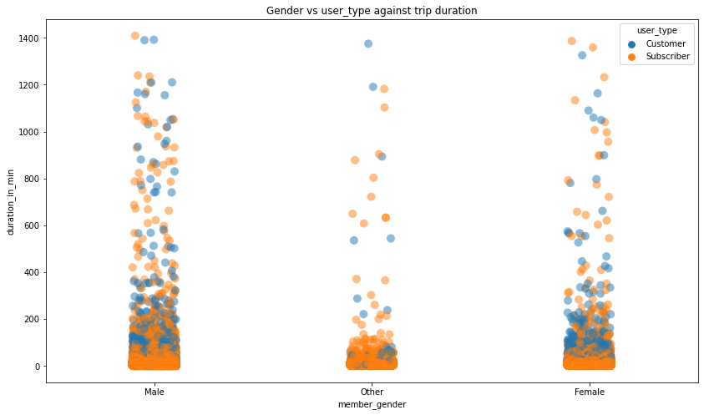
Gender/user type and trips duration
The plot shows the relation between three variables, gender and user type corresponding to the trip duration, the scatter plot shows more subscriber and male useres than other categories.

Slide 16
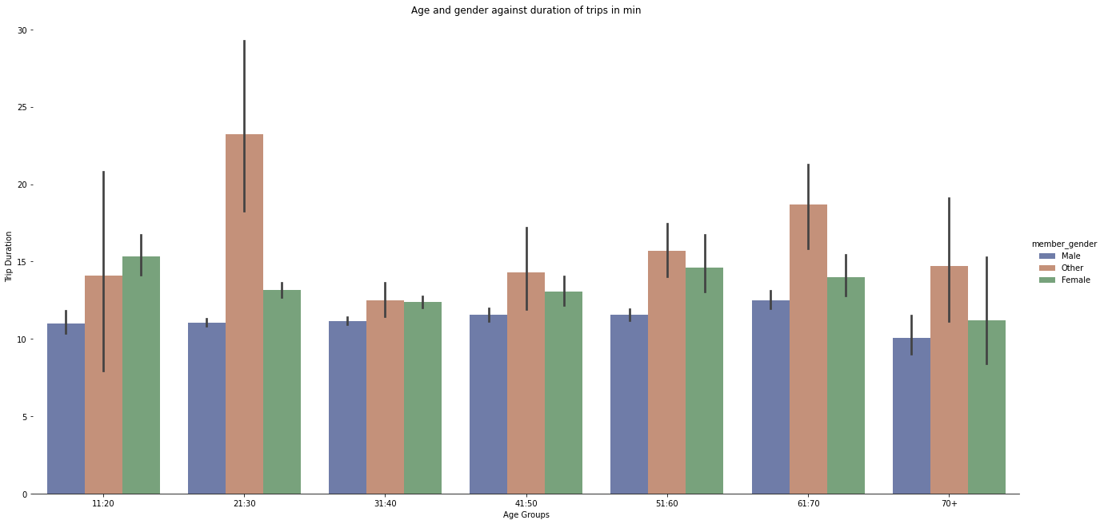
Age / Gender and duration of the trip
The plot showes that group other is usually having longer trips, the age of 20 up to 30 years taking longer trips than other groups.

Slide 17
Talk about some of the relationships you observed in this part of the investigation. Were there features that strengthened each other in terms of looking at your feature(s) of interest?
The gender vs trip duration shows that male are more likely to have longer trips than other groups, as well as we have seen from the univariate that subscribers they are more than customers however from our plot here we can see that did not affect the trip duration.
Were there any interesting or surprising interactions between features?
One of the surprising interaction between age and trip duration group is that most of the groups gender as other have the longer trip duration followed by female then male despite of male proportion are more than the other groups.

