Slide 1
Unicef Cash Transfer – Fund Request Subsystem
What
- The sub-system of Unicef Cash Transfer that handles fund requests.
- The backend is based on blockchain systems.
- A website is hosted for those who need access.
Who
- Whitelisted Implementing Partners (IP) can create fund requests.
- Fund managers can approve/reject requests and release funds.
- Admin can add/remove fund managers and IPs.

Slide 2
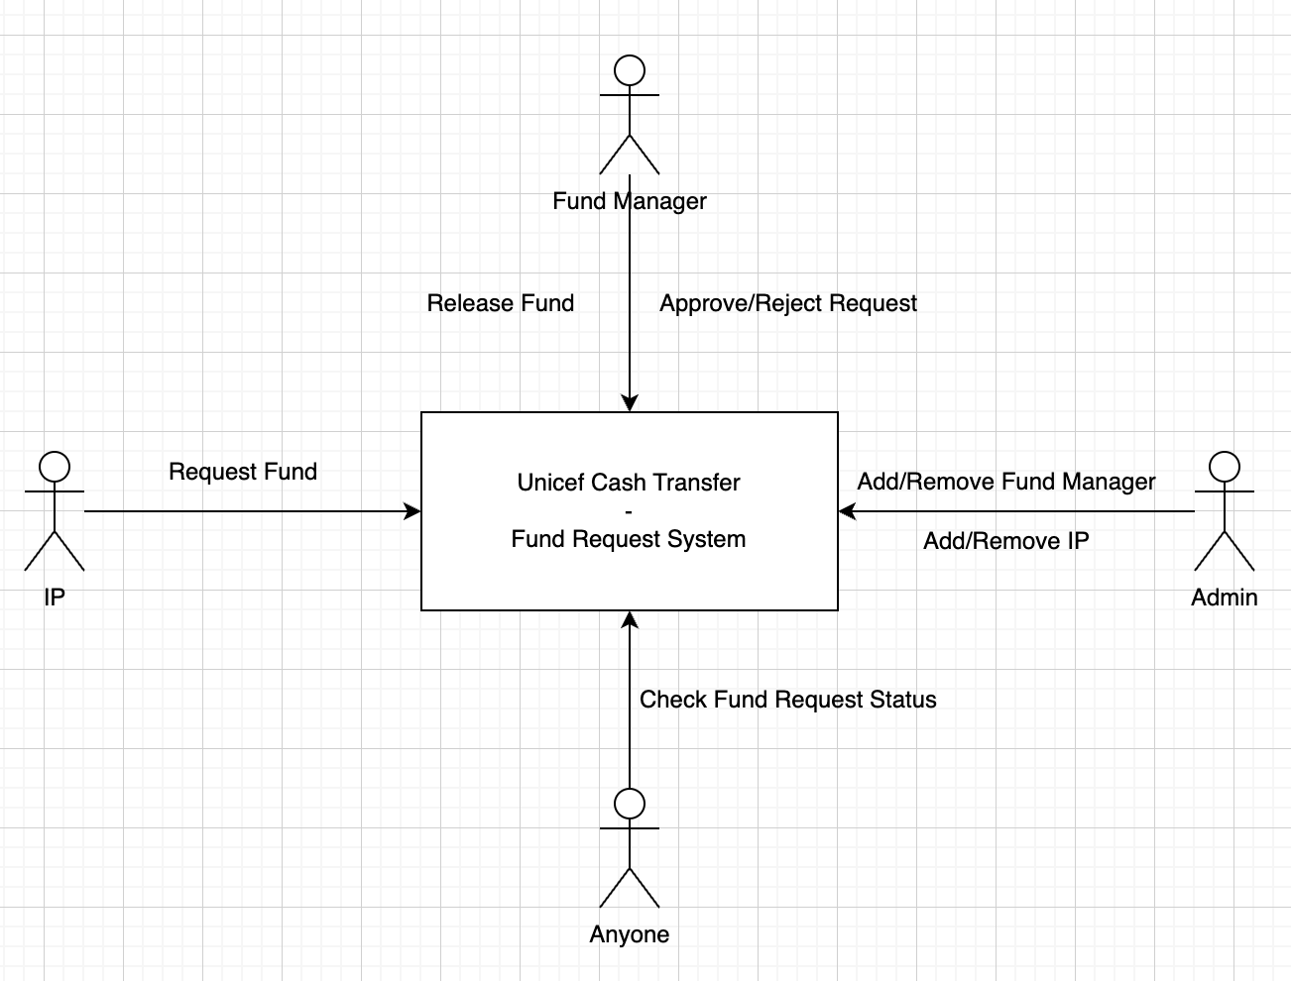
Unicef Cash Transfer – Fund Request Subsystem
System Architecture and UX Flow
Fund Requests are validated before logged in the system
- amount of the fund
- purpose of the fund
- deadline of the request

Slide 3
Unicef Cash Transfer – Fund Request Subsystem
Access Controls
Admin can add/remove implementing partners
Admin can add/remove fund managers.
Only fund manager can operate on requests.
Only whitelisted IP can create requests.
Anyone can check request status for transparency purpose.

