Slide 1

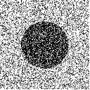
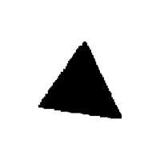
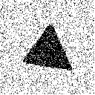
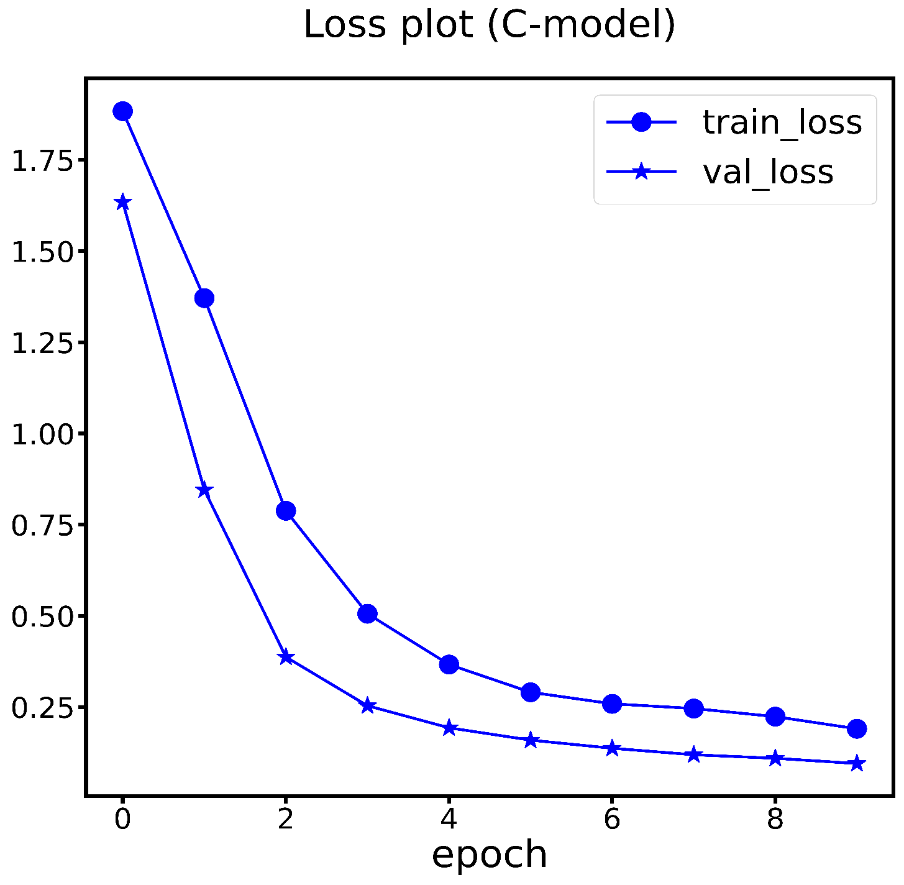
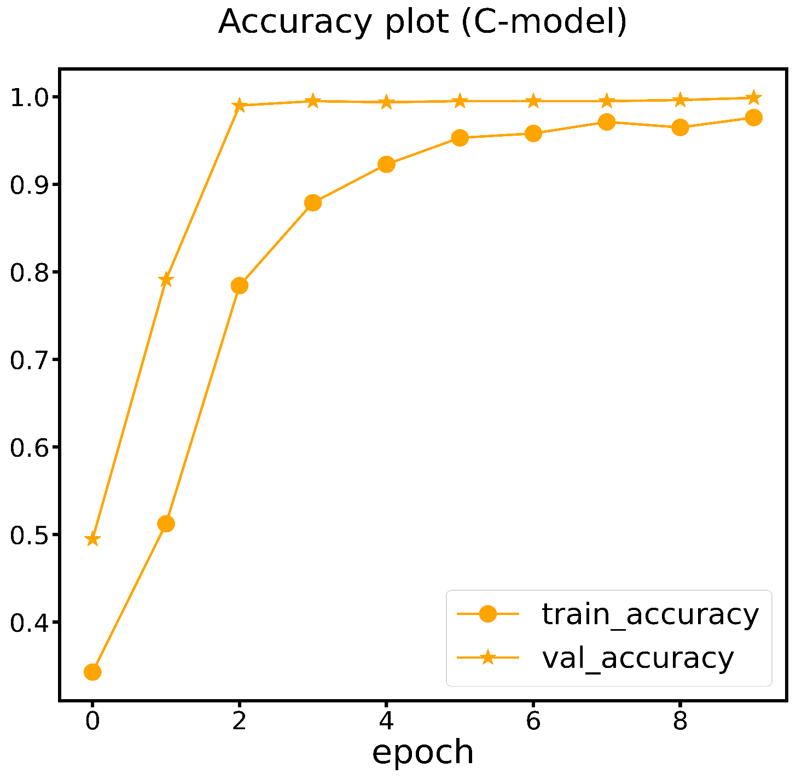

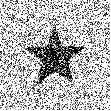

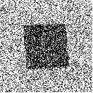
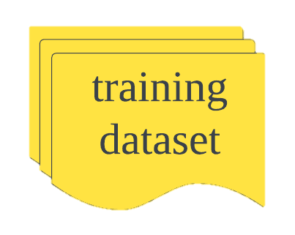
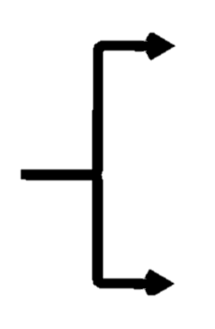
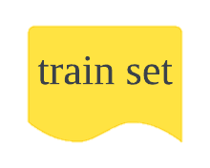
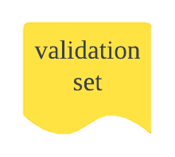
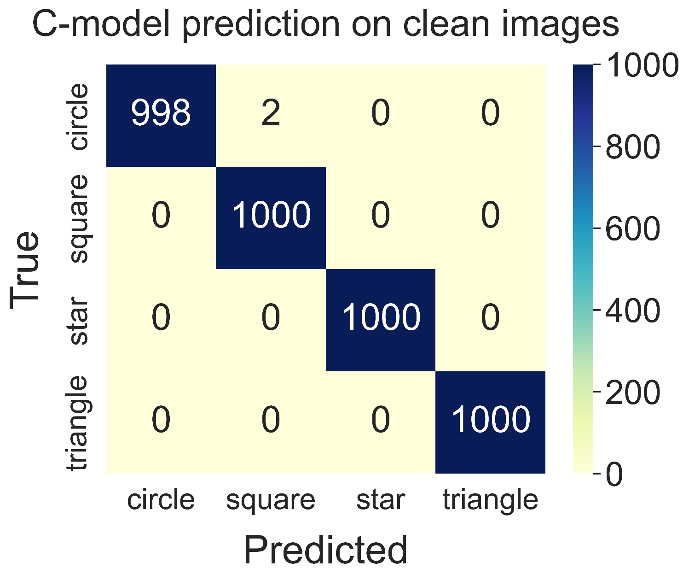
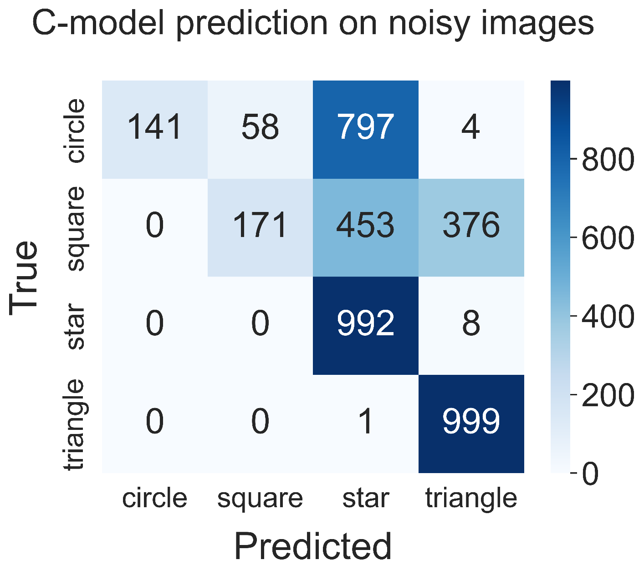

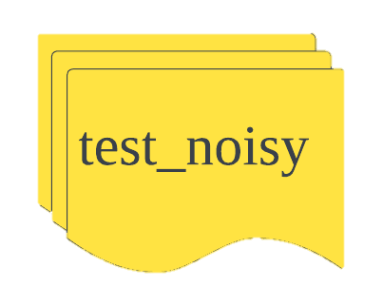
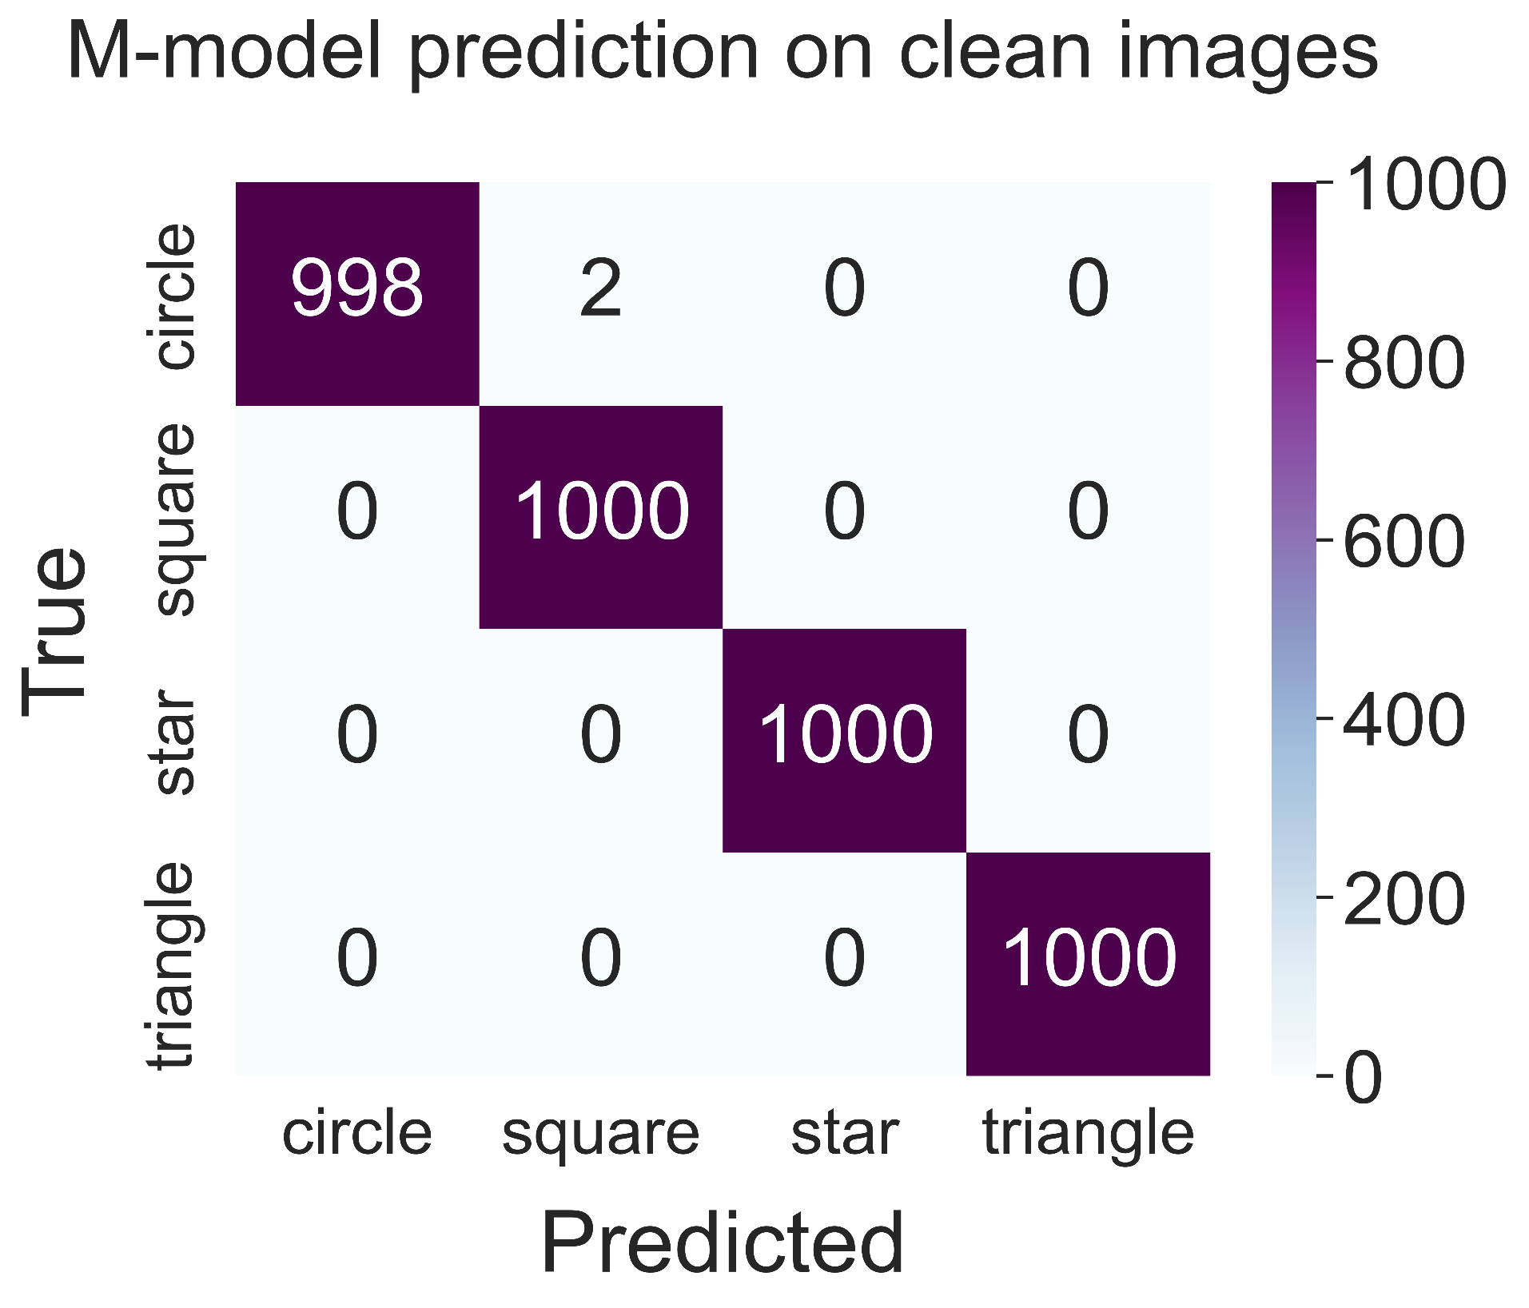
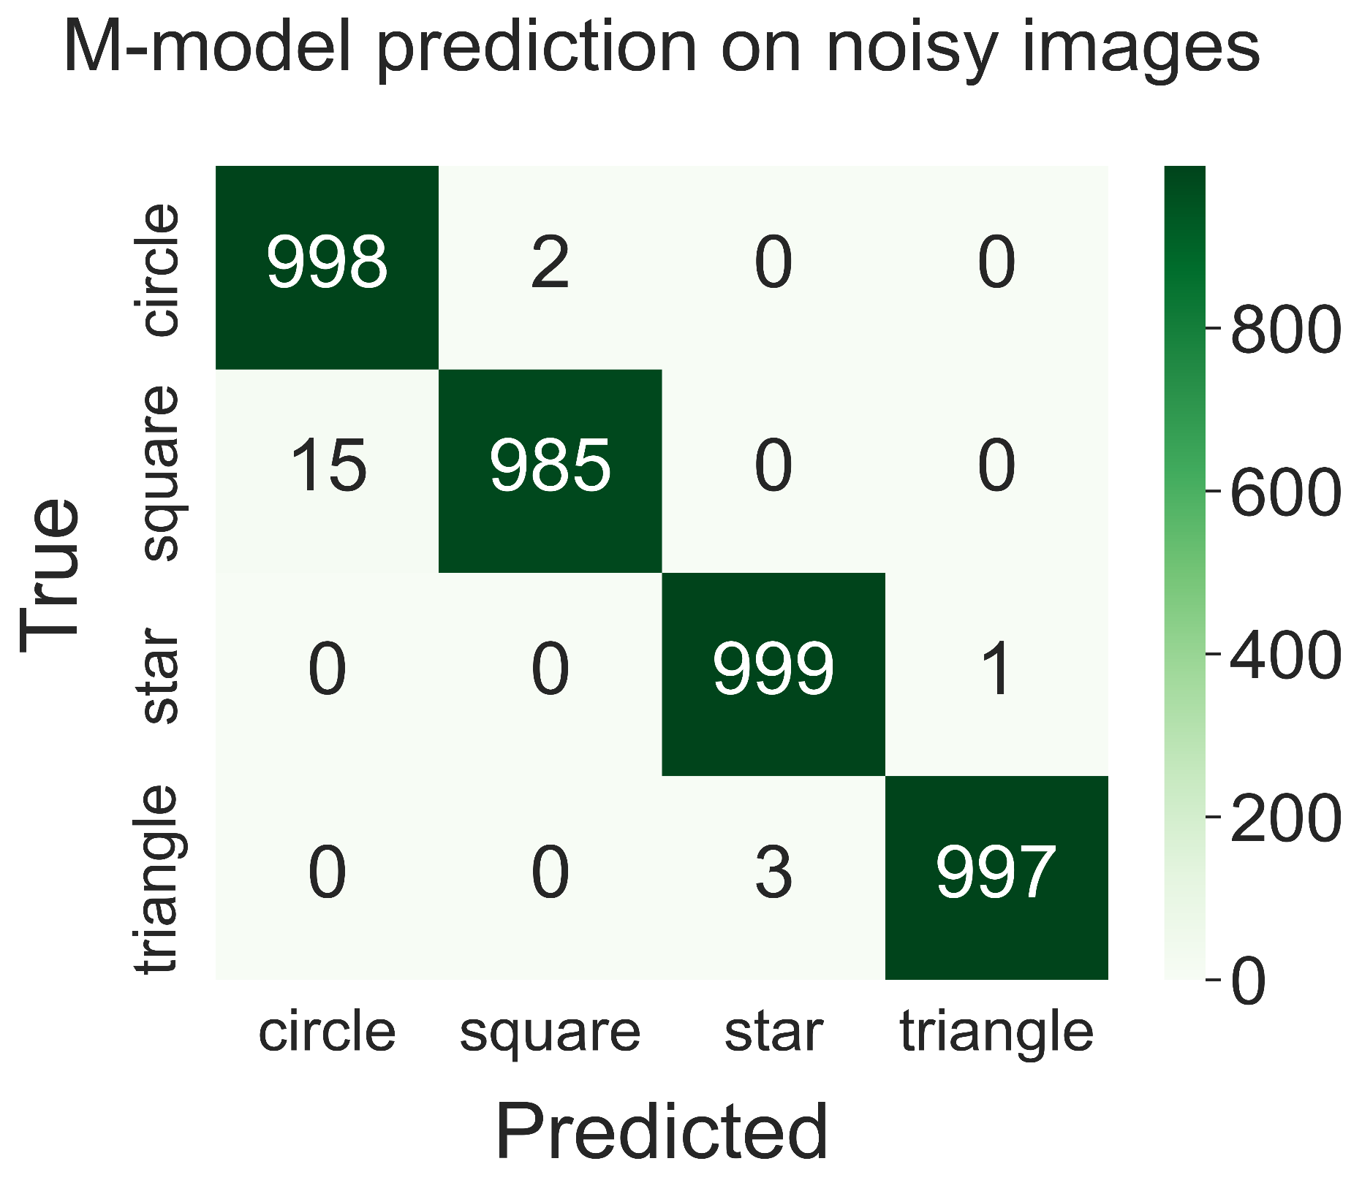
Unveiling the Impact of Noise: Enhancing CNN-based Image Classification by Addressing Misclassification Issues
Han-Yu Hsiao
Toronto school of management
Introduction
Artificial intelligence has gained popularity in recent years, bringing convenience and advancements to various aspects of human life. Convolutional Neural Networks (CNNs) are widely used for image classification tasks. This project aims to improve image classification performance, specifically focusing on the impact of noise. While humans can easily identify noise in an image, machine models struggle with it and may even mistake noise signals as important features. By incorporating clean images as references, the machine learns to differentiate and understand the concept of "noise," reducing its influence on classification. Additionally, adjusting the CNN network structure enhances the model's ability to handle noise, resulting in improved image classification performance.
Method & Dataset
C-model performance
Choose convolutional neural network(CNN) to build my artificial intelligence model.
There are 1000 clean images in each shape in the training dataset. Splitting them into training set and validation set.
3200
4000
Denote the model which trained with clean images as “C-model” and the CNN construction of the C-model is as shown below.
800
-1000
4000
4000
input
inputLayer
Conv2D
Maxpooling2D
Conv2D
Maxpooling2D
Through Loss and accuracy curve, I could inspect C-model is overfitting or not.
C-model has desirable prediction on clean images. However, the result of prediction on noisy images is extremely terrible.
ReLU
ReLU
Dense
Dropout
Dense
Dense
Dense
Maxpooling2D
Conv2D
Softmax
ReLU
ReLU
ReLU
ReLU
Issue solution
M-model performance
Noisy images were introduced into the original training dataset.
Compared with C-model, M-model shows significant improvement in prediction of noisy images.
3200
3200
-1000
4000
800
800
2. Enhance regularization ratios in convolutional layer and introduce dropout to each fully connected layer to mitigate overfitting.
Dense
Dropout
Dense
Dropout
Dense
Dropout
Dense
Softmax
ReLU
ReLU
ReLU
conclusion
1. For C-model and M-model, “ReLU” activation function performs well in both convolutional layer and fully connected layer.
2. The presence of noise in images will significantly effect the classification of the C-model because it can’t distinguish those signals from meaningful features. As a result, it misclassify the images.
3. Utilizing both clean and noisy images in the training dataset to provide contextual information to the model. During training process, the machine realize that noise is meaningless feature, which prevents model from making misclassification on noisy images.
4. “Regularization” and “Dropout” not only avoid overfitting but also reduce the model’s sensitivity to noise.

