Slide 1
Number of Island

Slide 2
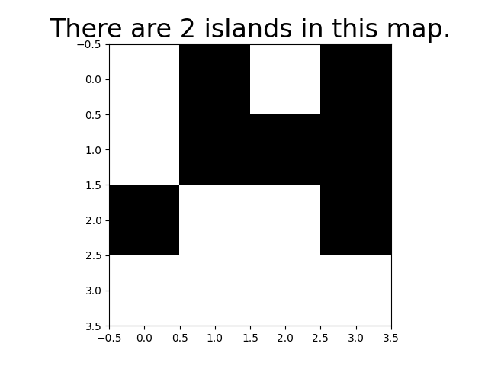
Algorithm explanation
This programming will generate random map as shown at right hand side.
Land positions that are connected horizontally or vertically are considered to be part of the same island.
Diagonal connections will be counted to the other island.
It will print out how many islands on this map at title.

Slide 3
Algorithm explanation
Define a list “is_land” to record the position of all land on the map.
Take this figure as example, the is_land list will be equal to [[0,1], [0,3], [1,1], [1,2], [1,3], [2,0], [2,3]].
Define the “search” function will searches for neighboring land positions.

Slide 4
Algorithm explanation
Create a empty buffer list to store the search process.
Take the first position from the is_land list as the starting point of a new island.
Start from land at [0,1] and the iterate through the following steps.

Slide 5
Algorithm explanation
Is_land = [[0,1], [0,3], [1,1], [1,2], [1,3], [2,0], [2,3]]
Buffer = [[0,1]]
##After I add the start position in Buffer, I delete the start position in Is_land and Buffer list to avoid duplicated searches.
Is_land = [[0,1], [0,3], [1,1], [1,2], [1,3], [2,0], [2,3]]
Buffer = [[0,1], [1,1]]
Is_land = [[0,1], [0,3], [1,1], [1,2], [1,3], [2,0], [2,3]]
Buffer = [[0,1], [1,1], [1,2]]
##Keep searching….
Is_land = [[0,1], [0,3], [1,1], [1,2], [1,3], [2,0], [2,3]]
Buffer = [[0,1], [1,1], [1,2],[1,3]]

Slide 6
Algorithm explanation
Is_land = [[0,1], [0,3], [1,1], [1,2], [1,3], [2,0], [2,3]]
Buffer = [[0,1], [1,1], [1,2],[1,3],[0,3],[2,3]]
Is_land = [[0,1], [0,3], [1,1], [1,2], [1,3], [2,0], [2,3]]
Buffer = [[0,1], [1,1], [1,2],[1,3],[0,3],[2,3]]
When the buffer is empty, it indicates that a complete island has been found. The island count is incremented by one. Afterward, continue searching for other land positions in the is_land list and repeat the aforementioned search process.

