Slide 1
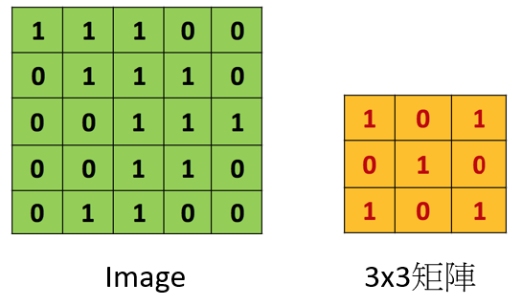
The principle of convolutional layer
A convolution is actually a two-step operation: sliding and dot product. It involves sliding a filter over an input image and continuously performing matrix dot product operations. The resulting image after convolution is called a feature map.
Ref: https://hackmd.io/@allen108108/rkn-oVGA4

Slide 2
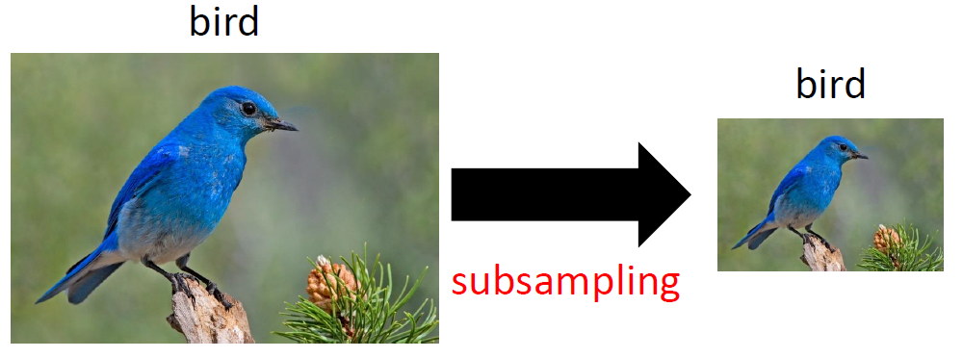
The principle of max pooling
The main concept of a pooling layer is that during the process of feature extraction from an image, the scaling of the image should not affect our objectives. By performing scaling in this way, we can further reduce the number of parameters in the neural network.
Ref: https://hackmd.io/@allen108108/rkn-oVGA4

Slide 3
The benefits of convolutional layer and Max pooling
Convolutional layer could extract features from the images and it will increase the accuracy of image classification
Through Max pooling, it could decrease the number of pixel in dimension. Moreover, max pooling could prevent overfitting by reducing the sensitivity of the network to small shifts in the input.
Above all, It can significantly reduce the input matrix. As a result, it will decrease the computational loading and the required temporary memory.

Slide 4
The purposes in the project
1. Actually understanding the background knowledge of convolutional layer and Max pooling.
2. Without importing machine learning-related modules, only consider basic mathematical logic to improve my algorithmic skills.
3. Generally speaking, when we do our ML research, we usually care about whether the machine model could predict successfully or not. Through this project, we could browse what the image will be look like after pre-processing.

Slide 5
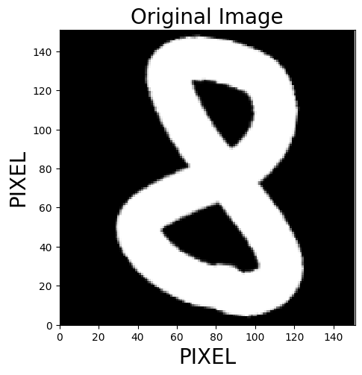
Assumption in the programming
The shape of the image is square as shown at the right hand side.
Create only one filter, which is a 2x2 matrix, will scan the entire image to extract the features.
The “stride” parameter is equal to one, which means the filter moves only one pixel to right or down after each scanning.
The max pooling has a scope of 2x2
The image undergoes only one round of convolutional layer and max pooling.

Slide 6
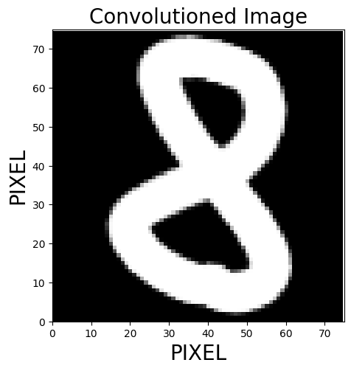
Result
Through
Convolutional and Maxpooling
Through the operation of convolutional layer and max pooling, we obtained a lower resolution image.
The convolutioned image still retains the features of the original image and we could know that is number 8.
The pixels in the dimension of the images decrease by factor two. It will effectively reduce the computational loading.

