Slide 1
Understanding sorted algorithm with data visualization

Slide 2
Outline
Sorted algorithm explanations
Walkthrough in selection sort
result

Slide 3
Sorted algorithm explanations
The concept of sorting means arranging a list with ascending or descending order.
It is not necessarily to be a list of numbers, it could also be the letters of the alphabet.
In this project, take list which only numerical elements in it to illustrate and visualize how the sorted algorithm work in the process.
There are many types of sorted algorithm. In this case, take “selection sort” for example.

Slide 4
Walkthrough in selection sort
Let take a list as shown below for example:
24 | 78 | 12 | 9 | 67
Use red color background to represent un-sorted list
Use blue background to represent sorted list
Find the minimum value in the unsorted list and exchange it with the element at the leftmost position of unsorted list.
24 | 78 | 12 | 9 | 67

Slide 5
Walkthrough in selection sort
And then we get new list like:
9 | 78 | 12 | 24 | 67
Use red color background to represent un-sorted list
Use blue background to represent sorted list
After first step, the list will be divided into sorted list(red)and sorted list(blue). Repeating the step and the result will be like as shown at the next slide.

Slide 6
Walkthrough in selection sort
9 | 78 | 12 | 24 | 67
9 | 12 | 78 | 24 | 67
9 | 12 | 24 | 78 | 67
9 | 12 | 78 | 24 | 67
9 | 12 | 24 | 78 | 67
9 | 12 | 24 | 67 | 78

Slide 7
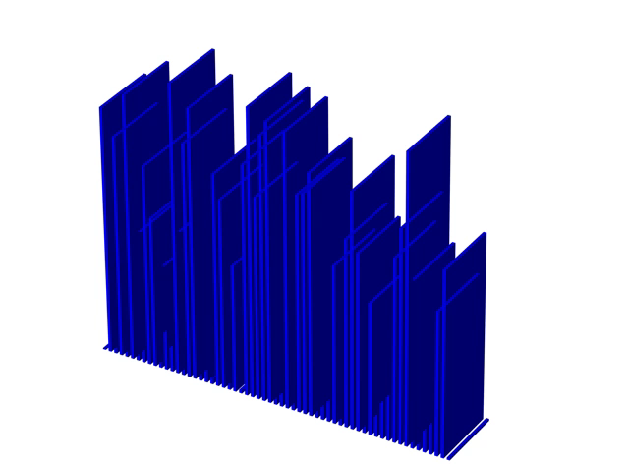
result
Create a list of length 60 with non-repeating numbers.
Plot a bar chart to represent the list at each step after exchanging the numbers.
Export the images as a video to visualize the process of the sorting algorithm.

