Slide 1

CS596-029 Machine Learning and Data Mining
Topic-1: Personal Photo Album
Xiaoling Dong
Hanyuan Zhuang
08/14/2015

Slide 2

What have we done?
1
Given the personal photo album folder, classify all faces in pictures
2
Use the face extraction function from OpenCV to locate faces
3
Apply face recognition functions

Slide 3
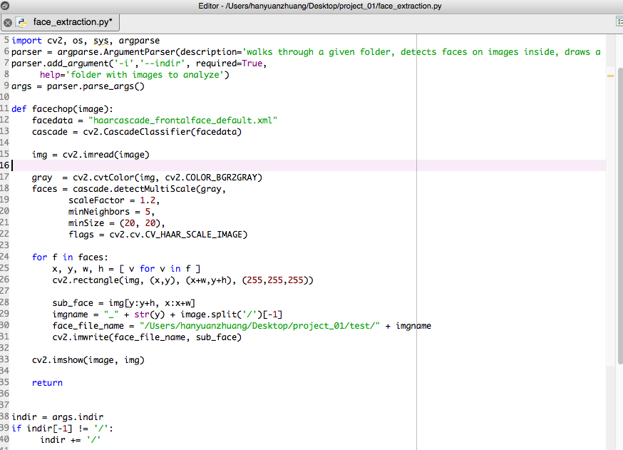
Objective 1 & 2

Slide 4

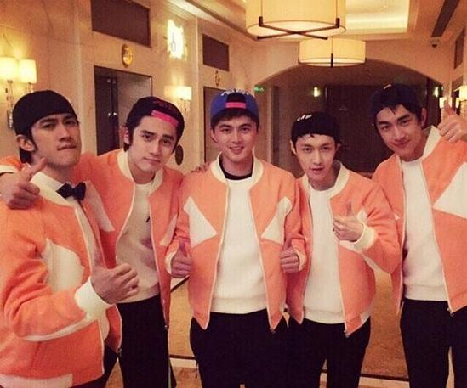
Objective 1 & 2
 | Title | Title | Title | Title | Title
Title | O | O | O | O | O
Title | O | O | O | O | O
Title |  | O |  | O | O
Title | O | O | O | O | O
Title | O | O | O | O | O

Slide 5
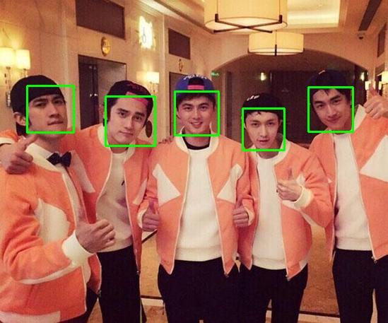





Objective 1 & 2

Slide 6
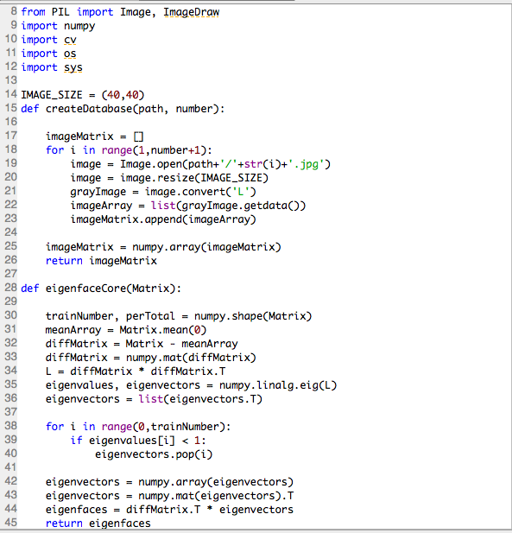
Objective 3

Slide 7
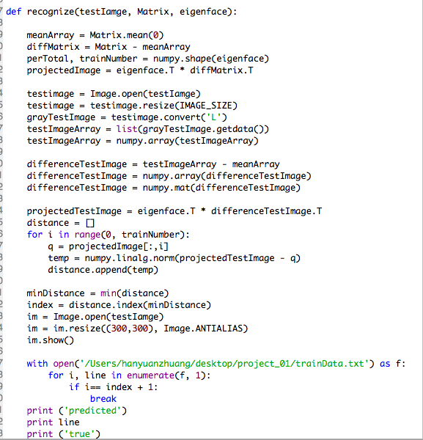
Objective 3

Slide 8
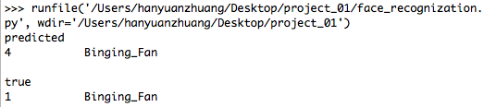
Objective 3

Slide 9
Thank You !

