Slide 1
Combinatorial Optimization by Shortest Path Algorithms

Slide 2
Group Members
Nguyễn Kim Huệ - MSSV : 51702108
Đặng Ngọc Lịch – MSSV: 51702129
Nguyễn Hữu Lợi – MSSV: 51702143

Slide 3
CONTENTS
1. Introduction
2. Approaches
3. Experiments and Results
4. Conclusion

Slide 4
INTRODUCTION
I

Slide 5
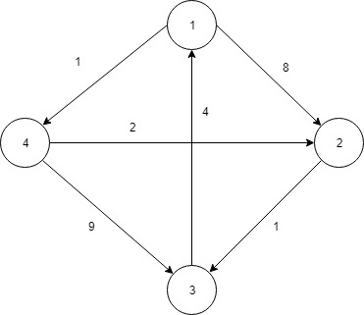
I. INTRODUCTION
Where is the shortest path from 4 to 2?
Because in fact there will be no such peaks, we need to develop an algorithm to solve this problem.

Slide 6
I. INTRODUCTION
Dijkstra’s Algorithm,
Floyd-Warshall Algorithm,
Bellman-Ford Algorithm,
Genetic Algorithm
…

Slide 7
Approaches
II

Slide 8
II. Approaches
The objective is to find the shortest possible path that connects the source and the target. For each vertex within a graph we assign a label that determines the minimal length from the starting point s to other vertices v of the graph.
The algorithm works sequentially and in each step it tries to decrease the value of the label of the vertices. The algorithm stops when all vertices have been visited.
In addition, for each vertex v we have to identify whether it has been visited or not.

Slide 9
II. Approaches
The algorithm consists of n iterations. If all vertices have been visited, the algorithm finishes; otherwise, choose the vertex which has the minimum value at its label
After that, consider all neighbors of this vertex
For each unvisited neighbor, consider a new length, which is equal to the sum of the label’s value at the initial vertex v (d[v]) and the length of edge l that connects them. If the resulting value is less than the value at the label, change the value in that label with the newly obtained value.

Slide 10
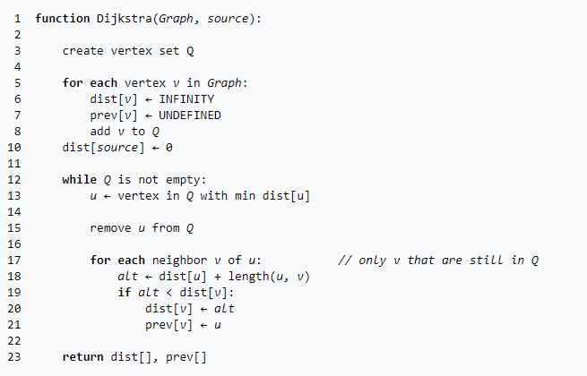
II. Approaches
Pseudocode of Dijkstra’s Algorithm

Slide 11
Experiments and Results
III

Slide 12
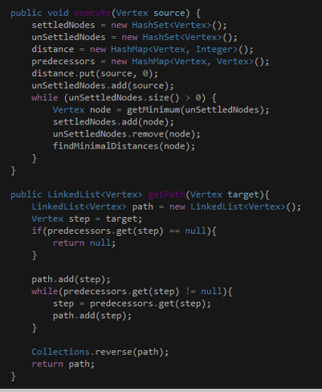
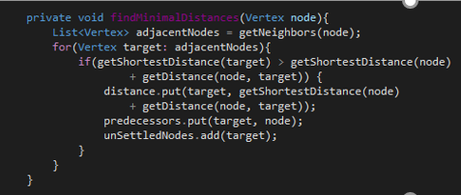
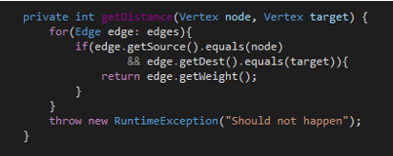
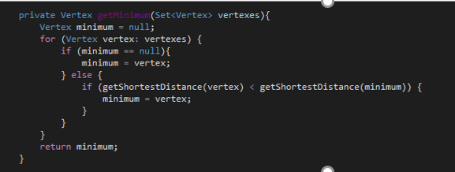
III. Experiments and Results

Slide 13
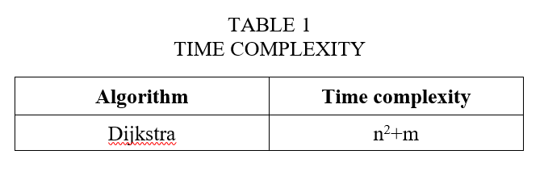
III. Experiments and Results
n represents the total number of vertices
m is the total number of edges.

Slide 14
Conclusion
IV

Slide 15
IV. MARKET
The computed time complexity for each of the Dijkstra’s algorithm show that the algorithm is acceptable in terms of the overall performance in solving the shortest path problem.
Nowadays, there are also many intelligent shortest path algorithms that have been introduced in several past research papers.

Slide 16
THANKS FOR LISTENING

