Slide 1
Dictionary
Created by Hanzala

Slide 2
What it does ?
It is, basically as the name suggests , a simple dictionary.
Like any dictionary, it allows a user to search the meaning of words.
It also has the option to add a word, if it is not present in dictionary.
It also allows user to delete a word if user wants to manually re-add a better meaning of that deleted word.

Slide 3
Project Contents
Main.c file consisting of all code and formatting
File “dictionary.txt” that contains words with their meaning and sentences in a pattern.
Temporary file “replicate.txt” that is used in delete function to copy all words from dictionary.txt file except the word which is to be deleted.

Slide 4
C Concepts Used In This Project
If-else Conditions, Switch Statements.
For loop , while loop , do while loop.
Functions
Function pass by reference using pointers.
Recursions
1D – Array , Strings.
Structures
Dynamic Memory Allocation , calloc.
Filing

Slide 5
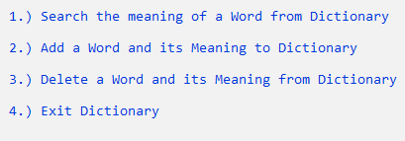
Main Menu Of Project
It contains 4 Options.
Uses Switch Statements to allow user to choose option.

Slide 6
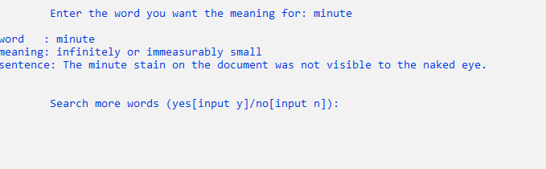
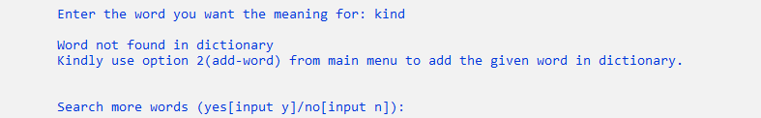
1. Search A Word
User searches a word, if the word exists in filing dictionary.txt , then the program shall display the word with its meaning.
If the word is not present in dictionary, It will ask user to add the word from main menu.

Slide 7
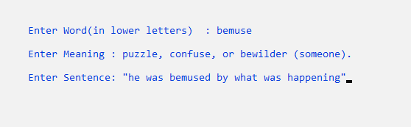
2. Add A Word
Words that are not present in dictionary can be added from here along with their meaning.
Due to append mode used in this option, It adds the word at end of file dictionary.txt.

Slide 8
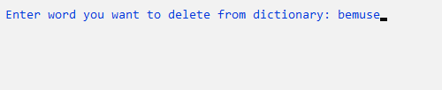
3. Delete Word
User can delete word with its meaning using this option.
With this option , user is able to delete words already stored in file dictionary.txt.

Slide 9

4. Exit Dictionary
This option allows the user to break the while loop present in main menu to break out of this program.
In simple words, it exits the program.

Slide 10
Thanks For Listening

