Slide 1


HIGH CLOUD Airlines
Presented By: Group 6

Slide 2

TEAM
MD HANZALLA ANSARI
PRABHANJAN RAO
SUHAS DATTARAM NAVALU
VIJAY SANJIV GAWAS
KOPPARTHI VARUN KUMAR REDDY

Slide 3

CONTENTS
OBJECTIVE
INTRODUCTION
SCOPE OF THE PROJECT
HOW DATA ANALYSIS IS USED IN THE PROJECT
DATA MODEL CHALLENGES
DASHBOARDS
SQL CODE
RECOMMENDATIONS
CONCLUSION

Slide 4

OBJECTIVE
To gain a comprehensive understanding of High Cloud Airlines operations through data analysis.
This involves: -> Investigating load factors to optimize capacity utilization. -> Identifying top carrier names based on passenger preferences. -> Analysing popular routes to enhance scheduling efficiency. -> Exploring key performance metrics for deeper insights.
Ultimate Goal: To provide actionable recommendations that enhance operational efficiency and drive profitability.

Slide 5

INTRODUCTION
In today’s fast-evolving airline industry, data-driven decision-making is crucial for enhancing efficiency and profitability. This project delves into the operations of High Cloud Airlines, leveraging advanced data analytics to uncover key insights that drive strategic improvements.
Through comprehensive data exploration, modelling, and visualization, we analyse critical metrics such as: ✈ Load Factor Trends – Optimizing seat occupancy for maximum revenue. ✈ Top Carrier Analysis – Understanding passenger preferences. ✈ Popular Flight Routes – Identifying high-demand connections. ✈ Operational Efficiency – Enhancing resource allocation and scheduling.
By extracting actionable insights from extensive datasets, this project aims to streamline operations, boost passenger satisfaction, and drive profitability, ultimately helping High Cloud Airlines maintain its competitive edge in the aviation industry.

Slide 6



SCOPE OF PROJECT
The Project aimed to leverage the power of data analysis and extract valuable insights to optimize high cloud airline operations and performance.
The specific scope of the project focused on analysing key performance indicators (KPIs) to gain deeper understanding of:
Load Factor
Passenger Preferences
Popular Routes
Operational Efficiency

Slide 7
HOW DATA ANALYSIS IS USED IN THE PROJECT?
Data analysis plays a pivotal role in optimizing airline operations, improving passenger experience, and maximizing profitability. By leveraging data-driven insights, High Cloud Airlines can make strategic decisions that enhance efficiency and competitiveness.
🔹 Optimizing Load Factor – Analyzing passenger trends to maximize seat occupancy and revenue. 🔹 Identifying Popular Routes – Understanding demand patterns to optimize flight scheduling. 🔹 Enhancing Passenger Experience – Personalizing services based on customer preferences and feedback. 🔹 Strategic Carrier Partnerships – Collaborating with top carriers to improve connectivity and performance. 🔹 Operational Efficiency – Allocating resources effectively to reduce costs and enhance productivity.
Through data cleaning, modeling, visualization, and dashboarding, this project translates raw data into actionable insights, enabling High Cloud Airlines to stay ahead in a competitive industry.

Slide 8
DATA MODEL CHALLENGES
During our analysis, we faced several challenges that were crucial to address for accurate and reliable insights:
🔹 Data Volume – Efficiently managing and processing large datasets. 🔹 Data Quality – Ensuring accuracy, consistency, and reliability. 🔹 Complex Relationships – Establishing meaningful connections between diverse data points

Slide 9

DASHBOARDS

Slide 10

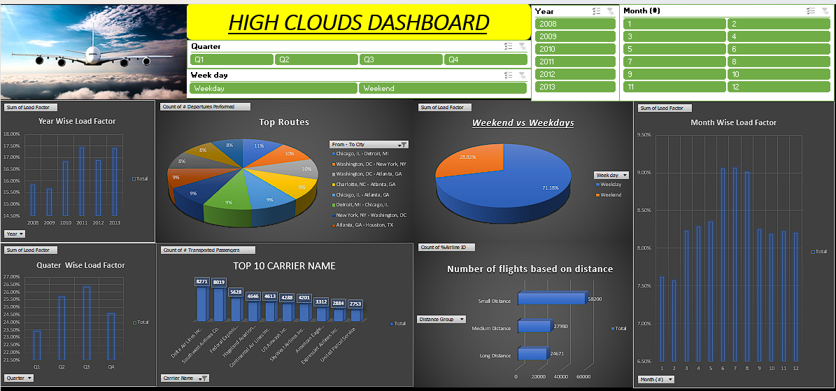
EXCEL DASHBOARD

Slide 11
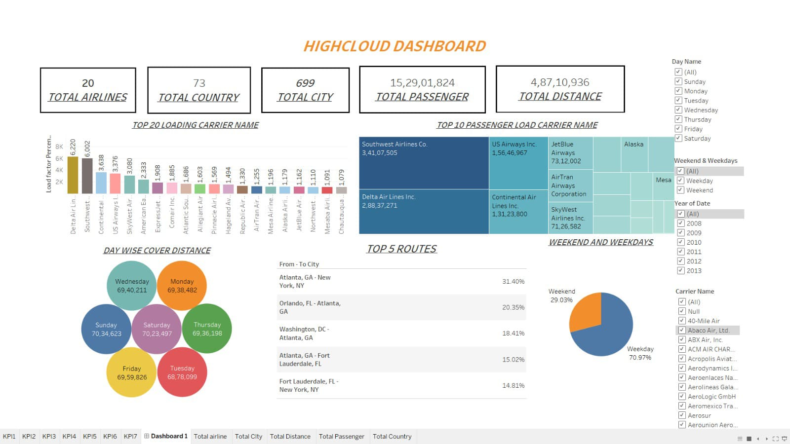
TABLEAU DASHBOARD

Slide 12
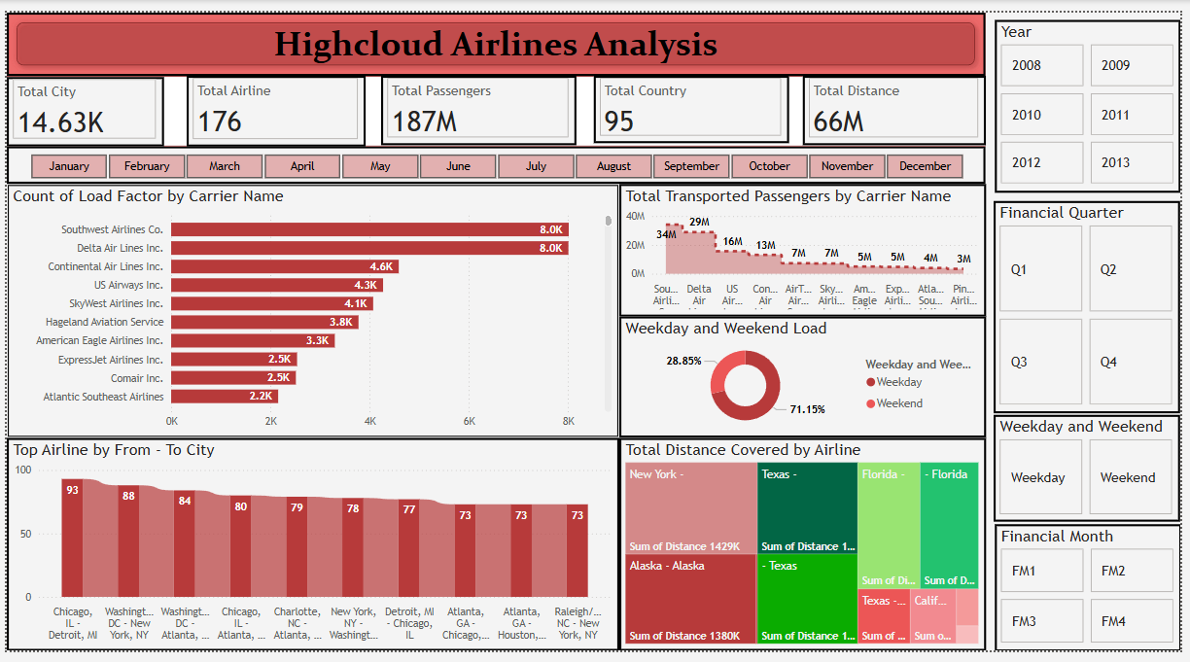
POWER BI DASHBOARD

Slide 13
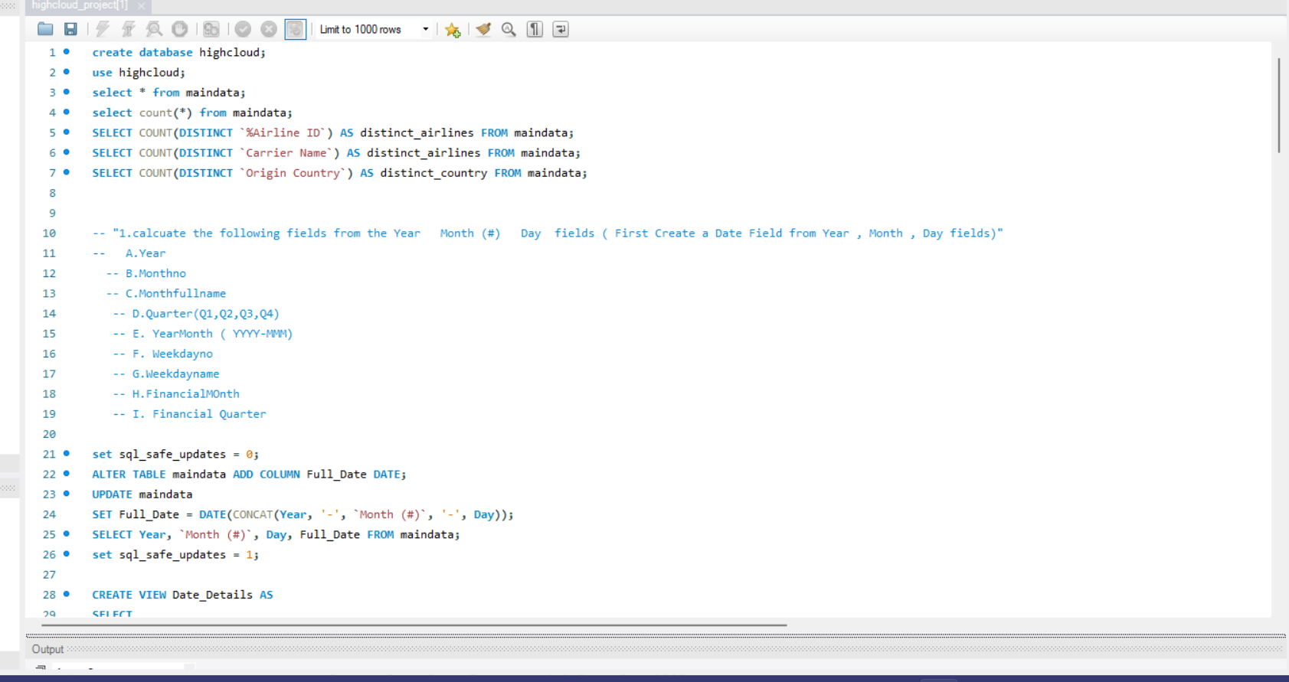
SQL CODE

Slide 14
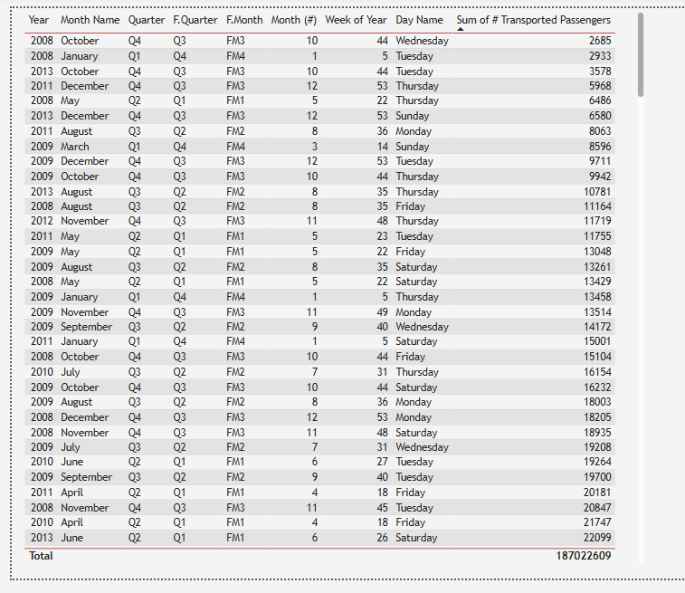
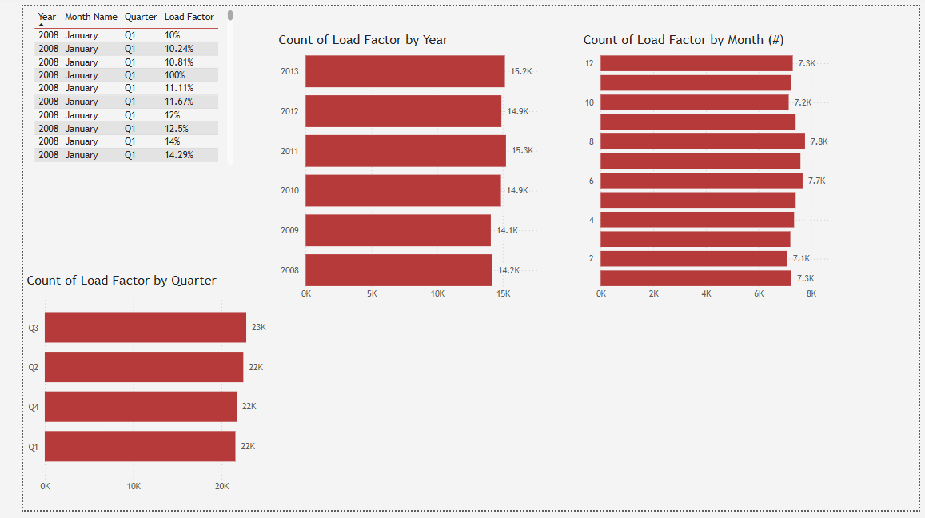
DATE SHEET
LOAD FACTOR ANALYSIS

Slide 15
RECOMMENDATIONS
To enhance operational efficiency and maximize profitability, High Cloud Airlines should focus on the following strategies:
✅ Optimize Flight Routes – Leverage data insights to refine flight schedules and improve resource allocation. ✅ Enhance Load Factor – Analyse trends to implement strategies for better seat utilization and efficiency. ✅ Strategic Carrier Partnerships – Collaborate with leading carriers to boost passenger transportation and network reach. ✅ Smart Resource Allocation – Allocate resources effectively based on flight schedules and passenger volume to minimize wait times and streamline operations.

Slide 16
CONCLUSION
High Cloud Airlines is transforming the aviation industry by leveraging actionable insights to drive efficiency and strategic decision-making.
The presented KPIs highlight key opportunities for growth and optimization, offering a glimpse into the immense potential within the sector.
By harnessing the power of data, we pave the way for smarter operations, enhanced passenger experiences, and sustainable growth.
This data-driven approach ensures a brighter future for High Cloud Airlines and its partners, shaping the next era of aviation excellence.

Slide 17
THANK YOU !

