Slide 1
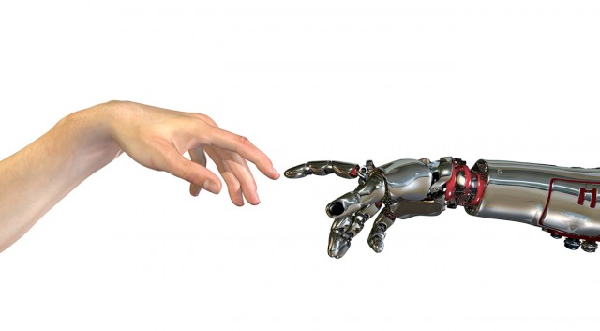
Machine Learning
4. neurale netwerken

Slide 2
ml:neurale netwerken

Slide 3

$$1$$
$$θ_{0}$$
update gewichten
Error
$$x_{1}$$
$$θ_{1}$$
+1
$$h_{θ}(x)$$
$$x_{2}$$
$$θ_{2}$$
$$θ_{n}$$
$$x_{n}$$
https://nl.wikipedia.org/wiki/Perceptron

Slide 4
It is observed that non-linear problems can not be solved using single layer network with conventional type of neuron activation function
http://hsmazumdar.net/single_layer_neural_net.htm

Slide 5
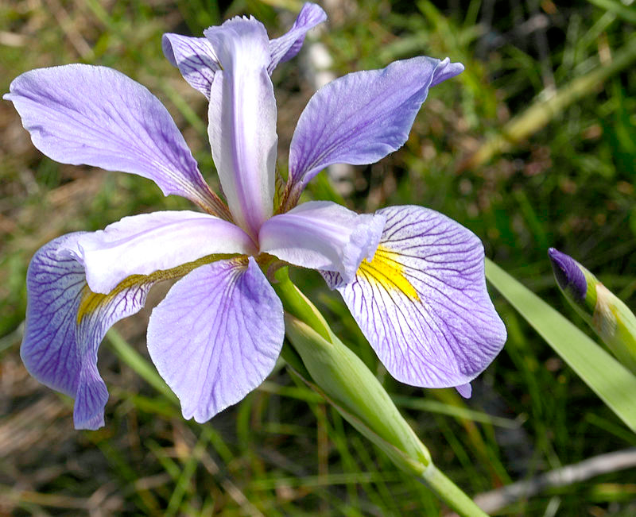
wat wij zien
wat de computer ‘ziet’
[ [ 4.9, 3.0, 1.4],
[ 4.7, 3.2, 1.3],
[ 4.6, 3.1, 1.5],
[ 5.0, 3.6, 1.4],
[ 5.4, 3.9, 1.7],
[ 4.6, 3.4, 1.4],
[ 5.0, 3.4, 1.5],
[ 4.4, 2.9, 1.4],
[ 4.9, 3.1, 1.5],
[ 5.4, 3.7, 1.5],
[ 4.8, 3.4, 1.6],
[ 4.8, 3.0, 1.4],
[ 4.3, 3.0, 1.1],
[ 5.8, 4.0, 1.2],
[ 5.7, 4.4, 1.5],
[ 5.4, 3.9, 1.3],
[ 5.1, 3.5, 1.4],
[ 5.7, 3.8, 1.7],
[ 5.1, 3.8, 1.5],
…
[ 5.4, 3.4, 1.7],
]

Slide 6
+1
+1
$$x^{(i)}$$
$$h_{Θ}(x^{(i)})$$
input layer
hidden layer
output layer

Slide 7
$$a_{x}^{(p)}$$
$$Θ_{yx}^{(p)}$$
$$a_{y}^{(q)}$$
x
y
laag p
laag q

Slide 8
$$a_{x}^{(p)}$$
$$Θ_{yx}^{(p)}$$
$$a_{y}^{(q)}$$
x
y
laag p
laag q
gewicht / belang dat neuron y aan de input van neuron x geeft / hecht.

Slide 9
$$a_{1}^{(2)}=g(Θ_{11}^{(1)}a_{1}^{(1)}+Θ_{12}^{(1)}a_{2}^{(1)}$$
$$a_{1}^{(1)}$$
$$Θ_{11}^{(1)}$$
$$a_{1}^{(2)}$$
A
C
$$Θ_{12}^{(1)}$$
$$Θ_{21}^{(1)}$$
B
D
$$a_{2}^{(1)}$$
$$Θ_{22}^{(1)}$$
$$a_{2}^{(2)}$$
laag 1
laag 2
$$Θ^{(1)}=\left[\begin{matrix}CA & CB \\ DA & DB\end{matrix}\right]$$

Slide 10
nn:forward propagation

Slide 11
+1
+1
+1
$$x^{(i)}$$
$$h_{Θ}(x^{(i)})$$
input layer
hidden layer 1
hidden layer 2
output layer

Slide 12
$$a^{(1)}=\left[\begin{aligned}0.5 \\ 0.7\end{aligned}\right]$$
$$Θ^{(1)}=\left[\begin{matrix}0.3 & 0.4 \\ 0.6 & 0.2\end{matrix}\right]$$
$$a_{1}^{(2)}=g(0.5×0.3+0.7×0.4)$$
A
0.5
0.5×0.3
C
0.5
0.5
0.7×0.4
0.7
0.5×0.6
B
D
0.7
0.7
0.7×0.2
$$a_{2}^{(2)}=g(0.5×0.6+0.7×0.2)$$
laag 1
(= inputlaag)
laag 2

Slide 13
$$a_{1}^{(2)}=g(Θ_{11}^{(1)}a_{1}^{(1)}+Θ_{12}^{(1)}a_{2}^{(1)})$$
$$a_{1}^{(1)}$$
$$Θ_{11}^{(1)}$$
$$a_{1}^{(2)}$$
A
C
$$Θ_{12}^{(1)}$$
$$Θ_{21}^{(1)}$$
B
D
$$a_{2}^{(1)}$$
$$Θ_{22}^{(1)}$$
$$a_{2}^{(2)}$$
laag 1
laag 2
$$Θ^{(1)}=\left[\begin{matrix}CA & CB \\ DA & DB\end{matrix}\right]$$

Slide 14
$$Θ^{(1)}$$
$$Θ^{(2)}$$
$$Θ^{(3)}$$
$$a^{(1)}$$
$$a^{(2)}$$
$$a^{(3)}$$
+1
+1
+1
$$x^{(i)}$$
$$h_{Θ}(x^{(i)})$$
input layer
hidden layer 1
hidden layer 2
output layer
$$\begin{matrix}a^{(1)} & =x \\ a_{0}^{(1)} & =1\end{matrix}$$
$$\begin{matrix}z^{(2)} & =Θ^{(1)}a^{(1)} \\ a^{(2)} & =g(z^{(2)}) \\ a_{0}^{(2)} & =1\end{matrix}$$
$$\begin{matrix}z^{(3)} & =Θ^{(2)}a^{(2)} \\ a^{(3)} & =g(z^{(3)}) \\ a_{0}^{(3)} & =1\end{matrix}$$
$$\begin{matrix}z^{(4)} & =Θ^{(3)}a^{(3)} \\ a^{(4)} & =g(z^{(4)}) \\ & =h_{Θ}(x^{(i)}) \\ & (={\overset{̂}{y}}^{(i)})\end{matrix}$$

Slide 15
$$Θ$$
C
A
D
B
E
$$Θ=\left[\begin{matrix}CA & CB \\ DA & DB \\ EA & EB\end{matrix}\right]$$

Slide 16
nn:cost function

Slide 17
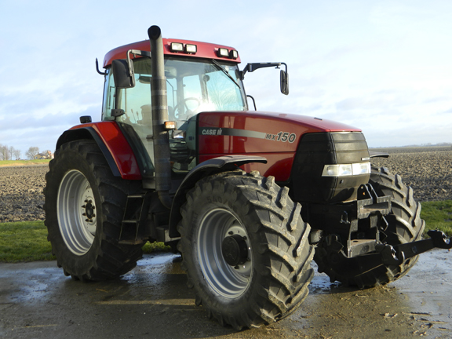
train network for specific goal
$$Σ$$
$$Σ$$
$$Σ$$
$$Σ$$

Slide 18
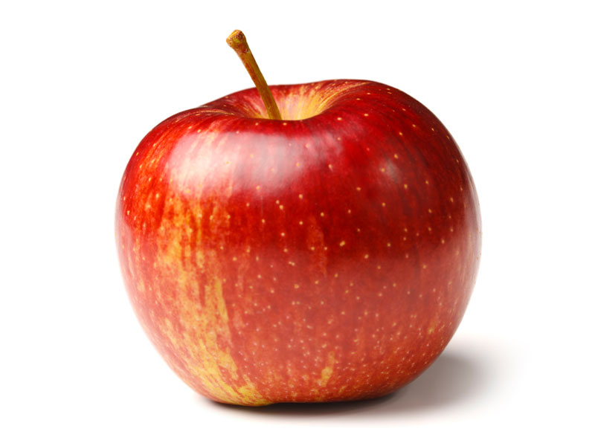
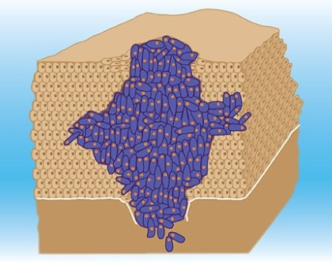


Multi-class classification: one versus all
$$Σ$$
$$Σ$$
$$Σ$$
$$Σ$$

Slide 19
$$Σ$$
$$h_{θ}(x)$$
$$Σ$$
$$h_{θ}(x)$$
$$\left[\begin{aligned}0.213 \\ 0.423 \\ 0.786 \\ 0.143\end{aligned}\right]$$
$$\left[\begin{aligned}0 \\ 0 \\ 1 \\ 0\end{aligned}\right]$$
$$Σ$$
$$h_{θ}(x)$$
$$Σ$$
$$h_{θ}(x)$$

Slide 20
$$h_{Θ}(x^{(i)})$$

Slide 21
$$J(Θ)=\frac{1}{m}\overset{m}{\underset{i=1}{∑}}\overset{K}{\underset{k=1}{∑}}\left[y_{k}^{(i)}log(h_{Θ}(x^{(i)}))_{k}+(1-y_{k}^{(i)})log(1-h_{Θ}(x^{(i)}))_{k}\right]$$

Slide 22
nn:backpropagation

Slide 23
+1
+1
+1

Slide 24
$$Θ$$
C
A
D
B
E
$$Θ=\left[\begin{matrix}CA & CB \\ DA & DB \\ EA & EB\end{matrix}\right]$$

Slide 25
$$δ_{1}^{(q+1)}$$
$$Θ_{11}^{(p)}$$
A
C
$$a_{1}^{(q)}$$
$$δ_{2}^{(q+2)}$$
$$Θ_{12}^{(p)}$$
$$Θ_{21}^{(p)}$$
$$δ_{1}^{(q+1)}$$
B
D
$$a_{2}^{(q)}$$
$$δ_{2}^{(q+1)}$$
$$Θ_{22}^{(p)}$$
layer p
layer q

Slide 26
sigmoïdefunctie
$$g(z)=\frac{1}{1+e^{-z}}$$
$$δ^{(4)}=a_{j}^{(4)}-y_{j}$$
$$δ^{(3)}=(Θ^{(3)})^{T}δ^{(4)}×g^{′}(z^{(3)})$$
$$δ^{(2)}=(Θ^{(2)})^{T}δ^{(3)}×g^{′}(z^{(2)})$$

Slide 27



$$δ^{(2)}=(Θ^{(2)})^{T}δ^{(3)}×g^{′}(z^{(2)})$$
$$δ^{(3)}=(Θ^{(3)})^{T}δ^{(4)}×g^{′}(z^{(3)})$$
$$δ^{(4)}=a_{j}^{(4)}-y_{j}$$
+1
+1
+1
$$Δ^{(2)}$$
$$Δ^{(3)}$$
$$g^{′}(z)=g(z)(1-g(z))$$

Slide 28
backpropagation algorithme
$$\text{Given a trainings set}\{(x^{(1)},y^{(1)}),(x^{(2)},y^{(2)}),…(x^{(m)},y^{(m)})\}$$
$$Δ_{ij}^{(l)}=0\text{for all}i,j,l$$
$$\text{repeat}i=1…m$$
$$\begin{matrix} & \text{set}a^{(1)}=x^{(i)} \\ & \text{calculate}a^{(l)}\text{voor}l=2,3,…,L \\ & \text{calculate}δ^{(L)}=a^{(L)}-y^{(L)}\text{on basis of}y^{(i)} \\ & \text{calculate}δ^{(L-1)},δ^{(L-2)},…,δ^{(2)} \\ & Δ_{ij}^{(l)}:=Δ_{ij}^{(l)}+a_{j}^{(l)}δ_{i}^{(l+1)}\end{matrix}$$
$$Δ_{ij}^{(l)}:=\frac{1}{m}Δ_{ij}^{(l)}$$

Slide 29
nn:implementatiedetails

Slide 30
Initiële waarden van de Theta’s (1/2)
$$a_{1}^{(1)}$$
$$Θ_{11}^{(1)}$$
$$a_{1}^{(2)}$$
A
C
$$Θ_{12}^{(1)}$$
$$Θ_{ij}^{(l)}=0$$
$$Θ_{21}^{(1)}$$
np.zeros((m,n))
B
D
$$a_{2}^{(1)}$$
$$Θ_{22}^{(1)}$$
$$a_{2}^{(2)}$$
laag 1
laag 2

Slide 31
Initiële waarden van de Theta’s (2/2)
symmetry breaking
$$Θ_{ij}^{(l)}=random[-ϵ,ϵ]$$

Slide 32
unrolling parameters
scipy.optimize.minimize()
>>> Theta1.shape
(25, 401)
>>> Theta2.shape
(10, 26)
>>> np.concatenate ( (Theta1.flatten(), Theta2.flatten()) ).shape
(10285,)
>>>

Slide 33
def nnCostFunction(Thetas, X, y):
global input_size, hidden_size, num_labels
size = hidden_size * (1+input_size)
Theta1 = Thetas[:size].reshape(hidden_size, input_size+1)
Theta2 = Thetas[size:].reshape(num_labels, hidden_layer_size+1)
J = computeCost(Theta1, Theta2, X, y)
grad1, grad2 = nnCheckGradients(Theta1, Theta2, X, y)
return J, np.concatenate( (grad1.flatten(), grad2.flatten()) )
res = minimize(nnCostFunction, init_params, args=args,
method='CG', callback=callbackF,
options={'maxiter':30,'disp':True})

Slide 34
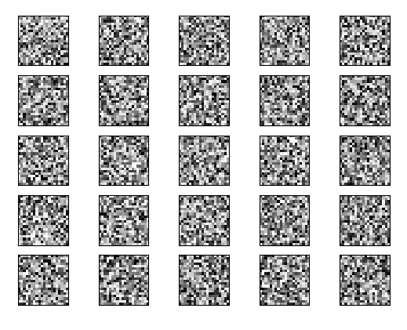

Slide 35
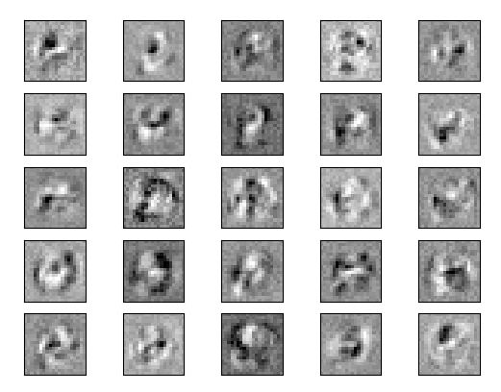

Slide 36


