Slide 1

Machine Learning
Drs. Bart Barnard, Fenna Feenstra Msc
Hanze University of Applied Sciences
Support Vector Machines

Slide 2
Support vector machines
Classifier that deals with outliers
Notes:
A suport vector machine is a versatile machine learning model capable of performing linear and non linear classification. It can deal with outliers, and therefor it is suitable for complex but small or medium size datasets.

Slide 3
Maximum Margin Classifier
Notes:
The fundament of the support vector machine is the maximum margin principle which is explained in the following minutes.

Slide 4
Observations class A
Observations class B
$$x_{i}→$$
Notes:
There are two classes class A and B and they look like they can easily be distinguished. The classification is done based on feature x

Slide 5
threshold
$$x_{i}→$$
Notes:
Lets make a treshold at value x where the blue dots stop. Consider new data points (yellow dots). These two are obviously class A and B

Slide 6
threshold
$$x_{i}→$$
Notes:
But consider this point, whit the green treshold it will be classified as B but it looks like it belongs to A

Slide 7
threshold
Max Margin Classifier
margin
Notes:
If we take the maximal distance (margin) between the two classes and we put our threshold here it might perform better. This is called max margin classifier.

Slide 8
threshold
Notes:
Now it will be correctly classified

Slide 9
threshold
Notes:
The distance to A is smaller then the distance to class B, So this is accurate.

Slide 10
Soft Margin Classifier

Slide 11
threshold
Outlier
margin
Notes:
But what if we have an outlier and we use the same principle to set the treshold. Then our threshold we be put close to B

Slide 12
threshold
Notes:
And then again the datapoint can be again wrongly classified.

Slide 13
threshold
Misclassification
soft margin
Notes:
If we ignore the outlier, and accept that this is a misclassification the principle of margins does work.

Slide 14
Soft Margin Classifier = Support Vector Classifier (SVC)
threshold
Misclassification
soft margin
Notes:
In the case that we ignore the misclassifications (the outliers) we use soft margins instead of hard margins. We search for the maximum cohesion of observations to determine the outliers and thence the soft margins.

Slide 15
Soft Margin Classifier = Support Vector Classifier (SVC)
threshold
Misclassification
support vectors
soft margin
Notes:
We need outliers as well as the soft margins to determine the thresholds. These we call support vectors.

Slide 16
threshold
Misclassification
Notes:
Now we see that with this soft margin principle the datapoint is correctly classified

Slide 17
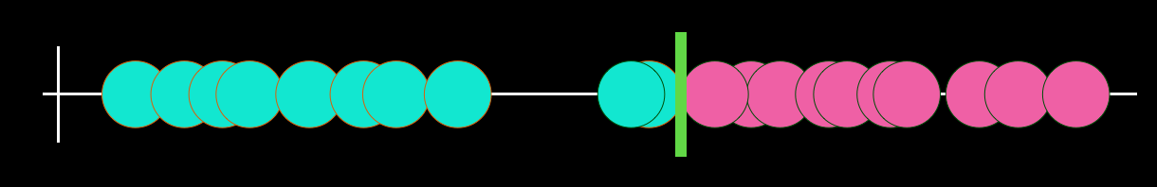
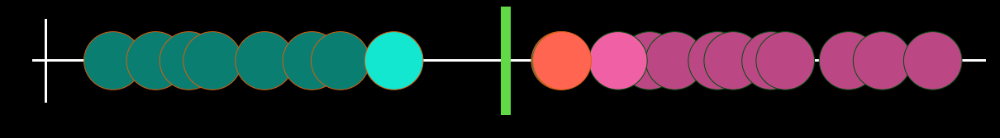
Variance
Bias
Notes:
The higher the variance the more prone to overfitting. The higher the bias more prone to underfitting. Remember there is a balance between those.

Slide 18
Kernels

Slide 19
$$x_{i}→$$
Notes:
Sometimes you cannot use linear distance (one line) to determine the margins and thresholds, since the magenta points are left and right from the cyan points.

Slide 20
$$x_{i}^{2}→$$
threshold
$$x_{i}→$$
Notes:
You should use a trick like adding an order in the equation to distinguish the two classes

Slide 21
Plan
1. Start with low dimensionality
2. Introduce higher dimensionality for same data
3. Train SVC to differentiate
$$x_{2}=x_{1}^{2}$$
$$x_{2}=logx_{1}$$
$$x_{2}=x_{1}^{3}$$
How do we know to introduce higher dimensionality?
$$x_{2}=\frac{x^{5}}{2x_{1}+4}$$
$$x_{2}=\sqrt{1+x_{1}}$$
Notes:
The question however is, what equation to use? We call such a equation a kernel

Slide 22
sklearn.svm.SVC()
kernel: string, optional (default=’rbf’)
Specifies the kernel type to be used in the algorithm. It must be one of ‘linear’, ‘poly’, ‘rbf’, ‘sigmoid’, ‘precomputed’ or a callable. If none is given, ‘rbf’ will be used. If a callable is given it is used to pre-compute the kernel matrix from data matrices; that matrix should be an array of shape (n_samples, n_samples).
degree: int, optional (default=3)
Degree of the polynomial kernel function (‘poly’). Ignored by all other kernels.
https://scikit-learn.org/stable/modules/generated/sklearn.svm.SVC.html
Notes:
So using the svm algorithm we need to specify the kernel. You can also implement your own kernel.

Slide 23
sklearn.svm.SVC()
C: float, optional (default=1.0)
Regularization parameter. The strength of the regularization is inversely proportional to C. Must be strictly positive. The penalty is a squared l2 penalty.
https://scikit-learn.org/stable/modules/generated/sklearn.svm.SVC.html
Notes:
C is the regularisation parameter.

Slide 24
Examples

Slide 25
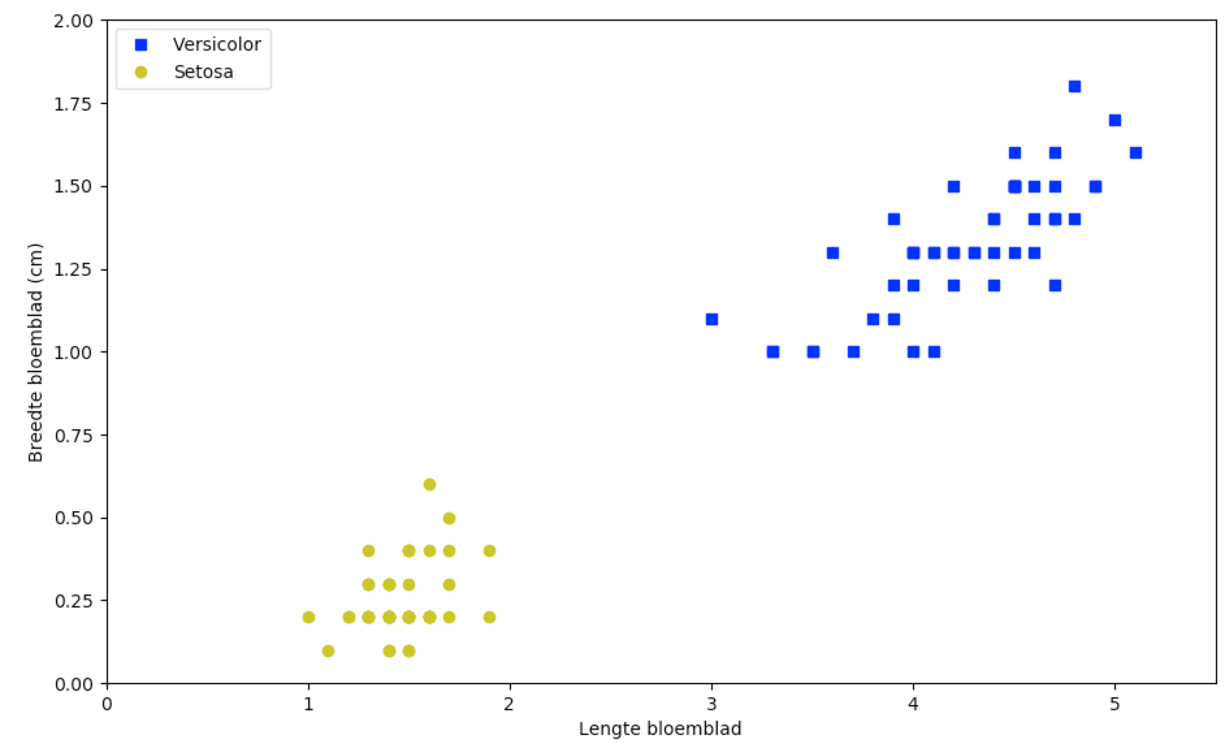
Notes:
Suppose we have two classes of the iris flower, versicolor and setosa. We can determine on the features petal length and petal width the decision boundery

Slide 26
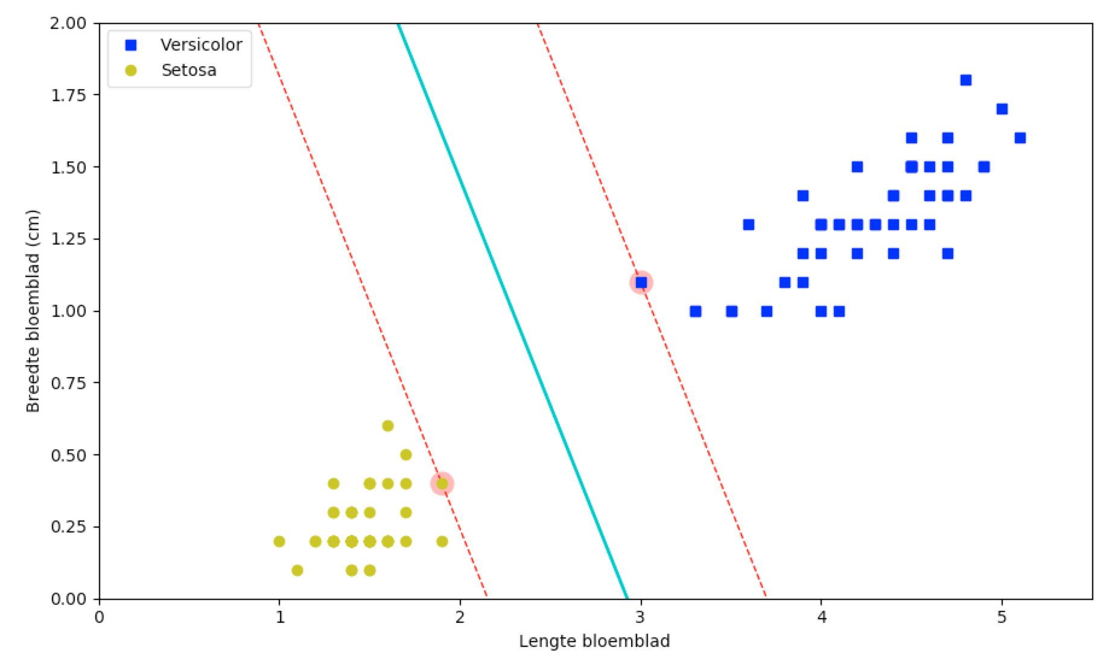
svm_clf = SVC(kernel="linear", C=float("inf"))
svm_clf.fit(X, y)
Notes:
As you can see, there is a reasonable distance between the *boundary* and the two support vectors (the ones with the glow). Also note that adding more examples on either side of the boundary does not make the classification better or more accurate: the lines in the figure above are completely determined by the boundary cases on either side of the “street”, the support vectors.

Slide 27
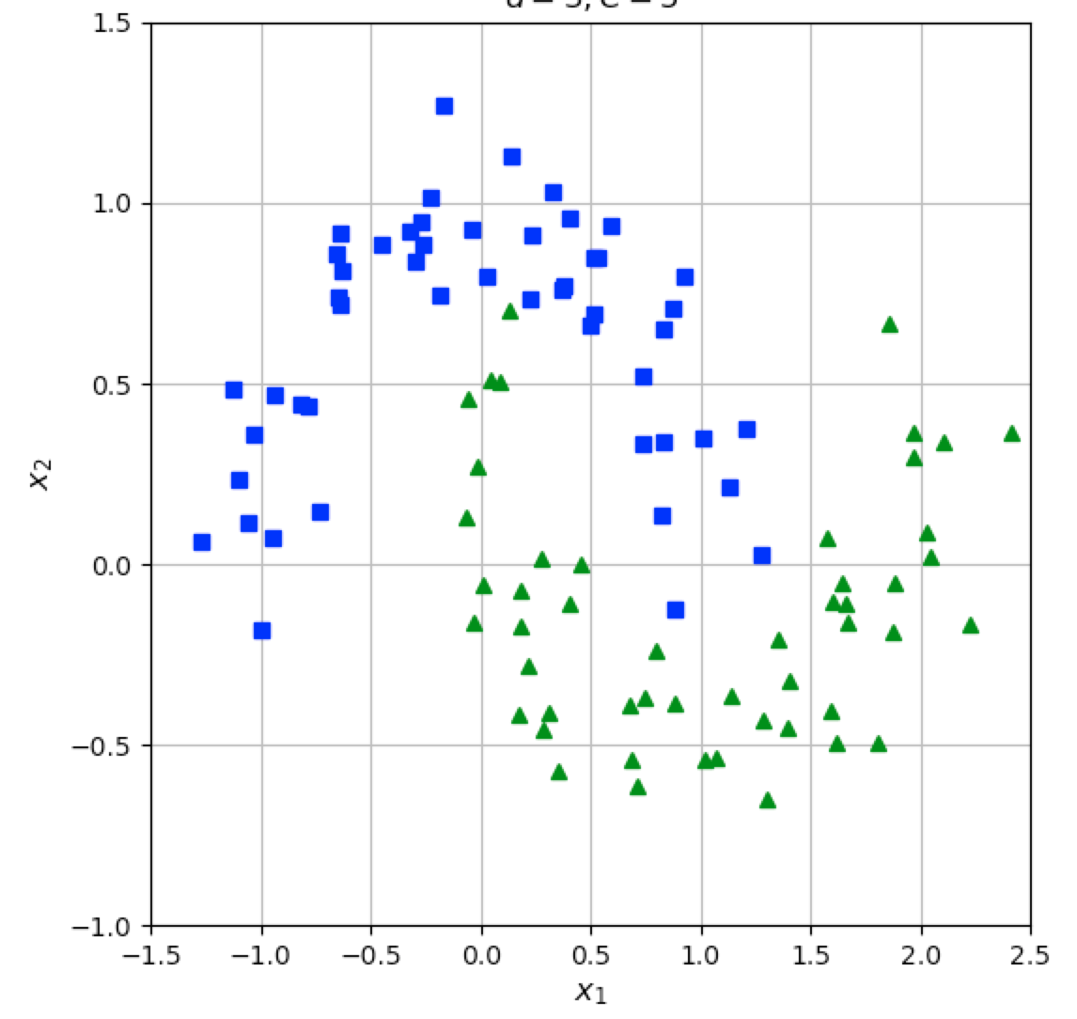
Notes:
These two classes clearly need some kind of polynomial kernel to separate the two classes. A straight line won’t fit.

Slide 28
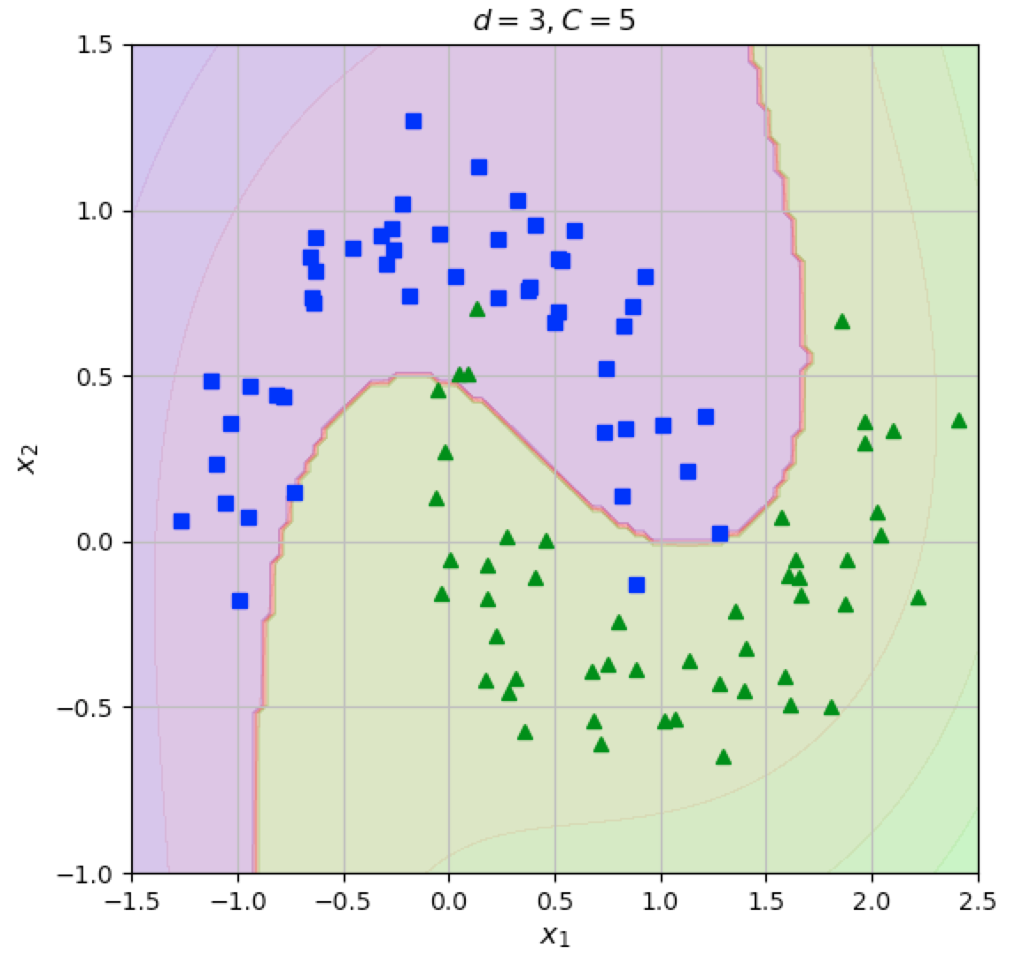
Notes:
We could use a third degree polynomial with a regularisation factor of 5

Slide 29
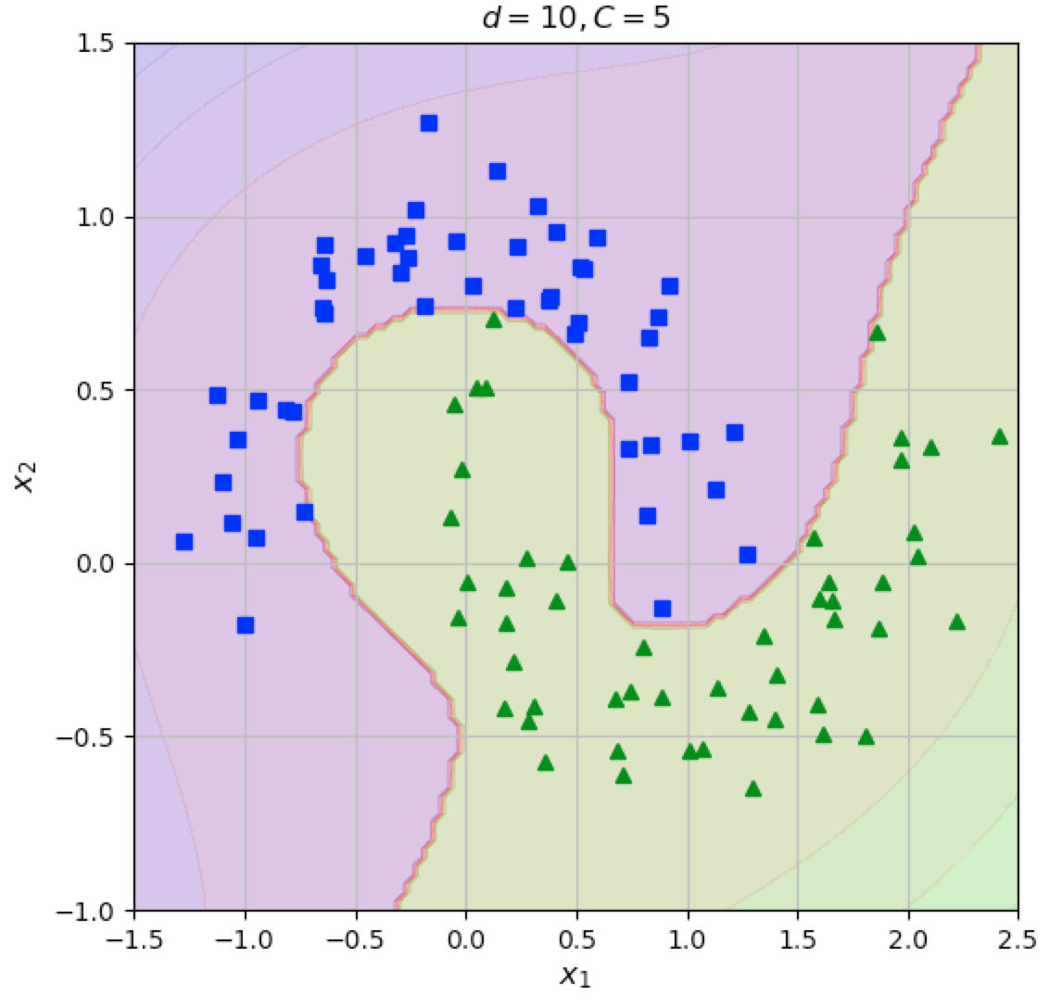
Notes:
Or a tenth degree polynomial with a regularisation factor of 5

Slide 30
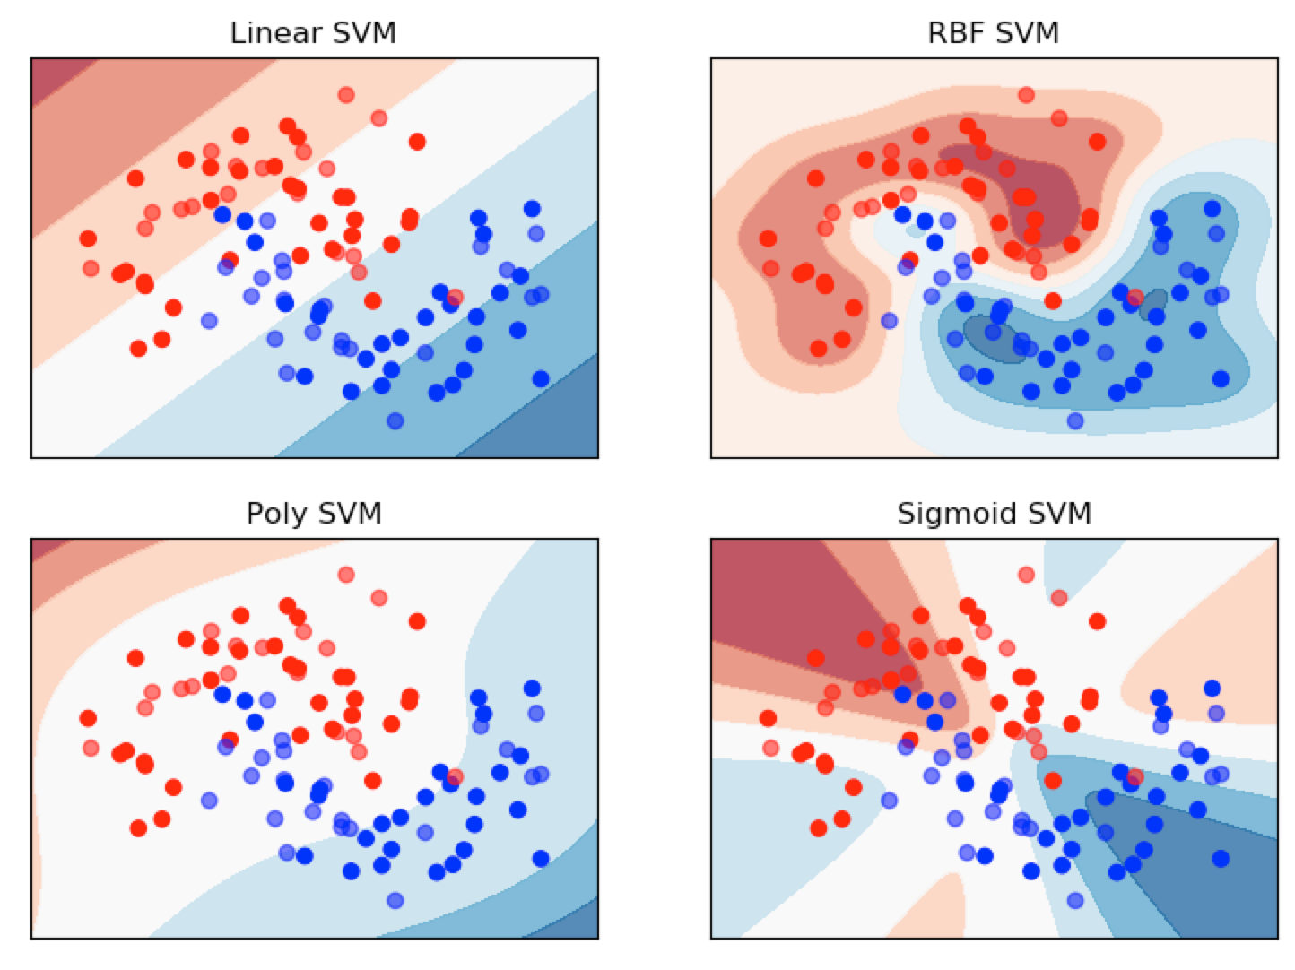
Notes:
Or maybe a totally different kernel.

Slide 31
Plan
1. Start with low dimensionality
2. Introduce higher dimensionality for same data
3. Train SVC to differentiate
$$x_{2}=x_{1}^{2}$$
$$x_{2}=logx_{1}$$
$$x_{2}=x_{1}^{3}$$
How do we know to introduce higher dimensionality?
$$x_{2}=\frac{x^{5}}{2x_{1}+4}$$
$$x_{2}=\sqrt{1+x_{1}}$$
Notes:
Best practice is always to use a baseline first. Then introduce some dimension and tweak things with the parameter settings. This might take however much computing time especially with large datasets to evaluate all these algorithm and their settings. A common used kernel is the gaussian kernel. It solves most of the classifier problems accurately

Slide 32
Assignment
Find out how the Gaussian kernel works and why it is commonly used

