Slide 1

Data Mining -
Information entropy
Fenna Feenstra Msc
Drs Bart Barnard
Hanze University of Applied Sciences

Slide 2
Entropy
Entropy is a scientific concept, as well as a measurable physical property, that is most commonly associated with a state of disorder, randomness, or uncertainty.

Slide 3

Entropy
The amount of surprise of an event:
P(G): probability that coin lands face up
H(G): the information gained by witnessing a face up coin
$$P(G)=1→H(G)=0$$
$$P(G)=0→H(G)=0$$

Slide 4
It is possible to add two entropies of two unrelated events
$$H(G_{1},G_{2})=H(G_{1})+H(G_{2})$$
The change of two unrelated events occurring together is given by
$$P(G_{1},G_{2})=P(G_{1})⋅P(G_{2})$$
To go from multiplication to addition, we use a logarithm, since
$$\log_{a}(xy)=\log_{a}(x)+\log_{a}(y)$$

Slide 5
$$P(G)≤1→H(G)≤0$$
$$H(G)≥1$$
But we want
, therefore
$$H(G)=-lg(P(G))$$
We use 2 as the base for our logarithm, hence lg

Slide 6
A = coin lands on heads
B = coin lands on tails
$$P(A)=p$$
$$P(B)=1-p$$
$$H=-plg(p)-(1-p)lg(1-p)$$
in general:
$$H=-\overset{k}{\underset{i=1}{∑}}p_{i}⋅lg(p_{i})$$

Slide 7
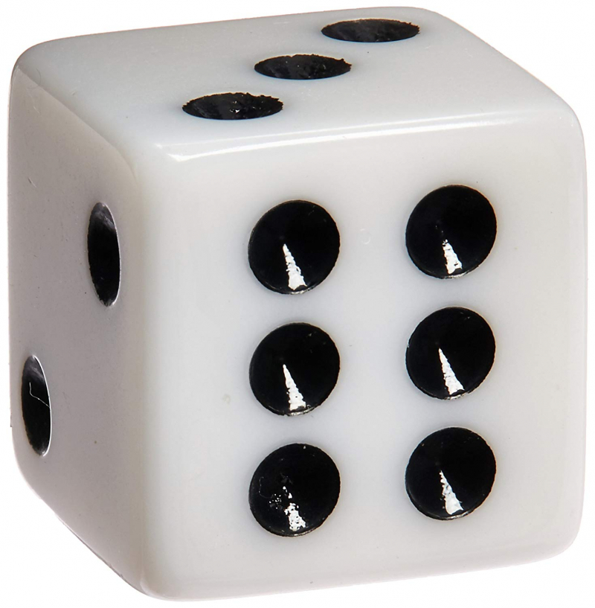
$$H=-\overset{k}{\underset{i=1}{∑}}p_{i}⋅lg(p_{i})$$
$$=-\overset{6}{\underset{i=1}{∑}}\frac{1}{6}⋅lg(\frac{1}{6})$$
$$=-6⋅(\frac{1}{6}lg(\frac{1}{6}))$$
$$=-1⋅lg(\frac{1}{6})=lg(6)≈2,585$$
(In between
$$2^{2}=4$$
and
)
$$2^{3}=8$$

