Slide 1

Machine Learning
Fenna Feenstra Msc
Hanze University of Applied Sciences
Optimising

Slide 2
Evaluation strategy
Fit a model(s) on the training set
Use evaluation metrics to evaluate the algorithm
TP/FP/FN/TN
Precision Recall
F-measure
Accuracy
When poor performance (poor metrics and/or calculation time): (options and in random order)
Choose other features (attributes)
Other preprocessing (normalize, other NaN strategy)
Adjust configuration (pruning, filters etc)
Select more data, resample data
Use Voting
Use Random Forest
Use bagging, boosting, stacking, smote
Notes:
In machine learning the generated model can be regarded as an expert. The expertise is of course based on the amount of training data and the quality of the training data. Wise people make critical decisions but they usually take into account the opinion of several experts rather then rely on their own judgement. The wisdom of the crowd is bigger then the wisdom of a single person it is just a law of large numbers. That is a strategy we can choose for our model selection as well. We can compare different models and come to a final decision what algorithm to choose. A strategy might be to train one classifier and adjust that one in the configuration. Or train many different classifiers and compare them. Or combine classifiers or vote based on either the accuracy or the probability. In this video I will explain a view of these strategies.

Slide 3
Sampling
Choosing a larger training set is likely to help when
There are many features (attributes)
Despite your training set had a high performance the test set had a poor performance
Choosing a large training set is unlikely to help when
The features (attributes) do not contain enough info to predict the class Y accurately
A too simple algorithm is used
Notes:
But first always evaluate the quality of the data. Garbage in is garbage out. Just adding more data will not help if your algorithm, is not suitable or if you choose the wrong features.

Slide 4
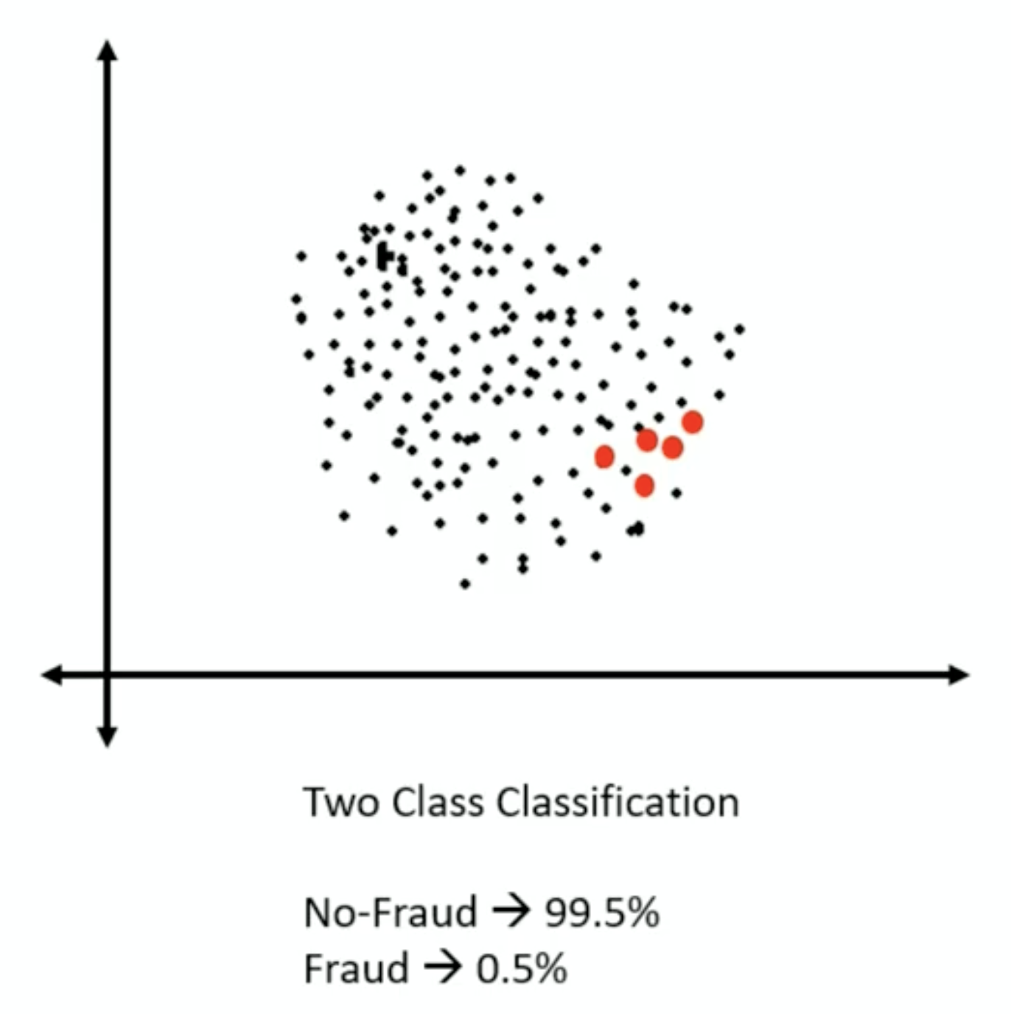
SMOTE : Synthetic Minority Oversampling Technique
Imbalanced dataset:
Manufacturing defects
Occurrence of fraud
Rare diseases
Challenge
Biased prediction
Misleading accuracy
Notes:
Data should of course be ballanced. But that is not always the case. A technique one can apply to rebalance the data is smote.

Slide 5
Strategies:
Increase minority class
Decrease majority class
Random undersampling majority
We might loss information or get biased information
Random oversampling minority
No information lost
Might be costly
-> synthetic minority oversampling technique
Notes:
By smart sampling we can rebalance our data. But that might lead to information loss. We also can generate artificially more data.

Slide 6
Create new `synthetic` observations
SMOTE process:
Identify the feature vector and its nearest neighbor
Take the difference between the two
Multiple the difference with a random number between 0 and 1
Identify a new point on the line segment by adding the random number to the feature vector
Repeat the process for identified featured vectors
Notes:
We can for instance take the same approach as the missing data approach and create samples ‘in between’

Slide 7
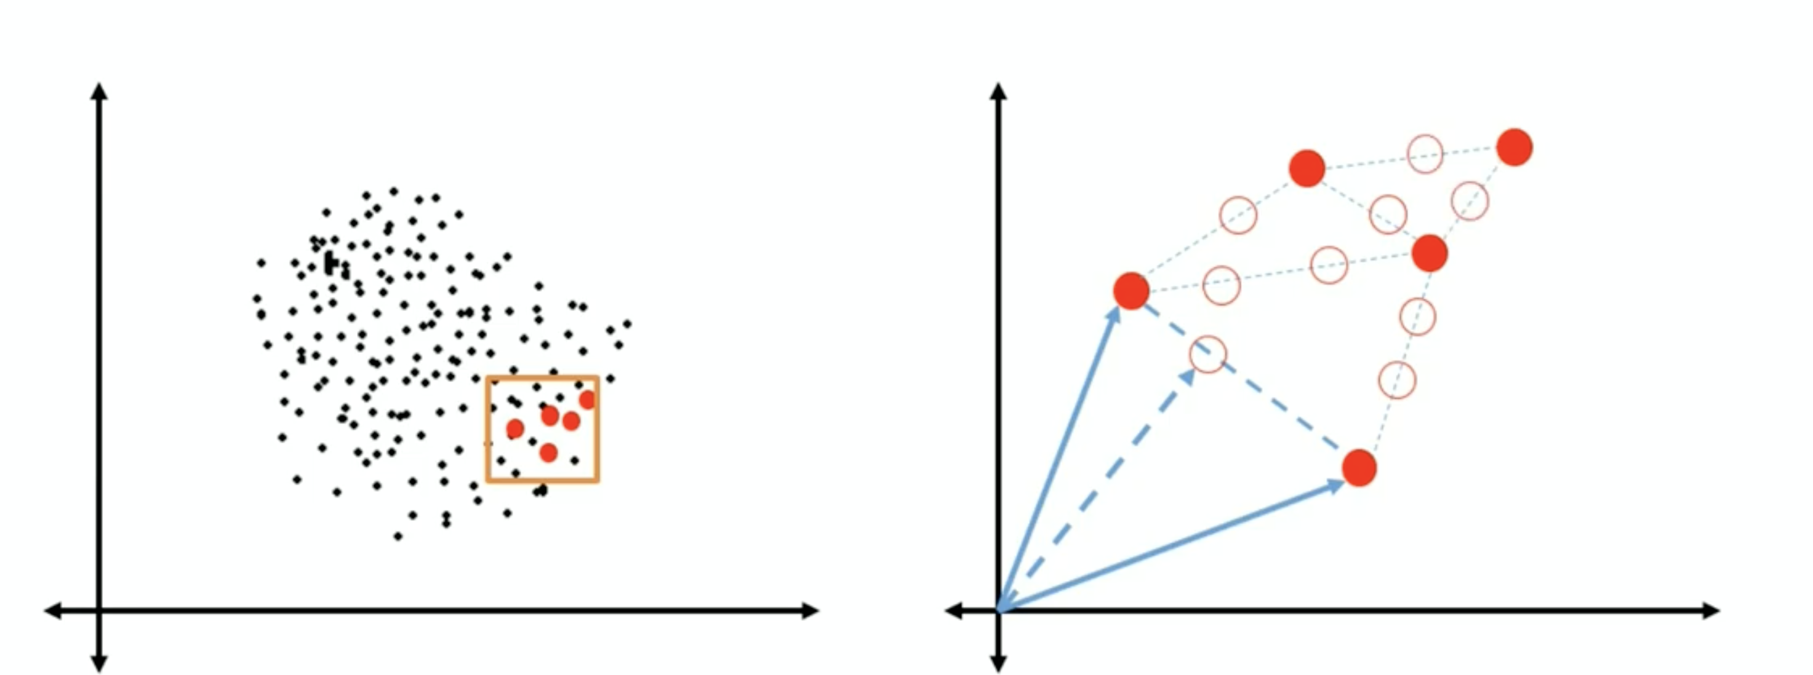
Notes:
In this picture the red dots are the actual data and the white dots are artificial generated data.

Slide 8
The best algorithm
Notes:
Assuming our data is of good quality. What is the best algorithm

Slide 9
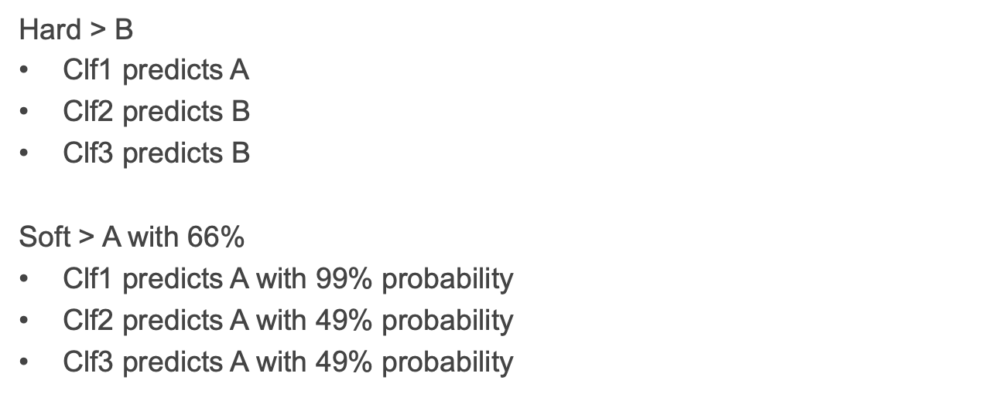
Voting
Notes:
So one strategy can be to use a voting classifier. The classifier takes a view algorithms (classifiers) and compares the outcome. This can be based on hard outcomes or the highest probability

Slide 10
Bagging
Bagging is mostly used to reduce the variance in a model. A simple example of bagging is the Random Forest algorithm.
Variance tells us how sensitive a model is to small changes in the training data. That is by how much the model changes. High variance in a model will make it prone to random noise present in the dataset thereby over-fitting the model.
https://medium.com/@saugata.paul1010/ensemble-learning-bagging-boosting-stacking-and-cascading-classifiers-in-machine-learning-9c66cb271674
Notes:
When you take several subsets of your training data and you train them on the same classifier type this is called bagging. Actually when sampling is performed with replacement it is called bagging and without replacement is called pasting, which is basically splitting up your data in several subsets. This bagging proces can be used to find the best classifier of a certain type, for instance the best model with a decision tree as a basis.

Slide 11
Boosting
Boosting is mostly used to reduce the bias in a model. Examples of boosting algorithms are Ada-Boost, XGBoost, Gradient Boosted Decision Trees.
Bias is an error which arises due to false assumptions made in the learning phase of a model. A high bias can cause an algorithm to skip important information and correlations between the independent variables and the class labels, thereby under-fitting the model.
Boosting involves training the weak learners iteratively, each trying to correct the error made by the previous model
https://medium.com/@saugata.paul1010/ensemble-learning-bagging-boosting-stacking-and-cascading-classifiers-in-machine-learning-9c66cb271674
Notes:
The general idea of a boosting principle is that it trains models sequentially each one trying to corrects its predecessor. There are many methods available the most popular one is the ada boost and gradient boost. Ada boost tweak the instance weights and gradient boost is based on fitting the residual errors.

Slide 12
Stacking
Stacking is mostly used to increase the prediction accuracy of a model
Stacking is an ensemble learning technique which is used to combine the predictions of diverse classification models into one single model also known as the meta-classifier.
https://medium.com/@saugata.paul1010/ensemble-learning-bagging-boosting-stacking-and-cascading-classifiers-in-machine-learning-9c66cb271674
Notes:
Stacking is an ensemble learning algorithm that does not simply aggregate by voting for the best classifier but it trains a model, a meta classifier to perform the aggregation. The meta classifier uses the outcome of the earlier trained model as input to make the final predictor.

