Slide 1
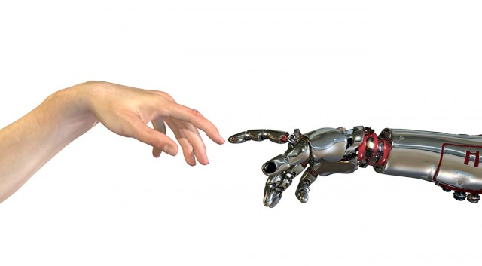
Machine Learning
6. andere (classificatie)modellen

Slide 2
Classificatie van classificatie-algoritmen
Linear classifiers
Fisher's linear discriminant
Logistic regression
Naive Bayes classifier
Perceptron
Support vector machines
Least squares support vector machines
Quadratic classifiers
Kernel estimation
k-nearest neighbor
Boosting (meta-algorithm)
Decision trees
Random forests
Neural networks
Learning vector quantization
Unsupervised clustering
k-means
DBSCAN

Slide 3
Onderwerp: andere (classificatie)modellen
Naive Bayes
Support Vector Classifiers/Machines
Clustering
k-means
DBSCAN
Decision trees

Slide 4
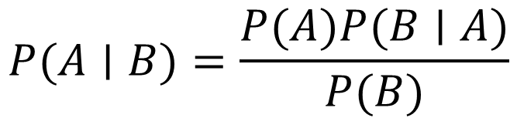
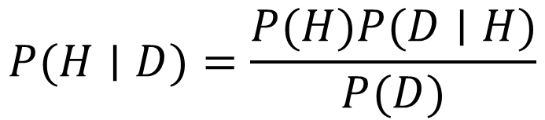
Bayes
$$P(A∣B)=\frac{P(A)P(B∣A)}{P(B)}$$
Prior
(Estimation)
Posterior
(P to compute)
Likelihood
(counted)
$$P(H∣D)=\frac{P(H)P(D∣H)}{P(D)}$$
Normalising constant
Notes:
The Bayes theorem calculates the conditional probability of A given B. We can use this simple theorem to calculate the probability of a hypothesis given some data (1) . This is called diachronic interpretation. For instance calculate the probability of a person getting Corona given the characteristics of a person (2). For this calculation we need the likelihood of the data based on prior knowledge(3). Likelihood we can count. For example the likelihood that a YOUNG person gets Corona. It is the probability of the data under the hypothesis which is the probability of D given H. p(H) (4) is the probability of the hypothesis before we see the data, called the prior. The prior sometimes can be calculated based on historical data, but sometimes is based on subjective estimation. The normalising constant is (5) the probability of seeing the data, it is a bit abstract concept, but with an example it will become more clear.
We can use this principle to calculate any class instance given the values of the features of that instance. It has a naive assumption that the features are independent from each other.

Slide 5
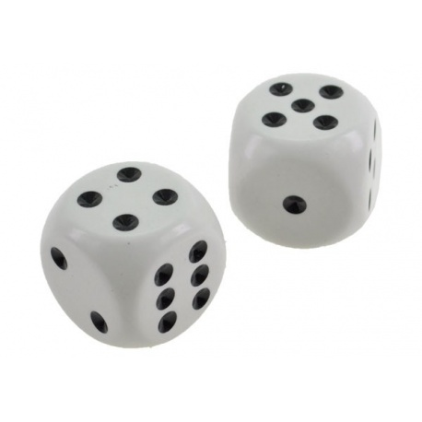
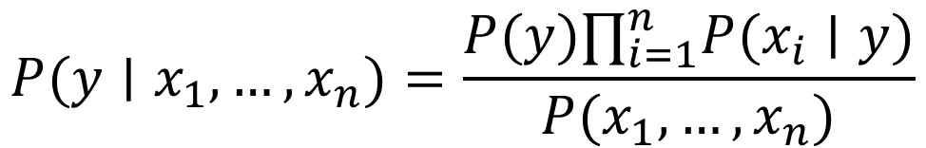
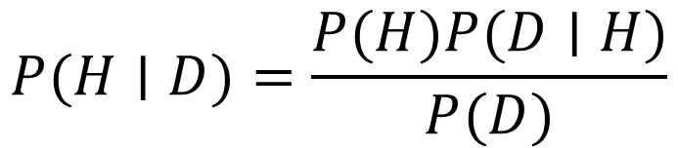
Naive Bayes
Aanname: alle features zijn even belangrijk en zijn onafhankelijk van elkaar
$$P(H∣D)=\frac{P(H)P(D∣H)}{P(D)}$$
$$P(y∣x_{1},…,x_{n})=\frac{P(y)∏_{i=1}^{n}P(x_{i}∣y)}{P(x_{1},…,x_{n})}$$
Notes:
Naive Bayes is an algorithm that is based on the bayes Theorem and popular in machine learning. Naive Bayes calculates the conditional probability of a class instance given the values of the features of that instance. It has a naive assumption that the features are independent from each other. Hence the name Naive Bayes. An example could be that in the example if we would like to compute the probability of a person having Corona based on age categorie and weight categorie then y = Corona Yes class, x1 is age category and x2 is weight category. The probability of a young light weighted person having corona is the product of the probality of corona times the probability of a young person having corona times the probability of a lightweighted person having corona divided by the probability of a ligthweighed person under the hypothesis. Let us work out the example with some numbers

Slide 6

Voorbeeld: kans dat iemand lenzen nodig heeft (y) gegeven een aantal eigenschappen (x1 t/m x4)
AGE |  |  | SPECTACLE PRESCRIPTION |  |  | ASTIGMATISM |  |  | TEAR PROD RATE |  |  | LENSES RECOMMENDED
 | YES | NO |  | YES | NO |  | YES | NO |  | YES | NO | YES | NO
YOUNG | 2 | 3 | MYOPE | 2 | 2 | WAAR | 3 | 4 | REDUCED | 6 | 2 | 9 | 5
PREPRESBYOPIC | 4 | 0 | HYPERMETROPE | 4 | 2 | ONWAAR | 6 | 1 | NORMAL | 3 | 3
PRESBYOPIC | 3 | 2 | NORMAL | 3 | 1
YOUNG | 2/9 | 3/5 | MYOPE | 2/9 | 2/5 | WAAR | 3/9 | 4/5 | REDUCED | 6/9 | 2/5
PREPRESBYOPIC | 4/9 | 0/5 | HYPERMETROPE | 4/9 | 2/5 | ONWAAR | 0/9 | 1/5 | NORMAL | 3/9 | 3/5
PRESBYOPIC | 3/9 | 2/5 | NORMAL | 3/9 | 1/5
AGE | SPECTACLE PRESCRIPTION | ASTIGMATISM | TEAR PROD RATE
YOUNG | NORMAL | WAAR | NORMAL
2/9 | 3/9 | 3/9 | 3/9
$$p\left(Yes\right)=9/14×2/9×3/9×3/9×3/9=0,0053$$
$$P(y∣x_{1},…,x_{n})=\frac{P(y)∏_{i=1}^{n}P(x_{i}∣y)}{P(x_{1},…,x_{n})}$$
$$p\left(No\right)=5/14×3/5×1/5×4/5×3/5=0,0206$$
$$p(Yes)=0.0053/(0.0053+0.0206)=0.205$$
$$p(No)=0.0206/(0.0053+0.0206)=0.759$$
Notes:
Here is an example of the principle. This is an overview of the lens database. We want to predict whether a client needs lenses. The first three rows of the table display the data, the final three rows of the table display the relative numbers. Out of 9 Yes, they needed lenses, there were 2 YOUNG persons. Out of the 9 persons that needed a lens, there were 3 persons with a normal tear production rate. You clearly can see from the table that the features are independent from each other. They relation is only to the class (need lenses yes or no). So what if we have a new patient (1) of young age, normal spectacle prescription, with astigmatism and normal prediction rate. What is the probability that this person needs lenses? We can do the math based on the equation and then we find that for the probability that this person needs lenses it is the product of the independent feature probability under the hypothesis of yes (2) . We also need to calculate the probability of the No (3) chance since we need this for the normalisation factor of the probability of the data. So finally (4) we find that the probability of the new client needs lenses is 20 percent based on the value of the features age, spectacle prescription, astigmatism and tear production rate.

Slide 7
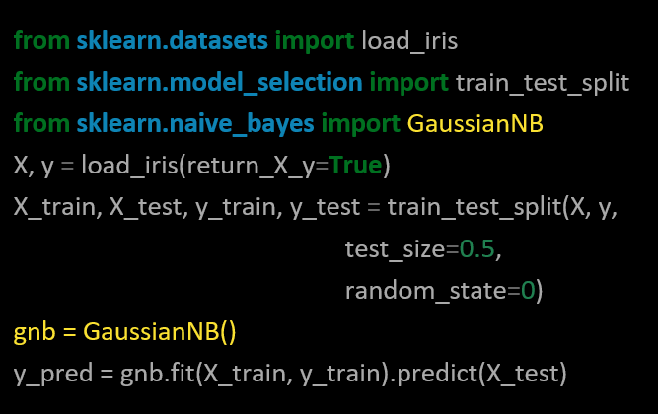
Naive Bayes in Code
https://scikit-learn.org/stable/modules/naive_bayes.html
NB: Gaussian wordt gebruikt als de features (ongeveer) normaal verdeeld zijn
Notes:
Skikit has a library for Naive Bayes. GaussianNB. Skitkit has a number of Naive Bayes libraries. CategoricalNB implements the categorical naive Bayes algorithm for categorically distributed data. MultinomialNB implements the naive Bayes algorithm for multi-nomially distributed data and ComplementNB implements the complement naive Bayes (CNB) algorithm. Naive Bayes is suitable for multi class problems as well. It can distinguish
Between more than two classes. It can handle multiple classes directly where linear classifiers or support vector machine are strictly binary and need another strategy to handle the multiple class problem.
So far we looked at supervised learning strategies for regression and classification. We looked at the logistic regression, support vector machines, decision trees and naive bayes. It is now time to compare the models and optimise our models. Next lecture we will discuss optimisation techniques like bagging, boosting and ensemble learning.

Slide 8
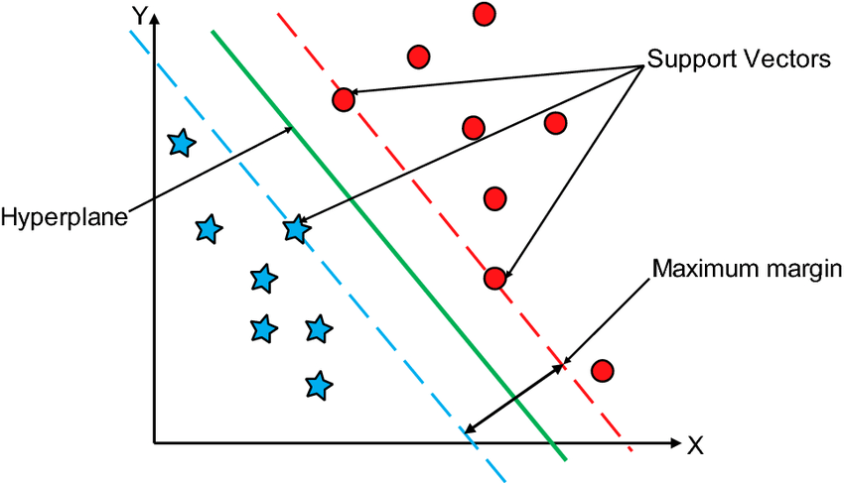
Support Vector Classifiers (SVC)
Doel: vinden van een optimale decision boundary tussen waarnemingen van verschillende klassen
Lijn (2D)
Vlak (3D)
Hyperplane (nD)
Kunnen goed omgaan met outliers (uitbijters)
Bron: researchgate.net

Slide 9
Large Margin Classifier
Notes:
The fundament of the support vector machine is the maximum margin principle which is explained in the following minutes.

Slide 10

Observations class A
Observations class B
$$x_{i}→$$
Notes:
There are two classes class A and B and they look like they can easily be distinguished. The classification is done based on feature x

Slide 11
threshold
$$x_{i}→$$
Notes:
Lets make a treshold at value x where the blue dots stop. Consider new data points (yellow dots). These two are obviously class A and B

Slide 12
threshold
$$x_{i}→$$
Notes:
But consider this point, whit the green treshold it will be classified as B but it looks like it belongs to A

Slide 13
threshold
Max Margin Classifier
margin
Notes:
If we take the maximal distance (margin) between the two classes and we put our threshold here it might perform better. This is called max margin classifier.

Slide 14
threshold
Notes:
Now it will be correctly classified

Slide 15
threshold
Notes:
The distance to A is smaller then the distance to class B, So this is accurate.

Slide 16
Soft Margin Classifier

Slide 17
threshold
Outlier
margin
Notes:
But what if we have an outlier and we use the same principle to set the treshold. Then our threshold we be put close to B

Slide 18
threshold
Notes:
And then again the datapoint can be again wrongly classified.

Slide 19
threshold
Misclassification
soft margin
Notes:
If we ignore the outlier, and accept that this is a misclassification the principle of margins does work.

Slide 20
Soft Margin Classifier = Support Vector Classifier (SVC)
threshold
Misclassification
soft margin
Notes:
In the case that we ignore the misclassifications (the outliers) we use soft margins instead of hard margins. We search for the maximum cohesion of observations to determine the outliers and thence the soft margins.

Slide 21
Soft Margin Classifier = Support Vector Classifier (SVC)
threshold
Misclassification
support vectors
soft margin
Notes:
We need outliers as well as the soft margins to determine the thresholds. These we call support vectors.

Slide 22
threshold
Misclassification
Notes:
Now we see that with this soft margin principle the datapoint is correctly classified

Slide 23
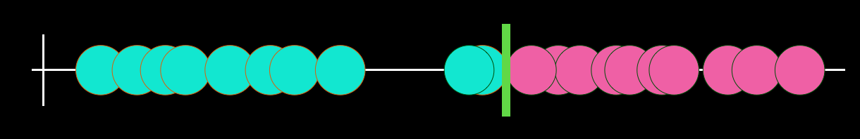
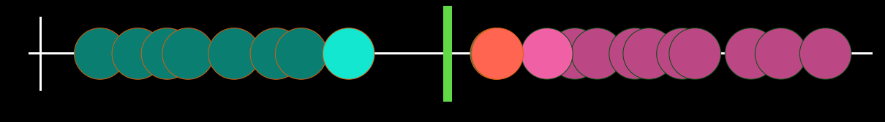
Variance
Bias
overfitting < --- > underfitting
Notes:
The higher the variance the more prone to overfitting. The higher the bias more prone to underfitting. Remember there is a balance between those.

Slide 24
Kernels

Slide 25

$$x_{i}→$$
Notes:
Sometimes you cannot use linear distance (one line) to determine the margins and thresholds, since the magenta points are left and right from the cyan points.

Slide 26


$$x_{i}^{2}→$$
threshold
$$x_{i}→$$
Notes:
You should use a trick like adding an order in the equation to distinguish the two classes

Slide 27

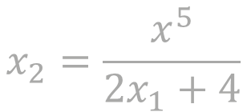



Plan
1. Start with low dimensionality
2. Introduce higher dimensionality for same data
3. Train SVC to differentiate
$$x_{2}=x_{1}^{2}$$
$$x_{2}=logx_{1}$$
How do we know to introduce higher dimensionality?
$$x_{2}=x_{1}^{3}$$
$$x_{2}=\frac{x^{5}}{2x_{1}+4}$$
$$x_{2}=\sqrt{1+x_{1}}$$
Notes:
The question however is, what equation to use? We call such a equation a kernel

Slide 28
sklearn.svm.SVC()
kernel: string, optional (default=’rbf’)
Specifies the kernel type to be used in the algorithm. It must be one of ‘linear’, ‘poly’, ‘rbf’, ‘sigmoid’, ‘precomputed’ or a callable. If none is given, ‘rbf’ will be used. If a callable is given it is used to pre-compute the kernel matrix from data matrices; that matrix should be an array of shape (n_samples, n_samples).
degree: int, optional (default=3)
Degree of the polynomial kernel function (‘poly’). Ignored by all other kernels.
https://scikit-learn.org/stable/modules/generated/sklearn.svm.SVC.html
Notes:
So using the svm algorithm we need to specify the kernel. You can also implement your own kernel.

Slide 29
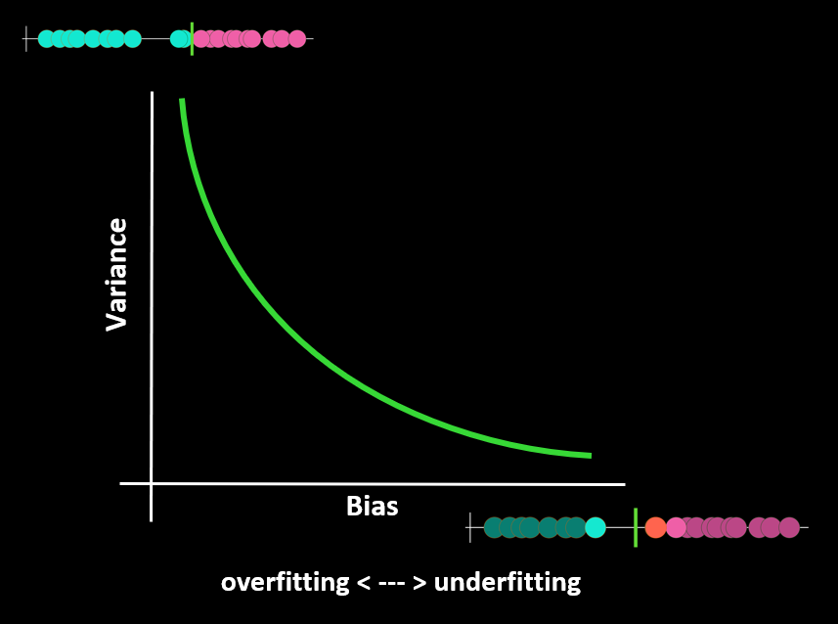
sklearn.svm.SVC()
C: float, optional (default=1.0)
Regularization parameter. The strength of the regularization is inversely proportional to C. Must be strictly positive. The penalty is a squared l2 penalty.
Hoe lager C, hoe zachter de marges => meer bias, richting underfitting
Hoe hoger C, hoe harder de marges => minder bias, richting overfitting
https://scikit-learn.org/stable/modules/generated/sklearn.svm.SVC.html
Notes:
C is the regularisation parameter.

Slide 30
Voorbeelden

Slide 31
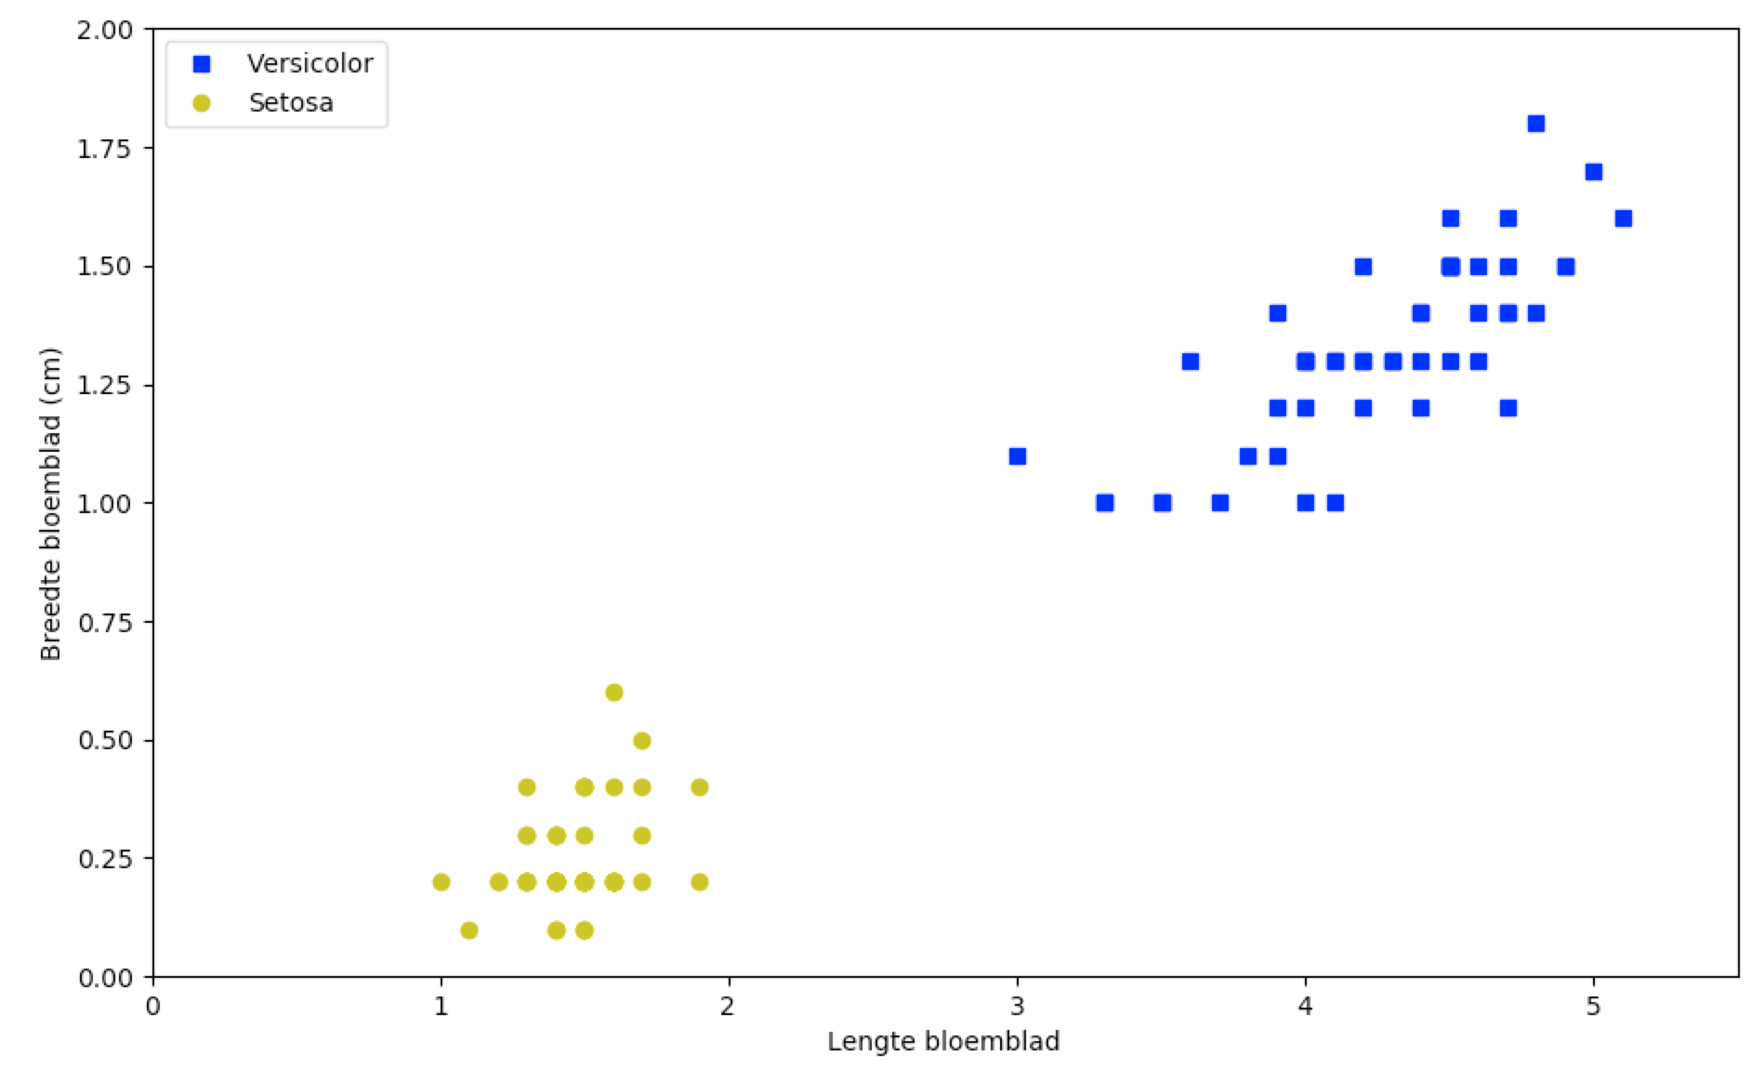
Notes:
Suppose we have two classes of the iris flower, versicolor and setosa. We can determine on the features petal length and petal width the decision boundery

Slide 32
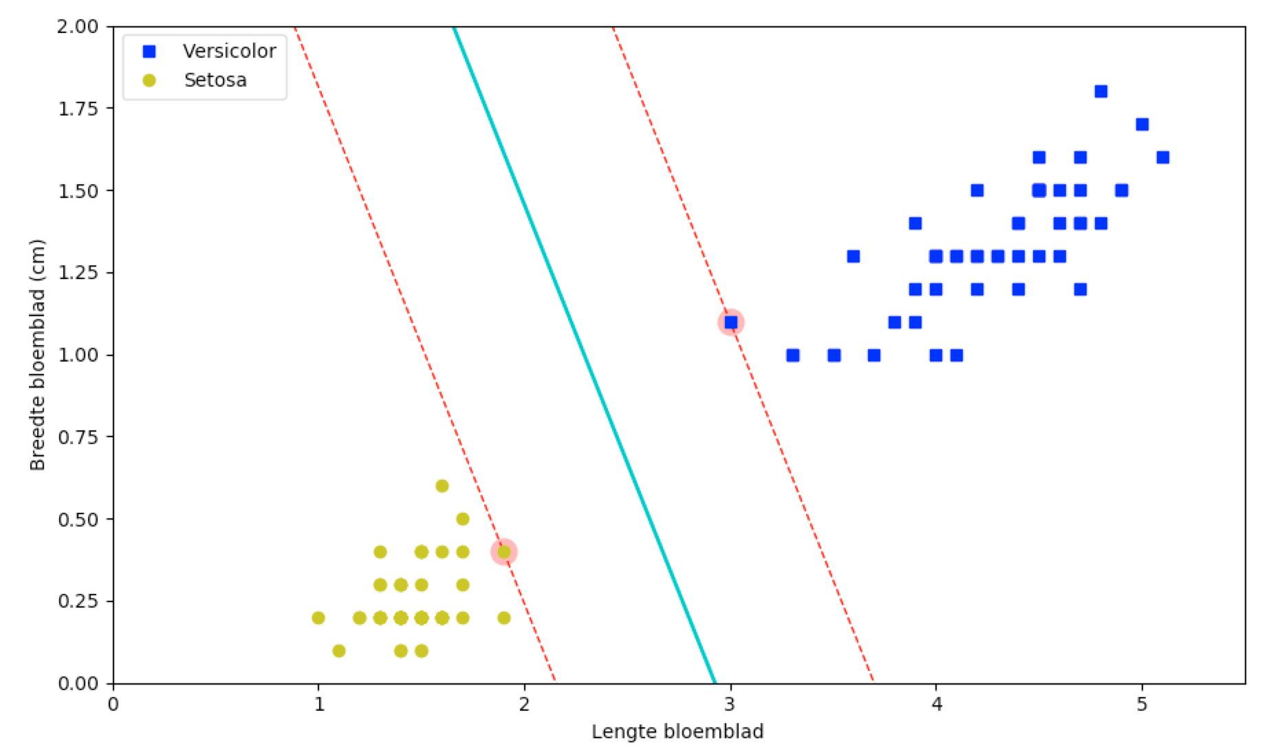
svm_clf = SVC(kernel="linear", C=float("inf"))
svm_clf.fit(X, y)
Notes:
As you can see, there is a reasonable distance between the *boundary* and the two support vectors (the ones with the glow). Also note that adding more examples on either side of the boundary does not make the classification better or more accurate: the lines in the figure above are completely determined by the boundary cases on either side of the “street”, the support vectors.

Slide 33
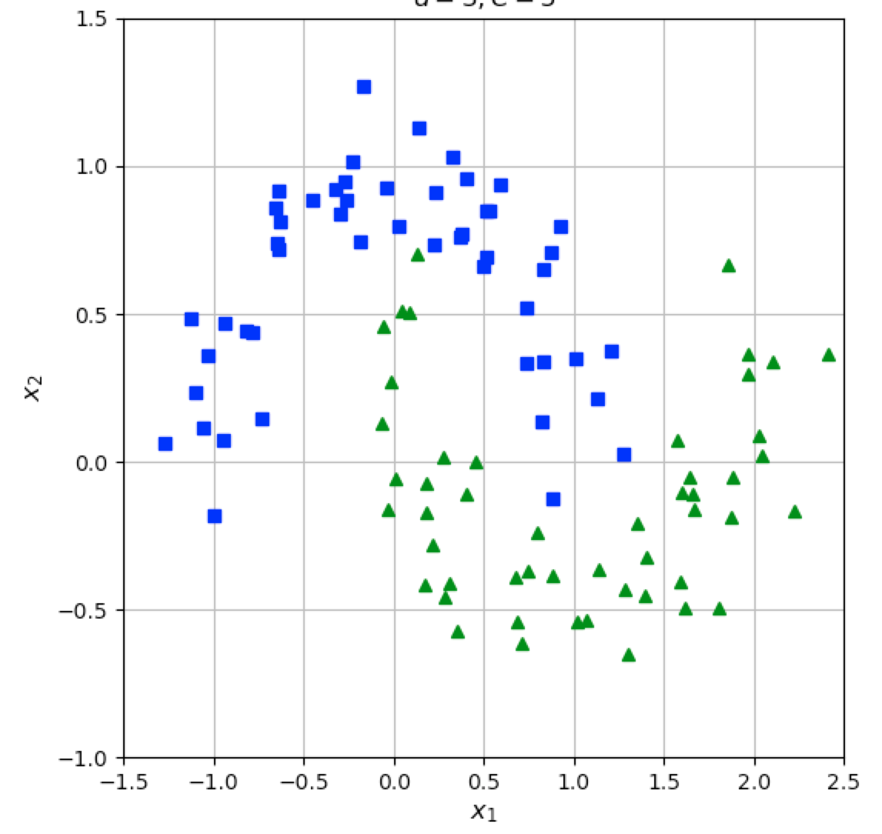
Notes:
These two classes clearly need some kind of polynomial kernel to separate the two classes. A straight line won’t fit.

Slide 34
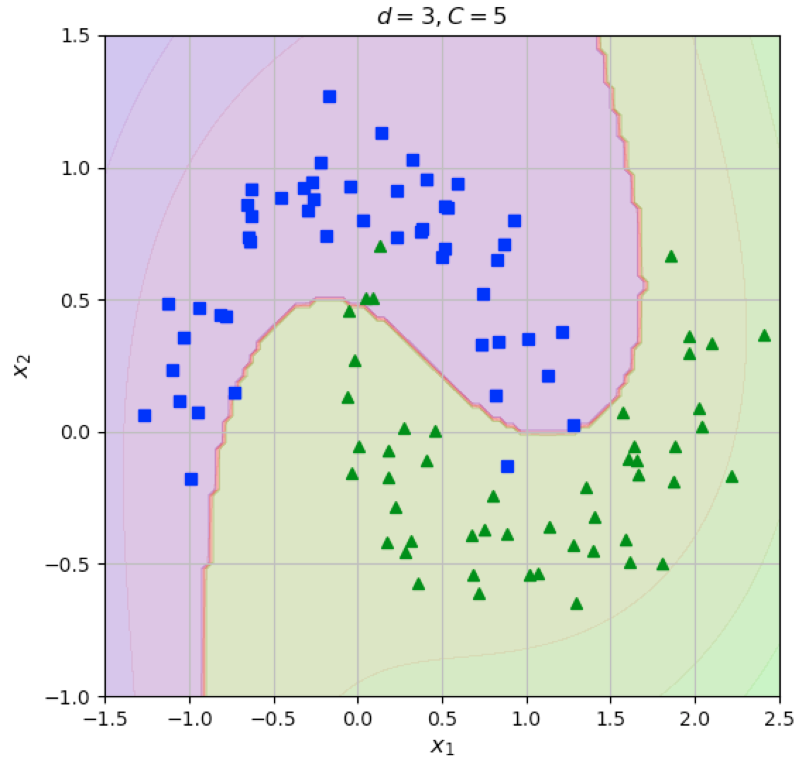
Notes:
We could use a third degree polynomial with a regularisation factor of 5

Slide 35
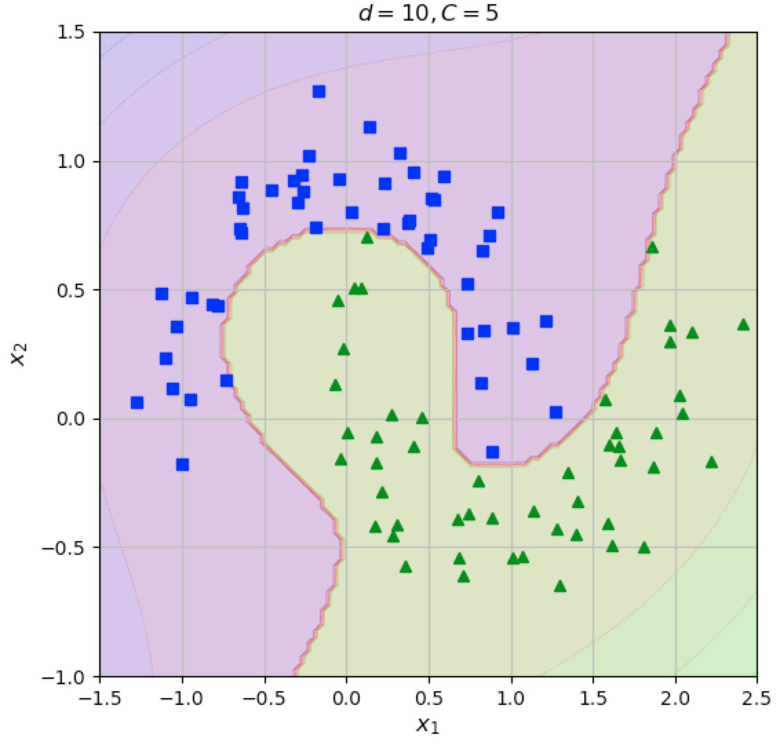
Notes:
Or a tenth degree polynomial with a regularisation factor of 5

Slide 36
Clustering: algemeen
Gelijksoortige observaties samen groeperen
Zonder te classificeren
Voorbeeld van unsupervised learning

Slide 37
Clustering: k-means
Afwisseling van twee stappen:
Assignment step: assign each observation to the cluster with the nearest mean: that with the least squared Euclidean distance.
Update step: recalculate means (centroids) for observations assigned to each cluster.

Slide 38
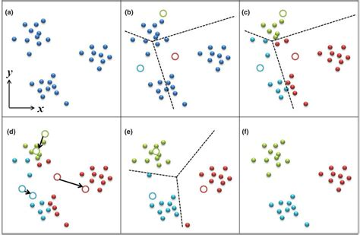
Clustering: k-means
Bron: researchgate.net

Slide 39
Clustering: k-means
Initialisatie van de centroids:
Op basis van voorkennis
Kiezen uit meerdere random initialisaties
Metric: inertia (sum of squared distances to centroids)
k-means++
Bevorder dat de initiële centroids ver uit elkaar liggen

Slide 40
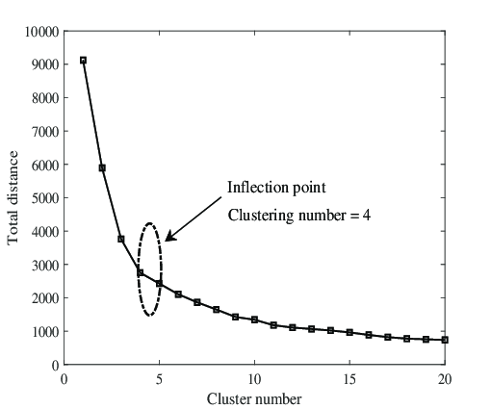
Clustering: k-means
Keuze van het aantal clusters:
“Elbow method”
Inertia
Bron: researchgate.net

Slide 41
Clustering: DBSCAN
Density-Based Spatial Clustering of Applications with Noise
Twee parameters:
ε (eps)
minPts

Slide 42
Clustering: DBSCAN
Het algoritme werkt als volgt:
Find the points in the ε neighborhood of every point, and identify the core points with more than minPts neighbors
Find the connected components of core points on the neighbor graph, ignoring all non-core points
Assign each non-core point to a nearby cluster if the cluster is an ε neighbor, otherwise assign it to noise/outliers

Slide 43
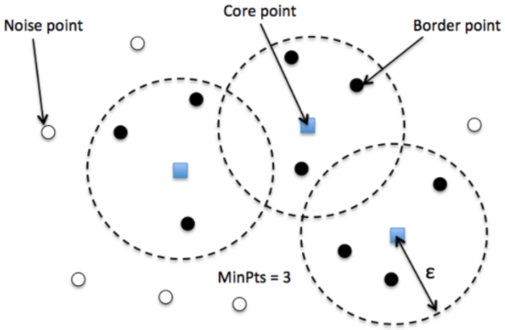
Clustering: DBSCAN
Bron: miro.medium.com

Slide 44
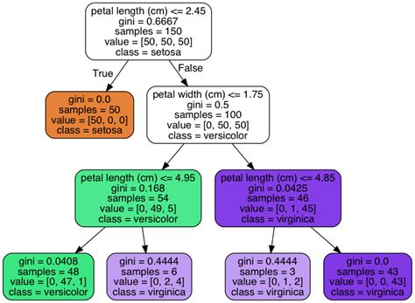
Decision trees

Slide 45
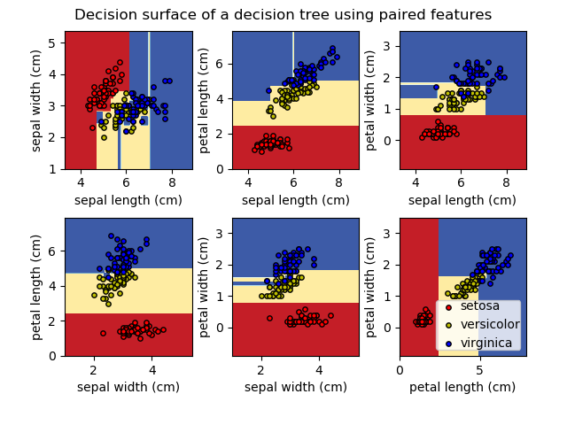
Decision trees: decision surface
Bron: scikit-learn.org

Slide 46
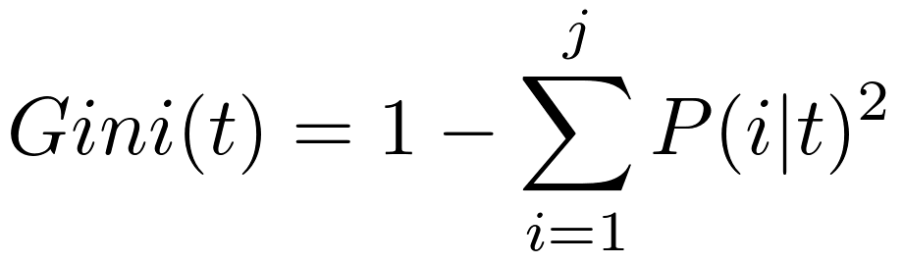
Decision trees: gini-impurity

Slide 47
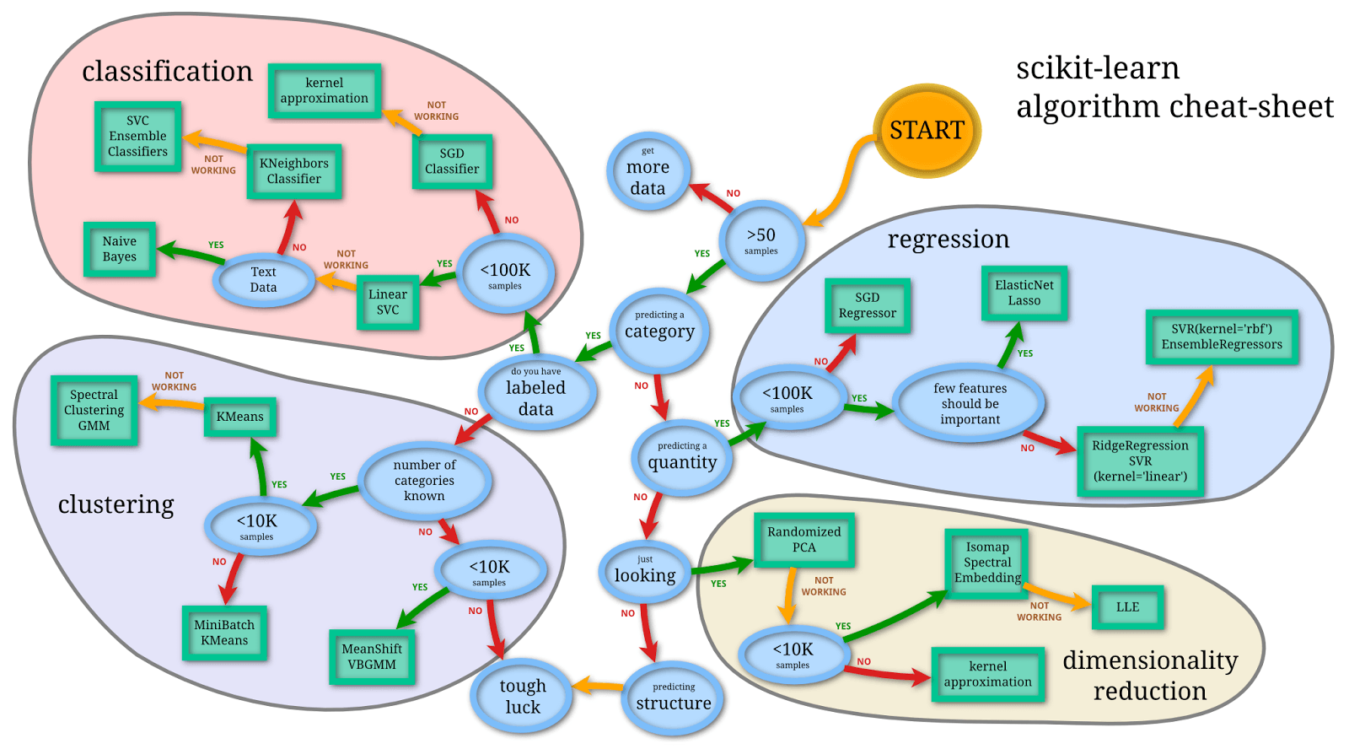

Slide 48
Deel 2 (na de pauze): live Notebooks
Decision trees
k-means
DBSCAN

