Slide 1
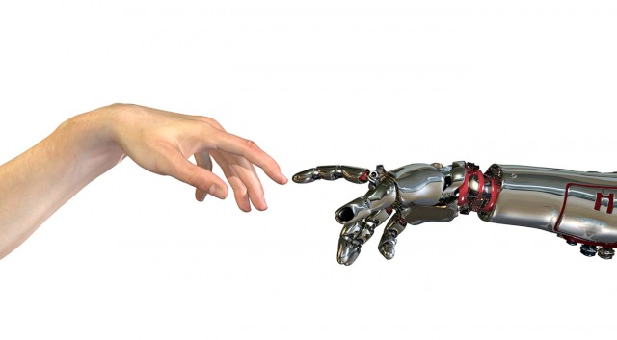
Machine Learning
4. neurale netwerken

Slide 2


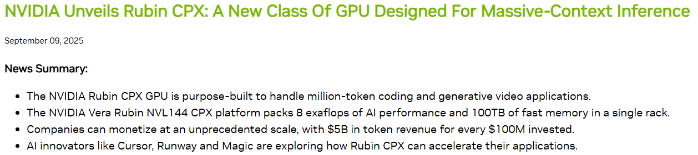
ML Actueel
Twee weken eerder:

Slide 3
ml:neurale netwerken

Slide 4










$$1$$
$$θ_{0}$$
Error
update gewichten
$$x_{1}$$
$$θ_{1}$$
+1
$$h_{θ}(x)$$
$$x_{2}$$
$$θ_{2}$$
$$θ_{n}$$
$$x_{n}$$
https://nl.wikipedia.org/wiki/Perceptron

Slide 5
It is observed that non-linear problems can not be solved using single layer network with conventional type of neuron activation function
http://hsmazumdar.net/single_layer_neural_net.htm

Slide 6
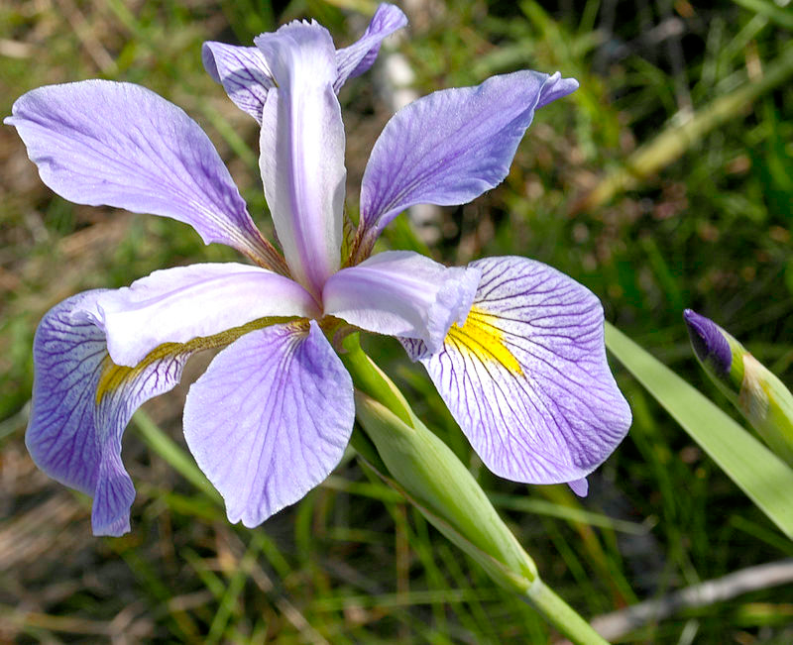
wat wij zien
wat de computer ‘ziet’
[ [ 4.9, 3.0, 1.4],
[ 4.7, 3.2, 1.3],
[ 4.6, 3.1, 1.5],
[ 5.0, 3.6, 1.4],
[ 5.4, 3.9, 1.7],
[ 4.6, 3.4, 1.4],
[ 5.0, 3.4, 1.5],
[ 4.4, 2.9, 1.4],
[ 4.9, 3.1, 1.5],
[ 5.4, 3.7, 1.5],
[ 4.8, 3.4, 1.6],
[ 4.8, 3.0, 1.4],
[ 4.3, 3.0, 1.1],
[ 5.8, 4.0, 1.2],
[ 5.7, 4.4, 1.5],
[ 5.4, 3.9, 1.3],
[ 5.1, 3.5, 1.4],
[ 5.7, 3.8, 1.7],
[ 5.1, 3.8, 1.5],
…
[ 5.4, 3.4, 1.7],
]

Slide 7
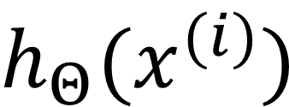
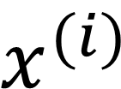
+1
+1
$$x^{(i)}$$
$$h_{Θ}(x^{(i)})$$
input layer
hidden layer
output layer

Slide 8
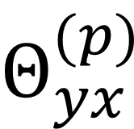
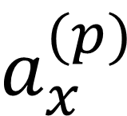
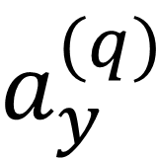
$$a_{x}^{(p)}$$
$$Θ_{yx}^{(p)}$$
$$a_{y}^{(q)}$$
x
y
laag p
laag q

Slide 9
$$a_{x}^{(p)}$$
$$Θ_{yx}^{(p)}$$
$$a_{y}^{(q)}$$
x
y
laag p
laag q
gewicht / belang dat neuron y aan de input van neuron x geeft / hecht

Slide 10
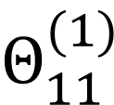
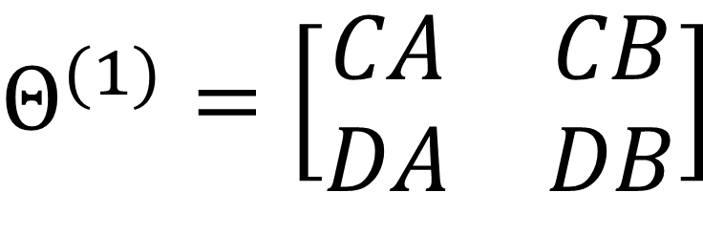
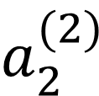
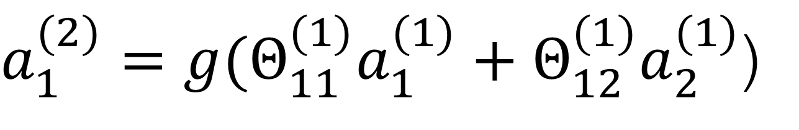
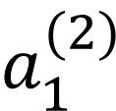
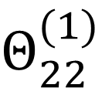
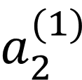
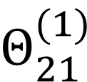
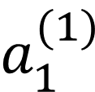
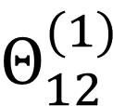
$a_{1}^{(2)}=g(Θ_{11}^{(1)}a_{1}^{(1)}+Θ_{12}^{(1)}a_{2}^{(1)}$)
$$a_{1}^{(1)}$$
$$Θ_{11}^{(1)}$$
$$a_{1}^{(2)}$$
A
C
$$Θ_{12}^{(1)}$$
$$Θ_{21}^{(1)}$$
B
D
$$a_{2}^{(1)}$$
$$Θ_{22}^{(1)}$$
$$a_{2}^{(2)}$$
laag 1
laag 2
$$Θ^{(1)}=\left[\begin{matrix}CA & CB \\ DA & DB\end{matrix}\right]$$

Slide 11
nn:forward propagation

Slide 12
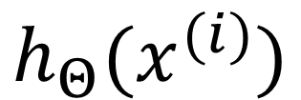
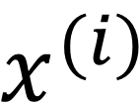
+1
+1
+1
$$x^{(i)}$$
$$h_{Θ}(x^{(i)})$$
input layer
hidden layer 1
hidden layer 2
output layer
Laag 1
Laag 2
Laag 3
Laag 4

Slide 13
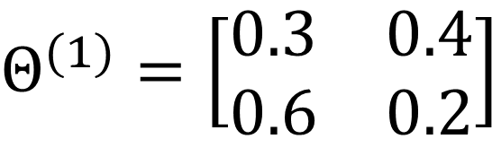
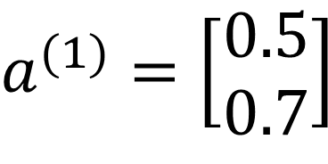


$$a^{(1)}=\left[\begin{aligned}0.5 \\ 0.7\end{aligned}\right]$$
$$Θ^{(1)}=\left[\begin{matrix}0.3 & 0.4 \\ 0.6 & 0.2\end{matrix}\right]$$
$$a_{1}^{(2)}=g(0.5×0.3+0.7×0.4)$$
A
0.5
0.5×0.3
C
0.5
0.5
0.7×0.4
0.7
0.5×0.6
B
D
0.7
0.7
0.7×0.2
$$a_{2}^{(2)}=g(0.5×0.6+0.7×0.2)$$
laag 1
(= inputlaag)
laag 2

Slide 14
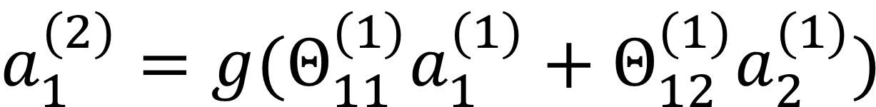
$$a_{1}^{(2)}=g(Θ_{11}^{(1)}a_{1}^{(1)}+Θ_{12}^{(1)}a_{2}^{(1)})$$
$$a_{1}^{(1)}$$
$$Θ_{11}^{(1)}$$
$$a_{1}^{(2)}$$
A
C
$$Θ_{12}^{(1)}$$
$$Θ_{21}^{(1)}$$
B
D
$$a_{2}^{(1)}$$
$$Θ_{22}^{(1)}$$
$$a_{2}^{(2)}$$
laag 1
laag 2
$$Θ^{(1)}=\left[\begin{matrix}CA & CB \\ DA & DB\end{matrix}\right]$$

Slide 15
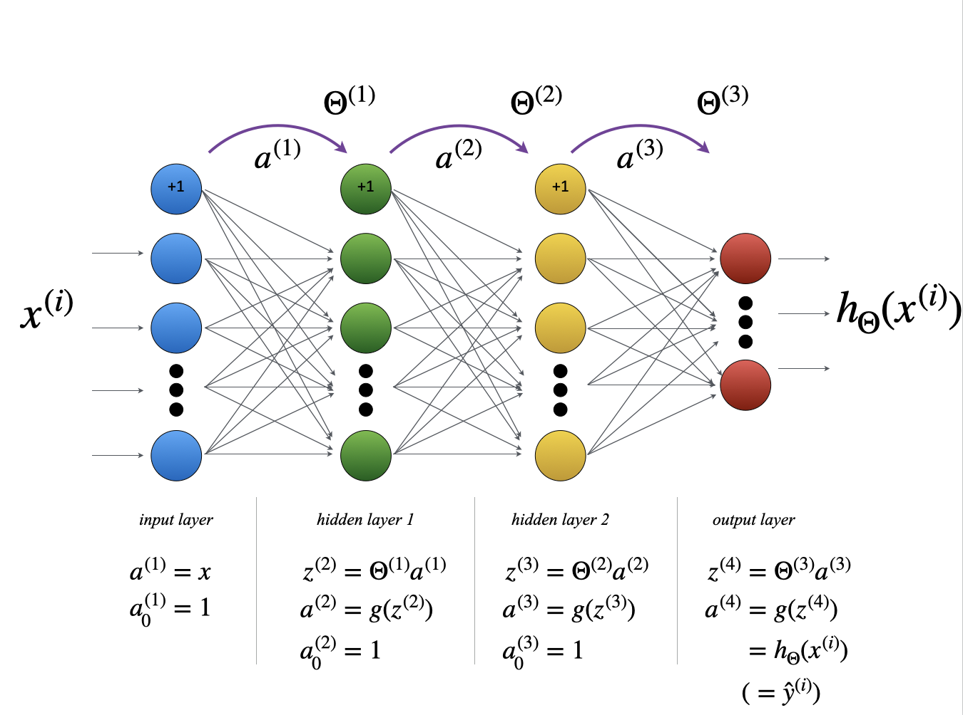

Slide 16

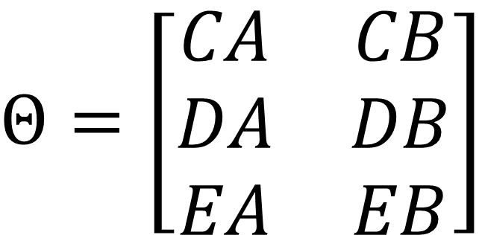
$$Θ$$
C
A
D
B
E
$$Θ=\left[\begin{matrix}CA & CB \\ DA & DB \\ EA & EB\end{matrix}\right]$$

Slide 17
nn:cost function

Slide 18
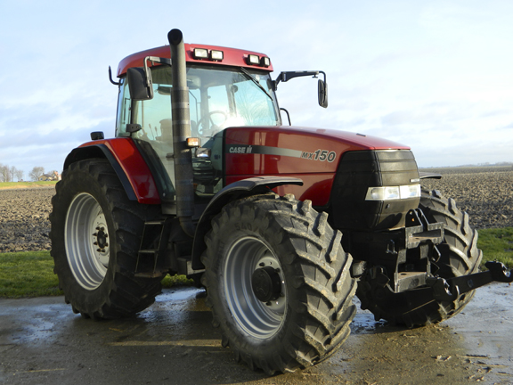




train network for specific goal
$$Σ$$
$$Σ$$
$$Σ$$
$$Σ$$

Slide 19
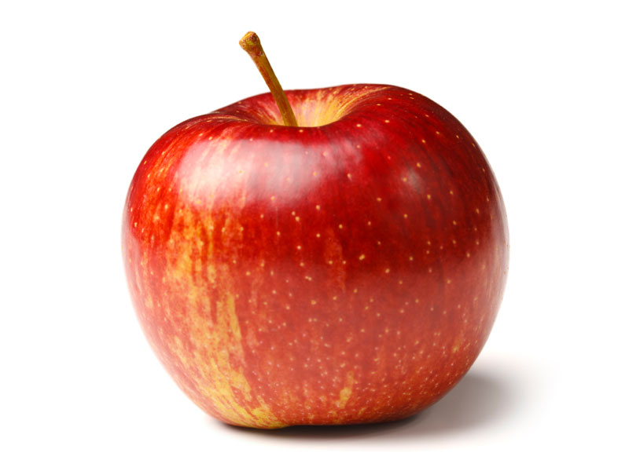
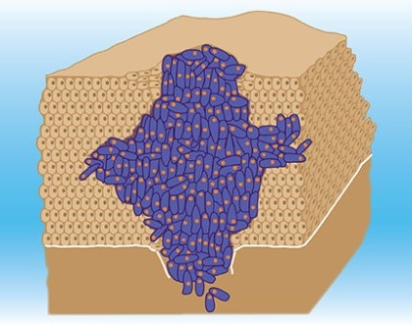






Multi-class classification: one versus all
$$Σ$$
$$Σ$$
$$Σ$$
$$Σ$$

Slide 20



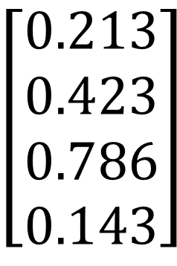


$$Σ$$
$$h_{θ}(x)$$
$$Σ$$
$$h_{θ}(x)$$
$$\left[\begin{aligned}0.213 \\ 0.423 \\ 0.786 \\ 0.143\end{aligned}\right]$$
$$\left[\begin{aligned}0 \\ 0 \\ 1 \\ 0\end{aligned}\right]$$
$$Σ$$
$$h_{θ}(x)$$
$$Σ$$
$$h_{θ}(x)$$

Slide 21

$$h_{Θ}(x^{(i)})$$

Slide 22
Kostenfunctie van een Neuraal Netwerk
let op de overeenkomsten met die van logistische regressie!
$$J(Θ)=\frac{1}{m}\overset{m}{\underset{i=1}{∑}}\overset{K}{\underset{k=1}{∑}}\left[y_{k}^{(i)}log(h_{Θ}(x^{(i)}))_{k}+(1−y_{k}^{(i)})log(1−h_{Θ}(x^{(i)}))_{k}\right]$$

Slide 23
nn:backpropagation

Slide 24
+1
+1
+1

Slide 25
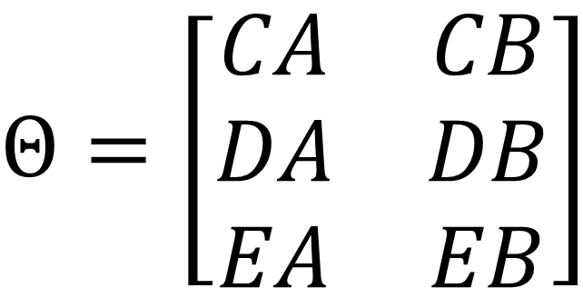
$$Θ$$
C
A
D
B
E
$$Θ=\left[\begin{matrix}CA & CB \\ DA & DB \\ EA & EB\end{matrix}\right]$$

Slide 26
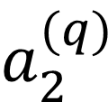
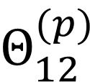
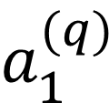
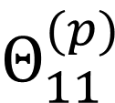
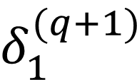
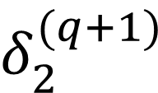
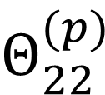
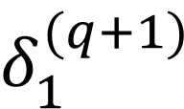
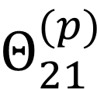
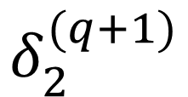
$$δ_{1}^{(q+1)}$$
$$Θ_{11}^{(p)}$$
A
C
$$a_{1}^{(q)}$$
$$δ_{2}^{(q+1)}$$
$$Θ_{12}^{(p)}$$
$$Θ_{21}^{(p)}$$
$$δ_{1}^{(q+1)}$$
B
D
$$a_{2}^{(q)}$$
$$δ_{2}^{(q+1)}$$
$$Θ_{22}^{(p)}$$
layer p
layer q

Slide 27
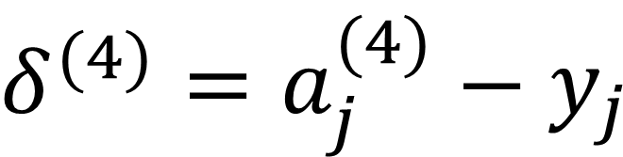
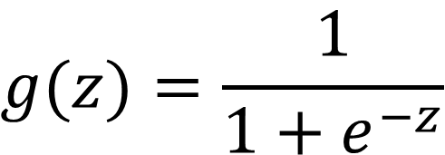

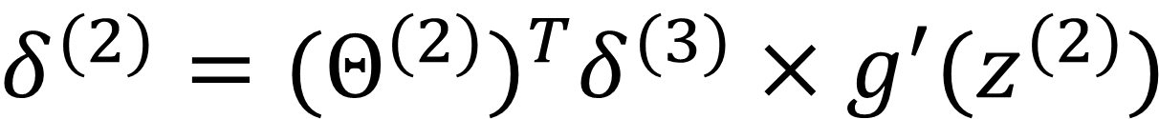
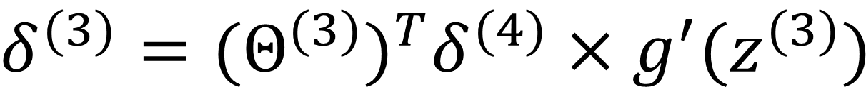
sigmoïdefunctie + afgeleide:
$$g(z)=\frac{1}{1+e^{−z}}$$
$$g^{′}(z)=g(z)(1−g(z))$$
kettingregel!
terugrekenen van de output-errors naar de eerdere lagen:
$$δ^{(4)}=a_{j}^{(4)}−y_{j}$$
$$δ^{(3)}=(Θ^{(3)})^{T}δ^{(4)}×g^{′}(z^{(3)})$$
$$δ^{(2)}=(Θ^{(2)})^{T}δ^{(3)}×g^{′}(z^{(2)})$$

Slide 28




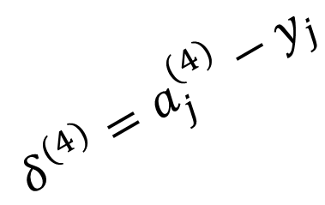
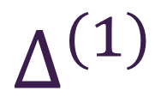
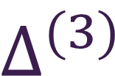

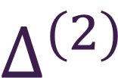

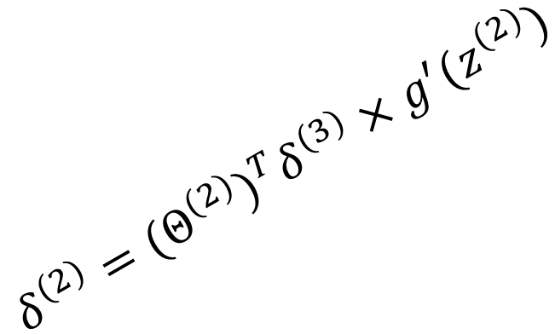

$$δ^{(1)}=(Θ^{(1)})^{T}δ^{(2)}×g^{′}(z^{(1)})$$
$$δ^{(2)}=(Θ^{(2)})^{T}δ^{(3)}×g^{′}(z^{(2)})$$
$$δ^{(3)}=(Θ^{(3)})^{T}δ^{(4)}×g^{′}(z^{(3)})$$
$$δ^{(4)}=a_{j}^{(4)}−y_{j}$$
+1
+1
+1
$$Δ^{(1)}$$
$$Δ^{(2)}$$
$$Δ^{(3)}$$
$$g^{′}(z)=g(z)(1−g(z))$$

Slide 29


forward
backward
$$∆_{ij}^{(l)}≔∆_{ij}^{(l)}+ a_{j}^{(l−1)}δ_{i}^{(l)}$$

Slide 30
nn:implementatiedetails

Slide 31

Initiële waarden van de Theta’s (1/2)
$$a_{1}^{(1)}$$
$$Θ_{11}^{(1)}$$
$$a_{1}^{(2)}$$
A
C
$$Θ_{12}^{(1)}$$
$$Θ_{ij}^{(l)}=0$$
$$Θ_{21}^{(1)}$$
np.zeros((m,n))
B
D
$$a_{2}^{(1)}$$
$$Θ_{22}^{(1)}$$
$$a_{2}^{(2)}$$
laag 1
laag 2

Slide 32


Initiële waarden van de Theta’s (2/2)
symmetry breaking
$$Θ_{ij}^{(l)}=random[−ε,ε]$$
$$ε= \sqrt{\frac{6}{Lin+Lout}}$$

Slide 33
Extra uitleg bij deel 2 – opgaveset 2
zelf een Neuraal Netwerk trainen op de MNIST-set
unrolling parameters
>>> Theta1.shape
(25, 401)
>>> Theta2.shape
(10, 26)
>>> np.concatenate ( (Theta1.flatten(), Theta2.flatten()) ).shape
(10285,)
>>>
https://numpy.org/doc/stable/reference/generated/numpy.ndarray.flatten.html

Slide 34
scipy.optimize.minimize()
def nnCostFunction(Thetas, X, y):
global input_size, hidden_size, num_labels
size = hidden_size * (1+input_size)
Theta1 = Thetas[:size].reshape(hidden_size, input_size+1)
Theta2 = Thetas[size:].reshape(num_labels, hidden_layer_size+1)
J = computeCost(Theta1, Theta2, X, y)
grad1, grad2 = nnCheckGradients(Theta1, Theta2, X, y)
return J, np.concatenate( (grad1.flatten(), grad2.flatten()) )
res = minimize(nnCostFunction, init_params, args=args,
method='CG', callback=callbackF,
options={'maxiter':30,'disp':True})

Slide 35


Slide 36


Slide 37


Na de pauze… live Notebook over Keras

