Slide 1

AI UX & Data Visualisation Design Principles (CA6002)
Beyond Raw Ratings: Interpreting Google Play App Performance
by
Group 22
email:
XUANHUI002@e.ntu.edu.sg
LIUY0345@e.ntu.edu.sg
YUHAN048@e.ntu.edu.sg
C260089@e.ntu.edu.sg

Slide 2

How much of the app rating information available on Google Play actually explains?
Explore
Diagnose
Condition
Model
Evaluate
Story
We don't just want to predict ratings; we want to understand：
what information is truly effective？
where the model fails？
what a high rating actually means？
Data source: Google Play Store, 10,841 raw records, 13 variables
Responsible member: LIU YUHAN
Notes:
Hello everyone, today we'll be exploring an interesting question: How much of the visible information from the Google Play Store actually explains app ratings? Our project isn't just about predicting ratings; we aim to use a visual survey approach to deeply understand which information is truly effective, where our model fails, and what a high rating really means. Our analysis is based on raw data from the Google Play Store, containing over 10,000 records and 13 variables. We'll then unfold our findings through six steps: exploration, diagnosis, preprocessing, modeling, evaluation, and storytelling.

Slide 3

Exploration of Dataset
dataset overview:
raw rows: 10841
raw variables: 13
missing rating: 13.6%(1474)
exact duplicate rows: 483
Malformed row: 19
Before choosing an algorithm,
we first ensure that
all visualizations and models are
built on reliable data.
Responsible member: LIU YUHAN
Notes:
Before we dive into modeling, it's crucial to understand our raw data and ensure its quality. This slide presents our initial dataset overview and diagnosis. We started with 10,841 rows and 13 variables. However, we immediately identified several quality issues. As shown, the 'Rating' column has a significant 13.6% missing values. Additionally, we found 483 duplicate entries and one malformed row with an impossible rating of 19, which is a clear outlier. Furthermore, columns like 'Installs' and 'Price' are stored as strings, which need to be converted into numeric format for analysis. Addressing these issues is the first step to building reliable models and visualizations.

Slide 4
Data Conditioning & Cleaning
before
after
row-count funnel
Installs
'10,000+'
10,000
Raw dataset: 10841
Preserve the business meaning
price
'$4.99'
4.99
After malformed-row removal: 10840
After exact-duplicate removal: 10357
size
500k'
0.488MB
transforming into a form that can be used by both visualizations and models.
Observed Rating for modelling: 8892
"August 1, 2018"
2018
Responsible member: LIU YUHAN
Notes:
After identifying the data quality issues, the next critical step is data conditioning and cleaning. The goal is to transform messy metadata into comparable fields while preserving their original business meaning. As shown in the key transformations section, we converted string fields like 'Installs' and 'Price' into numeric values by removing symbols and converting units. For the 'Size' field, we standardized all values to megabytes. Importantly, for our target variable 'Rating', we chose not to impute missing values to avoid introducing bias. The pipeline in the center illustrates our cleaning process: starting from 10,841 raw records, we removed 1 malformed row, then 483 duplicates, resulting in a final clean dataset of 8,892 records ready for analysis and modeling.

Slide 5
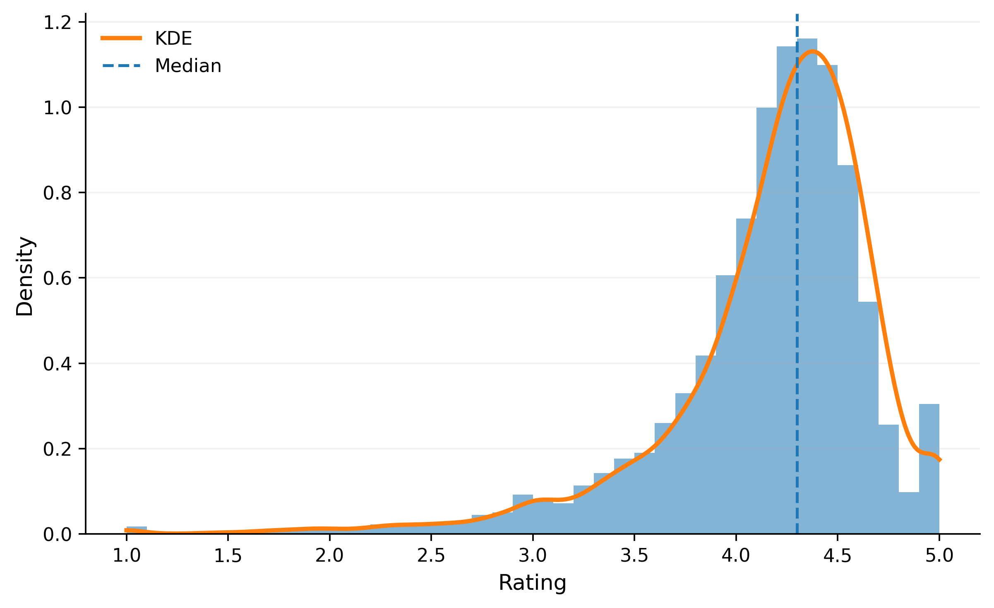
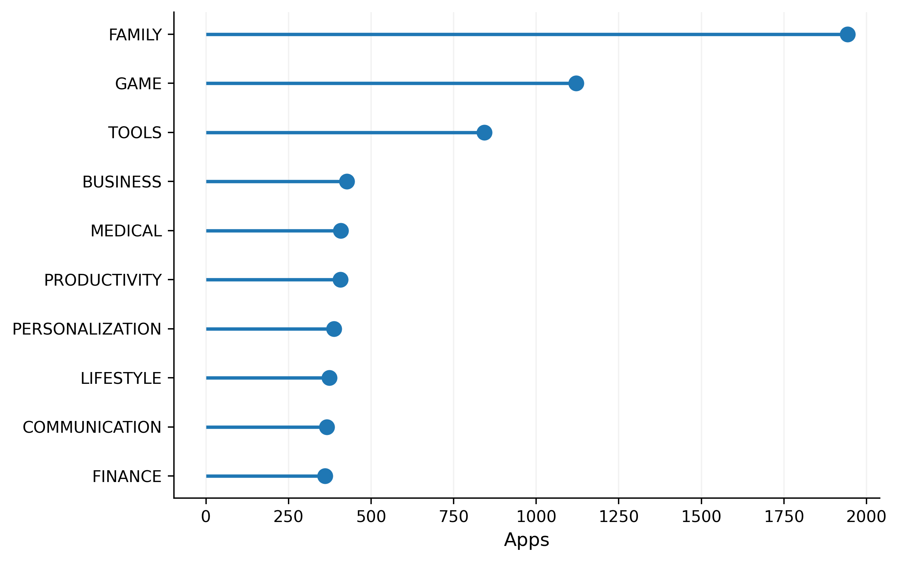
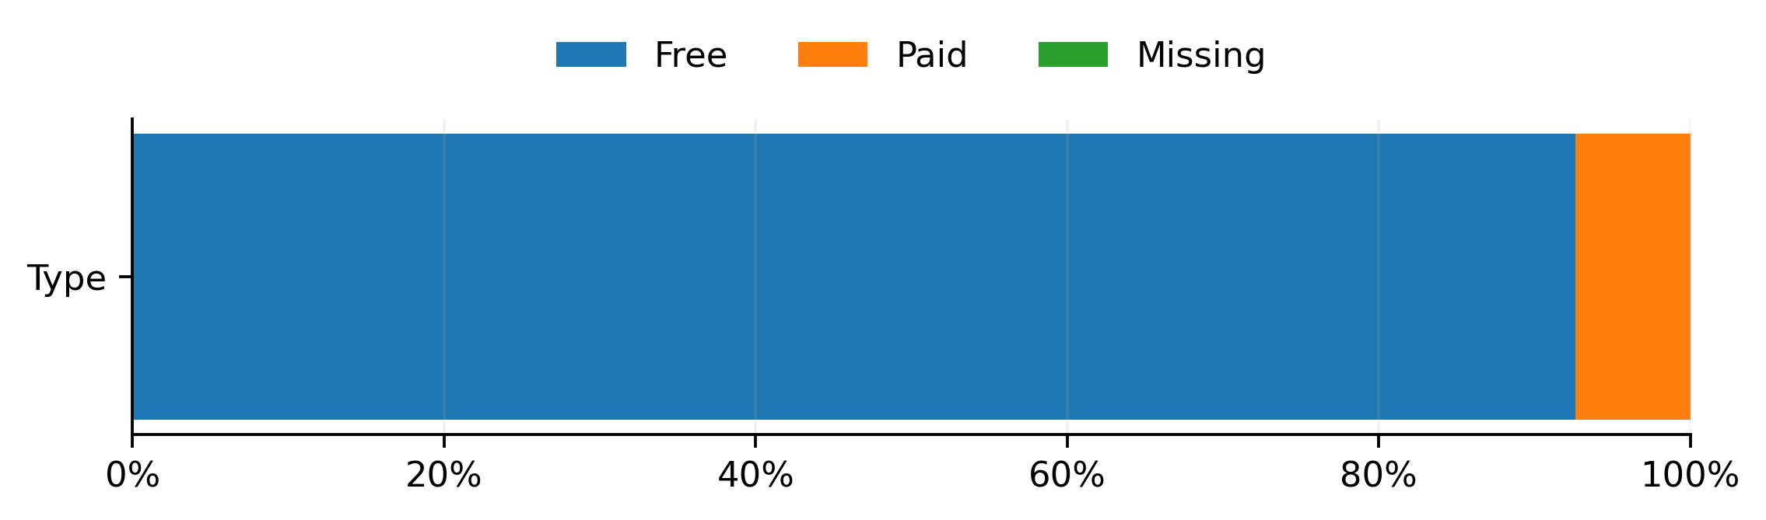
Rating distribution
Core Insight: App ratings are heavily skewed toward 4-5 stars, creating a data landscape where high-quality apps dominate. This concentration simplifies learning for models targeting high-score regions.
Mean Rating
4.188
Median Rating
4.30
Apps ≥ 4.0 Stars
78.1%
Apps ≥ 4.5 Stars
31.7%
Responsible member: LIU YUHAN
Notes:
Now that our data is clean, let's explore the distribution of our target variable, 'Rating', and the overall market structure. As shown in the main plot on the left, the rating distribution is heavily skewed towards the higher end, with a mean of 4.188 and a median of 4.30. In fact, 78.1% of apps have a rating of 4.0 or higher, and 31.7% have a rating of 4.5 or higher. This indicates that the market is dominated by well-rated apps. The plot on the right shows the top 10 app categories, with 'Family' and 'Game' being the most prevalent. Finally, the bottom plot reveals that the vast majority of apps are free. These three visualizations together highlight an imbalanced market structure, which is crucial to consider for our modeling phase.

Slide 6
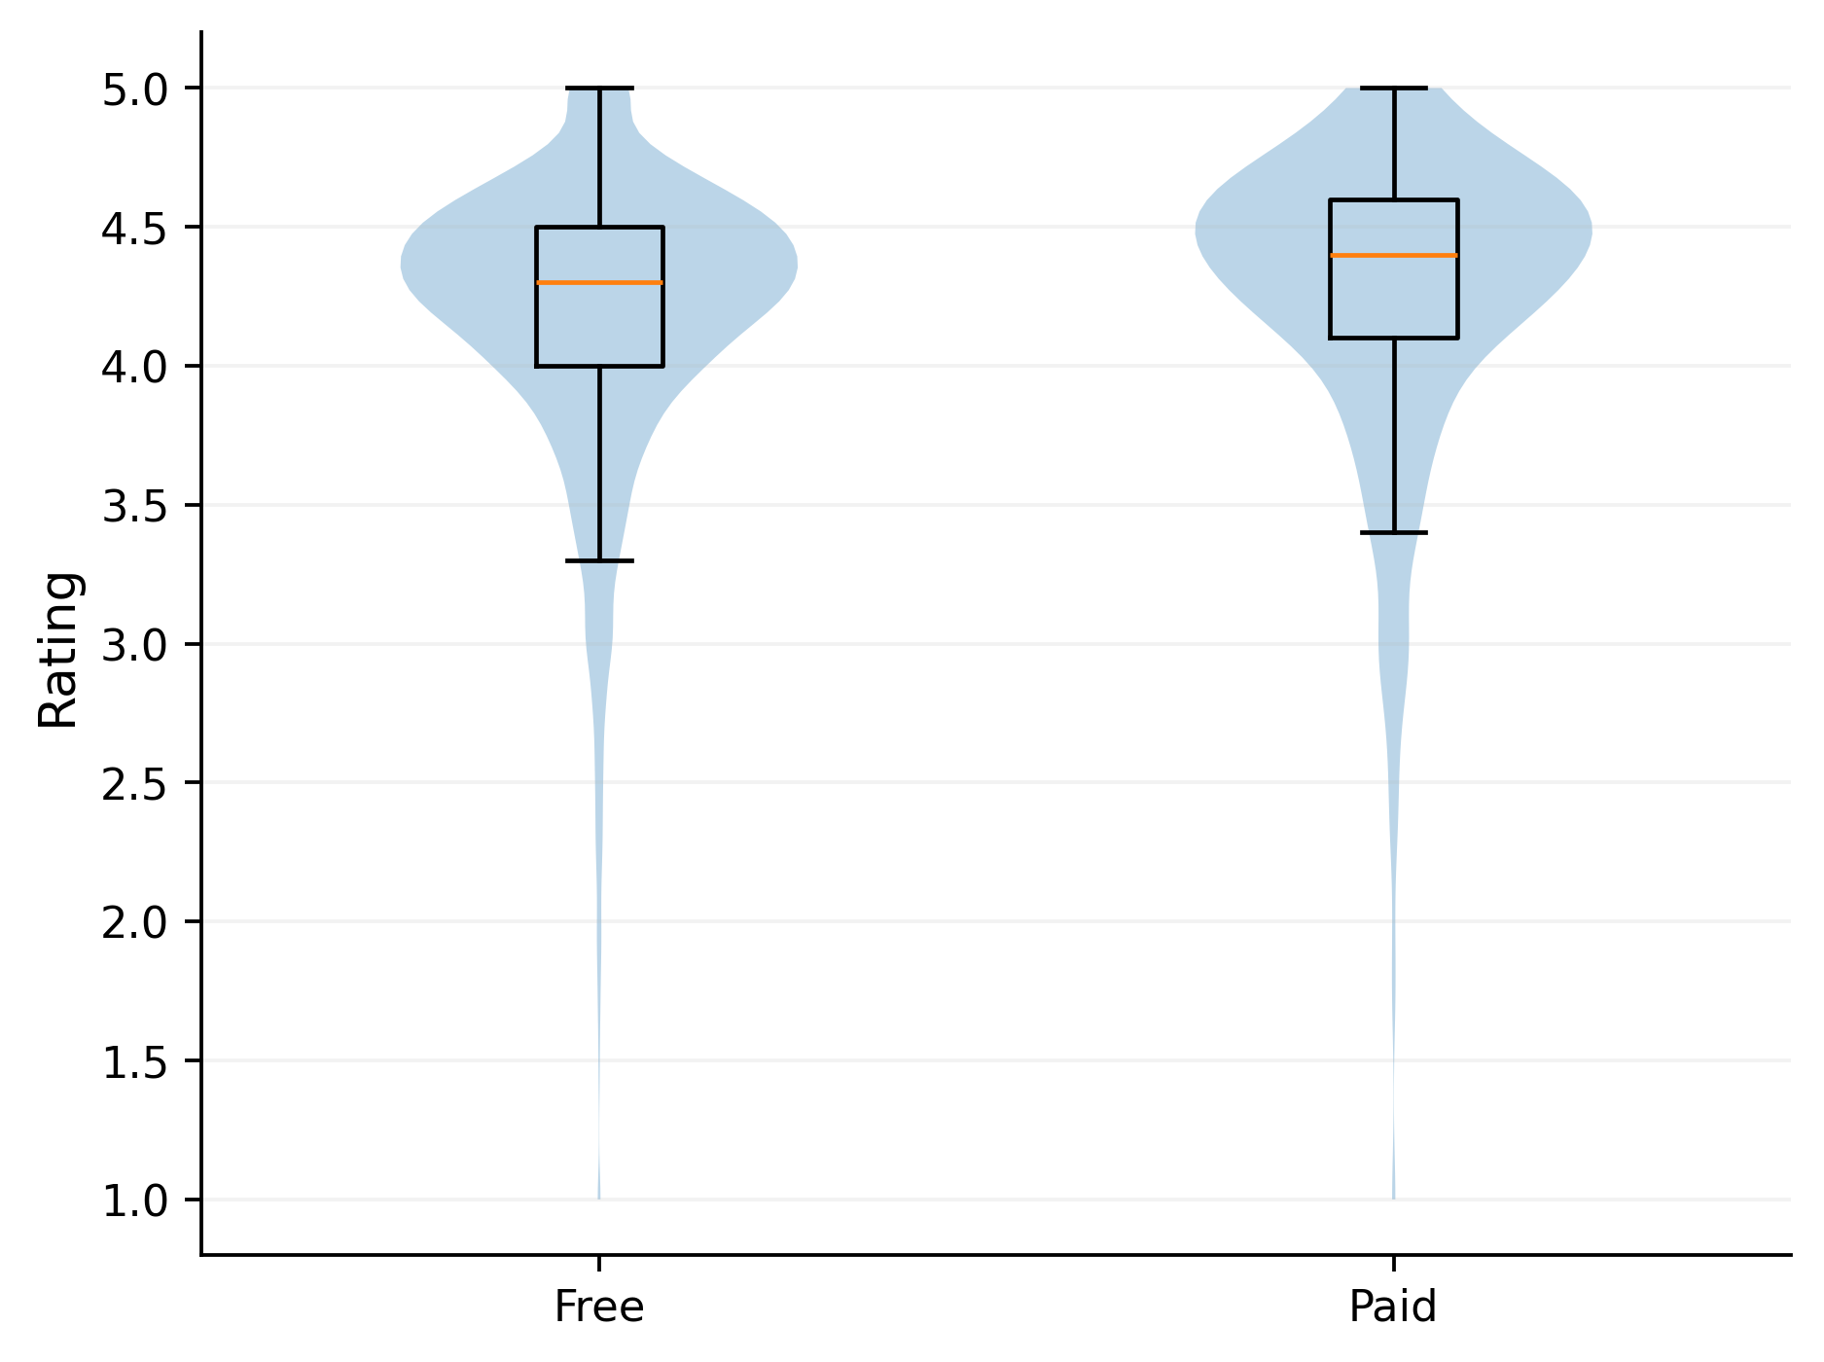
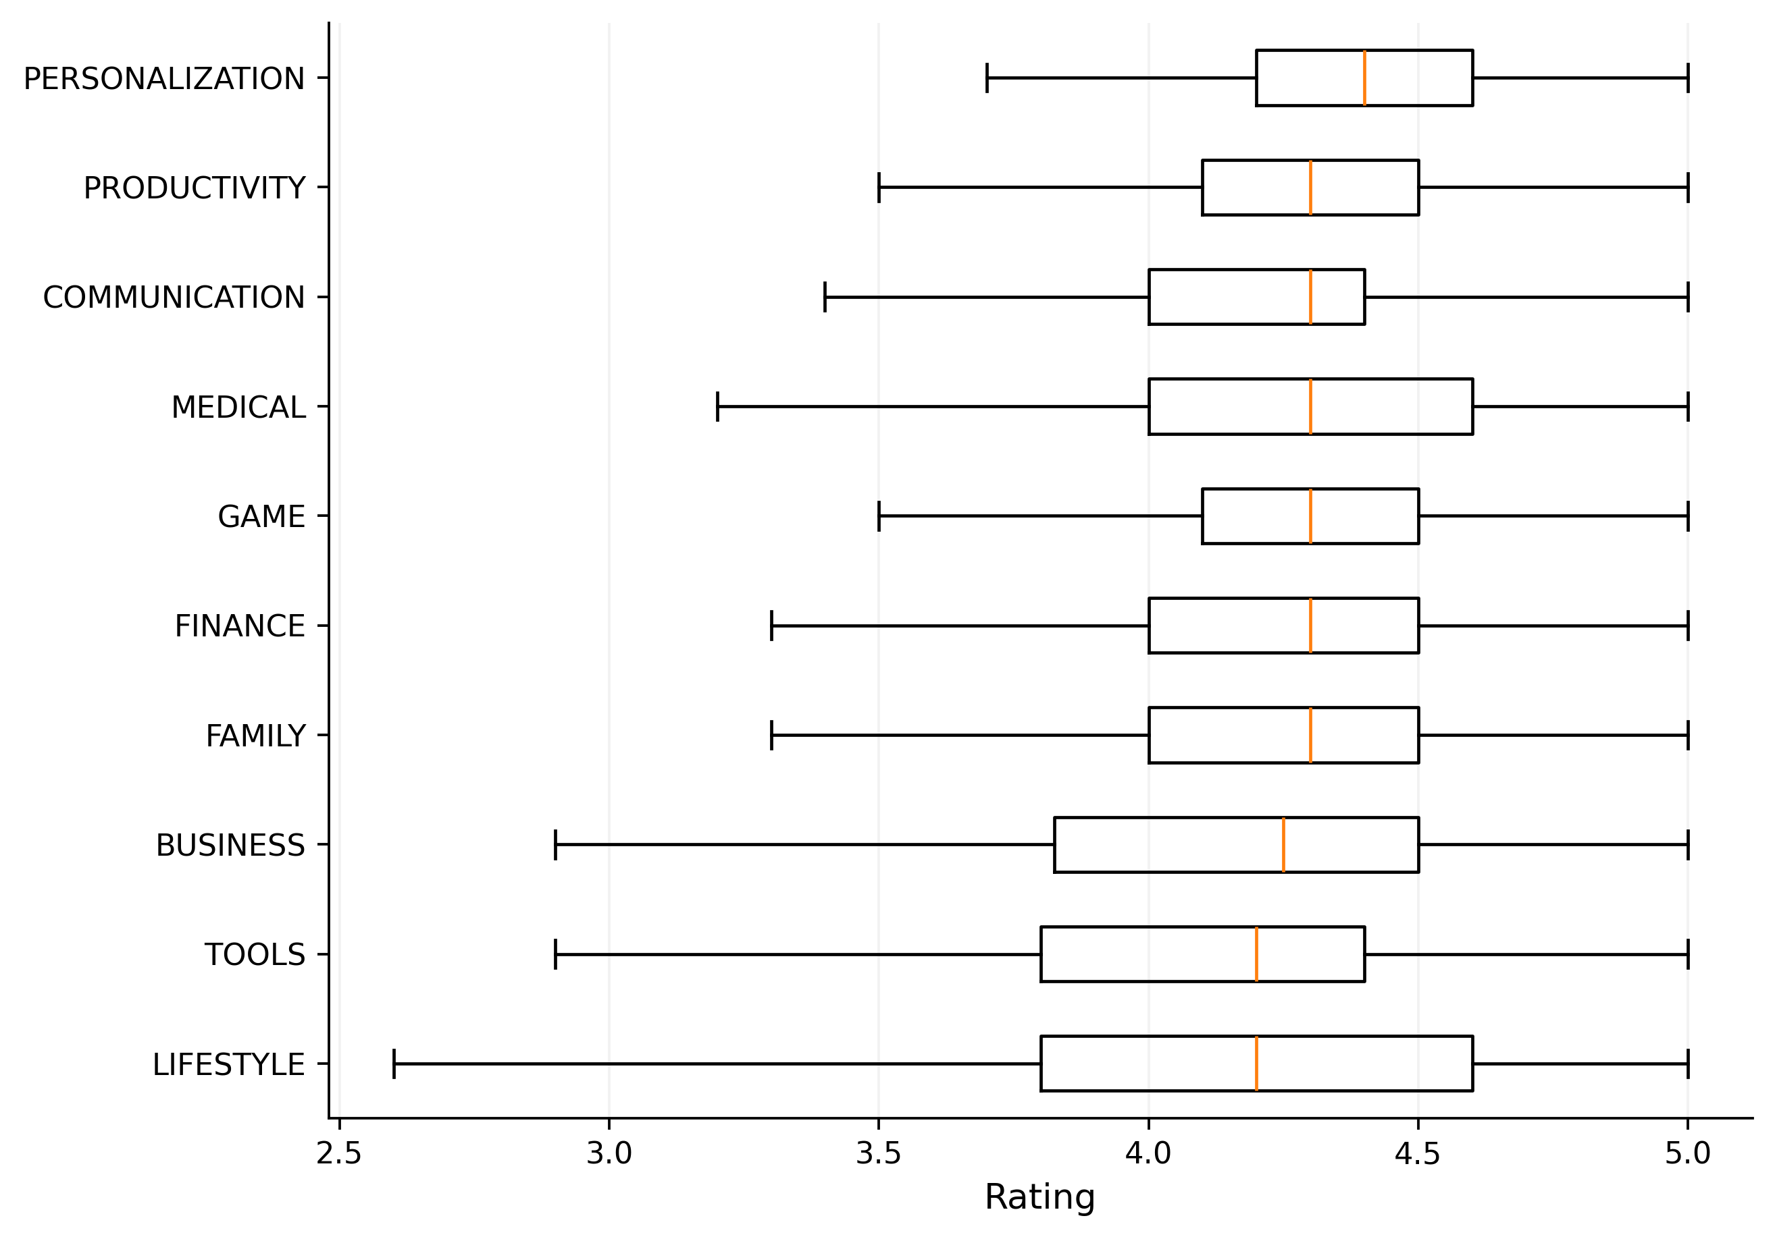


Rating Distribution by Type and Category
Key Insight: While Paid apps show marginally higher average ratings than Free apps, the variation within each group (Free/Paid or across Categories) far outweighs the differences between group averages.
Free Apps (Sample: 8,279)
Mean = 4.182
Medain = 4.3
Paid Apps (Sample: 613)
Mean = 4.262
Medain = 4.4
Responsible member: LIU YUHAN
Notes:
Next, we investigate how ratings vary across different app types and categories. On the left, the violin plot shows the rating distribution for free versus paid apps. We can see that paid apps tend to have a slightly higher median rating. This is confirmed by the comparison cards, where the mean rating for paid apps (4.262) is slightly higher than for free apps (4.182). On the middle, the boxplot displays ratings across the top 10 categories. While there are minor differences in median ratings between categories, the most striking observation is the significant overlap in their distributions. This indicates that while type and category provide some predictive information, the variation within each group is much larger than the differences between groups.

Slide 7
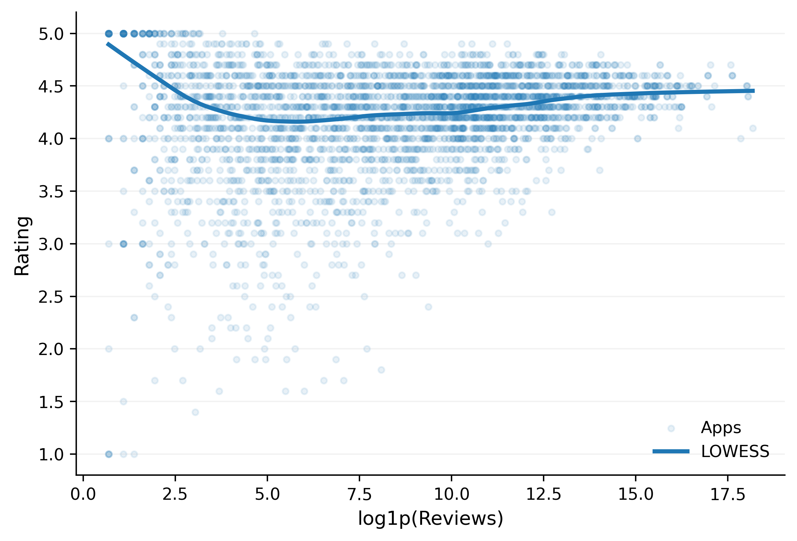
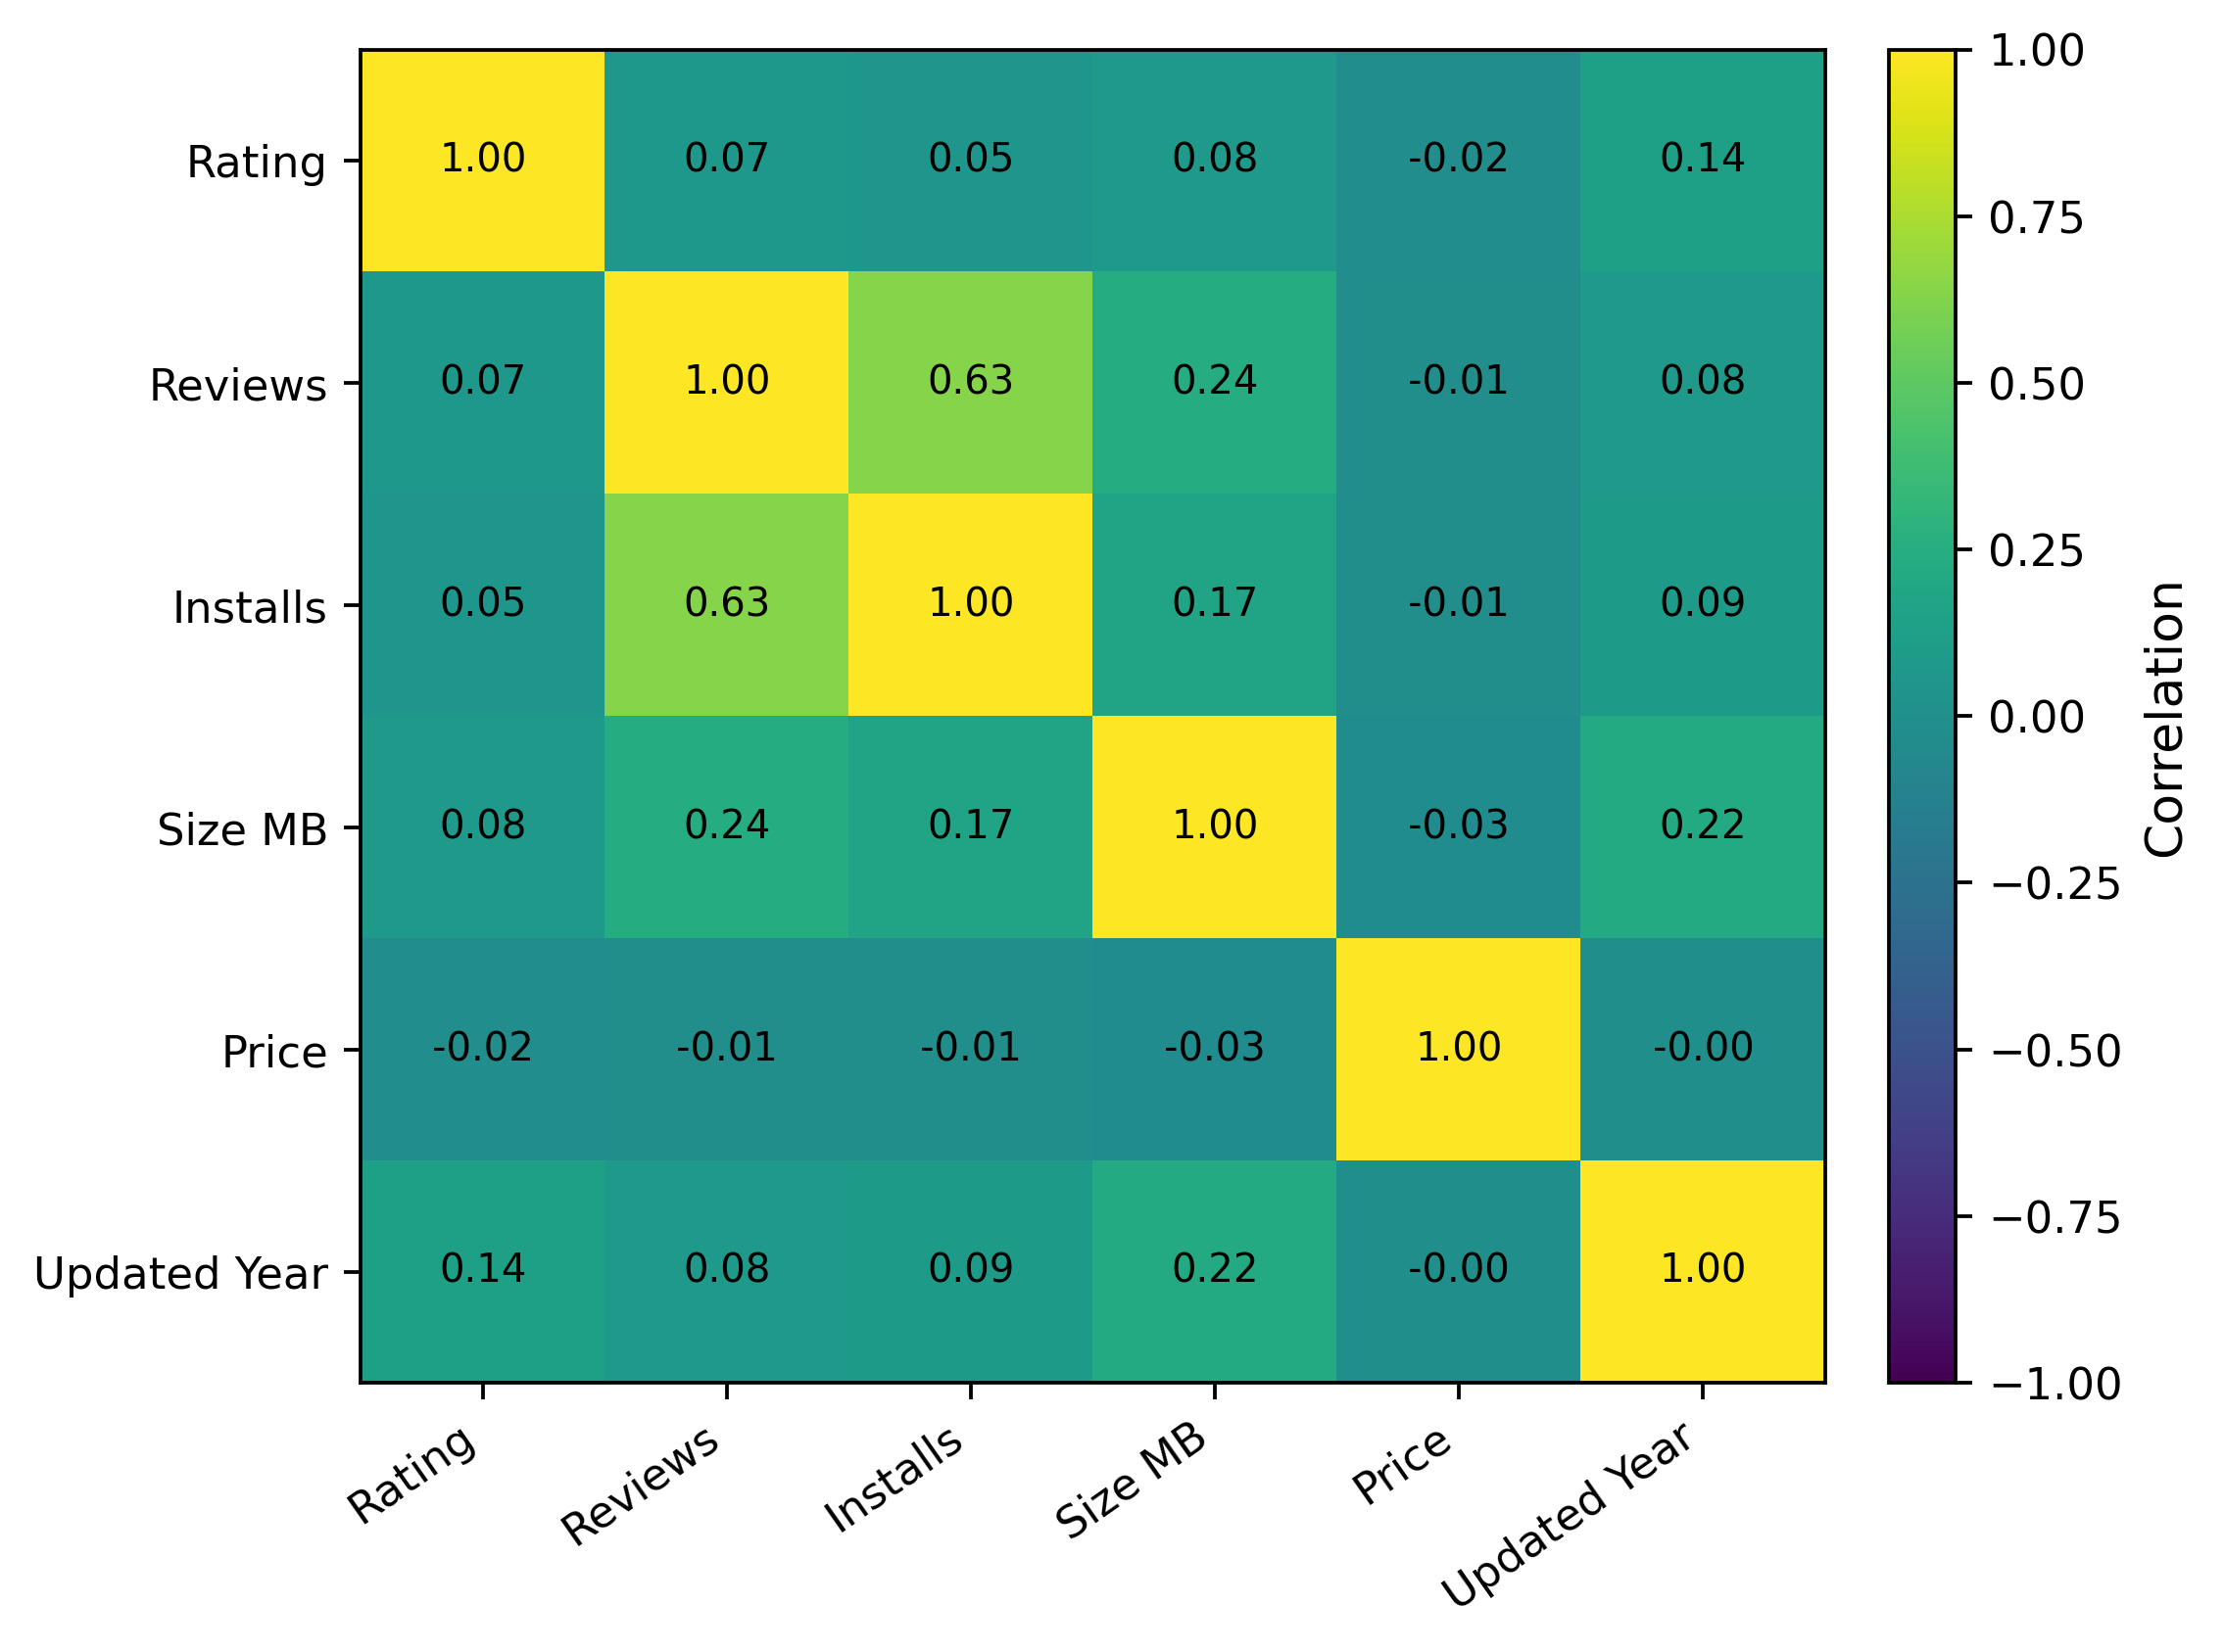
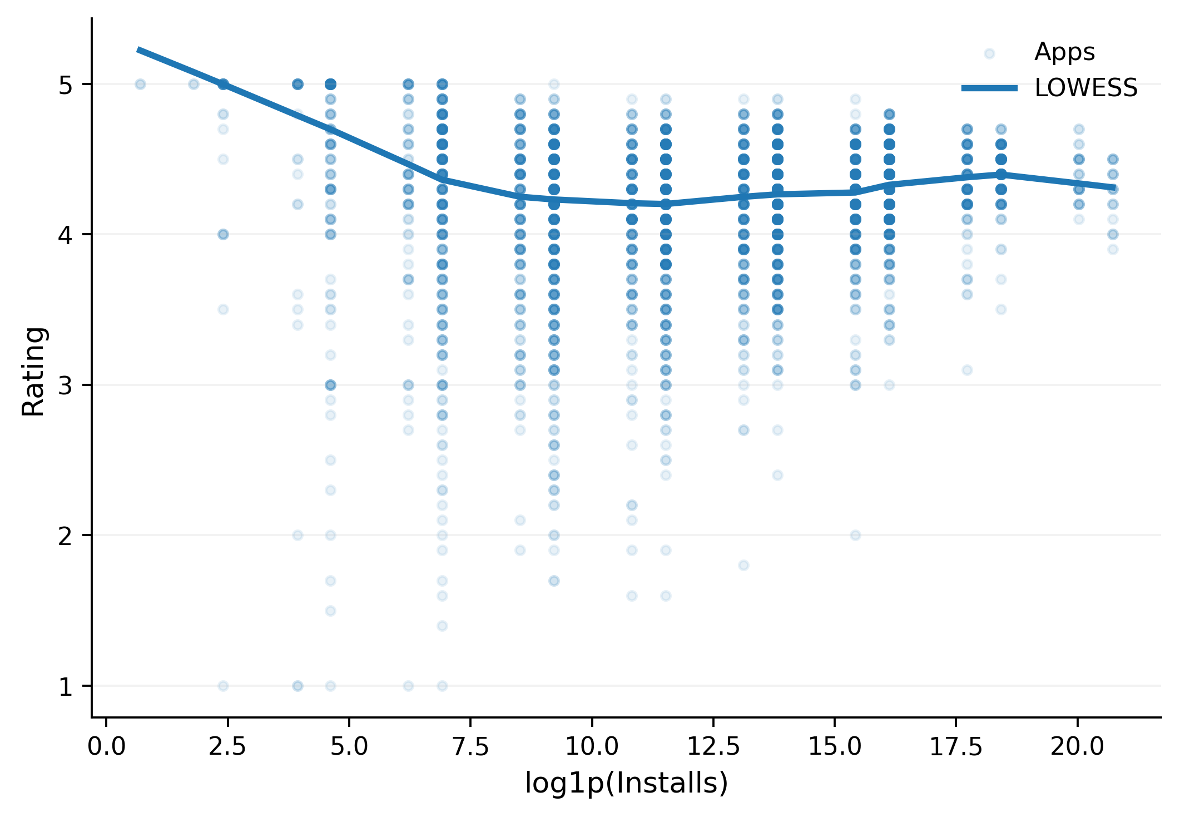
Multivariate Correlation Analysis
Key Insight: Univariate relationships between individual features and app ratings are relatively weak (Pearson r < 0.15). The modeling strategy must focus on combining these weak signals to build a robust predictive model.
Correlation Strength with Target (Rating)
Pearson (Linear):
• Updated_Year: 0.137 (Highest)
• Reviews: 0.069 | Installs: 0.051
Selected Features for Model Training
1. Rating (Target)
2. Reviews Count
3. Installs Volume
4. App Size (MB)
5. Price (USD)
6. Last Updated Year
7. Category
8. Type (Free/Paid)
Responsible member: LIU XUANHUI
Notes:
To understand the drivers of app ratings, we first examine the relationship between individual variables and ratings. The two LOWESS plots on the left show the trend between reviews/installs and ratings. We can see a slight positive relationship, but it is very weak and noisy. This is confirmed by the correlation coefficients listed on the right, where the highest Pearson correlation with rating is only 0.137 (for Updated_Year). The heatmap on the right further illustrates these weak correlations across all numeric features. The key insight here is that no single variable can explain a significant portion of the rating variation. Therefore, our modeling strategy must focus on combining these multiple weak signals to create a more robust and stable prediction model. The features we will retain for modeling are listed in the chips at the bottom.

Slide 8
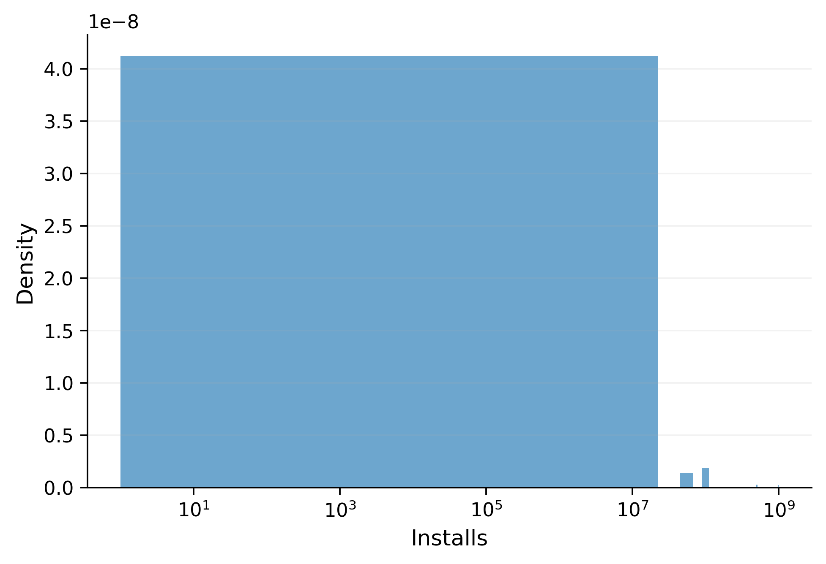
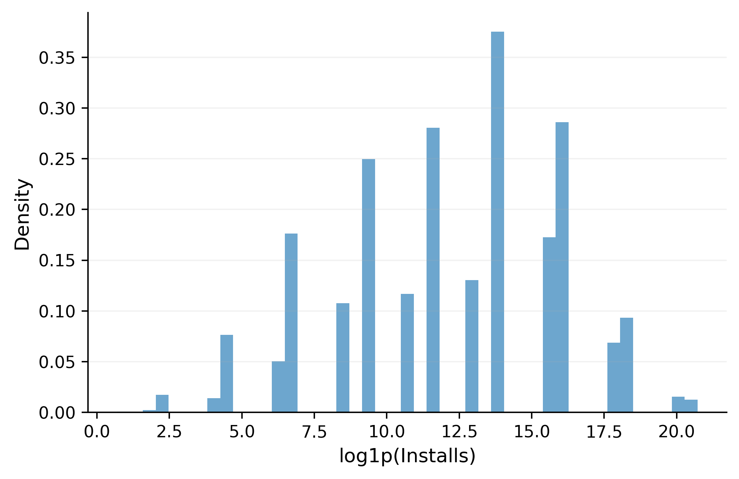
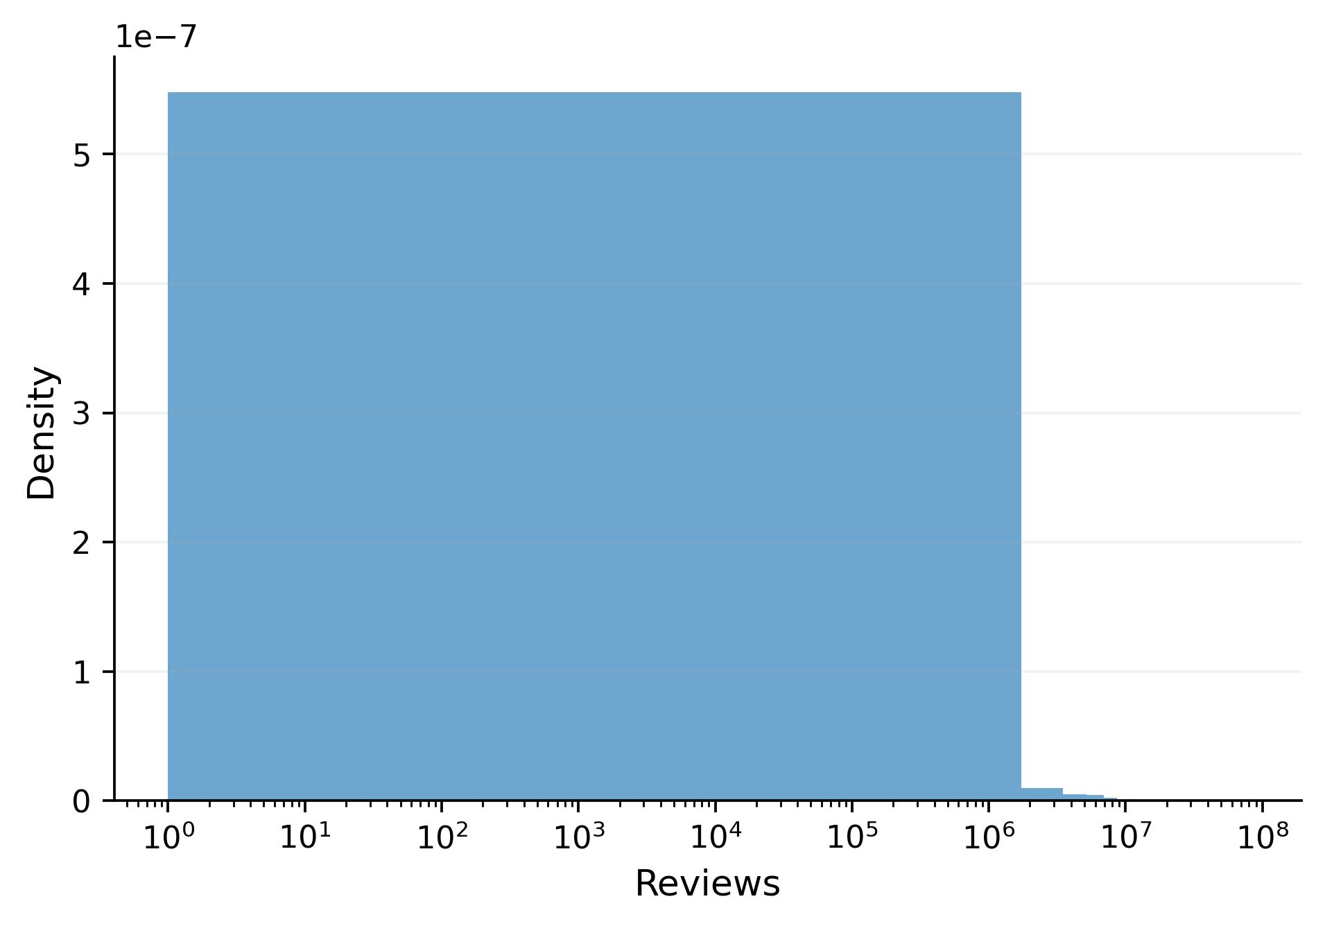
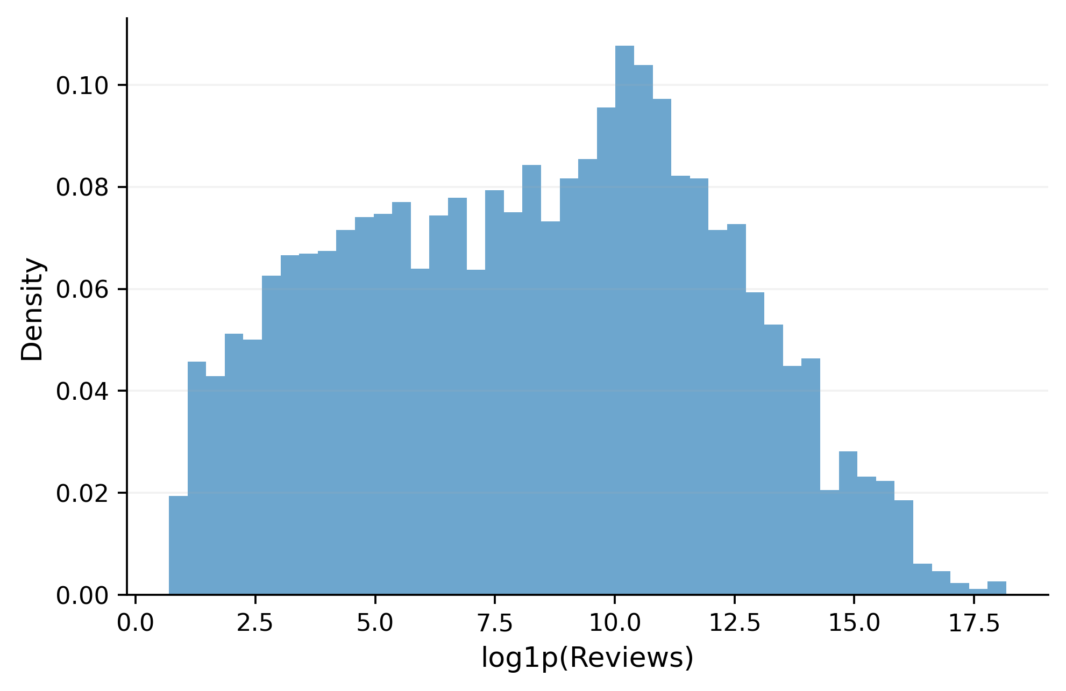
Preprocessing: Log Transformation for Long-Tail Features
Log transformation mitigates extreme value bias in skewed datasets (Reviews/Installs), converting long-tailed distributions into symmetric, Gaussian-like forms to boost accuracy for scale-sensitive AI models.
Installs Skewness
9.38 (Raw) → -0.28 (Log)
Model Performance
(RMSE Reduction)
Linear Reg
0.509 → 0.480
↓ 5.7% Error
KNN
0.556 → 0.488
↓ 12.2% Error
Reviews Skewness
16.21 (Raw) → -0.02 (Log)
Random Forest
0.478 → 0.475
~ Stable
Responsible member: LIU XUANHUI
Notes:
A critical preprocessing step was applying a log transformation to the highly skewed 'Reviews' and 'Installs' features. As shown in the plots, the raw distributions (on the left) are heavily long-tailed, making it difficult for models to learn patterns across the entire range. After log transformation (on the right), the distributions become much more symmetrical and bell-shaped, as reflected in the skewness values dropping from 16.21 to near zero for reviews. This transformation had a significant positive impact on model performance, especially for scale-sensitive models like Linear Regression and KNN, as seen in the RMSE reduction on the right. Tree-based models like Random Forest were less affected, demonstrating the importance of understanding your data and choosing appropriate preprocessing for your algorithm.

Slide 9
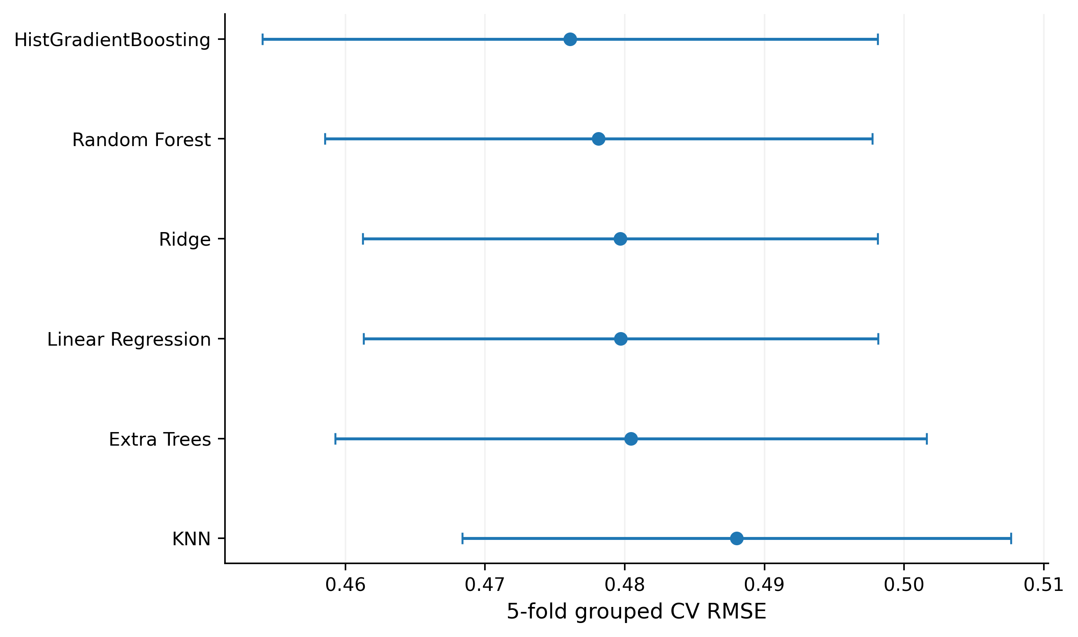

Model Selection: Beyond Just Performance
Effective model selection balances raw performance (RMSE) with stability, computational efficiency, and crucially, explainability for actionable insights.
01. Linear Regression
Core: Models linear relationships between features & target.
Pros: Fully interpretable, lightning-fast training.
Cons: Fails on non-linear data, sensitive to outliers.
Result: 5-fold CV RMSE = 0.480
02. Random Forest (Selected)
Core: Ensemble of decision trees (bagging) to reduce overfitting.
Pros: Robust to outliers, provides feature importance.
Cons: More computationally intensive than linear models.
Result: 5-fold CV RMSE = 0.478
03. HistGradientBoosting
Core: Gradient boosting with histogram-based binning for speed.
Pros: State-of-the-art accuracy, efficient on big data.
Cons: High risk of overfitting if not tuned; less interpretable.
Result: 5-fold CV RMSE = 0.476
Final Decision: Random Forest
RMSE=0.478
exceptional stability
built-in explainability tools
Responsible member: LIU XUANHUI
Notes:
Choosing the right model is not just about picking the one with the lowest RMSE. It requires a holistic evaluation of performance, stability, and explainability. We compared three promising strategies: Linear Regression, Random Forest, and HistGradientBoosting. As shown in the error-bar plot below, HistGradientBoosting (HGB) has the lowest RMSE of 0.476, making it the top performer. However, Random Forest is a very close second at 0.478 and offers significant advantages. It is more robust, less prone to overfitting, and crucially, provides built-in tools for understanding feature importance and model behavior. Therefore, we selected Random Forest as our primary model because it strikes the best balance between performance, stability, and explainability, which is essential for our goal of gaining insights from the data.

Slide 10
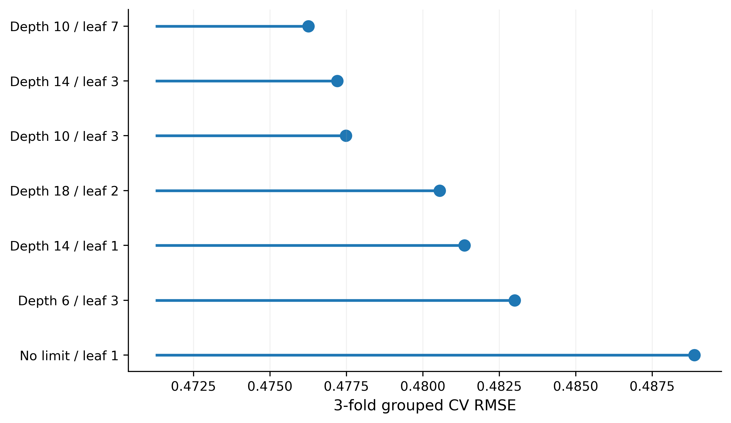
Hyperparameter Tuning: Finding the Optimal Complexity
Key Insight: More complex trees do not guarantee better generalization. Moderate regularization (e.g., limiting depth) yields the most stable and accurate predictions.
OPTIMAL MODEL (RMSE: 0.476)
Params: max_depth=10, min_samples_leaf=7
Best balance of bias & variance, lowest error on validation set.
GOOD FIT (RMSE: 0.478)
Params: max_depth=14, min_samples_leaf=3
Slightly higher complexity, marginally increased error.
MODERATE (RMSE: 0.480)
Params: max_depth=10, min_samples_leaf=3
Under-regularized, slight overfitting to training data.
OVERFITTING (RMSE: 0.489)
Params: No depth limit, min_samples_leaf=1
Extremely complex, high variance, poor generalization.
Responsible member: LIU XUANHUI
Notes:
To optimize our Random Forest model, we performed hyperparameter tuning to find the optimal level of complexity. The parameter tiles on the left show different combinations of maximum depth and minimum samples per leaf, with their corresponding RMSE values. Using a color gradient (from green for low RMSE to red for high RMSE), we can clearly see that the combination of max_depth=10 and min_samples_leaf=7 yields the best performance with an RMSE of 0.476. Interestingly, the most complex model (no depth limit, leaf=1) actually performs worse, with an RMSE of 0.489, indicating overfitting. This demonstrates that more complexity is not always better, and moderate regularization is key for stability.

Slide 11
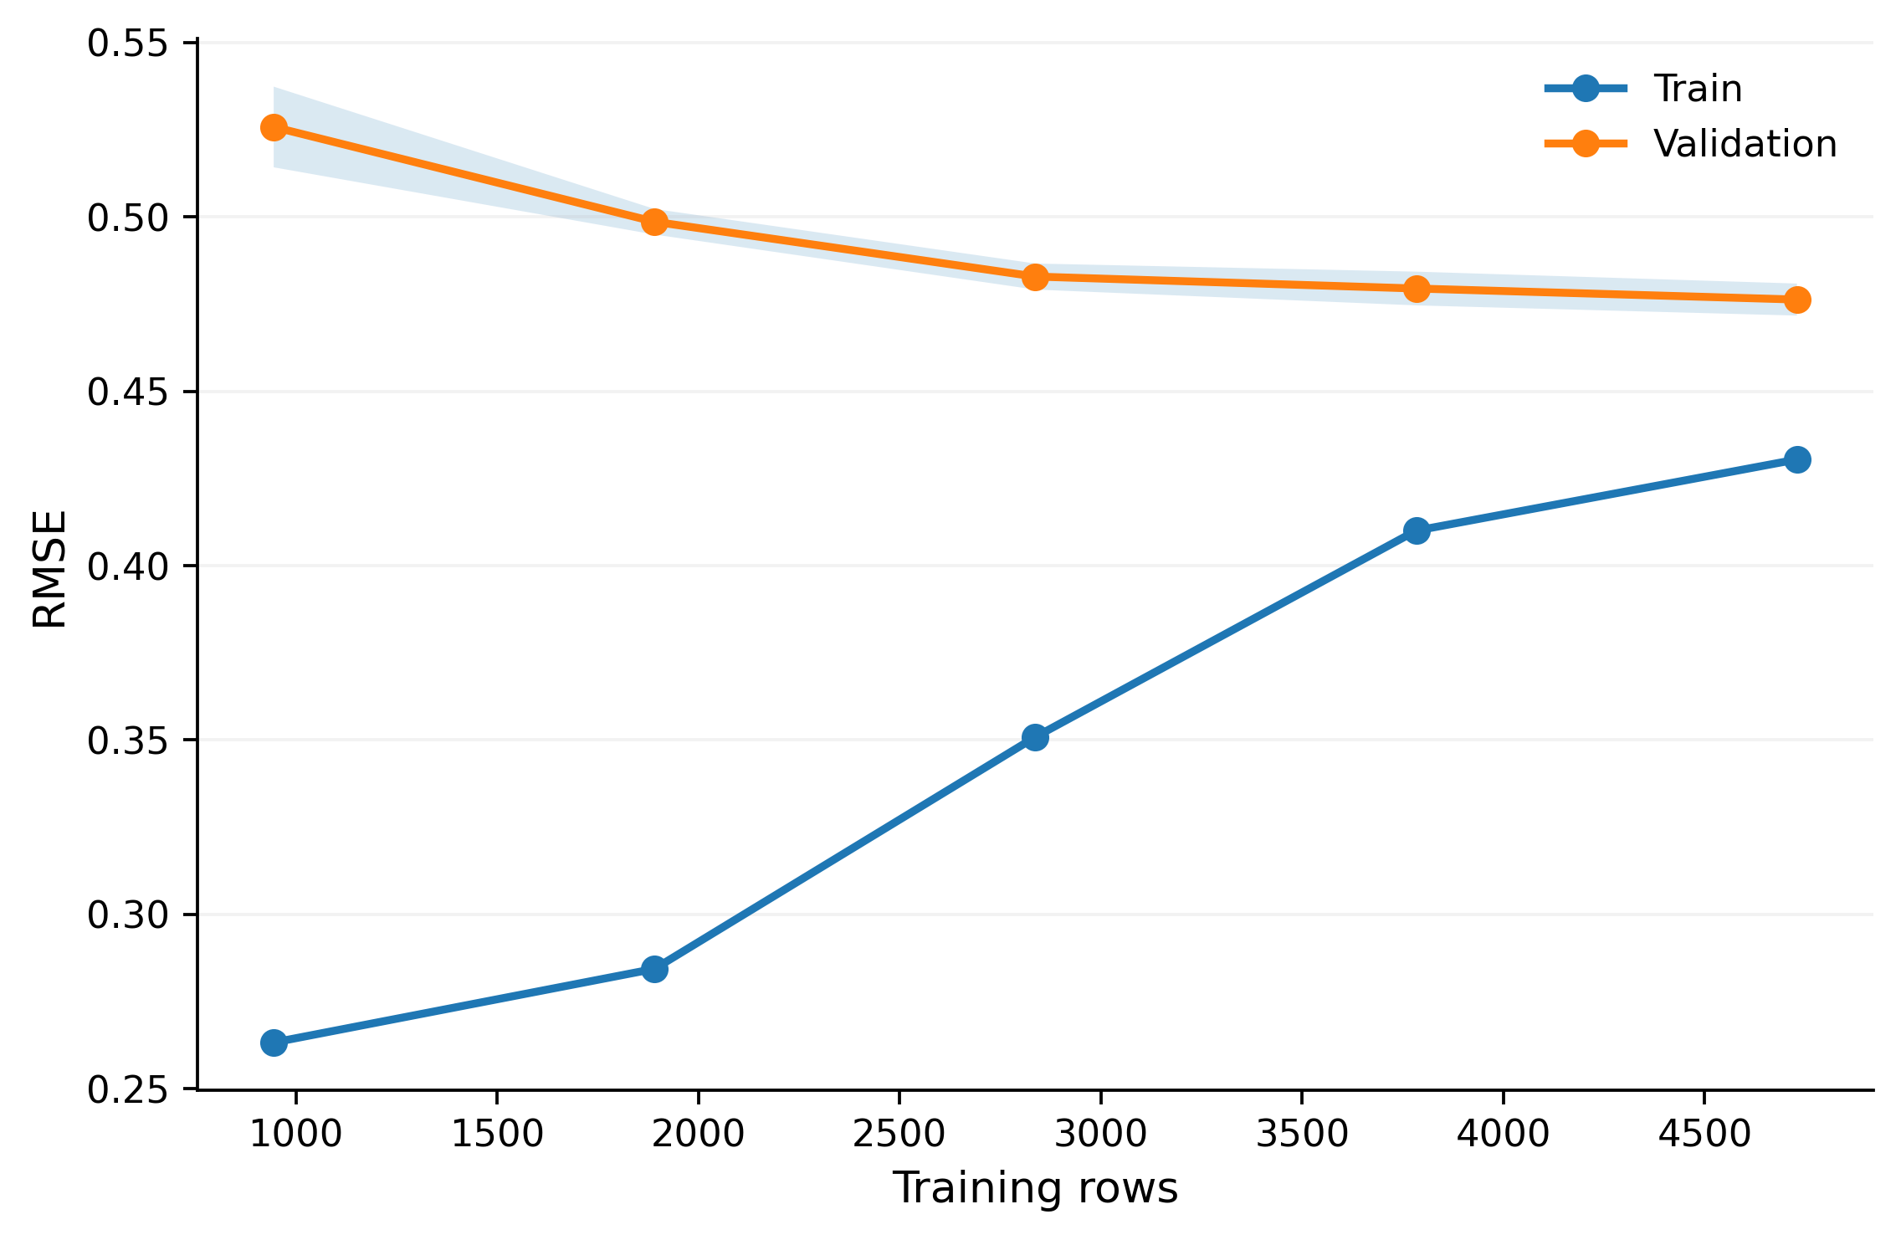
Learning Curve: Assessing Data Sufficiency
Validation RMSE
0.526 → 0.476
Gain
~9.5%
The dataset size is sufficient to observe stable trends. Further performance improvement is more likely to come from new, interpretable features, rather than adding more similar records.
Responsible member: LIU YAODONG

Slide 12
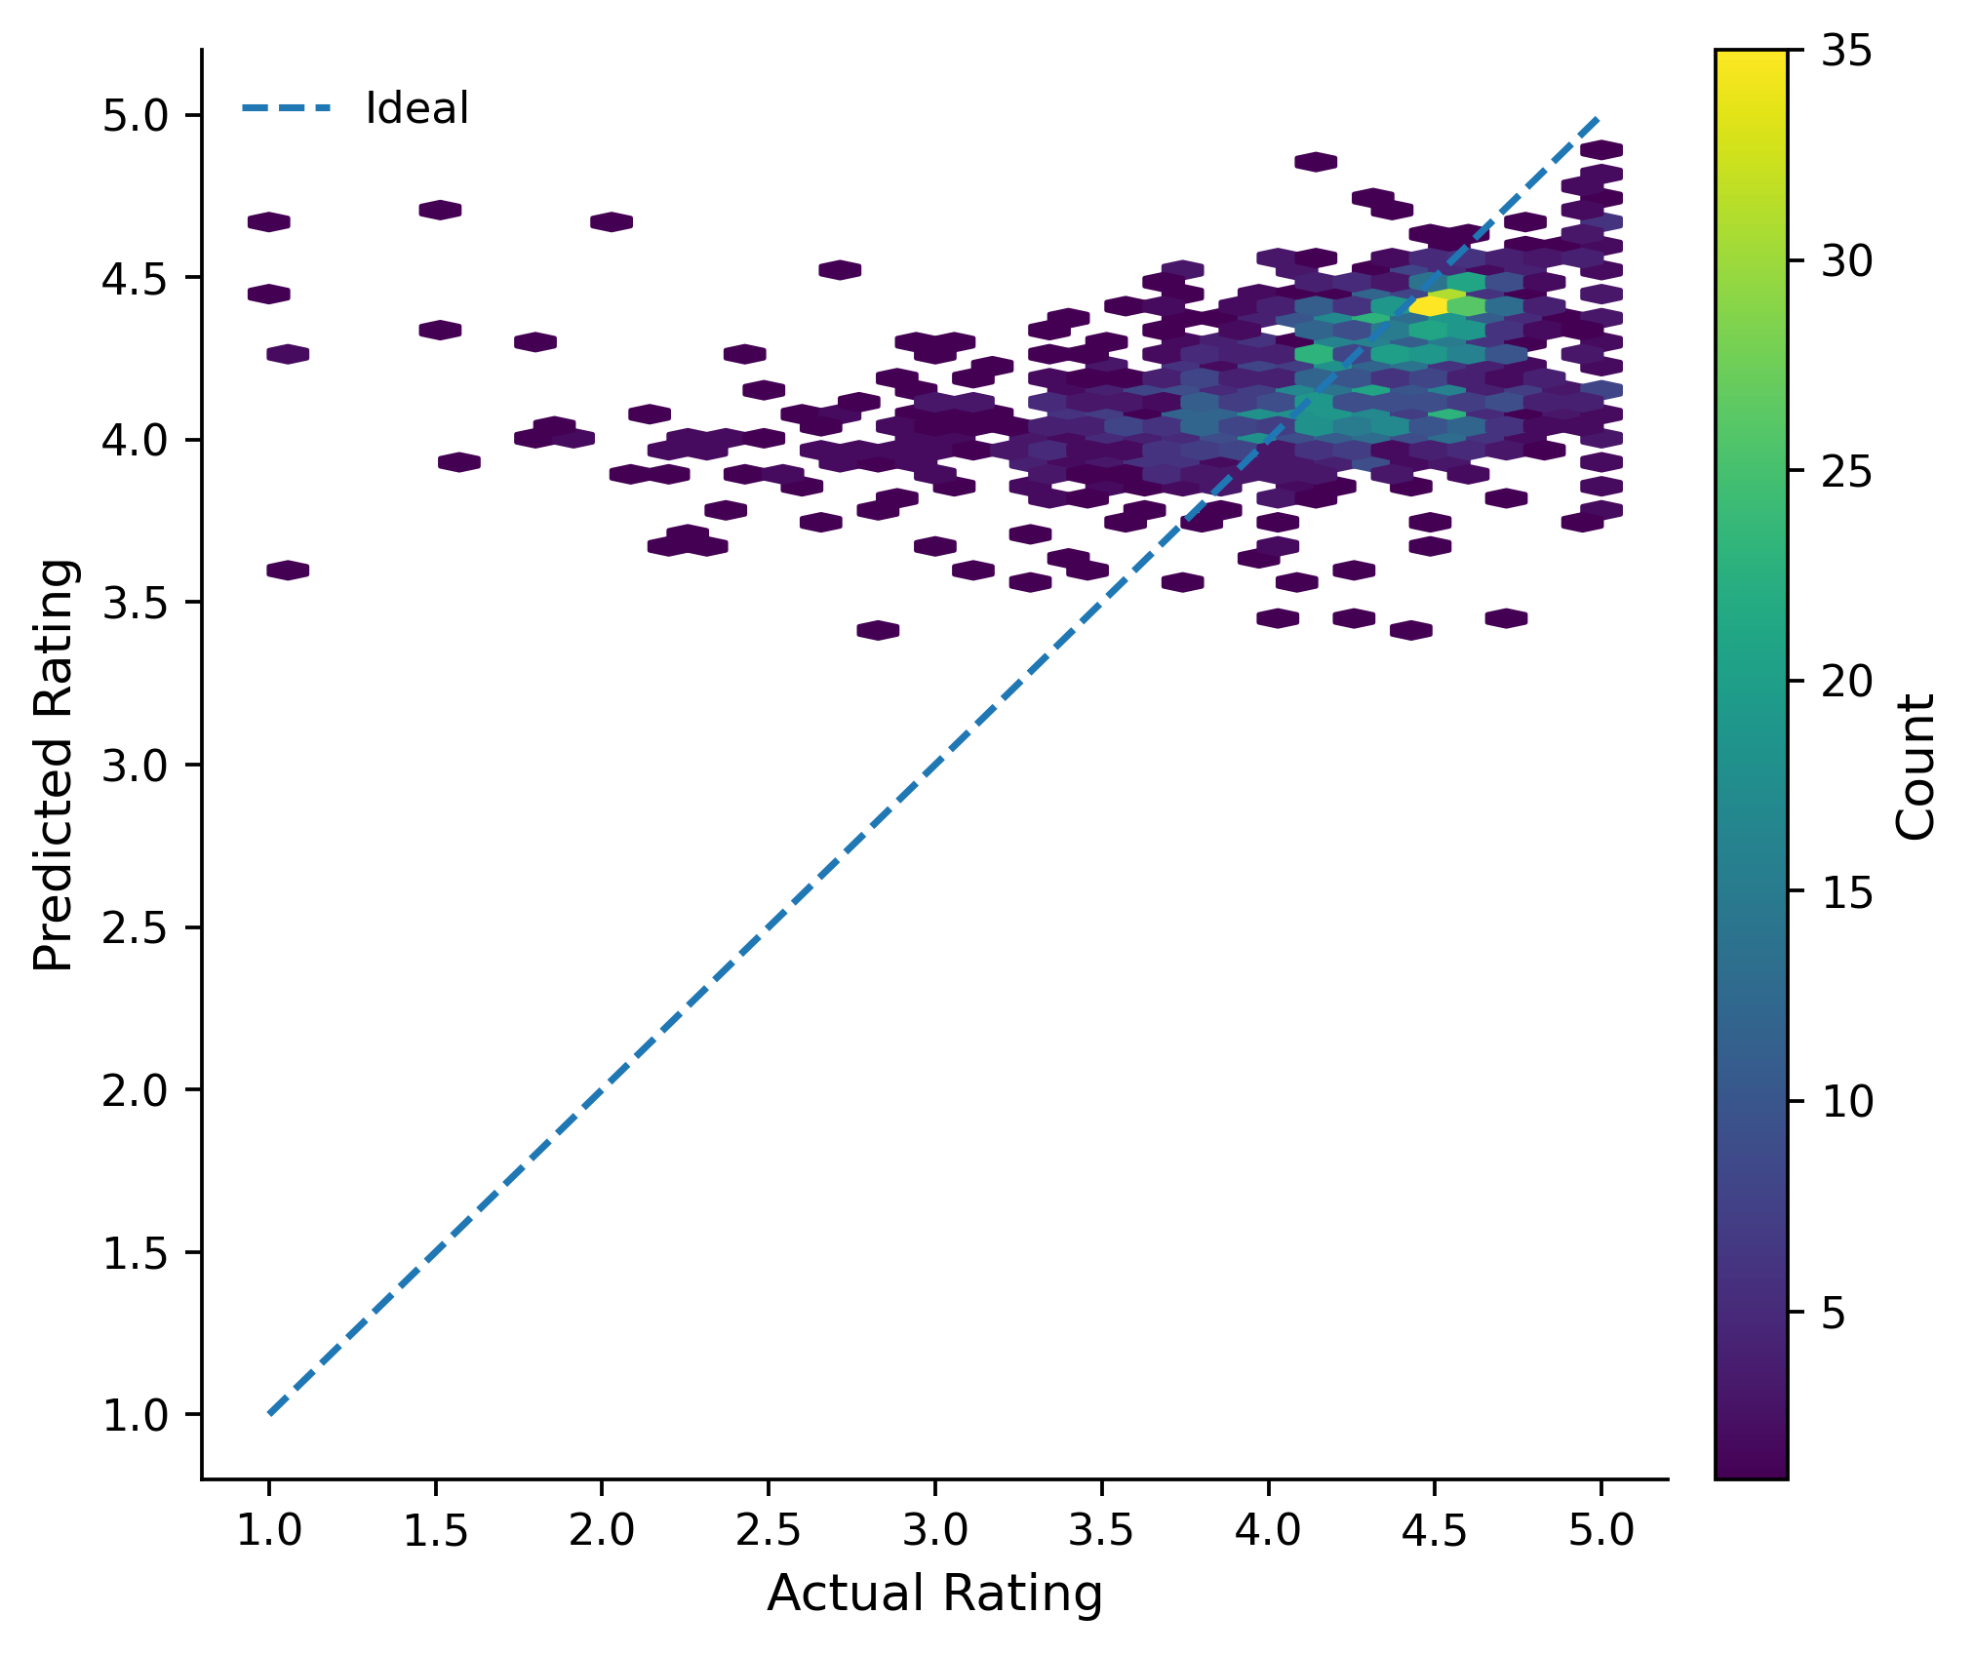
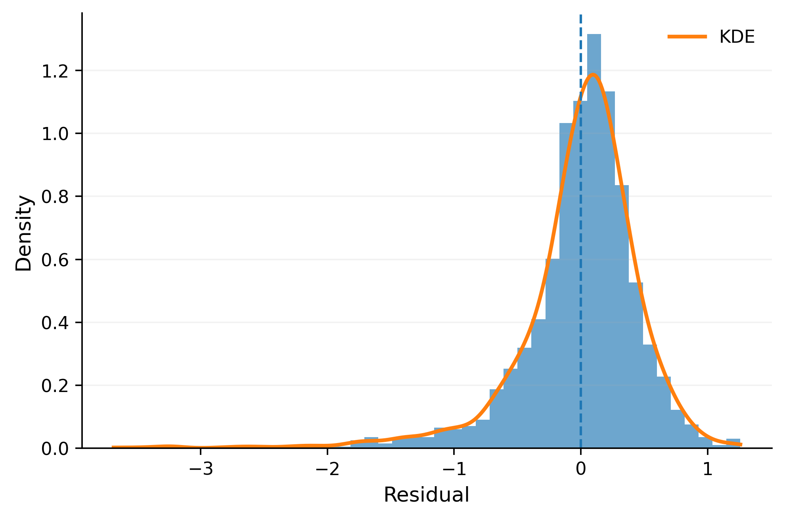
Overall metrics improve, but predictions shrink toward the middle
Holdout test
1,798
MAE
0.332
RMSE
0.495
R²
0.156
Visible store metadata explains only a small share of Rating variation.
Introduction Conclusion
Exploration of Dataset
Design of AI Algorithm
Model Evaluation
Visual Storytelling
Responsible member: LIU YAODONG
Notes:
The final Random Forest was evaluated on a holdout set of 1,798 apps. MAE is 0.332, RMSE is 0.495 and R² is 0.156. The hexbin plot is more informative than a single metric because it shows the model compressing predictions toward the mid-to-high rating range rather than reproducing the full spread. The residual distribution is centred near zero, but the modest R² indicates that the available metadata explains only a limited fraction of Rating variation. Limitation: this is predictive performance on the current feature set, not evidence that the metadata causally determines user ratings.

Slide 13
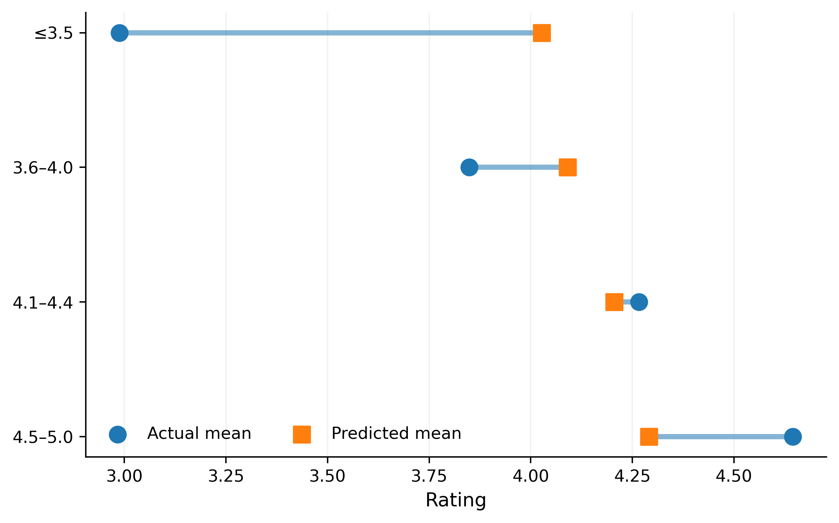
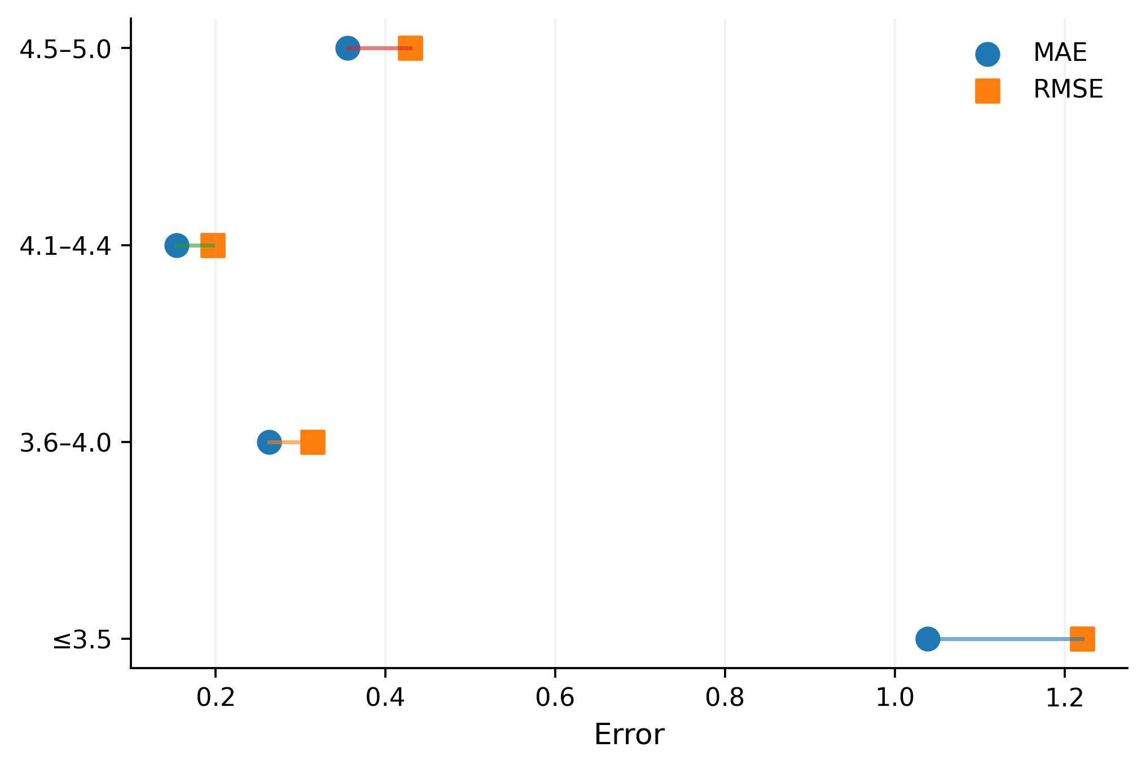
Average RMSE hides the real failure point: extreme ratings
≤3.5: actual mean ≈ 2.99 → predicted mean ≈ 4.03; MAE ≈ 1.039.
4.1–4.4: MAE ≈ 0.154 — the model is strongest in the dense middle.
Introduction Conclusion
Exploration of Dataset
Design of AI Algorithm
Model Evaluation
Visual Storytelling
Responsible member: LIU YAODONG
Notes:
The aggregate RMSE hides a much more important pattern. The left dumbbell plot compares mean actual and predicted Rating within each rating band, while the right connected-dot plot compares MAE and RMSE by band. For apps rated 3.5 or below, the actual mean is about 2.99 but the predicted mean is about 4.03, and MAE rises to about 1.039. By contrast, the 4.1–4.4 band has MAE of only about 0.154. This shows regression toward the centre: the model struggles most with genuinely low-rated apps. Limitation: the low-rating band has fewer observations than the middle bands, so band size should be considered when interpreting the error gap.

Slide 14
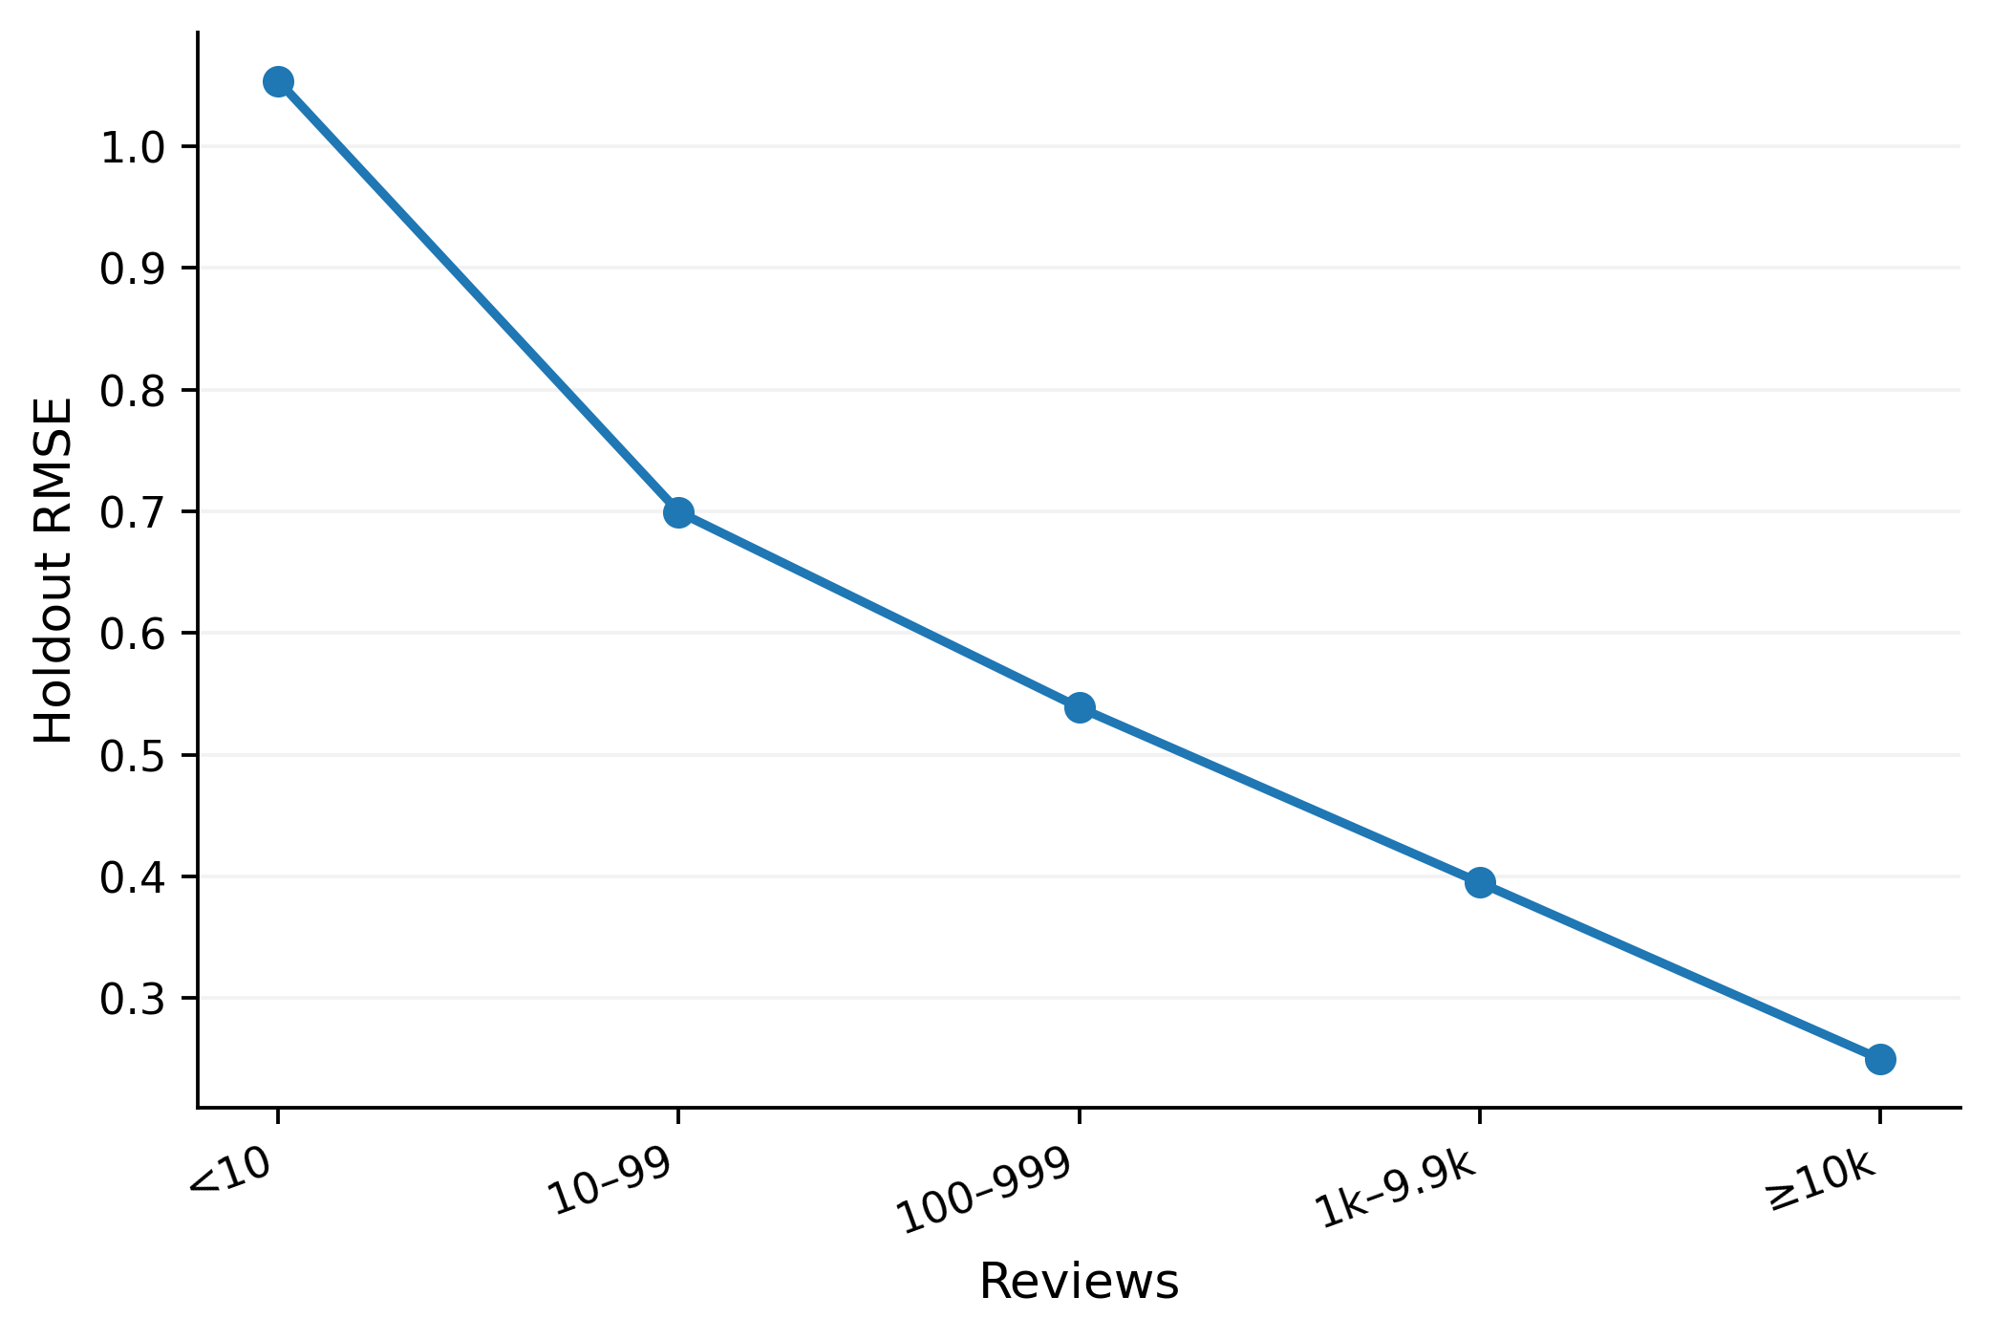
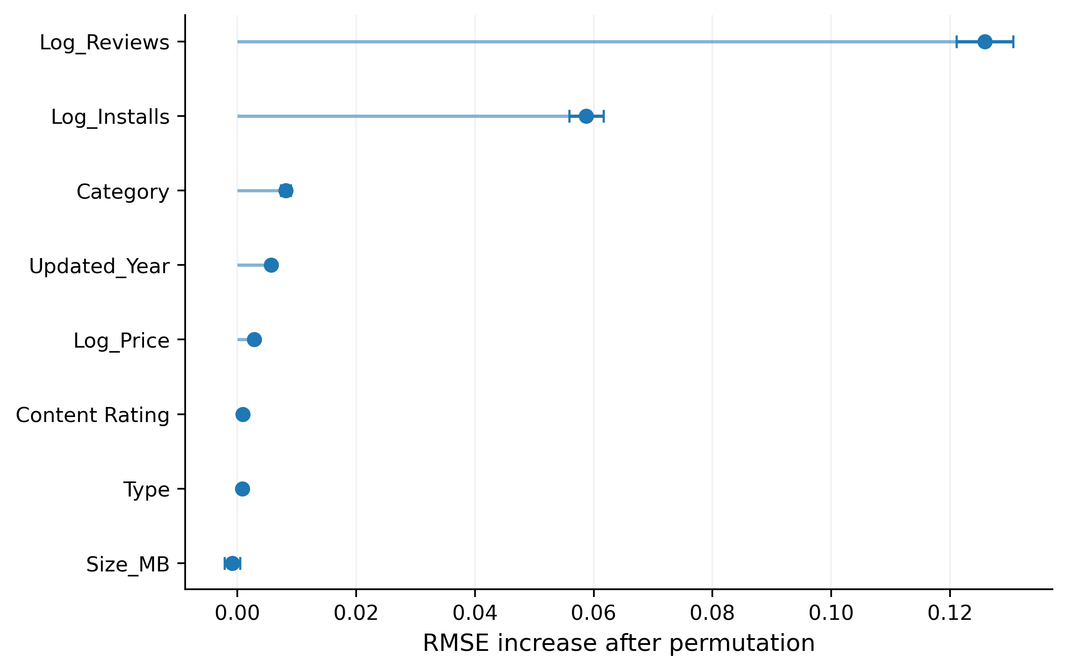
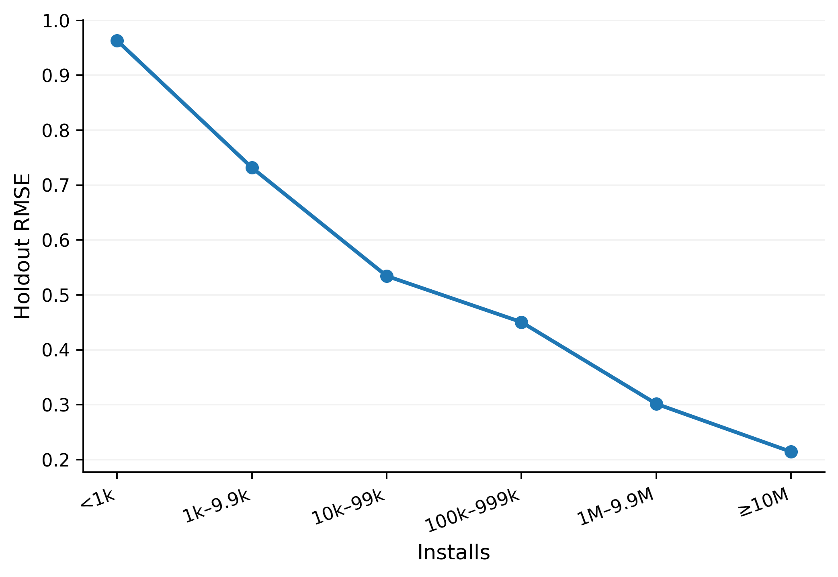
The model depends on Reviews / Installs—and is unreliable at low exposure
Permutation importance is predictive, not causal.
Reviews <10: RMSE ≈ 1.054 | Installs <1k: RMSE ≈ 0.963
Introduction Conclusion
Exploration of Dataset
Design of AI Algorithm
Model Evaluation
Visual Storytelling
Responsible member: LIU YAODONG
Notes:
Permutation importance identifies which features the trained model relies on most. Log Reviews is the strongest signal: permuting it increases RMSE by about 0.126, while Log Installs increases RMSE by about 0.059. The reliability plots then show where the model is weakest. Holdout RMSE is about 1.054 for apps with fewer than 10 Reviews, and about 0.963 for apps with fewer than 1,000 Installs. Error drops sharply as evidence and exposure increase. The visual sequence therefore links explainability to reliability: the model relies on Reviews and Installs, and low values of those same variables mark the least reliable predictions. Important limitation: permutation importance describes predictive dependence and should not be interpreted as a causal effect.

Slide 15
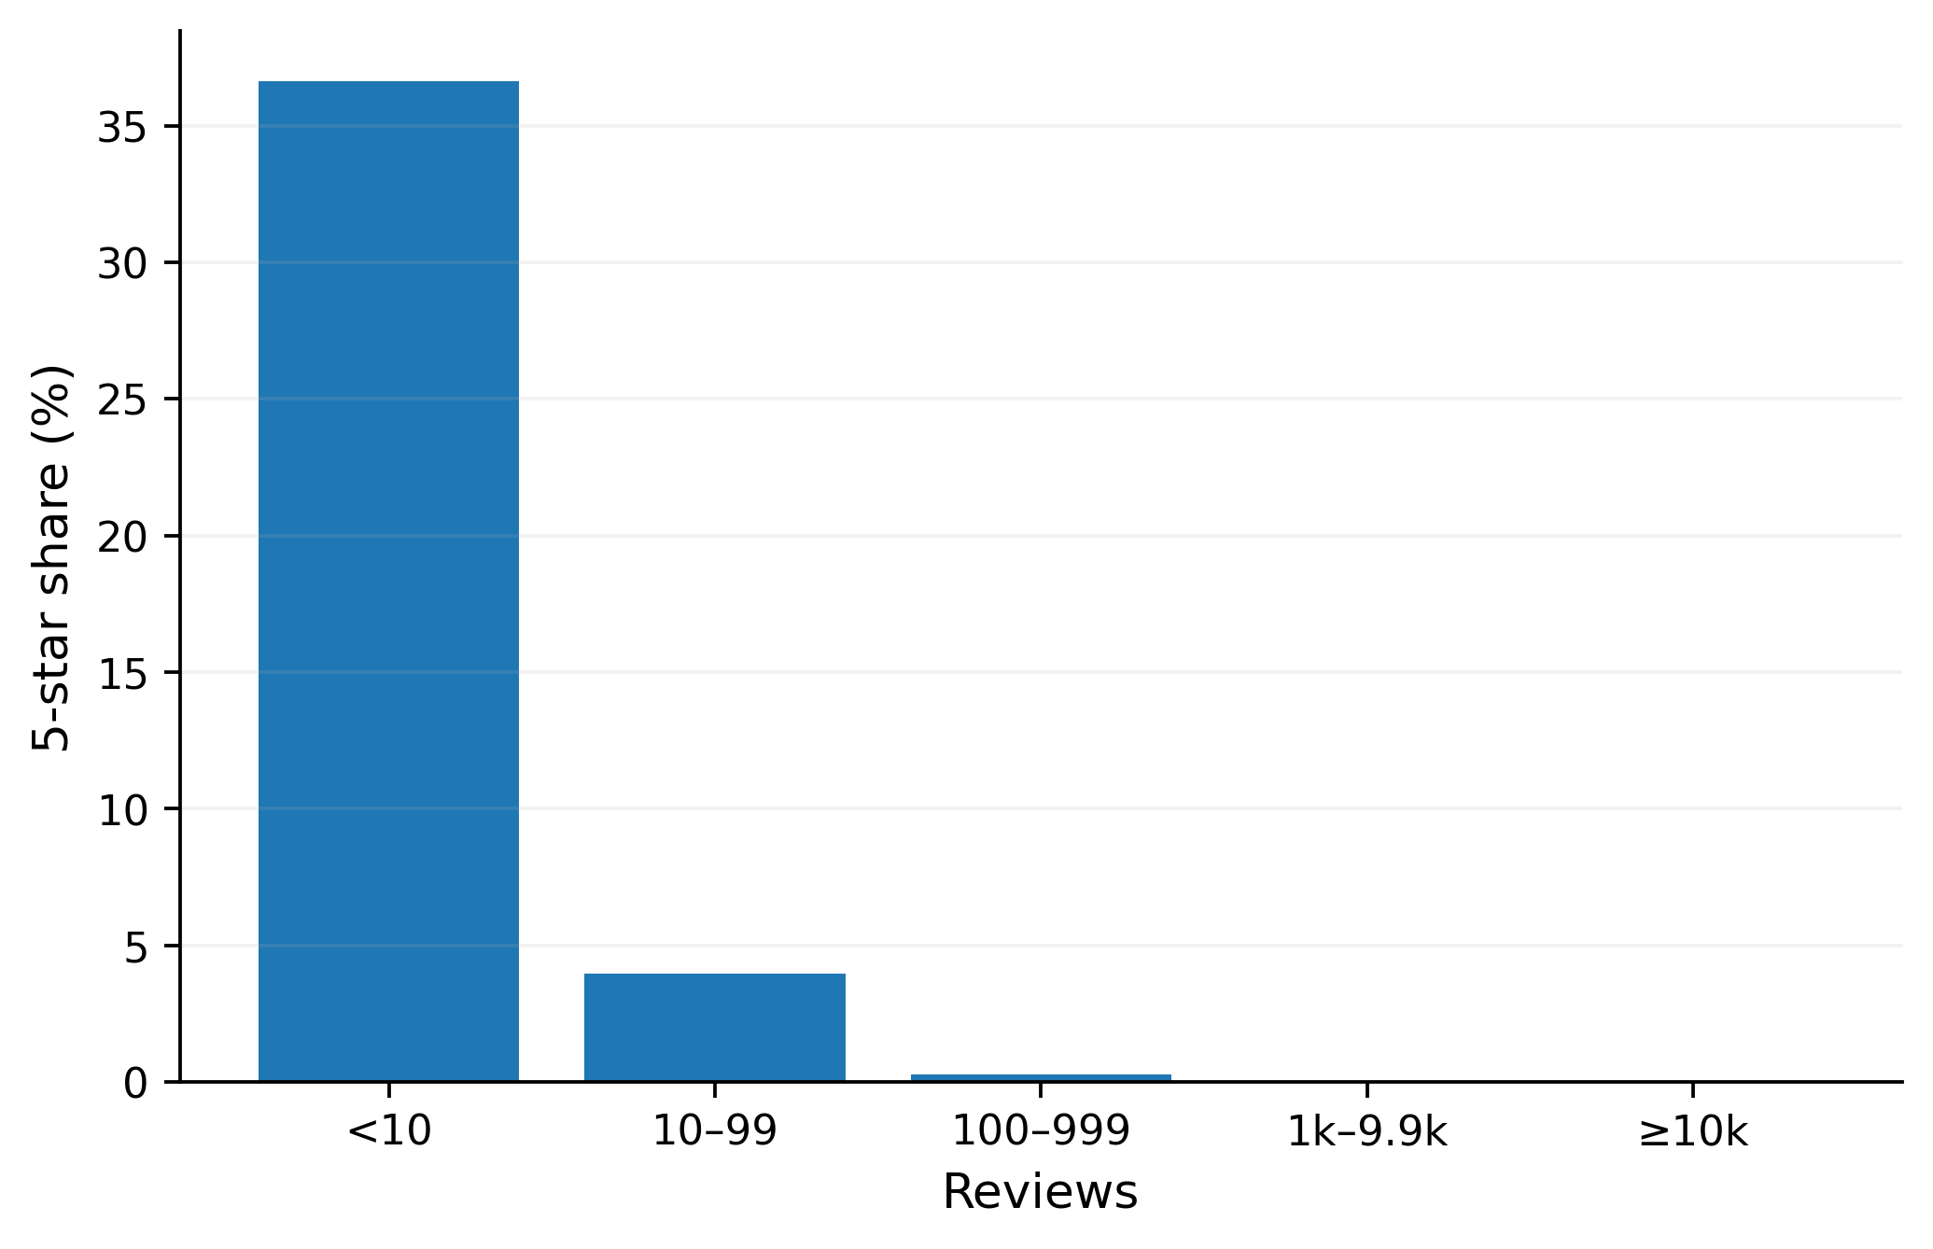
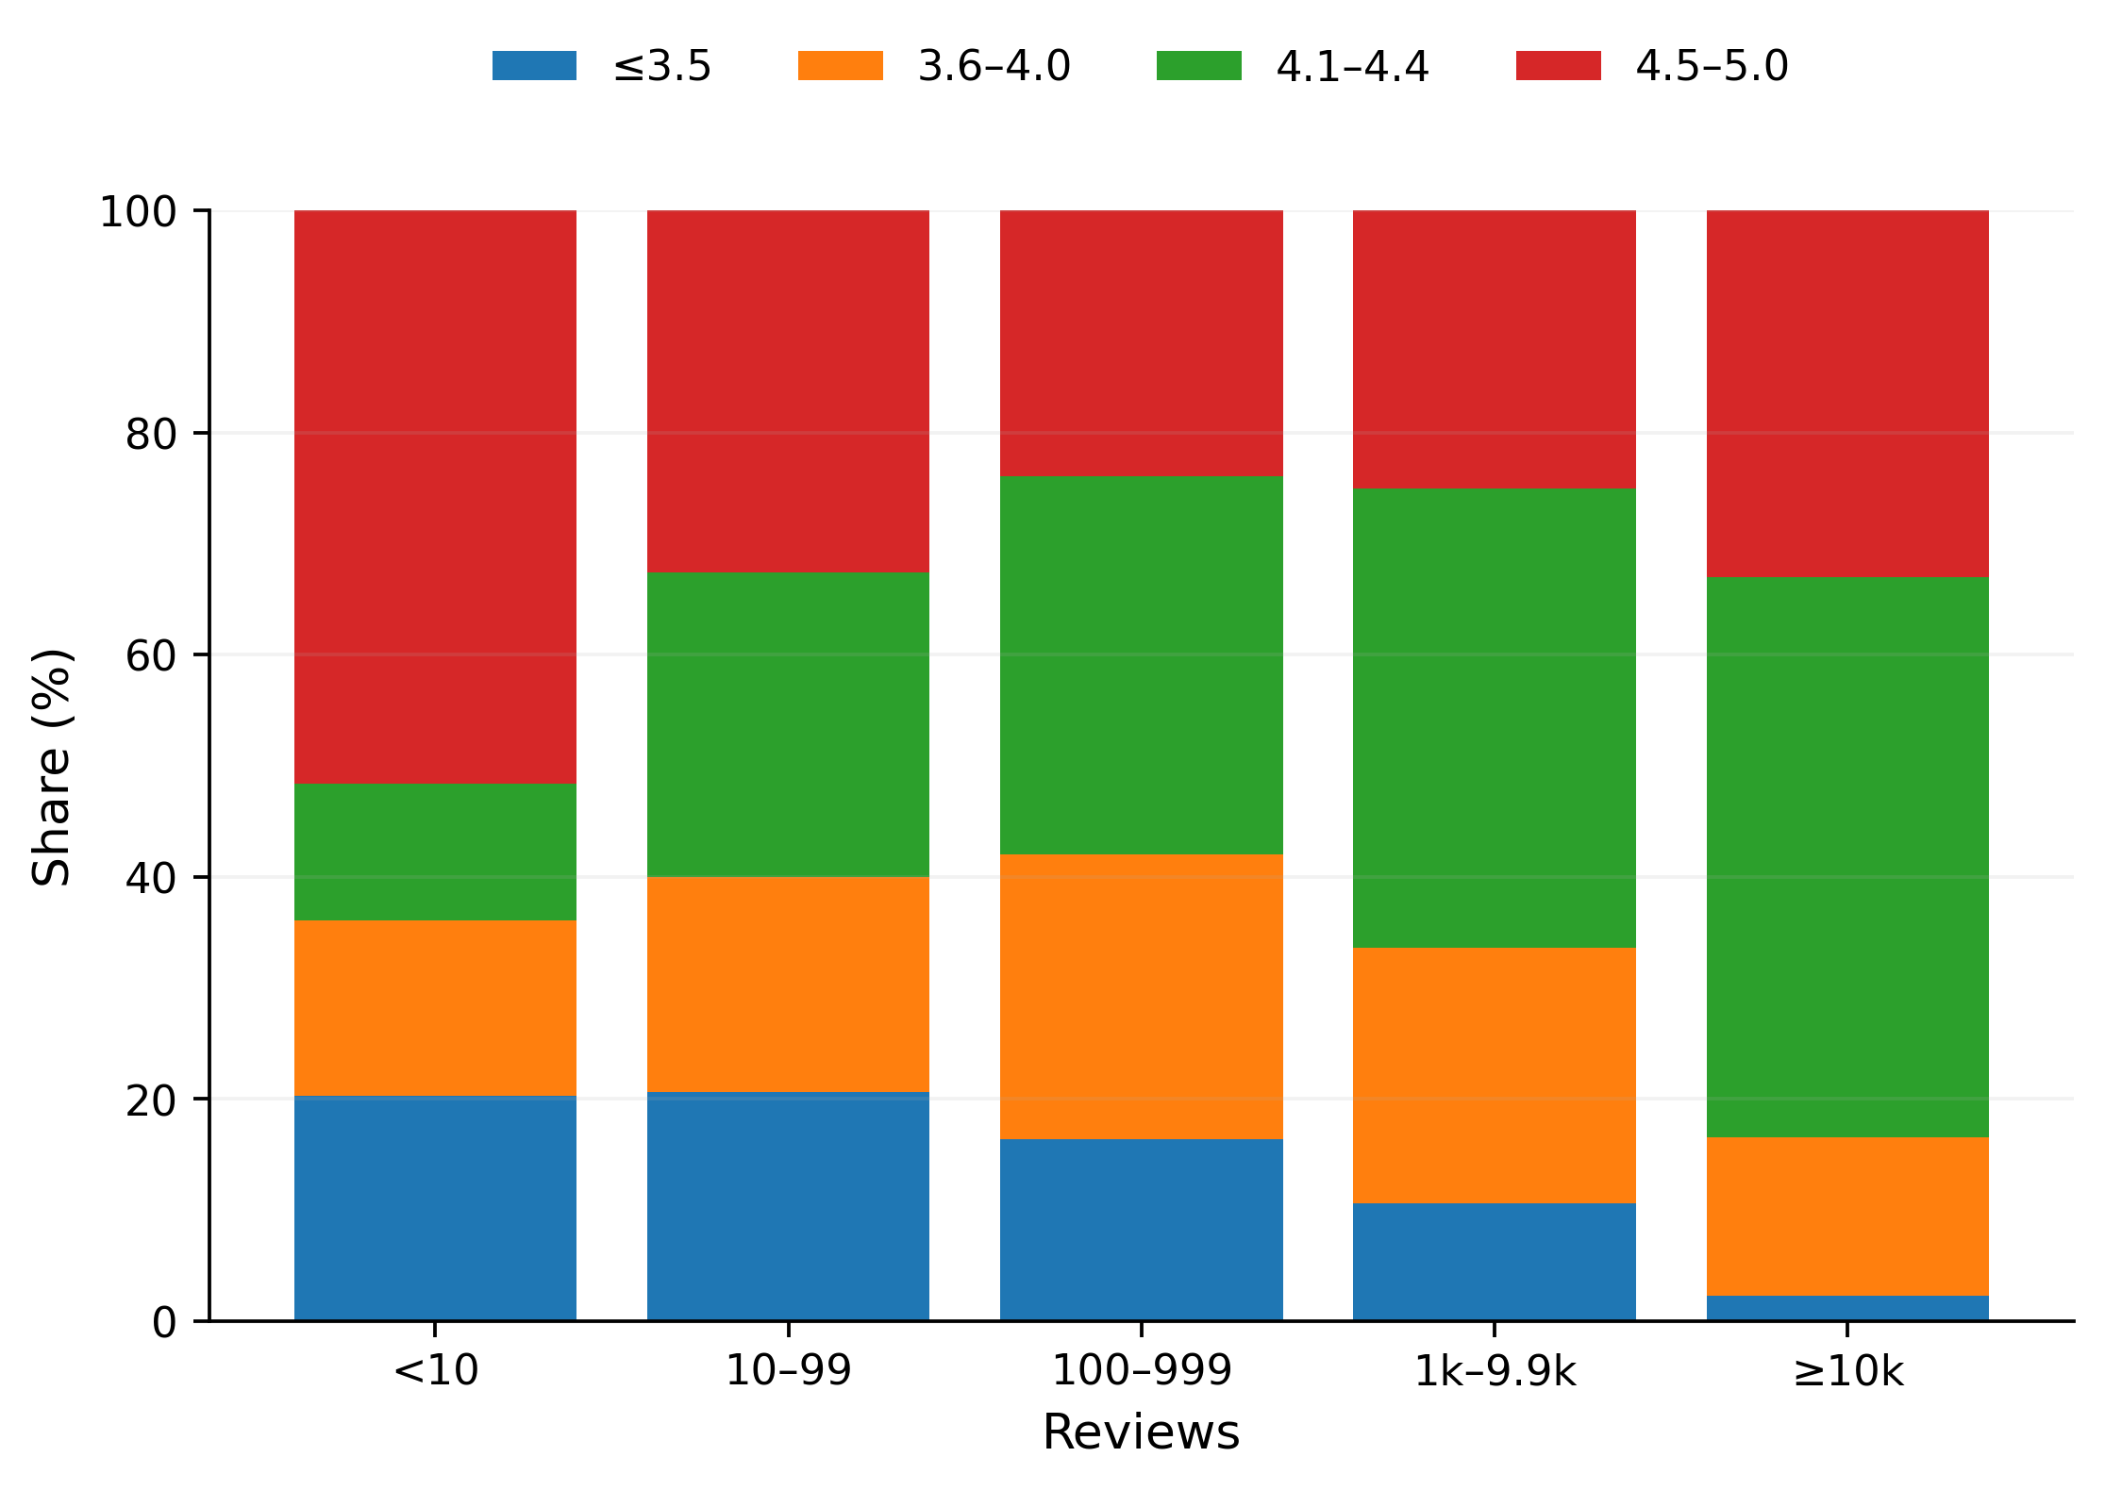
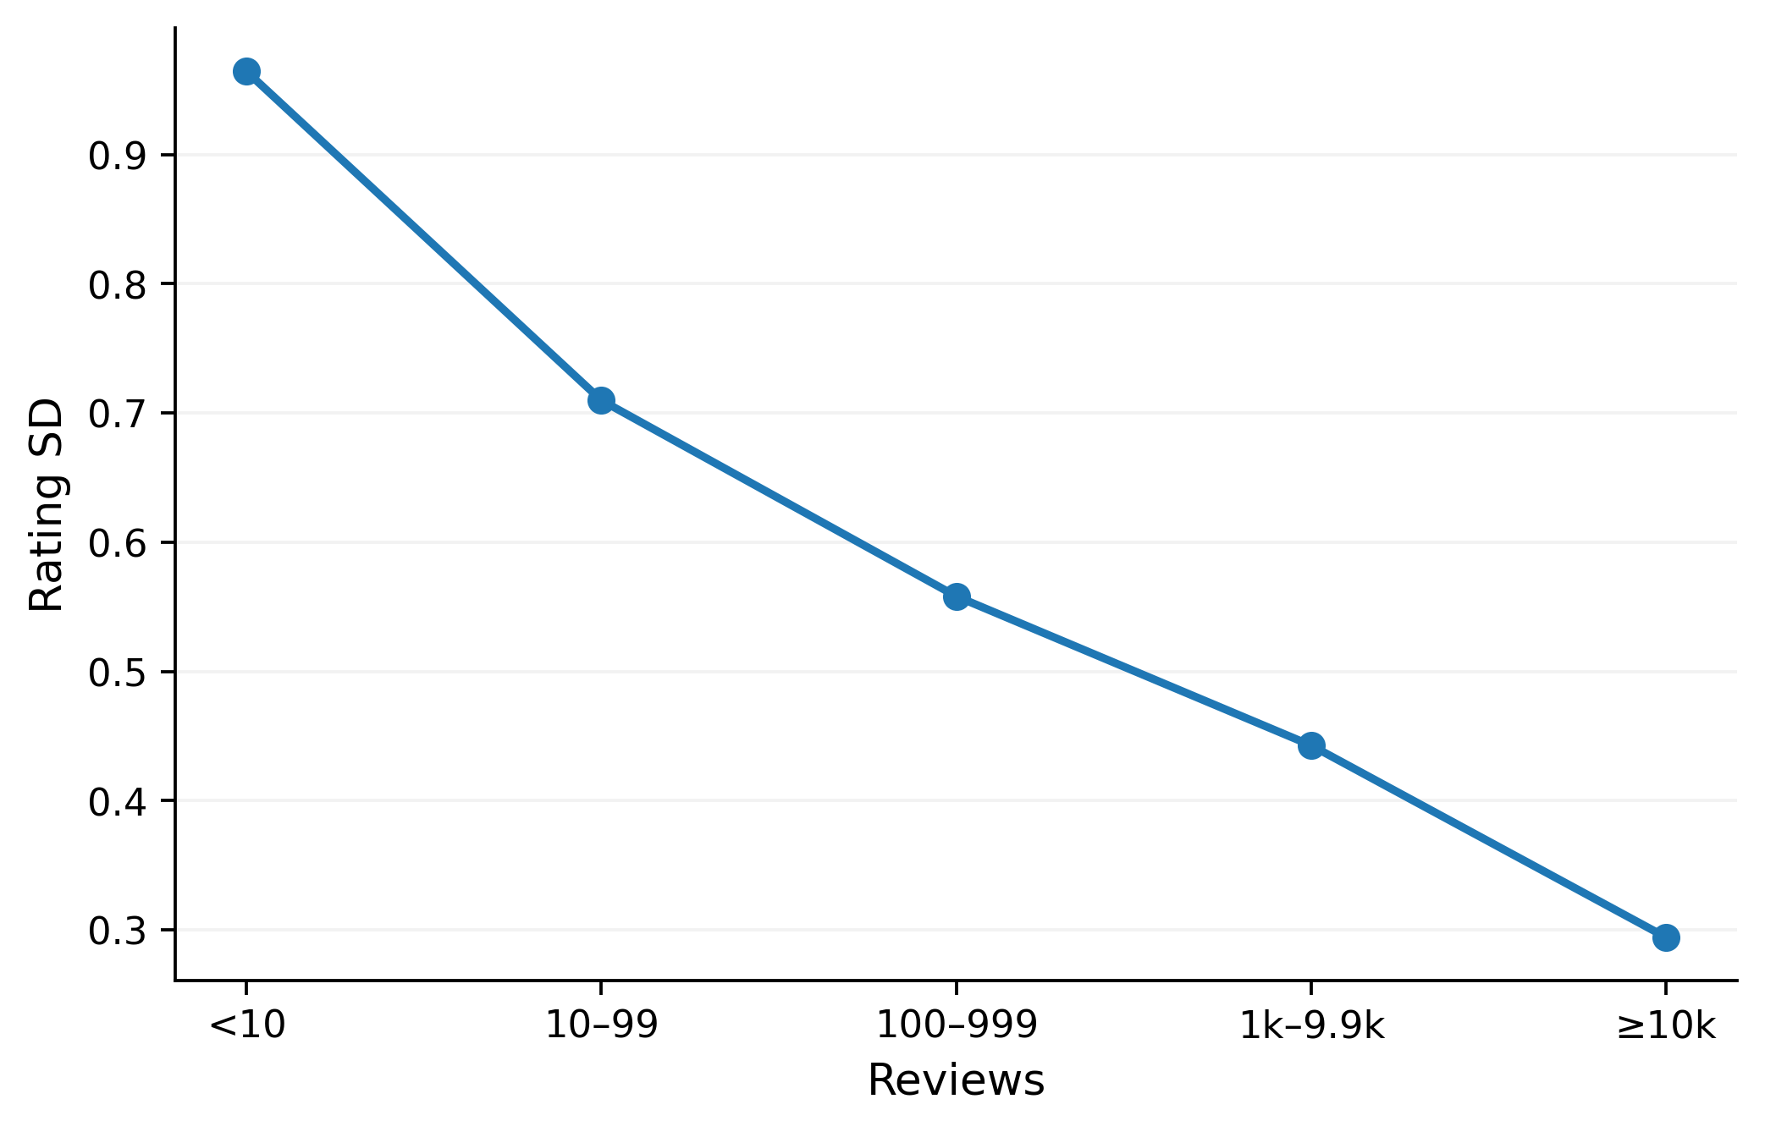
As review evidence grows, “perfect” 5-star ratings almost disappear
<10 Reviews
36.6%
100–999
0.27%
≥1,000
0%
A 5-star Rating can be a small-sample result. Read Rating together with Reviews.
Introduction Conclusion
Exploration of Dataset
Design of AI Algorithm
Model Evaluation
Visual Storytelling
Responsible member: LIU YUTONG
Notes:
This slide shifts from model behaviour to visual storytelling. When an app has fewer than 10 Reviews, about 36.6% are rated exactly 5 stars and Rating variability is also much larger. For 100–999 Reviews, the 5-star share falls to about 0.27%, and once Reviews reach 1,000 or more, the 5-star share is 0% in this dataset. Among all 271 five-star apps, the median number of Reviews is only 4 and the median Installs is 100. The stacked composition shows that the apparent perfection of low-evidence apps is not representative of mature apps with substantial review evidence. Business interpretation: a high Rating should be qualified by how much evidence supports it.

Slide 16
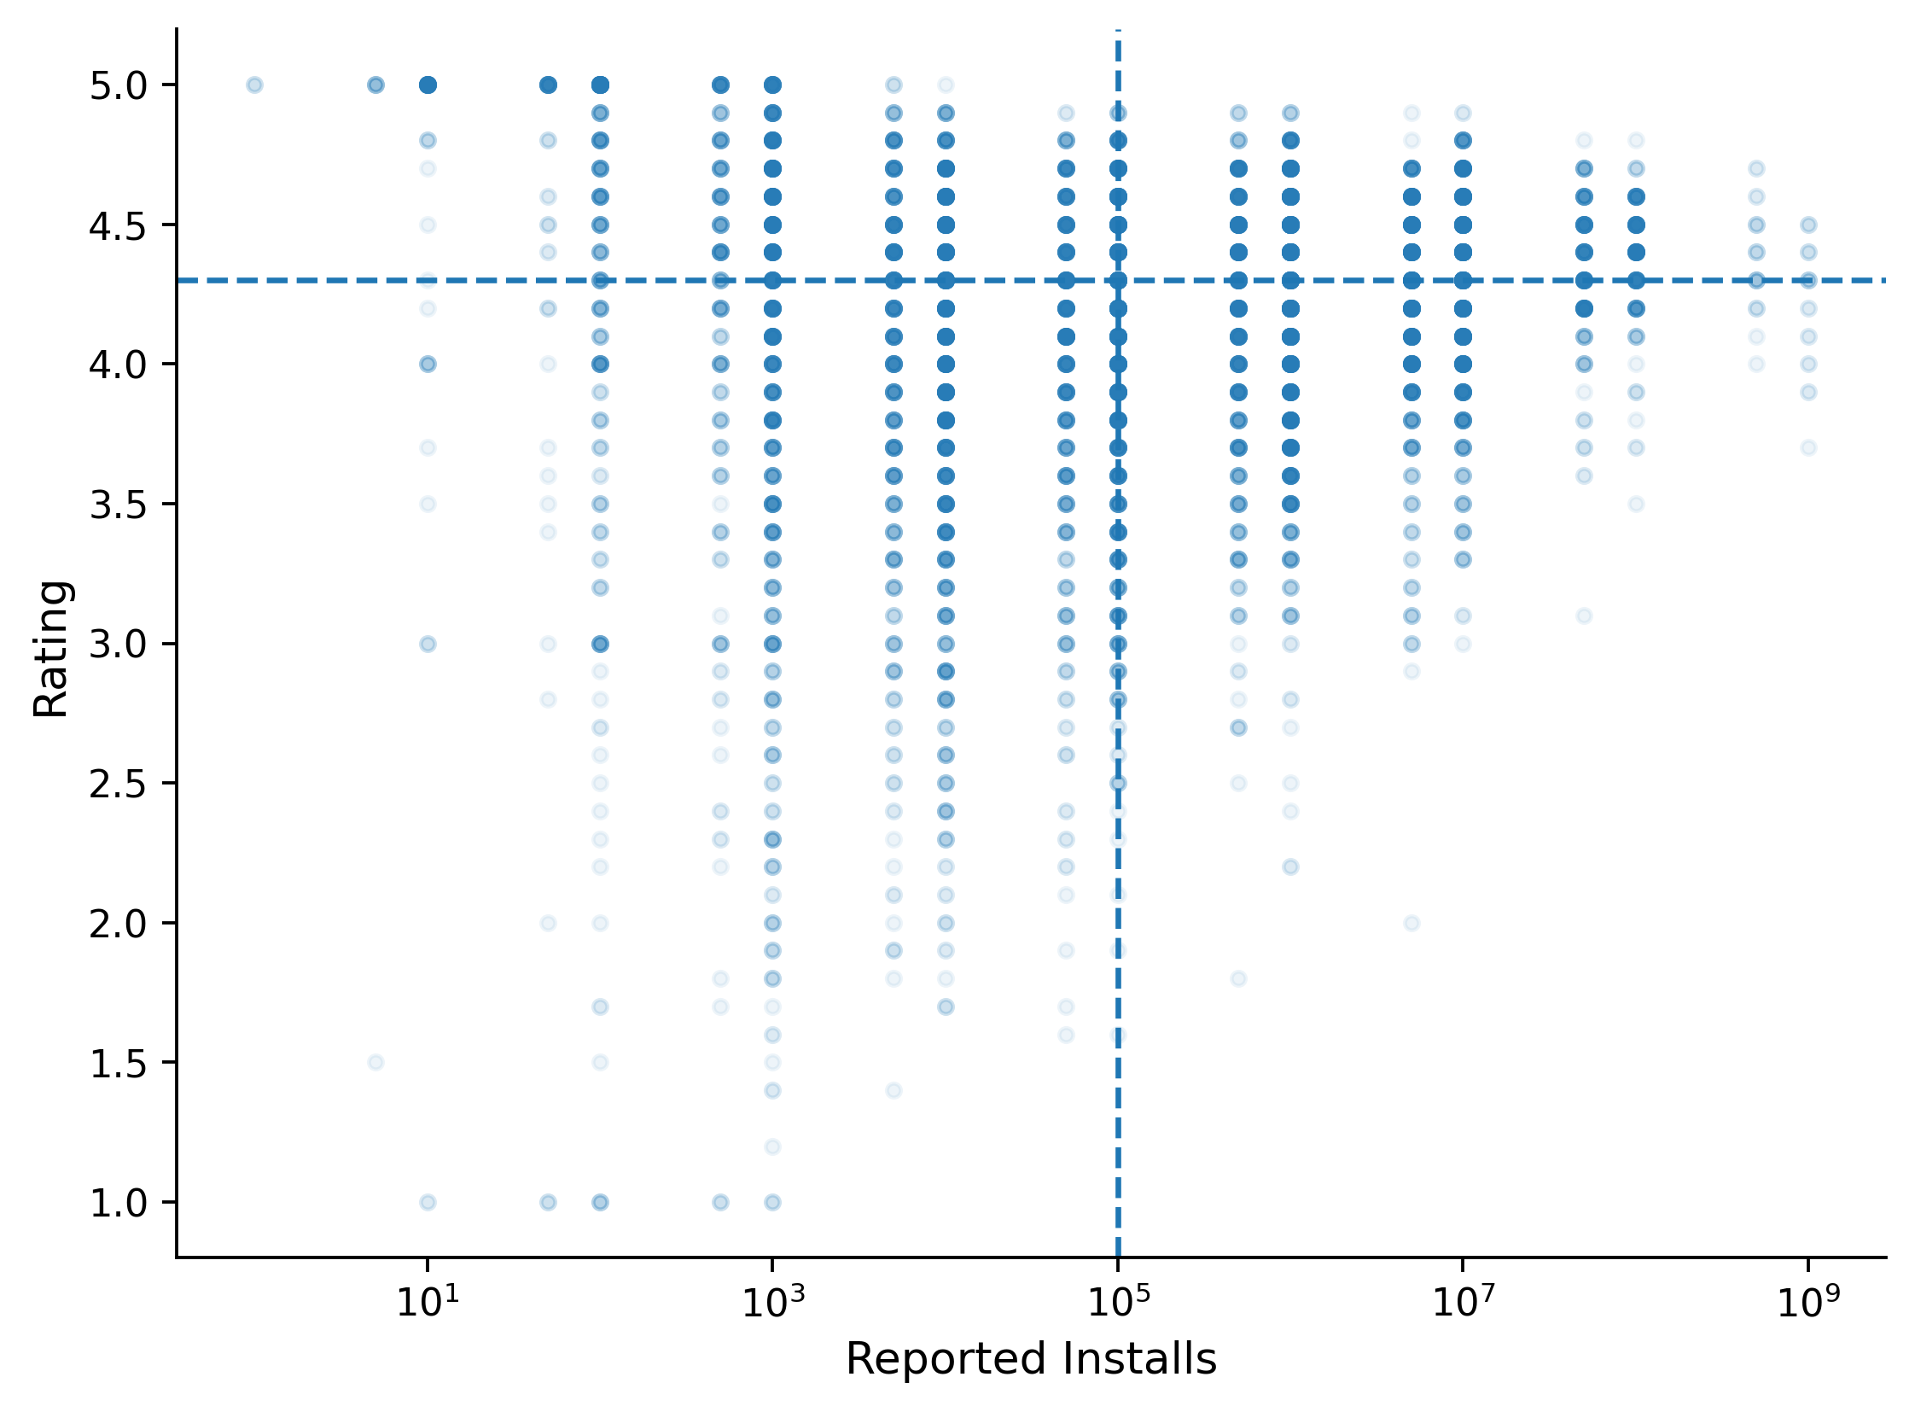
The same Rating can correspond to four different market states
Market Leaders
33.4%
High Rating / High Exposure
Hidden Gems
19.6%
High Rating / Low Exposure
At-Risk Scale
27.6%
Low Rating / High Exposure
Weak Signals
19.5%
Low Rating / Low Exposure
Rating = satisfaction; Installs = market coverage. Use both to define “success”.
Introduction Conclusion
Exploration of Dataset
Design of AI Algorithm
Model Evaluation
Visual Storytelling
Responsible member: LIU YUTONG
Notes:
A high Rating is not a complete definition of app success. Using the median Rating of 4.3 and median Installs of 100,000 creates four interpretable market states. High Rating / High Exposure accounts for about 33.4% of apps and represents Market Leaders. High Rating / Low Exposure accounts for 19.6% and can be viewed as Hidden Gems. Low Rating / High Exposure accounts for 27.6% and represents At-Risk Scale, while Low Rating / Low Exposure accounts for 19.5% and represents Weak Signals. The quadrant framework combines satisfaction with adoption and therefore distinguishes apps that would look identical if we considered Rating alone. Limitation: the median thresholds are descriptive cut-offs for this dataset rather than universal business standards.

Slide 17
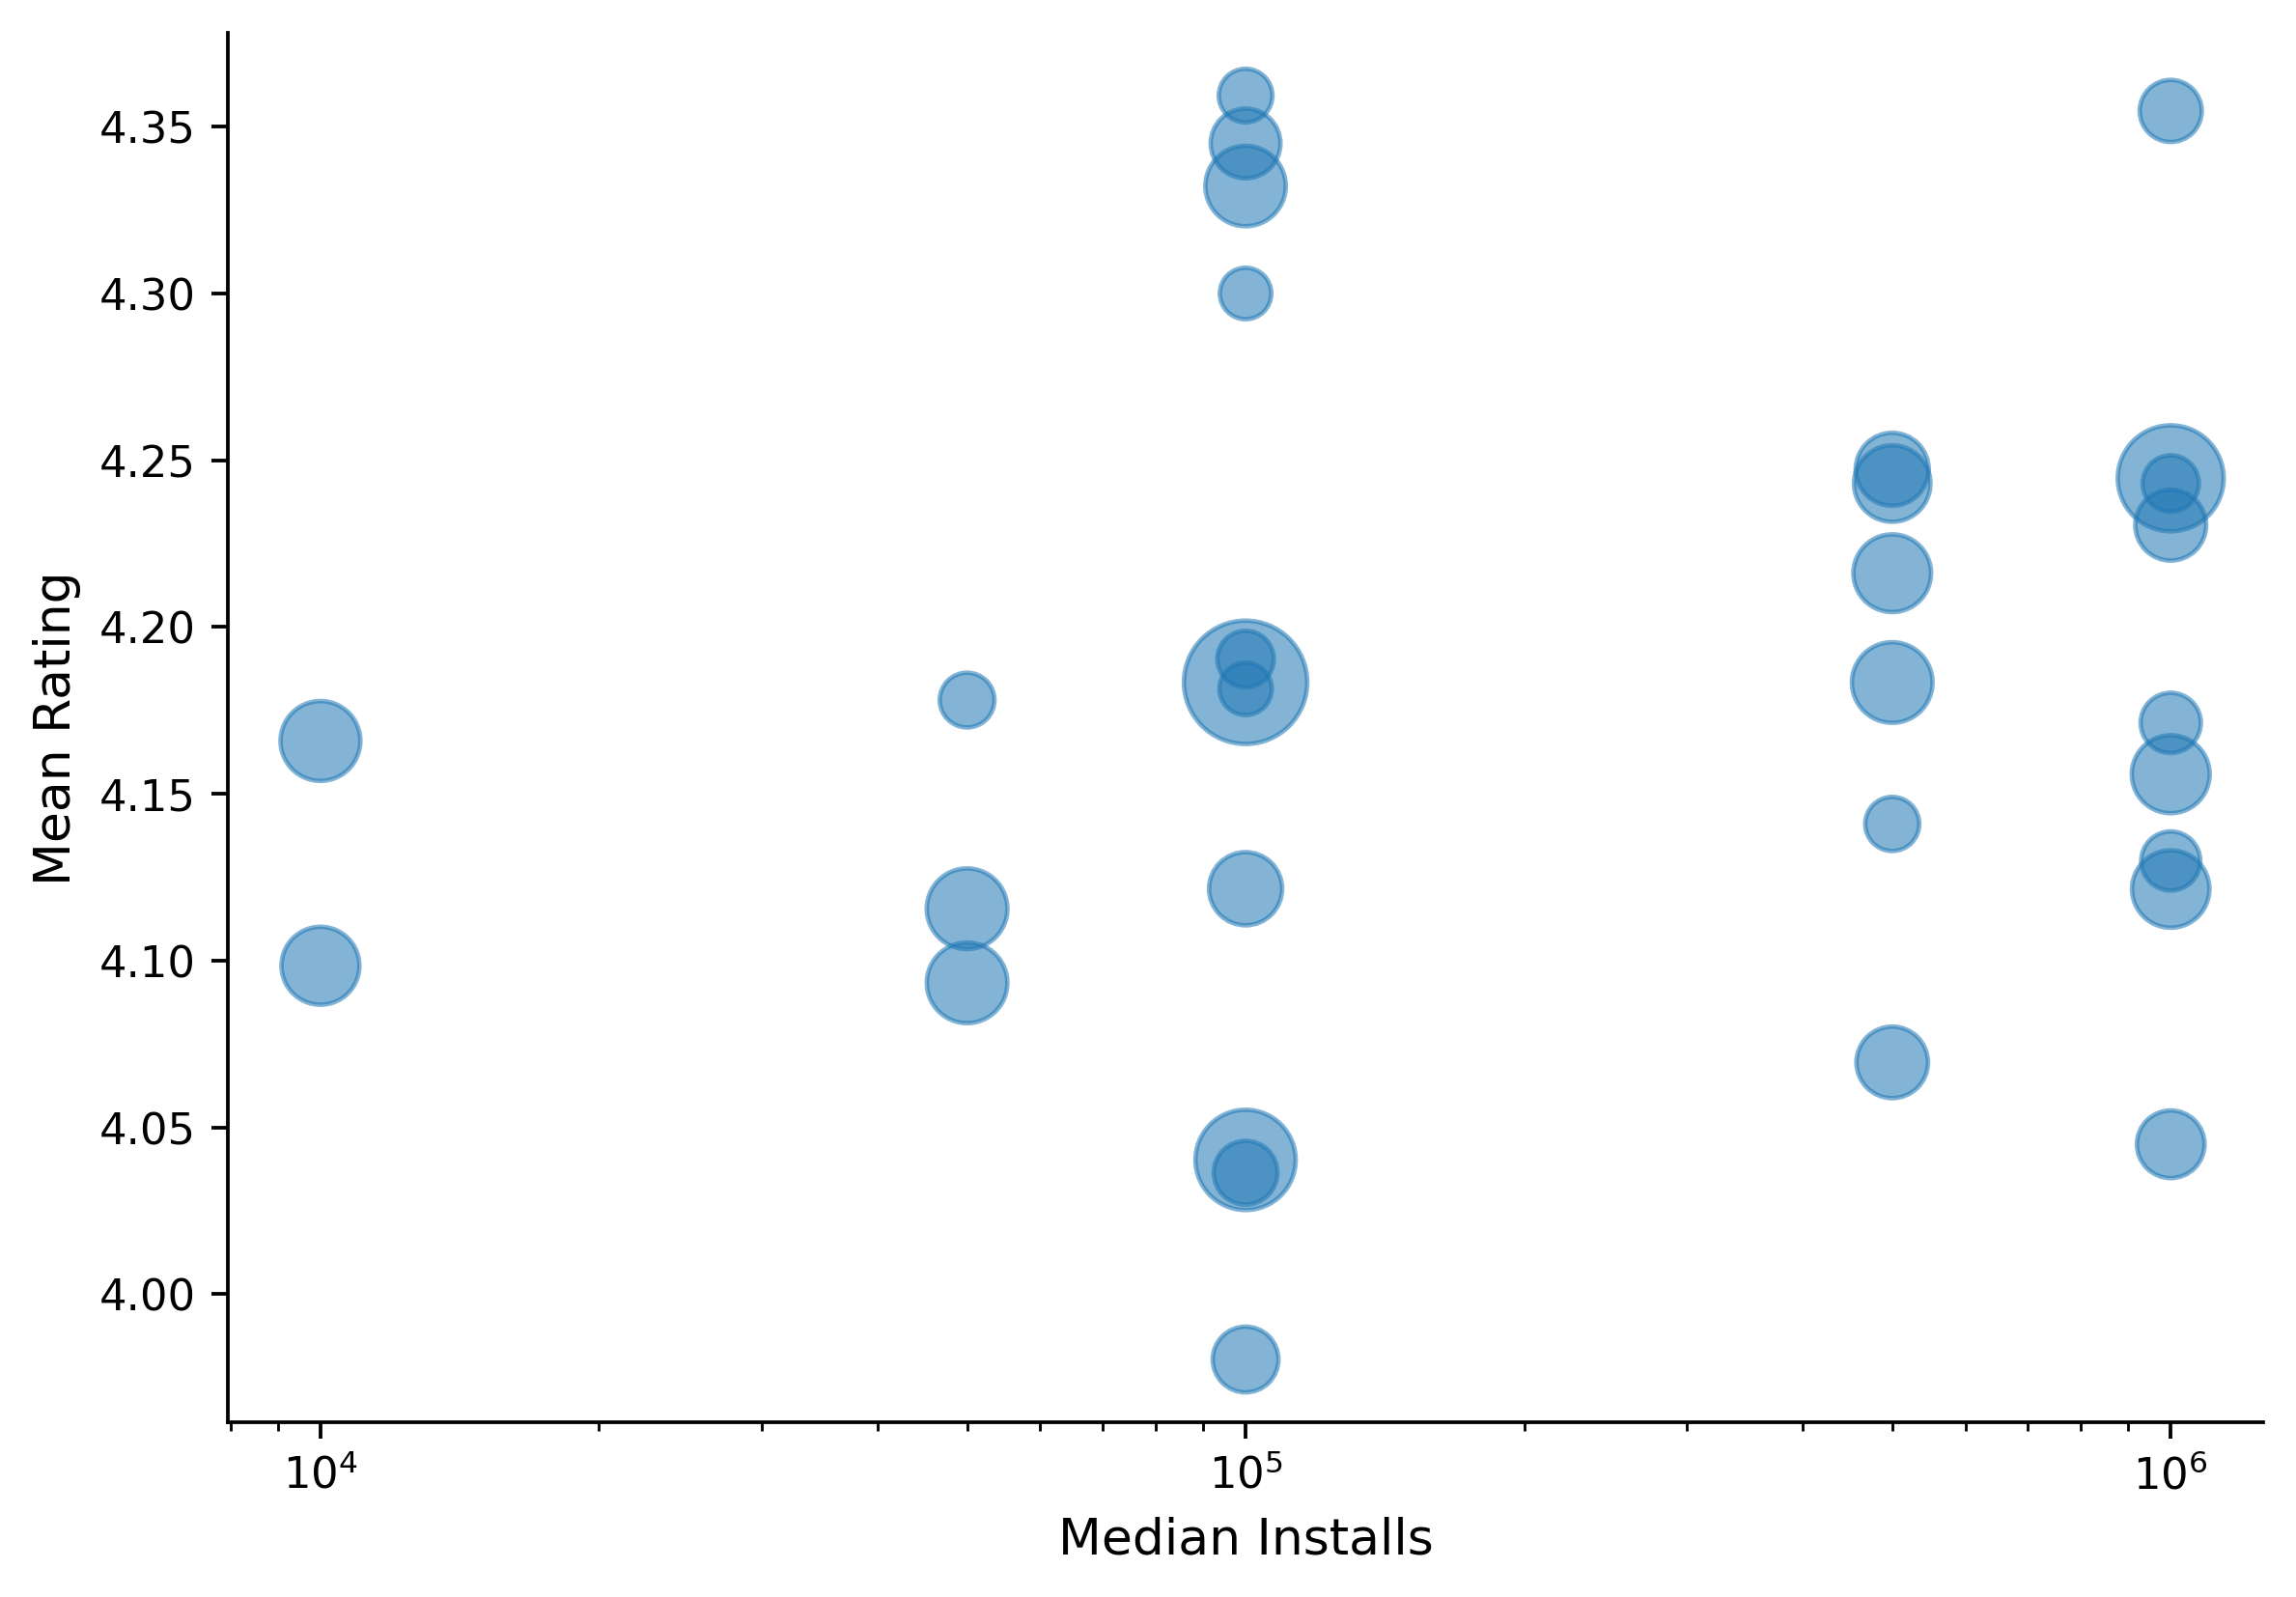
Categories also show a satisfaction-versus-adoption trade-off
High adoption, lower satisfaction
COMMUNICATION ≈ 4.121
VIDEO_PLAYERS ≈ 4.045
GAME ≈ 4.245
High satisfaction, lower adoption
ART_AND_DESIGN ≈ 4.359
EDUCATION ≈ 4.355
Large adoption ≠ high satisfaction.
Introduction Conclusion
Exploration of Dataset
Design of AI Algorithm
Model Evaluation
Visual Storytelling
Responsible member: LIU YUTONG
Notes:
The category bubble plot moves the story from individual apps to portfolio-level strategy. The horizontal axis shows median Installs on a log scale, the vertical axis shows mean Rating, and bubble size represents the number of apps. Several high-adoption categories have comparatively lower satisfaction: COMMUNICATION has mean Rating about 4.121 and VIDEO_PLAYERS about 4.045, despite median Installs around one million. ART_AND_DESIGN has a higher mean Rating of about 4.359 but median Installs of only about 100,000. EDUCATION combines a high mean Rating of about 4.355 with median Installs around one million. The managerial message is that market scale and user satisfaction are related but distinct dimensions. Only representative categories are labelled to avoid visual clutter.

Slide 18
Recommendation: App Health should not be judged by Rating alone
Rating
Satisfaction
What users feel after use
Reviews
Evidence strength
How much evidence supports the score
Installs
Market coverage
How far the app has reached
Collect more evidence
High Rating + weak evidence
Maintain quality
High Rating + strong evidence
Why this framework? Low Reviews / Installs produce the largest errors, and they are also the strongest predictive signals.
Reassess positioning
Low Rating + low evidence
Prioritise UX diagnosis
Low Rating + high exposure
Introduction Conclusion
Exploration of Dataset
Design of AI Algorithm
Model Evaluation
Visual Storytelling
Responsible member: LIU YUTONG
Notes:
The management recommendation is to replace a single Rating KPI with a three-signal App Health framework. Rating measures satisfaction, Reviews represent evidence strength, and Installs represent market coverage. The action matrix turns the four market states into decisions: collect more evidence for high-rated but weak-evidence apps; maintain quality for high-rated strong-evidence apps; reassess positioning when both rating and evidence are weak; and prioritise UX diagnosis when low ratings occur at high exposure. This recommendation is supported by three earlier findings: prediction error is highest at low Reviews and low Installs, perfect five-star ratings are concentrated at low review evidence, and Reviews / Installs are the model’s strongest predictive signals. The goal is not to create a new causal score, but to make interpretation of App Health more evidence-aware.

Slide 19
Conclusion: a complete evidence chain is more useful than one model score
Data + model
10,841 raw → 8,892 modelling rows
RF holdout RMSE ≈ 0.495
Main boundary
R² ≈ 0.156
Low-rating and low-evidence apps are hardest
Most useful outcome
Interpret Rating with Reviews + Installs
for evidence-aware App Health
Data Quality
10,841 raw
EDA
Ratings cluster
Preprocess
Log tails
Model
RF selected
Failure
Low ratings
Explain
Reviews / Installs
Story
4 states
Action
3-signal health
Key contribution: the project links data quality, model behaviour, failure modes and business interpretation into one evidence chain.
Introduction Conclusion
Exploration of Dataset
Design of AI Algorithm
Model Evaluation
Visual Storytelling
Responsible member: LIU YUTONG
Notes:
The strongest outcome of the project is not a claim that Rating can be accurately predicted from store metadata. The final Random Forest has holdout RMSE of about 0.495 but R² of only about 0.156, so the model boundary must remain explicit. Instead, the project creates a connected evidence chain: data quality and conditioning support trustworthy visualisation; EDA motivates log preprocessing; model evaluation reveals shrinkage toward the centre; band-level diagnostics expose failure on low ratings; explainability shows dependence on Reviews and Installs; and visual storytelling converts these findings into a practical App Health framework. The final recommendation is therefore to interpret Rating together with review evidence and market coverage rather than treating Rating as a standalone success KPI. Acknowledgement: Generative AI was used to assist with slide layout, wording and notes; all displayed results were checked against the supplied CSV and PNG assets.

