Slide 1
High Relative Embedding For Multiple Categories Recommendation System
By Weltmeister @ HackSc
Zixi Wang & zixiw@usc.edu
Han Zhang & zhan704@usc.edu
Ying Long & longying@usc.edu
Peilin Zhou & zpeilin@usc.edu

Slide 2
Objective
General goal is to design a recommendation system that makes accurate and useful future predictions of purchases
Data Source: Tailored Brand’s historical transaction data, inventory data, and customers’ personal demograph data
Benefits:
1. Effective recommendation increases revenue and reduce aged inventory
2. Help customers identify unique dressing styles that best fit them. Hence loyalty is increased.

Slide 3
Challenge
Data Confusion
Preference Similarity
Efficient Recommend
In real world, there are lots of unusable feature and complex data. How to do the data processing is a key to improve performance of recommended system.
Preference similarity, by nature, a category of discrete information encoded in a trading network, can be encapsulated in a continuous embedding space. It’s the fundation of our analysis.
Traditional recommended system have some problem. It cannot recommend effectively and it could recommend some item what consumers don’t like. Finally, it cannot use and analyze feature fully.

Slide 4
System Design
Items are clothing that a customer is likely to purchase with high probability for a given genre.
Aged inventory interesting to the customer
Class 1
We have a customer !
Item 1
Item 2
Item 3
Aged
Classes representate the genres of clothing interesting to the customer
Class 2
Item 1
Item 2
Item 3
Aged
Class 3
Item 1
Item 2
Item 3
Aged

Slide 5
Feature Engineering
Since there are lots of unclearn, meaningless and useless data in some feature, we have to do the data processing and creative some relative new feature to fit in our embedding model in order to get the best relatively for each data.

Slide 6
Feature Engineering & ML Models
Features are important. We use embeddings to engineer features that is most relevant. The process will be discussed later.
Then geners are clustered among 1.3 million products using K-means.
Next, based on successful transaction, a logistic regression is deployed to find the most desirable products in each genre, which are to be recommended to the customer.

Slide 7
Embeddings
Use Embedding Model can help us to extract high level feature for products and consumers.

Slide 8
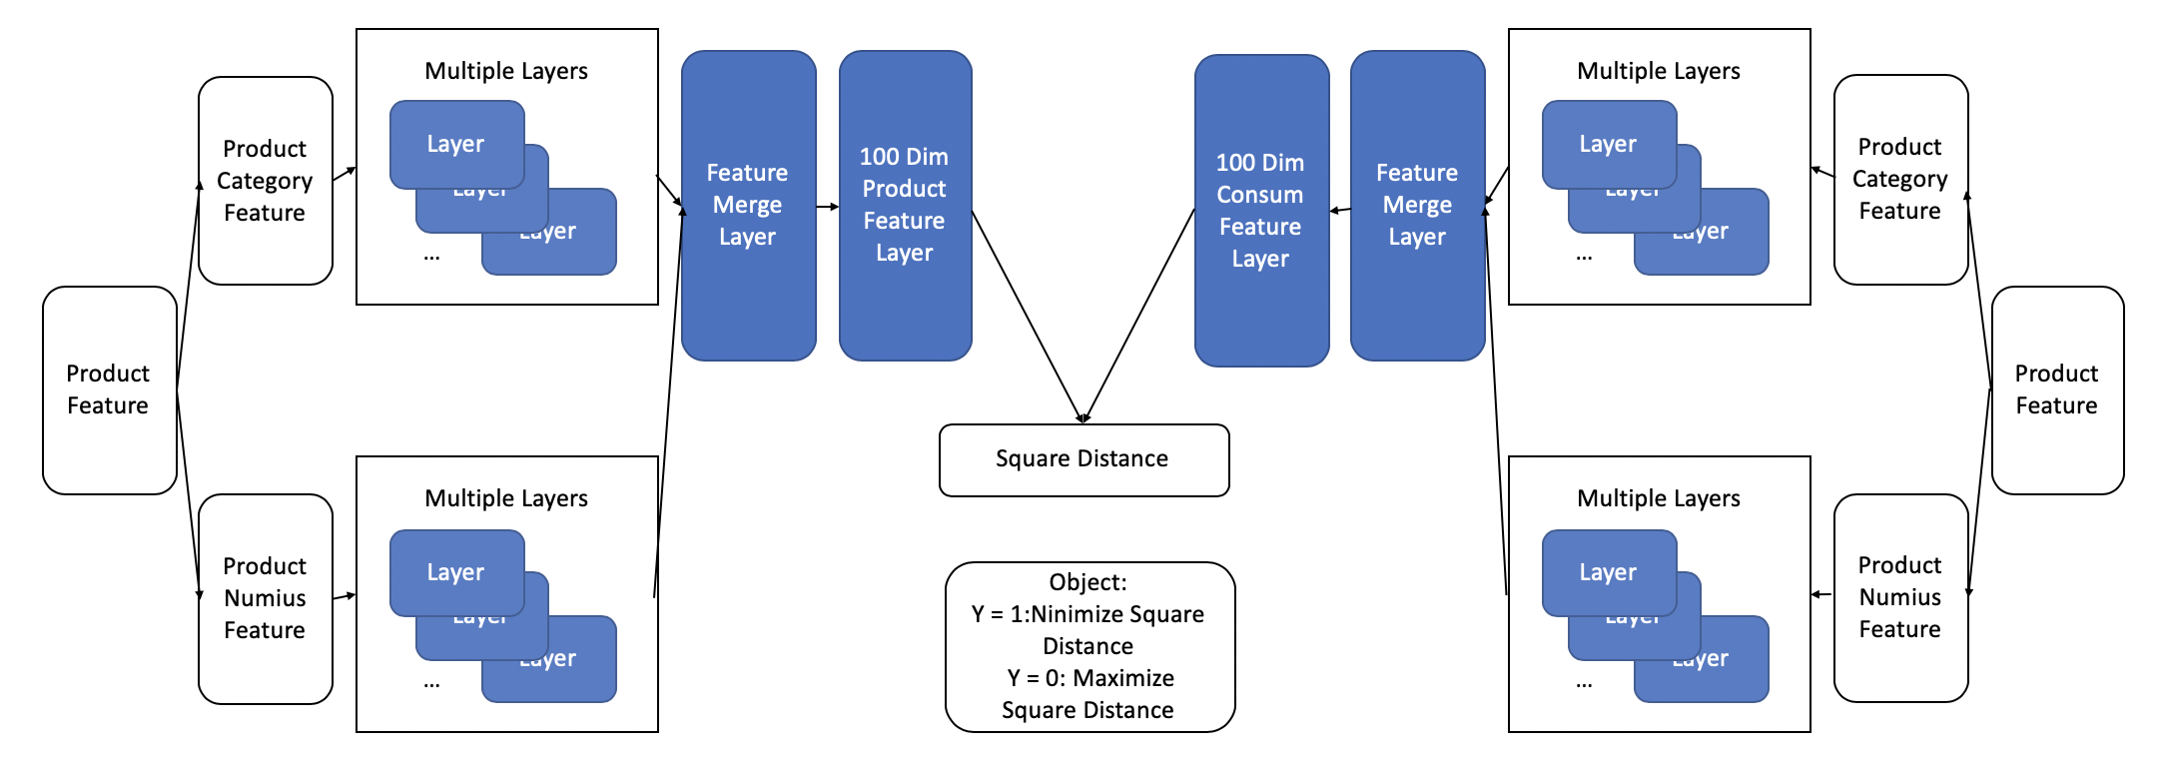
Embedding Model

Slide 9
Multiple Categories Recommendation System
Compared to traditional recommendation, multiple categories recommendation system can help the user to find their favorite categories and recommend the best items for according to categories.

Slide 10
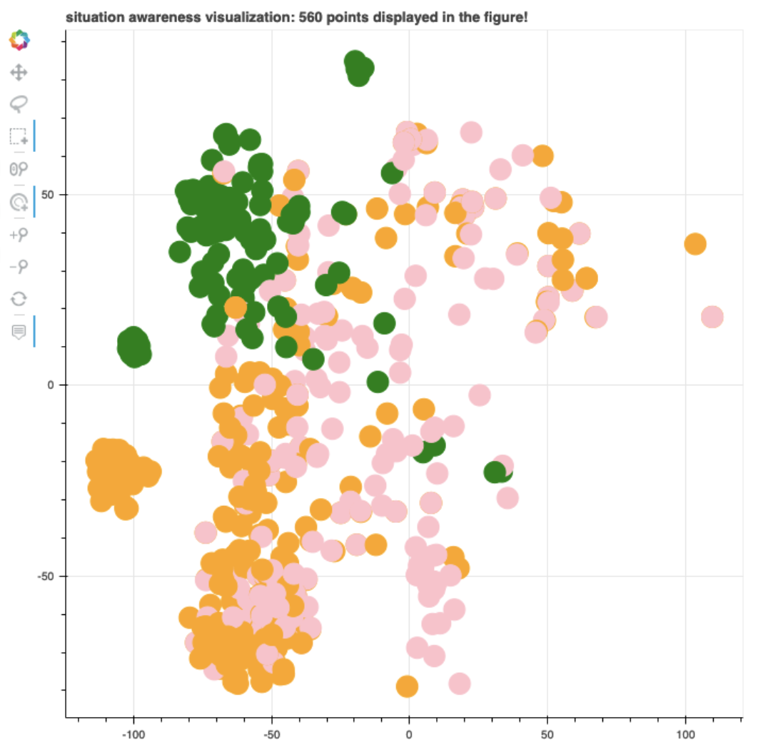
Multiple Categories Classification
High Quality Item Recommend
Use Kmeans to do cluster based by embedding feature.
It can find the most favorite type for the consumer.
Use classification model to go to find the best match item for each recommended Categories. We got Precision for 0.4, which means we have very good performance to recommend.

Slide 11
Thank You For Your Attention!

