Slide 1
Falcon: Live Reconfiguration for Stateful Stream Processing
Pritish Mishra , Nelson Bore , Brian Ramprasad , Myles Thiessen, Moshe Gabel , Alexandre da Silva Veith Oana Balmau , Eyal de Lara
2024 IEEE/ACM Symposium on Edge Computing
Slides by Han Zhang

Slide 2
Overview
Background
Proposed Solution
Evaluation
Strengths/Weakness

Slide 3




Background – Stream Processing
Key Framework for processing edge data
But Why?
https://flink.apache.org/what-is-flink/powered-by/
Notes:
Stream Processing is the dominant framework used for edge computing. But the main question here is why? Why not use an alternative such as batch processing?
The reason behind this is because we require low latency! -> continuously streaming data allows for better analysis of real time data
What’s the tradeoff? Comparatively to batch computing, we have much more complexity and power requirements, mass sending data allows us to be more efficient at scale
This increase in continuous streaming proves tricky for flexibility -> Effectively no downtime to change applications

Slide 4



Background – Stream Processing
How do we represent stream processing?
Utilize directed acyclic graphs (DAGs), with operators becoming vertices and edges become data sources
Oftentimes, these have states and windows associated with them
SUM
Notes:
The way we represent stream processing is through the collection of various nodes, with each node representing an producer, sink, or transformation function.

Slide 5
Background – Stream Processing
How do we represent stream processing?
Utilize directed acyclic graphs (DAGs), with operators becoming vertices and edges become data sources
Oftentimes, these have states and windows associated with them
SUM
Notes:
The way we represent stream processing is through the collection of various nodes, with each node representing an operation, generator, or a sink.

Slide 6
Background – Stream Processing
How do we represent stream processing?
Utilize directed acyclic graphs (DAGs), with operators becoming vertices and edges become data sources
Oftentimes, these have states and windows associated with them
SUM
1 Car
Notes:
The way we represent stream processing is through the collection of various nodes, with each node representing an operation, generator, or a sink.

Slide 7
Background – Stream Processing
How do we represent stream processing?
Utilize directed acyclic graphs (DAGs), with operators becoming vertices and edges become data sources
Oftentimes, these have states and windows associated with them
SUM
1 Car
Notes:
The way we represent stream processing is through the collection of various nodes, with each node representing an operation, generator, or a sink.

Slide 8
Background – Stream Processing
How do we represent stream processing?
Utilize directed acyclic graphs (DAGs), with operators becoming vertices and edges become data sources
Oftentimes, these have states and windows associated with them
C1
Curr: 6
SUM
1 Car
C1
Notes:
The way we represent stream processing is through the collection of various nodes, with each node representing an operation, generator, or a sink.

Slide 9
Background – Stream Processing
How do we represent stream processing?
Utilize directed acyclic graphs (DAGs), with operators becoming vertices and edges become data sources
Oftentimes, these have states and windows associated with them
Note that this representation is the logical plan
C1
12:00-12:01
SUM
1 Car
C1
Notes:
The way we represent stream processing is through the collection of various nodes, with each node representing an operation, generator, or a sink.
Note that the representation is logical plan, but the actual plan changed by Falcon is the physical plan. This includes more value ssuch as the number of instances of each operator and the computing node that it exists on.

Slide 10
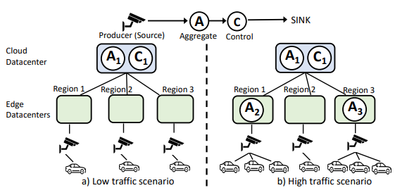
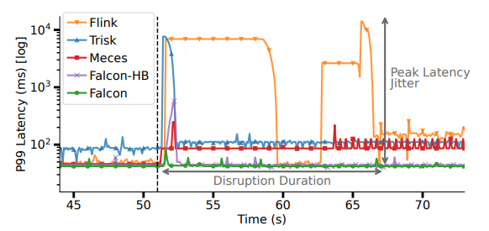
Current Challenge
Because of variable/expensive amounts of compute on edge servers, flexibility is needed
Key constraint to be kept is correctness
Current solutions either migrate completely, partial-pause, and on demand transfer.
Notes:
Variable/expensive amounts of compute on edge servers happen because edge datacenters aren’t as cheap as cloud. You decide to migrate when the “cost of cpu” is greater than the cost of bandwidth.
Correctness is hard to keep because of a couple of cases with stateful transitions
Tuples that are currently being processed can still modify state; example is the sum in traffic, can still increment during migration
In order processing is necessary, can only process once
Windows still must be the same pre and post reconfiguration
Source mobility, data sources with keys might migrate from one area to another.
Current solutions don’t provide the latencies that we want.

Slide 11
Overview
Background
Proposed Solution
Evaluation
Strengths/Weakness

Slide 12
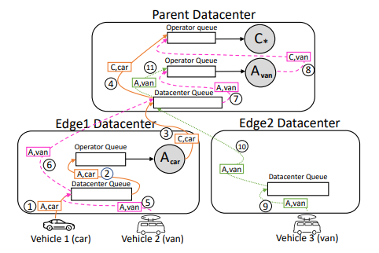
Falcon System Design
Three core Components
Job Manager handles applications and operators, as well high-level migration
Routers exist on the edge datacenters, manages individual queues for both datacenter and operators
Workers exist to manage processes with queue, state, and IO, along with key-value pairs for keyspace. The entire design is operating on key level granularity
Notes:
Three component design
Job Manager, handles applications and operators, and also handles the reconfiguration and the reconfiguration plan that occurs
Routers, handles the inputs to the queues for both datacenter and operators, exist on the datacenter level
Workers, deployed at each node, can handle multiple operators. They track the queue, state, and IO.
Need to have key-value paradigm, everything musted be a keyed state. The reason for this is that a keyed state paradigm allows for easy scaling, which is another huge benefit to stream processing.

Slide 13
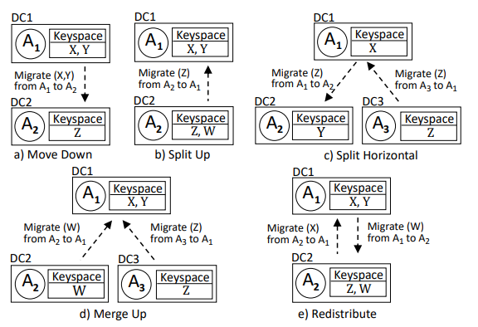
Falcon Implementation Details
Tuple Routing
Routes using key late binding, which checks if target operator matches locally
Scalable, don’t have to be aware of rest of network
Migrate Primitive
A function call is made that allows for moving Keyset from one instance to another instance.
Notes:
Note that the instances here refer to instances of an operator
If it doesn’t already exist, the destination instance of the operator will be created

Slide 14
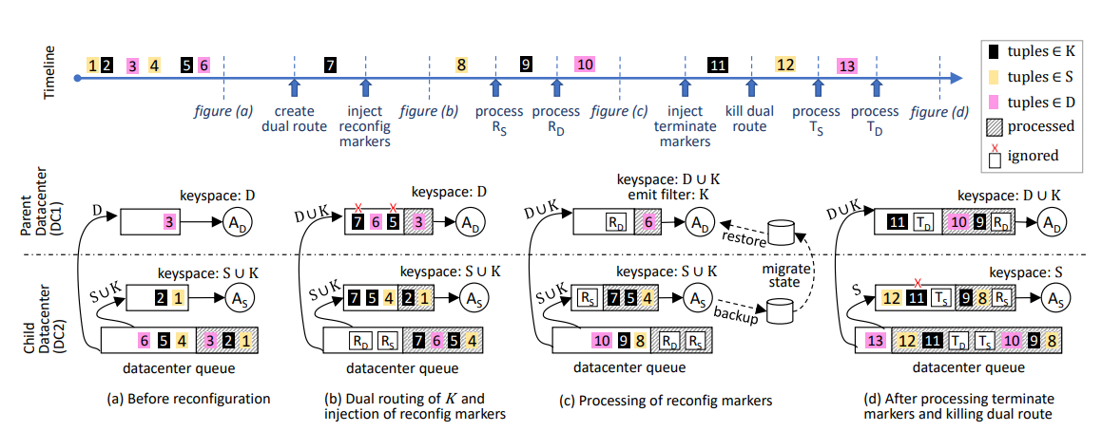
Falcon: Live Migration
Notes:
Initial State: Before anything happens, we see that the datacenter queue has configuration for S, K, need to migrate K up

Slide 15
Falcon: Live Migration
Notes:
Step 1: Create a Dual route, the migrated tuples/data goes both the original and new intended keyspace
Note this doesn’t violate the Tuple Routing, the only thing you have to do is route it up as well whenever a migration request is triggered.
Step 2: Insert markers at the same time from the source datacenter queue, this will initiate the migration processes

Slide 16
Falcon: Live Migration
Notes:
-Step 3: State transfer happens by creating a checkpoint to copy to storage, then also copies the entries in the buffer so you can replay. This can be seen with packet number 9, after Rs get’s processed it’s in the queue, but it’s still copied into the buffer. Processing Rd means that the reconfiguration download occurs, we also get emit filter. Done to synchronize state, avoids double outputs, both will be the same values.

Slide 17
Falcon: Live Migration
Notes:
Step 4: Once you have enough backlog gone, you inject termination markers: paper is kinda vague, these markers will kill dual route. (Step 5) Killing dual route can be done immediately.
Step 6: Once you process termination markers, get rid of emit filter. Syncs from an Ack to prevent termination markers being processed async.

Slide 18
Falcon: Live Migration Correctness
Duplicate processing is prevented via the emitting blockers, once processing is maintained
In order processing is only violated if the new operator emits before the old operator. Fixed via the acknowledgement
Datacenter queue synchronizes the markers when they get sent out
Notes:
Note that acknowledgement is where the latency spike comes from

Slide 19
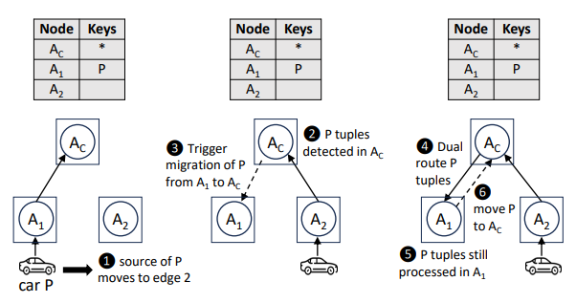
Falcon: Source Mobility
Utilizes live migration to move sources around the node
Key concept include the global map of node keysets, and dual routing
Ping-pong solved by terminating current migration
Notes:
Threshold mentioned in online YouTube video for ping-pong, but not for the actual paper.

Slide 20
Overview
Background
Proposed Solution
Evaluation
Strengths/Weakness

Slide 21

Experimental Setup
Two datacenters, one in North California and one in Montreal
Tested using custom workloads to evaluate across different operators, with stateful + stateless operators, tumbling and sliding windows.
Evaluated to the existing solutions mentioned before, full-restart, partial-pause, on-demand, hot backups.
Setup changes for experiments like edge count scaling and data mobility
Notes:
- The 3 workloads are traffic, nexus workload, and linear road. Nexus had greatest variety in windows.

Slide 22
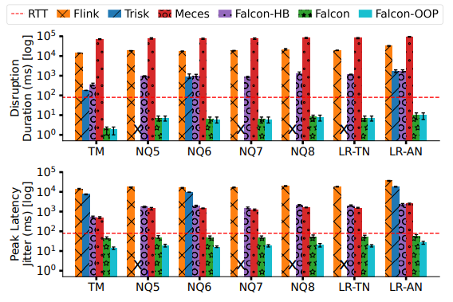
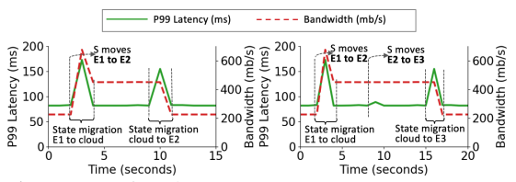
Performance Results
Order of magnitude better than comparisons
Critically better than round trip
Data mobility done across three edge servers
Notes:
- Data bandwidth is heightened because of dual routing

Slide 23
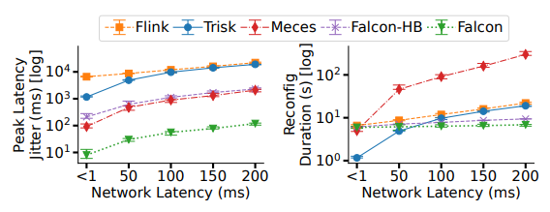
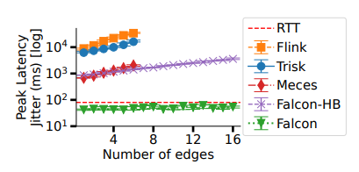
Scalability Results
Overall shows a strong capacity to scale, doesn’t rise in magnitude with respect to network latency, edges, nor state size/key count.
Notes:
Configuration for the Network latency is just using Linux Traffic Control, an external tool, to add latency between parent and node. Here, we see a rise slowly because the ack is directly proportional to network latency. However, peak latency isn’t much of total reconfig time.
Number of edges config changed to have N child datacenters, MOV AVG operator.

Slide 24
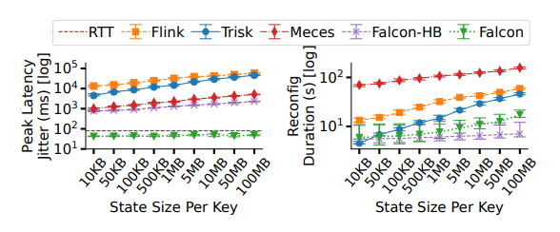
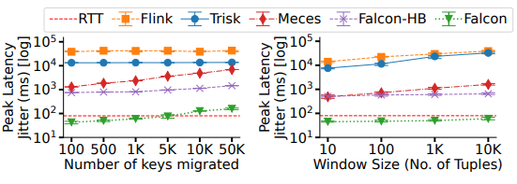
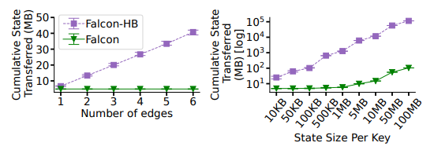
Scalability Results Cont
Notes:
Latency is going to be constant, but the size of our state impacts our download, which is why reconfig duration can increase.
Window size means larger states, also increasing jitter, while increasing the number of keys increasing queue overhead.

Slide 25
Overview
Background
Proposed Solution
Evaluation
Strengths/Weakness

Slide 26
Strengths
Strong results, orders of magnitude better and better than RTT
Cohesive design with a clear optimization goal
Open-source code
Breadth of experiments is strong

Slide 27
Weaknesses
The limit testing doesn’t feel fully representative of a true workload
What is the lower bound on practical datacenters? Performance profiling required for application
Load balancing algorithm needs to be introduced to justify evaluating cpu usage vs bandwidth tradeoff
Critical acknowledge tolerance needs to be address in case of lossy transmission

Slide 28
Questions?

Slide 29
Clipart Citations
https://www.vecteezy.com/vector-art/21706916-traffic-barrier-in-pixel-art-style
https://www.vecteezy.com/vector-art/9877672-pixel-art-traffic-light-vector-icon-for-8bit-game-on-white-background
https://pngtree.com/free-car-clipart

