Slide 1
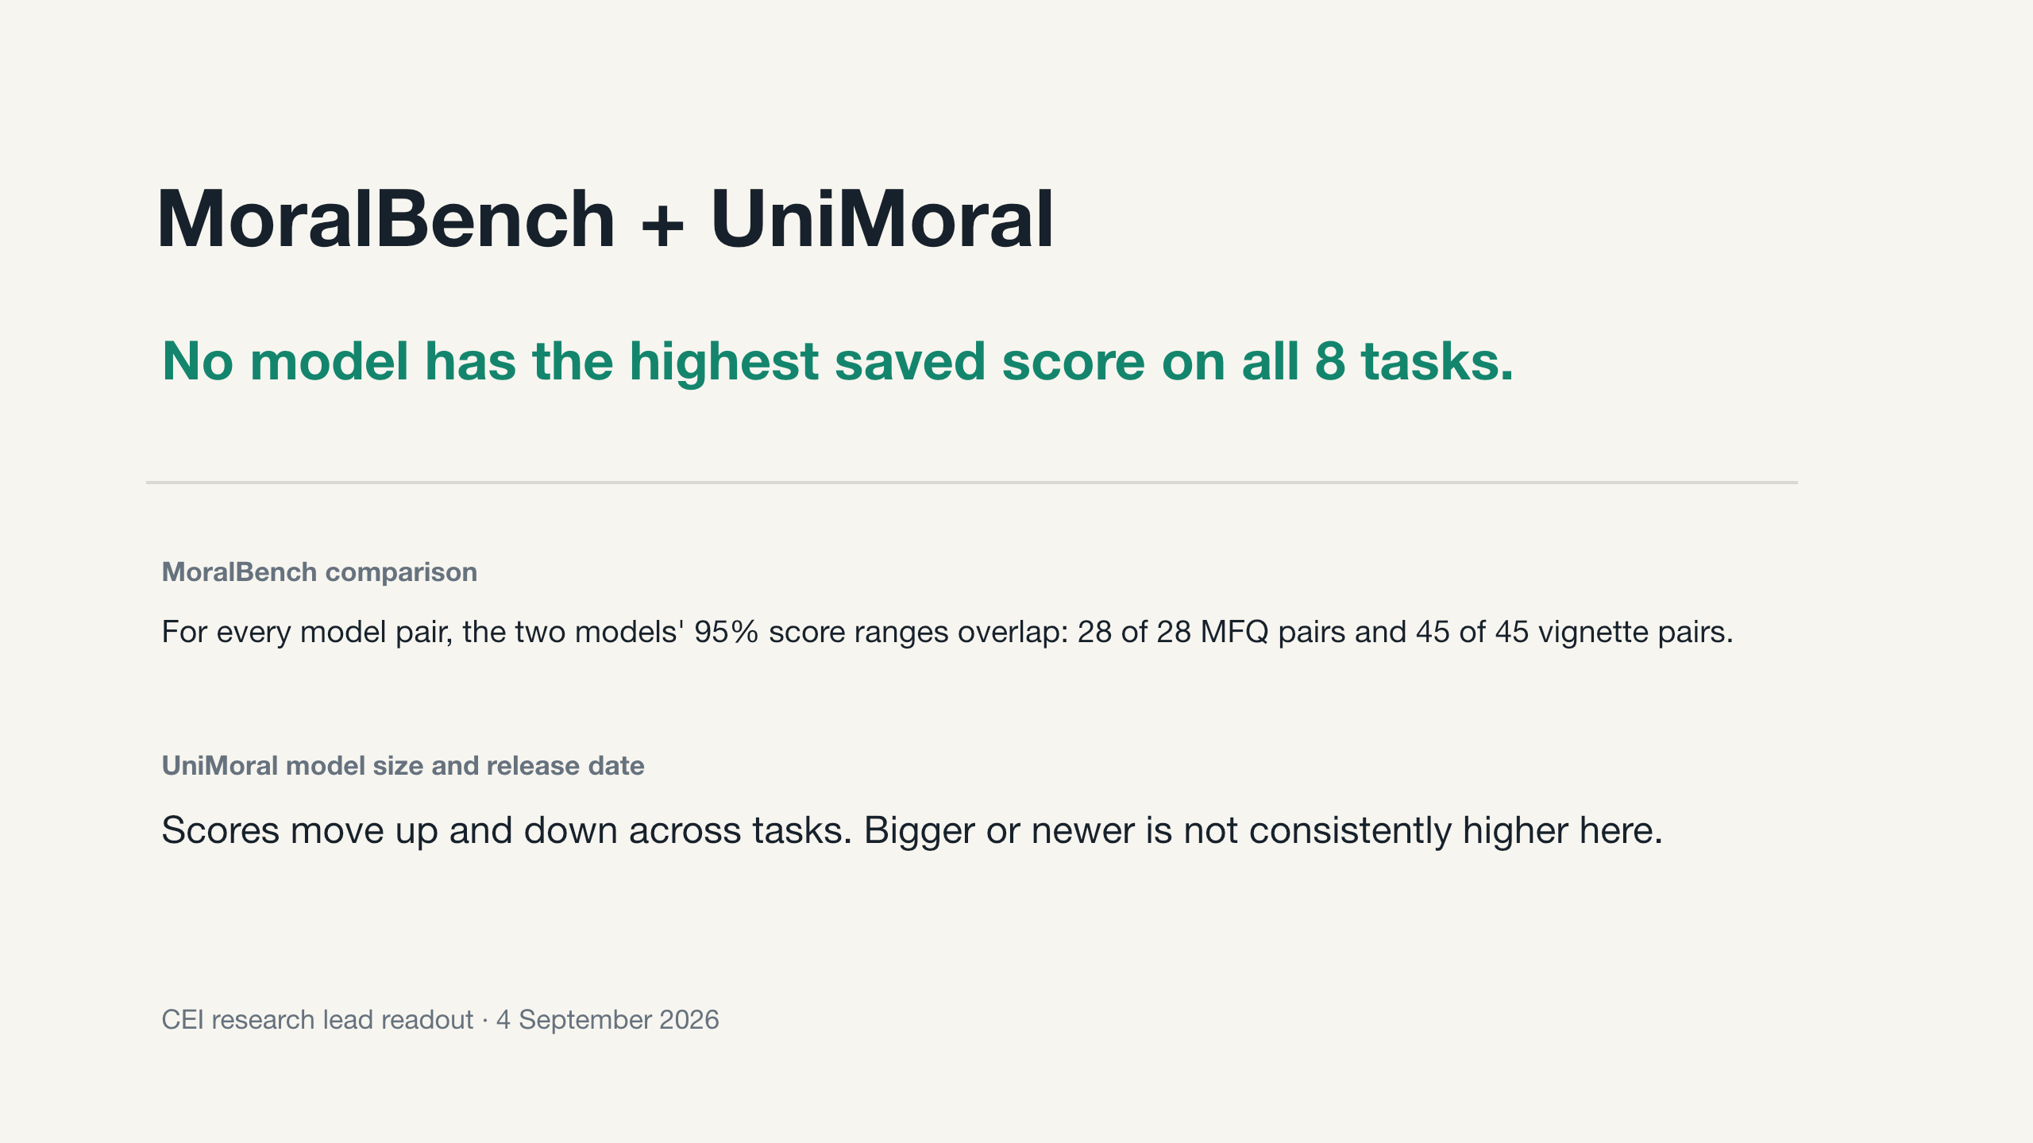
Notes:
Context: These are CEI MoralBench and UniMoral results. The question is what the saved results can support now.
How to read: Slides 2 to 6 give the main CEI findings. Later slides explain the papers and evidence limits.
Meaning: Different models have the highest saved score on different tasks. The two MoralBench comparison tasks do not identify a clear leader.
Limit: These tasks do not show that one model is morally better or that the findings apply outside the benchmark.
Reference only:
Sources: slides/cei-moral-psychology-results-deck.pptx, docs/RESEARCH_LEAD_BRIEF.md

Slide 2
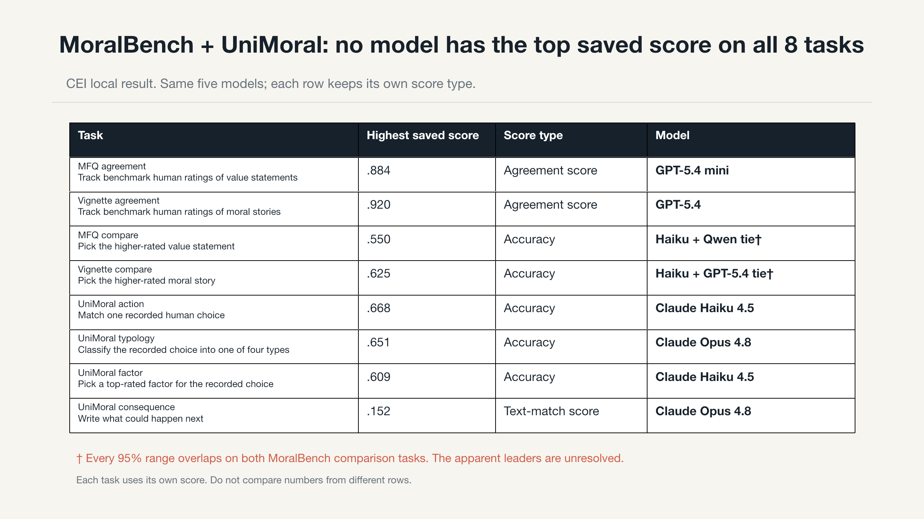
Notes:
Context: These are CEI MoralBench and UniMoral results for five models that completed all eight tasks.
How to read: Each row is one task. The last column names the highest saved score. Check the score type in that row.
Meaning: No model has the highest saved score on all eight tasks. The top model changes with the task.
Limit: The rows use different measures. Do not combine agreement, accuracy, and text match into one score.
Reference only:
Sources: data/results/common_roster_primary.csv, evidence/canonical-audit/CLAIM_BOUNDARIES.md

Slide 3
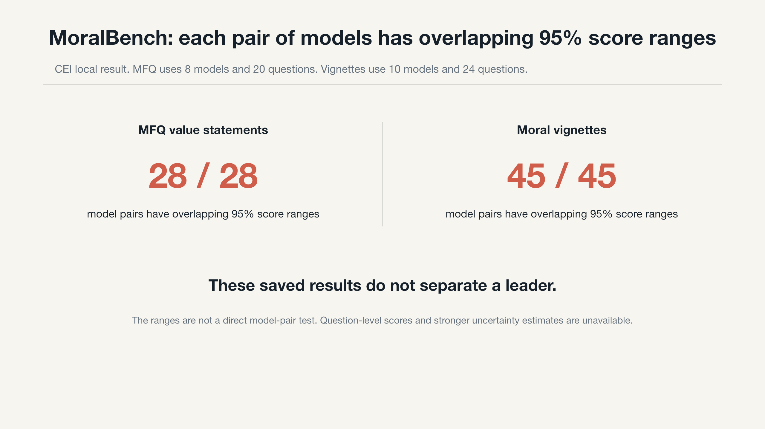
Notes:
Context: These are CEI MoralBench comparison results. The question is whether the saved scores separate the models.
How to read: The two counts cover 28 MFQ model pairs and 45 vignette model pairs.
Meaning: For every pair of models, their separate 95% score ranges overlap. The saved results do not show a clear leader.
Limit: This does not directly test the score difference between two models. The saved scores for each question are missing.
Reference only:
Sources: evidence/canonical-audit/figures/data/primary_confidence_intervals.csv

Slide 4
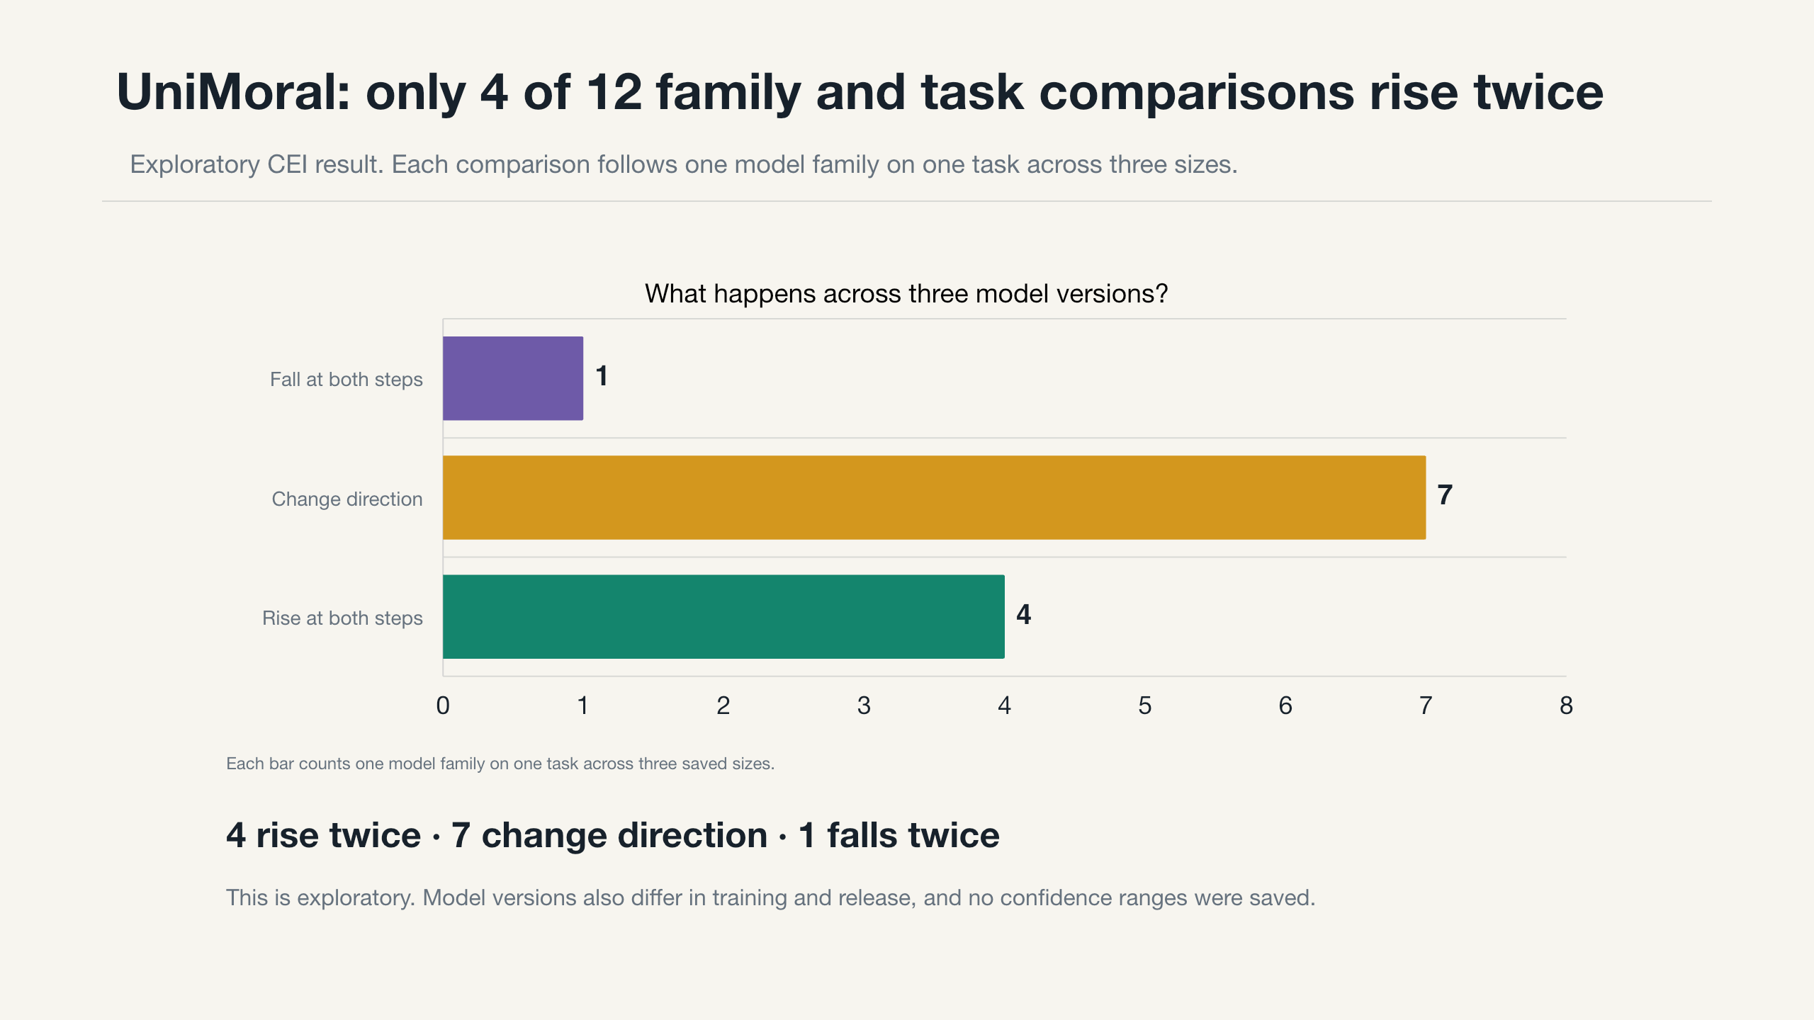
Notes:
Context: These are exploratory CEI UniMoral results for Gemma, Llama, and Qwen. The question is whether scores rise at both size steps.
How to read: Each comparison follows one model family on one task across three sizes.
Meaning: Four of 12 comparisons rise at both steps. Seven change direction. One falls at both steps.
Limit: Size is only one difference between the model versions. These scores have no saved uncertainty ranges.
Reference only:
Sources: data/results/size_path_summary.csv, data/results/size_task_points.csv

Slide 5
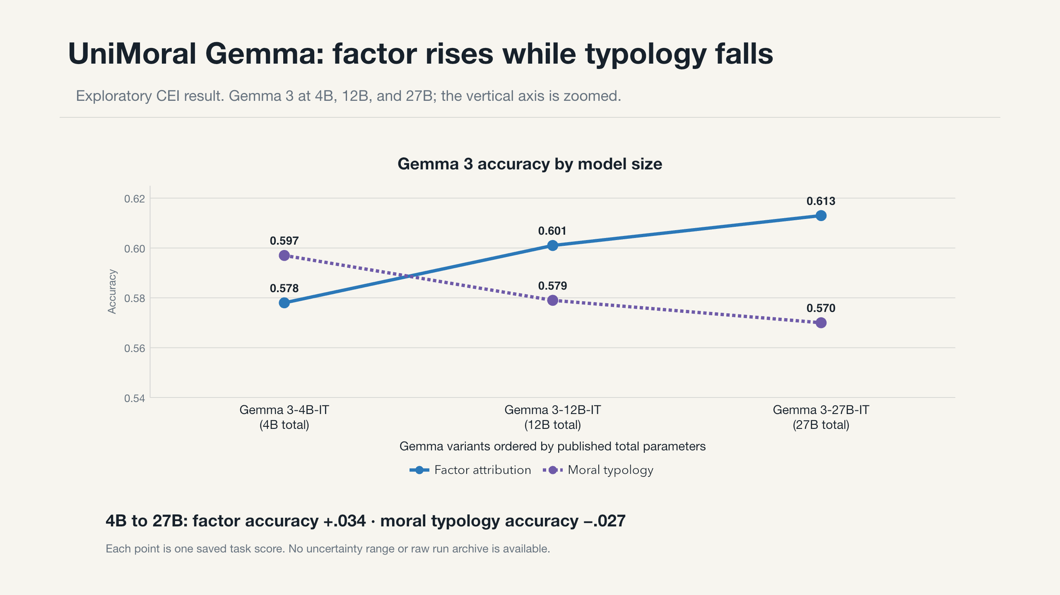
Notes:
Context: These are exploratory CEI UniMoral results for Gemma 3 at 4B, 12B, and 27B.
How to read: Model size runs from left to right. Each line shows accuracy for one UniMoral task.
Meaning: Factor accuracy rises from .578 to .613. Moral typology accuracy falls from .597 to .570.
Limit: The vertical scale is zoomed. The versions also differ in training, and no uncertainty ranges are saved.
Reference only:
Sources: data/results/size_task_points.csv, evidence/model-parameter-sources.csv

Slide 6
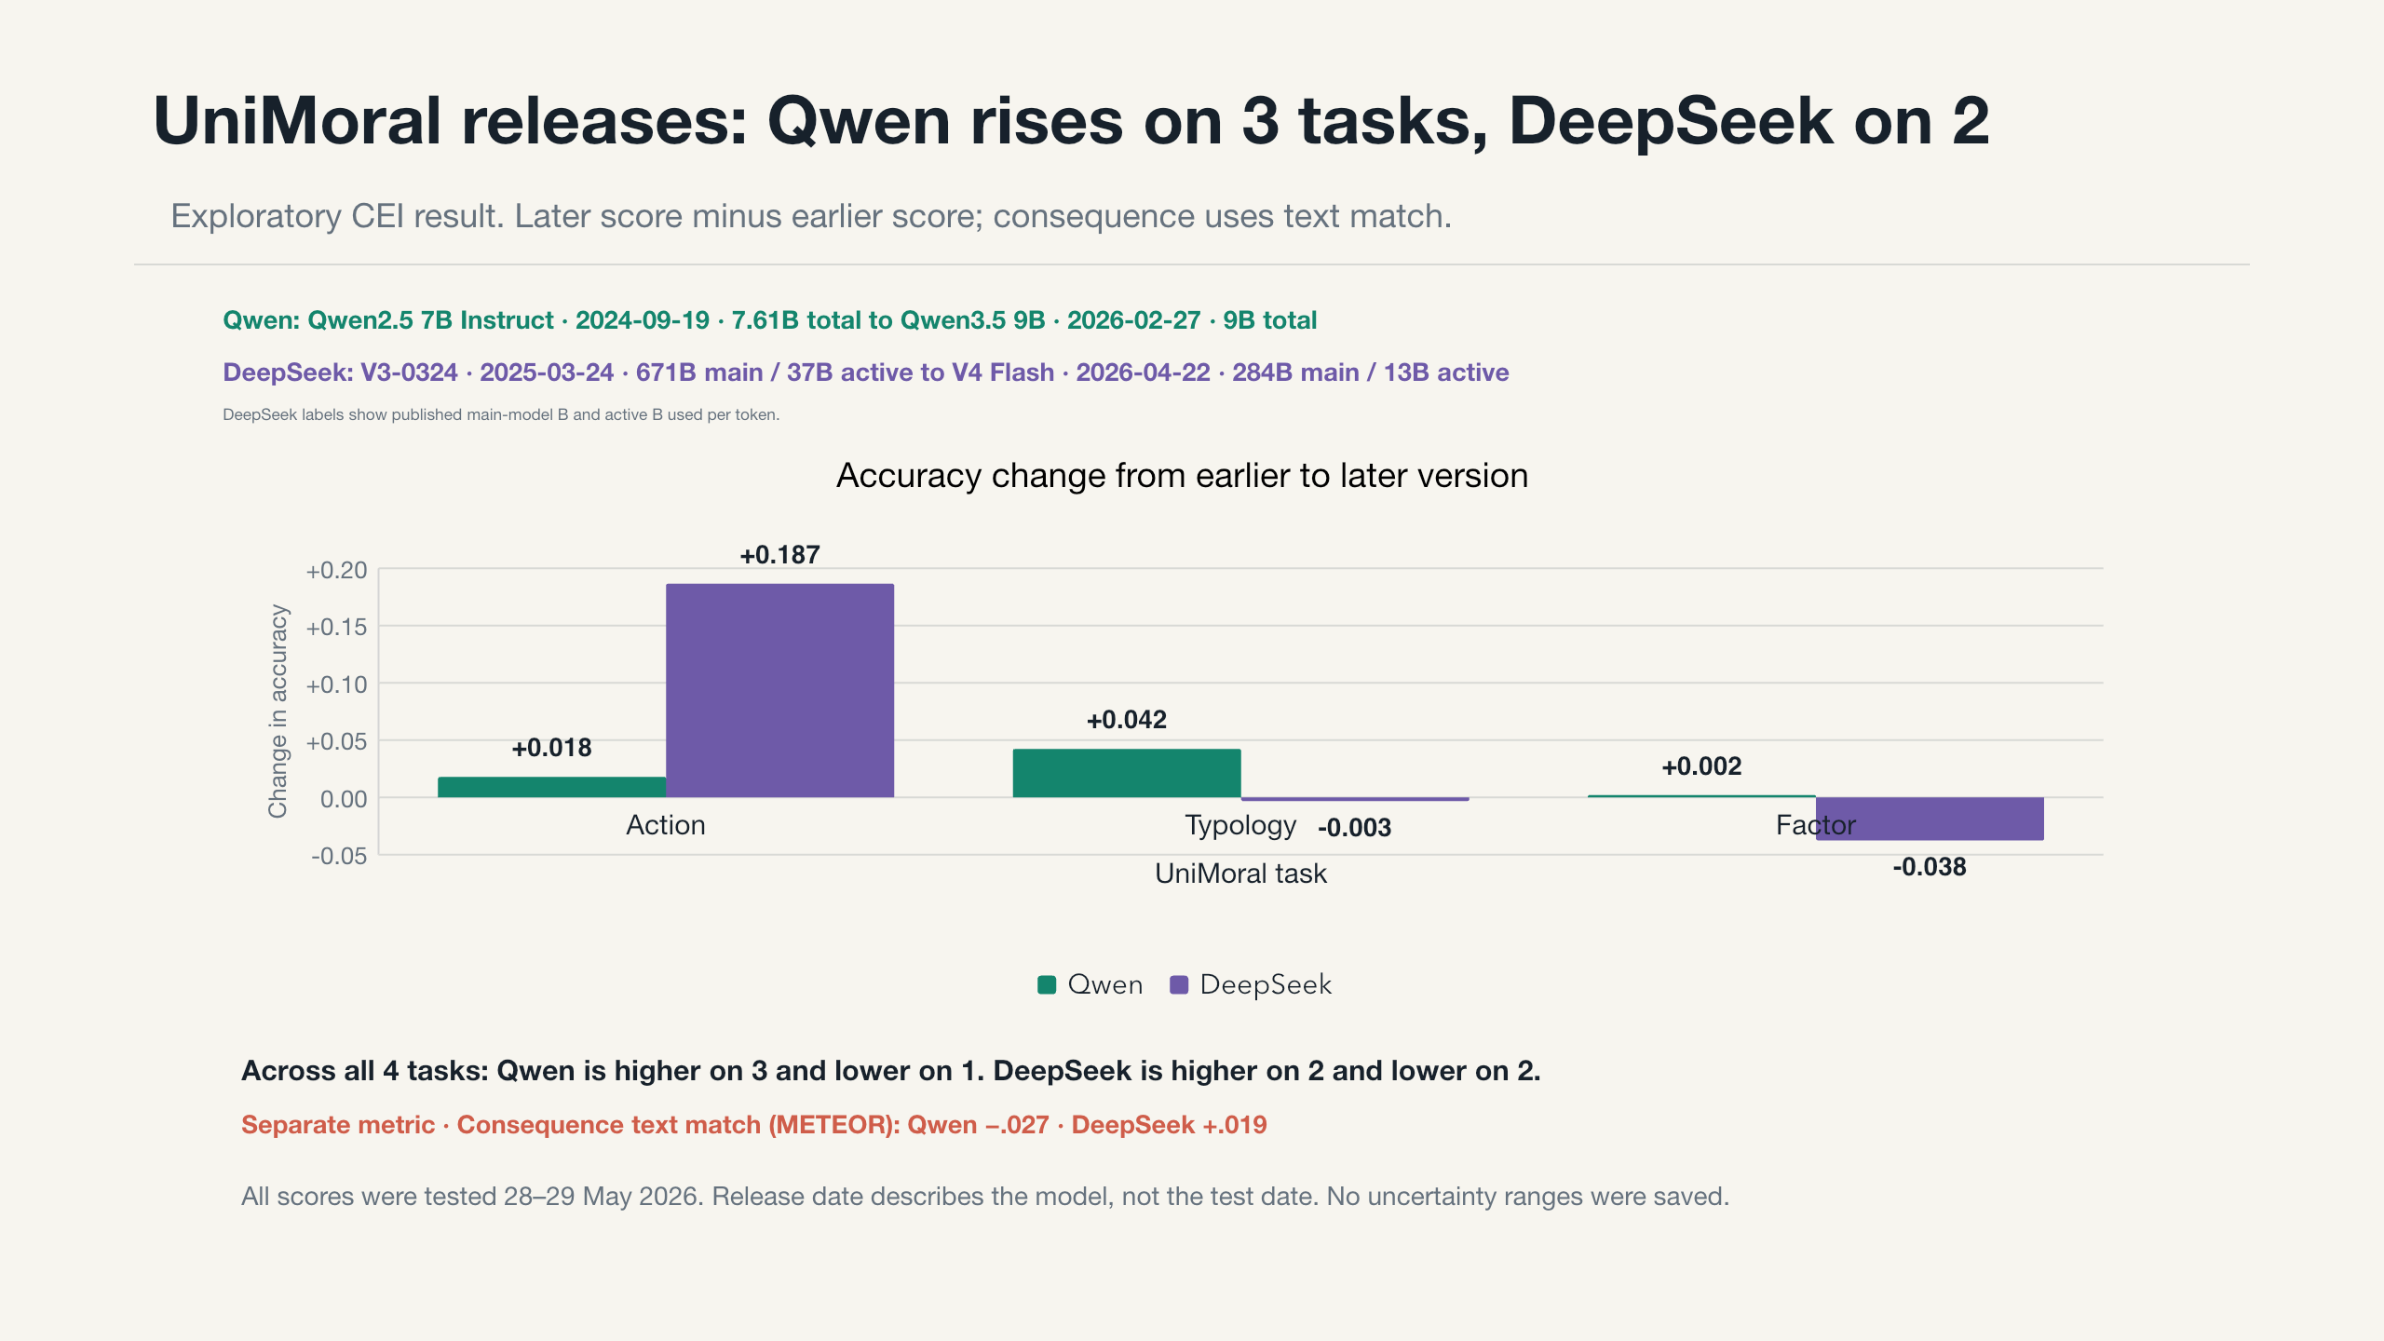
Notes:
Context: These are exploratory CEI UniMoral results for earlier and later Qwen and DeepSeek models.
How to read: Bars show changes in three accuracy tasks. The separate line shows the change in consequence text match.
Meaning: Qwen is higher on three tasks and lower on one. DeepSeek is higher on two and lower on two.
Limit: Release date describes the model, not the test date. All shown scores were run on May 28 or 29, 2026.
Reference only:
Sources: data/results/release_path_summary.csv, data/results/release_period_task_points.csv

Slide 7
Five papers ask different questions. None is exactly repeated here.
Paper results and CEI results use different models, data, prompts, or scores.
Paper | What it asks | Headline paper result | Closest CEI evidence
MoralBench | Do model choices track human ratings? | Different models lead its four assessments | Related tasks, different setup
UniMoral | Can models predict actions, types, factors, and consequences? | Llama action F1 ranges from .506 to .662 | Narrower versions of four tasks
MoReBench | Does reasoning meet expert criteria? | Harmless 81.1%; logical 47.9% | Keyword check only
MoralLens | Does reasoning order change reasons and choices? | CD GAP .230 to .052; utility .641 to .792 | Keyword check only
Value Kaleidoscope | How do value tasks change with model size? | Most gains occur before 3B | Different models and scoring
Keep paper scores and CEI scores separate. They answer related but different questions.
Notes:
Context: This map covers MoralBench, UniMoral, MoReBench, MoralLens, and Value Kaleidoscope.
How to read: Read each row from the paper question to the paper result and the closest CEI evidence.
Meaning: None of the CEI tests is documented as an exact repeat of a paper experiment.
Limit: The 37 row count on Slide 26 covers only UniMoral and ValuePrism, not all five papers.
Reference only:
Sources: data/paper_protocol_map.csv, data/paper_visual_results.csv, evidence/canonical-audit/PAPER_REPO_EVIDENCE_LEDGER.csv

Slide 8
CEI evidence audit: 78 of 143 results support main findings
The other 65 results are checks, a separate multimodal extension, or exclusions.
78 · Main text · 55%
Support the main task findings
26 · Checks only · 18%
143
Use to test robustness
9 · Multimodal · 6%
audit cells
Report as a separate extension
30 · Excluded · 21%
Do not use for model claims
The other 65 results should not be used for headline model claims.
Notes:
Context: This evidence audit covers 143 saved model and task results. It asks which results may support the main findings.
How to read: The ring divides the results into four groups. The green group contains 78 main text results.
Meaning: Seventy eight of 143 results, or 55%, meet the rules for main findings.
Limit: This does not prove that we can reproduce the raw runs or that the tasks match human judgment. Excluded does not mean model failure.
Reference only:
Sources: evidence/canonical-audit/figures/data/audit_partition.csv

Slide 9
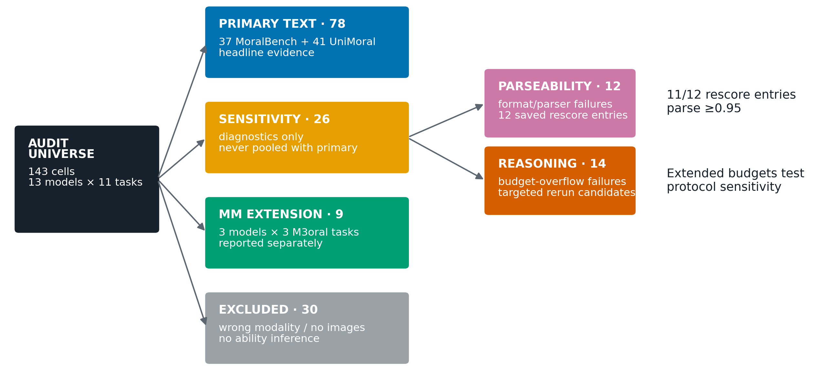
CEI evidence audit: what each result group can support
143 saved results are split into main findings, checks, multimodal results, and exclusions.
A file check confirms that the package is intact. It does not make weak or excluded evidence stronger.
Notes:
Context: The same 143 CEI results are divided by how they may be used.
How to read: Follow each result group to the type of claim it can support.
Meaning: Main text results support task findings. Other groups support checks, a separate extension, or exclusion records.
Limit: Confirming that the files are intact does not make weak evidence stronger.
Reference only:
Sources: evidence/canonical-audit/figures/01_audit_partition_flow.png

Slide 10
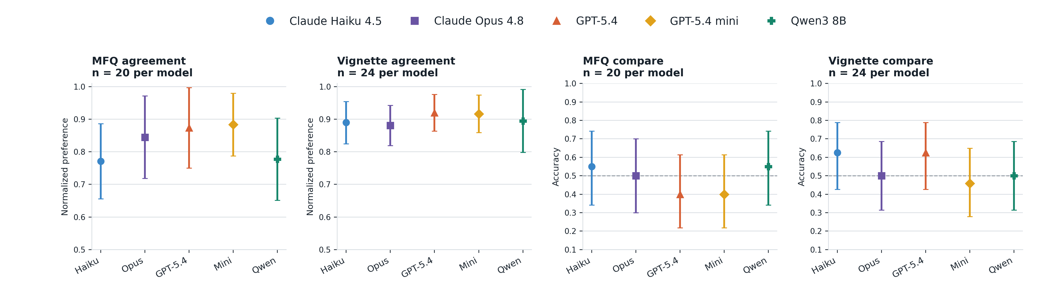
MoralBench: different models have the highest saved score
CEI local result. x = model; y = task score; dot = score; line = saved 95% range.
Agreement and accuracy stay separate. These ranges are not direct tests between two models.
Notes:
Context: These are CEI MoralBench results for the same five models on four tasks.
How to read: Each panel has its own score. A dot is a saved score. A line is its saved 95% range.
Meaning: The highest saved score belongs to different models on different MoralBench tasks.
Limit: Agreement and accuracy are different measures. The ranges do not directly test the gap between two models.
Reference only:
Sources: assets/results/01_common_roster_task_results.png, data/results/common_roster_primary.csv

Slide 11
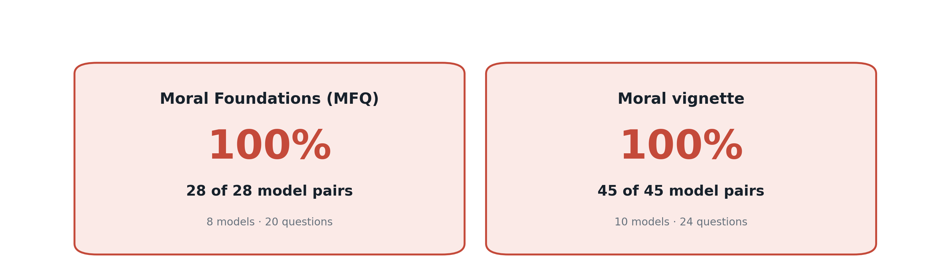
MoralBench: all model pairs have overlapping 95% ranges
CEI local result. 28 of 28 MFQ pairs and 45 of 45 vignette pairs overlap.
This is not a direct model-pair test. Question-level scores and stronger uncertainty estimates are missing.
Notes:
Context: These are CEI MoralBench forced-choice results. The question is whether the two tests identify a model leader.
How to read: Each count shows how many model pairs have overlapping score ranges.
Meaning: For each pair of models, their separate 95% score ranges overlap. The saved results do not show a clear leader.
Limit: This does not directly test the difference between two models. The saved scores for each question are missing.
Reference only:
Sources: assets/results/02_precision_by_task.png, evidence/canonical-audit/figures/data/primary_confidence_intervals.csv

Slide 12
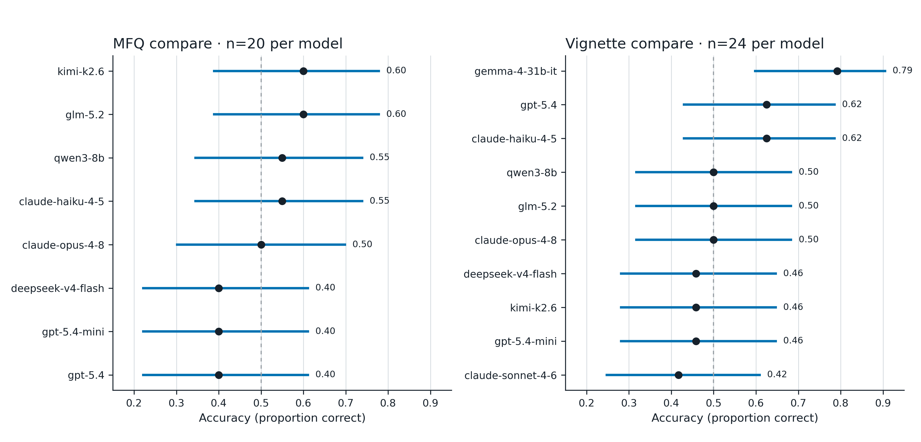
MoralBench: all 18 saved intervals are wider than .30
CEI local result. x = accuracy; y = model; dot = score; line = saved 95% range.
The calculation does not use paired model answers or related-question structure. It does not test human validity.
Notes:
Context: These are CEI MoralBench accuracy results based on 20 MFQ questions and 24 vignettes per model.
How to read: The dot is accuracy. The horizontal line is the saved 95% range.
Meaning: The available ranges are wide and do not resolve the small score gaps.
Limit: The saved data do not let us compare two models on the same questions. They also do not show whether the benchmark matches human judgment.
Reference only:
Sources: evidence/canonical-audit/figures/03_primary_uncertainty.png

Slide 13
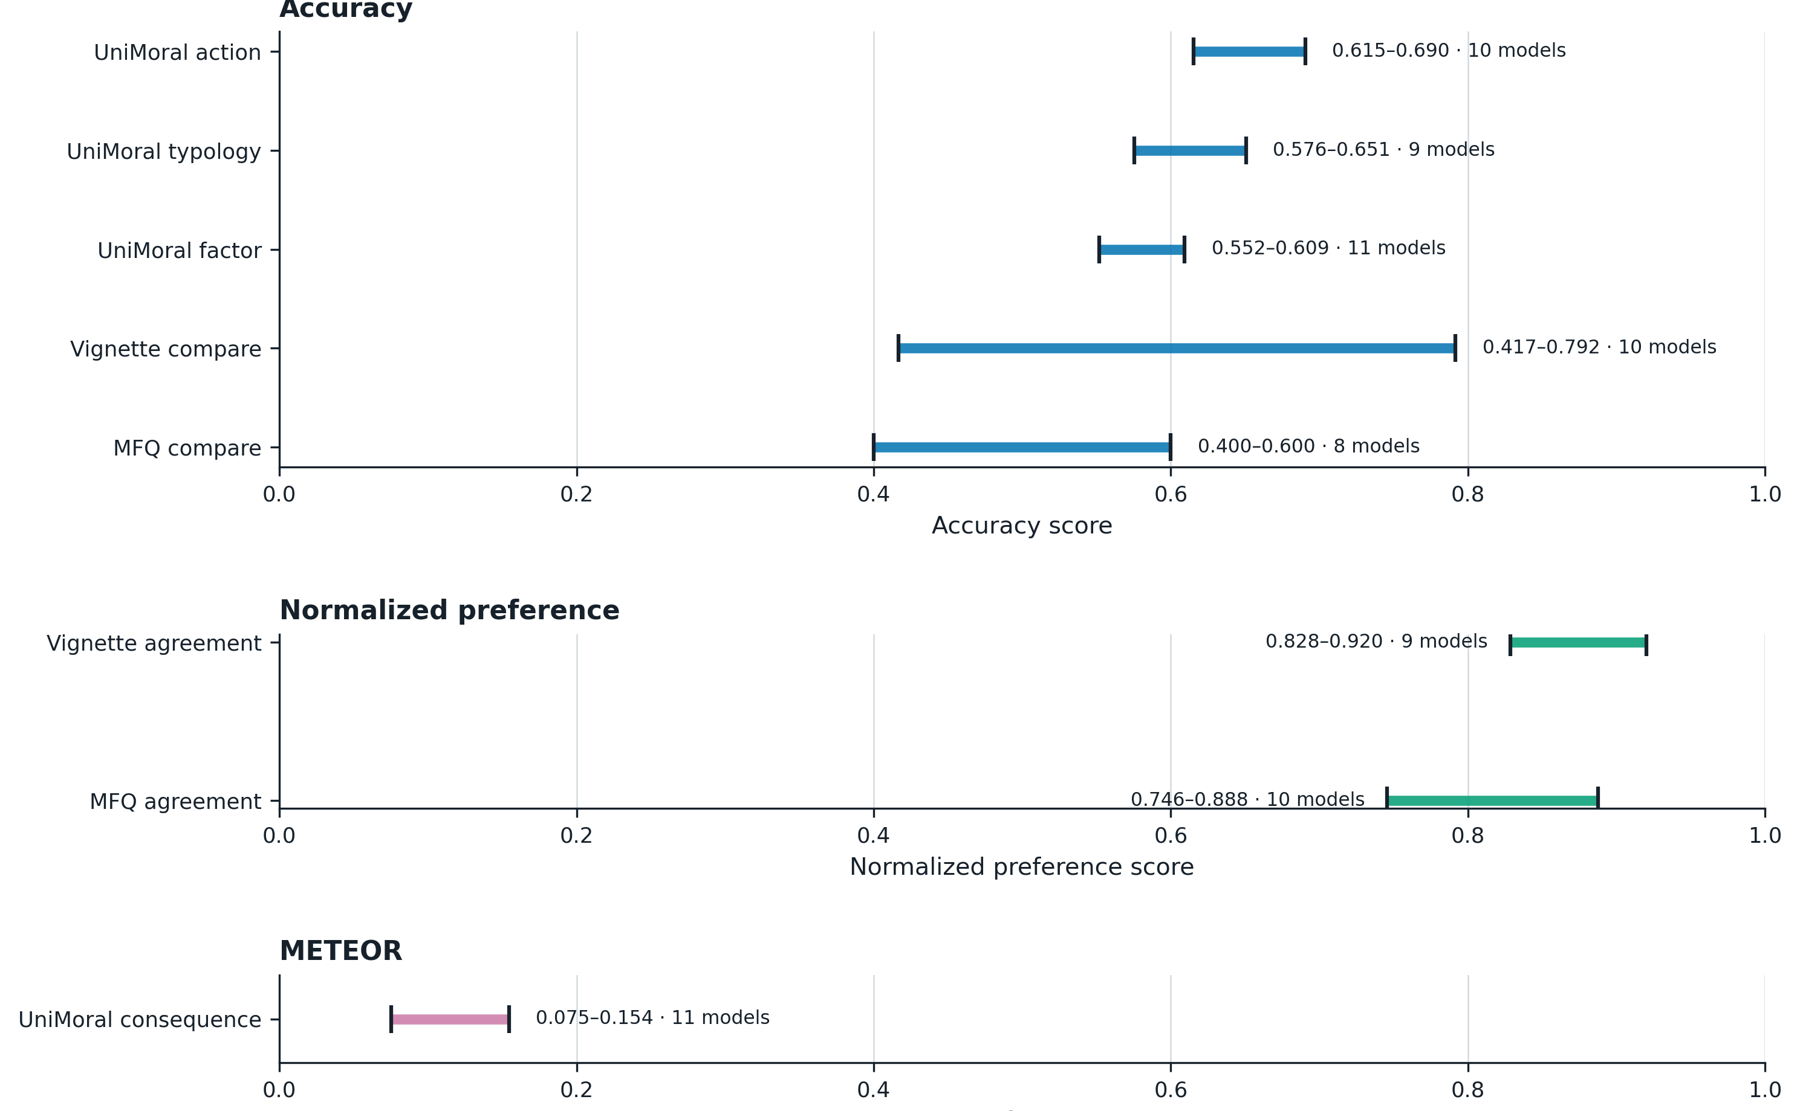
MoralBench + UniMoral: keep the 3 score types separate
CEI local result. x = score within one metric; each line = one task's five-model range.
A high score in one panel cannot be compared with a high score in another. There is no overall moral score here.
Notes:
Context: Eight CEI MoralBench and UniMoral tasks use different kinds of scores. The question is whether they can form one overall score.
How to read: Each line runs from the lowest to the highest saved score for one task. Read the three score types separately.
Meaning: Models are closer on some tasks and farther apart on others. Averaging these panels would mix different measures.
Limit: A high score in one panel cannot be compared with a high score in another. There is no supported overall moral score.
Reference only:
Sources: evidence/canonical-audit/figures/04_task_diagnostic_spread.png

Slide 14
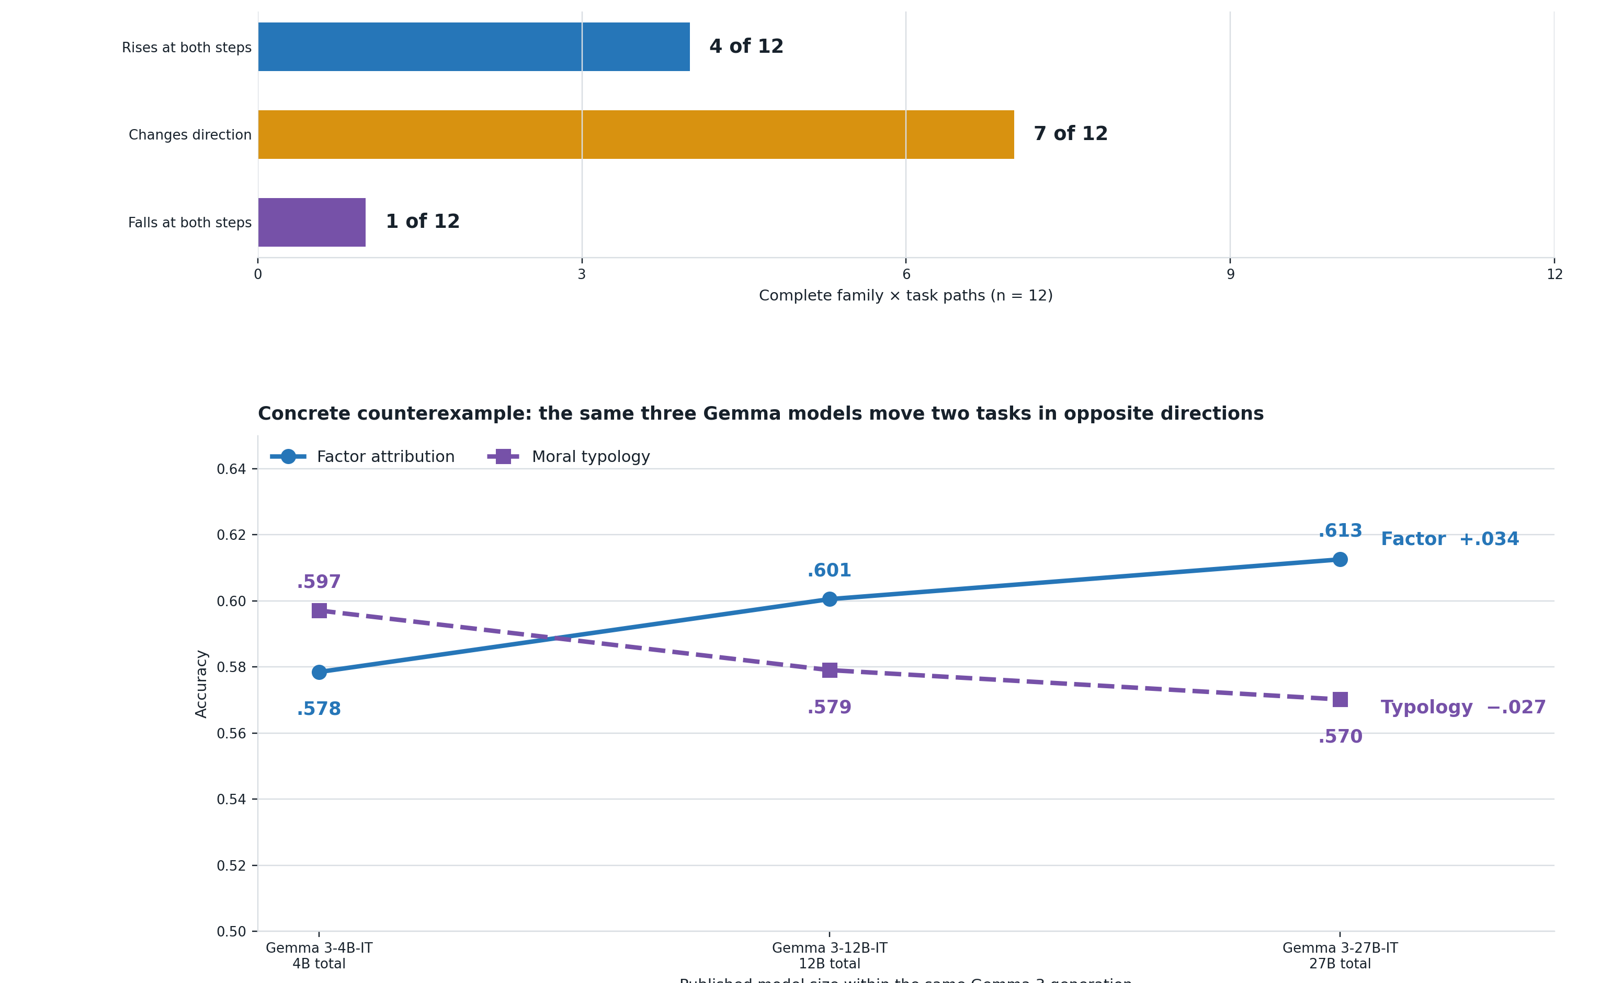
UniMoral: only 4 of 12 family and task comparisons rise twice
Exploratory CEI result. Bars = 12 comparisons; lines = Gemma at 4B, 12B, and 27B.
The Gemma vertical axis is zoomed. Size is not the only model difference. No uncertainty ranges were saved.
Notes:
Context: These are exploratory CEI UniMoral results across three model families and four tasks.
How to read: The top chart counts 12 family and task comparisons. The lower chart shows Gemma at three sizes.
Meaning: Only four comparisons rise at both steps. Gemma moves in opposite directions on two tasks.
Limit: Size is not isolated from training and release changes. No uncertainty ranges are saved.
Reference only:
Sources: assets/results/03_size_paths.png, data/results/size_path_summary.csv

Slide 15
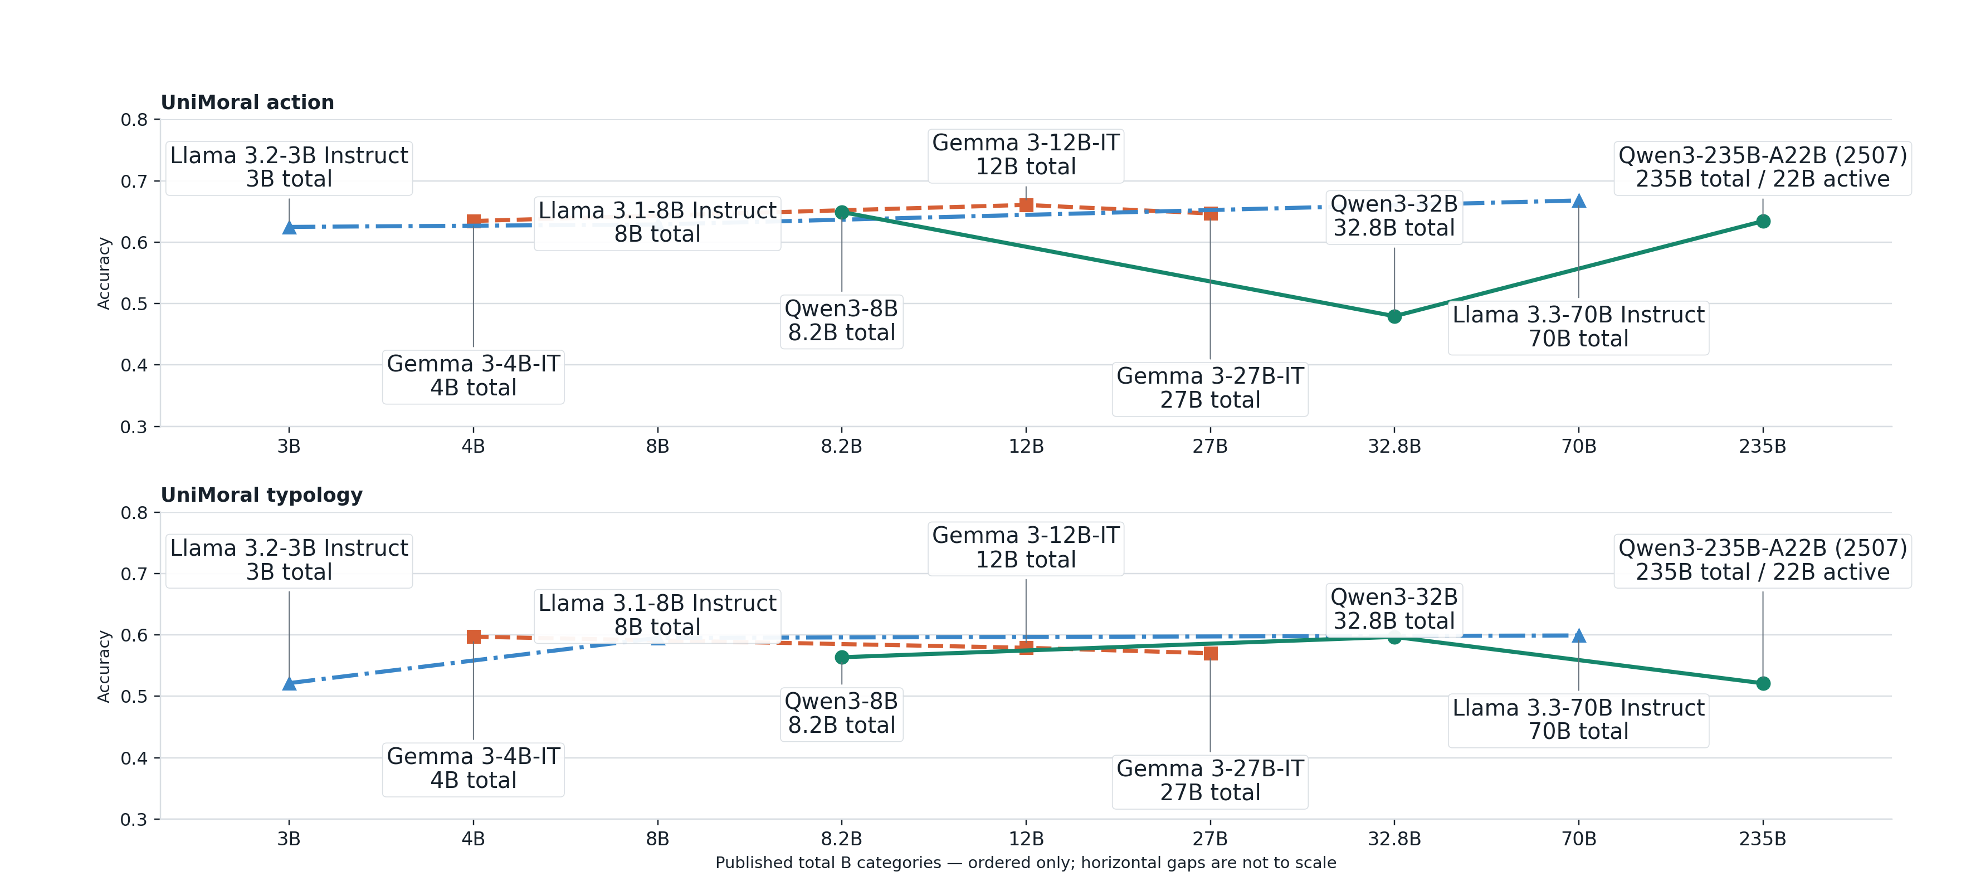
UniMoral size: 3 of 6 family and task comparisons change direction
Exploratory CEI result. x = published size category, ordered only; y = accuracy; labels = model + B.
Each line stays within one family and task. No saved uncertainty ranges or raw run archive are available.
Notes:
Context: These are exploratory CEI UniMoral action and typology results for Qwen, Gemma, and Llama.
How to read: Move left to right within one family. Each point names the model and its published size.
Meaning: Three of six comparisons change direction. Larger versions are not consistently more accurate on these two tasks.
Limit: The chart has no saved uncertainty ranges or raw run archive. The model versions differ in more than size.
Reference only:
Sources: assets/results/03_size_action_typology_detail.png, data/results/size_task_points.csv

Slide 16
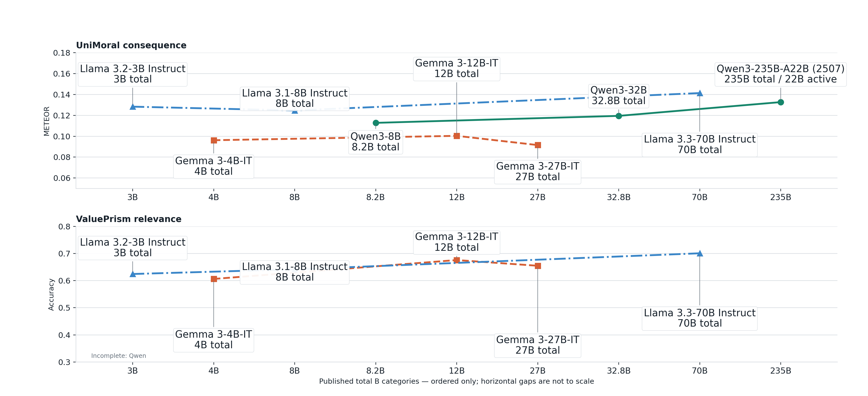
UniMoral + ValuePrism: 3 of 5 size paths change direction
Exploratory CEI result. x = published size category, ordered only; y = named metric; labels = model + B.
The CEI ValuePrism test is not a repeat of the paper's Kaleido experiment. No uncertainty ranges were saved.
Notes:
Context: These are exploratory CEI UniMoral consequence and ValuePrism relevance results across model sizes.
How to read: Move left to right within one family. Read consequence text match and relevance accuracy separately.
Meaning: Three of five complete comparisons change direction. No one size pattern holds across both tasks.
Limit: Text match and accuracy cannot be compared directly. CEI ValuePrism is not the Value Kaleidoscope paper test.
Reference only:
Sources: assets/results/03_size_consequence_relevance_detail.png, data/results/size_task_points.csv

Slide 17
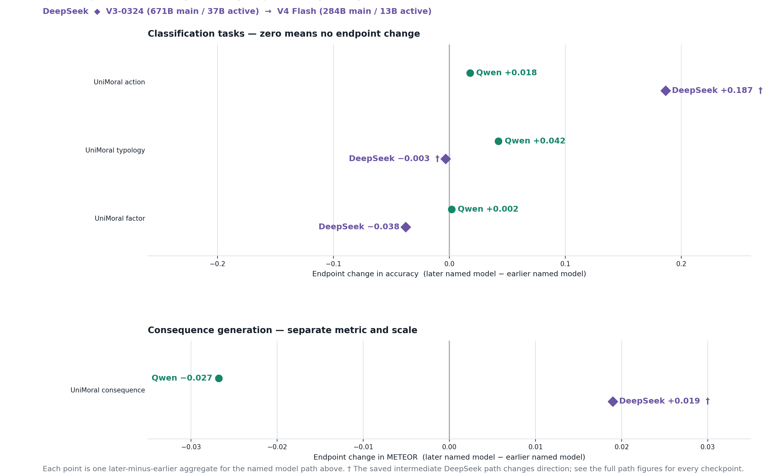
UniMoral: Qwen is higher on 3 tasks; DeepSeek on 2
Exploratory CEI result. x = later minus earlier score; y = task; metrics stay separate.
All scores were tested on May 28 or 29, 2026. Release date describes the model, not the test date.
Notes:
Context: This is an exploratory CEI UniMoral comparison of the first and last Qwen and DeepSeek models.
How to read: The horizontal value is later score minus earlier score. Right is higher. Left is lower.
Meaning: Qwen is higher on three of four tasks. DeepSeek is higher on two of four.
Limit: All scores were tested in May 2026. Looking only at first and last models can hide changes in between.
Reference only:
Sources: assets/results/04_release_period_paths.png, data/results/release_path_summary.csv

Slide 18
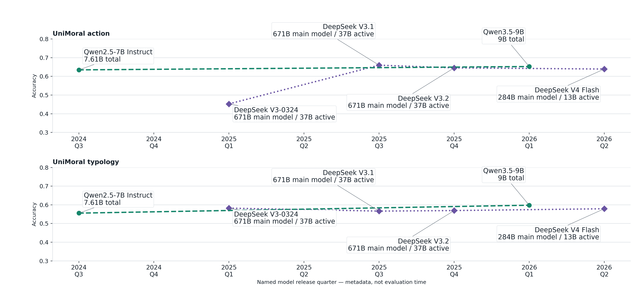
DeepSeek reverses on UniMoral action and typology
Exploratory CEI result. x = model release quarter; y = accuracy; labels = model + B.
Release quarter is model metadata, not test time. The lines do not show a cause. The available files have no saved uncertainty ranges or raw run archive.
Notes:
Context: These are exploratory CEI UniMoral action and typology results across saved Qwen and DeepSeek release quarters.
How to read: Move left to right within one family. Each point names the model and its published size.
Meaning: DeepSeek changes direction on both tasks. The reported score depends on which saved model version is used.
Limit: Release quarter is model metadata, not test time. Training, size, architecture, and provider details can also differ. The available files have no saved uncertainty ranges or raw run archive.
Reference only:
Sources: assets/results/04_release_action_typology_detail.png, data/results/release_period_task_points.csv

Slide 19
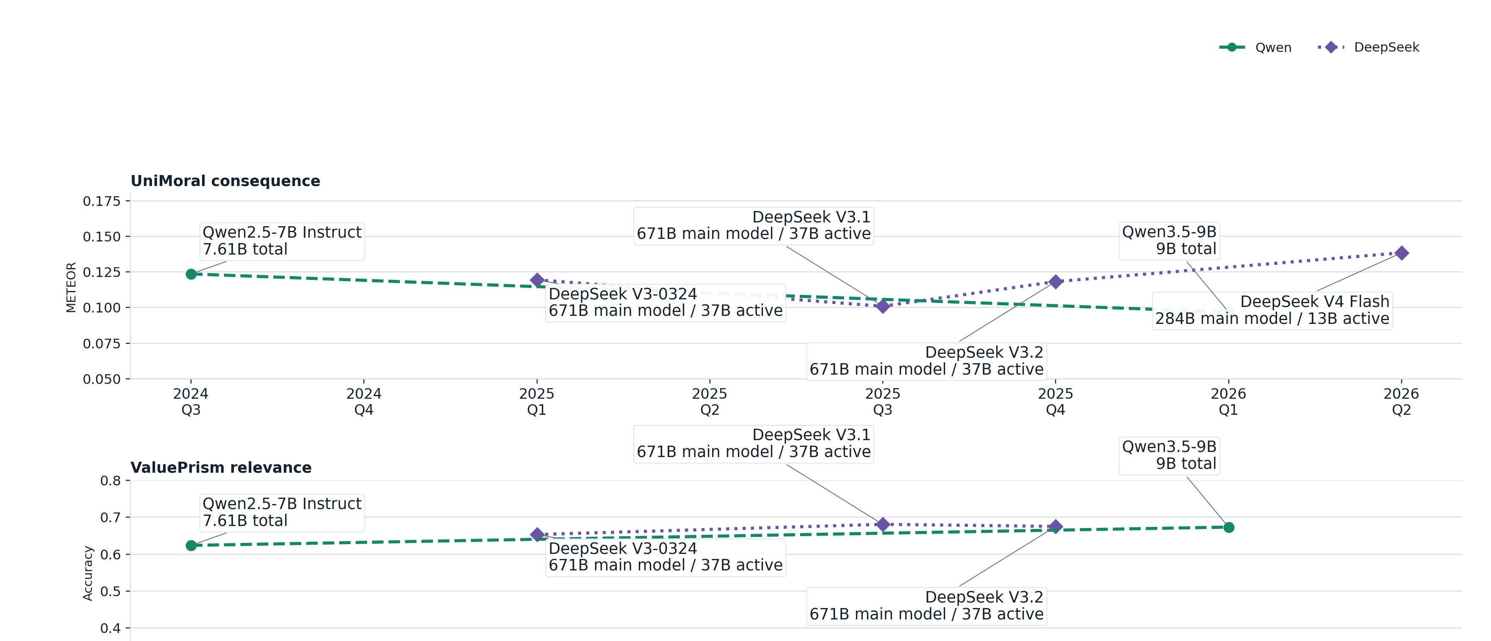
UniMoral and ValuePrism: later Qwen falls on consequence and rises on relevance
Exploratory CEI result. x = model release quarter; y = named metric; labels = model + B.
Consequence uses text match. Relevance uses accuracy. Release quarter is model metadata. The available files have no saved uncertainty ranges or raw run archive.
Notes:
Context: These are exploratory CEI UniMoral consequence and ValuePrism relevance results across model release quarters.
How to read: Move left to right within one family. Read consequence text match and relevance accuracy separately.
Meaning: Later Qwen is lower on consequence text match and higher on ValuePrism relevance. DeepSeek ends higher on both.
Limit: Text match and accuracy cannot share one scale. Release quarter is model metadata, not test time. The available files have no saved uncertainty ranges or raw run archive.
Reference only:
Sources: assets/results/04_release_period_paths_detail_b.png, data/results/release_period_task_points.csv

Slide 20
UniMoral action: 671B DeepSeek releases range from .453 to .660
Every point names the model, release date, published size, and CEI accuracy.
DeepSeek V3.1
2025-08-21 · 671B main / 37B active
accuracy 0.660
0.7
Qwen3.5-9B
2026-02-27 · 9B total
accuracy 0.653
Same published size, different scores
Qwen2.5-7B Instruct
2024-09-19 · 7.61B total
accuracy 0.635
DeepSeek 671B
0.6
.453 .660 .646
UniMoral action accuracy
DeepSeek V3.2
2025-12-01 · 671B main / 37B active
accuracy 0.646
DeepSeek V4 Flash
2026-04-22 · 284B main / 13B active
accuracy 0.639
These 6 points do not show a steady size or date pattern.
0.5
DeepSeek V3-0324
2025-03-24 · 671B main / 37B active
accuracy 0.453
Bubble area shows published total or main-model B. DeepSeek labels also show active B.
0.4
Only 6 saved results. No uncertainty ranges. Some served-model details were not saved.
Sep 2024
Mar 2025
Sep 2025
Mar 2026
Model release date
Notes:
Context: These are six exploratory CEI UniMoral action results. The question is whether larger or later models always score higher.
How to read: The horizontal axis is release date. The vertical axis is action accuracy. Bubble area shows published model size.
Meaning: Three 671B DeepSeek releases range from .453 to .660. The six points do not form a steady size or date pattern.
Limit: Six results cannot show a general pattern. The chart has no uncertainty ranges, and some details about the models actually used were not saved.
Reference only:
Sources: data/model_release_periods.csv, data/results/release_period_task_points.csv, evidence/model-parameter-sources.csv

Slide 21
MoralBench paper: the top model differs across 4 tests
Paper result. It asks whether model choices align with human ratings.
MFQ binary · summed score (raw)
Vignette binary · summed score (raw)
MFQ comparison · mean correct choices
Vignette comparison · mean correct choices
The paper does not report confidence ranges or the maximum binary score. The saved task files contain 20 MFQ and 24 vignette pairs.
Paper inconsistency: Gemma-1.1 vignette prints 44.4, while its six printed subscores sum to 51.8.
LLaMA-2 has the top MFQ binary score. GPT-4 has the top vignette binary score. GPT-3.5 tops both comparison tests.
Notes:
Context: This is a MoralBench paper result, not a CEI result. The paper asks whether model choices align with human ratings.
How to read: Read the four assessments separately because they use different score scales.
Meaning: LLaMA-2 leads MFQ binary. GPT-4 leads vignette binary. GPT-3.5 leads both comparison tests.
Limit: The paper gives no confidence ranges for these tables. One printed Gemma total conflicts with its shown parts.
Reference only:
Sources: MoralBench paper Tables 1 and 2, data/paper_visual_results.csv

Slide 22
UniMoral paper: CEI does not test all paper questions
No matching CEI test for cues, languages, or story sources; 4 task types are related but different.
Paper question | Paper result | CEI measure | Relation
Can models predict an annotator's selected action? | Llama: .5057 to .6617 weighted F1 | No-persona accuracy on annotator labels | Related task, different score
Can models classify moral typology? | Llama: .1742 to .5701 weighted F1 | No-cue accuracy | Related task, different score
Can models identify the factor behind a choice? | Llama: .0630 to .3859 weighted F1 | No-cue accuracy | Related task, different score
Can models generate a plausible consequence? | Derived from 6 paper-table language cells: BLEU .0138, METEOR .0968, BERTScore .7193 | METEOR and offline BERTScore, no BLEU | Related task, different setup
Do cues, language, and story source matter? | Higher with cues, in some languages, and for psychological rather than Reddit stories | No matching comparison | Not tested
Paper numbers and CEI numbers are not directly comparable.
Notes:
Context: This compares the UniMoral paper with CEI evidence. The paper studies action, moral type, factor, consequence, prompts, language, and story source.
How to read: Read each row from the paper question to the paper score and the related CEI measure.
Meaning: The paper reports that cues help, some languages score higher, and psychological stories score above Reddit stories. The saved CEI evidence does not test these comparisons.
Limit: Paper and CEI numbers are not directly comparable. The paper does not show a no-context baseline or clear significance tests for every condition claim. The consequence means were calculated from six paper table cells.
Reference only:
Sources: UniMoral paper, data/paper_visual_results.csv, evidence/canonical-audit/PAPER_REPO_EVIDENCE_LEDGER.csv

Slide 23
MoReBench paper: harmlessness 81.1%, logical process 47.9%
Paper question: which parts of a model's written reasoning before the final answer meet expert criteria?
81.1%
harmless
47.9%
logical process
The CEI keyword check is not the same expert review.
x = expert criteria satisfied (%)
Paper Table 2 uses thinking traces: written reasoning before the final answer. Nearby text gives different summaries.
Notes:
Context: This is a MoReBench paper result. It asks whether a model's thinking trace, the written reasoning before its final answer, meets expert criteria.
How to read: Each bar shows how often one expert criterion was met in those traces.
Meaning: The paper table reports 81.1% for harmless outcomes and 47.9% for logical process.
Limit: These are not final-answer results. For models whose internal reasoning is not available, the paper says these traces may be generated summaries. The CEI keyword check is not the same review.
Reference only:
Sources: MoReBench paper displayed Table 2, data/paper_visual_results.csv

Slide 24
MoralLens paper: reasoning first shifts reasons and choices
Reason score: .230 to .052. Larger-group choices: .641 to .792.
CD GAP
Utility
−1 deontological · +1 consequentialist
Share choosing the larger group
Decide → explain
0.230
Decide → explain
0.641
-1
0
1
0.0
0.5
1.0
Reason → decide
0.052
Reason → decide
0.792
Reasoning first shifts the mean toward duty-based reasons
Reasoning first raises larger-group choices
The CEI keyword check does not reproduce CD GAP, Utility, or the reasoning-order test.
Notes:
Context: This is a MoralLens paper result. The paper asks what changes when a model reasons before choosing.
How to read: The left panel shows the reason score. The right panel shows how often the model chooses the larger group.
Meaning: Reasoning first moves the mean toward duty-based reasons and raises the larger-group choice rate.
Limit: Both reason scores remain above zero. The larger-group rate is not moral quality, and the CEI keyword check cannot repeat this test.
Reference only:
Sources: MoralLens paper Table 2, data/paper_visual_results.csv

Slide 25
Value Kaleidoscope paper: most gains occur before 3B
Paper question: how do four value-task scores change from 60M to 11B?
Relevance accuracy
Valence accuracy
Generation perplexity ↓
Explanation perplexity ↓
Paper result. CEI ValuePrism uses different models and tests. Size labels are evenly spaced, not numeric distance.
Relevance compares a GPT-4 example for this situation with one from another. Valence uses GPT-4 Supports / Opposes / Either. Not human judgments.
From 3B to 11B: relevance +.007, valence +.011, generation perplexity −.01, explanation perplexity −.15.
Notes:
Context: This is a Value Kaleidoscope paper result for Kaleido models from 60M to 11B.
How to read: Higher is better for the two accuracy panels. Lower is better for the two perplexity panels.
Meaning: Most of the shown change occurs before 3B. The change from 3B to 11B is small on all four measures.
Limit: The paper gives no uncertainty ranges. Relevance and valence use GPT-4 targets, not human judgments. CEI ValuePrism uses different models and test steps.
Reference only:
Sources: Value Kaleidoscope paper Table 13, data/paper_visual_results.csv

Slide 26
CEI has 0 exact repeats of UniMoral or Value Kaleidoscope
Across 37 paper-to-CEI comparison rows: 17 are related but different, 4 are indirect, and 16 cannot be compared.
Exact repeat
0 of 37
Related but different
17 of 37
Indirect check
4 of 37
Cannot compare
16 of 37
Scope: 13 UniMoral rows + 24 ValuePrism rows. Related evidence is not a repeat of the paper test.
The detailed row-by-row matrix is in the evidence audit folder.
Notes:
Context: This compares 37 paper-to-CEI rows covering the UniMoral paper, the Value Kaleidoscope paper, and related CEI UniMoral and ValuePrism tests. It asks whether the tests are exact repeats.
How to read: Each column checks one part of the model, data, score, or test setup.
Meaning: None of the 37 rows matches exactly. Seventeen are related but different, four are indirect checks, and sixteen cannot be compared with the saved CEI evidence.
Limit: This count covers only UniMoral and ValuePrism. Related evidence does not repeat the paper test.
Reference only:
Sources: evidence/canonical-audit/figures/02_evidence_status_matrix.png, evidence/canonical-audit/PAPER_REPO_EVIDENCE_LEDGER.csv

Slide 27
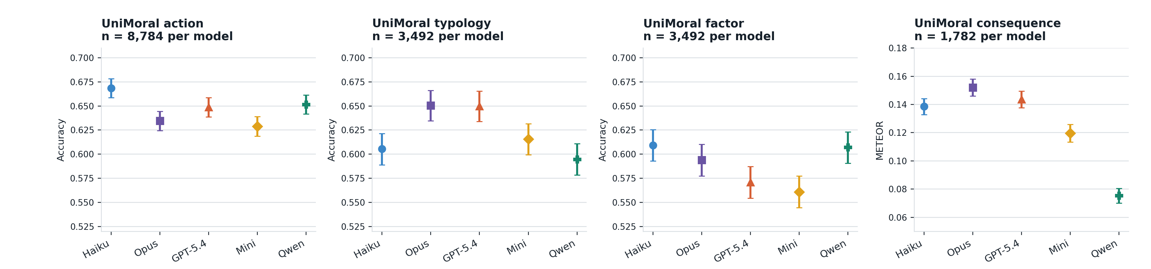
UniMoral: different models have the highest saved score
CEI local result. x = model; y = task score; dot = score; line = saved 95% range.
Accuracy and text match stay separate. These ranges are not direct tests between two models.
Notes:
Context: These are CEI UniMoral results for the same five models on four tasks.
How to read: Each panel has its own score. A dot is a saved score. A line is its saved 95% range.
Meaning: The highest saved score belongs to different models on different UniMoral tasks.
Limit: Accuracy and text match are different measures. The ranges do not directly test the gap between two models.
Reference only:
Sources: assets/results/01_common_roster_task_results.png, data/results/common_roster_primary.csv

Slide 28
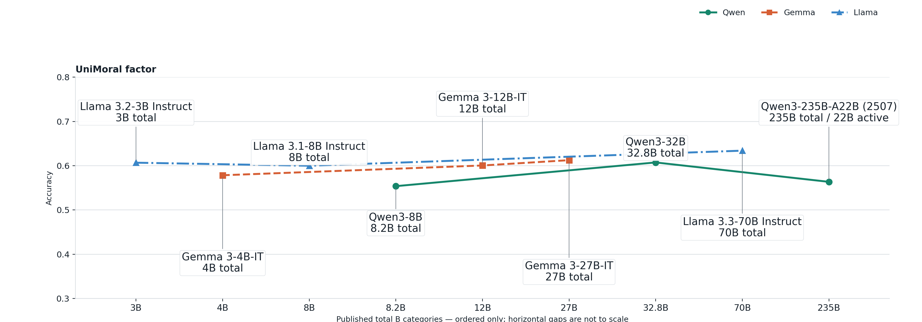
UniMoral factor size: Gemma rises; Qwen and Llama reverse
Exploratory CEI result. x = published size category, ordered only; y = factor accuracy; labels = model + B.
Size is not isolated from training differences. The available files have no saved uncertainty ranges or raw run archive.
Notes:
Context: These are exploratory CEI UniMoral factor results for Qwen, Gemma, and Llama at three model sizes.
How to read: Move left to right within one family. Each point names the model and its published size.
Meaning: Gemma rises at both size steps. Qwen and Llama change direction across the three saved sizes.
Limit: The models differ in training as well as size, so size alone may not explain the scores. The available files have no saved uncertainty ranges or raw run archive.
Reference only:
Sources: assets/results/03_size_factor_detail.png, data/results/size_task_points.csv

Slide 29
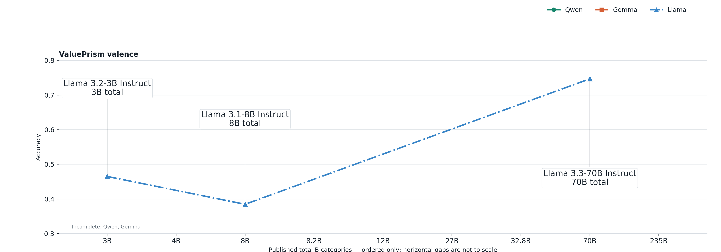
ValuePrism valence size: Llama falls, then rises
Exploratory CEI result. x = published size category, ordered only; y = valence accuracy; labels = model + B.
Only Llama has all three sizes. CEI ValuePrism is not the paper's Kaleido test. The available files have no saved uncertainty ranges or raw run archive.
Notes:
Context: These are exploratory CEI ValuePrism valence results across saved Llama model sizes.
How to read: Move left to right along the Llama line. Each point names the model and its published size.
Meaning: The complete Llama path falls from 3B to 8B, then rises at 70B.
Limit: Only Llama has results at all three sizes. Qwen and Gemma do not. CEI ValuePrism is not the Value Kaleidoscope paper test. The available files have no saved uncertainty ranges or raw run archive.
Reference only:
Sources: assets/results/03_size_valence_detail.png, data/results/size_task_points.csv

Slide 30
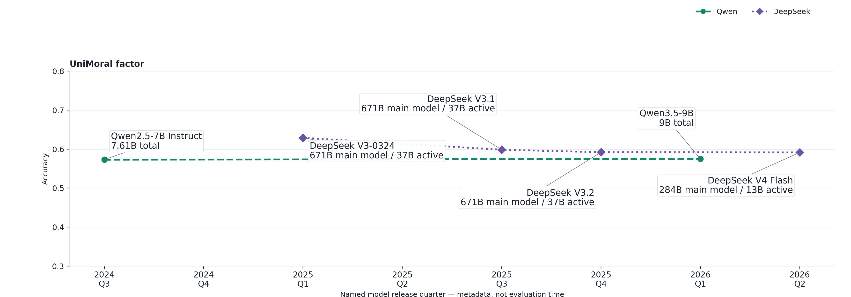
UniMoral factor releases: DeepSeek falls .038; Qwen changes .002
Exploratory CEI result. x = model release quarter; y = factor accuracy; labels = model + B.
Release quarter is model metadata, not test time. It does not explain the change. All scores were tested in May 2026; no saved uncertainty ranges.
Notes:
Context: These are exploratory CEI UniMoral factor results across saved Qwen and DeepSeek release quarters.
How to read: Move left to right within one family. Each point names the model and its published size.
Meaning: From first to last, DeepSeek is lower by .038. Qwen changes by only .002.
Limit: Release quarter is model metadata, not test time, and does not explain why the score changed. All scores were tested in May 2026 and have no saved uncertainty ranges.
Reference only:
Sources: assets/results/04_release_factor_detail.png, data/results/release_period_task_points.csv

Slide 31
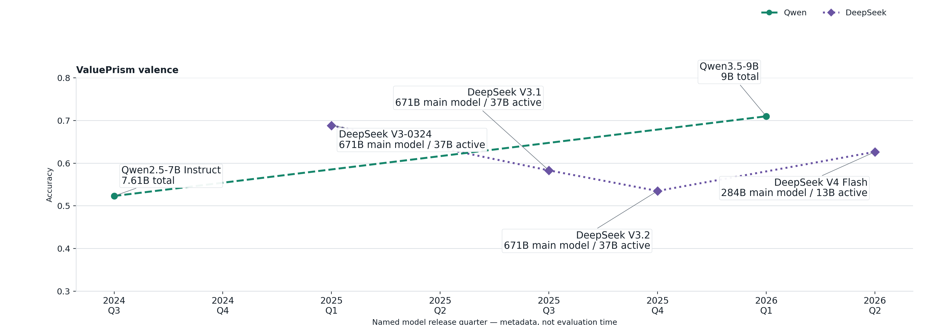
ValuePrism valence releases: Qwen +.187; DeepSeek -.062
Exploratory CEI result. x = model release quarter; y = valence accuracy; labels = model + B.
Release quarter is model metadata, not test time. CEI ValuePrism is not the paper's Kaleido test. The available files have no saved uncertainty ranges or raw run archive.
Notes:
Context: These are exploratory CEI ValuePrism valence results across saved Qwen and DeepSeek release quarters.
How to read: Move left to right within one family. Each point names the model and its published size.
Meaning: From first to last, Qwen is higher by .187 and DeepSeek is lower by .062.
Limit: Release quarter is model metadata, not test time. It does not explain the score change. CEI ValuePrism is not the paper test. The available files have no saved uncertainty ranges or raw run archive.
Reference only:
Sources: assets/results/04_release_valence_detail.png, data/results/release_period_task_points.csv

Slide 32
Next: check the current evidence before buying more model runs
Research priority, not a model result. Read from top to bottom.
1
Review 12 cases where parsing may be wrong
no new model runs
2
Check duplicate labels and verify scores using the paper's method
no new model runs
3
Run human validation
human study
4
Add MoralBench comparison items
new items + reruns
5
Rerun 14 answers that hit the length limit, using one fixed limit
targeted runs
6
Complete 30 image and text results only if needed
high cost
7
Repeat Kaleido and UniMoral paper conditions only if we plan a replication claim
model access + scoring
Run paid models only after these checks.
Notes:
Context: This is a CEI research priority, not a model result. It asks which work would reduce the most uncertainty.
How to read: Read from top to bottom.
Meaning: Review parsing, labels, and scoring first. Then add human review before broad new runs.
Limit: This order is our research judgment. Run paid models only after these checks.
Reference only:
Sources: evidence/canonical-audit/figures/05_evidence_acquisition_priority.png, evidence/canonical-audit/RERUN_PRIORITY.md

Slide 33
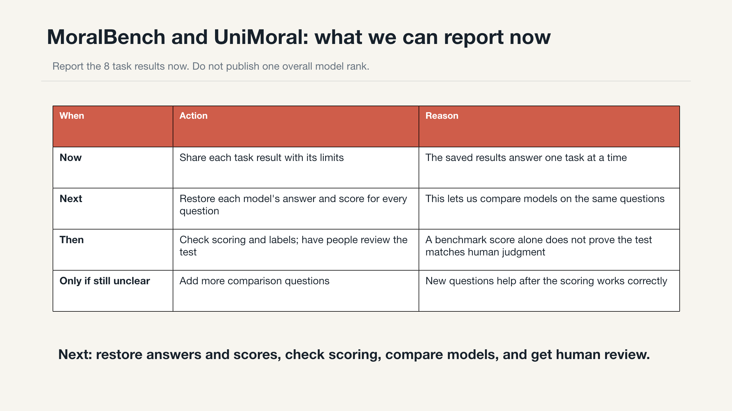
Notes:
Context: This is the decision summary for the CEI research lead. It asks what the team can report now.
How to read: The first row states the current claim. Later rows show what must improve before stronger claims.
Meaning: Share MoralBench and UniMoral task results with their limits. Do not give one overall model rank.
Limit: We cannot claim that CEI exactly repeated a paper or that one model is morally better. We still need better records and human review.
Reference only:
Sources: slides/cei-moral-psychology-results-deck.pptx, docs/RESEARCH_LEAD_BRIEF.md, evidence/canonical-audit/RERUN_PRIORITY.md

