Slide 1
A Skewed Loss Function for Correcting Predictive Bias in Brain Age Prediction
Hanzhi Wang, Matthias S. Treder, David Marshall,
Derek K. Jones, Yuhua Li
Accepted by IEEE Transactions on Medical Imaging

Slide 2
Outline
Brain Age Prediction and related predictive bias explained.
Existing approaches to solve the bias in the literature.
Our proposed approach using the skewed loss.
Experiment results and model comparisons.

Slide 3
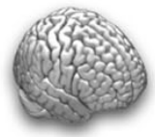
Brain Age Prediction explained
Training Set
Test Set
Brain MRI
Age
Brain MRI
Age
predicted brain-age
brain-age delta
Model
+3
25
20
23
75
74
72
-2
Brain-age delta acts as a bio-marker related to various pathological phenotypes, such as cognitive decline and dementia.^{[1]}
A positive/negative delta may indicate accelerated/delayed brain aging.
[1] J. H. Cole, R. P. Poudel, D. Tsagkrasoulis, M. W. Caan, C. Steves, T. D. Spector, and G. Montana, “Predicting brain age with deep learning from raw imaging data results in a reliable and heritable biomarker,” NeuroImage, vol. 163, pp. 115–124, 2017.

Slide 4
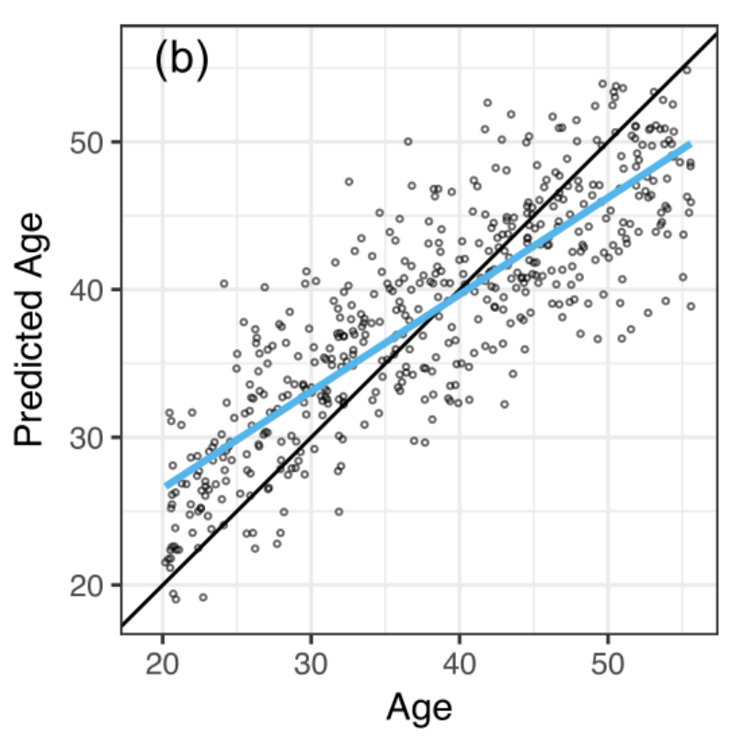
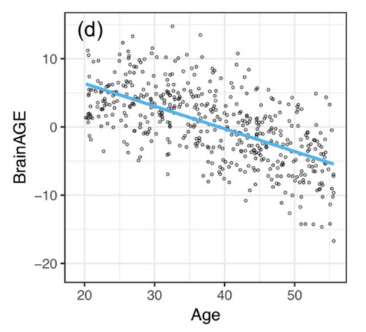
Age-related bias in brain-age delta
However, the brain-age delta tends to be positive for young individuals and negative for the elderly individuals regardless of the regression models being used.
The correlation between age and brain-age delta may affect the apparent relationship between the delta and variables of interest when these other variables are also related to age.
[2] Le, T. T., Kuplicki, R. T., McKinney, B. A., Yeh, H. W., Thompson, W. K., Paulus, M. P., ... & Tulsa 1000 Investigators. (2018). A nonlinear simulation framework supports adjusting for age when analyzing BrainAGE. Frontiers in aging neuroscience, 10, 317.

Slide 5
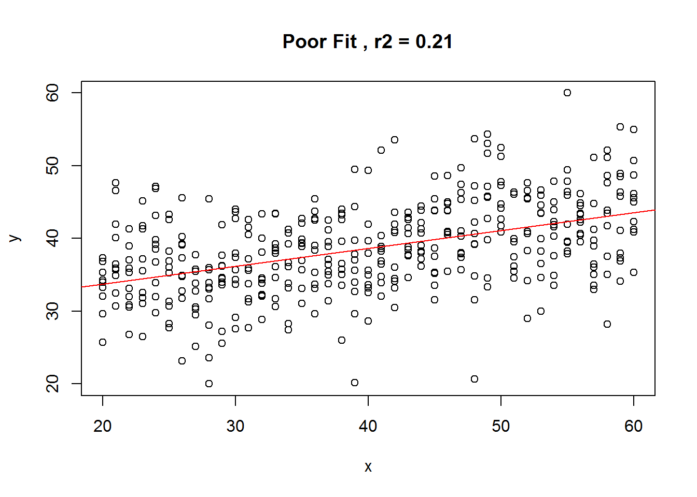
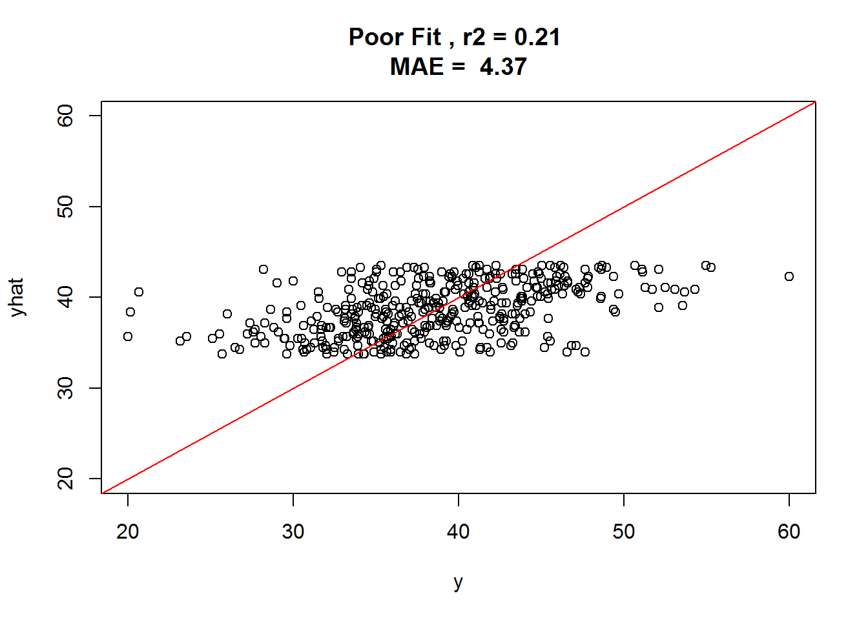
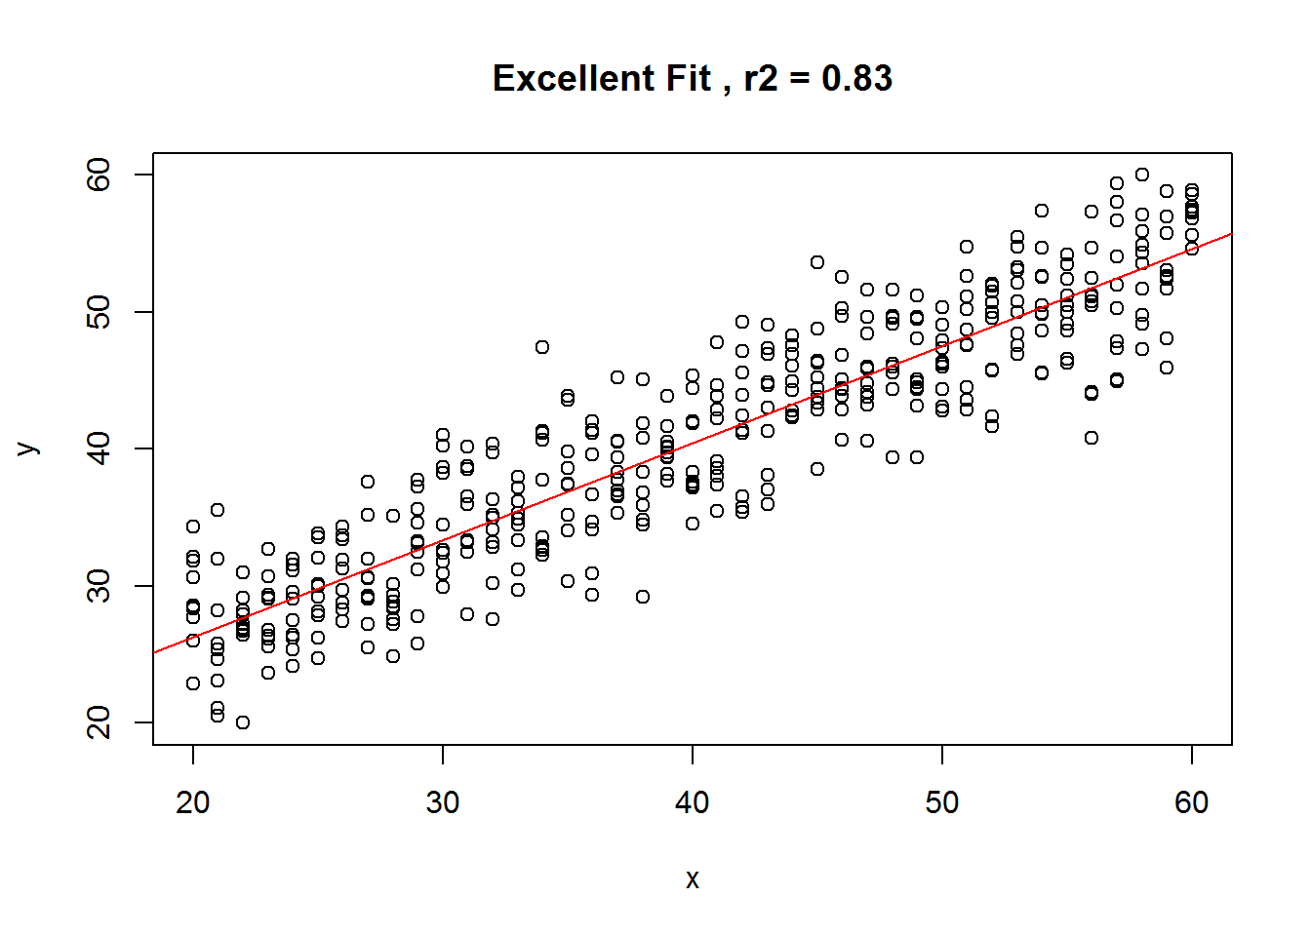
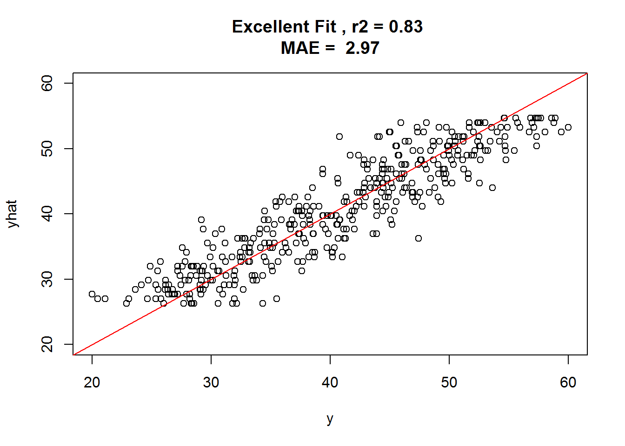
Potential reasons of this bias
Different reasons of this bias has been illustrated, such as “Regression to the Mean” or “Regression dilution”.
We tend to favor the explanation that there always exists some noise not explained by the model.
Training
Testing
Considering a Model:
y = x + epsilon
where noise epsilon is normally distributed with mean 0 and different std.
High
Std
Low
Std

Slide 6
Relevant challenges were held for solving the bias
The Predictive Analytic Challenge (PAC) 2019 was to predict age from brain MRI scans.
The goal of the challenge includes two parts:
achieve the most accurate age prediction, as measured by MAE
achieve the best MAE while keeping the Spearman correlation between the prediction error (brain age delta) and the actual age below 0.1 (|r| < 0.1).

Slide 7
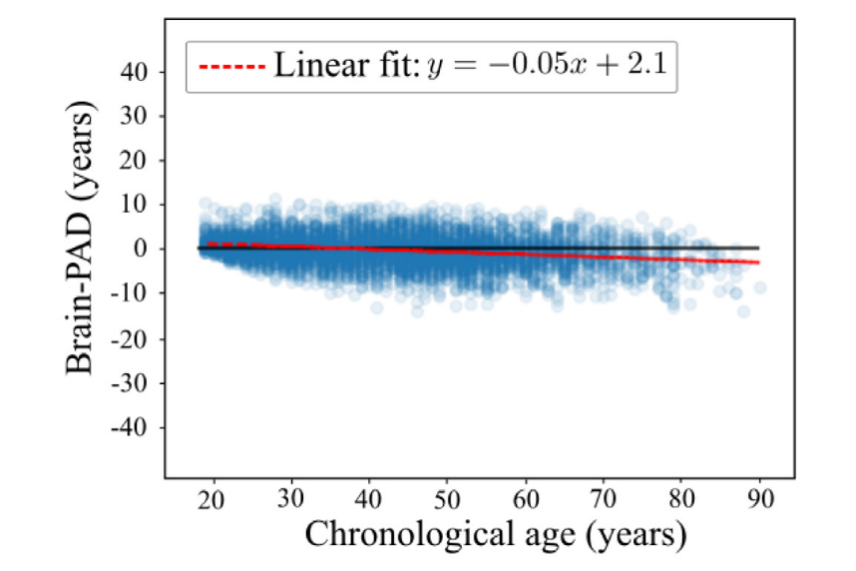
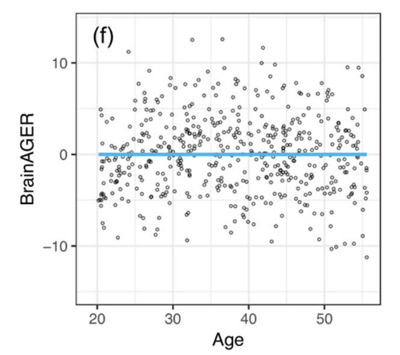
How to solve this bias
Ideally, this bias could be alleviated by using more sophisticated models, larger datasets etc. Wood et. al trained a DenseNet-121 model on more than 20000 MR images, achieving a correlation of -0.18.
Remove the age dependence for brain-age delta using additional steps.
D. A. Wood, S. Kafiabadi, A. Al Busaidi, E. Guilhem, A. Montvila, J. Lynch, M. Townend, S. Agarwal, A. Mazumder, G. J. Barker et al., “Accurate brain-age models for routine clinical mri examinations,” NeuroImage, 2022.

Slide 8
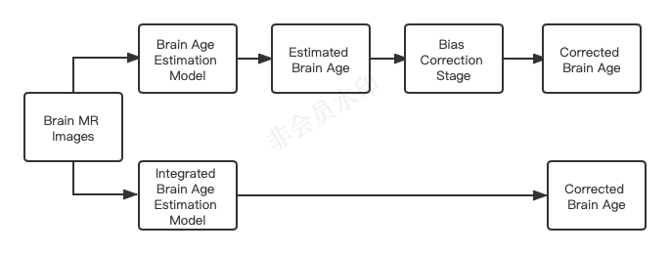
Bias correction approaches in the literature
Two-stage approach: Train a model to predict brain age and make corrections on the model predictions to derive the corrected brain age.
Integrated (Unified) approach: Train a model that gives corrected brain age predictions at the end of the training process.

Slide 9
Two-stage approach^{[4]}:
Stage-1: Brain age prediction
Train a regression model f to predict chronological age (Y) given brain MRIs (X).
Stage-2: Bias correction
Fit a linear regression between predicted age f(X) and chronologial age Y on the validation set
The corrected predicted age is defined as
[4] J. H. Cole, S. J. Ritchie, M. E. Bastin, M. V. Hern ́andez, S. M. Maniega,
N. Royle, J. Corley, A. Pattie, S. E. Harris, Q. Zhang et al., “Brain age predicts mortality,” Molecular psychiatry, vol. 23, no. 5, pp. 1385–1392, 2018.

Slide 10
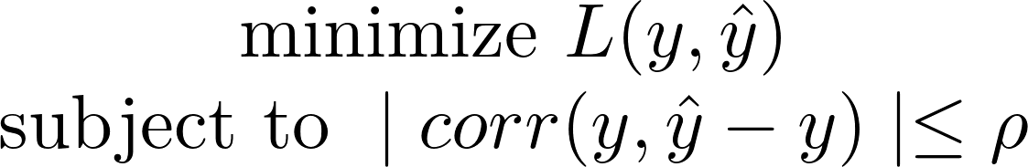
Integrated approach^{[5]}:
Matthias et.al developed an integrated approach by adding the correlation constraints into the model, turning the optimizations into a constraint optimization problem.
They has obtained analytical solutions for Linear, Ridge and Kernel Ridge regression.
[5] M. S. Treder, J. P. Shock, D. J. Stein, S. Du Plessis, S. Seedat, and K. A. Tsvetanov, “Correlation constraints for regression models: Controlling bias in brain age prediction,” Frontiers in psychiatry, vol. 12, 2021

Slide 11
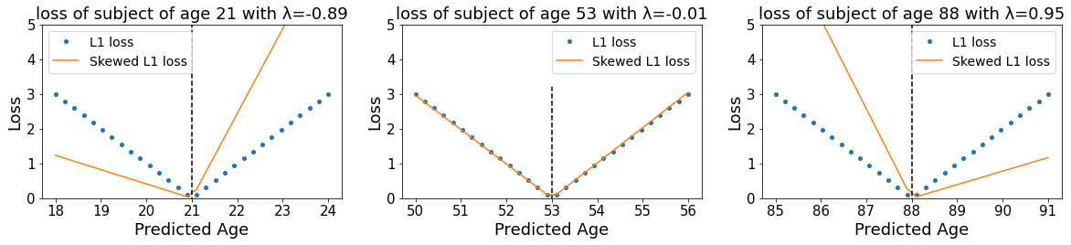
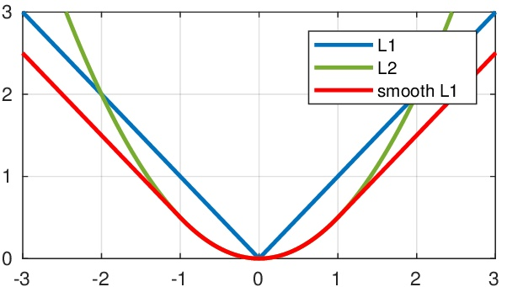
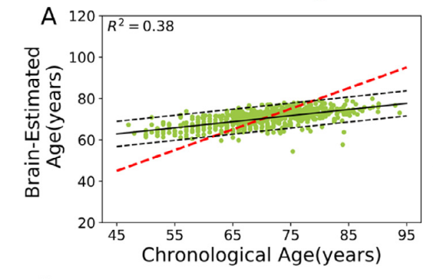
Skewed loss function
We firstly observe that loss functions are typically symmetric. Therefore, overestimations and underestimations are treated equally.

Slide 12
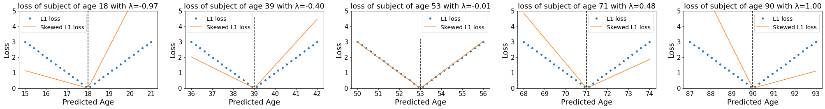
Skewed loss function
Two points shoud be noted:
Parameter lambda controls the level of the skew. The youngest participant has the largest level of left skew and the oldest paticipant has the largest level of right skew.
The range of lambda is controlled within [-lambda_max, +lambda_max].

Slide 13
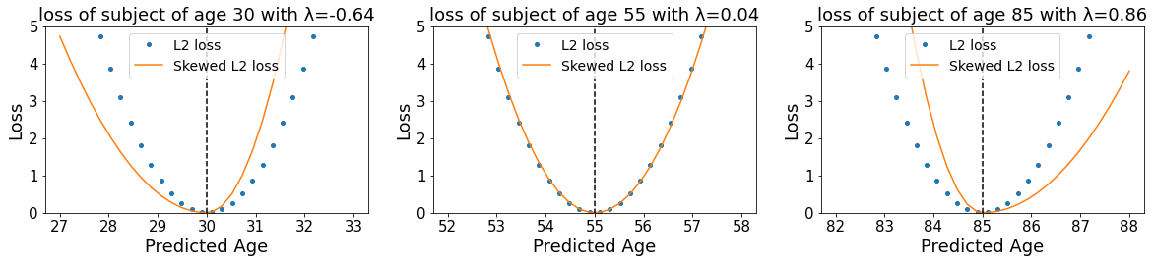
Skewed loss function
The skewed loss function can be defined as

Slide 14
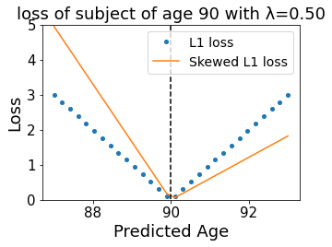
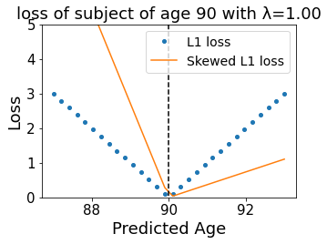
Potential problems for the skewed loss
By setting the hyperparameter lambda_max with different values, the model may not give the same result each time.

Slide 15
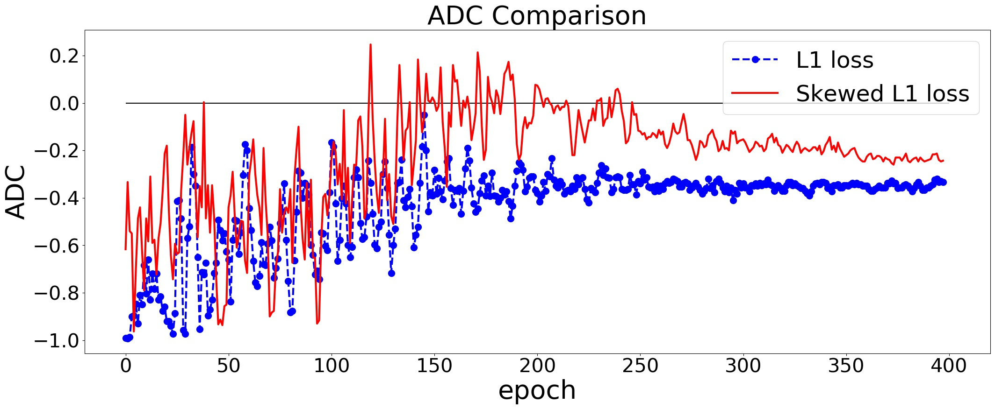
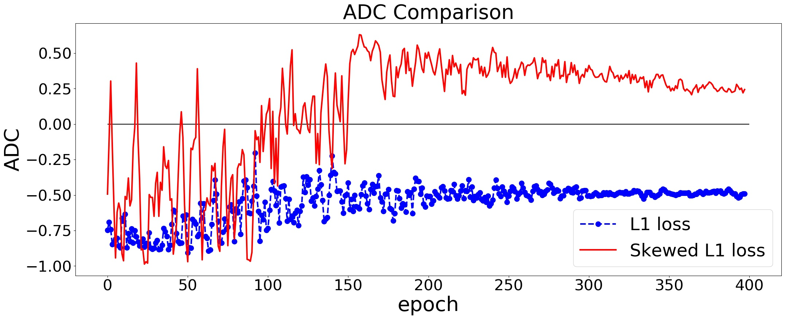
Potential problems for the skewed loss
By setting the hyperparameter with different values, a zero ADC at the end of training can not be guaranteed.

Slide 16
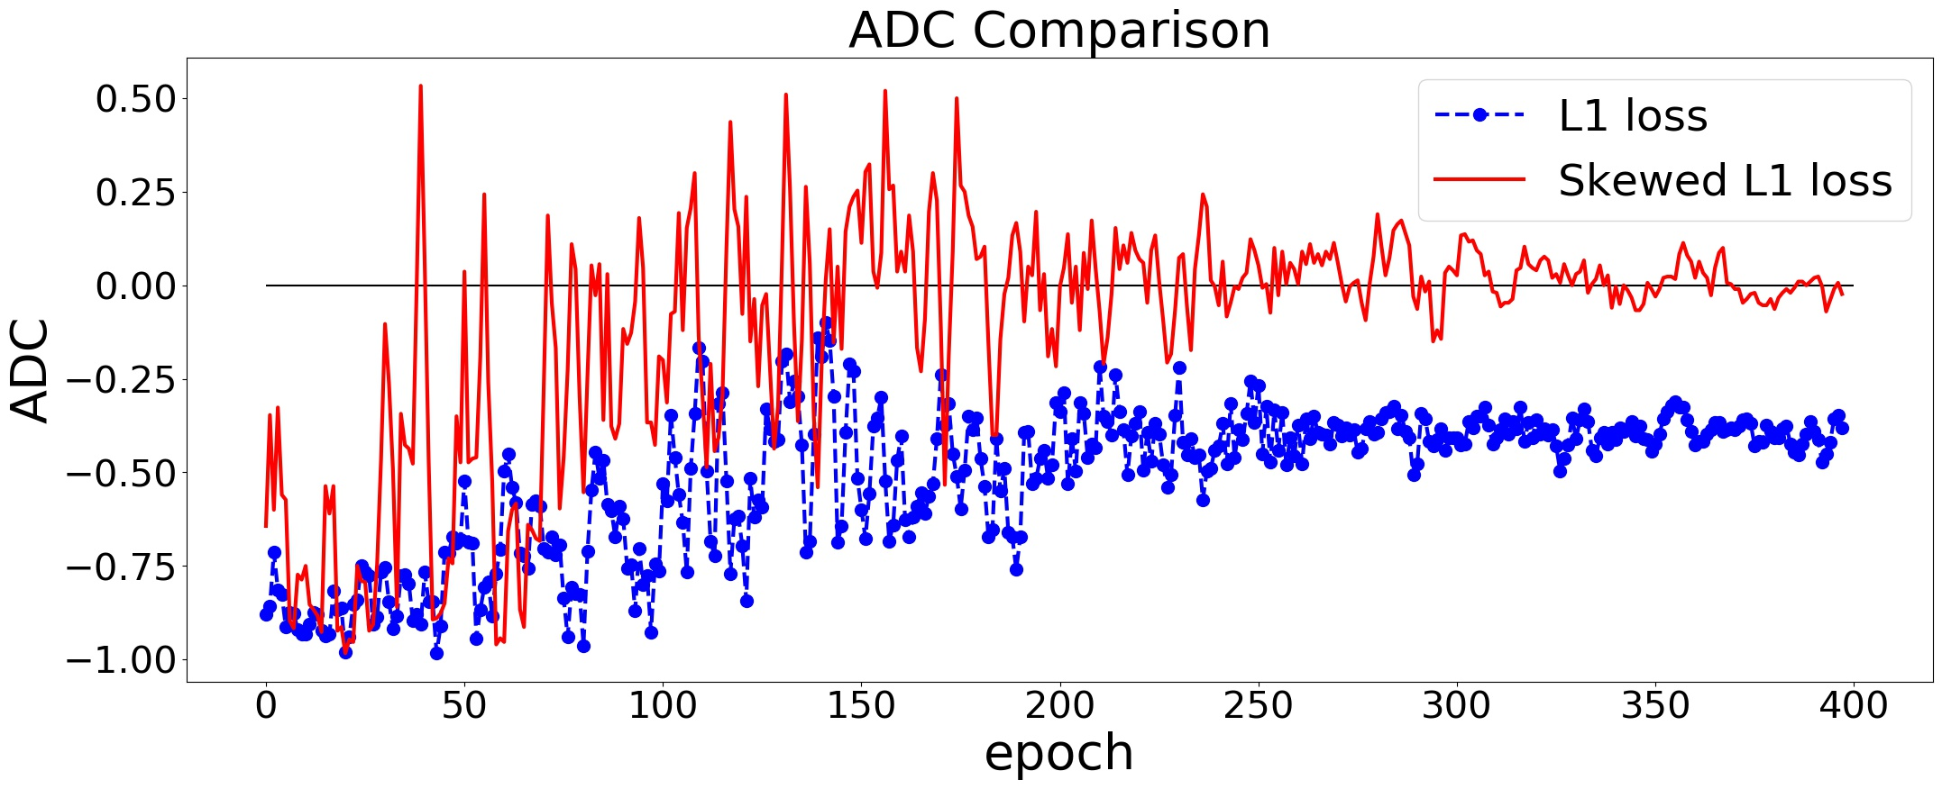
Our solution for searching the optimal value of lambda
In the early training process, we set lambda to different values every a few epoches. Then we calculate the ADC for each value of lambda.
Fit a linear regression between the lambda and the ADC. Then select the lambda that gives zero ADC value as the next lambda.
Repeat step 2 every a few epoches until the end of training.

Slide 17
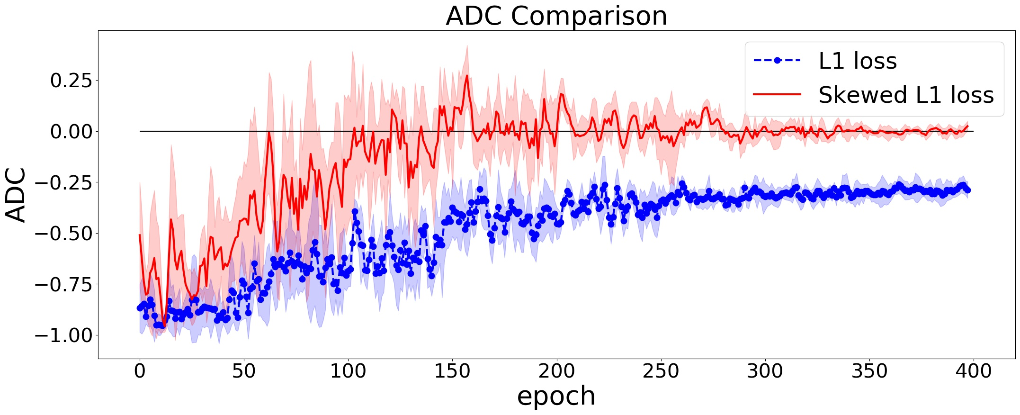
Robustness of the skewed loss function
The skewed loss has been validated on two publicly available datasets using three different model architectures. It also works on different correlation metrics (Pearson’s r & Spearman’s rank corrrelation).

Slide 18
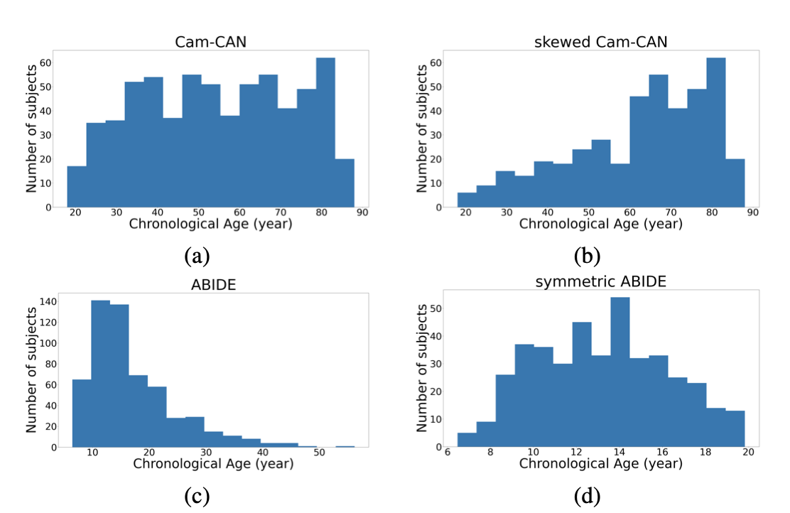
Datasets and model comparisons

Slide 19
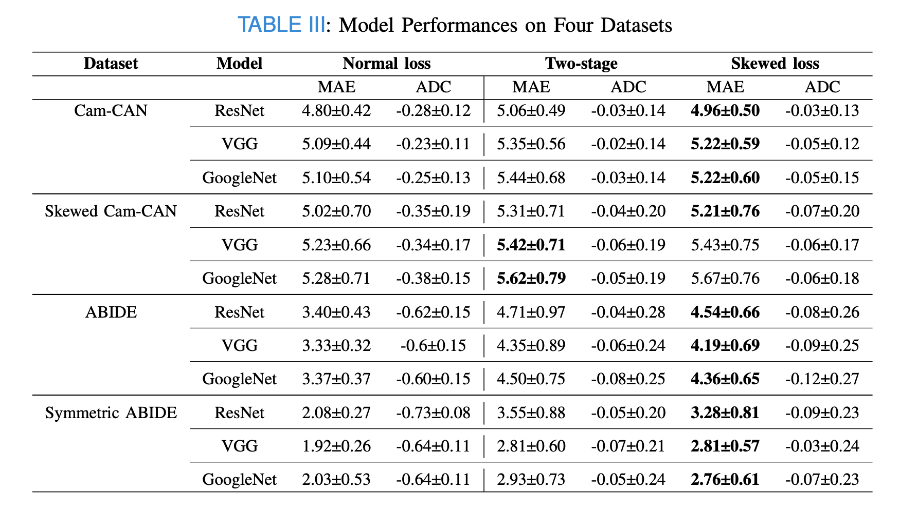
Datasets and model comparisons

Slide 20
Summary
The skewed loss function acts as an alternative correction method to the two-stage approach, whereas it achieves significantly better accuracy.
The skewed loss is robust to different datasets and model architectures. It could also be generalized to different problems other than brain age prediction.

