Slide 1
Microstructure Age Prediction
Summary

Slide 2
Data Overview
Data Source: cubric/collab/314_wand/bids
All image modalities: FA_CHARMED, AD_CHARMED, RD_CHARMED, MD_CHARMED, FRtot_CHARMED, KFA_DKI, MWF_mcDESPOT, ICVF_NODDI
AD_CHARMED and MWF_mcDESPOT are not being used at the moment (AD_CHARMED contains nan value and MWF_mcDESPOT has different image size)
Number of subjects with Age: 176
Number of subjects with all image modalities: 140
Number of subjects with Age and all modalities: 136
Image shape is (110, 110, 66) and we use stratified sampling to split dataset (108/14/14)

Slide 3
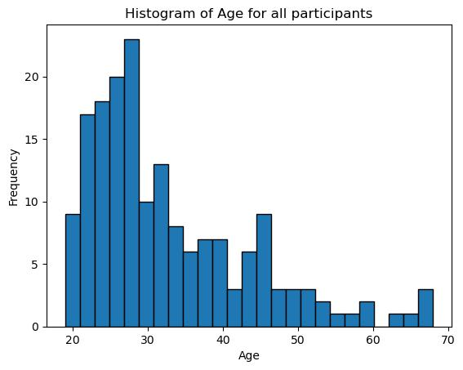
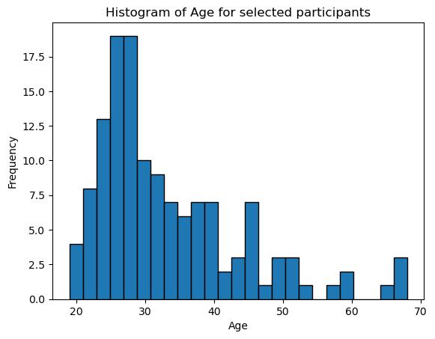
Data Overview

Slide 4
Baseline model config
We select DenseNet from MONAI (03/11/2023) as the base model with config:
init_features=16, growth_rate=8, block_config=(4, 8, 12, 10), 348427 parameters.
The base model will be trained for each image modalities and for each modality, model is repeated for 5 times. (result dir: ~/new_results/)
To improve the performance, we apply model averaging and model stacking.
Averaging: 1. we average the predictions of the 5 model runs for each image modality, resulting in one ensembled model for each modality.
2. Alternatively, for each run, we average model predictions for all image modalities, resulting in 5 ensembled models. (DONE)
Stacking: For each modality, we first select the best-performing trained model from the 5 runs, then predictions from phase 1 will be used as the training data for phase 2. We select Linear Regression and SVR for stacking. (DONE)

Slide 5
Averaging model performance (03/11/2023)
DenseNet | Run 1 | Run 2 | Run 3 | Run 4 | Run 5 | Averaging
KFA_DKI | 6.65 | 5.67 | 5.42 | 5.57 | 6.58 | 4.91
FA_CHARMED | 8.02 | 7.08 | 6.12 | 6.1 | 6.32 | 5.62
RD_CHARMED | 6.44 | 5.95 | 8.01 | 6.06 | 7.28 | 6.28
MD_CHARMED | 6.5 | 8.23 | 6.65 | 7.78 | 6.65 | 6.51
FRtot_CHARMED | 7.81 | 6.53 | 7.89 | 7.81 | 6.66 | 6.39
ICVF_NODDI | 4.44 | 4.68 | 7.08 | 6.69 | 4.65 | 4.17
Modality Averaging | 5.56 | 5.28 | 5.63 | 4.92 | 5.31

Slide 6
Few-shot-learning (IN_P)
We use prototypical network as a backbone for regression framework. We would like to perform a Nearest Neighbor Regression given the support set and use Mean-squared error as the loss function forthe query set.
Some notes:
1. We apply classical training rather than episodic training (DONE)
2. In evaluation time, we randomly divide the test set as support set and query set. Each support set point will serve as the prototype and their label will be visible to perform NNR for all points from the query set. This process will be performed several times until all points in the test set are assigned with at least one prediction. The final prediciton is the average value of all previous predictions during the sampling process. (IN_P)
3. For validation set, we may perform the same operation in 2. (IN_P)
4. As the backbone network, we choose to use the same baseline network (DenseNet) or a different one (DONE).

Slide 8
Tract Metrics training Pipeline
1. Dataset: (123, 29, 8) -> (num_subjects, num_tract_regions, num_d_measures)
2. Train-validation-test split using random state i
3. Preprocessing: Robust Scaler and PCA (for each tract regions instead of all regions)
4. Apply SMOTE to generate synthetic training data (almost double the training set)
5. Train SVR, Xgboost and stacking model (svr-xgb) for each tract regions. -> 29 models
6. Select tracts with the best performance on validation set (top3) and test on the test set.
7. In total, we have 20 different random states and for each state, we repeat models 3 times.

Slide 9
Result Summary
Mean Absolute Error (20 random states) | Mean | Std | Min | Max
SVR_single | 3.61 | 0.62 | 2.42 | 5.02
XGBoost_single | 3.88 | 0.67 | 2.71 | 5.74
Stacking_single | 3.85 | 0.77 | 2.53 | 6.23
Ensemble_single | 3.23 | 0.58 | 2.00 | 4.63
SVR_multi_runs | 3.47 | 0.52 | 2.47 | 4.46
XGBoost_multi_runs | 3.42 | 0.49 | 2.54 | 4.71
Stacking_multi_runs | 3.20 | 0.73 | 2.46 | 5.68
Ensemble_multi_runs | 3.10 | 0.50 | 2.04 | 4.13
logger.info(f'Std MAE: {np.std(res_dict_total[models[i]])}')

Slide 10
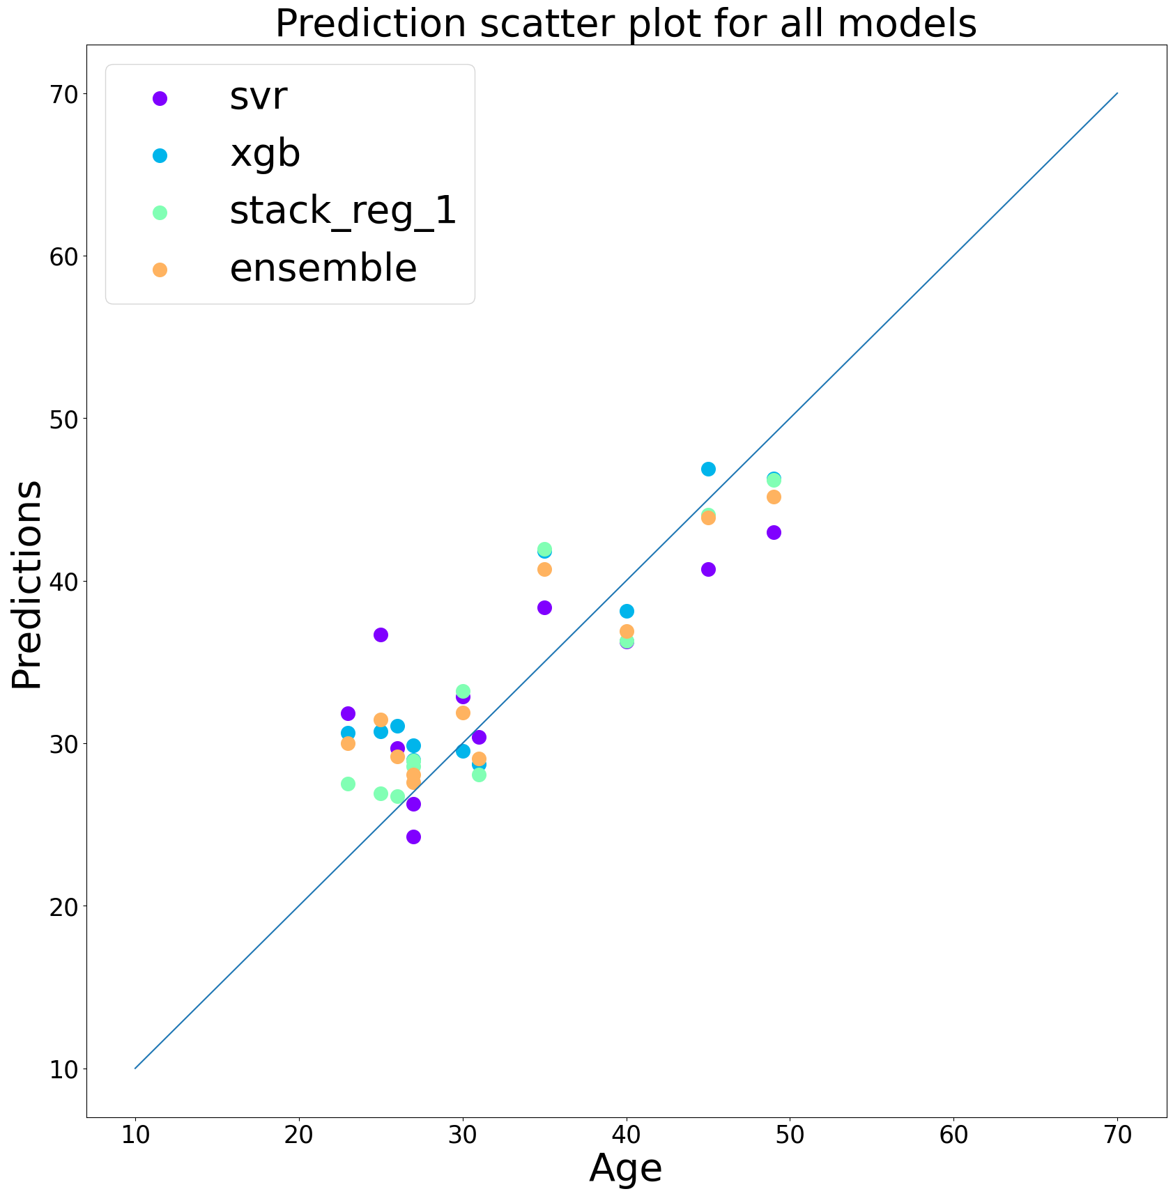
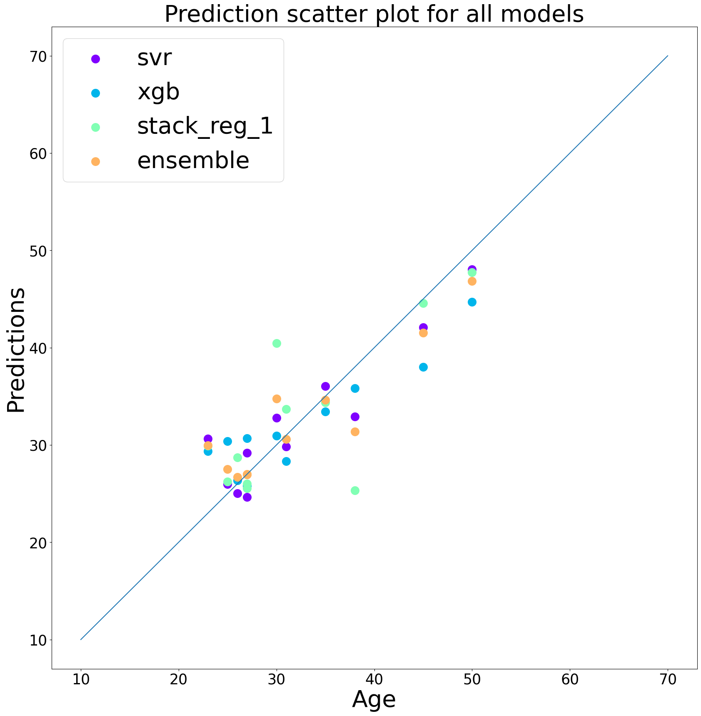
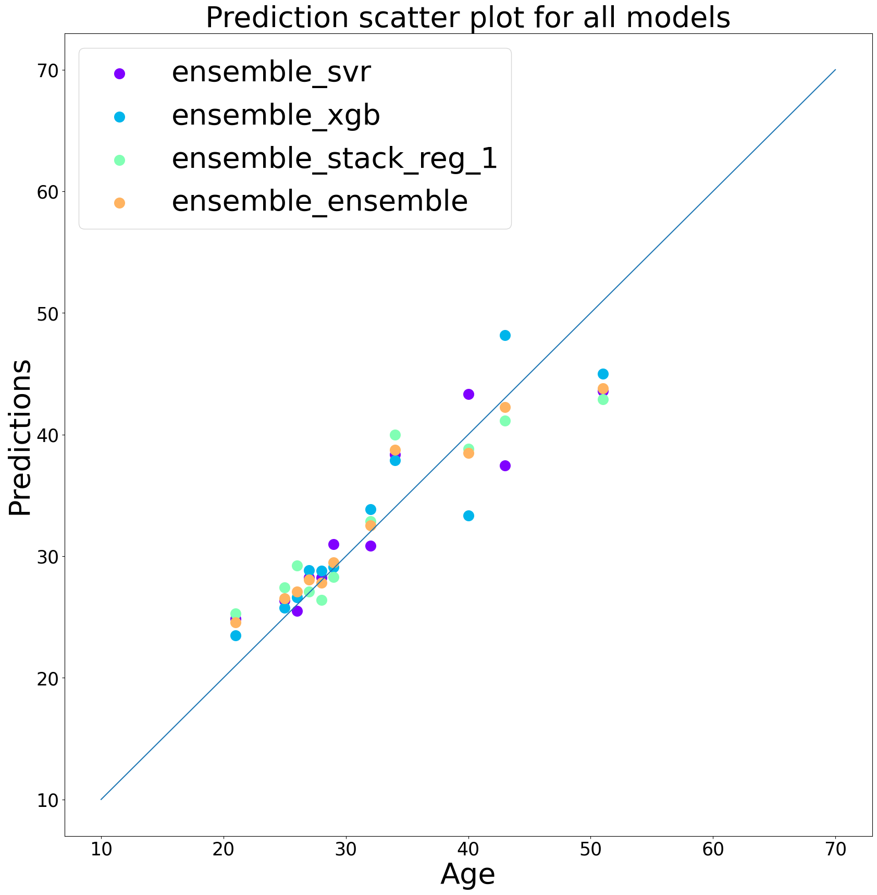
Prediction Plots
https://docs.google.com/document/d/11vDyRdQbgV6F9NzTO3vFWuZgWCkflZoJfW_MsFqTmY4/edit

Slide 11
Image training Pipeline
1. Raw T1 weighted images from /cubric/collab/314_wand/bids/rawdata/.
Preprocessing: skull-stripping, FLIRT registration to MNI152, intensity normalization (z-score), background removal.
2. Dataset shape: (123, 153, 192, 161)
3. DenseNet and ResNet are trained. Model averaging is applied.
4. In total, we have 20 different random states and for each state, we repeat models 3 times.

Slide 12
Result Summary
Mean Absolute Error (20 random states) | Mean | Std | Min | Max
DenseNet_single | 3.68 | 0.89 | 2.15 | 6.01
ResNet_single | 4.01 | 0.87 | 2.7 | 6.37
Ensemble_single | 3.55 | 0.80 | 2.28 | 5.53
DenseNet_multi_runs | 3.45 | 0.93 | 2.02 | 5.51
ResNet_multi_runs | 3.71 | 0.72 | 2.51 | 5.15
Ensemble_multi_runs | 3.34 | 0.75 | 2.12 | 4.79

Slide 13
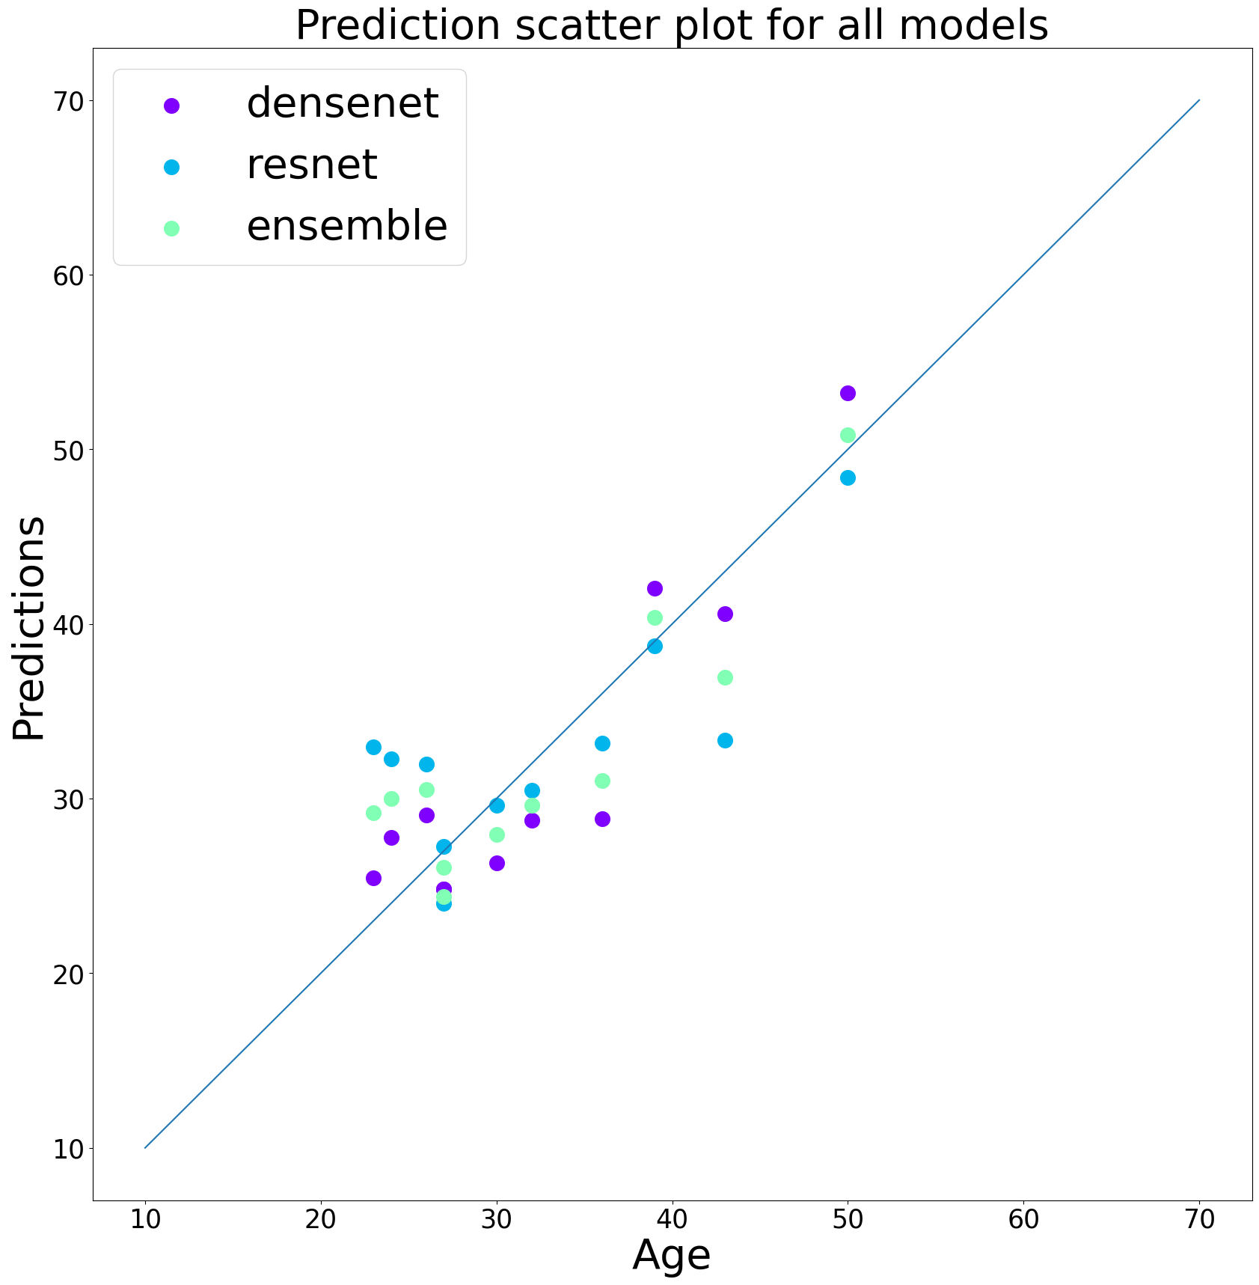
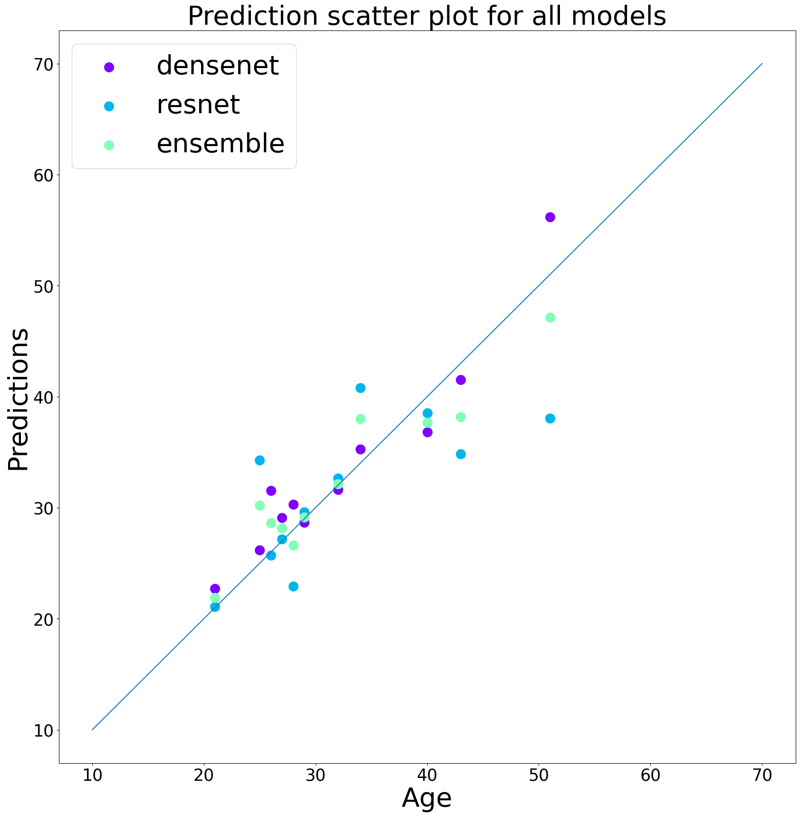
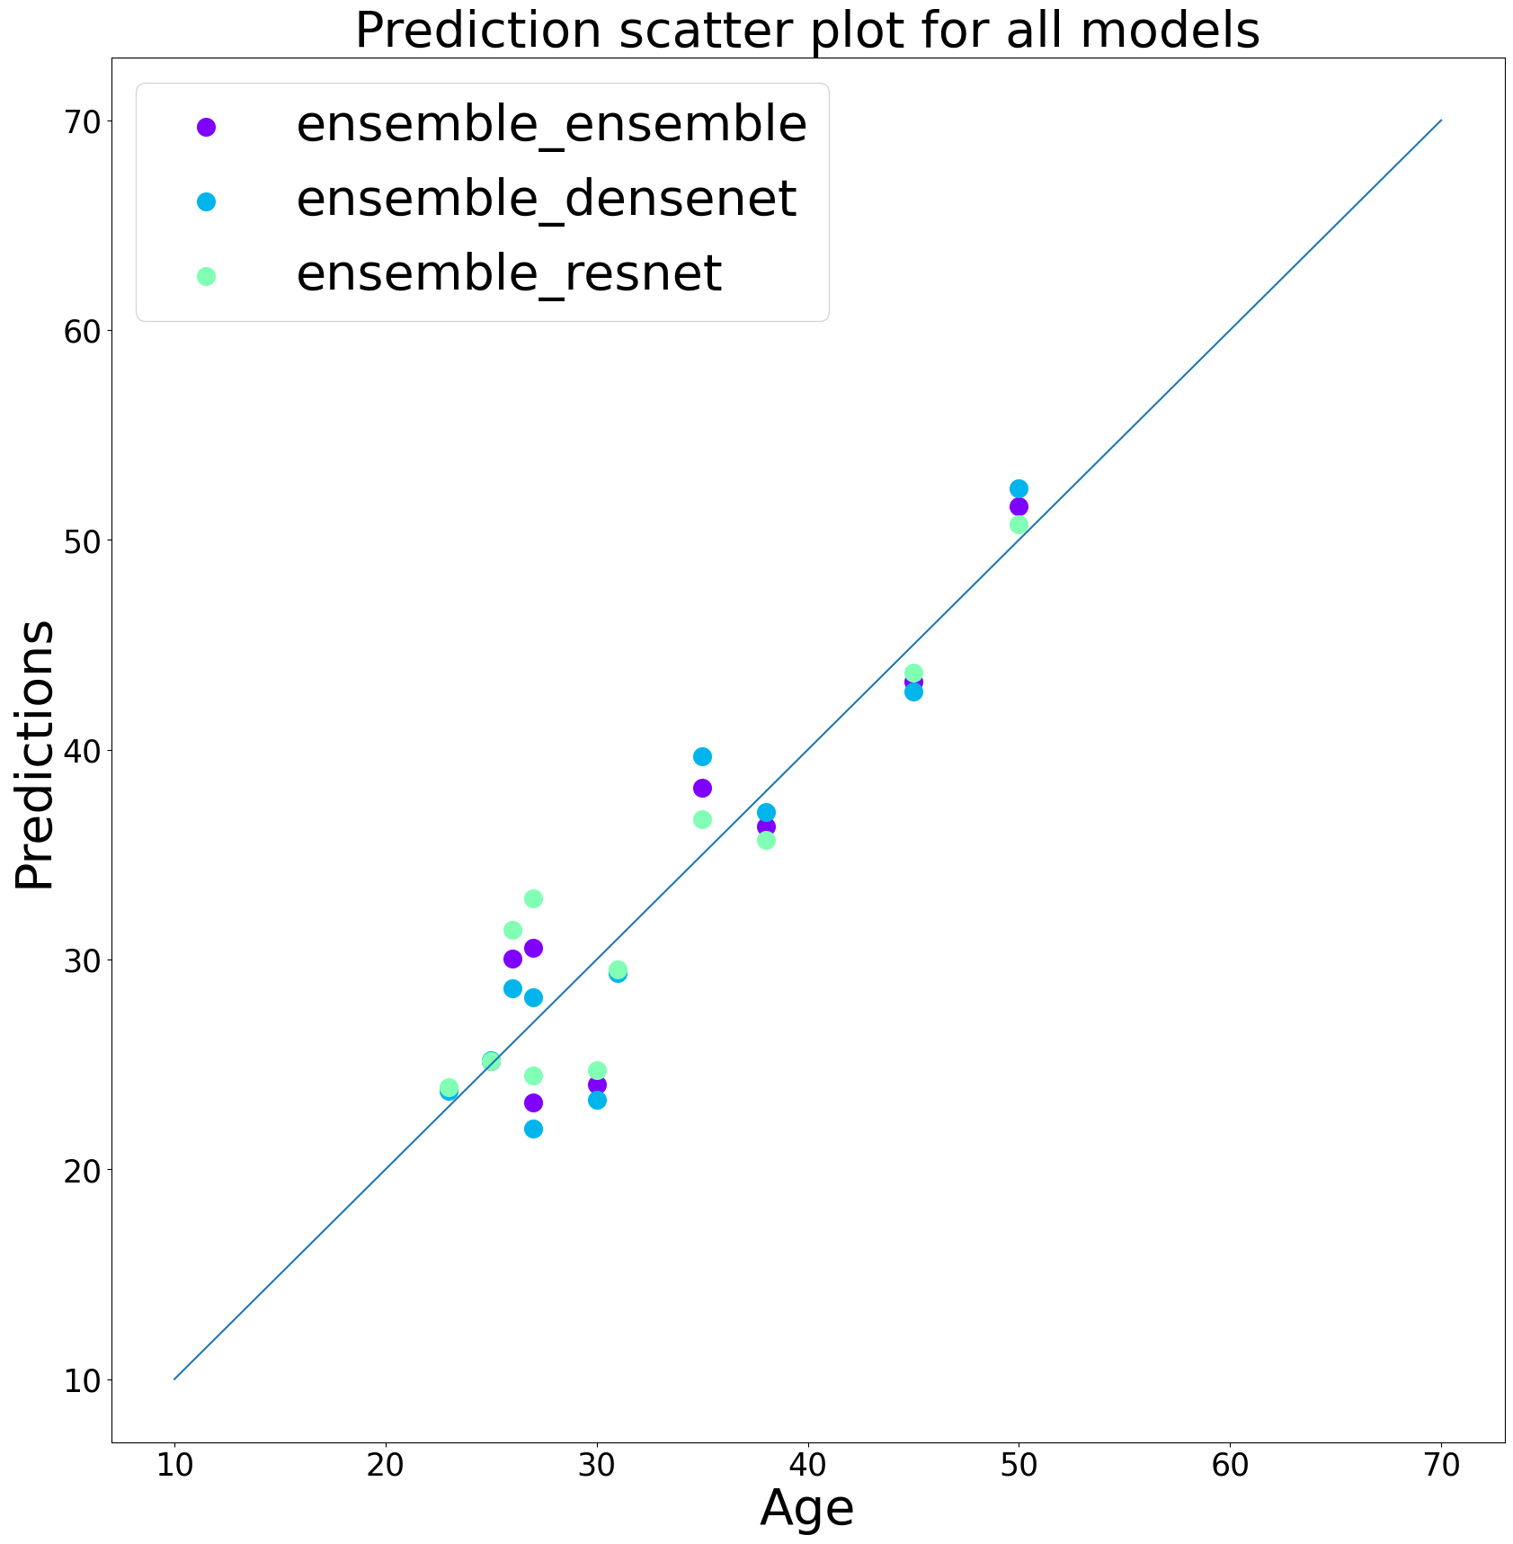
Prediction Plots

Slide 14
Combining T1 image and micro data
Mean Absolute Error (20 random states) | Mean | Std | Min | Max
Tract Data ensemble | 3.10 | 0.50 | 2.04 | 4.13
Image Data ensemble | 3.34 | 0.75 | 2.12 | 4.79
Total Data ensemble | 3.00 | 0.49 | 2.08 | 3.87

Slide 15
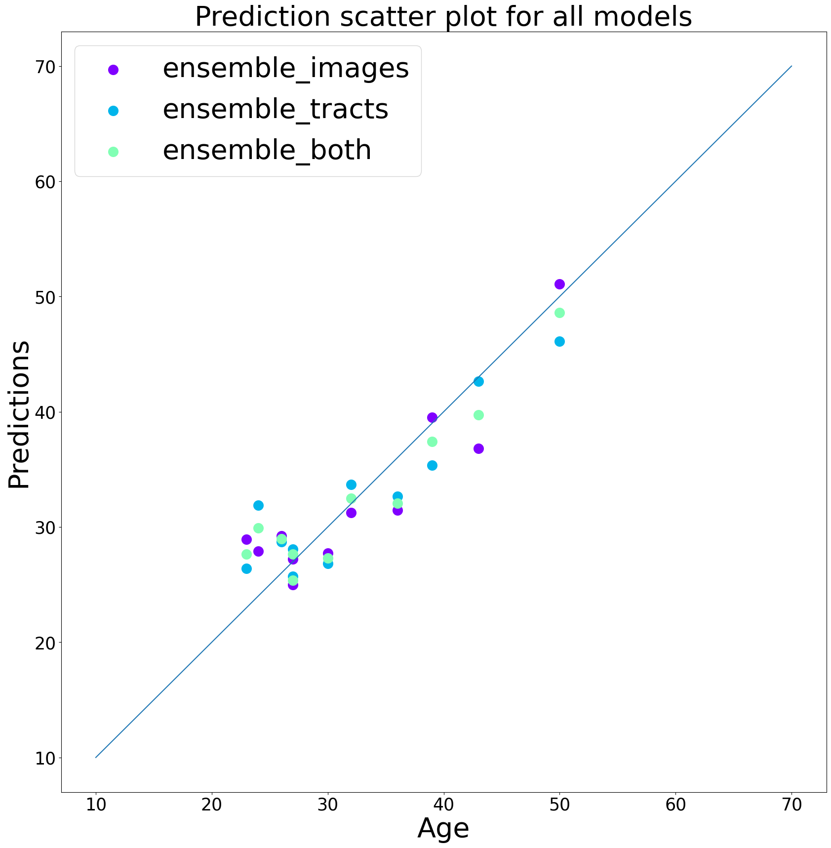
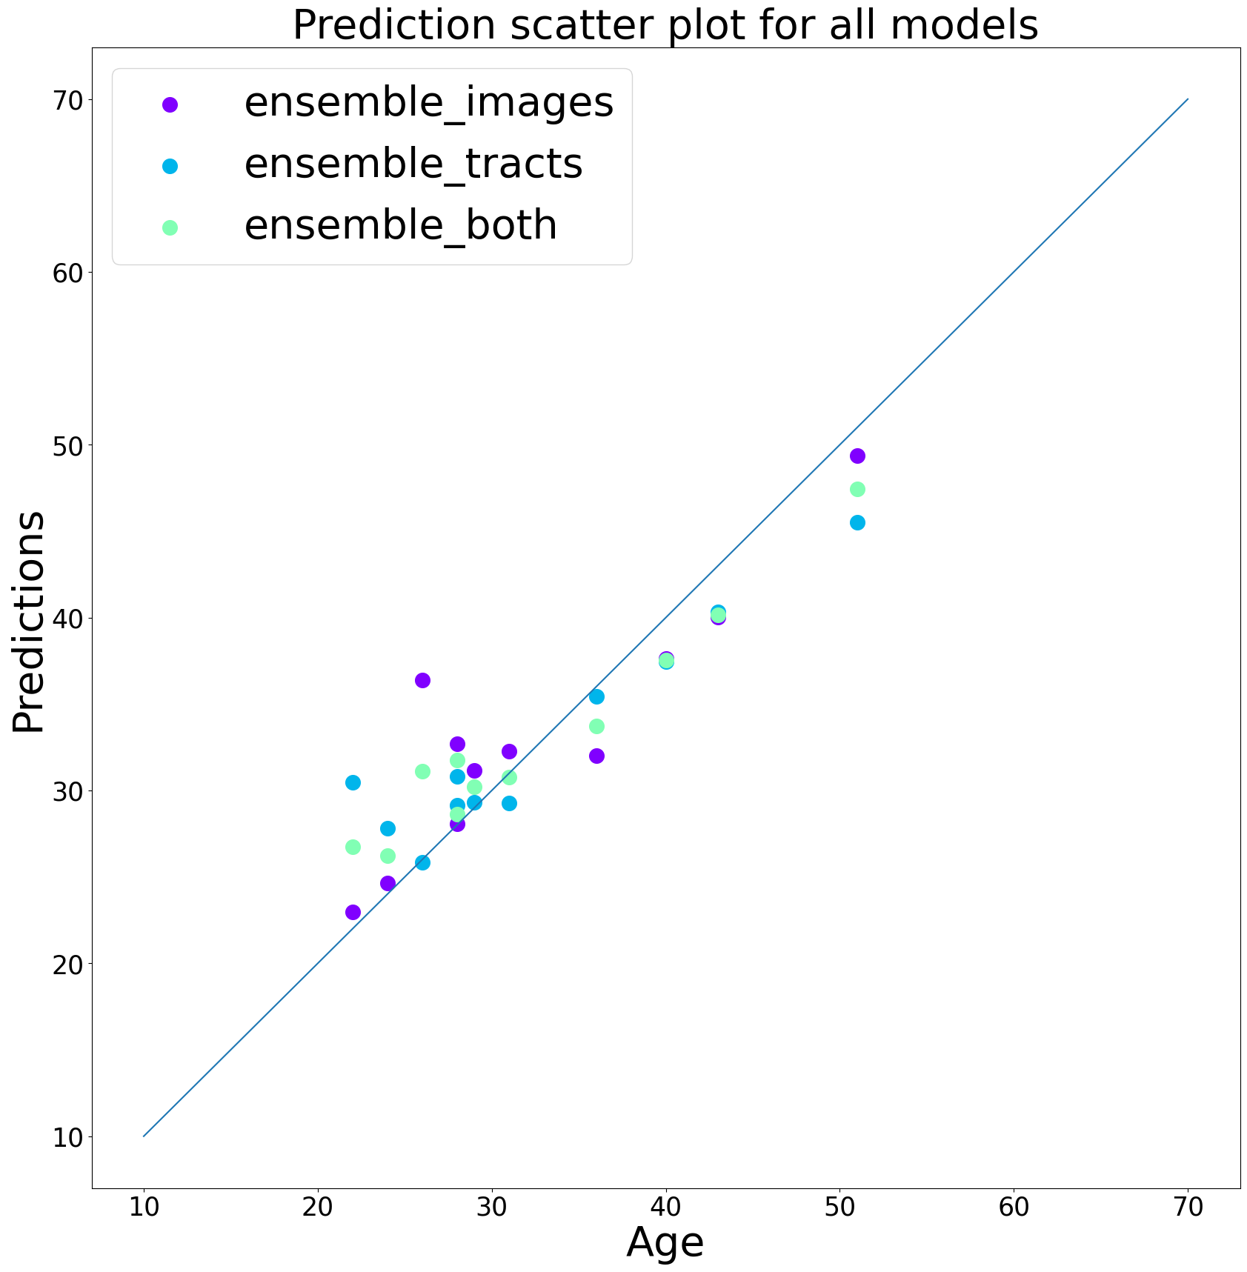
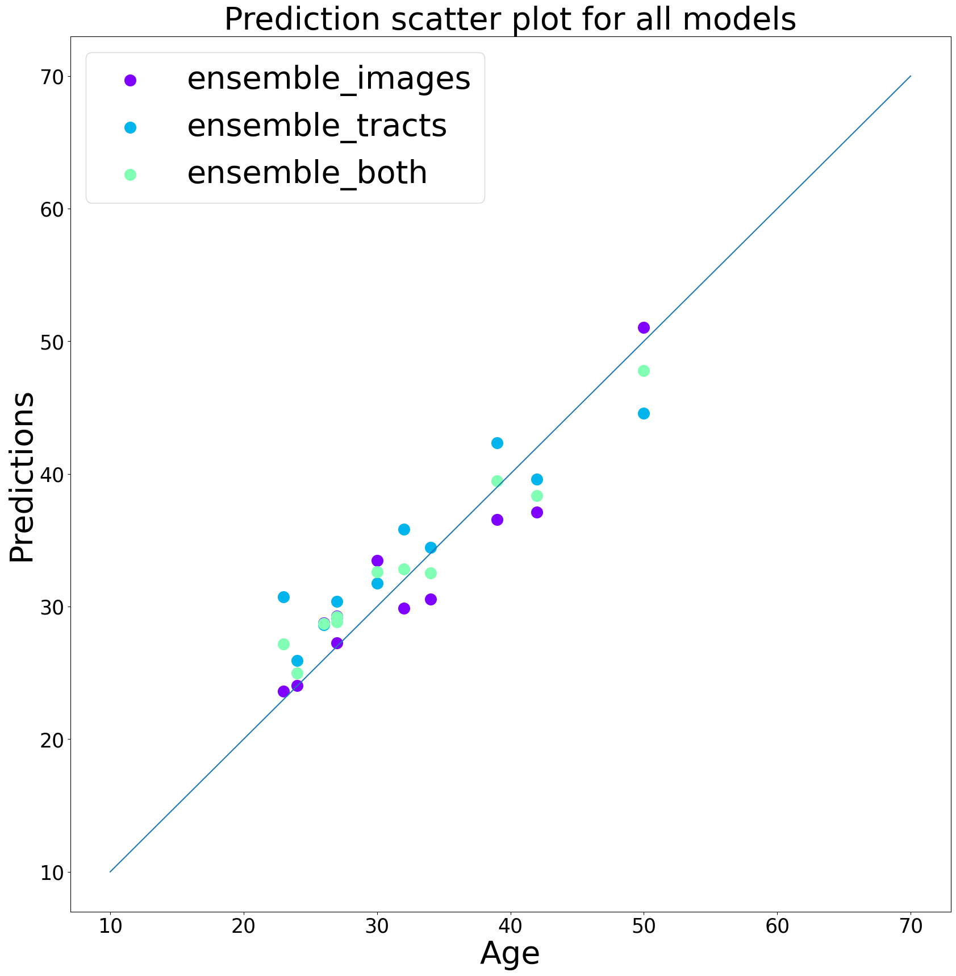
Prediction Plots

