Slide 1
学习汇报
汇报人：黄铭杰
日期：2021.01.05

Slide 2
Overview of the Cross-Domain
Authorship Verification Task at PAN 2021
Design Rationale
“Stylome Hypothesis”:
stylistic
Writing
Individual
“fingerprint”
linguistic
large-enough
writing sample
stable empirical characteristics
different text variaties
Challenge
collaborative authorship
copy editors who inject additional stylistic noise

Slide 3
Overview of the Cross-Domain
Authorship Verification Task at PAN 2021
2020
2021
evaluation scenario
closed-set
open-set
material set
The largest
disjunct
domains included in the calibration
included
not included

Slide 4
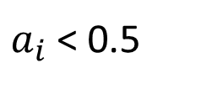

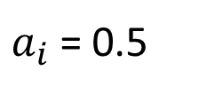



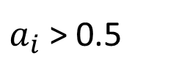


Overview of the Cross-Domain
Authorship Verification Task at PAN 2021
$$φ : (Dk, du)→\{T, F \}$$
$$where Dk is a set of documents of known authorship by the same author$$
$$du is a document of unknown or questioned authorship$$
$$φ(Dk, du) = T$$
$$the author of Dk is also the author of du$$
$$φ(Dk, du) = F$$
$$the author of Dk is not the author of du$$
$$the systems had to produce a scalar score a_{i} in the range [0, 1]$$
$a_{i}$ > 0.5
$$the same author$$
$a_{i}$ = 0.5
$$non−answer$$
$a_{i}$ < 0.5
$different author$s

Slide 5
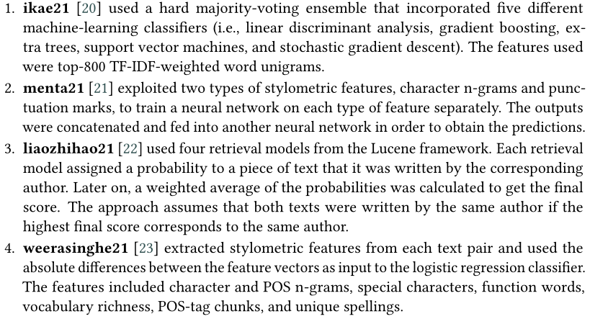
Overview of the Cross-Domain
Authorship Verification Task at PAN 2021

Slide 6
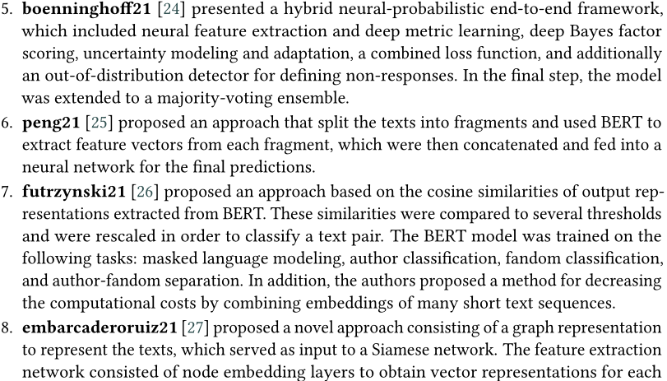
Overview of the Cross-Domain
Authorship Verification Task at PAN 2021

Slide 7
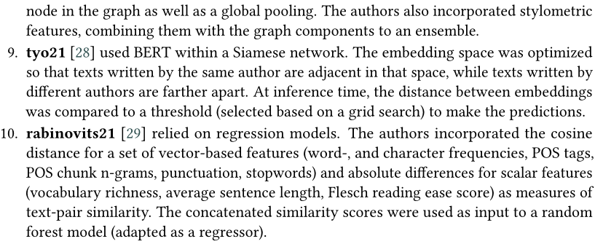
Overview of the Cross-Domain
Authorship Verification Task at PAN 2021

Slide 8
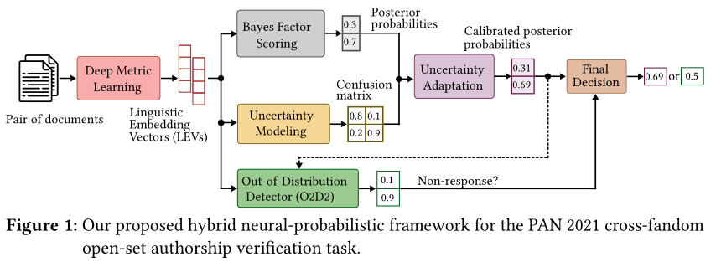
O2D2 Out-Of-Distribution Detector to Capture
Undecidable Trials in Authorship Verification

Slide 9
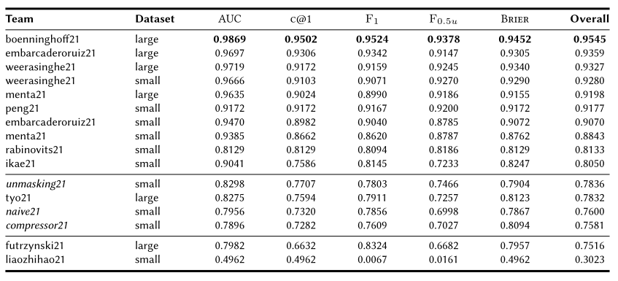
Overview of the Cross-Domain
Authorship Verification Task at PAN 2021
Table 1
System rankings for all PAN 2021 submissions across five evaluation metrics: AUC, c@1, F1, F0.5u, Brier, and an overall mean score (as the final ranking criterion). The dataset column indicates which calibration dataset was used. Bold digits reflect the per-column maximum. Horizontal lines indicate
the range of scores yielded by the baselines (in italics)

Slide 10
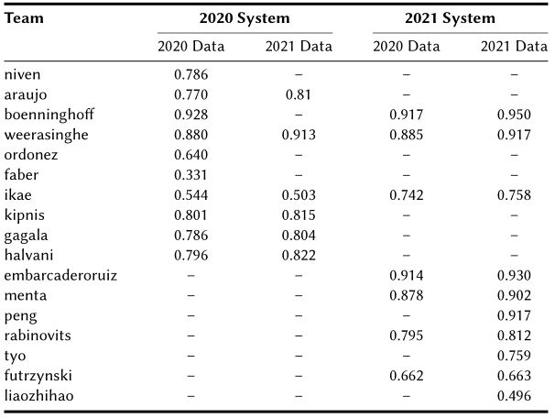
Overview of the Cross-Domain
Authorship Verification Task at PAN 2021
Discussion
Table 3
Cross-comparison of the performances (in terms of c@1) across different combinations of submissions (2020 vs. 2021) and test datasets (also 2020 vs. 2021). Some combinations could not be evaluated due to failures when running the system on a dataset it was not designed for.
The open-set formulation is easier to solve than the closed setting

Slide 11
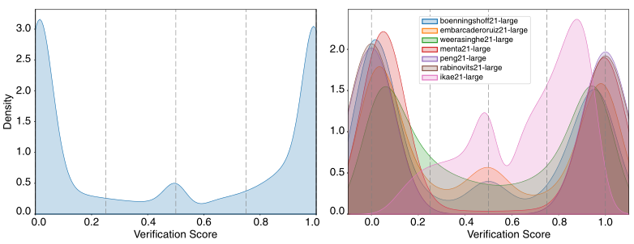

Overview of the Cross-Domain
Authorship Verification Task at PAN 2021
only few answers lie in between the three peaks

Slide 12
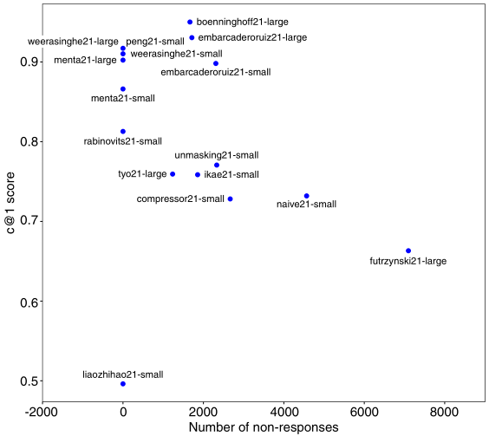
Overview of the Cross-Domain
Authorship Verification Task at PAN 2021
boenninghoff21 and ikae21 took greater care to fine-tune this aspect of their systems
It’s generally paid off for systems to submit non-answers for difficult cases
competitive edge can be attributed to the system’s ability to correctly identify such difficult cases in order to leave them unanswered
Figure 3: The c@1 scores per system as a function of the absolute number of non-answers.

Slide 13
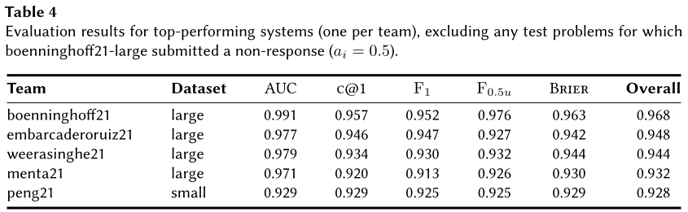
Overview of the Cross-Domain
Authorship Verification Task at PAN 2021
the treatment of difficult cases is not the only magic ingredient

