Slide 1
学习汇报
汇报人：黄铭杰
日期：2022.01.12

Slide 2
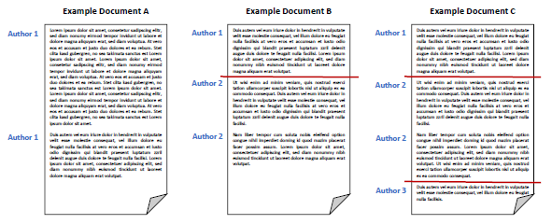
Unsupervised Multi-Author Document Decomposition Based on Hidden Markov Model
基于隐马尔可夫模型的无监督多作者文档分解
Authorship verification
判断是否为特定作者编写
Authorship analysis
Plagiarism detection
揭示文本相似性
Author attribution
从候选中预测出真正作者
Authorship-based document decomposition(ABDD)
基于作者身份的文档分解
图片来源：Overview of the Style Change Detection Task at PAN 2021

Slide 3
Unsupervised Multi-Author Document Decomposition Based on Hidden Markov Model
The Proposed Approach：
使用非监督方法初始化HMM参数
使用Baum-Welch算法学习HMM参数
用Viterbi算法找到句子最可能的作者

Slide 4







Unsupervised Multi-Author Document Decomposition Based on Hidden Markov Model
隐马尔科夫模型HMM
$$Q=\left\{q_{1},q_{2},…,q_{N}\right\}$$
所有N个可能隐藏状态的集合
$$V=\left\{v_{1},v_{2},…,v_{M}\right\}$$
所有M个可能观测状态的集合
对于一个长度为$T$的序列：
$$I=\left\{i_{1},i_{2},…,i_{T}\right\}$$
$I$对应的状态序列，$i_{t}∈Q$
$$O=\left\{o_{1},o_{2},…,o_{T}\right\}$$
$O$对应观察序列，$o_{t}∈V$

Slide 5
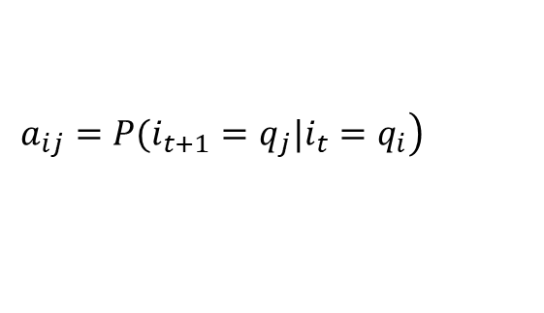
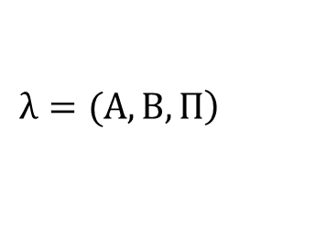

Unsupervised Multi-Author Document Decomposition Based on Hidden Markov Model
HMM模型假设
$$\left.λ=(A,B,Π\right)$$
① 齐次假设
任意时刻隐藏状态只依赖于前一时刻隐藏状态
假设隐藏状态$i_{t}=q_{i}$，$i_{t+1}=q_{j}$，则t到t+1的状态转移概率为：
$$\left.a_{ij}=P(i_{t+1}=q_{j}|i_{t}=q_{i}\right)$$
状态转移矩阵为：$A={\left[a_{ij}\right]}_{N×N}$

Slide 6
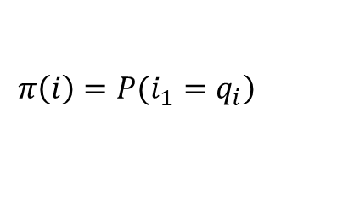


Unsupervised Multi-Author Document Decomposition Based on Hidden Markov Model
② 观测独立性
任意时刻观测状态只依赖于当前时刻隐藏状态
假设隐藏状态$i_{t}=q_{j}$，观测状态$o_{t}=v_{k}$，在$q_{j}$下生成$v_{k}$的概率为：
$$b_{j}\left(k\right)=P(o_{t}=v_{k}|i_{t}=q_{j})$$
观测状态生成概率矩阵为：$B={{[b}_{j}(k)]}_{N×M}$
除此之外
在时刻$t=1$的隐藏状态概率分布$Π$
$$\left.π\left(i\right)=P(i_{1}=q_{i}\right)$$
$$Π={\left[π(i)\right]}_{N}$$

Slide 7

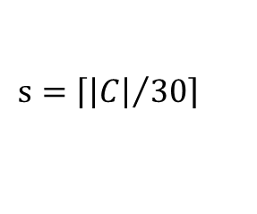
Unsupervised Multi-Author Document Decomposition Based on Hidden Markov Model
Initialization
Assume document C has N co-authors
① divide C into segments of 30 sentences
$$s=\left\lceil {\left|C\right|}/{30}\right\rceil$$
② words appearing in C at least two times. This produces a set of D words
create a D-dimensional vector for each segment
$$x= \{b_{1},b_{2},…,b_{D}\}$$
for segment $s_{i}$, if $b_{j}$ in $s_{i}$, $b_{j}$ get the value of 1, or else get 0
Thus we get $X=\{x_{1},…,x_{s}\}$

Slide 8



Unsupervised Multi-Author Document Decomposition Based on Hidden Markov Model
Initialization
③ used GMMS to cluster the D-dimensional vectors X into N components
$$\left\{s_{1},…,s_{N}\right\}$$
Where $s_{i}$ get a label of a author
④ words appearing in C at least once. This produces a set of D’ words
create a D’-dimensional vector for each segment
$$x′= \{{b′}_{1},{b′}_{2},…,{b′}_{D}\}$$
for segment $s_{i}$, if ${b′}_{j}$ in $s_{i}$, ${b′}_{j}$ get the value of 1, or else get 0
Thus we get $X′=\{{x′}_{1},…,{x′}_{s}\}$

Slide 9





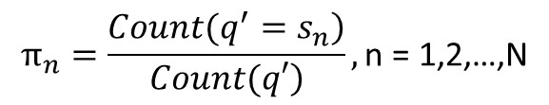



Unsupervised Multi-Author Document Decomposition Based on Hidden Markov Model
Initialization
⑤ construct an HMM model
$$hidden states Q′$$
$$Q′=\left\{{q′}_{1},…,{q′}_{s}\right\}$$
(The most likely author of each segment)
$$observations O′$$
$X′=\{{x′}_{1},…,{x′}_{s}\}$ in step ④
$s_{i}$ in S
The label of hiden state of ${x′}_{j}$
计算状态转移矩阵A
${x′}_{j}$ in X’
The $i^{th}$ segment in document C
$$π_{n}=\frac{\left.Count(q^{′}=s_{n}\right)}{\left.Count(q′\right)},\text{n}\text{ = 1,2,…,}\text{N}$$

Slide 10
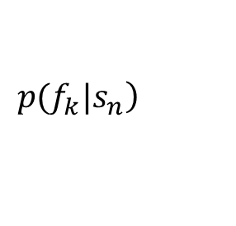
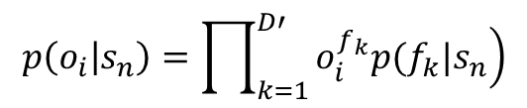
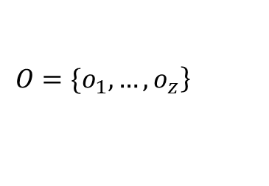
Unsupervised Multi-Author Document Decomposition Based on Hidden Markov Model
Initialization
⑥ Given the sequence X’, and the set of all possible values of labels
the conditional probability of feature $f_{k}$ is compute
$$\left.p(f_{k}|s_{n}\right)$$
⑦ divide C into sentences, $z=\left|C\right|$
use method in step ④ to create a D-dimensional vector
$$\left.O=\{o_{1},…,o_{z}\right\}$$
use method in step ⑥ to compute initial values of B
$$p\left(o_{i} | s_{n}\right)=\prod_{k=1}^{D′}{\left.o_{i}^{f_{k}}p(f_{k}|s_{n}\right)}$$
use add-one smoothing for avoiding zero probabilities of A and B.

Slide 11





Unsupervised Multi-Author Document Decomposition Based on Hidden Markov Model
Learning HMM
① construct an HMM model
$$hidden states Q$$
the resulted sentence vectors (step⑦)
$$observations O$$
the $i^{th}$ binary D’-dimensional vector
② Baum-Welch algorithm
$$E−step$$
finds the expected author sequence of sentence sequence
$$M−step$$
updates the HMM parameter values
Start at the initial values, stop until a convergence is achieved in π, B and A

Slide 12
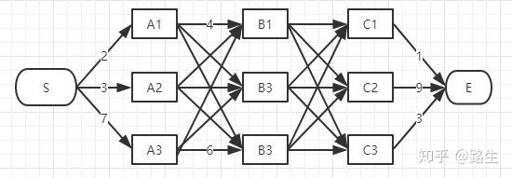
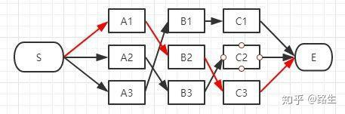
Unsupervised Multi-Author Document Decomposition Based on Hidden Markov Model
Viterbi Decoding
there are more than one sequence of states in generating the observation sequence.
Viterbi decoding algorithm is applied tofind the best sequence of authors for the given sentences
如何通俗地讲解 viterbi 算法？https://www.zhihu.com/question/20136144

Slide 13
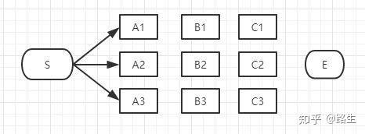
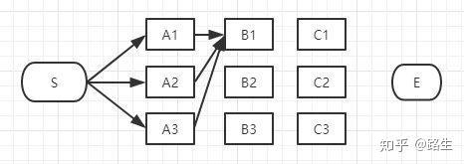
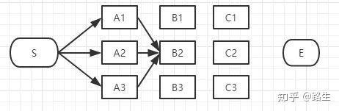
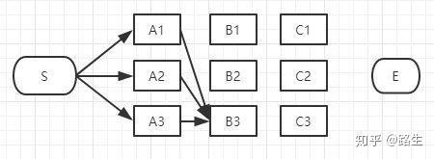
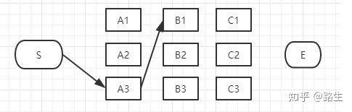
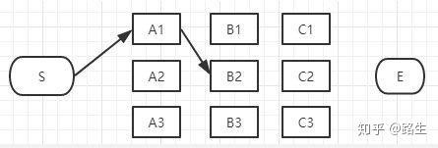
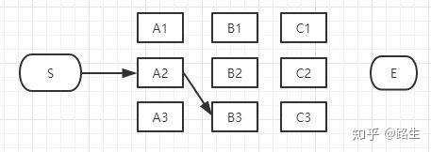

Slide 14
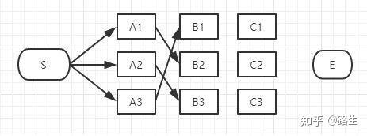
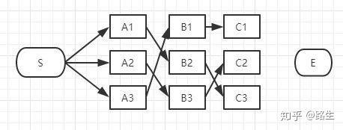

Slide 15
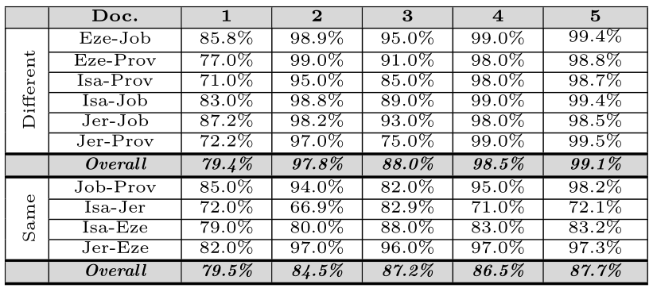
Unsupervised Multi-Author Document Decomposition Based on Hidden Markov Model
Table 2: Classification accuracies of merged documents of different literature or the same literature bible books using the approaches of 1- Koppel et al. (2011), 2- Akiva and Koppel (2013)-500CommonWords, 3- Akiva and Koppel (2013)-SynonymSet, 4- Aldebei et al. (2015) and 5- our approach.

Slide 16
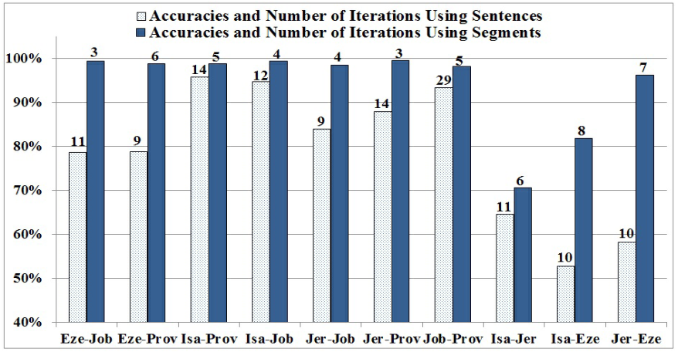
Unsupervised Multi-Author Document Decomposition Based on Hidden Markov Model
Figure 1: Comparisons between using segments and using sentences in the unsupervised method for estimating the initial values of the HMM of our approach in terms of accuracy (representd as the cylinders) and number of iterations required for convergence (represented as the numbers above cylinders) using the 10 merged Bible documents.

Slide 17
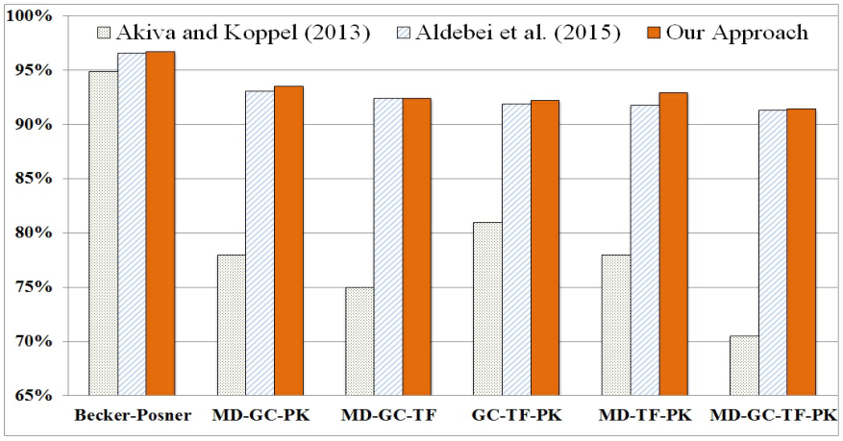
Unsupervised Multi-Author Document Decomposition Based on Hidden Markov Model
Figure 2: Classification accuracy comparisons between our approach and the approaches pre-
sented in Akiva and Koppel (2013) and Aldebei et al. (2015) in Becker-Posner documents,
and documents created by three or four New York Times columnists (TF = Thomas Fried-
man, PK = Paul Krugman, MD = Maureeen Dowd, GC = Gail Collins)

Slide 18
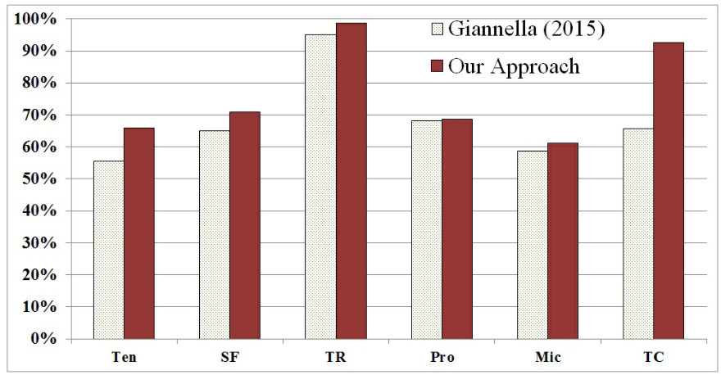
Unsupervised Multi-Author Document Decomposition Based on Hidden Markov Model
Figure 3: Classification accuracy comparisons between our approach and the approach pre-
sented in (Giannella, 2015) in the six single-topic documents of Becker-Posner blogs.

Slide 19
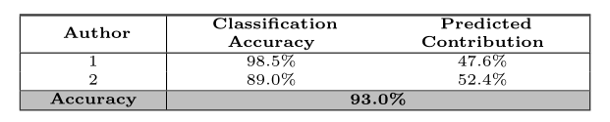
Unsupervised Multi-Author Document Decomposition Based on Hidden Markov Model
Table 3: The classification accuracies and predicted contributions of the two authors of the scientific paper using the proposed approach.

