Slide 1
Multicore CPUs
Introduction to OpenMP

Slide 2
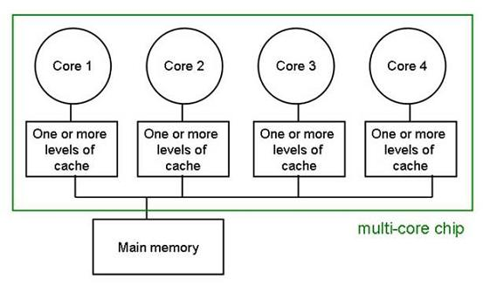
Multi-core processor

Slide 3
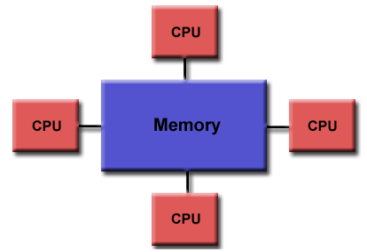
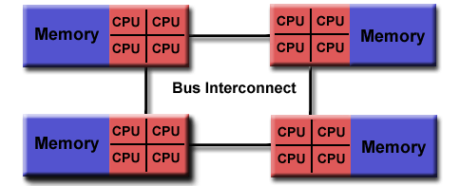
UMA and NUMA
Uniform Memory Access
Non-Uniform
Memory Access

Slide 4
Motivation
Parallel machines are abundant
  Modern processors have 4-68 cores
  Upcoming processors are multicore – parallel programming is necessary to get high performance
Multithreading is the natural programming model for SMP
  All processors share the same memory
  Threads in a process see the same address space
  Lots of shared-memory algorithms defined
Multithreading is (correctly) perceived to be hard!
  Lots of expertise necessary
  Deadlocks and race conditions
  Non-deterministic behavior makes it hard to debug

Slide 5
Motivation: OpenMP
A language extension that introduces parallelization constructs into the language
Parallelization is orthogonal to the functionality
  If the compiler does not recognize the OpenMP directives, the code remains functional (albeit single-threaded)
Based on shared-memory multithreaded programming
Includes constructs for parallel programming: critical sections, atomic access, variable privatization, barriers etc.
Industry standard
  Supported by Intel, Microsoft, Sun, IBM, HP, etc.
  Some behavior is implementation-dependent
  Intel compiler available for Windows and Linux

Slide 6
OpenMP execution model
Fork and Join: Master thread spawns a team of threads as needed
Worker
Thread
Master thread
Master thread
FORK
JOIN
FORK
JOIN
Parallel
Region
Parallel
Region

Slide 7
OpenMP memory model
Shared memory model
  Threads communicate by accessing shared variables
The sharing is defined syntactically
  Any variable that is seen by two or more threads is shared
  Any variable that is seen by one thread only is private
Race conditions possible
  Use synchronization to protect from conflicts
  Change how data is stored to minimize the synchronization

Slide 8
OpenMP syntax
Most of the constructs of OpenMP are pragmas
  #pragma omp construct [clause [clause] …]
  An OpenMP construct applies to a structural block (one entry point, one exit point)
Categories of OpenMP constructs
  Parallel regions
  Work sharing
  Data Environment
  Synchronization
  Runtime functions/environment variables
In addition:
  Several omp_<something> function calls
  Several OMP_<something> environment variables

Slide 9
OpenMP: Parallel Regions
double D[1000];
#pragma omp parallel
{
int i; double sum = 0;
for (i=0; i<1000; i++) sum += D[I];
printf(“Thread %d computes %f\n”,
omp_thread_num(), sum);
}
Executes the same code several times (as many as there are threads)
  How many threads do we have?
  omp_set_num_threads(n)
  What is the use of repeating the same work several times in parallel?
  Can use omp_thread_num() to distribute the work between threads.
D is shared between the threads, i and sum are private

Slide 10
OpenMP: Work Sharing Constructs 2
Sequential code
(Semi) manual parallelization
Automatic parallelization of the for loop
for (int i=0; i<N; i++) { a[i]=b[i]+c[i]; }
#pragma omp parallel
{
int id = omp_get_thread_num();
int Nthr = omp_get_num_threads();
int istart = id*N/Nthr, iend = (id+1)*N/Nthr;
for (int i=istart; i<iend; i++) { a[i]=b[i]+c[i]; }
}
#pragma omp parallel
#pragma omp for schedule(static)
{
for (int i=0; i<N; i++) { a[i]=b[i]+c[i]; }
}

Slide 11
Notes on #parallel for
Only simple kinds of for loops are supported
  One signed integer variable in the loop.
  Initialization: var=init
  Comparison: var op last, op: <, >, <=, >=
  Increment: var++, var--, var+=incr, var-=incr, etc.
  All of init, last, incr must be loop invariant
Can combine the parallel and work sharing directives:
#pragma omp parallel for …

Slide 12
#pragma omp shared modifier
Notify the compiler that the variable is shared
What’s the problem here?
float dot_prod(float* a, float* b, int N)
{
float sum = 0.0;
#pragma omp parallel for shared(sum)
for(int i=0; i<N; i++) {
sum += a[i] * b[i];
}
return sum;
}

Slide 13
Shared modifier cont’d
Protect shared variables from data races
Another option: use #pragma omp atomic
  Can protect only a single assignment
  Generally faster than critical
float dot_prod(float* a, float* b, int N)
{
float sum = 0.0;
#pragma omp parallel for shared(sum)
for(int i=0; i<N; i++) {
#pragma omp critical
sum += a[i] * b[i];
}
return sum;
}

Slide 14
#pragma omp reduction
Syntax: #pragma omp reduction (op:list)
The variables in “list” must be shared in the enclosing parallel region
Inside parallel or work-sharing construct:
  A PRIVATE copy of each list variable is created and initialized depending on the “op”
  These copies are updated locally by threads
  At end of construct, local copies are combined through “op” into a single value and combined with the value in the original SHARED variable
float dot_prod(float* a, float* b, int N)
{
float sum = 0.0;
#pragma omp parallel for reduction(+:sum)
for(int i=0; i<N; i++) {
sum += a[i] * b[i];
}
return sum;
}

Slide 15
Problems of #parallel for
Load balancing
  If all the iterations execute at the same speed, the processors are used optimally
  If some iterations are faster than others, some processors may get idle, reducing the speedup
  We don’t always know the distribution of work, may need to re-distribute dynamically
Granularity
  Thread creation and synchronization takes time
  Assigning work to threads on per-iteration resolution may take more time than the execution itself!
  Need to coalesce the work to coarse chunks to overcome the threading overhead
Trade-off between load balancing and granularity!

Slide 16
Schedule: controlling work distribution
schedule(static [, chunksize])
  Default: chunks of approximately equivalent size, one to each thread
  If more chunks than threads: assigned in round-robin to the threads
  Why might we want to use chunks of different size?
schedule(dynamic [, chunksize])
  Threads receive chunk assignments dynamically
  Default chunk size = 1 (why?)
schedule(guided [, chunksize])
  Start with large chunks
  Threads receive chunks dynamically. Chunk size reduces exponentially, down to chunksize

Slide 17
Controlling Granularity
#pragma omp parallel if (expression)
  Can be used to disable parallelization in some cases (when the input is determined to be too small to be beneficially multithreaded)
#pragma omp num_threads (expression)
  Control the number of threads used for this parallel region

Slide 18
OpenMP: Data Environment
Shared Memory programming model
  Most variables (including locals) are shared by default – unlike Pthreads!
  {
  int sum = 0;
  #pragma omp parallel for
  for (int i=0; i<N; i++) sum += i;
  }
  Global variables are shared
Some variables can be private
  Automatic variables inside the statement block
  Automatic variables in the called functions
  Variables can be explicitly declared as private.
  In that case, a local copy is created for each thread

Slide 19
Overriding storage attributes
private:
  A copy of the variable is created for each thread
  There is no connection between the original variable and the private copies
  Can achieve the same using variables inside { }
firstprivate:
  Same, but the initial value of the variable is copied from the main copy
lastprivate:
  Same, but the last value of the variable is copied to the main copy
int i;
#pragma omp parallel for private(i)
for (i=0; i<n; i++) { … }
int idx=1;
int x = 10;
#pragma omp parallel for \
firsprivate(x) lastprivate(idx)
for (i=0; i<n; i++) {
if (data[i]==x) idx = i;
}

Slide 20
Threadprivate
Similar to private, but defined per variable
  Declaration immediately after variable definition. Must be visible in all translation units.
  Persistent between parallel sections
  Can be initialized from the master’s copy with
  #pragma omp copyin
  More efficient than private, but a global variable!
Example:
int data[100];
#pragma omp threadprivate(data)
…
#pragma omp parallel for copyin(data)
for (……)

Slide 21
Reduction
for (j=0; j<N; j++) {
sum = sum+a[j]*b[j];
}
How to parallelize this code?
  sum is not private, but accessing it atomically is too expensive
  Have a private copy of sum in each thread, then add them up
Use the reduction clause!
#pragma omp parallel for reduction(+: sum)
  Any associative operator must be used: +, -, ||, |, *, etc.
  The private value is initialized automatically (to 0, 1, ~0 …)

Slide 22
OpenMP Synchronization
X = 0;
#pragma omp parallel
X = X+1;
What should the result be (assuming 2 threads)?
  2 is the expected answer
  But can be 1 with unfortunate interleaving
OpenMP assumes that the programmer knows what (s)he is doing
  Regions of code that are marked to run in parallel are independent
  If access collisions are possible, it is the programmer’s responsibility to insert protection

Slide 23
Synchronization Mechanisms
Many of the existing mechanisms for shared programming
  Single/Master execution
  Critical sections, Atomic updates
  Ordered
  Barriers
  Nowait (turn synchronization off!)
  Flush (memory subsystem synchronization)
  Reduction (already seen)

Slide 24
Single/Master
#pragma omp single
  Only one of the threads will execute the following block of code
  The rest will wait for it to complete
  Good for non-thread-safe regions of code (such as I/O)
  Must be used in a parallel region
  Applicable to parallel for sections
#pragma omp master
  The following block of code will be executed by the master thread
  No synchronization involved
  Applicable only to parallel sections
Example:
#pragma omp parallel
{
do_preprocessing();
#pragma omp single
read_input();
#pragma omp master
notify_input_consumed();
do_processing();
}

Slide 25
Critical Sections
#pragma omp critical [name]
  Standard critical section functionality
Critical sections are global in the program
  Can be used to protect a single resource in different functions
Critical sections are identified by the name
  All the unnamed critical sections are mutually exclusive throughout the program
  All the critical sections having the same name are mutually exclusive between themselves

Slide 26
Atomic execution
Critical sections on the cheap
  Protects a single variable update
  Can be much more efficient (a dedicated assembly instruction on some architectures)
#pragma omp atomic
update_statement
Update statement is one of: var= var op expr, var op= expr, var++, var--.
  The variable must be a scalar
  The operation op is one of: +, -, *, /, ^, &, |, <<, >>
  The evaluation of expr is not atomic!

Slide 27
Ordered
#pragma omp ordered
statement
  Executes the statement in the sequential order of iterations
Example:
#pragma omp parallel for
for (j=0; j<N; j++) {
int result = heavy_computation(j);
#pragma omp ordered
printf(“computation(%d) = %d\n”, j, result);
}

Slide 28
Barrier synchronization
#pragma omp barrier
Performs a barrier synchronization between all the threads in a team at the given point.
Example:
#pragma omp parallel
{
int result = heavy_computation_part1();
#pragma omp atomic
sum += result;
#pragma omp barrier
heavy_computation_part2(sum);
}

Slide 29
Controlling OpenMP behavior
omp_set_dynamic(int)/omp_get_dynamic()
  Allows the implementation to adjust the number of threads dynamically
omp_set_num_threads(int)/omp_get_num_threads()
  Control the number of threads used for parallelization (maximum in case of dynamic adjustment)
  Must be called from sequential code
  Also can be set by OMP_NUM_THREADS environment variable
omp_get_num_procs()
  How many processors are currently available?
omp_get_thread_num()
omp_set_nested(int)/omp_get_nested()
  Enable nested parallelism
omp_in_parallel()
  Am I currently running in parallel mode?
omp_get_wtime()
  A portable way to compute wall clock time

