Slide 1
Deep Learning and Application in Neural Networks
Hugo Larochelle
Yoshua Bengio
Jerome Louradour
Pascal Lamblin
Geoffrey Hinton
Andrew Ng.
Andrew L. Nelson
R. Salskhutdinov

Slide 2
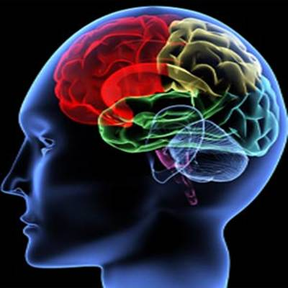
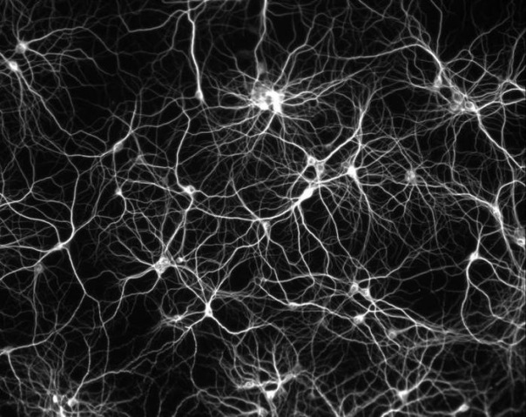
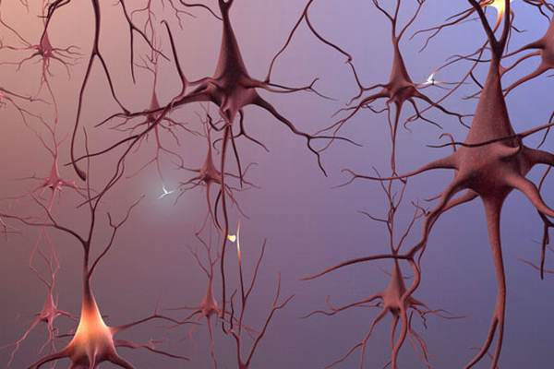
Biological Neurons

Slide 3
Artificial Neural Networks (ANN)
Activation Function
Slide credit : Andrew L. Nelson

Slide 4
Layered Networks
Input nodes
Output nodes
Hidden nodes
Connections

Slide 5
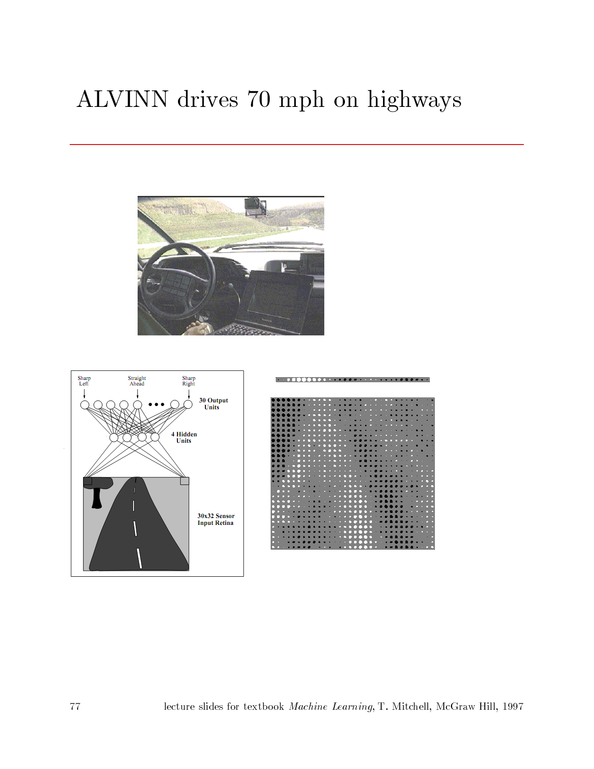
Neural network application
ALVINN drives 70 mph on highways
Slide credit : T.Michell

Slide 6
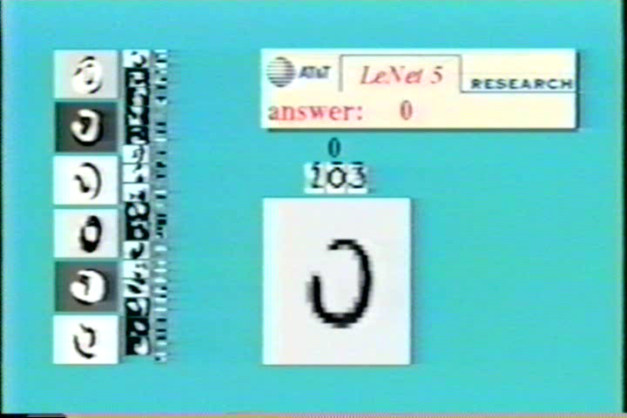
Neural network application
Slide credit : Andraw Ng.

Slide 7
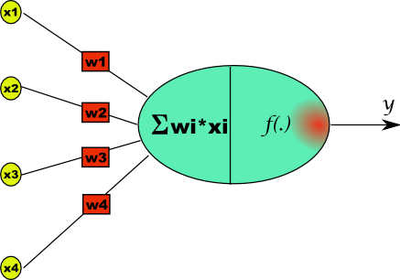
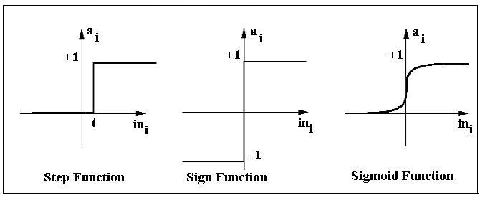



The simplest model- the Perceptron
The Perceptron was introduced in 1957 by
Frank Rosenblatt.
Perceptron:
-
D0
d
D1
Activation
functions:
D2
Learning:
Input
Layer
Output
Layer
Destinations
Update
Slide credit : Geoffrey Hinton

Slide 8
Second generation neural networks (~1985)
Compare outputs with correct answer to get error signal
Back-propagate error signal to get derivatives for learning
outputs
hidden layers
input vector
Slide credit : Geoffrey Hinton

Slide 9






























BP-algorithm
1
.5
0
-5
0
5
Activations
errors
The error:
Update
Update
Weights:
Slide credit : Geoffrey Hinton

Slide 10
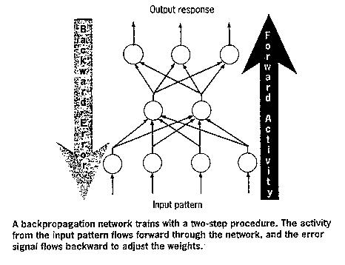
Back Propagation
Advantages
Multi layer Perceptron network can be trained by the back propagation algorithm to perform any mapping between the input and the output.
What is wrong with back-propagation?
It requires labeled training data.
Almost all data is unlabeled.
The learning time does not scale well
It is very slow in networks with multiple hidden layers.
It can get stuck in poor local optima.
Slide credit : Geoffrey Hinton

Slide 11
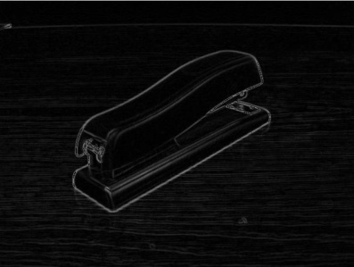
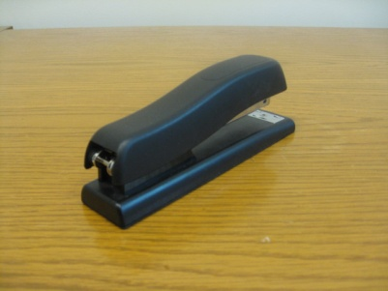

Why Deep multi-layered neural network
object models
object parts
(combination
of edges)
edges
pixels

Slide 12
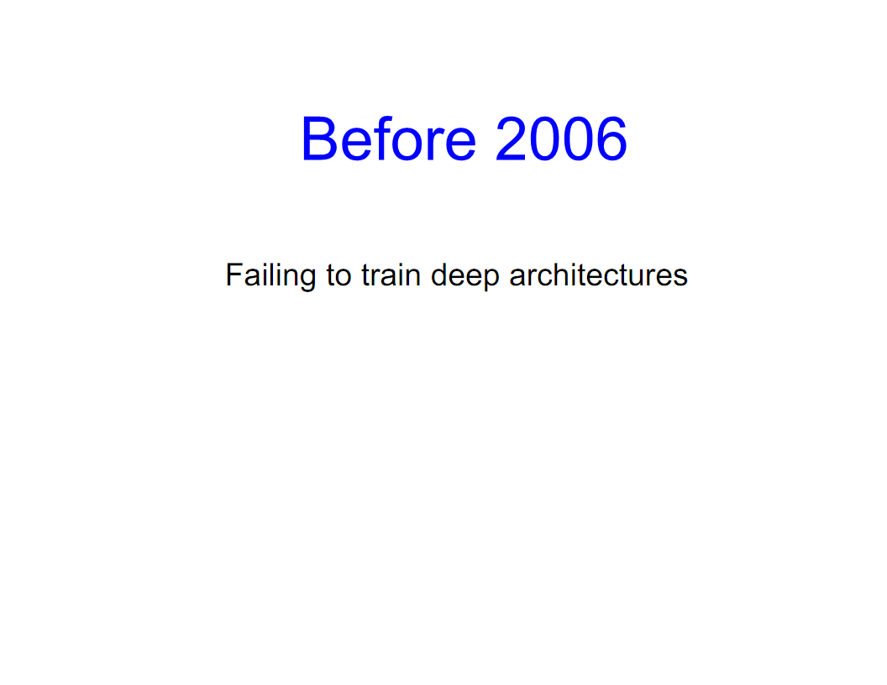

Slide 13
Deep Neural Networks
Standard learning strategy
Randomly initializing the weights of the network
Applying gradient descent using backpropagation
But, backpropagation does not work well (if randomly initialized)
Deep networks trained with back-propagation (without unsupervised pre-train) perform worse than shallow networks
ANN have limited to one or two layers

Slide 14
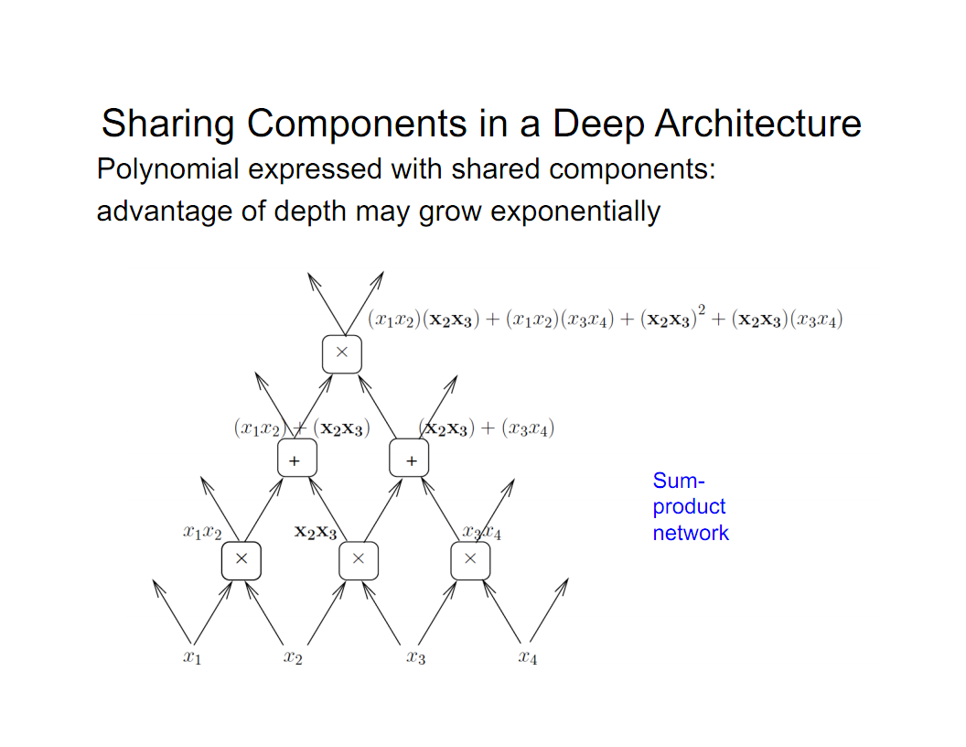
Slide credit : Yoshua Bengio

Slide 15
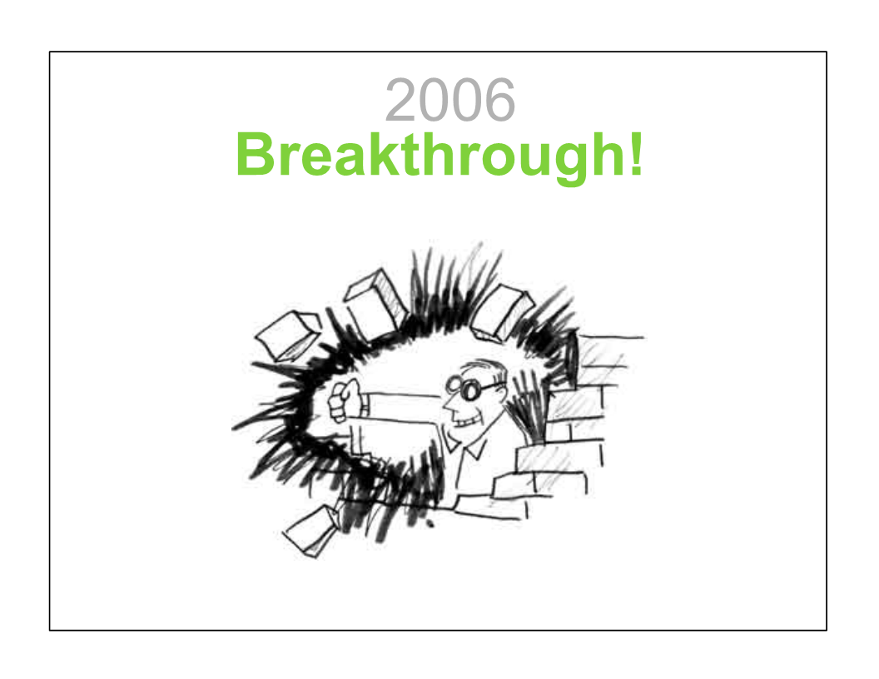

Slide 16
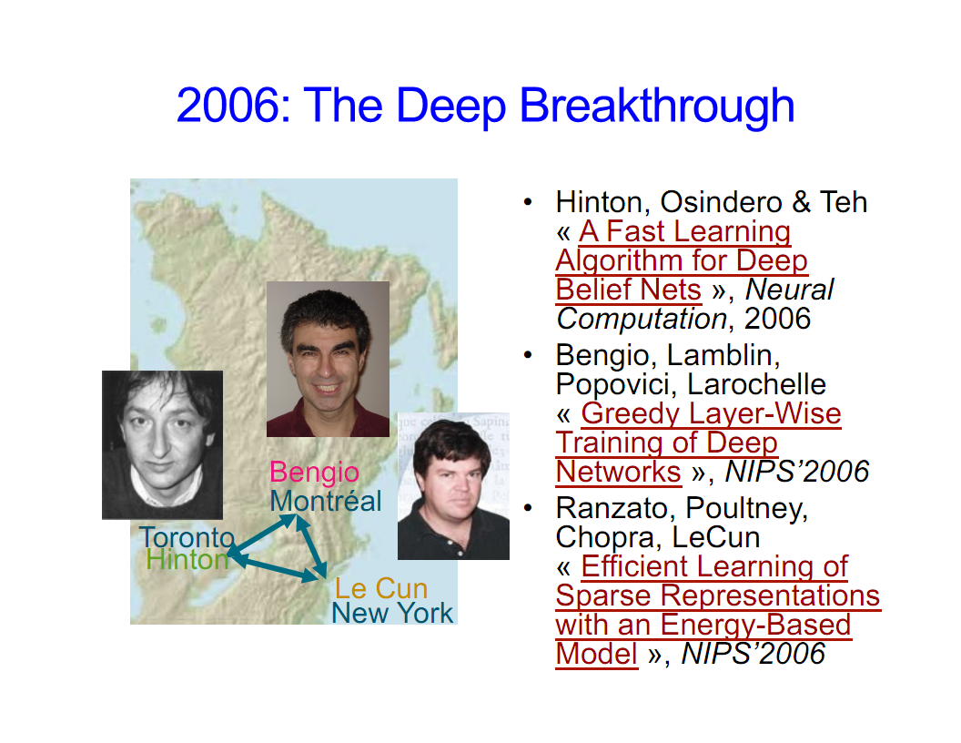
Slide credit : Yoshua Bengio

Slide 17
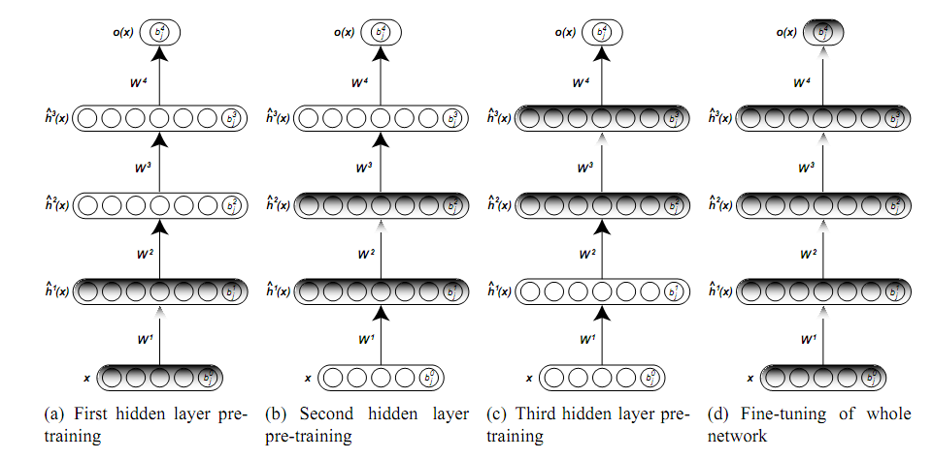
Unsupervised greedy layer-wise training procedure.

Slide 18
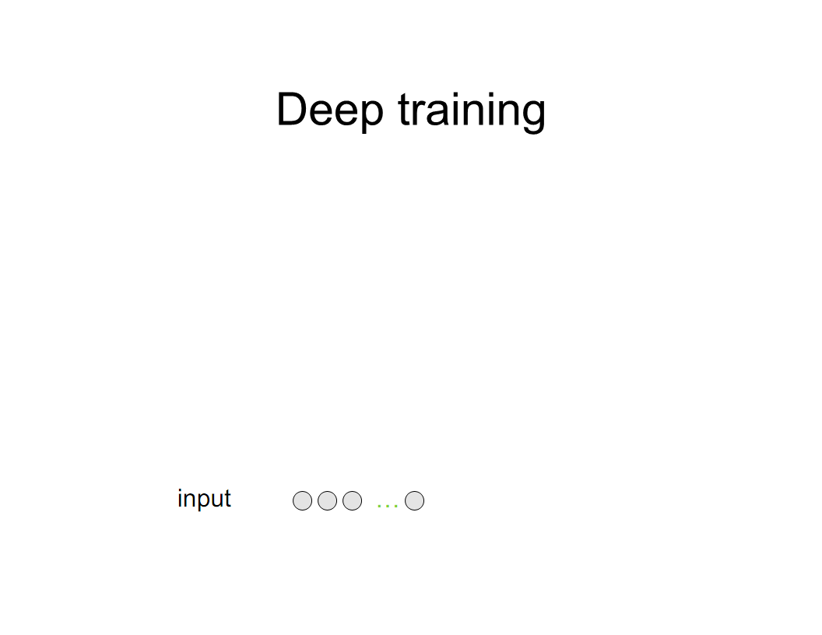

Slide 19
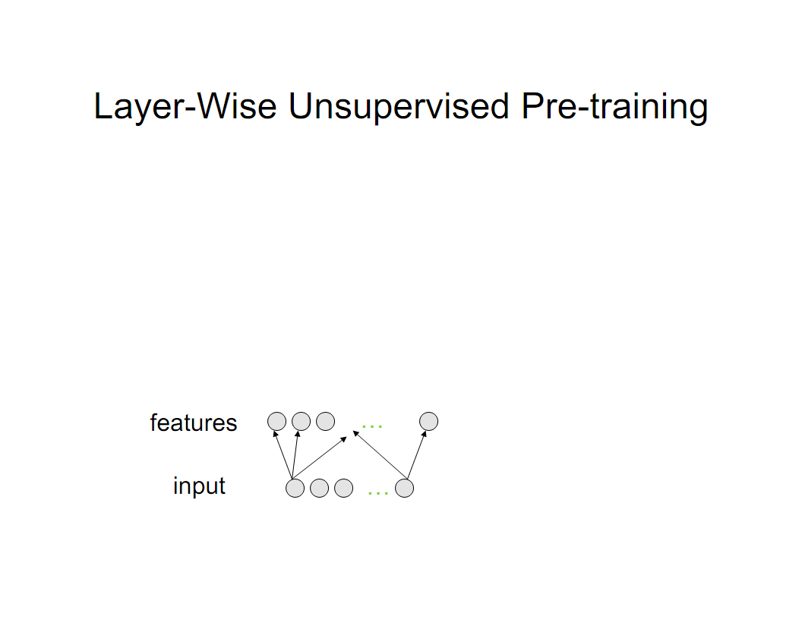

Slide 20
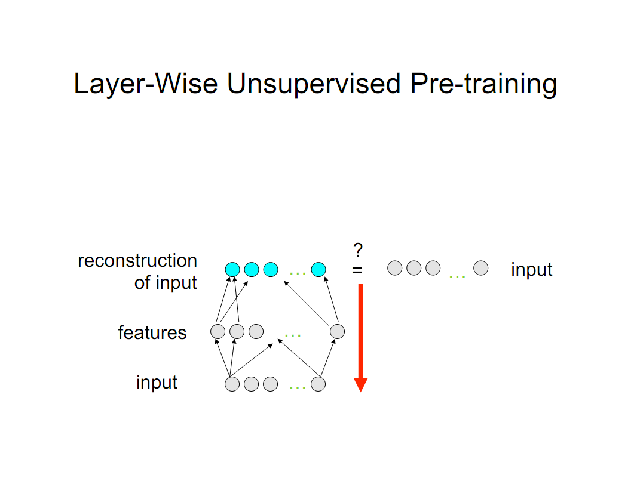

Slide 22
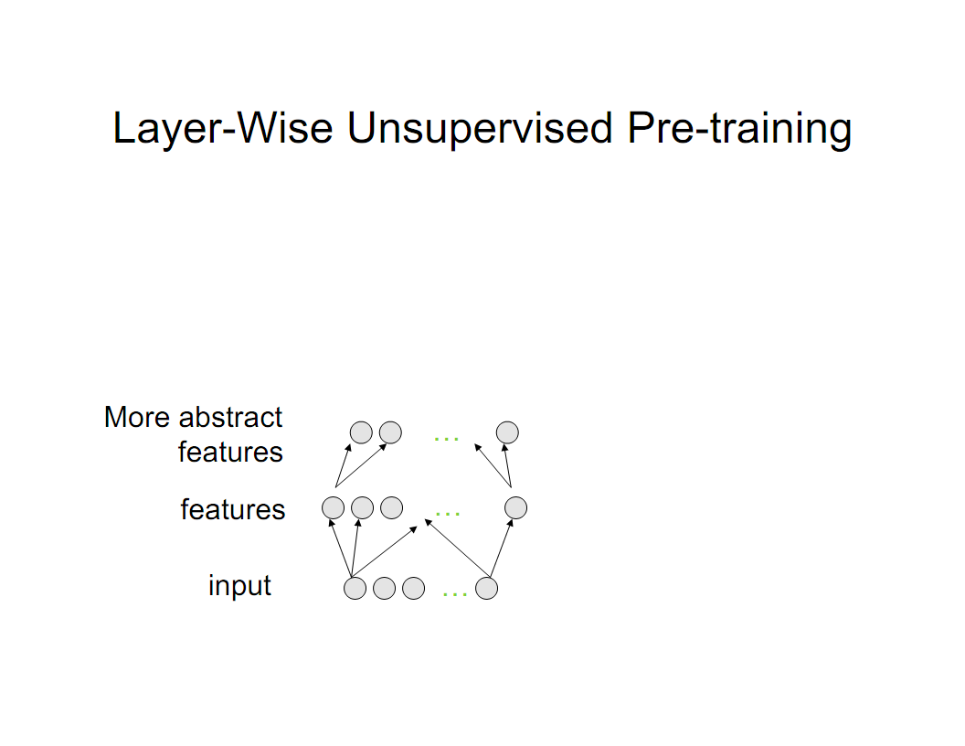

Slide 23
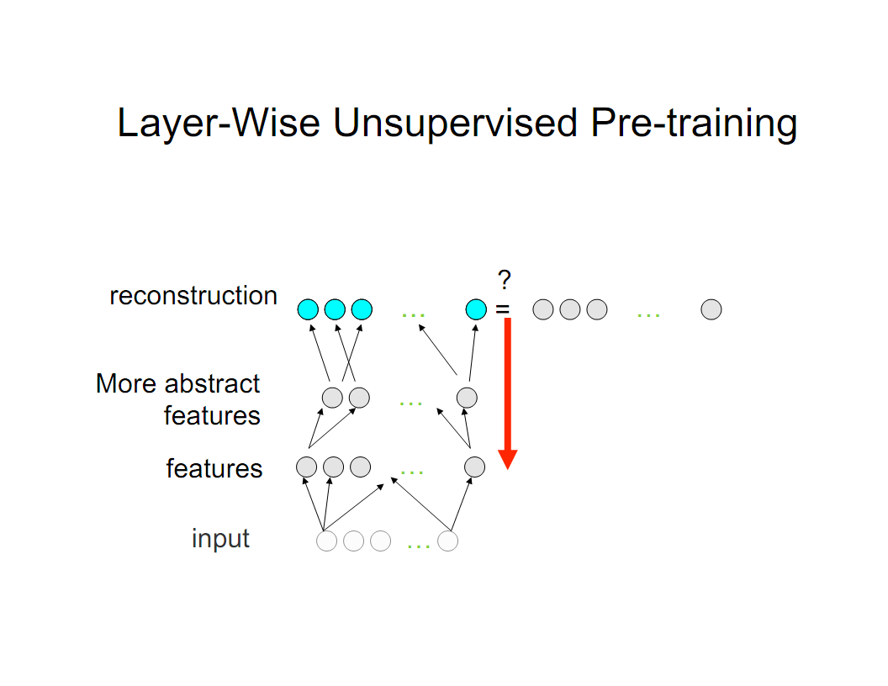

Slide 24
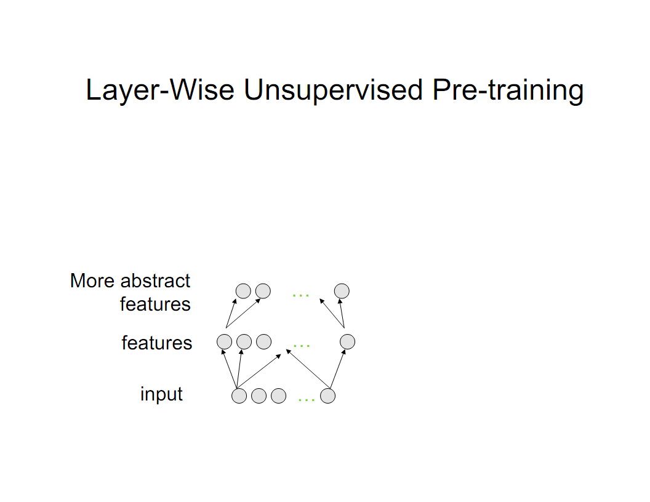

Slide 25
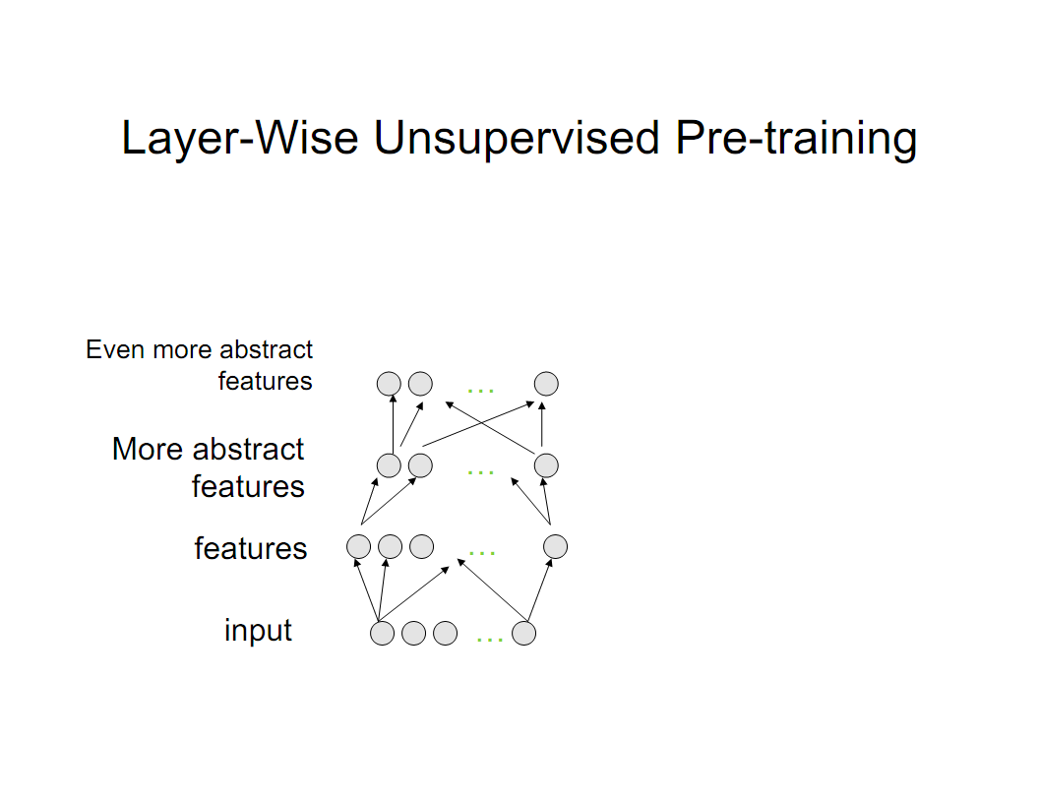

Slide 26
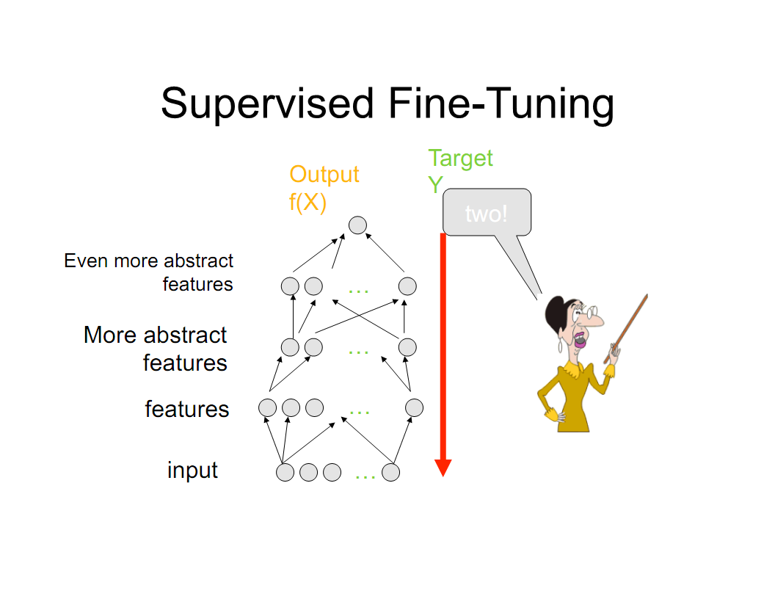

Slide 27
Layer-Local Unsupervised Learning
Restricted Boltzmann Machine (SRBM) (Hinton et al, NC’2006)
Auto-encoders (Bengio et al, NIPS’2006)
Sparse auto-encoders (Ranzato et al, NIPS’2006)
Kernel PCA (Erhan 2008)
Denoising auto-encoders (Vincent et al, ICML’2008)
Unsupervised embedding (Weston et al, ICML’2008)
Slow features (Mohabi et al, ICML’2009, Bergstra & Bengio NIPS’2009)

Slide 28
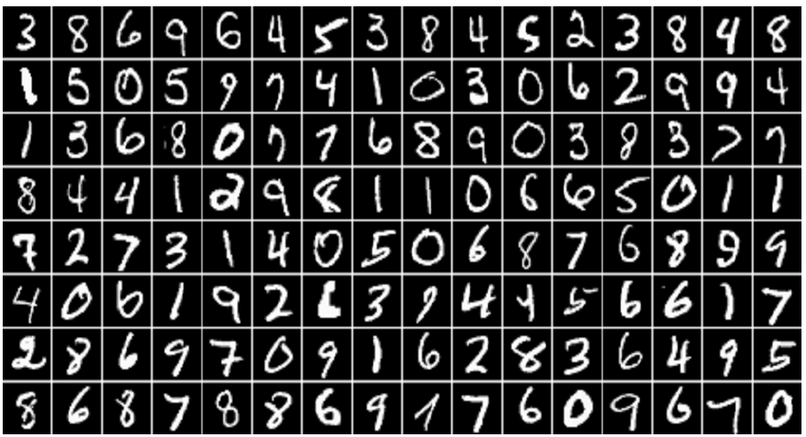
Experiments
MNIST data set
A benchmark for handwritten digit recognition
The number of classes is 10 (corresponding to the digits from 0 to 9)
The inputs were scaled between 0 and 1
Exploring Strategies for Training Deep Neural Networks. Hugo Larochelle, Yoshua Bengio, Jérôme Louradour, Pascal Lamblin; 10(Jan):1--40, 2009.

Slide 29
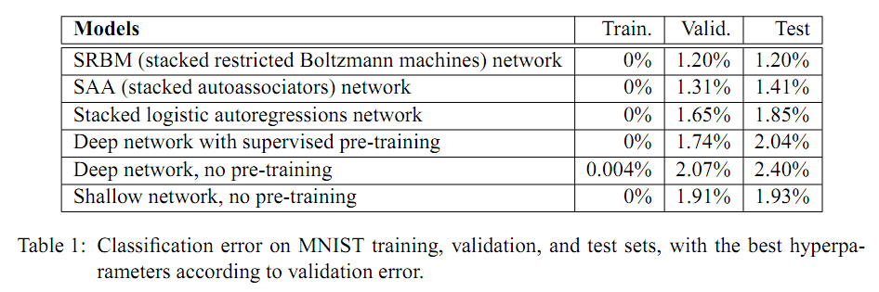
Classification error on MNIST training

Slide 30
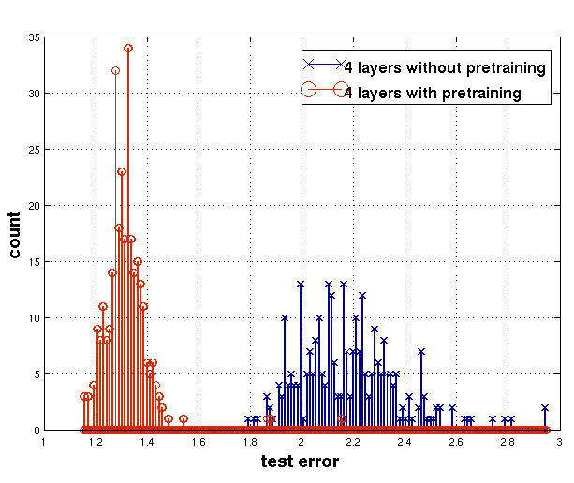
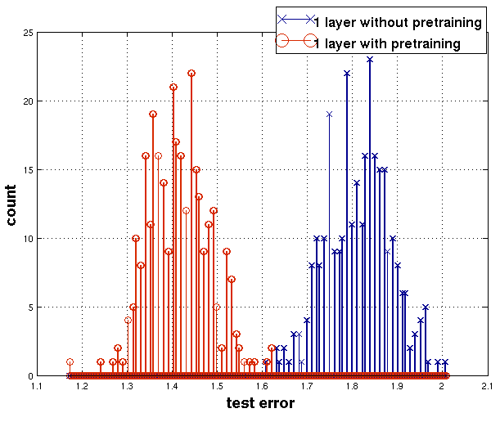
Experiments
Histograms presenting the test errors obtained on MNIST using models trained with or without pre-training.
The difficulty of training deep architectures and the effect of unsupervised pre-training.
Dumitru Erhan, Pierre-Antoine Manzagol, Yoshua Bengio, Samy Bengio, and Pascal Vincent;
pages 153-160, 2009.

Slide 31
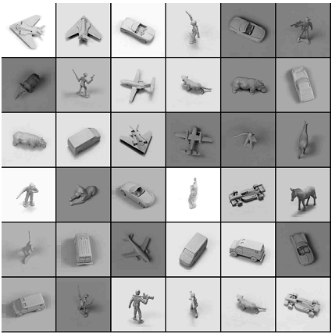
Experiments
NORB data set
5 object categories, 5 difference objects within each category.
Classification error rate
DBM : 10.8 %
SVM : 11.6 %
Logistic Regression : 22.5 %
KNN : 18.4 %
Efficient Learning of Deep Boltzmann Machines.
Ruslan Salakhutdinov, Hugo Larochelle ;
JMLR W&CP 9:693-700, 2010.

Slide 32
Conclusion
Deep Learning : powerful arguments & generalization priciples
Unsupervised Feature Learning is crucial many new algorithms and applications in recent years
Deep Learning suited for multi-task learning, domain adaptation and semi-learning with few labels

Slide 33
Application
Classiﬁcation (Bengio et al., 2007; Ranzato et al., 2007b; Larochelle et al., 2007; Ranzato et al.,2008)
Regression (Salakhutdinov and Hinton, 2008)
Dimensionality Reduction (Hinton Salakhutdinov, 2006; Salakhutdinov and Hinton, 2007)
Modeling Textures (Osindero and Hinton, 2008)
Information Retrieval (Salakhutdinov and Hinton, 2007)
Robotics (Hadsell et al., 2008)
Natural Language Processing (Collobert and Weston, 2008; Weston et al., 2008)
Collaborative Filtering (Salakhutdinov et al., 2007)

Slide 34
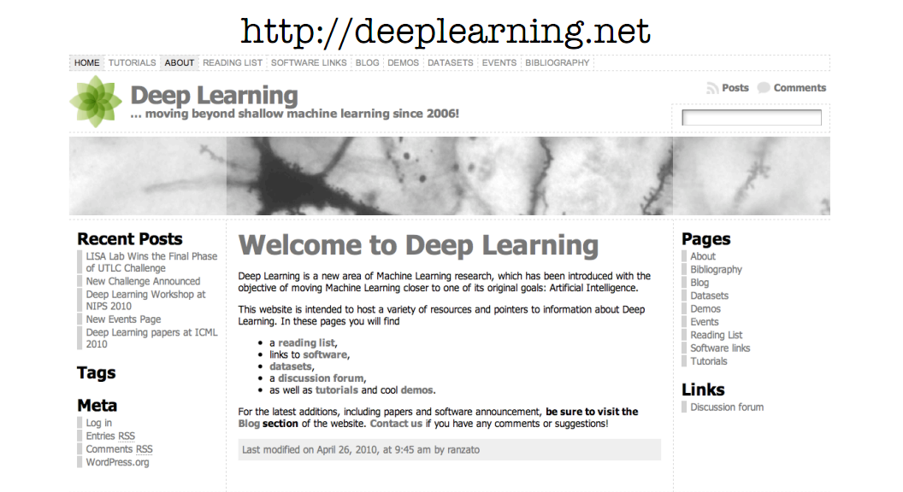
Recent Deep Learning Highlights

Slide 35
Recent Deep Learning Highlights
Google Goggles uses Stacked Sparse Auto Encoders (Hartmut Neven @ ICML 2011)
The monograph or review paper Learning Deep Architectures for AI (Foundations & Trends in Machine Learning, 2009).
Exploring Strategies for Training Deep Neural Networks, Hugo Larochelle, Yoshua Bengio, Jerome Louradour and Pascal Lamblin in: The Journal of Machine Learning Research, pages 1-40, 2009.
The LISA publications database contains a deep architectures category. http://www.iro.umontreal.ca/~lisa/twiki/bin/view.cgi/Public/ ReadingOnDeepNetworks
Deep Machine Learning – A New Frontier in Artificial Intelligence Research – a survey paper by Itamar Arel, Derek C. Rose, and Thomas P. Karnowski.

Slide 36
Thank You

