Slide 1
Head First Dropout
Naiyan Wang

Slide 2
Outline
Introduction to Dropout
Basic idea and Intuition
Some common mistakes for dropout
Practical Improvement
DropConnect
Adaptive Dropout
Theoretical Justification
Interpret as an adaptive regularizer.
Output approximated by NWGM.

Slide 3
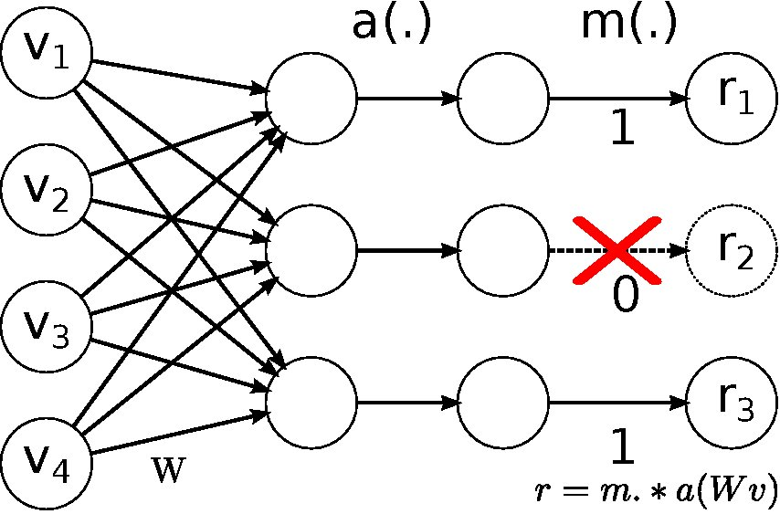
Basic Idea and Intuition
What is Dropout?
It is a simple but very effective technique that could alleviate overfitting in training phase.

Slide 4
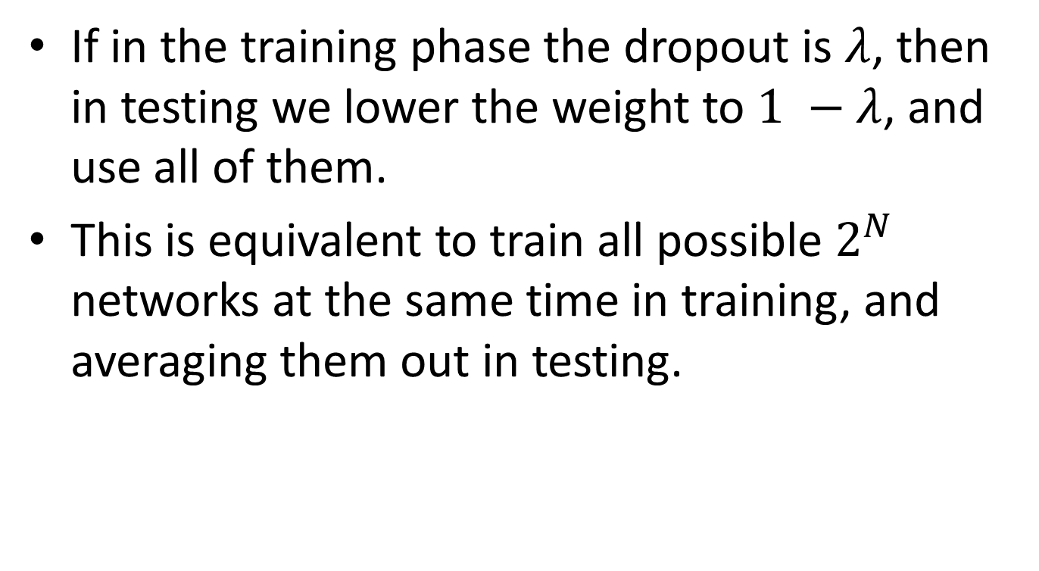
Basic Idea and Intuition
If in the training phase the dropout is $λ$, then in testing we lower the weight to $1 −λ$, and use all of them.
This is equivalent to train all possible $2^{N}$ networks at the same time in training, and averaging them out in testing.

Slide 5
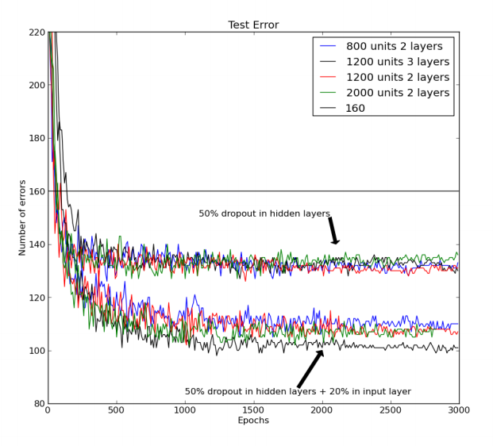
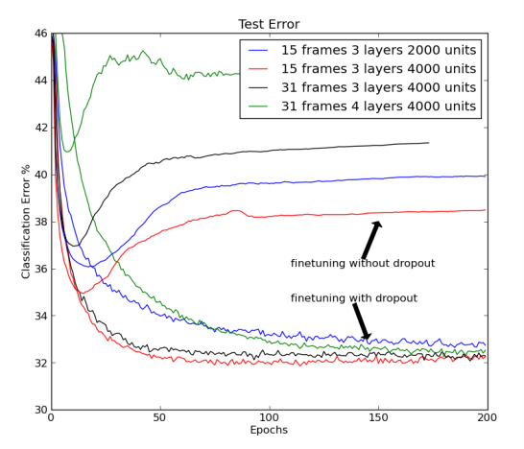
Results
MNIST
TIMIT

Slide 6
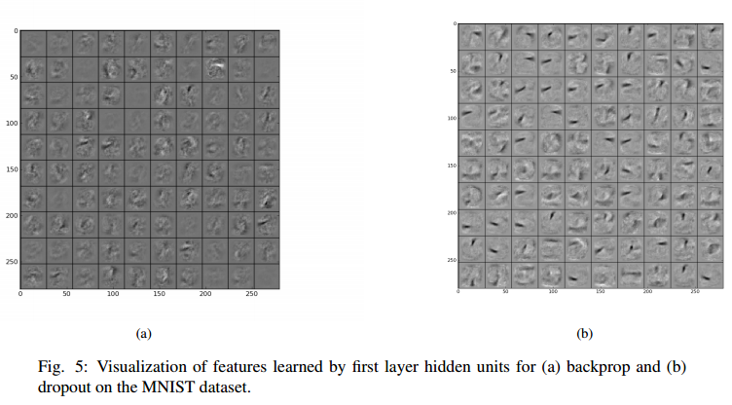
Results

Slide 7
Some Common Mistakes
Dropout is only limited to deep learning
No, even simple logistic regression will benefit from it.
Dropout is a just magic trick. (bug or feature?)
No, we will show it is equivalent to a kind of regularization soon.

Slide 8
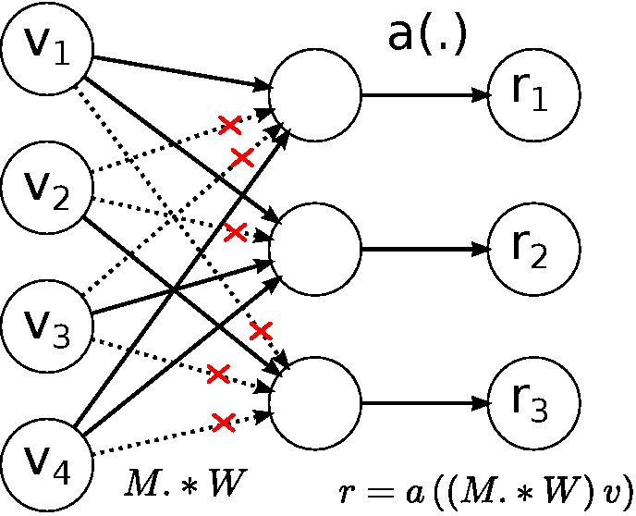
DropConnect
DropConnect also masks the weight.
Dropout
DropConnect

Slide 9



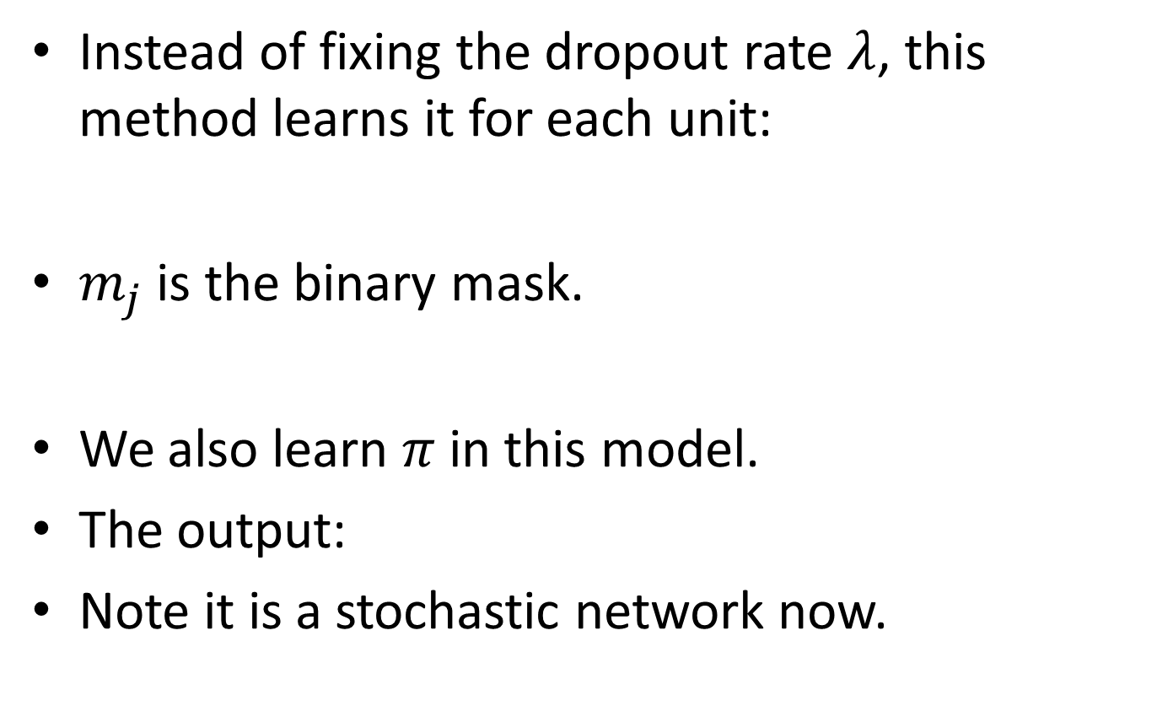
Standout
Instead of fixing the dropout rate $λ$, this method learns it for each unit:
$m_{j}$ is the binary mask.
We also learn $π$ in this model.
The output:
Note it is a stochastic network now.

Slide 10



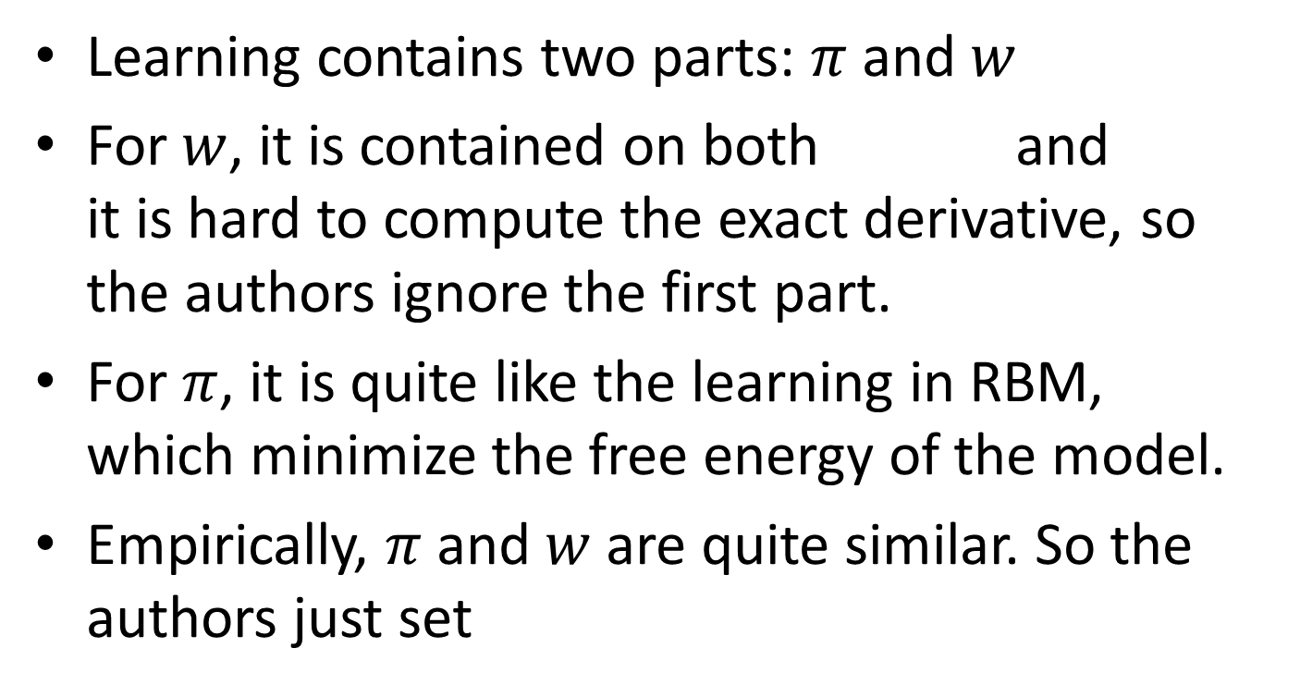
Standout(con’t)
Learning contains two parts: $π$ and $w$
For $w$, it is contained on both and it is hard to compute the exact derivative, so the authors ignore the first part.
For $π$, it is quite like the learning in RBM, which minimize the free energy of the model.
Empirically, $π$ and $w$ are quite similar. So the authors just set

Slide 11
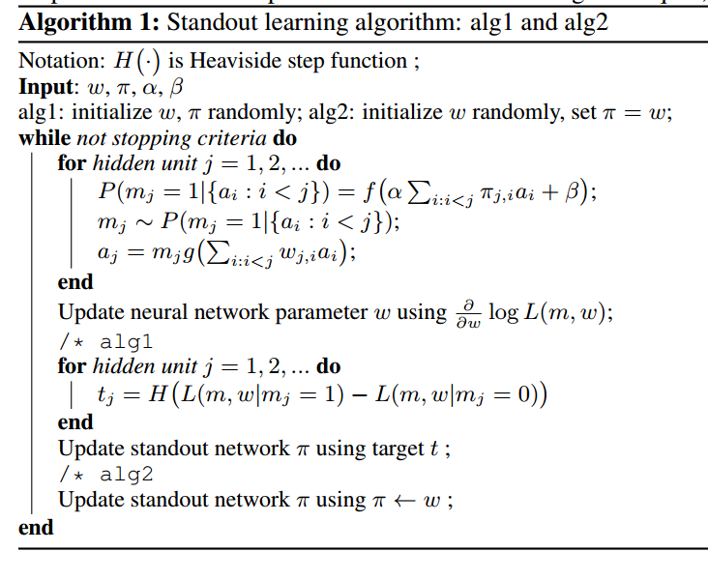
Standout(con’t)

Slide 12
Results
Both DropConnect and Standout show improvement over standard dropout in the paper.
The real performance need to be tested in a fair environment.

Slide 13
Discussion
The problem in testing
Lower the weight is not an exact solution because of the use of nonlinear activation function
DropConnect: Approximate the output by a moment matched Gaussian
More results in the “Understanding Dropout”.
Possible connection to Gibbs sampling with Bernoulli variable?
Better way of dropout?

Slide 14



Adaptive Regularization
In this paper, we consider the following GLM:
Standard MLE on noisy observation optimizes:
Some simple math gives:
The Regularizer!

Slide 15

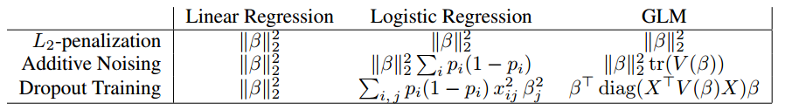
Adaptive Regularization(con’t)
The explicit form is not tractable in general, so we resort to a second order approximation:
Then the main result of this paper:

Slide 16
Adaptive Regularization(con’t)
It is interesting in logistic regression:
First, both types of noise penalize less to the highly activated or non-activated output.
It is OK if you are confident.
In addition, dropout penalizes less to the rarely activated features.
Works well with sparse and discriminative features.

Slide 17
Adaptive Regularization(con’t)
The general GLM case is equivalent to scale the penalty along the shape of diagonal of Fisher information matrix
Also connect to AdaGrad, an online learning algorithm.
Since the regularizer doesn’t depend on the label, we can also utilize the unlabeled data to design better adaptive regularizers.

Slide 18




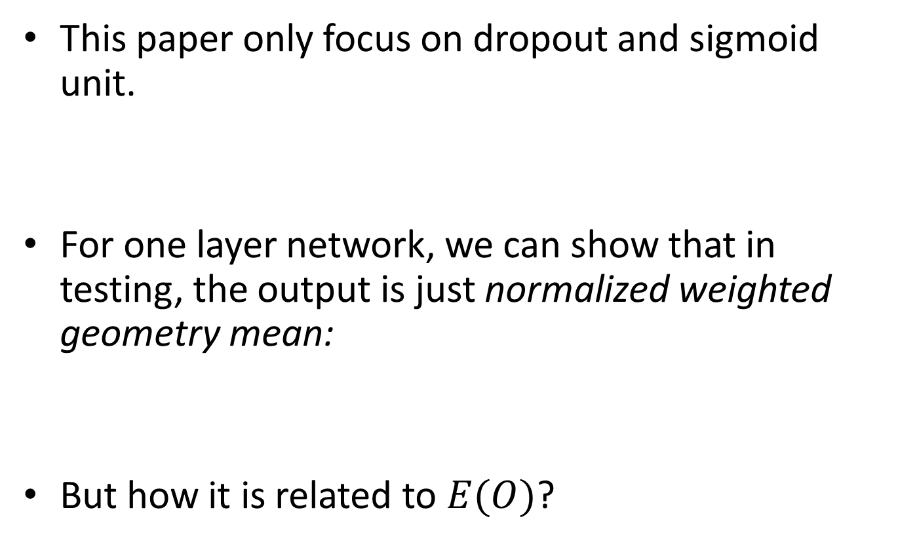
Understanding Dropout
This paper only focus on dropout and sigmoid unit.
For one layer network, we can show that in testing, the output is just normalized weighted geometry mean:
But how it is related to $E(O)$?

Slide 19



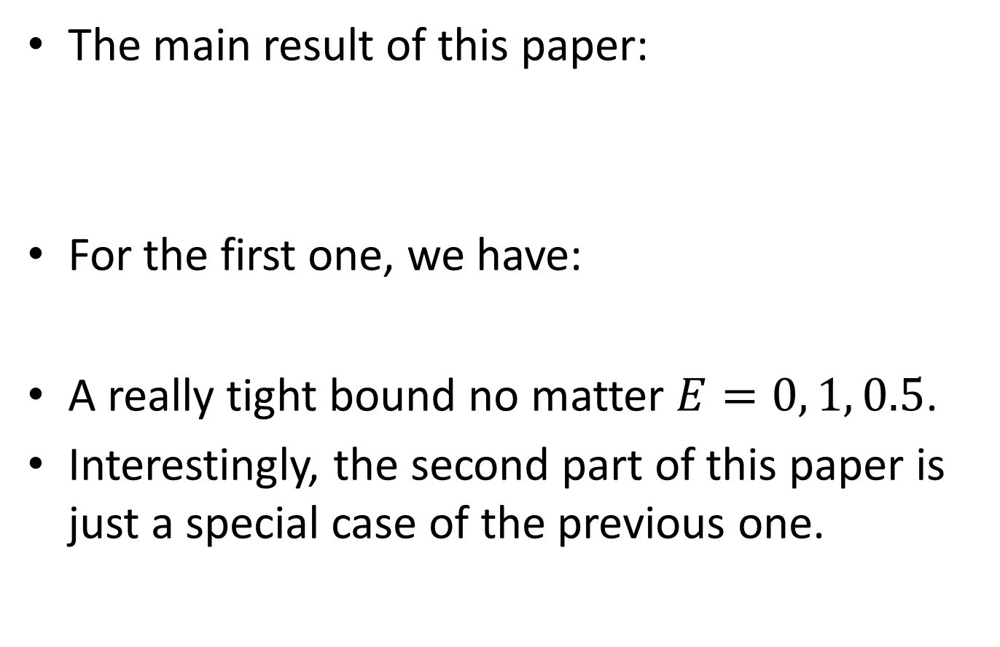
Understanding Dropout
The main result of this paper:
For the first one, we have:
A really tight bound no matter $E=0, 1, 0.5$.
Interestingly, the second part of this paper is just a special case of the previous one.

Slide 20
Discussion
These two papers are both limited to linear unit and sigmoid unit, but the most popular unit now is relu. We still need understand it.

Slide 21
Take Away Message
Dropout is a simple and effective way to reduce overfitting.
It could be enhanced by designing more advanced perturbation way.
It is equivalent to a kind of adaptive penalty could account for the characteristic of data.
Its testing performance could be approximated well by normalized weighted geometry mean.

Slide 22
References
Hinton, Geoffrey E., et al. "Improving neural networks by preventing co-adaptation of feature detectors." arXiv preprint arXiv:1207.0580 (2012).
Wan, Li, et al. "Regularization of neural networks using dropconnect." In ICML 2013.
Ba, Jimmy, and Brendan Frey. "Adaptive dropout for training deep neural networks." in NIPS 2013.
Wager, Stefan, Sida Wang, and Percy Liang. "Dropout training as adaptive regularization." in NIPS. 2013.
Baldi, Pierre, and Peter J. Sadowski. "Understanding Dropout.“in NIPS. 2013.
Uncovered Papers:
Wang, Sida, and Christopher Manning. "Fast dropout training." in ICML 2013.
Warde-Farley, David, et al. "An empirical analysis of dropout in piecewise linear networks." arXiv preprint arXiv:1312.6197 (2013).

