Slide 1
A brief review of non-neural-network approaches to deep learning
Naiyan Wang

Slide 2
Outline
Non-NN Approaches
Deep Convex Net
Extreme Learning Machine
PCAnet
Deep Fisher Net (Already presented before)
Discussion

Slide 3
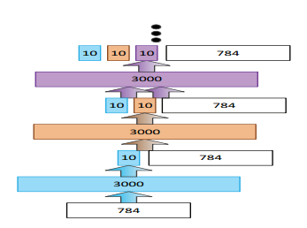
Deep convex net
Each module is a two- layer convex network.
After we get the prediction from each module, we concatenate it with the original input, and send it to a new module.

Slide 4



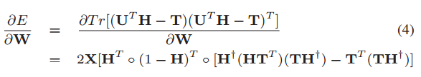
Deep Convex Net
For each module
We minimize
U has a closed form solution:
Learning of W relies on gradient descent:
Note that no global fine tuning involved, so it can stack up to more than 10 layers. (Fast Training!)

Slide 5
Deep Convex Net
A bit wired of why this works.
The learned features in mid-layers are NOT representative for the input.
Maybe learn the correlation between prediction and input could help?
Discussion?

Slide 6
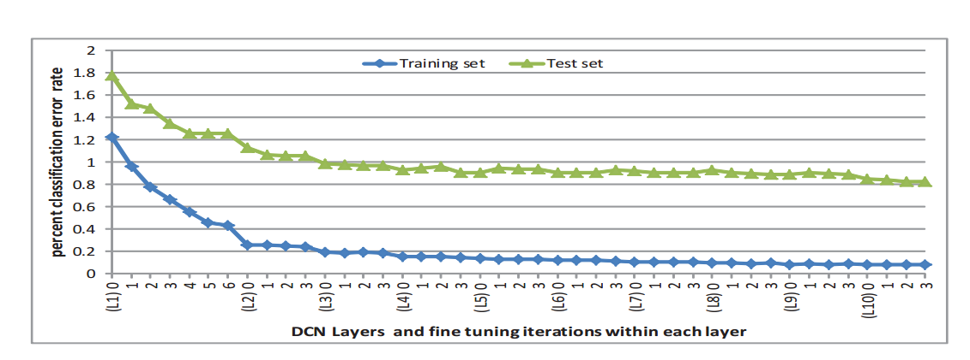
Deep Convex Net

Slide 7
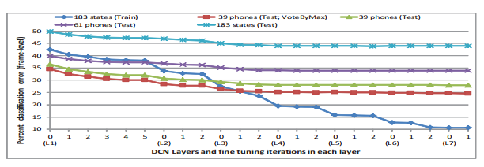
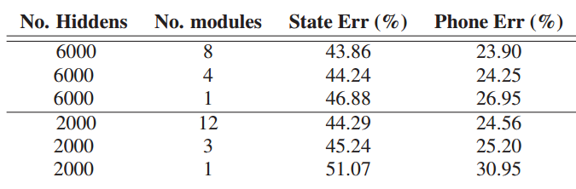
Deep Convex Net

Slide 8
Extreme Learning Machine
It is also a two layer networks:
The first layer performs random projection of input data.
The second layer performs OLS/Ridge regression to learn the weight.
After that, we could take the transpose of the learned weight as the projection matrix, and stack several ELM into a deep one.

Slide 9
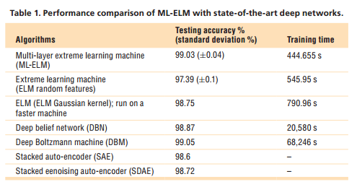
Extreme Learning Machine
Extremely fast learning
Note that even with simple random projection and linear transformation, the results still can be improved!

Slide 10
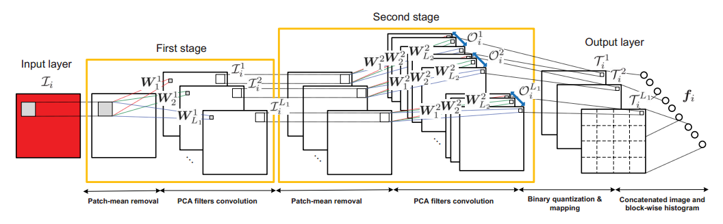
PCANet
In the first two layers, use patch PCA to learn the filters.
Then it binarizes the output in second layer, and calculate the histogram within a block.

Slide 11
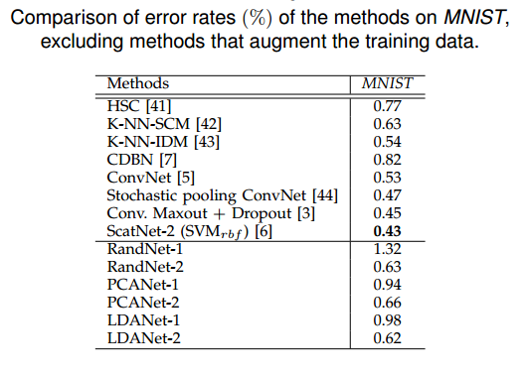
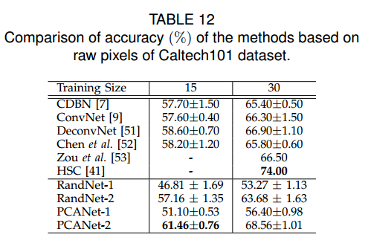
PCANet
To learn the filters, the authors also proposed to use Random initialization and LDA.
The results are acceptable in a wide range of datasets.

Slide 12
Summary
Most of the paper (except deep Fisher Net) report their results on relatively toy data. We cannot draw any conclusion about their performance.
This could enlighten us some possible research directions.

Slide 13
Discussion
Why deep architectures always help? (We don’t concern about overfitting now)
The representation power increases exponentially as more layers add in.
However the number of parameters increases linearly as more layers add in.
Given a fixed budget, this is a better way to organize the model.
Take PCA net as an example, if there are m, n neurons at first and second layer, then there exists an equivalent m*n single layer net.

Slide 14
Discussion
Why CNN is so successful in image classification?
Data abstraction
Locality! (The image is a 2D structure with strong local correlation.)
The convolution architecture could propagate local information to a broader region
1st: m * m, 2nd : n * n, then it corresponds to (m + n - 1) * (m + n - 1) in the original image.
This advantage is further expanded by spatial pooling.
Other ways to concern about these two issues simultaneously?

Slide 15
Discussion
Convolution is a dense architecture. It induces a lot of unnecessary computation.
Could we come up a greedy or more clever selection in each layer to just focus on those discriminative patches?
Or possibly a “convolutional cascade”?

Slide 16
Discussion
Random weights are adopted several times, and it yields acceptable results.
Pros:
Data independent
Fast
Cons:
Data independent ☺
So could we combine random weights and learned weights to combat against overfitting?
Some work have been done on combining deterministic NN and stochastic NN.

