Slide 1
Name:Pragnesh Dodiya

Slide 2
ENCAPSULATION & INHERITANCE
What is an encapsulation.
How encapsulation works.
Benefits of encapsulation
What is inheritance.
Types of inheritance
Advantages of inheritance

Slide 3


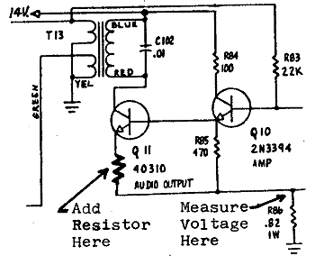
Encapsulation
encapsulation: Hiding implementation details of an object from its clients.
Encapsulation provides abstraction.
separates external view (behavior) from internal view (state)
Encapsulation protects the integrity of an object's data.

Slide 4
Private fields
A field can be made invisible to outsiders
No code outside the class can access or change it easily.
__name
Examples:
self.__id
self.__name
Client code sees an error when accessing private fields:

Slide 5
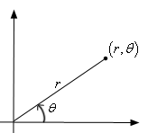
Benefits of encapsulation
Provides abstraction between an object and its clients.
Protects an object from unwanted access by clients.
A bank app forbids a client to change an Account's balance.
Allows you to change the class implementation.
Point could be rewritten to use polar coordinates (radius r, angle θ), but with the same methods.
Allows you to constrain objects' state (invariants).
Example: Only allow Points with non-negative coordinates.

Slide 6
Inheritance
Inheritance is a feature or a process in which, new classes are created from the existing classes.
The new class created is called“derived class” or“child class”.The existing class is known as the“base class”or“parent class”.
The child class now is said to be inherited from the parent class.
The extends keyword is used for inheritance in Java.
Using the extends keyword indicates you are derived from an existing class.

Slide 7
Types of Inheritance
Single inheritance
Multilevel inheritance
Multiple inheritance
Hierarchical inheritance
Hybrid inheritance

Slide 8
Advantages of Inheritance
Code Reusability: Inheritance lets you reusecode from an existing class, which means you don't have to write the same code again. This saves time and effort.
Organization: It helps in organizing classes in a hierarchy. You can have a base (parent) class with common attributes and methods, and then create specialized (child) classes that inherit from the base class and add their unique features.
Extensibility: You can extend the functionality of a class by creating a new class (child class)that inherits from it and adds or overrides methods. This makes it easier to make changes and additions to your code.
Polymorphism: Inheritance is essential for achieving polymorphism, which allows objects of different classes to be treated as objects of a common parent class. This simplifies code and makes it more flexible.
Maintenance: When you need to make changes to acommon feature shared by multiple classes, you can make the change in the parent class, and it will automatically reflect in all the child classes. This reduces the chances of errors and makes maintenance easier.

Slide 9
Thank you

