Slide 1
ENCAPSULATION & INHERITANCE
What is an encapsulation.
How encapsulation works.
Benefits of encapsulation
What is inheritance.
Types of inheritance
Advantages of inheritance

Slide 2


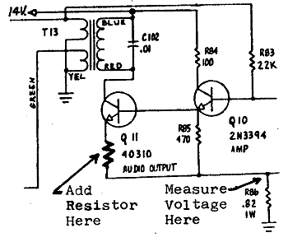
Encapsulation
encapsulation: Hiding implementation details of an object from its clients.
Encapsulation provides abstraction.
separates external view (behavior) from internal view (state)
Encapsulation protects the integrity of an object's data.

Slide 3
Private fields
A field can be made invisible to outsiders
No code outside the class can access or change it easily.
__name
Examples:
self.__id
self.__name
Client code sees an error when accessing private fields:

Slide 4
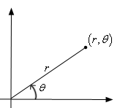
Benefits of encapsulation
Provides abstraction between an object and its clients.
Protects an object from unwanted access by clients.
A bank app forbids a client to change an Account's balance.
Allows you to change the class implementation.
Point could be rewritten to use polar coordinates (radius r, angle θ), but with the same methods.
Allows you to constrain objects' state (invariants).
Example: Only allow Points with non-negative coordinates.

Slide 5
Inheritance
Inheritance is a feature or a process in which, new classes arecreated from the existing classes.
The new class created is called“derived class” or“child class”.The existing class is known as the“base class”or“parent class”.
The child class now is said to be inherited from the parent class.
The extends keyword is used for inheritance in Java.
Usingthe extends keyword indicates you are derived from an existingclass.

Slide 6
Types of Inheritance
Single inheritance
Multilevel inheritance
Multiple inheritance
Hierarchical inheritance
Hybrid inheritance

Slide 7
Advantages of Inheritance
Code Reusability: Inheritance lets you reusecode from an existing class, which means youdon't have to write the same code again. This saves time and effort.
Organization: It helps in organizing classes in ahierarchy. You can have a base (parent) classwith common attributes and methods, and thencreate specialized (child) classes that inherit fromthe base class and add their unique features.
Extensibility: You can extend the functionalityof a class by creating a new class (child class)that inherits from it and adds or overridesmethods. This makes it easier to make changesand additions to your code.
Polymorphism: Inheritance is essential forachieving polymorphism, which allows objects ofdifferent classes to be treated as objects of acommon parent class. This simplifies code andmakes it more flexible.
Maintenance: When you need to make changes to acommon feature shared by multiple classes, you canmake the change in the parent class, and it willautomatically reflect in all the child classes. Thisreduces the chances of errors and makesmaintenance easier

