Slide 1
RSTS
Real-time Speech Translation System
Team 6 : Austin Ashworth, Narin Rahimzadeh, Muhammad Khushnood, Hao Cheng
Notes:
Hello everyone, we are team 6, today we will present our final project called RSTS, which means Real-Time Speech Translation System.
It is a small but complete system that can listen to speech, recognize it, translate it, and optionally speak it back.

Slide 2
MOTIVATION
Why build this System?
Real-time translation is useful in daily life.
Many tools only support full sentence mode.
We wanted a simple, local, private system.
Good practice for pre-trained model (like Whisper) and Google API.
Notes:
Our motivation is simple. Real-time translation is useful, but many apps only support full-sentence or cloud only mode. We wanted a simple local system that we can fully control. And this project also helps us
practice WebSocket streaming, FastAPI and Whisper.

Slide 3
System Overview
- Frontend (HTML + JavaScript) - Backend (Fast API, Whisper)
- WebSocket streaming
Backend
Processing
Text
Display
Source Voice
Audio
Speech Recognition
Text
Streaming
Data
Translation
TTS
Notes:
The system has three parts. The frontend runs in the browser and captures audio.
The backend runs FastAPI and Whisper. The two sides communicate through WebSocket so the system can work in real time.

Slide 4

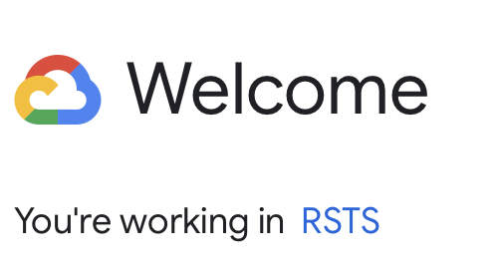


4
4
4
Key backend modules
- Whisper small model
- VAD-based segmentation
- Translation (Google API + Argos translate)
- TTS endpoint
https://openai.com/index/whisper/
Notes:
The backend uses FastAPI. It loads the Whisper small model. It also includes VAD-based segmentation: speech, end, and final recognition.
Translation uses Google Cloud, but I also added a local fallback.

Slide 5

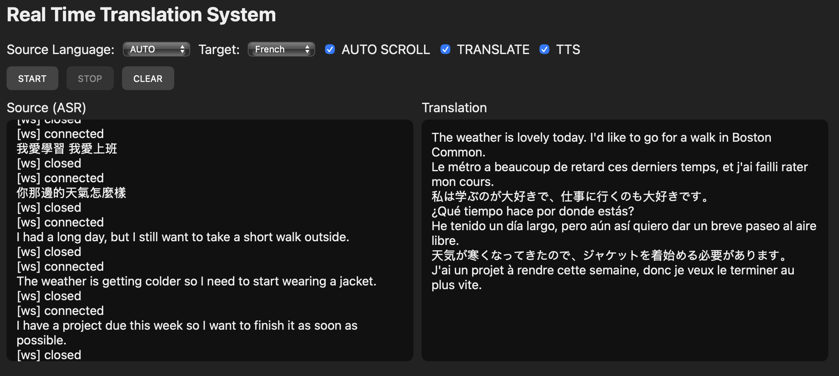
5
4
Main features
- Microphone capture
- Source text / Translation display
- TTS toggle
Notes:
The frontend is lightweight. It captures microphone audio and sends small chunks to the backend.
It shows source text, translated text, and can also request TTS playback.

Slide 6
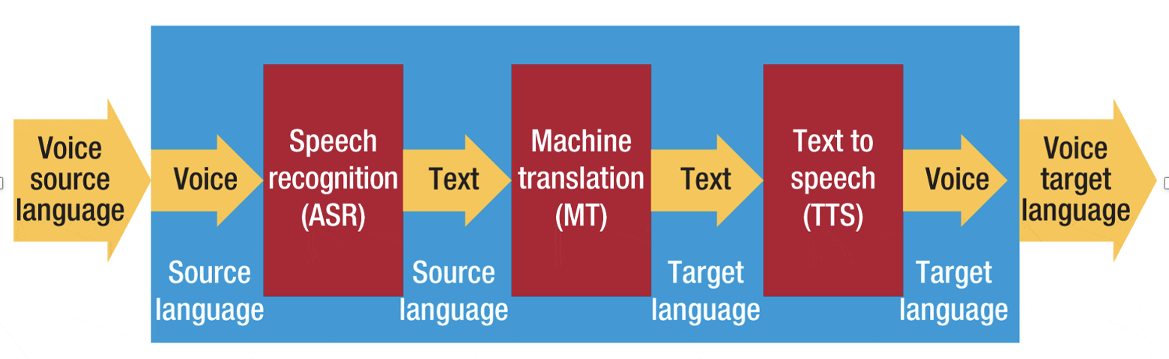
Work flow
Notes:
User speaks
Browser captures audio, send it to the backend through WebSocket
Backend detects silence,
Then Whisper model start to transcribe
Then we send the text to Translate model ( like Google translate, argos translate)
Last, TTS play the results.

Slide 7
Demo Summary

Slide 8
Thanks
Team 6 : Austin Ashworth, Narin Rahimzadeh,
Muhammad Khushnood, Hao Cheng

