Slide 1

Accidental_Drug_Related_Deaths_2012-2018
Peng Tan
Master of Computer Science
VT

Slide 2
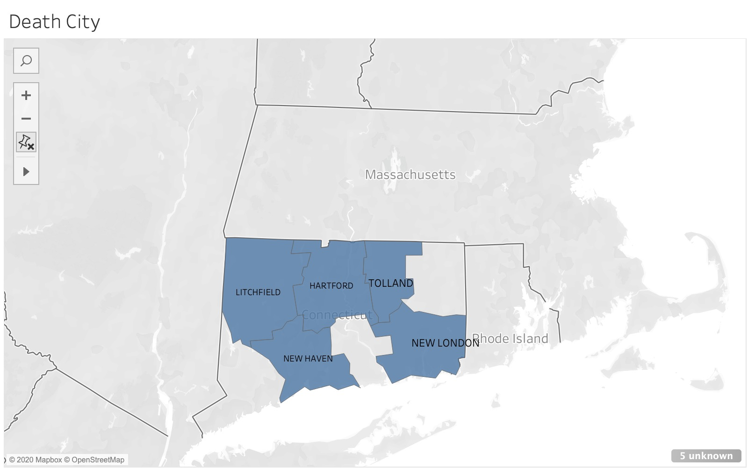
Introduction of Dataset
A listing of each accidental death associated with drug overdose in Connecticut from 2012 to 2018.
1.8 mega byte
This dataset store 5105 dead caused by drug overdose.
Most interesting thing about this dataset is that three columns of data “Death City”, “Injury City”, “Residence City” contains Latitude and longitude coordinates, which means that I can show all information by map rather than just number comparison.
When we want to draw map, using tableau is more efficient
method.

Slide 3
About my project
In this project, I just use two different method to help me to analyze data. Python and Tableau.
In python, I just using a package called “Plotly” to help me draw an interactive image. When we move the mouse to image, it will show the information of this data.
For tableau, it is also a brilliant data visualization software, which can help me to draw map or other image much more efficient than before.
I believe that the audience include some specific department of government, police and public service organization.

Slide 4
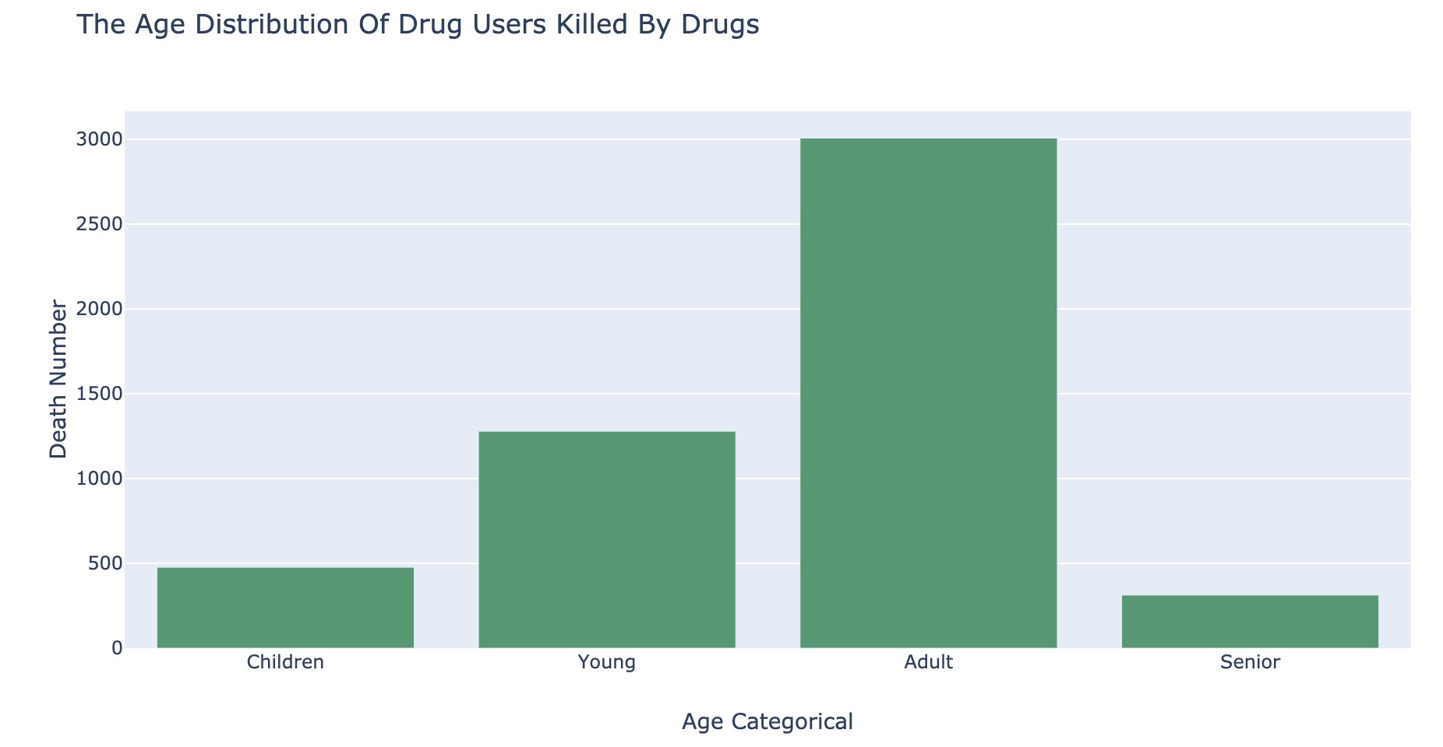
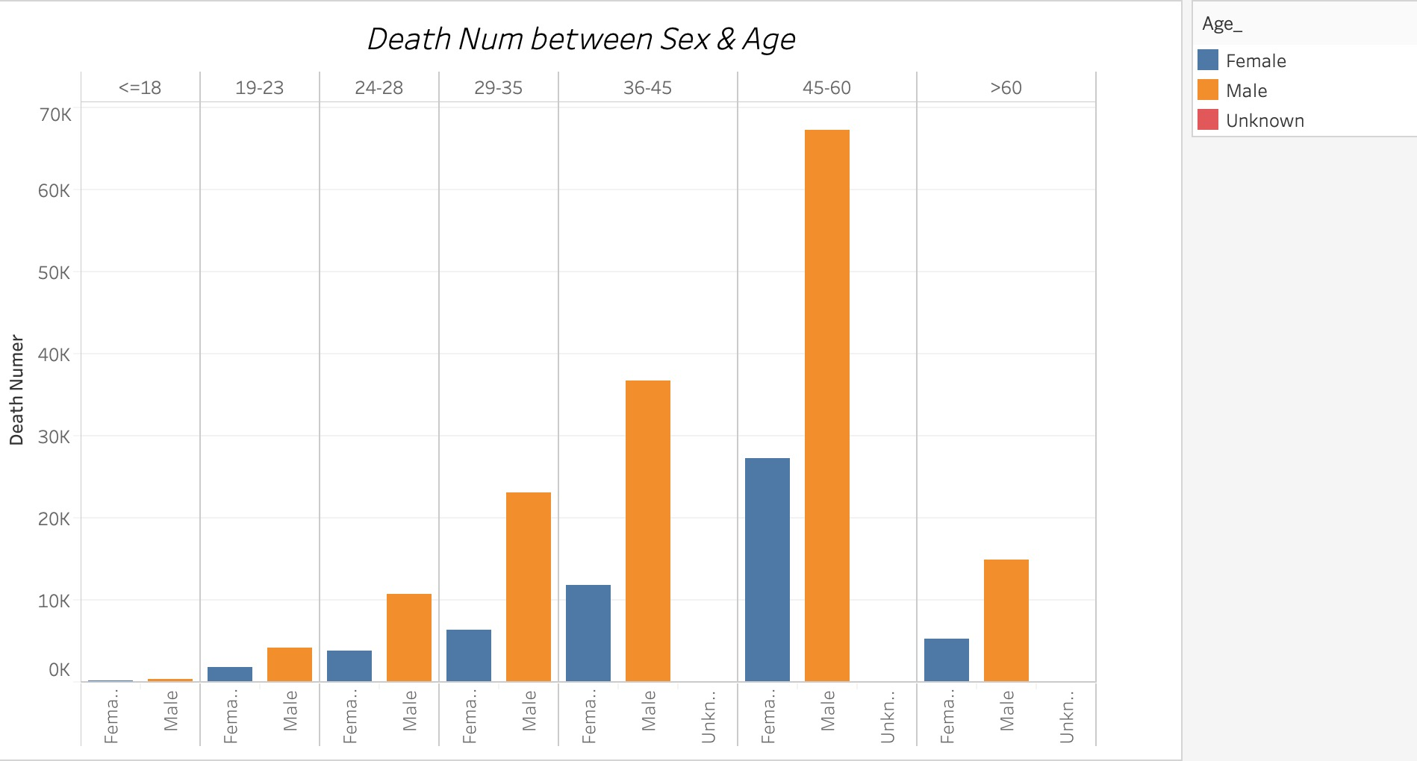

Slide 5
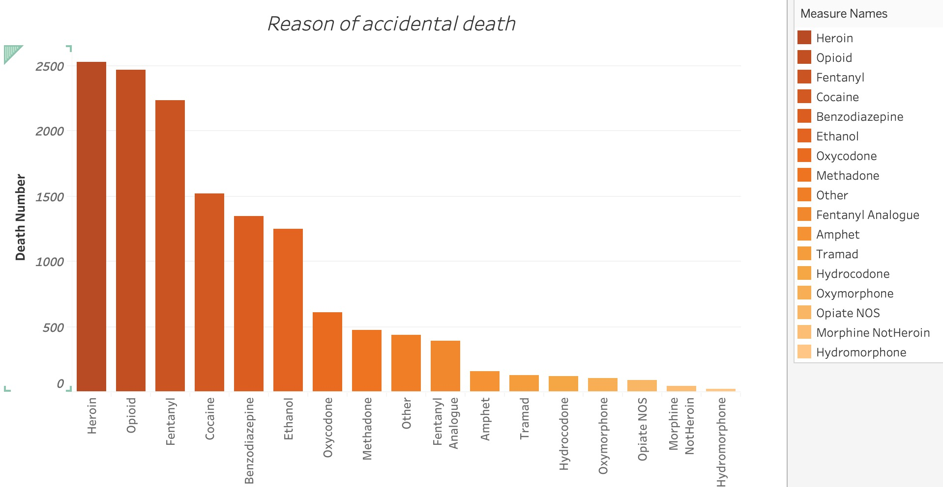
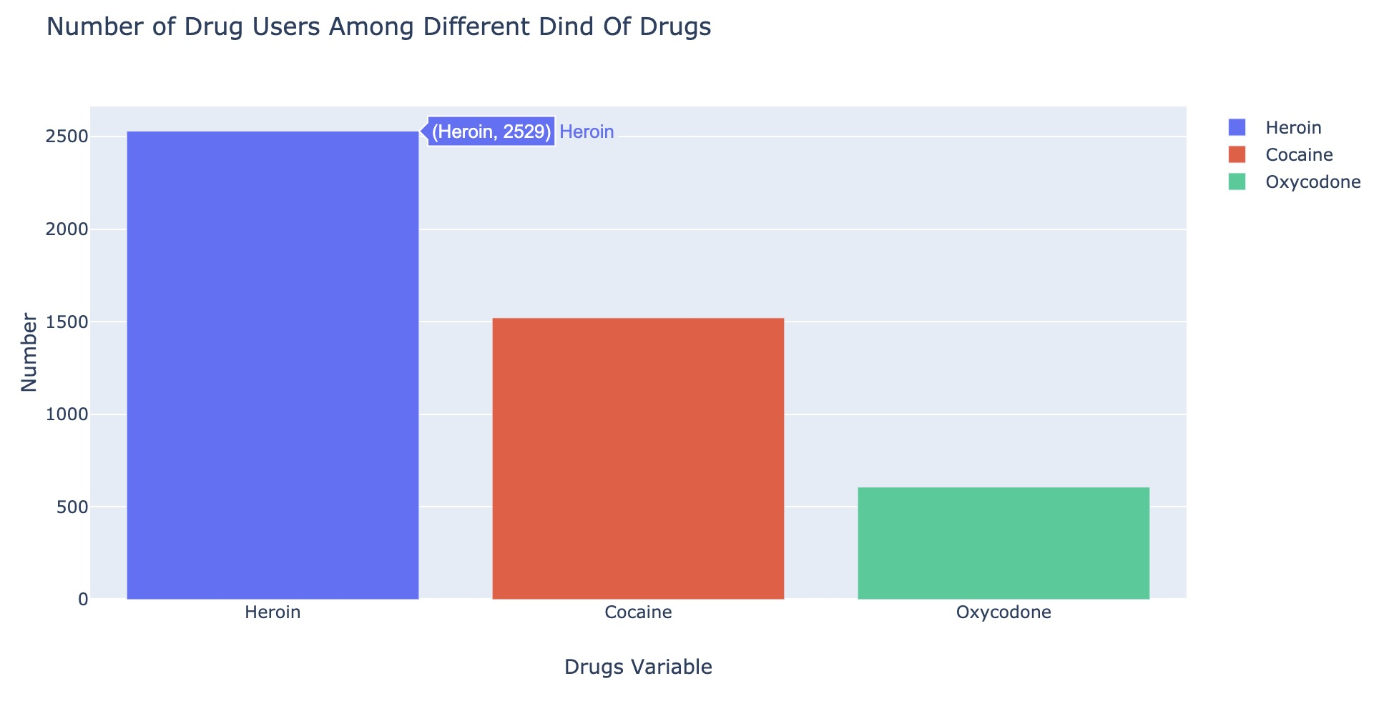

Slide 6
For the policeman, from my data analysis, they can find that Heroin is the most lethal drug or most people prefer taking Heroin. And more than 60% death caused by Heroin and cocaine. So, police can more focus on the trade of these two drugs.

