Slide 1
04.图片和表格
梁昊

Slide 2
Table of Contents
图片（Figures）

Slide 3
图片（Figures）

Slide 4
外部图片
我们可以直接用Markdown语法
![A nice image.](images/flow.png){width=50%}
还可以用Chunk
```{r, echo=FALSE, out.width="50%", fig.cap="A nice image."} knitr::include_graphics("images/flow.png") ```

Slide 5
stargazer
This is an R Markdown presentation. Markdown is a simple formatting syntax for authoring HTML, PDF, and MS Word documents. For more details on using R Markdown see http://rmarkdown.rstudio.com.
When you click the Knit button a document will be generated that includes both content as well as the output of any embedded R code chunks within the document.

Slide 6
texreg
Bullet 1
Bullet 2
Bullet 3

Slide 7
tableone
summary(cars)
## speed dist ## Min. : 4.0 Min. : 2.00 ## 1st Qu.:12.0 1st Qu.: 26.00 ## Median :15.0 Median : 36.00 ## Mean :15.4 Mean : 42.98 ## 3rd Qu.:19.0 3rd Qu.: 56.00 ## Max. :25.0 Max. :120.00

Slide 8
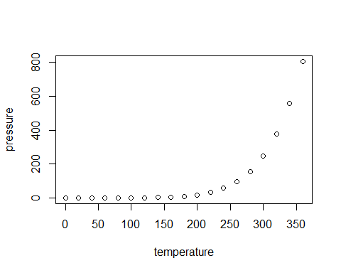
gtsummary

