Slide 1

Crime rate and Highschool Graduation Rate
Team 1 :
Hao Bai
Van Scott
Danson Carter
Silvana Murphy

Slide 2

Hard Pill to Swallow
65% of individuals in prison do not hold a high school diploma.
Annual incomes more than 25 percent lower than high school graduates and nearly 60 percent lower college graduates
Higher unemployment rates — approximately 2 percent and 5 percent higher — than high school and college graduates, respectively.
Notes:
https://www.apha.org/-/media/files/pdf/sbhc/dropout_crisis.ashx?la=en&hash=45980EEE0E7AD5063B04AC8183C2B463AD3031BE

Slide 3

Questions
Is there a correlation between the high school graduation/dropout rate rate and crime in the area?
Is there a correlation between student/teacher ratios and violent/property crime?
Notes:
Describe the questions you asked, and why you asked them
Describe whether you were able to answer these questions to your satisfaction, and briefly summarize your findings

Slide 4
Hypothesis
Null hypothesis: There is no relationship between crime and student/teacher ratio or between crime and students dropping out of high school.
Assumptions: Areas with higher crime risk have a higher teacher student ratio, therefore a lower graduation rate.
We expected to reject the null hypothesis and find some relationship between crime and student/teacher ratio or the rate of student dropping out of high school.

Slide 5

Data Sources
FBI.gov Violent Crime City rating list
ATTOM Data Solutions – APIs for property developers an realtor companies
Socrata API – Graduation rate
Notes:
Describe the questions you asked, and why you asked them
Describe whether you were able to answer these questions to your satisfaction, and briefly summarize your findings

Slide 6

Notes:
Describe the exploration and cleanup process
Discuss insights you had while exploring the data that you didn't anticipate
Discuss any problems that arose after exploring the data, and how you resolved them
Present and discuss interesting figures developed during exploration, ideally with the help of Jupyter Notebook

Slide 7
Data cleaning
634 cities with crime and high school student teacher ratio data. 29567 data for high school graduation information
Merge them together to get a total of 218 cities’ data
After removing outliers, sample size is 211
Sample size for low total crime risk cities (cities with total crime risk <=60) is 34
Sample size for high total crime risk cities (cities with total crime risk >=160) is 34
Sample size for low assault risk cities (cities with assault risk <=60) is 57
Sample size for high assault risk c cities (cities with assault risk >=160) is 42

Slide 8
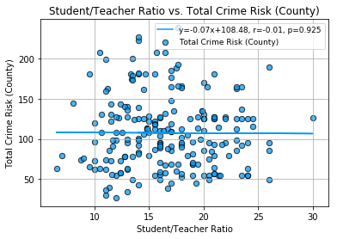
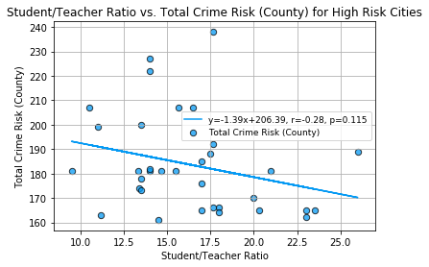
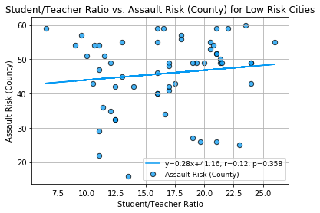
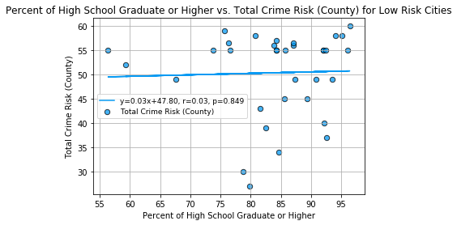
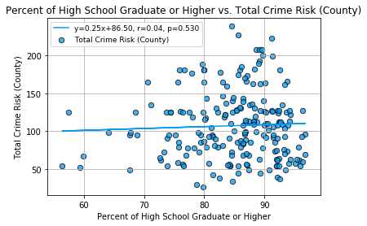
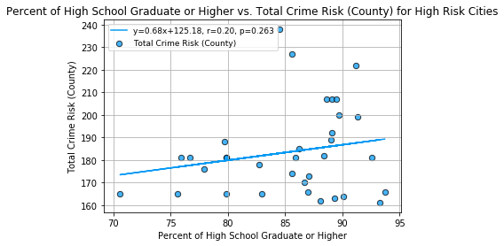
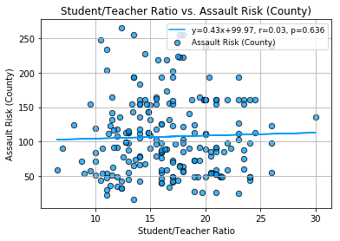
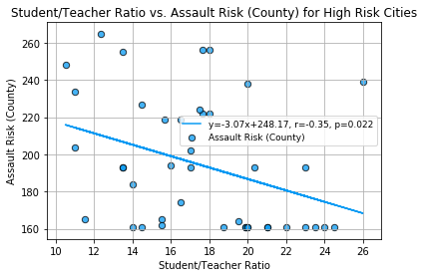
Side by side view

Slide 9
Findings..
1. For low total crime risk cities (cities with total crime risk <=60, sample size: 34), there is a positive relationship between student teacher ratio and total crime risk. R-square = 18.8%
2. For high assault risk cities (cities with assault risk >=160, sample size: 42), there is a negative relationship between student teacher ratio and assault risk. R-square = 12.4%
3. For high assault risk cities (cities with assault risk >=160, sample size: 42), there is a positive relationship between percent of high school graduate or higher and assault risk. R-square = 19.9%
The above three cases are where we found significant p value of the regression coefficients. They are using linear models with total crime risk or assault risk as the dependent variable being predicted by either student teacher ratio or percent of high school graduate or higher."

Slide 10
r-squared: 0.188414
Notes:
for low total crime risk cities (cities with total crime risk <=60, sample size: 34), there is a positive relationship between student teacher ratio and total crime risk

Slide 11

r-squared: 0.124434

Slide 12
r-squared: 0.199230

Slide 13
…Findings
We also tried multivariate regression
For low total crime risk cities
Dependent variable: total crime risk
Predictors: student teacher ratio and percent of high school graduate or higher
It is found that 20% of the variances in total crime risk are explained
The coefficient is 0.92 for student teacher ratio and 0.10 for percent of high school graduate or higher
For high assault risk cities
Dependent variable: assault risk
Predictors: student teacher ratio and percent of high school graduate or higher
It is found that 13% of the variances in assault risk are explained
The coefficient is -2.11 for student teacher ratio and 0.67 for percent of high school graduate or higher

Slide 14
Conclusions
Student/teacher ratio and high school graduation rates possibly contribute to part of the variances in crime for low total crime cities and for high assault risk cities.

Slide 15
Post Mortem Talking Points
Difficulties that arose and how we dealt with them
Additional questions that we didn’t have time to answer
There are multiple factors that would potentially affect the crime
Notes:
Limitations of data and analysis: "We did not find a source of data that included all components needed for the analysis. "Some of the data was collected monthly, quarterly or yearly so we had to pass on sources because they\n", wouldn't align correctly. We used high school and above education rate instead of drop out rate because we could not find a free source of date for 2017, most of the dropout rate data readily available stopped at 2014. “compare the graduation rate against the graduation rates”

Slide 16


