Slide 1

BGP Scalability Update

Slide 2
Introduction
RPD presented tests results at bgp-hacks meeting in Fall 2000
  Most results/assumptions were correct
  A few were not
Today we will:
  Make some corrections from last years presentation
  Quantify some scalability improvements that were made years ago
  Discuss the results of this years testing and improvements

Slide 3
Old Improvements
CSCdr50217 – “BGP: Sending updates slow”
Fixed in 12.0(13)S
Description
  Fixed a problem in bgp_io which allows BGP to send data to TCP more aggressively
Rex’s results
  “It was 3+ minutes before the fix and after it reduced to 25 seconds. The following update times were observed for 80K prefixes:
  Without policy - 25 seconds
  With AS-PATH filter - 27 seconds
  With prefix match (using access-list & route-map) - 30 seconds”

Slide 4
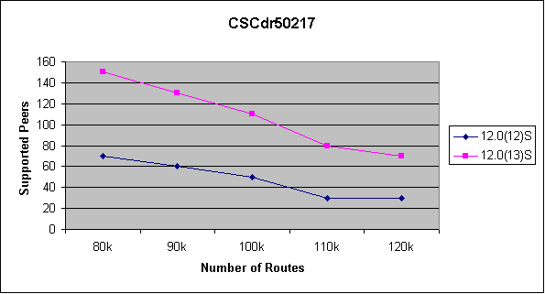
Old Improvements
What does CSCdr50217 mean in terms of scalability?
Almost 100% improvement!!

Slide 5
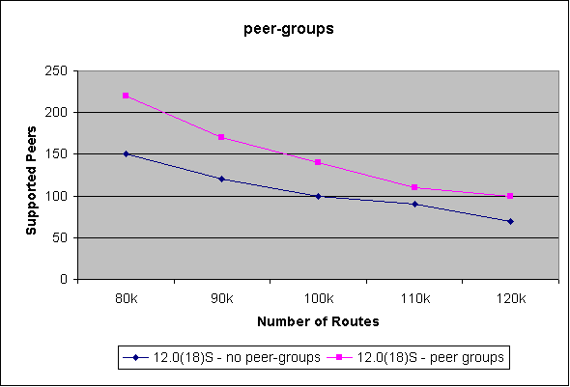
Old Improvements
A lot of customers still do not realize that peer-groups help convergence
Peer-groups give between 35% - 50% increase in scalability

Slide 6
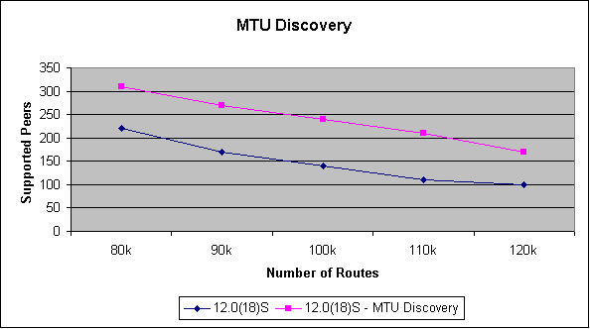
MTU Discovery
Default MSS (Max Segment Size) is 536 bytes
Inefficient for today’s POS/Ethernet networks
Using “ip tcp path-mtu-discovery” improves convergence

Slide 7
MTU Discovery
Need to turn on path-mtu-discovery by default for all BGP sessions
  TCP code is not set up to allow an application to set flags when opening a session
  Need TCP developers to write an API for the TCP flags
CSCdt70482 has been filed to track this from the BGP side

Slide 8
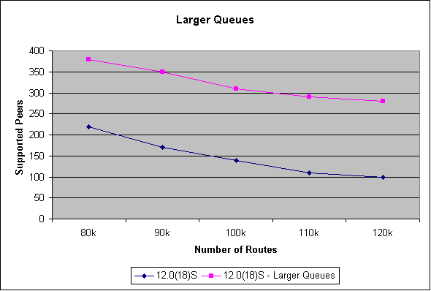
Larger Input Queues
Rush of TCP Acks from peers can quickly fill the 75 spots in process level input queues
Increasing queue depths (4096) improves BGP scalability

Slide 9
Larger Input Queues
Why not change default input queue size?
  May happen someday but people are nervous
  CSCdu69558 has been filed for this issue
Even with 4096 spots in the input queue we can still see drops given enough routes/peers
Need to determine “How big is too big” in terms of how large an input queue can be before we are processing the same data multiple times

Slide 10
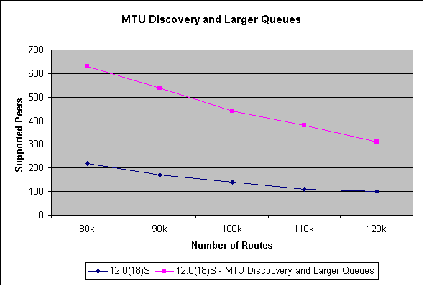
MTU Discovery and Larger Input Queues
Simple config changes can give 3x improvement
Sprint’s convergence times drop from 1 hour to 22 minutes when they made these changes

Slide 11
TCP Window Size – Fall 2000
Once believed that a window-size of 4 * MSS was ideal
Test results were faster with this setting because we were getting fewer input queue drops
This happened because there were fewer Acks coming back in a short period of time
Real solution is to reduce input drops without throttling TCP in the process

Slide 12
READ_ONLY Mode
RO and RW modes were introduced via CSCdm56595
RO timer (120 seconds) started when BGP process started
Never worked on GSR because it takes more than 120 seconds for linecards to boot, IGP to converge, etc…

Slide 13
READ_ONLY Mode
CSCds66429 corrects oversights made by CSCdm56595
RO timer now starts when the first peer comes up
  Linecard boot times and IGP convergence are accounted for automatically
Will transition to RW mode when one of the following happens:
  All peers have sent us a KA
  All peers that were up within 60 seconds of the first peer have sent us a KA. This way we do not wait 120s for a peer that is mis-configured
  The 120s timer pops

Slide 14
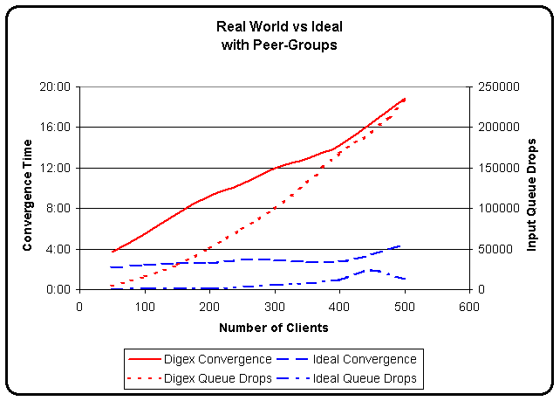
UPDATE Packing – Fall 2000
Attribute distribution plays a key role in UPDATE Packing
The more efficient the UPDATE packing, the faster BGP converges

Slide 15
UPDATE Packing
UPDATE packing bugs
BGP would pack one NLRI per update unless “set metric” was configured in an outbound route-map
  CSCdt81280 - BGP: Misc fixes for update-generation – 12.0(16.6)S
  CSCdv52271 - BGP update packing suffers with confederation peers – 12.0(19.5)S
Same fix but CSCdt81280 is for regular iBGP and CSCdv52271 is for confed peers

Slide 16
UPDATE Packing
Example of CSCdt81280 from customer router
BGP has 132k routes and 26k attribute combinations
Took 130k messages to advertise 132k routes
132853 network entries and 1030454 paths using 49451673 bytes of memory
26184 BGP path attribute entries using 1361568 bytes of memory
Neighbor V AS MsgRcvd MsgSent TblVer InQ OutQ Up/Down State/PfxRcd
144.228.46.1 4 1239 19 130681 354811 0 0 00:20:31 34
144.228.105.1 4 1239 816 130782 354811 0 0 00:21:04 2676

Slide 17
UPDATE Packing
CSCdt34187 introduces an update-cache that gives us:
  100% update packing – attribute distribution no longer makes a significant impact
  100% peer-group replication – no longer have to worry about peers staying “in sync”
In a nutshell, it is amazing!!
Details from Gargi later…

Slide 18
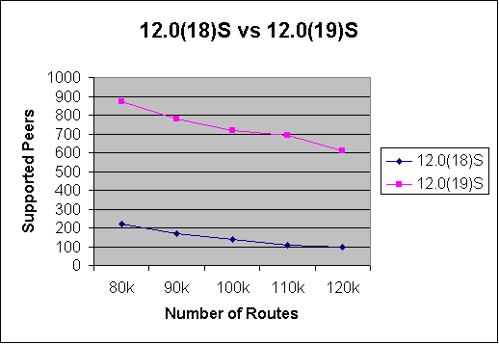
UPDATE Packing
4x – 6x improvement!!

Slide 19
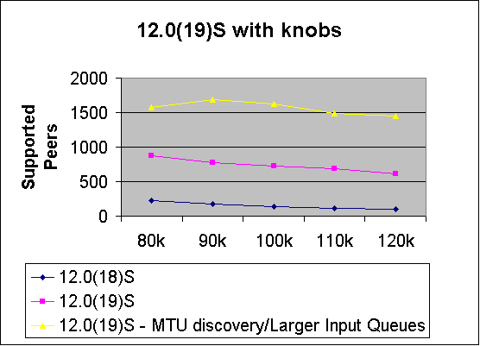
UPDATE Packing
12.0(19)S + MTU discovery + Larger Input Queues = 14x improvement

Slide 20
Current Bottlenecks
Edisms
  Older IOS timer mechanism
  Causes TCP queues to drain slowly
  Profiling suggest this is consuming 50% - 75% of convergence time in 12.0(19)S
Dynamic peer-groups a.k.a update-groups
  Many ISPs are not using peer-groups on eBGP peers

Slide 21
Current Bottlenecks
BGP → TCP Interaction
  BGP on NPE400 sends less than 10M/sec
  May have a Gig of data to send so this will take a while
  Fixing edisms may take care of this problem
Reduce memory copies in peer-group replication
  HFR did some work here to improve convergence
  Need to see if this is a bottleneck in IOS
BGP scanner
  Chews up a ton of CPU cycles
  Need to determine why scanner uses so much CPU

